Slide 1

An overview
Zoom meeting dated 16 May 2023

Slide 2

CS & wider market trends

Slide 3
Researchers share valuable scholarly insights differently
There are differences per Scientific fields - with Computer Science the most “different “ .
CS and tech view of sTm ;
Journals AND conference peer review
Life & Physical Science l view of StM
Journals peer review ONLY
Scientific Fields in Scopus ranked by their ratio of conference reviewed publications to journal reviewed publications
Despite Lockdown – CS conference peer review remains important as conferences go fully virtual
Conference review culture Journal review culture
Source Scopus , visualization by S Roffel
Notes:
Subject Fields DIFFER fundamentally in how they communicate new research findings : In Technology conferences are an integral part of the scientific dissemination ecosystem - especially in CS conference publications actually count for tenure – e.g. Technology has a “conference publication culture”
In journal dominated fields like Medicine this is not the case ….

Slide 4
DBLP Computer Science Bibliography
The ratio of conference vs journal peer review seems to be slowly converging over the years 2013 to 2019
up until 2020 when the pandemic negatively impacted conference peer review in CS
DBLP data suggests that after pandemic journal reviewed papers overtook conference reviewed papers
Continue to monitor this as the world slowly opens again
2020 Covid
Lockdowns affect many conferences over multiple years
Source:DBLP analyzed by Sweitze Roffel

Slide 5
CS Paper growth per region visualized for journals and conferences separately
EU28 and China growing at similar trajectory for CS Journal papers
China growing in CS Conference papers
Source: Scopus (Mar 2023) full year data for the years 2015 to 2022 ( disclaimer -2022 conference papers not fully indexed by Scopus yet ) - analysis by Cristiana Petru-Stefanescu

Slide 6
Digitalization drives growth of CS R&D - and ICT industry
People put sensors in everything
sensors generate tons of Data
Data no human can reason with
Offloading reasoning to machine’s at scale
Internet of Things
Big Data
Artificial Intelligence
Cloud Computing

Slide 7
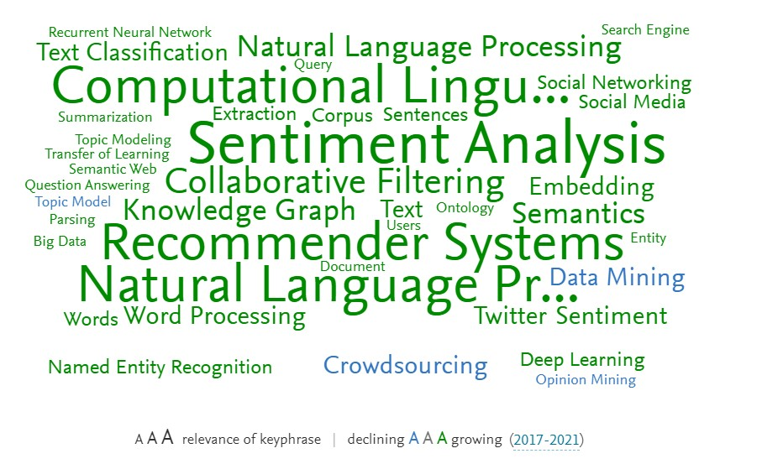
Example of Scival Topic Cluster 37 – (Semantics , Models , Recommender Systems)
Most cited JOURNALS in TC 37 | Papers | Citation Count | Field-Weighted Citation Impact | Field-Weighted Citation Impact
Expert Systems with Applications | 744 | 26709 | Elsevier | 2.63
Knowledge-Based Systems | 621 | 21456 | Elsevier | 2.2
IEEE Access | 1380 | 15500 | IEEE | 1.36
IEEE Transactions on Knowledge and Data Engineering | 443 | 15493 | IEEE | 2.24
Information Processing and Management | 583 | 14793 | Elsevier | 2.7
PLoS ONE | 466 | 11665 | PLOS | 1.05
Journal of Biomedical Informatics | 427 | 10373 | Elsevier | 1.36
Information Sciences | 391 | 10350 | Elsevier | 1.97
Neurocomputing | 428 | 8298 | Elsevier | 1.48
Journal of the Association for Information Science and Technology | 338 | 4525 | Wiley | 1.16
Applied Sciences (Switzerland) | 359 | 2232 | MPDI | 0.91
Most cited inst. In TC 37 | Sector | Country/Region | ALL Scholarly Output | Citation Count | Field-Weighted Citation Impact
Alphabet Inc. | corporate | United States | 1048 | 82152 | 6.5
Microsoft USA | corporate | United States | 2241 | 75679 | 3.85
Stanford University | academic | United States | 874 | 66653 | 6.09
Carnegie Mellon University | academic | United States | 1487 | 50445 | 3.8
Tsinghua University | academic | China | 1930 | 42626 | 2.7
Chinese Acad. of Sc. | Govt | China | 2421 | 35248 | 1.64
IBM | Corporate | United States | 1597 | 29874 | 2.22
U. of Washington | Academic | United States | 725 | 28776 | 4.86
Nanyang Tech. Univ. | Academic | Singapore | 851 | 28060 | 3.48
CNRS | Govt | France | 2925 | 27426 | 1.06
Mass. Inst. of Tech. | Academic | United States | 669 | 27196 | 3.88

Slide 8
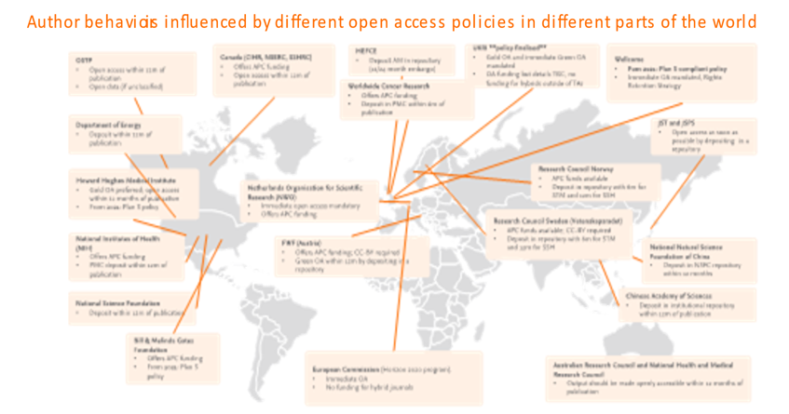

Slide 9
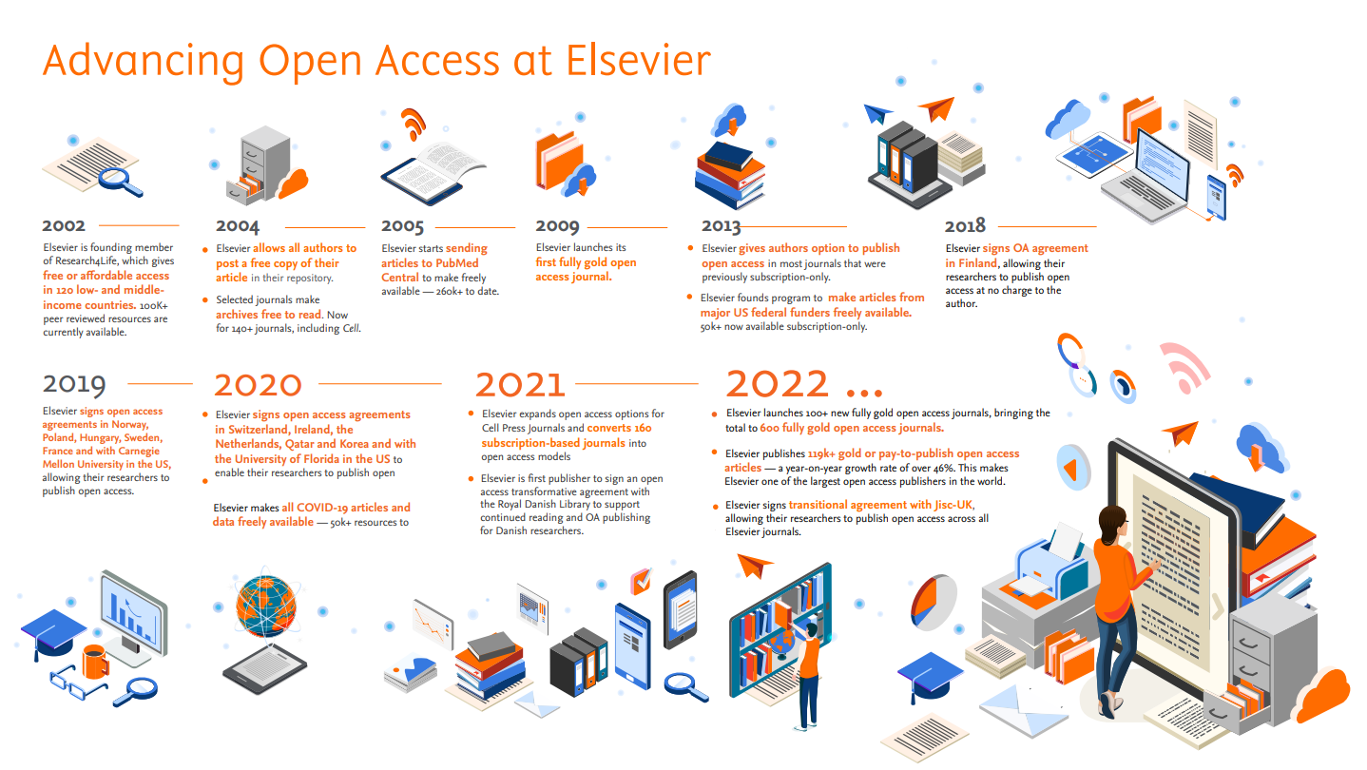

Slide 10
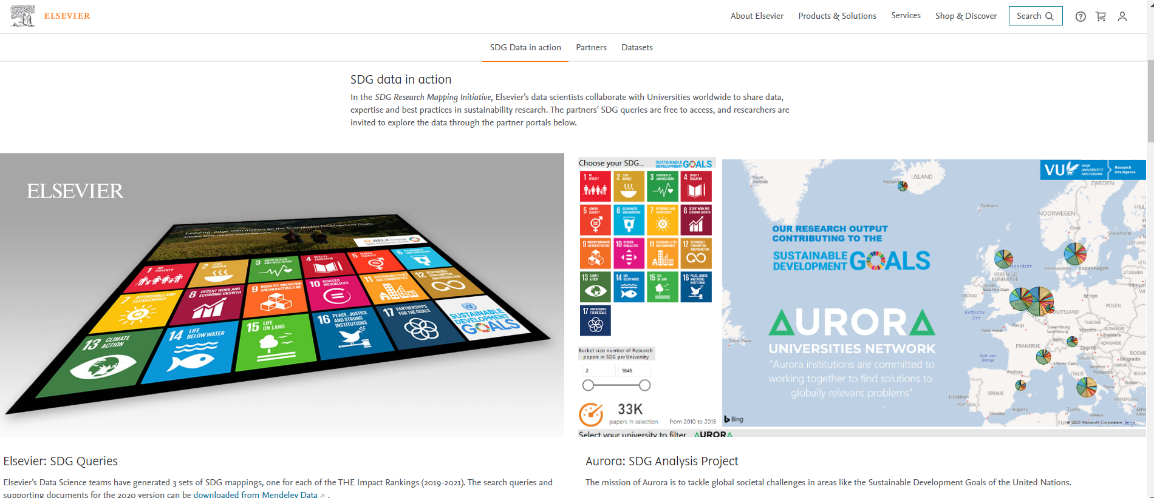
Elsevier believes Science can help advance Humanity -
https://www.elsevier.com/about/partnerships/sdg-research-mapping-initiative
https://sdgresources.relx.com/

Slide 11
Journal overview

Slide 12
Annual paper copy flow in Information Systems

Slide 13
Version
Of
Record
Access type
Stmj Article Access Type | 2019 | 2020 | 2021 | 2022 | 2023
Hybrid Open Access | 3 | 8 | 11 | 23 | 8
Subscription | 102 | 68 | 100 | 79 | 22

Slide 14
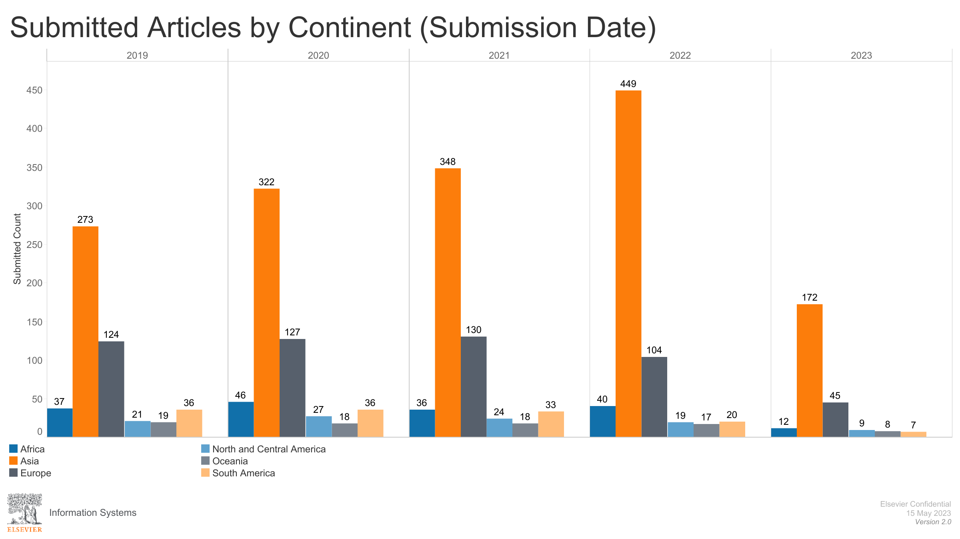

Slide 15
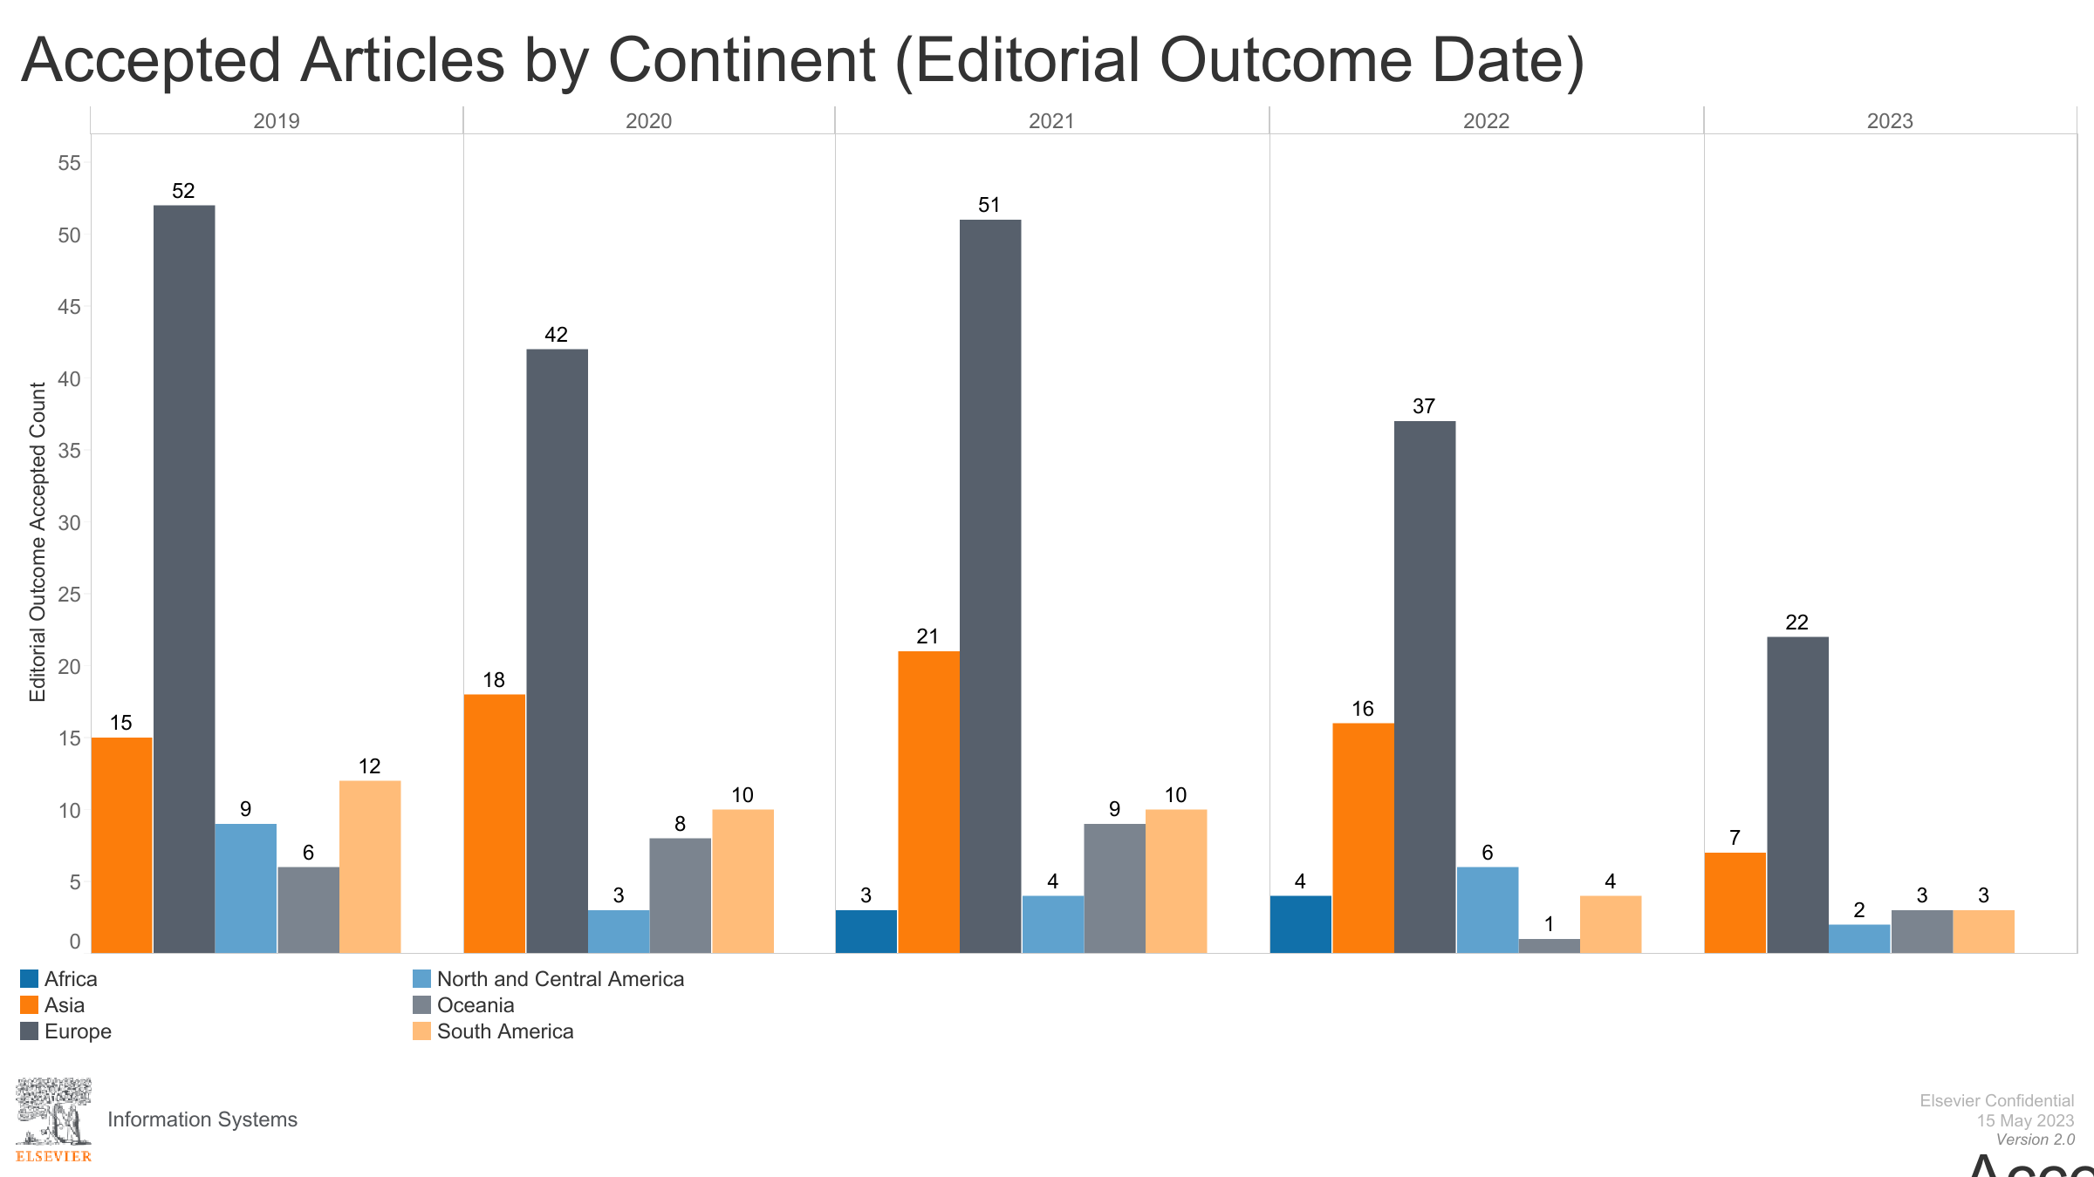

Slide 16
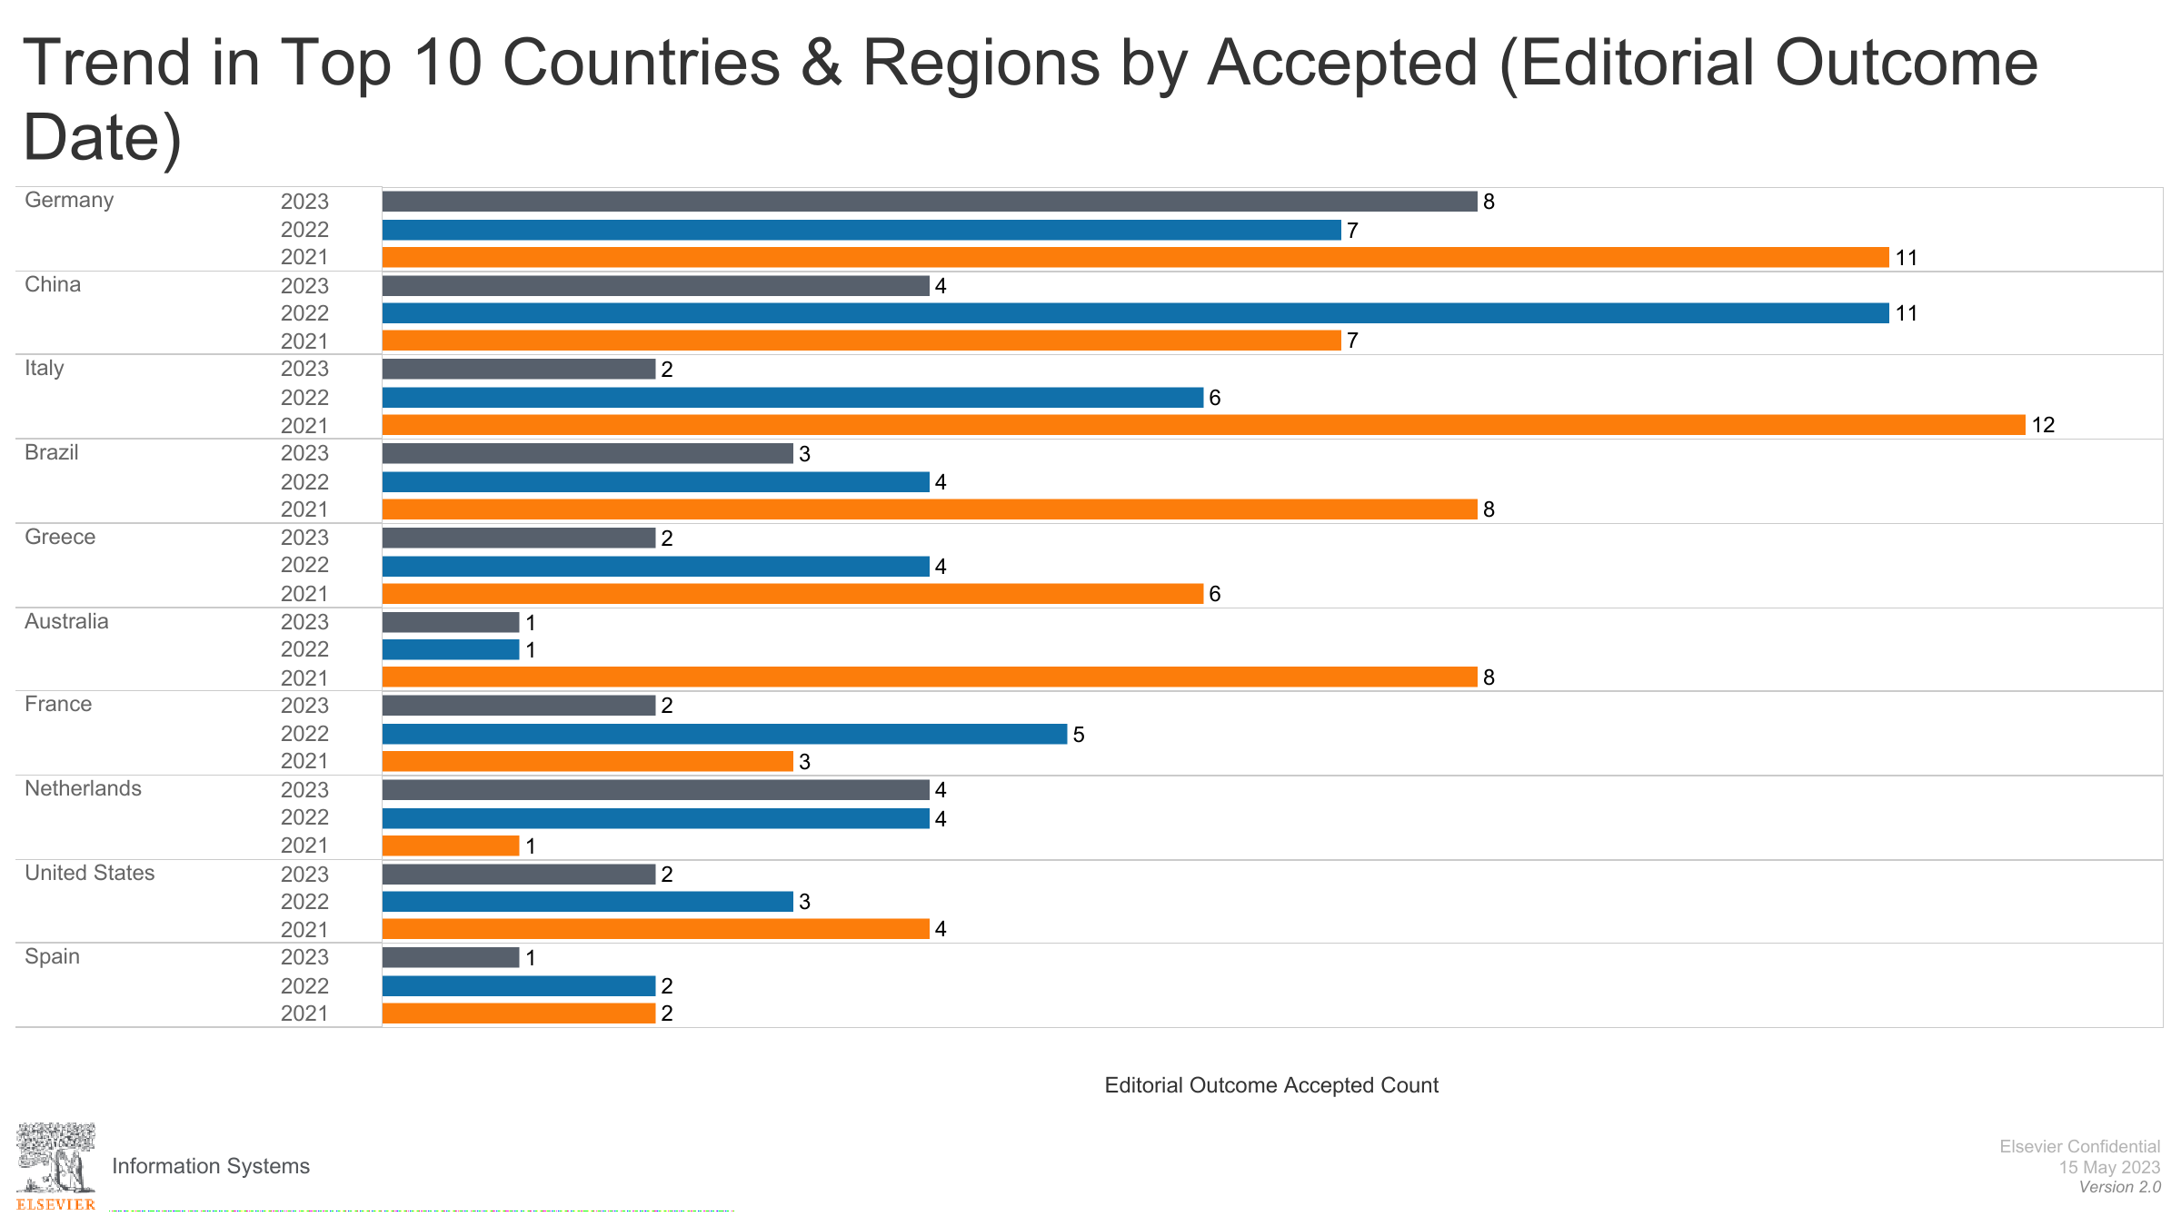

Slide 18
Actual Speed to publication

Slide 19
Usage and Citation

Slide 20
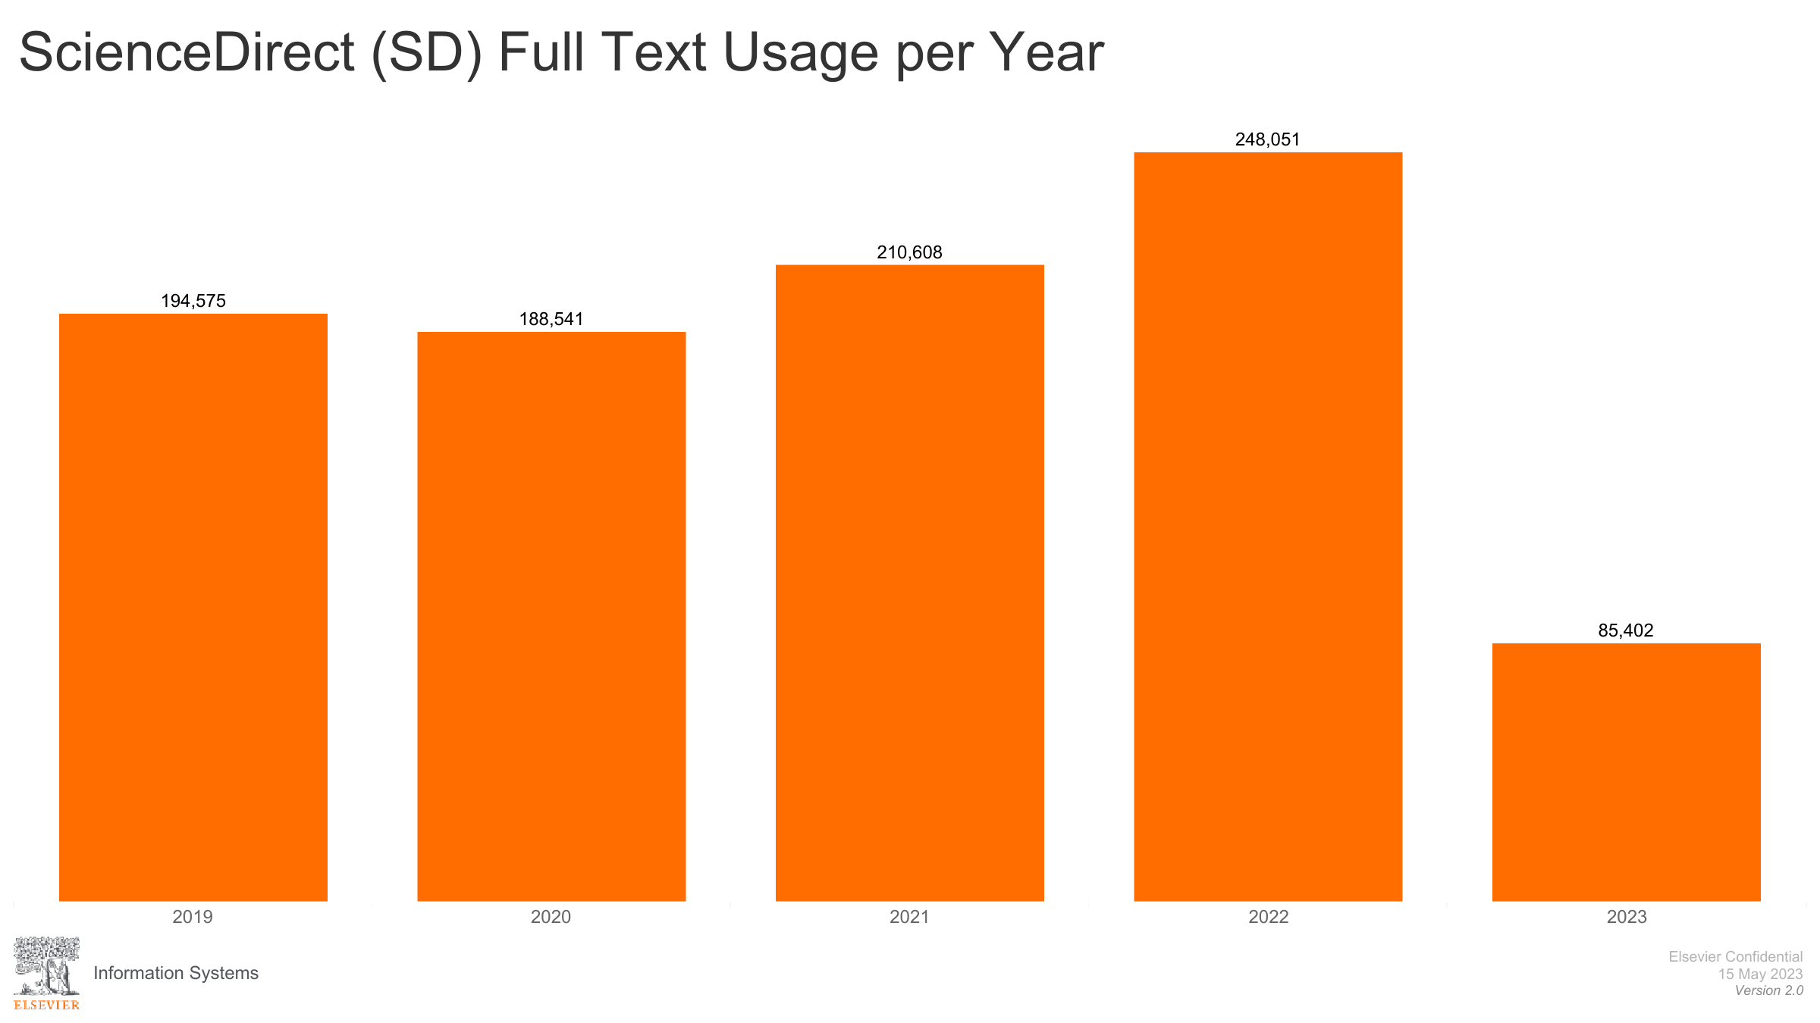

Slide 21
Science Direct full text Usage per country

Slide 22
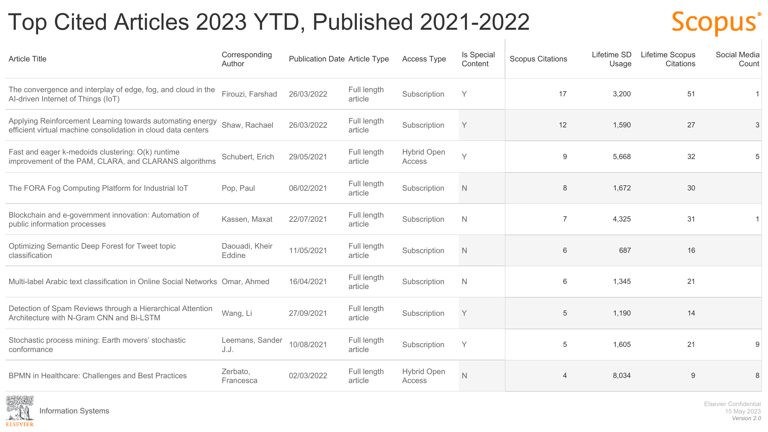

Slide 23
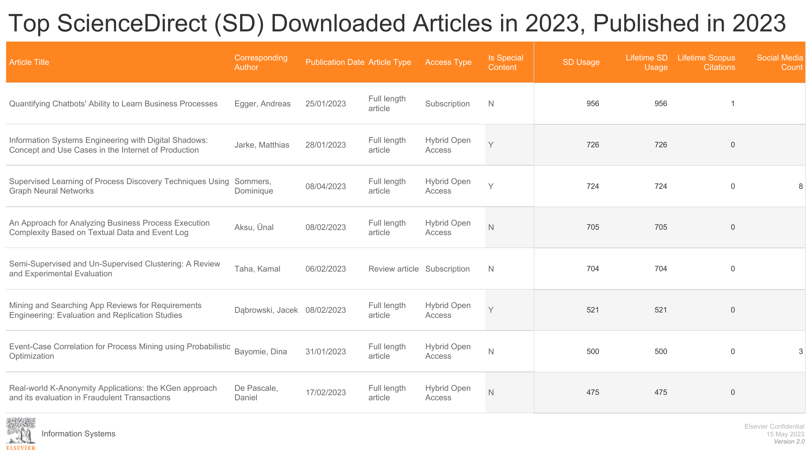

Slide 24
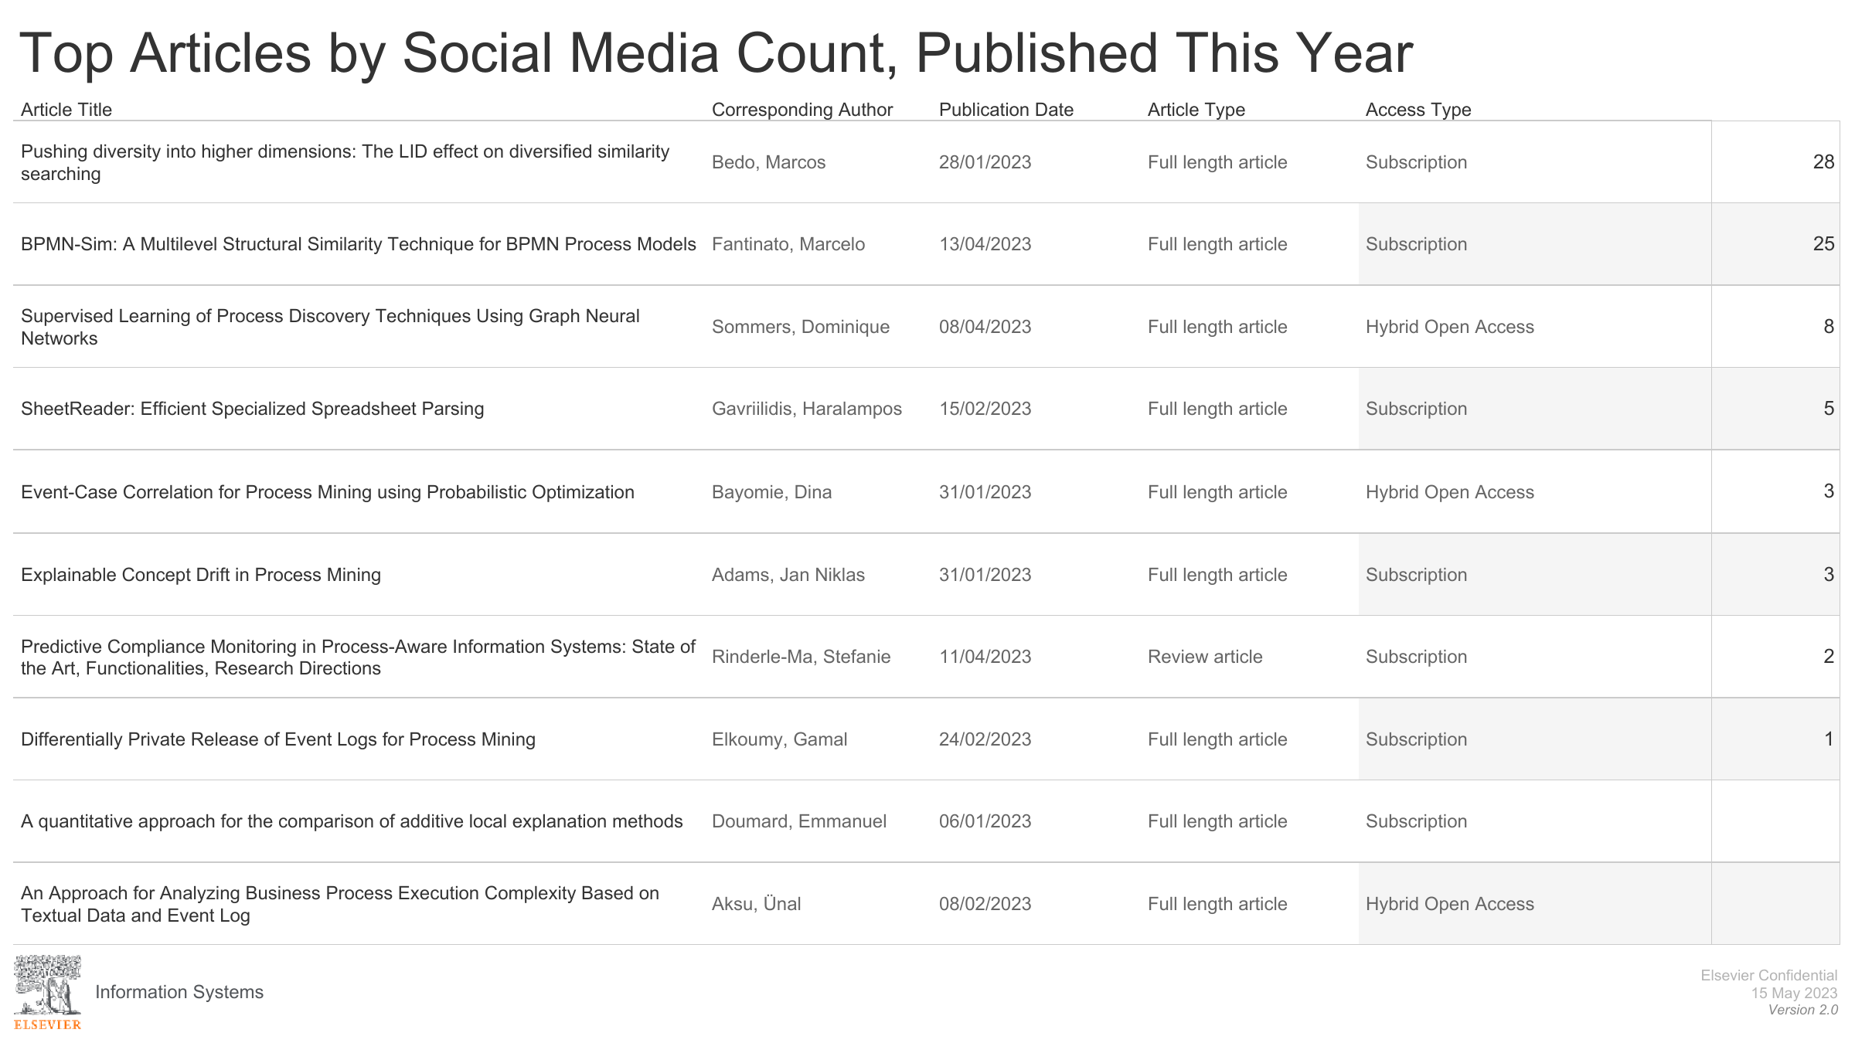

Slide 25
People

Slide 26
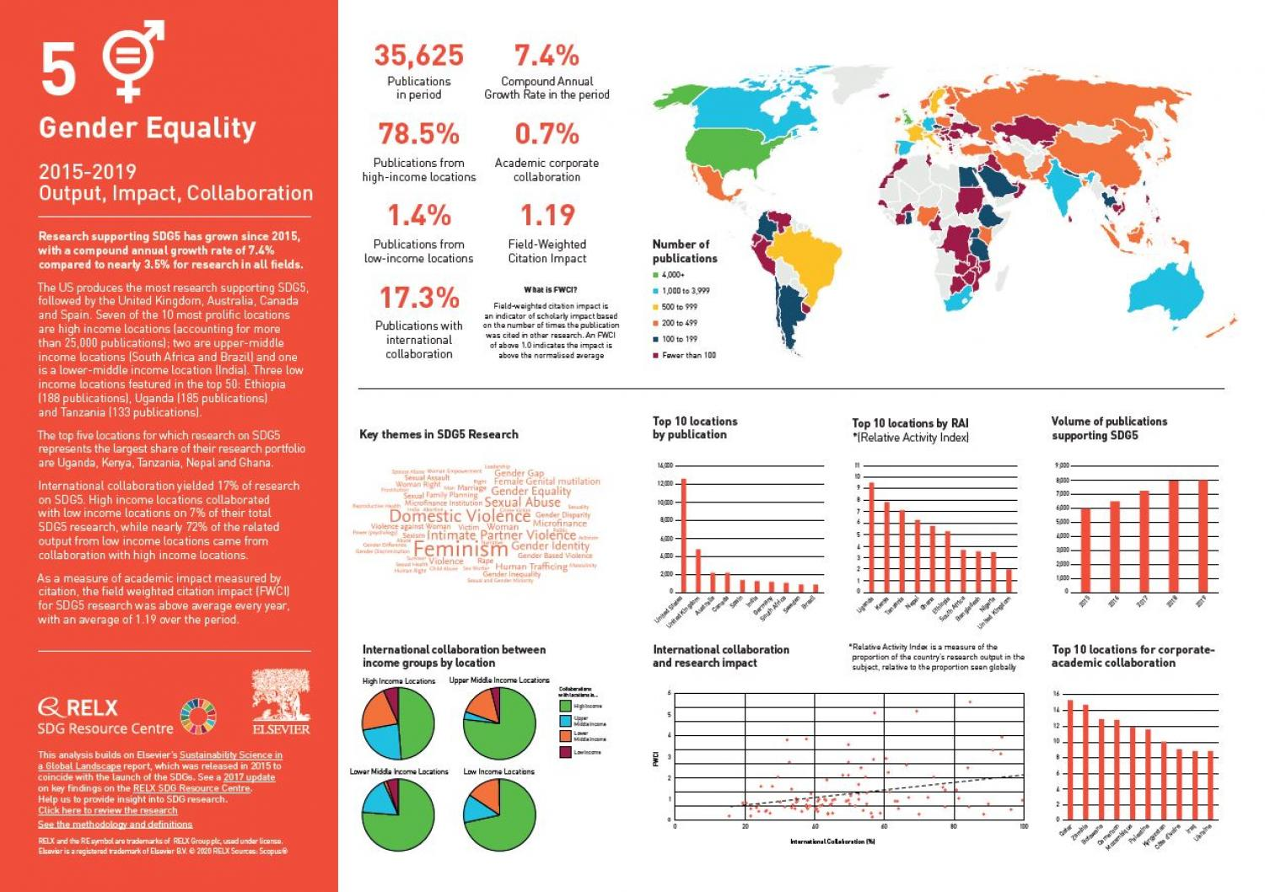
SDG number 5
What can WE do ?

Slide 27
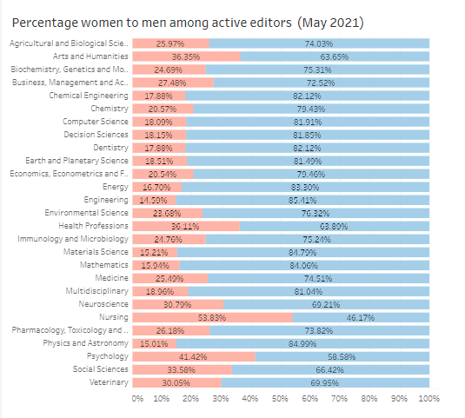
Gender balance per field
Editors per field differ

Slide 28
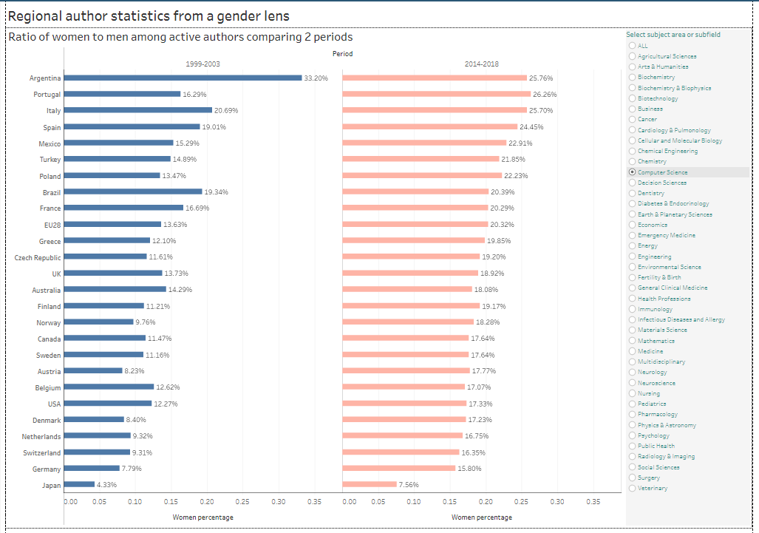
Gender balance per field
Authors in computer Science differ per region

Slide 29
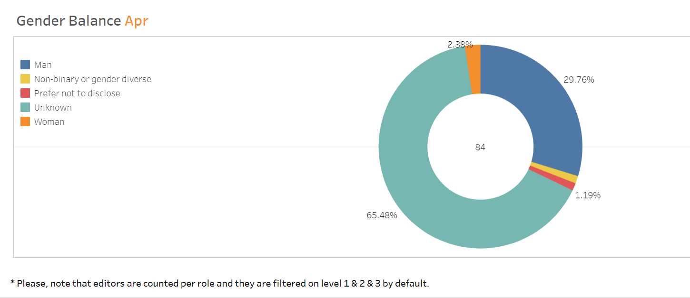
Inclusion and Diversity – editors in IS

Slide 30
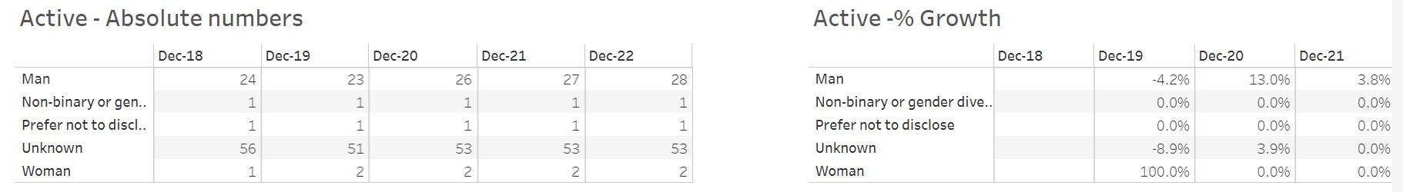
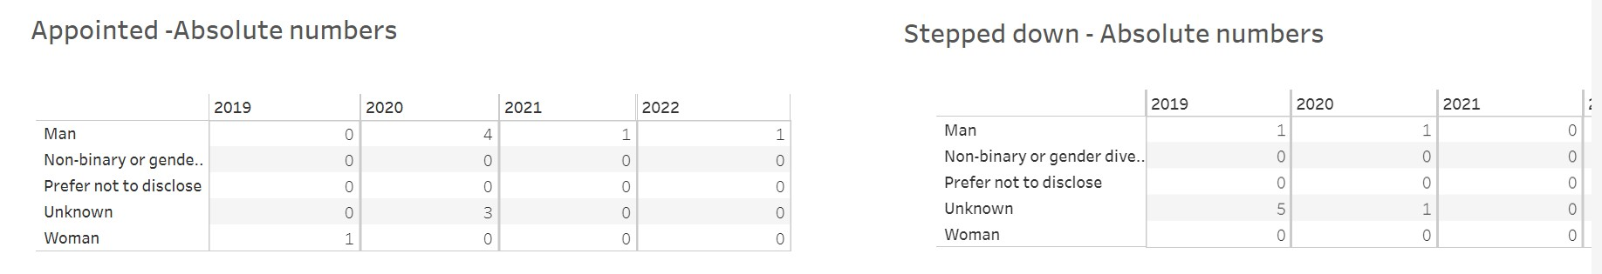
Moving the needle on editorial Inclusion and Diversity

Slide 31
stakeholder Feedback

Slide 32

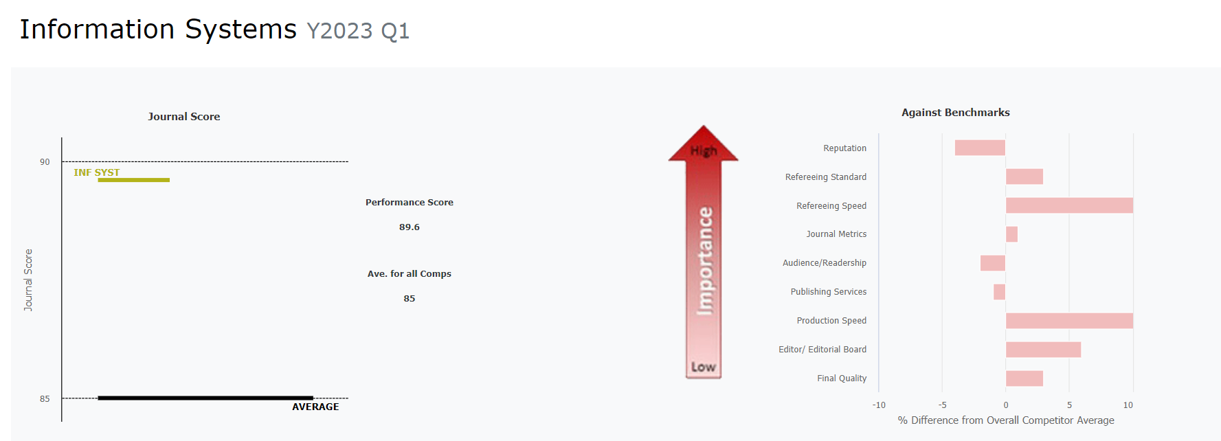
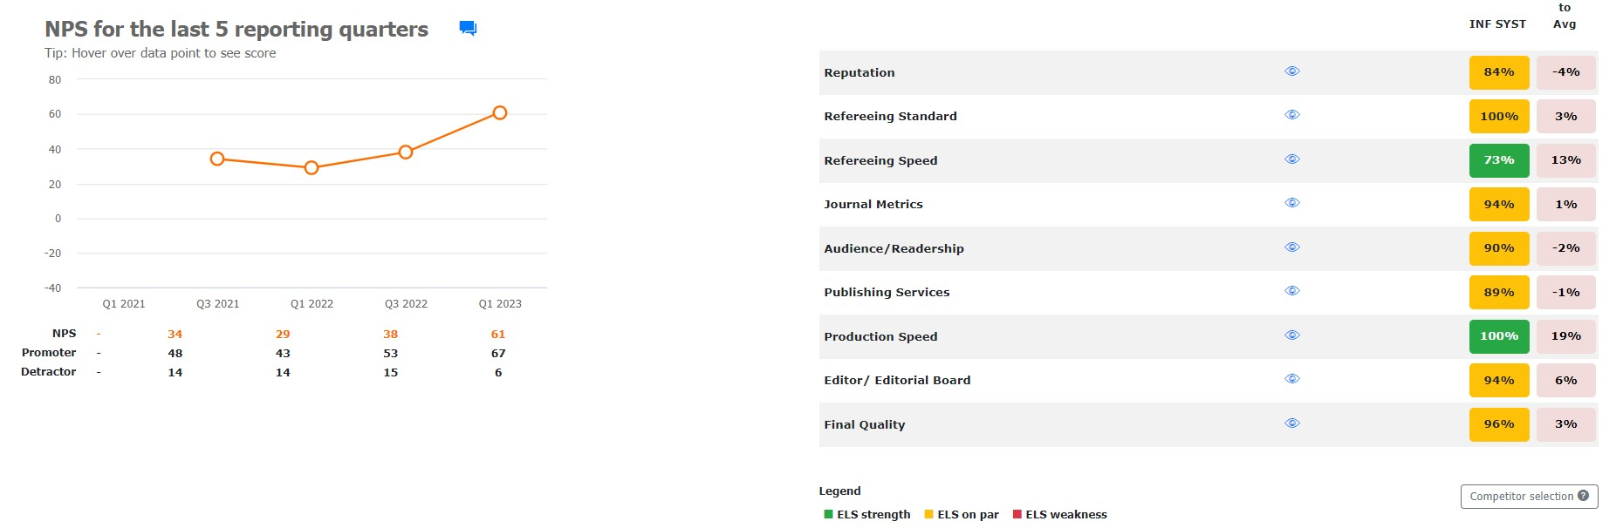
Author
FeedBack

Slide 33
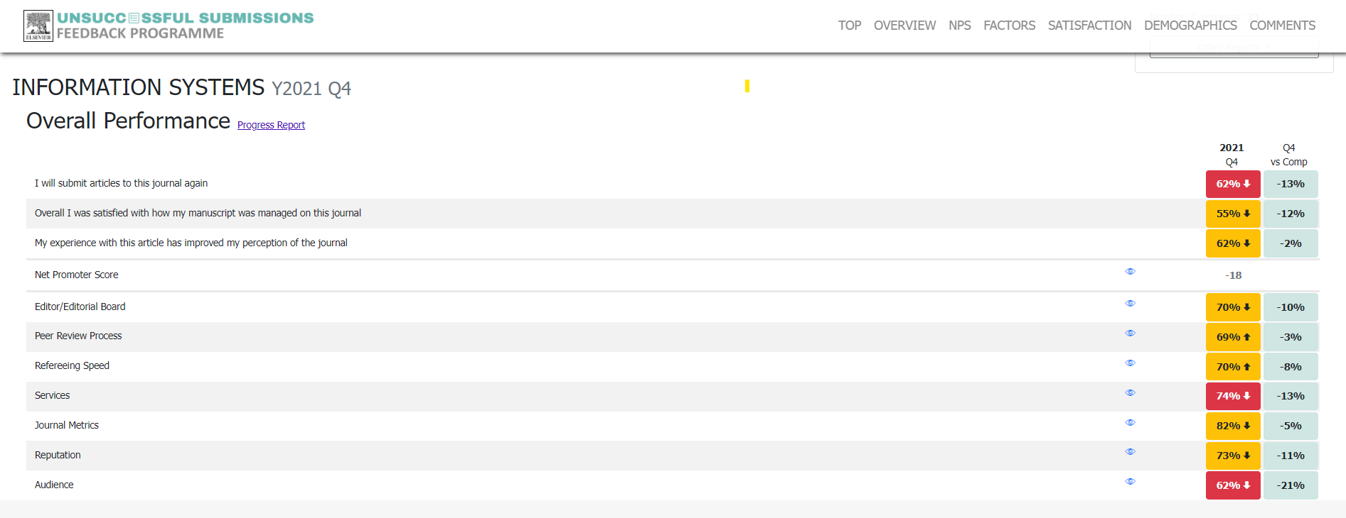
Diplomacy is …

Slide 34
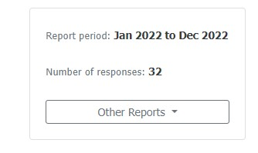
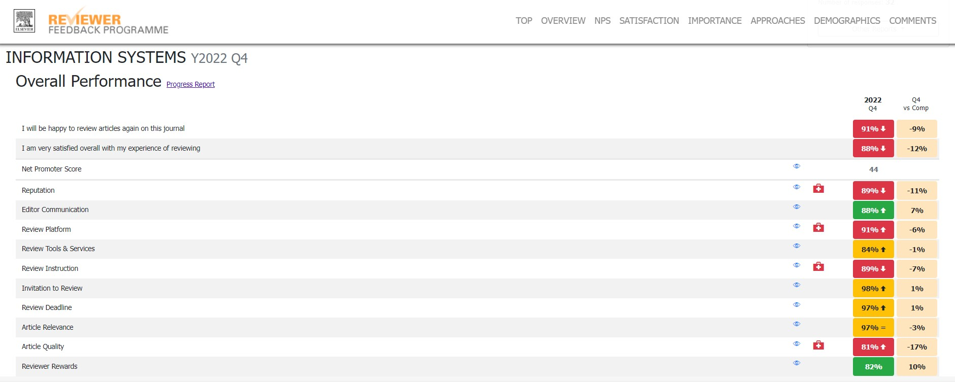
Reviewer Feed Back

Slide 35
IS compared to others

Slide 36
Journals with similar Citation patterns in Scopus
Compared Journal Title | Publisher | Citation Similarity Rank | Cited Similarity | Citing Similarity | Citation Similarity
Information Systems | Elsevier | 0 | 1.00 | 1.00 | 1.00
Data & Knowledge Engineering | Elsevier | 1 | 0.95 | 0.96 | 0.95
Journal on Data Semantics | Springer Nature | 2 | 0.88 | 0.95 | 0.91
International Journal of Cooperative Information Systems | World Scientific | 3 | 0.91 | 0.90 | 0.91
Proceedings of the ACM Symposium on Applied Computing | Association for Computing Machinery | 4 | 0.90 | 0.91 | 0.90
Journal of Intelligent Information Systems | Springer Nature | 5 | 0.84 | 0.90 | 0.87
International Journal of Web Information Systems | Emerald | 6 | 0.81 | 0.91 | 0.86
International Journal of Data Warehousing and Mining | IGI Global Publishing | 7 | 0.84 | 0.88 | 0.86
Journal of Web Semantics | Elsevier | 8 | 0.83 | 0.89 | 0.86
ACM Computing Surveys | Association for Computing Machinery | 9 | 0.85 | 0.86 | 0.86
Knowledge Engineering Review | Cambridge University Press | 10 | 0.87 | 0.83 | 0.85
ACM Transactions on the Web | Association for Computing Machinery | 11 | 0.85 | 0.85 | 0.85
Knowledge and Information Systems | Springer Nature | 12 | 0.82 | 0.87 | 0.85
Computer Journal | Oxford University Press | 13 | 0.81 | 0.88 | 0.84
Distributed and Parallel Databases | Springer Nature | 14 | 0.90 | 0.78 | 0.84
Journal of Universal Computer Science | technische universitat graz from austria | 15 | 0.84 | 0.83 | 0.84
AI Communications | IOS Press | 16 | 0.84 | 0.82 | 0.83
Journal of Data and Information Quality | Association for Computing Machinery | 17 | 0.81 | 0.86 | 0.83
Transactions on Data Privacy | university of skovde | 18 | 0.76 | 0.90 | 0.83
International Journal of Information Security | Springer Nature | 19 | 0.79 | 0.87 | 0.83
Science of Computer Programming | Elsevier | 20 | 0.79 | 0.87 | 0.83

Slide 37
Scopus Citescore

Slide 38
Scopus Citescore
Journal | 2018 | 2019 | 2020 | 2021 | 2022
Journal of Web Semantics | 9.500 | 9.200 | 6.900 | 7.200 | 8.500
Information Systems | 8.800 | 6.700 | 7.300 | 7.100 | 7.900
ACM Transactions on the Web | 3.800 | 4.400 | 4.700 | 6.500 | 7.200
Knowledge and Information Systems | 5.400 | 5.200 | 5.800 | 5.900 | 6.000
Journal of Data and Information Quality | 2.700 | 3.000 | 3.500 | 5.600 | 5.900
Journal of Intelligent Information Systems | 2.700 | 4.100 | 4.400 | 5.400 | 5.900
International Journal of Information Security | 3.400 | 3.500 | 4.000 | 4.800 | 5.600
Journal on Data Semantics | 4.300 | 3.600 | 2.900 | 3.400 | 4.700
Data & Knowledge Engineering | 3.100 | 3.700 | 4.700 | 4.900 | 3.900
Science of Computer Programming | 3.300 | 3.300 | 3.200 | 3.600 | 3.500
Computer Journal | 1.900 | 2.400 | 2.600 | 3.100 | 3.400
Innovations in Systems and Software Engineering | 1.900 | 1.900 | 2.600 | 2.100 | 3.000
International Journal of Data Warehousing and Mining | 2.200 | 1.800 | 1.200 | 1.900 | 2.800
International Journal of Web Information Systems | 1.100 | 1.600 | 1.800 | 1.900 | 2.800
Distributed and Parallel Databases | 2.400 | 2.100 | 1.900 | 2.400 | 2.700
Journal of Universal Computer Science | 2.500 | 2.300 | 2.000 | 2.700 | 2.700
AI Communications | 1.900 | 2.500 | 3.700 | 2.700 | 2.200
International Journal of Cooperative Information Systems | 2.000 | 2.900 | 3.000 | 2.900 | 2.200
Transactions on Data Privacy | 2.200 | 2.200 | 1.900 | 2.900 | 2.100
Citescore is a 3 year impact metric on scopus data
IS ranked # 2 on Citescore

Slide 39
Total Citations in Scopus

Slide 40
IS # 2 on Total Citations in Scopus
Total Citations | 2018 | 2019 | 2020 | 2021 | 2022
Knowledge and Information Systems | 2,422 | 2,697 | 3,293 | 3,309 | 3,443
Information Systems | 3,029 | 2,121 | 2,347 | 2,026 | 2,833
Computer Journal | 754 | 1,044 | 1,192 | 1,520 | 1,722
Journal of Intelligent Information Systems | 448 | 793 | 868 | 1,083 | 1,231
International Journal of Information Security | 485 | 542 | 649 | 832 | 1,153
Science of Computer Programming | 1,395 | 1,052 | 1,068 | 1,181 | 984
Journal of Web Semantics | 1,057 | 980 | 703 | 705 | 846
Journal of Universal Computer Science | 782 | 669 | 572 | 816 | 708
Data & Knowledge Engineering | 514 | 638 | 861 | 892 | 663
Journal of Data and Information Quality | 241 | 282 | 313 | 501 | 574
ACM Transactions on the Web | 371 | 413 | 415 | 458 | 528
International Journal of Web Information Systems | 114 | 178 | 210 | 231 | 335
Distributed and Parallel Databases | 185 | 164 | 177 | 265 | 316
Innovations in Systems and Software Engineering | 139 | 152 | 193 | 177 | 296
International Journal of Data Warehousing and Mining | 140 | 115 | 90 | 144 | 188
AI Communications | 303 | 339 | 335 | 221 | 182
Journal on Data Semantics | 216 | 180 | 126 | 167 | 174
International Journal of Cooperative Information Systems | 106 | 153 | 177 | 136 | 92

Slide 41
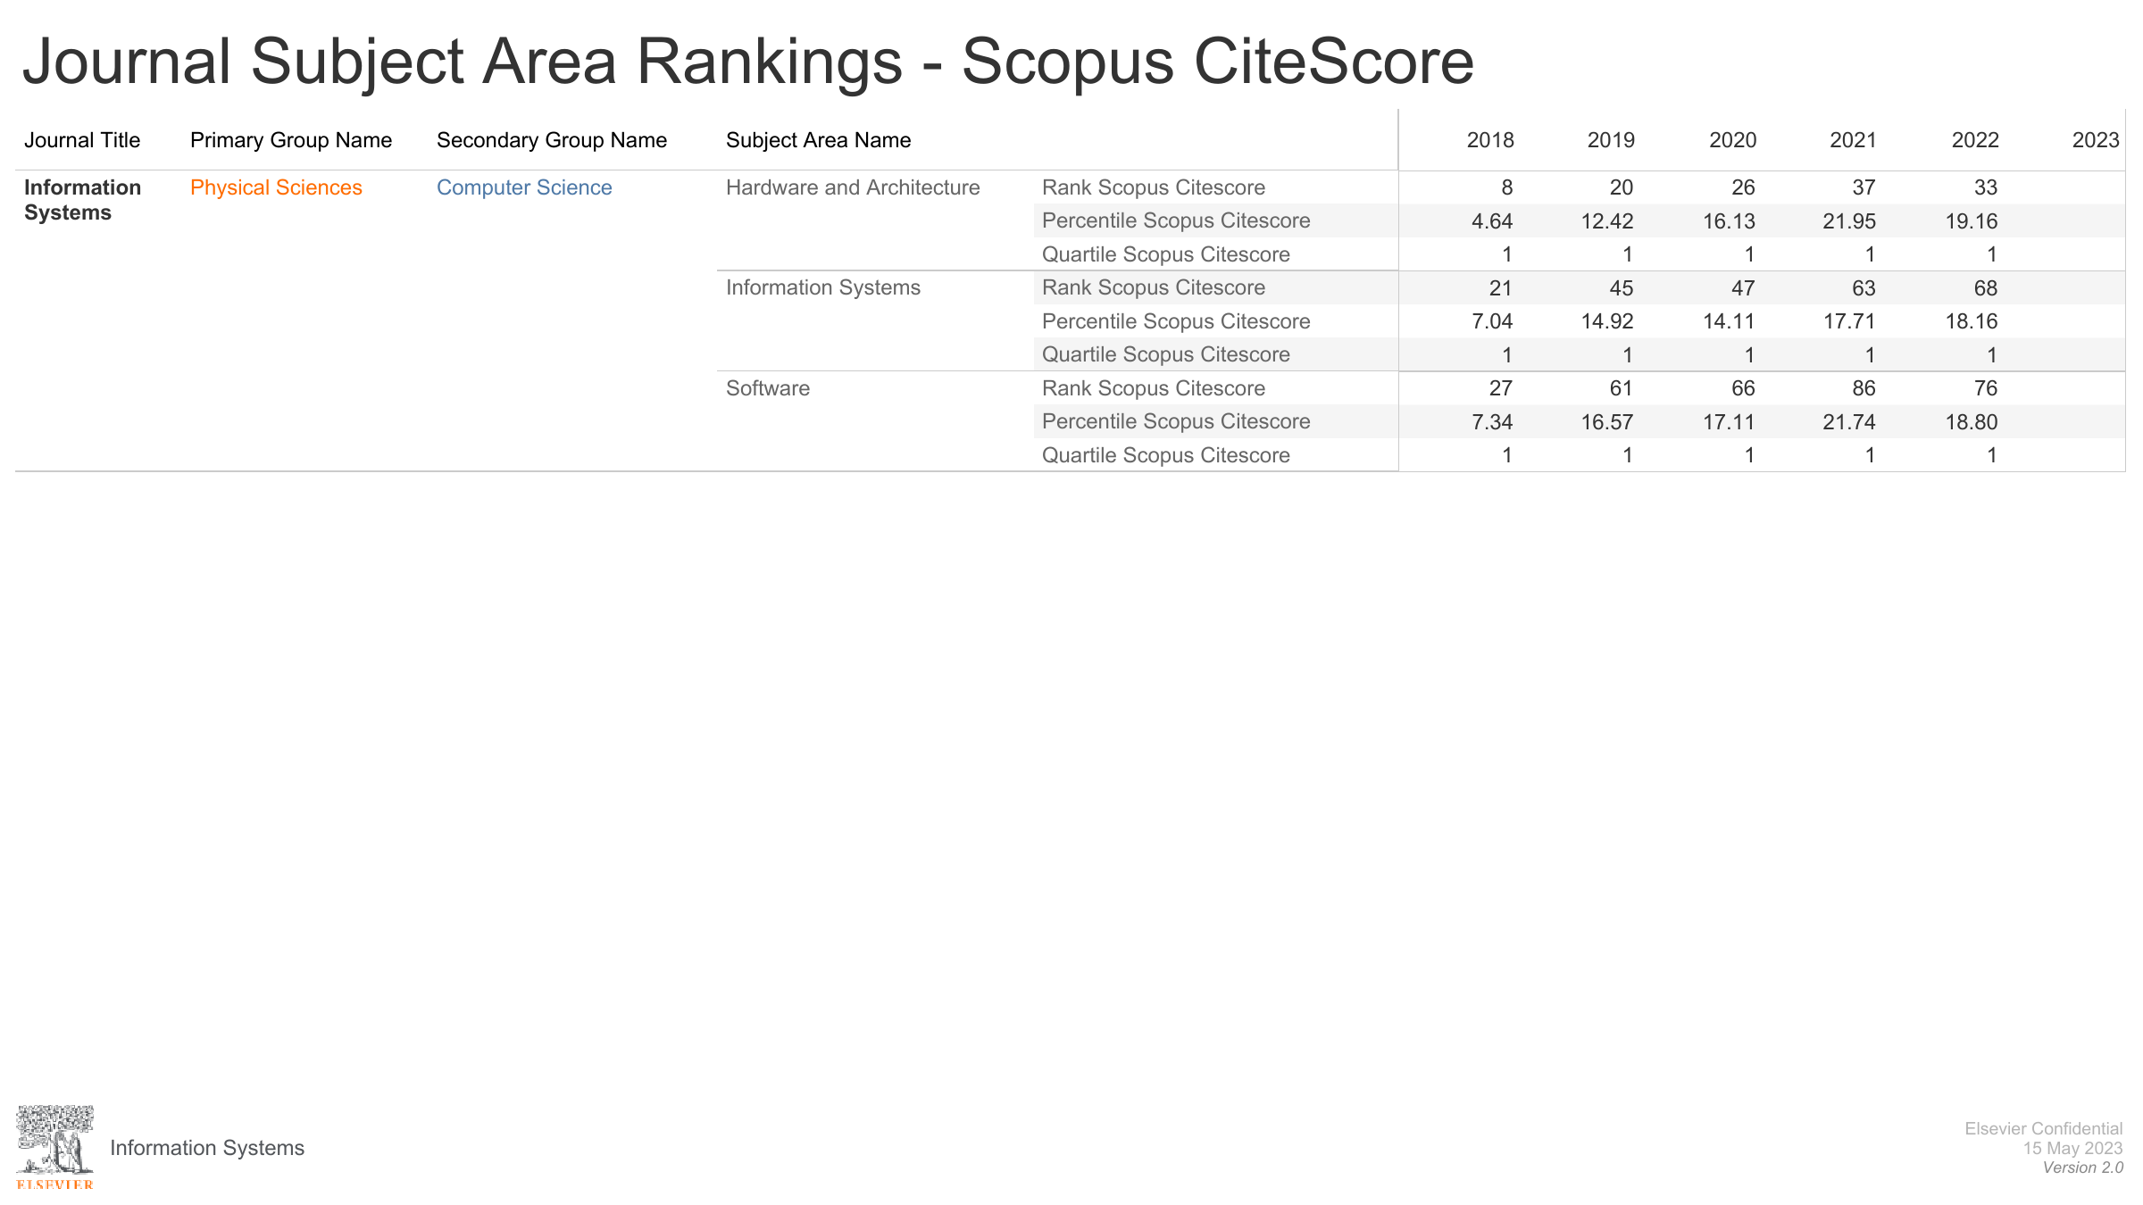
SCOPUS ranks Information Systems as Q1 in all categories it is in
Scopus data used in THE (Times Higher Education , ) and more …
Scopus data used in various national assessments ….
.

Slide 42
Clarivate Impact Factor

Slide 43
Clavivate Impact factor
Impact Factor | 2018 | 2019 | 2020 | 2021
ACM Transactions on the Web | 1.580 | 1.157 | 2.043 | 3.350
Information Systems | 2.066 | 2.466 | 2.309 | 3.180
Journal of Web Semantics | 2.429 | 2.238 | 1.897 | 2.770
Knowledge and Information Systems | 2.397 | 2.936 | 2.822 | 2.531
Journal of Intelligent Information Systems | 1.589 | 1.813 | 1.888 | 2.504
International Journal of Information Security | 1.822 | 1.494 | 1.988 | 2.427
Computer Journal | 0.980 | 1.077 | 1.494 | 1.762
Data & Knowledge Engineering | 1.583 | 1.476 | 1.992 | 1.500
International Journal of Data Warehousing and Mining | 0.968 | 0.406 | 0.625 | 1.333
Journal of Universal Computer Science | 0.910 | 0.701 | 1.139 | 1.056
Science of Computer Programming | 1.088 | 0.775 | 0.863 | 1.039
AI Communications | 0.765 | 1.000 | 0.537 | 1.029
Distributed and Parallel Databases | 1.147 | 0.757 | 1.500 | 0.974
International Journal of Cooperative Information Systems | 0.769 | 1.929 | 1.286 | 0.563
Impact Factor is a 2 year impact metric on web of Science Data
IS ranked # 2 on Impact Factor

Slide 44
IS # 3 on Clarivate Total Citations
Clarivate total citations | 2018 | 2019 | 2020 | 2021
Knowledge and Information Systems | 3006 | 3242 | 4008 | 4789
Computer Journal | 3663 | 3599 | 4057 | 4631
Information Systems | 2234 | 2437 | 2604 | 3032
Data & Knowledge Engineering | 1606 | 1602 | 1742 | 1713
Journal of Intelligent Information Systems | 883 | 967 | 1129 | 1373
Science of Computer Programming | 1502 | 1253 | 1248 | 1367
Journal of Universal Computer Science | 1065 | 954 | 1060 | 1132
Journal of Web Semantics | 1162 | 1207 | 1081 | 1110
International Journal of Information Security | 645 | 620 | 836 | 1028
ACM Transactions on the Web | 768 | 769 | 782 | 850
AI Communications | 416 | 429 | 489 | 553
Distributed and Parallel Databases | 322 | 290 | 353 | 366
International Journal of Data Warehousing and Mining | 235 | 221 | 259 | 334
Journal of Data and Information Quality |  |  | 184 | 279
Innovations in Systems and Software Engineering |  |  | 194 | 240
International Journal of Web Information Systems |  |  | 166 | 190
Transactions on Data Privacy |  |  | 182 | 179
International Journal of Cooperative Information Systems | 204 | 222 | 196 | 178
Journal on Data Semantics |  |  | 113

Slide 45
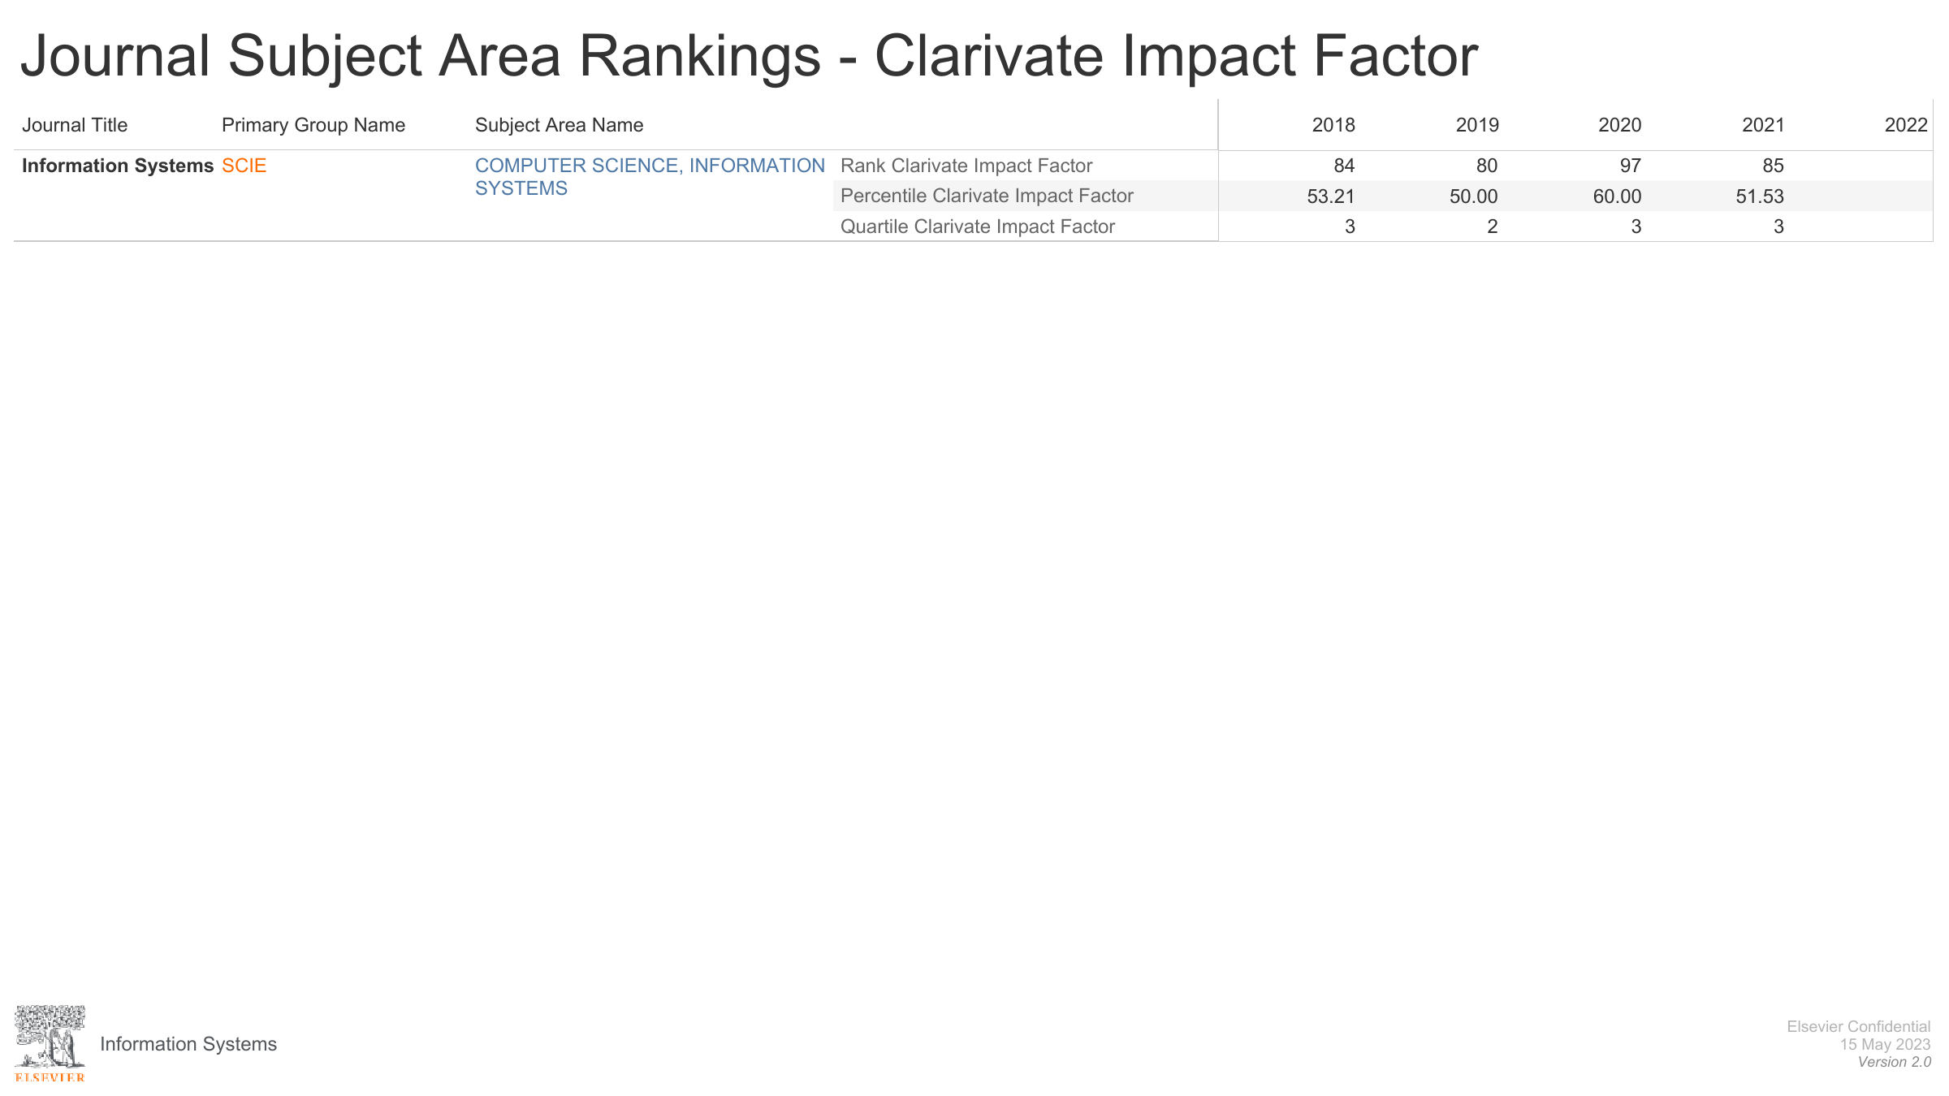
CLARIVATE ranks Information Systems in Q3 in all categories it is in
CLARIVATE Web of Science data used in various national assessments ….

Slide 46
Summary

Slide 47
Summarizing
It seems
  Journal is well managed
  Journal well ranked
  Journal well respected
  Journal is well read
  Journal is well cited
  Flatlining in a growth market amounts to relative decline
Things to discuss
  Gender balance ( I&D)
  Editorial succession planning
  How can we grow the journal, whilst keeping scientific quality
  Making the journal a bit faster
  How can we increase real world societal impact ( UN SDG’s )
  AOB
Most importantly
  Thank YOU !!!!
  You are what makes this journal come alive and be successful

Slide 48
Appendix

Slide 49
More data and slides ….

Slide 50


Slide 51
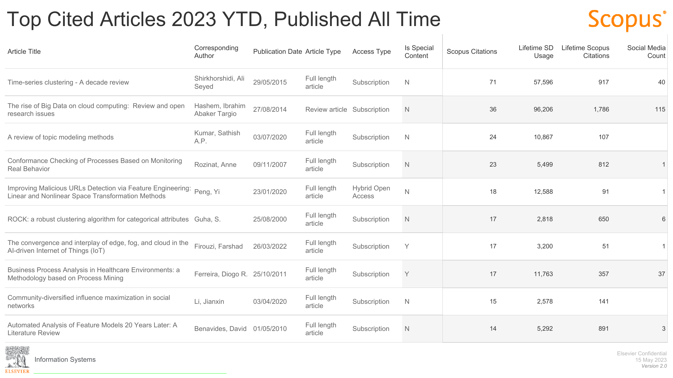

Slide 53
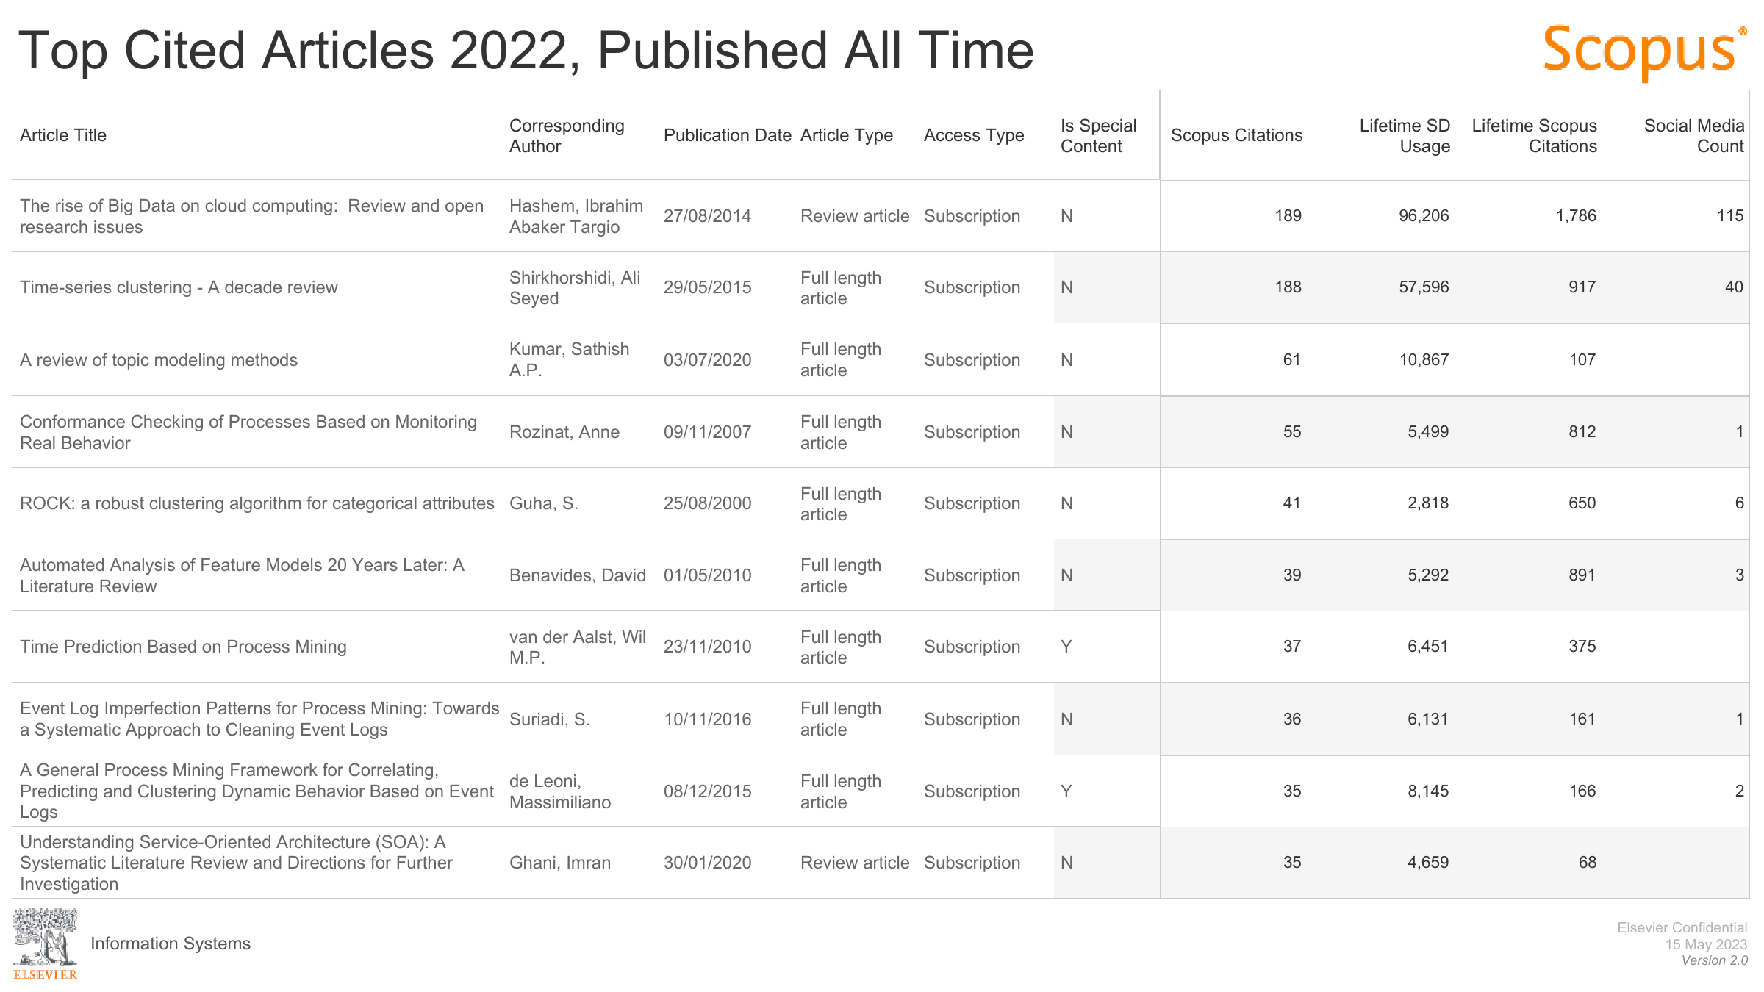

Slide 54
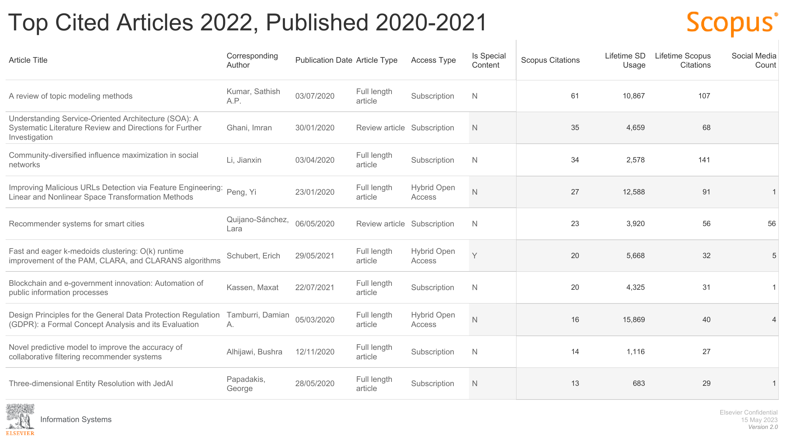

Slide 55
Special issues and more journal data

Slide 56
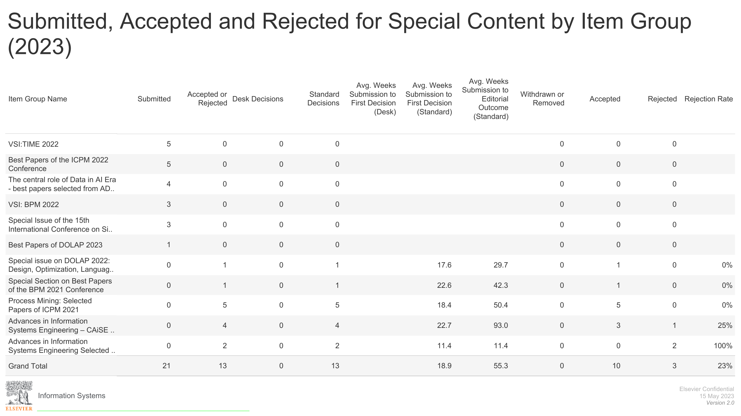

Slide 57
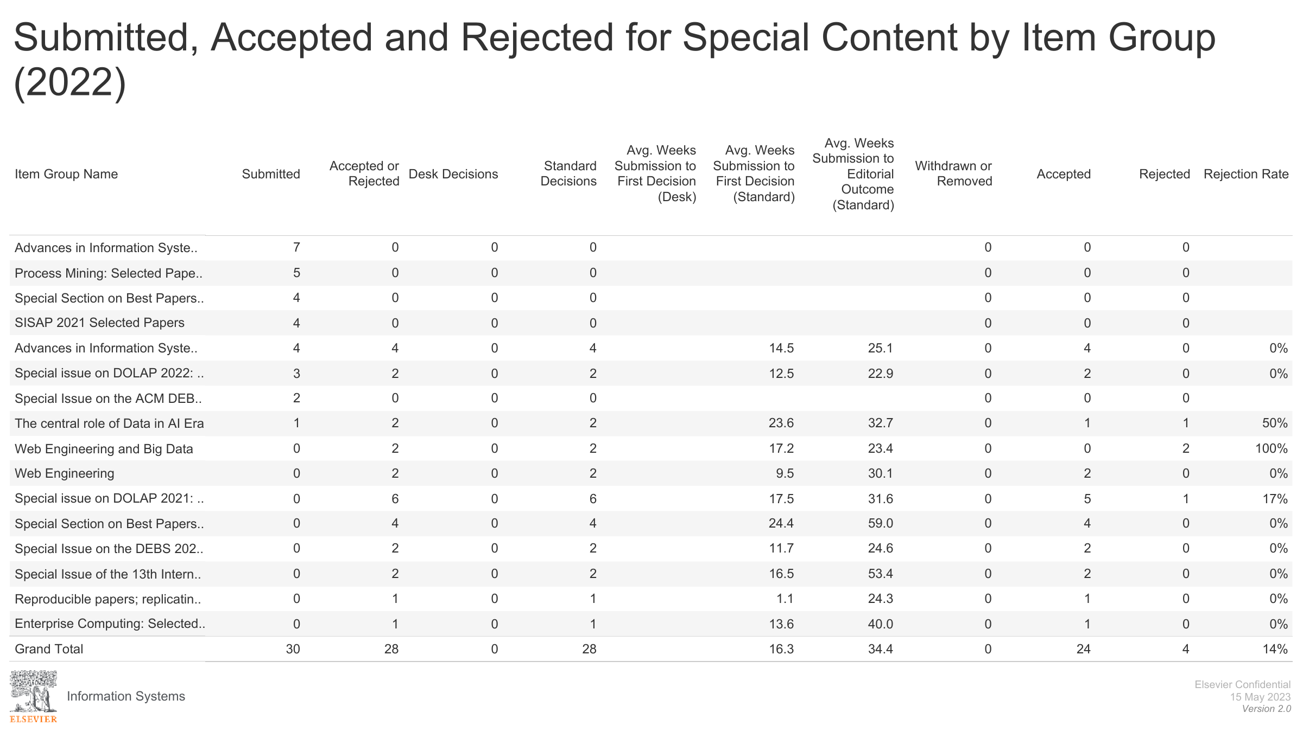

Slide 58
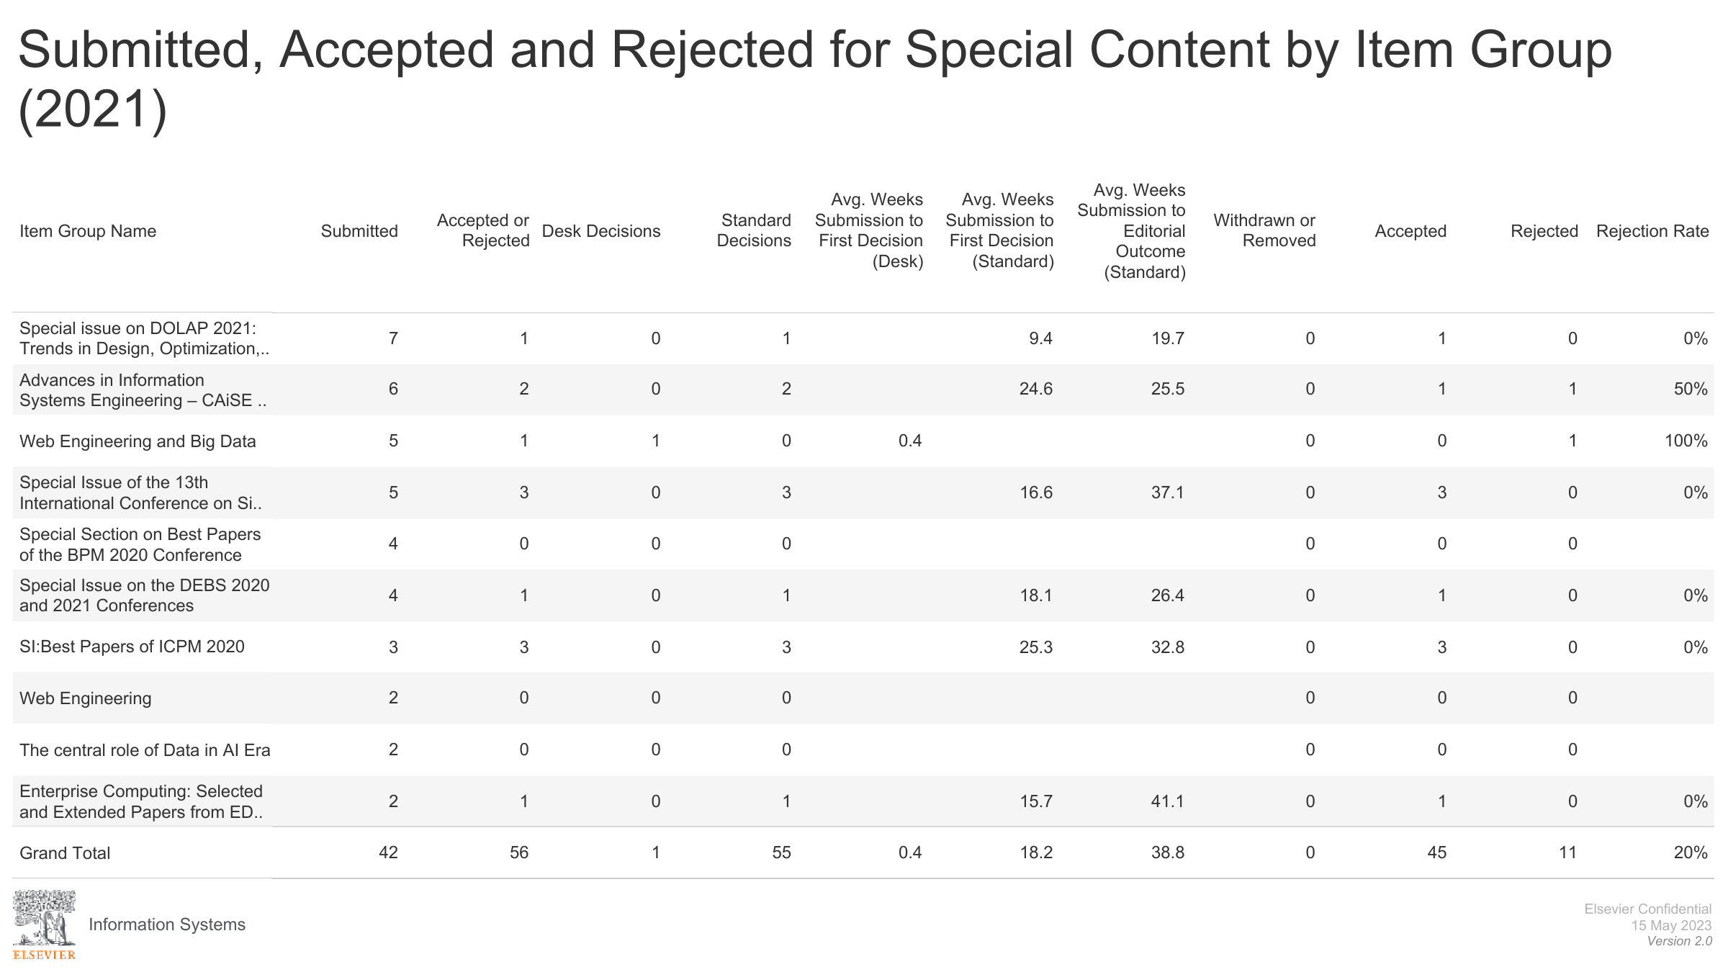

Slide 59
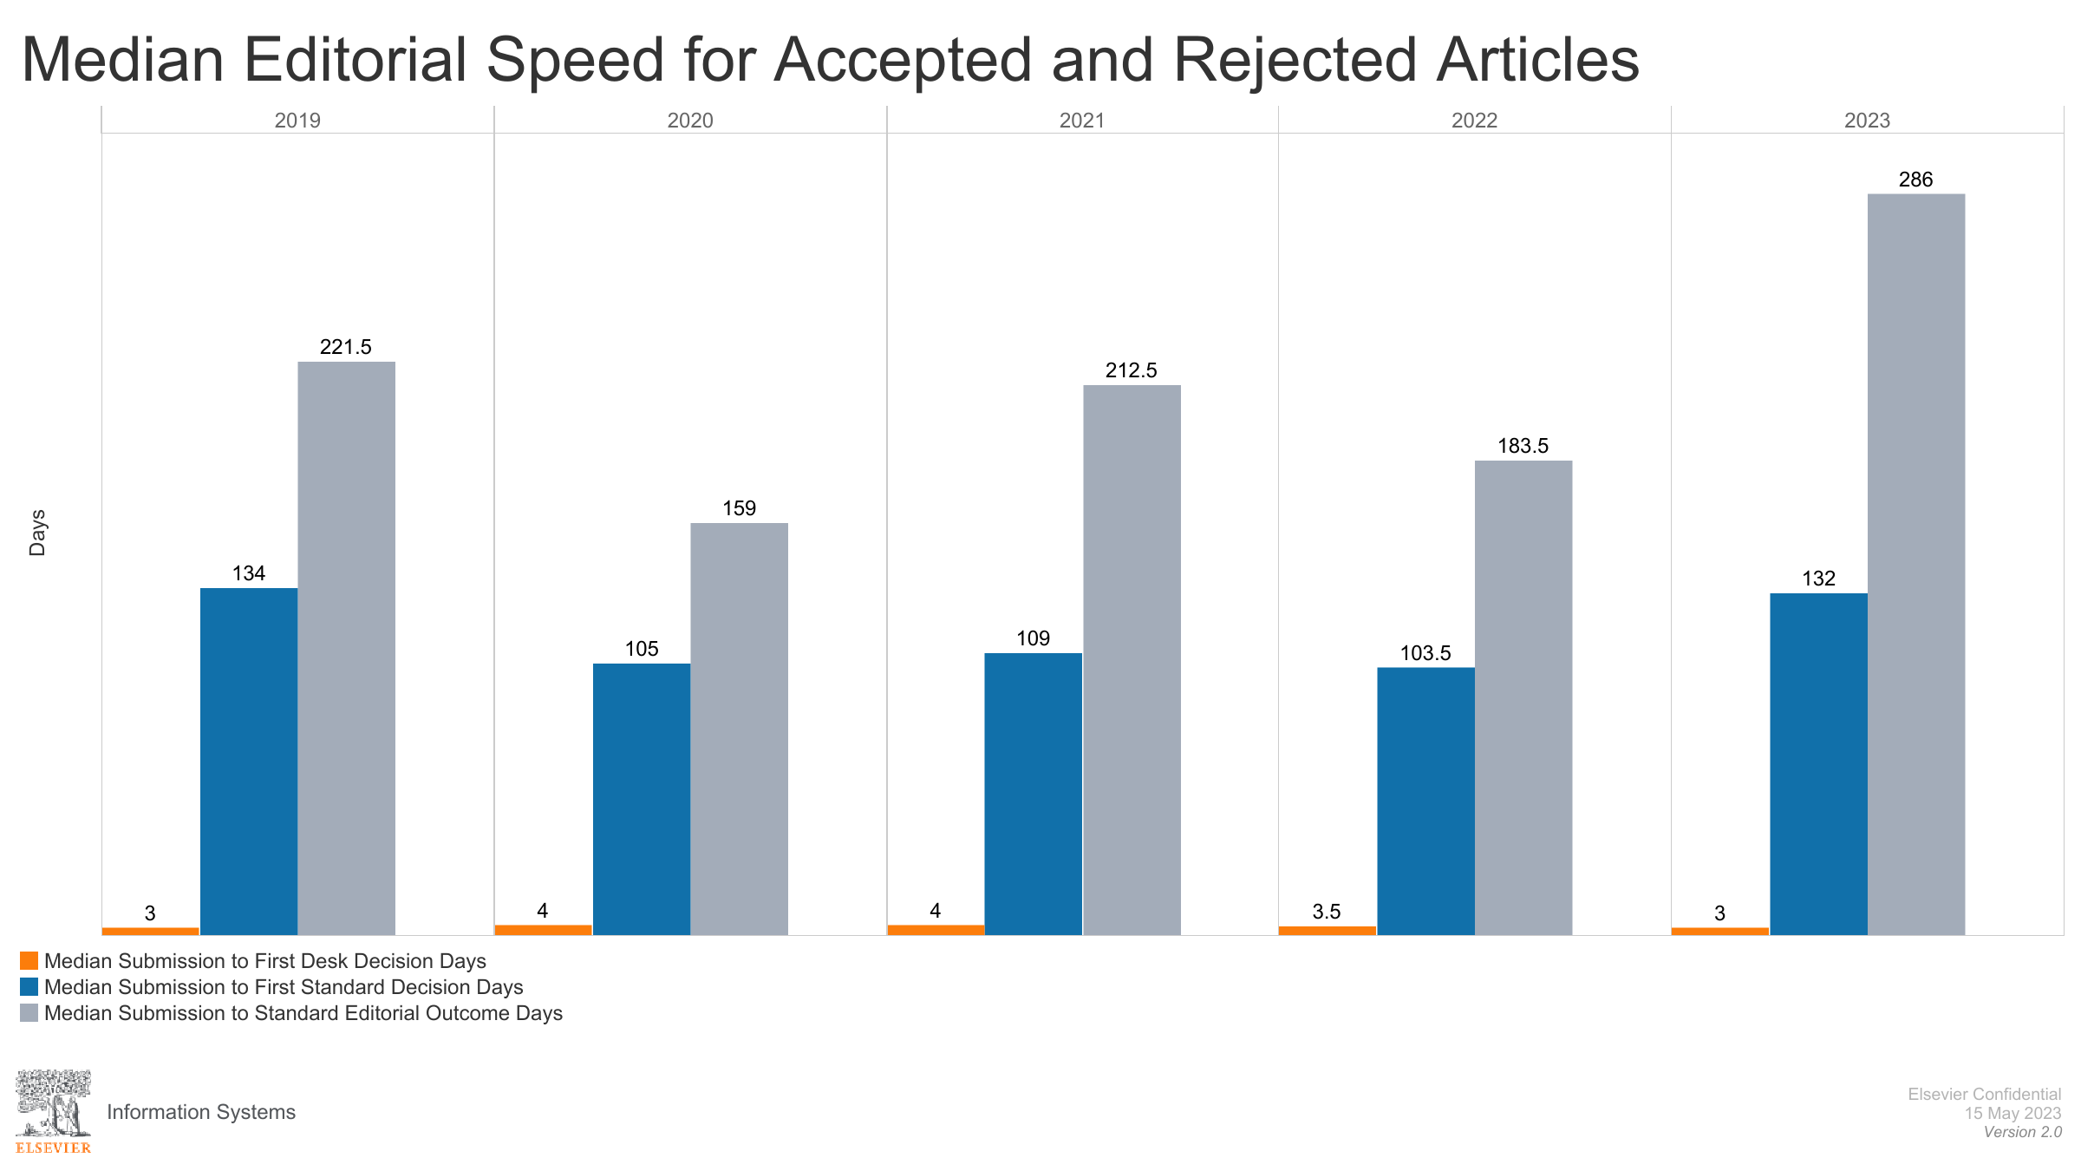

Slide 60
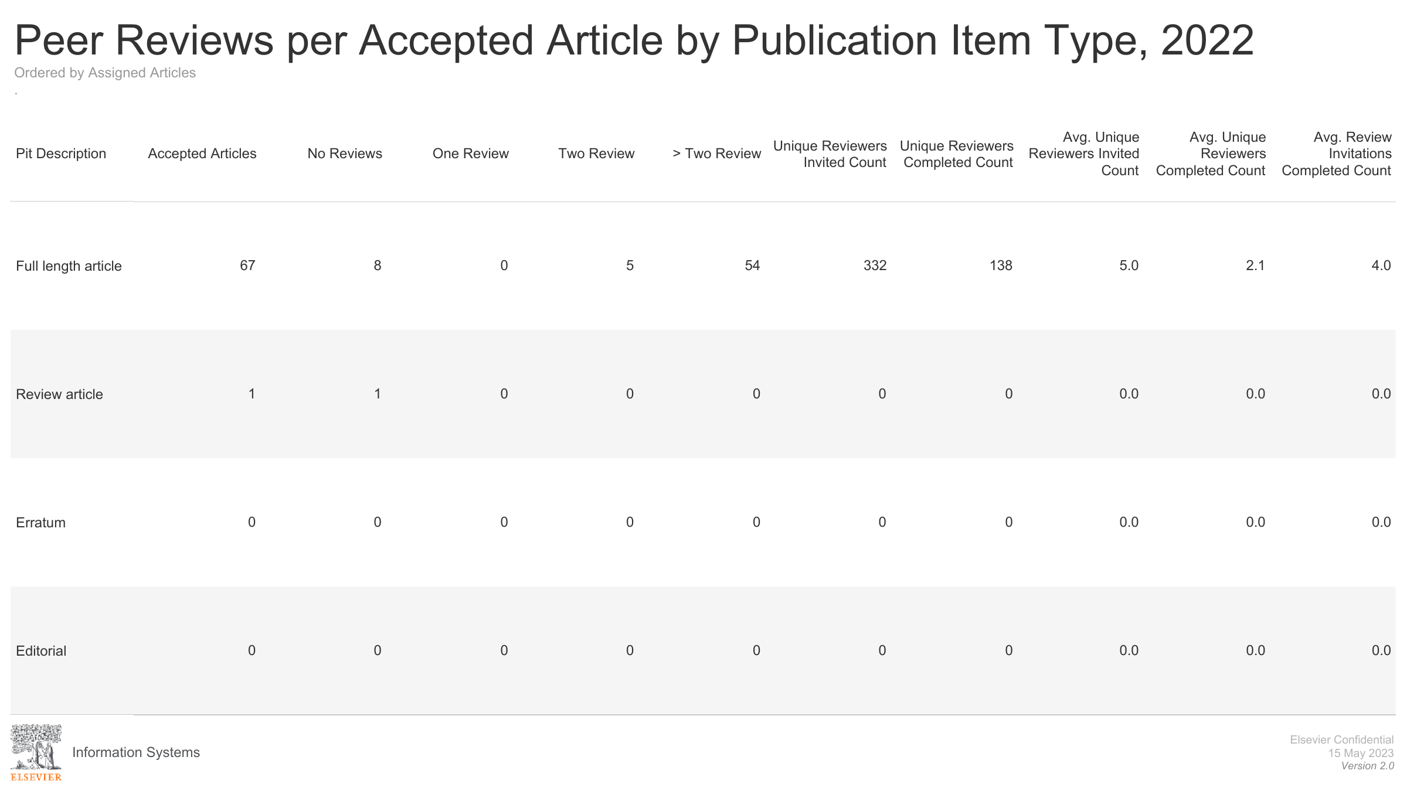

Slide 61
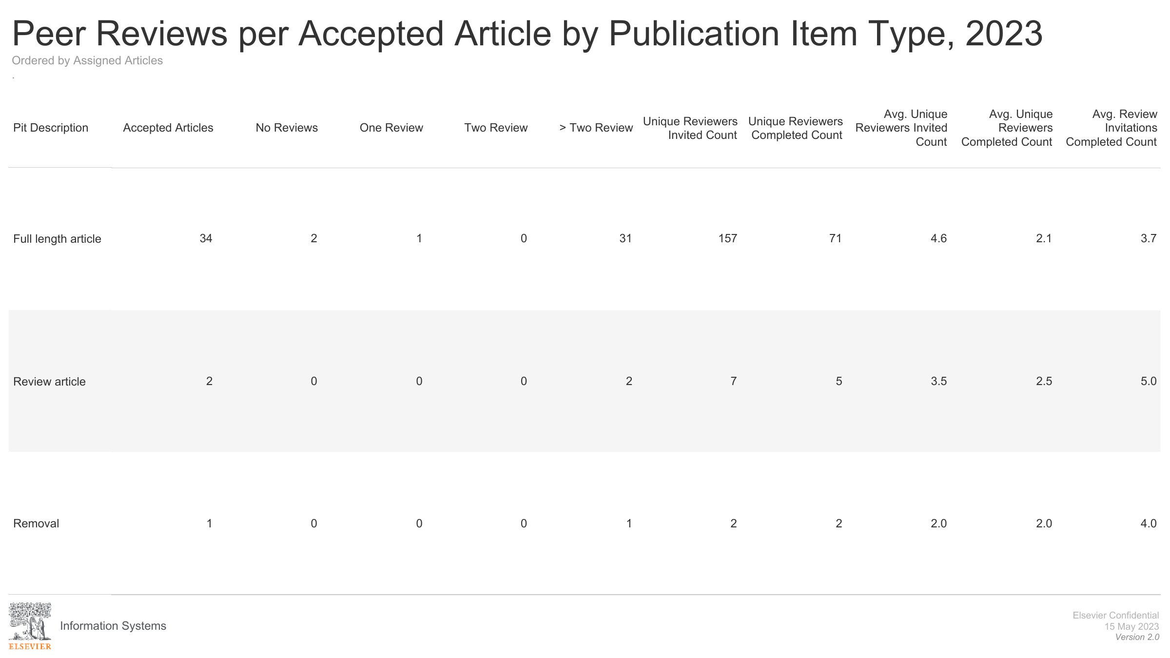

Slide 62
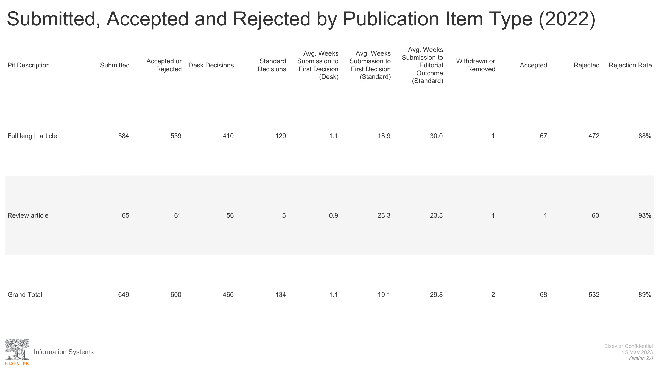

Slide 63
More Usage & citation data

Slide 64
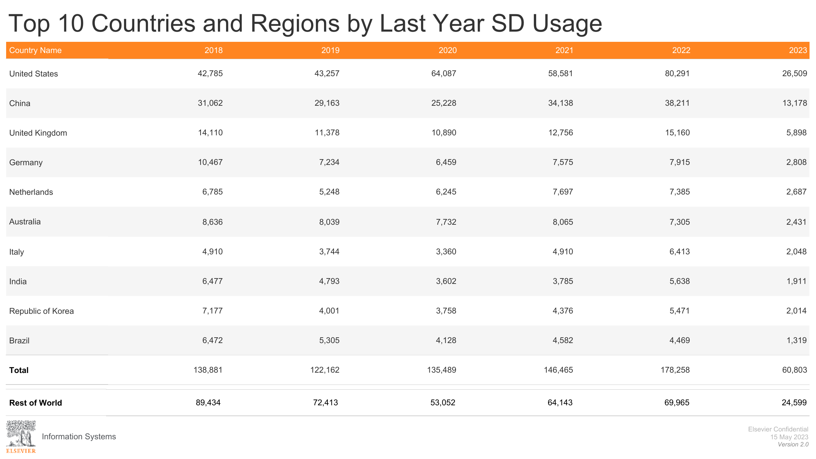

Slide 65
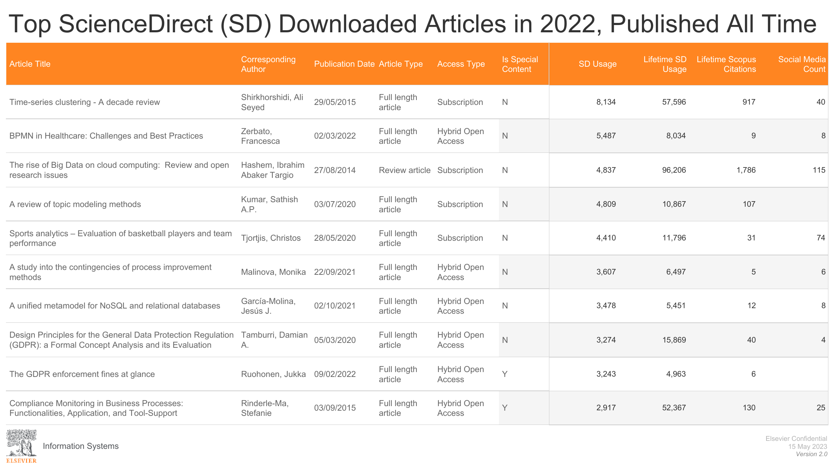

Slide 66
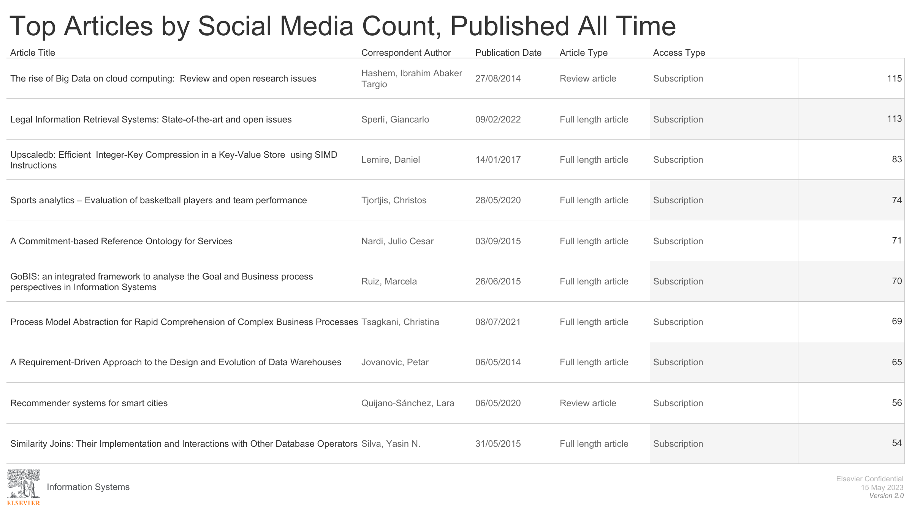

Slide 67
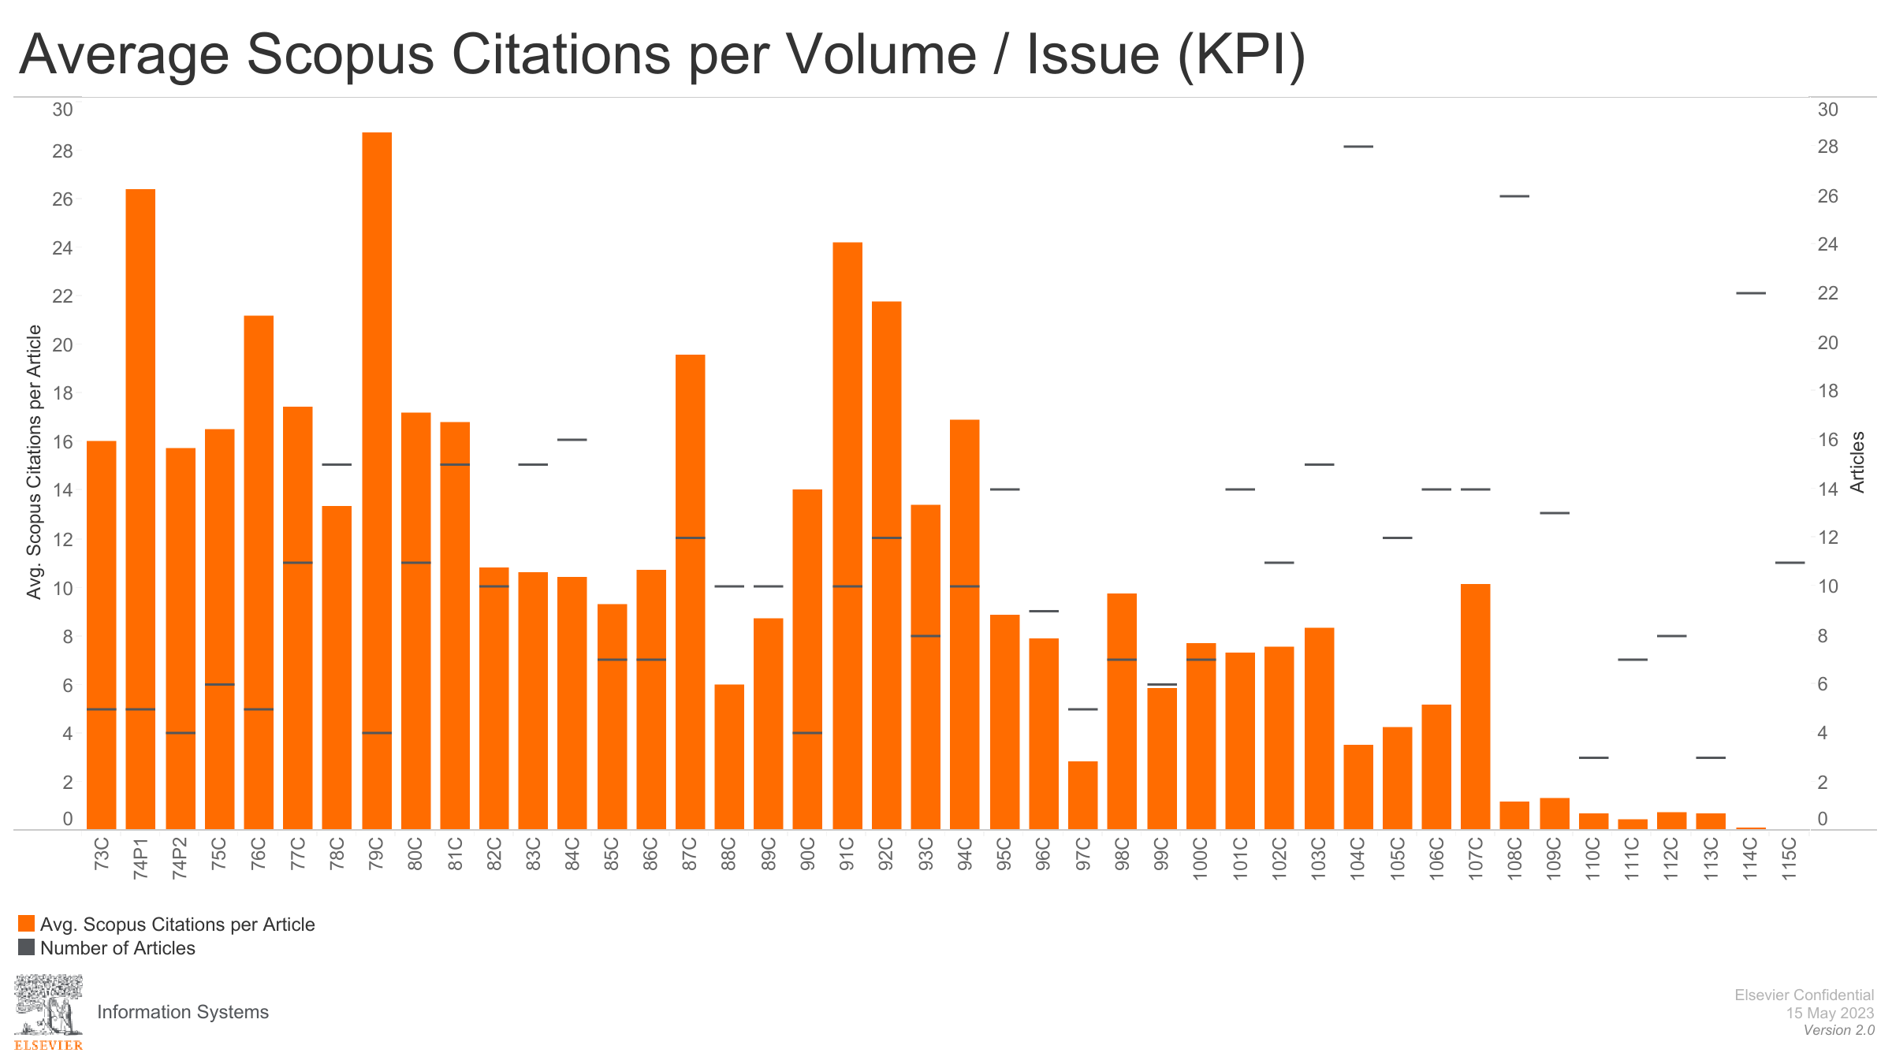

Slide 68
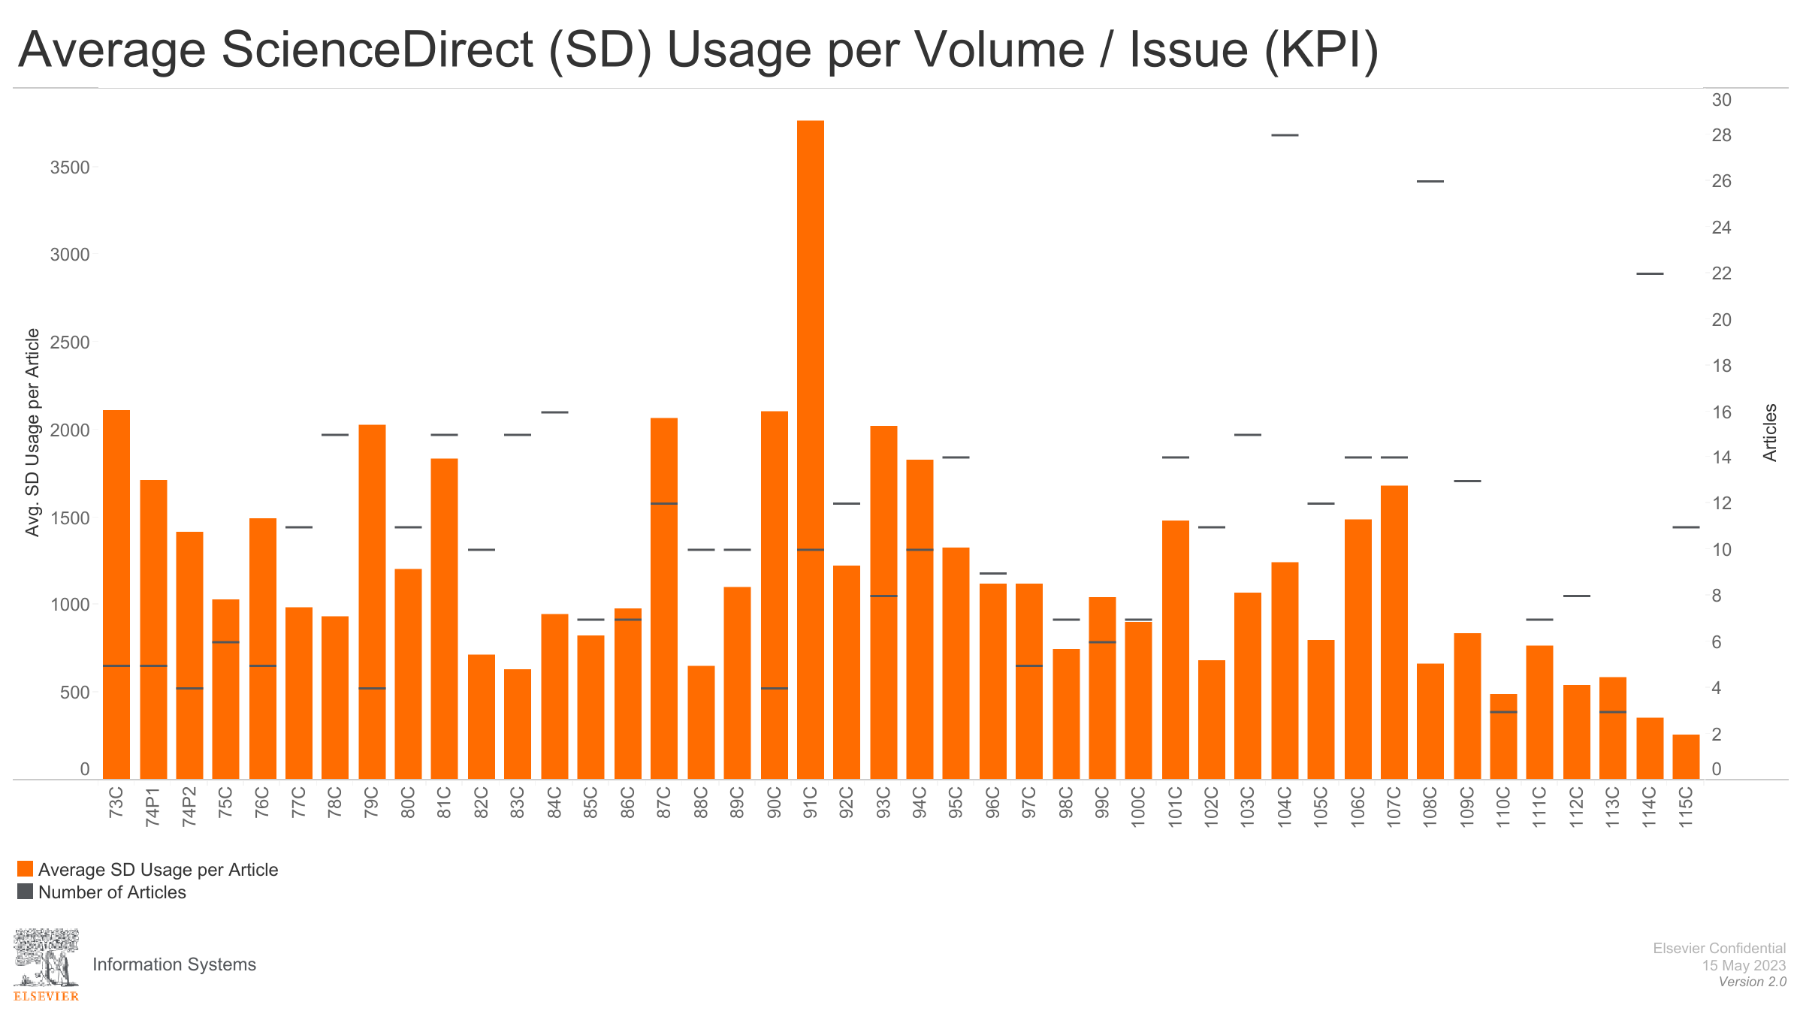

Slide 69
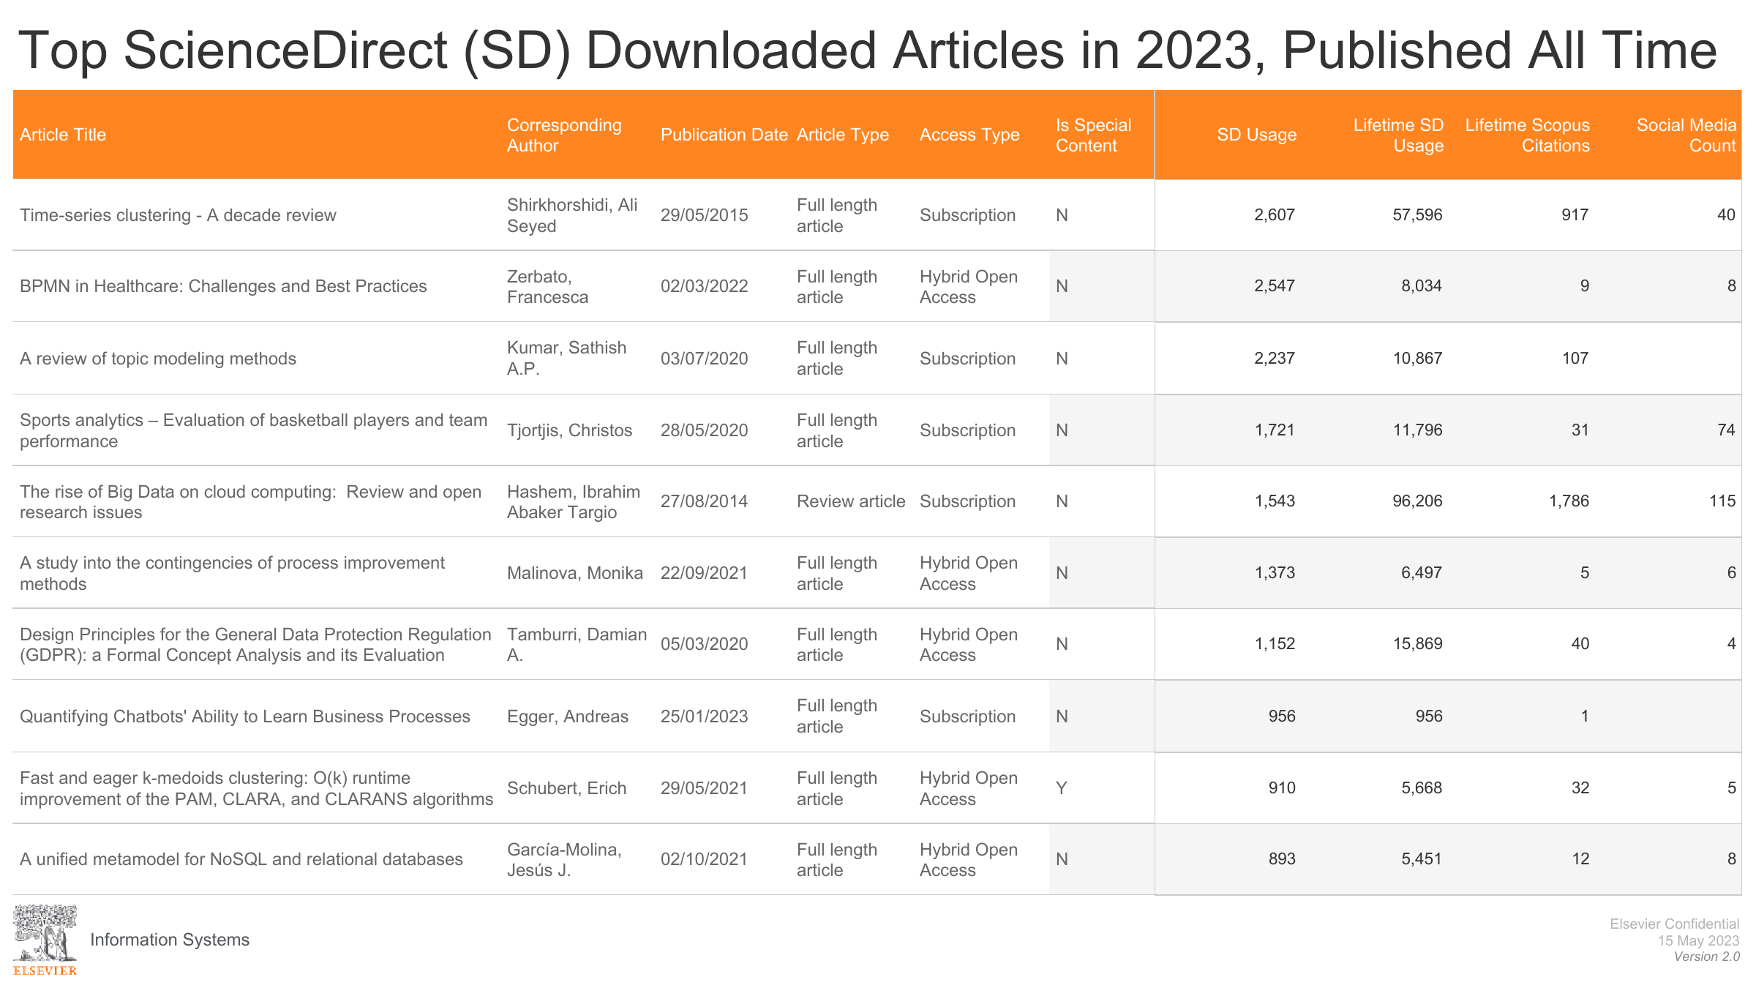

Slide 70
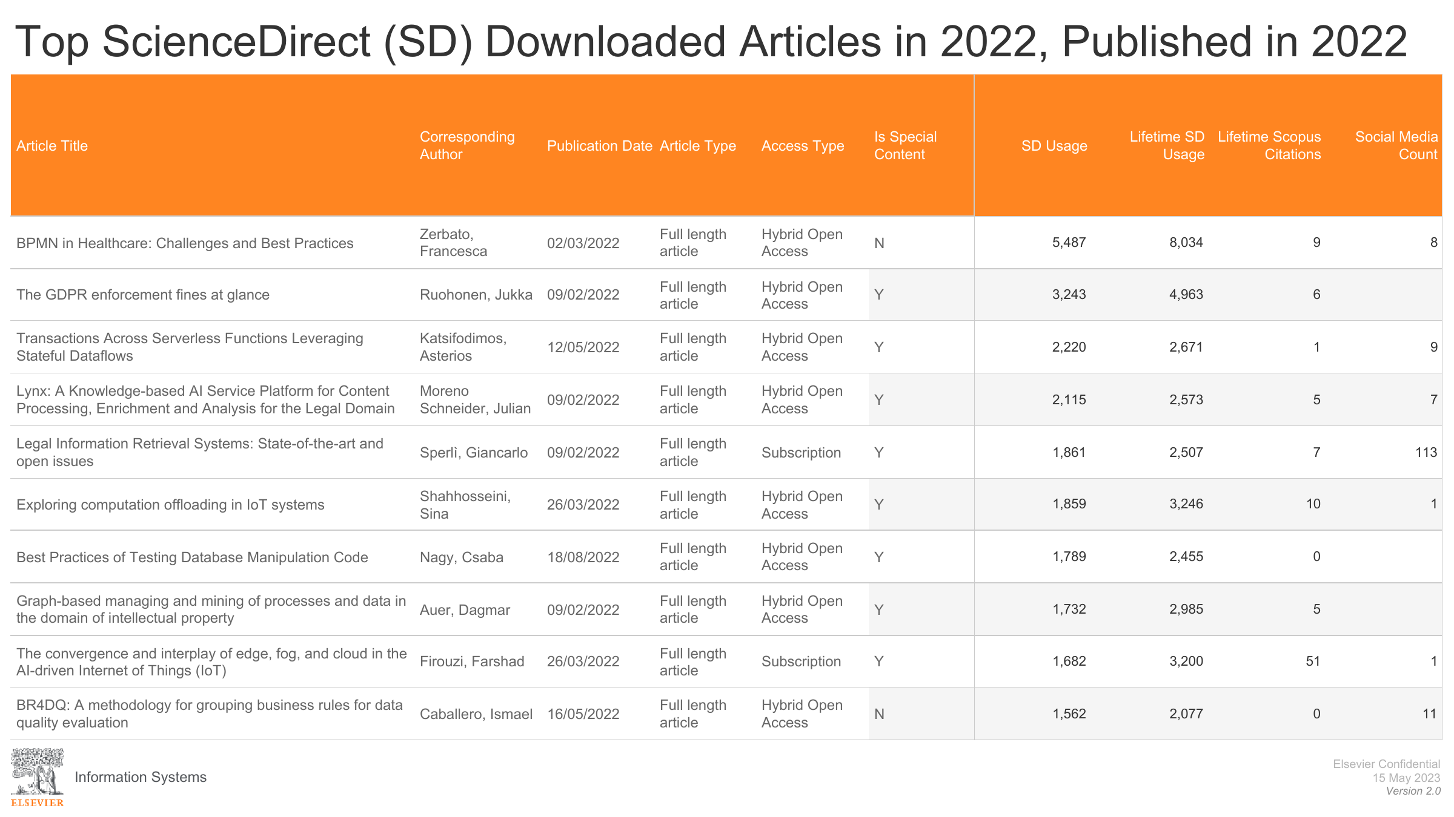

Slide 71
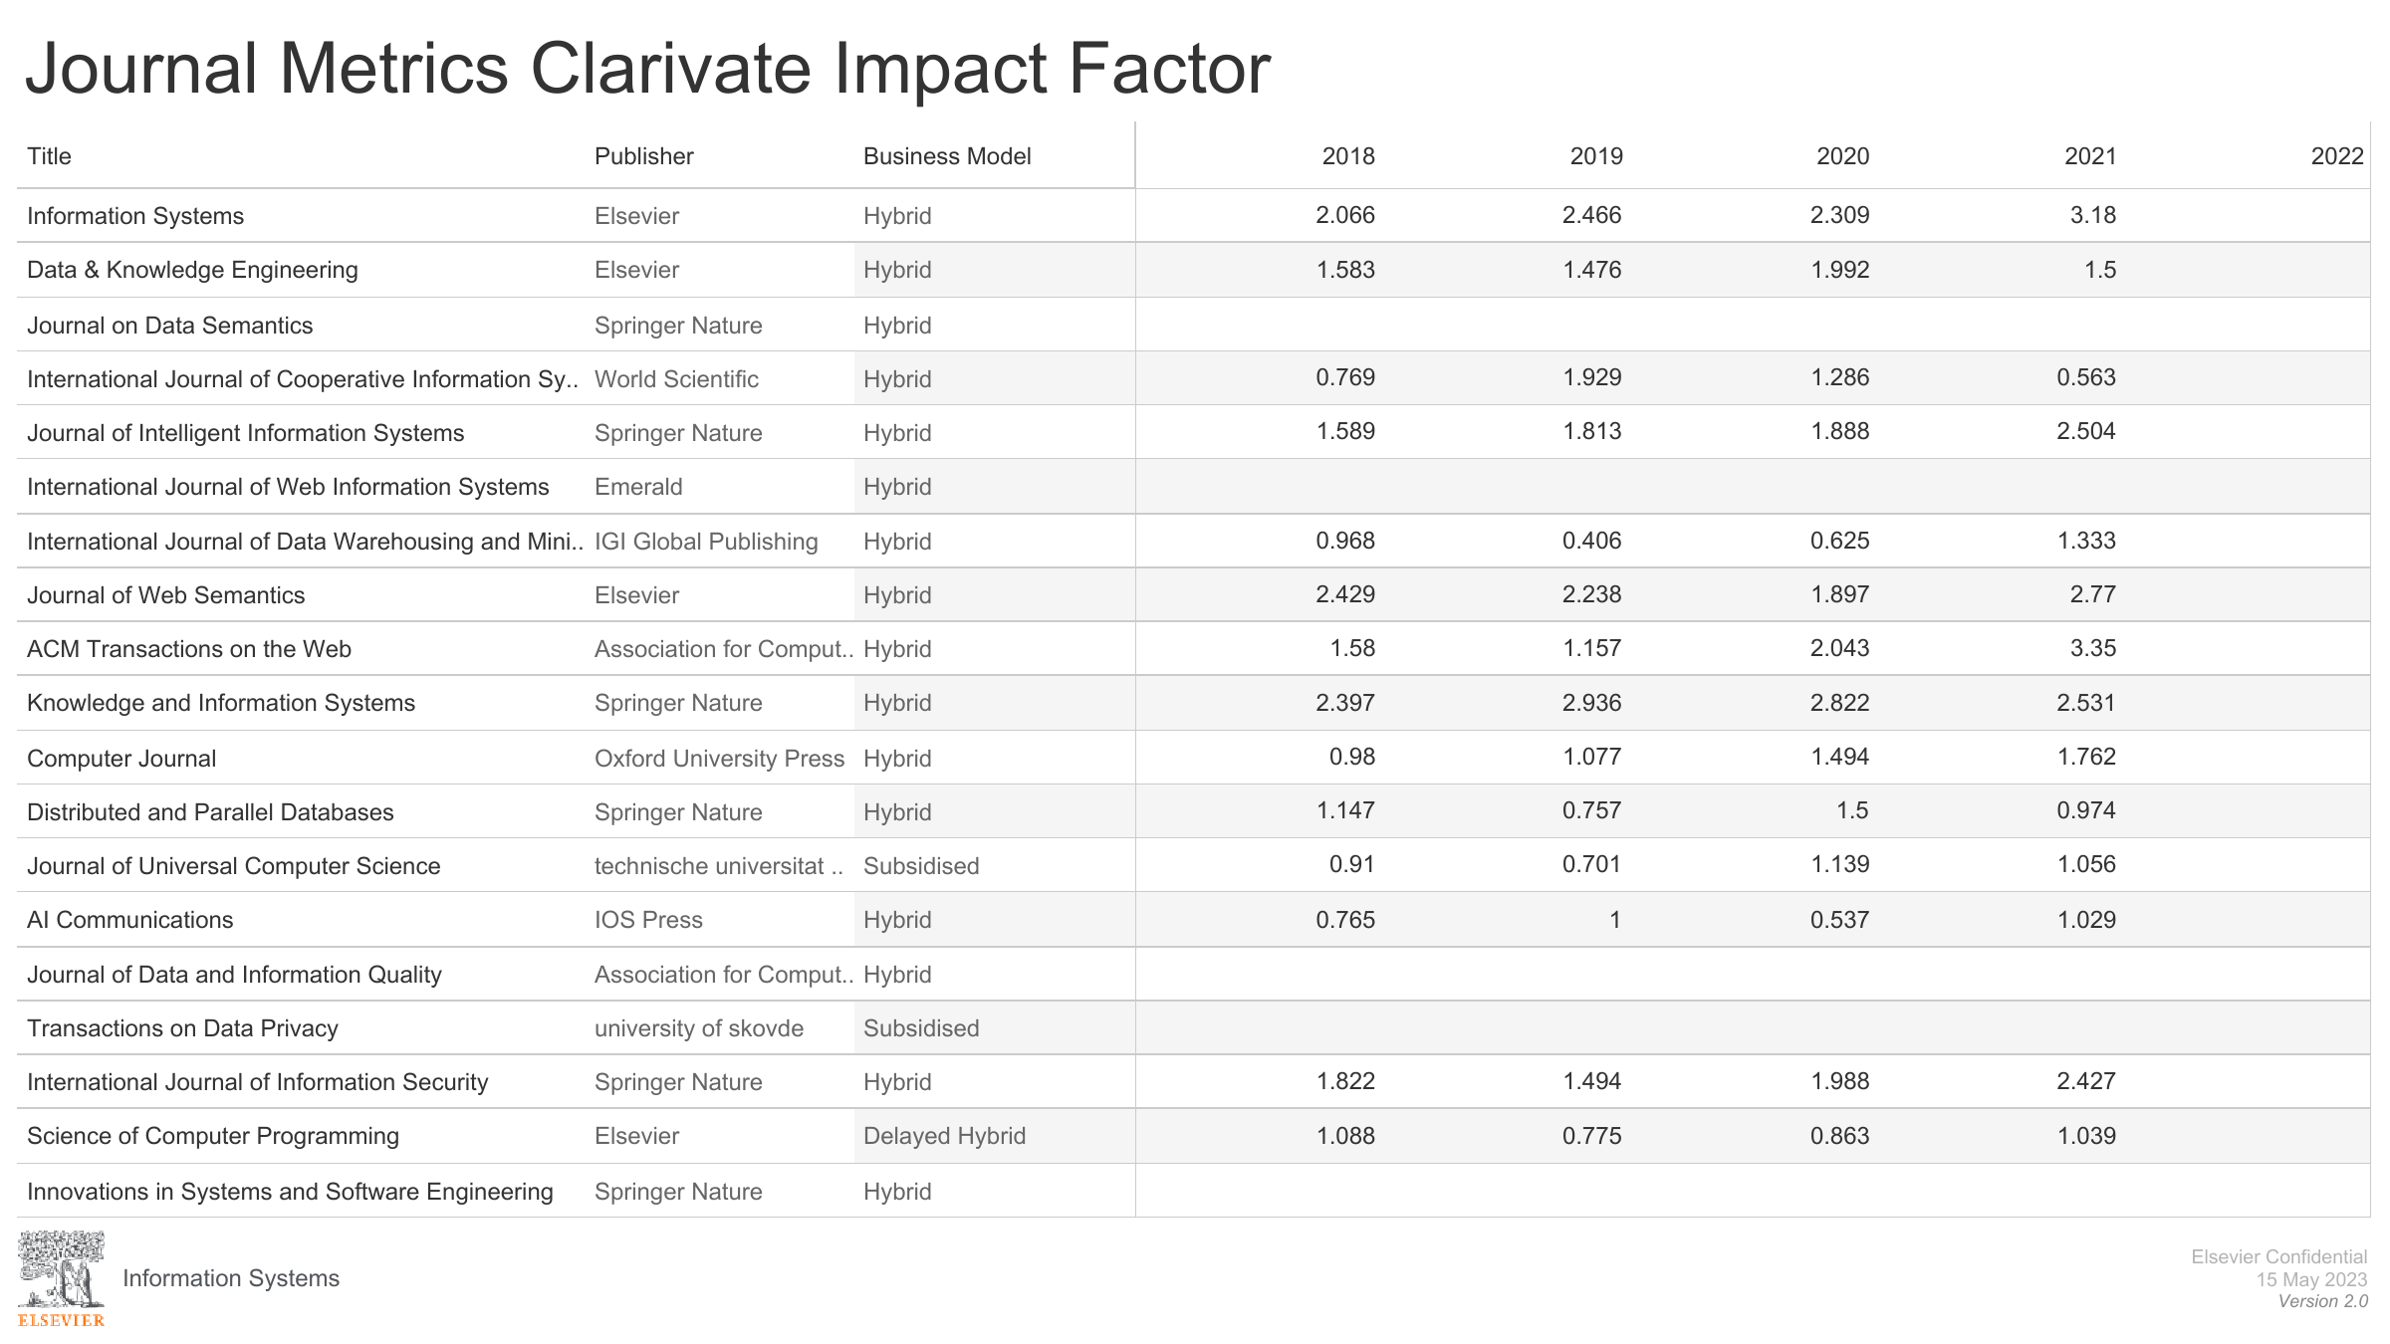

Slide 72
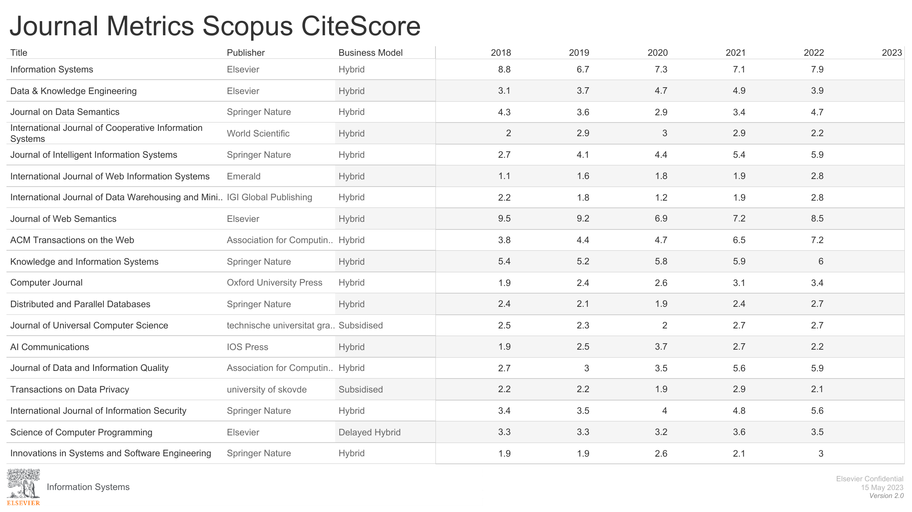

Slide 73
