Slide 1
SafePredict: Reducing Errors by Selectively Refusing to Act
Mustafa A. Kocak⁰, Elza Erkip¹ Dennis Shasha² Shantanu Jain²
⁰Broad Institute¹NYU Tandon SoE, ²Courant Institute

Slide 2
Motivation
Making a bad decision can be costly
an unnecessary medical operation, a bad trade in finance.
Most of medicine is i.i.d. (independent identically distributed). One patient has same causal factors as other.

Slide 3
Concept Drift in Several Domains
Recommender systems must change over time, e.g. if I go to a movie recommendation system, it should not recommend Casablanca if I’m looking for a recent release.
Epidemic spreads can change as the epidemic evolves.
Financial decisions can be independent of politics often, but what about around election time?

Slide 4
Tools at Our Disposal
(i) Machine learning methods that adapt over time.
(ii) Ensemble algorithms that can weight different algorithms.
(iii) Confidence-based prediction based on self-evaluation of predictors.
(iv) SafePredict to refuse to predict sometimes.

Slide 5
Neural Nets – adaptive by design
Neural nets use an updating algorithm called gradient descent: each prediction is compared with the correct answer and weights are adjusted if there are errors.
Thus feedback is continuous.
So, neural nets are adaptive to concept drift by design.
However…. Not always the most accurate choice.

Slide 6
Random Forests – can be made adaptive
A random forest is a collection of decision trees (or if we want a continuous outcome, classification and regression trees), each on randomly chosen subset of data features.
Normally (for i.i.d. data), train once and use forever.
Adaptation strategy idea: If a tree or trees are often wrong, rebuild based on recent data. We call those Forgetful Forests.

Slide 7
Tools at Our Disposal
(i) Machine learning methods that adapt over time.
(ii) Ensemble style algorithms that can weight different algorithms.
(iii) Confidence-based prediction based on self-evaluation of predictors.
(iv) SafePredict to refuse to predict sometimes.

Slide 8
Adjusting Weights Among Machine Learning Algorithms
Suppose you have several machine learning algorithms, e.g. different neural nets, several random forests, others.
Evaluate predictions of each machine learning method.
Adaptation strategy (ensemble idea): If one method does better than others, then give it more weight.
Similar to adaptive random forests except that one adjusts weights given to algorithms rather than changing the algorithms themselves.

Slide 9
Tools at Our Disposal
(i) Machine learning methods that adapt over time.
(ii) Ensemble style algorithms that can weight different algorithms.
(iii) Confidence-based prediction based on self-evaluation of predictors.
(iv) SafePredict to refuse to predict sometimes.

Slide 10
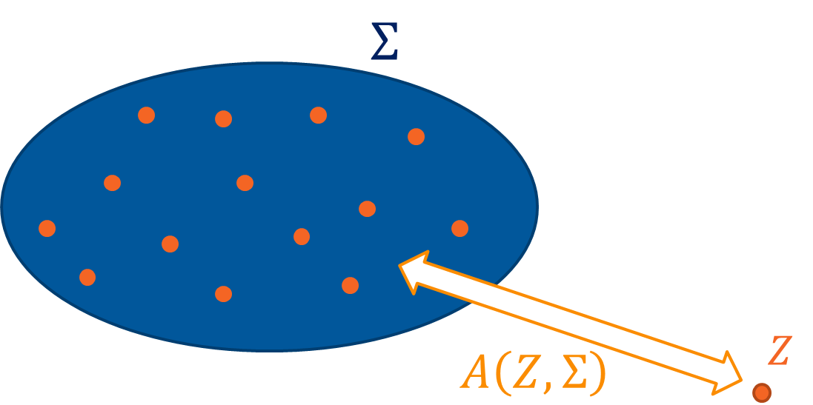
Non-conformity Score of Data Point to a Set
Distance between a data point ($Z$) and a data set ($Σ$).
Denote with $A\left(Z,Σ\right)$.
The farther Z is from $Σ$, the larger the score. Intuitively, if $Σ$ doesn’t provide a good prediction model for Z, then non-conformal.

Slide 11
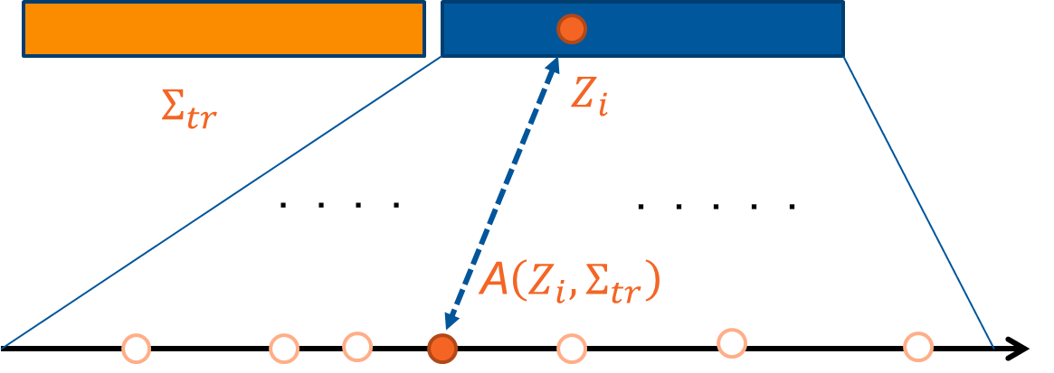
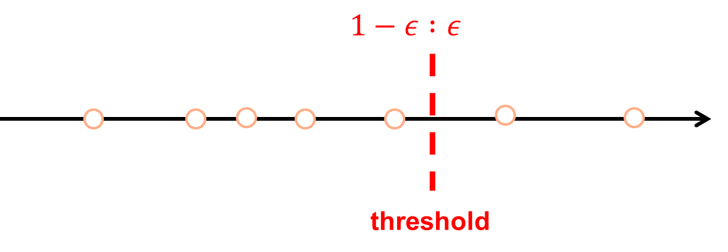
Conformal Prediction – Train & Calibration
Split training set into core and calibration sets.
In calibration set, find fraction of trees that must agree to make prediction that exceeds correctness target (e.g. 90%).
If a given data point gets insufficient votes, refuse.
Conforming Non-conforming

Slide 12
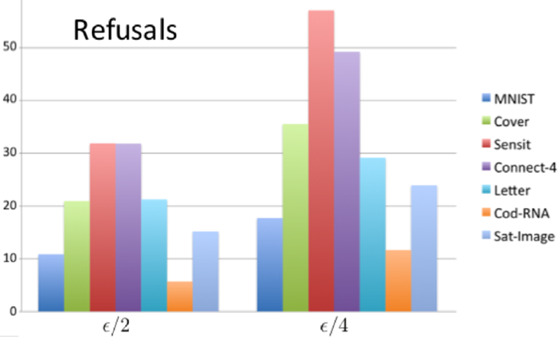
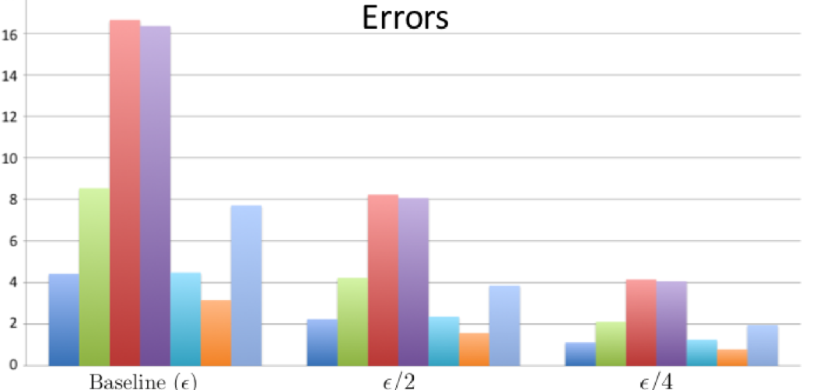
Accuracy refusal tradeoff
Can cut the error rate for iid (independent identically distributed)
in half by refusing 6 -32% of the time.
to a quarter by refusing 12-57% of the time.

Slide 13
Tools at Our Disposal
(i) Machine learning methods that adapt over time.
(ii) Ensemble style algorithms that can weight different algorithms.
(iii) Confidence-based prediction based on self-evaluation of predictors.
(iv) SafePredict to refuse to act sometimes.

Slide 14
What if not Independent Identically Distributed (iid), i.e. you have concept drift?
In that case conformal prediction (self-confidence of predictor) may be false. (“We’re not in Kansas anymore”)
Your friend tells you he loves some movie, but you realize your tastes have changed and you don’t want to see another action movie without character development.
.

Slide 15
Idea of SafePredict
Basic idea is to use base predictor or predictors perhaps with an ensemble method while everything is good.
Confidence-based (conformal) prediction to accept those predictions only if self-confidence is high
SafePredict intervenes if error rate is too high, perhaps due to concept drift
Can give asymptotic guarantees even against an adversary.

Slide 16
What Does Working Mean?
Validity guarantee (asymptotic): Will get desired error rate on non-refused predictions (fine print in next slide).
Efficiency: if error rate is in fact below desired error rate, will accept almost all predictions.

Slide 17
Dealing with the Adversary – specific goals
Adversary is powerful: knows when you will refuse and when you won’t
So adversary can foil any specific predictor no matter how confident. But if adversary causes predictor to be wrong above error bound you will accept the prediction almost never.
Guarantee is that if number of non-refused predictions approaches infinity, then will meet error bound on those.

Slide 18
Dealing with the Adversary – mechanics
Set up a two-bandit setting where with some probability, act based on output of the confidence-based predictor, but otherwise don’t act on the prediction.
If the confidence-based predictor is correct, then give it higher probability. Otherwise give the refusing bandit higher probability.
Adjust learning rate using the “doubling trick”.

Slide 19
At time $t=1,…, T$:
Environment reveals $x_{t}$
Adaptive predictor(s) P makes prediction: ${\hat{y}}_{t}$, computes reliability score: $r_{t}$
Confidence Based Rejection (CBR) rejects based on $r_{t}$
Combine based on bandits.
SafePredict (SP) decides on whether to accept.
Ground truth $y_{t}$ is revealed, CBR and SP updates their inner states.
Parameters: target error rate $ε$, CBR window size: w
Algorithm
Notes:
Problems:
Font in model graph is too small.
Bar graph too small font. Lacking x-axis name.
Bar graph no explanation: error rate and efficiency? Explain model names (arf, hat). Change sp to sf.
Include only one dataset (wireless): include plot of error rate.
Stashed text: dataset 2: Input variables are prices and demands in New South Whales and Victoria, and the amount of power transferred between the states.
The class label identifies the change of the transfer price relative to a moving average of the last 24 hours (increase or decrease).

Slide 20
Recovering from Excessive Refusals
Your friend has given you three bad movie recommendations so you don’t listen any more…
Issue: get into a regime in which you never listen to your friend, but what if his tastes also change and he likes French movies.
Resolution: “weight-shifting” accept predictions on occasion even if predictions have been bad.

Slide 22
MNIST results (digit recognition)

Slide 24
SafePredict Implementation (Shantanu Jain)
SafePredict is implemented as a meta-estimator in the popular Python framework scikit-learn.
It works out-of-the-box with the same familiar scikit-learn API with methods like .fit(), .partial_fit(), .predict() and can be directly integrated into existing analysis pipelines.
The implementation acts like a wrapper around scikit-learn estimators, just adding the possibility to refuse predictions.

Slide 25
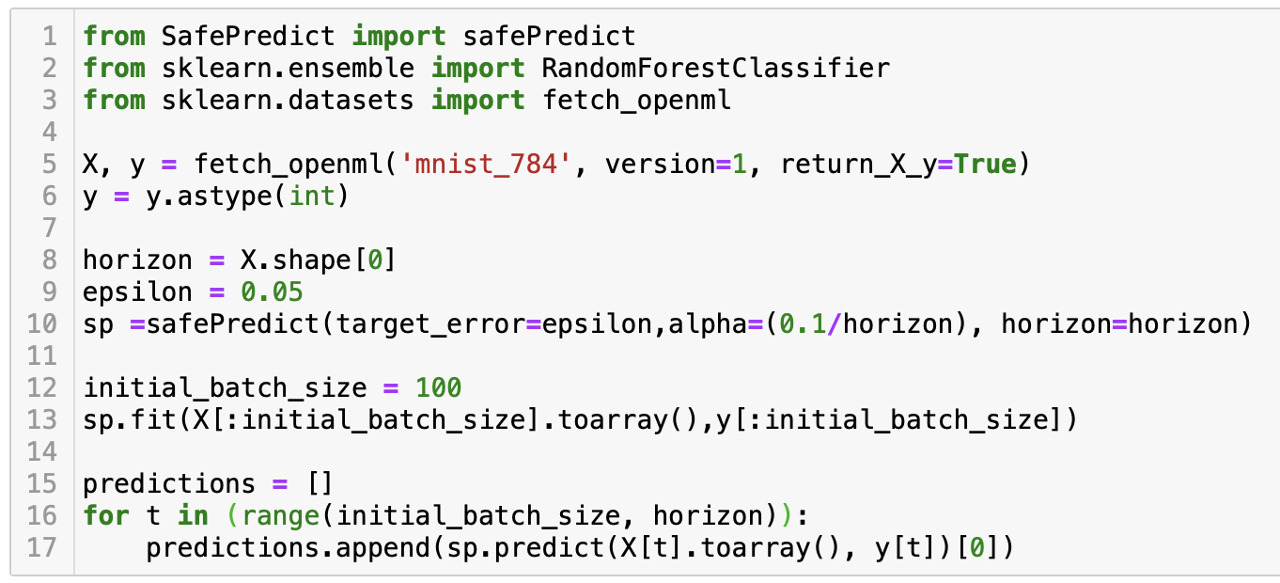
Notes:
Problems:
Font in model graph is too small.
Bar graph too small font. Lacking x-axis name.
Bar graph no explanation: error rate and efficiency? Explain model names (arf, hat). Change sp to sf.
Include only one dataset (wireless): include plot of error rate.
Stashed text: dataset 2: Input variables are prices and demands in New South Whales and Victoria, and the amount of power transferred between the states.
The class label identifies the change of the transfer price relative to a moving average of the last 24 hours (increase or decrease).

Slide 26
SafePredict Parameters
Target error: Required upper bound on error rate.
Horizon: Total number of data points to be predicted
Alpha: Strict lower bound on probability that SafePredict accepts a prediction. (Validity of SafePredict is probabilistically guaranteed when alpha is on the order of 1/Horizon)
Refusal class: The required output indicating that a prediction is refused
Calibration: Addition of calibration method (Platt/Isotonic) for confidence-based refusals in addition to SafePredict

Slide 27
SafePredict Implementation
Github repo: https://github.com/ShanJ35/SafePredict
Medium Blog post with example: https://medium.com/@sj2538/safepredict-asymptotic-error-bounds-for-online-learning-c02da4e4b846

Slide 28
Summary
Concept Drift is an issue in many fields (causal factors can change)
Machine learning algorithms can be made adaptive.
Ensemble method to weight among them can also be adaptive.
ConformalPrediction looks at confidence of algorithm to accept prediction or not.
SafePredict uses previous error rate to accept or not.
Weight shifting to avoid getting stuck.

Slide 29
References
Good performance against adversaries: https://ii.uni.wroc.pl/~lukstafi/pmwiki/uploads/AGT/Prediction_Learning_and_Games.pdf N. Cesa-Bianchi, Y. Mansour, and G. Stoltz, “Improved Secondorder Bounds for Prediction with Expert Advice,” Machine Learning, vol. 66, no. 2-3, pp. 321–352, 2007.
Conformal Prediction: V. Vovk, A. Gammerman, and G. Shafer, Algorithmic Learning in a Random World. Springer Sci. & Bus. Media, 2005.

