Slide 1

Computational Reproducibility: state-of-the-art, challenges, database research opportunities
Juliana Freire, Philippe Bonnet, and Dennis Shasha
Juliana.freire@nyu.edu
phbo@itu.dk
shasha@courant.nyu.edu
Notes:
While computational experiments have become an integral part of the scientific method, it is still a challenge to repeat such experiments, because often, computational experiments require specific hardware, non-trivial software installation, and complex manipulations to obtain results. To address this problem, we are building infrastructure to support the life-cycle of 'reproducible publications': their creation, review and re-use. This infrastructure makes it easier to generate and share repeatable results by making provenance a central component in scientific exploration, and the conduit for integrating data acquisition, derivation, and analysis as executable components throughout the publication process. Besides giving authors the ability to link results to their provenance, it enables reviewers to assess the correctness and the relevance of the experimental results described in a submitted paper; and, upon publication, it also allows readers to repeat and utilize the computations embedded in the papers. In this talk, we give an overview of this infrastructure and present case studies that show how this infrastructure has been used. We also discuss its limitations and open problems that require further research.

Slide 2
Science and Reproducibility
Reproducibility is the cornerstone of science
Notes:
If a result is not reproducible, it is questionable whether it is actually science
http://www.nytimes.com/2011/07/08/health/research/08genes.html
http://en.wikipedia.org/wiki/Scientific_misconduct
http://ori.dhhs.gov/misconduct/cases/
Some seemed careless — moving a row or a column over by one in a giant spreadsheet — while others seemed inexplicable. The Duke team shrugged them off as “clerical errors.”
Nobel Laureate Retracts Two Papers, NYTimes 09/24/2010
But the research at Duke turned out to be wrong. Its gene-based tests proved worthless, and the research behind them was discredited.

Slide 3
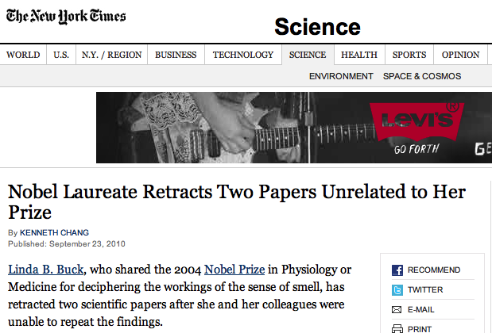
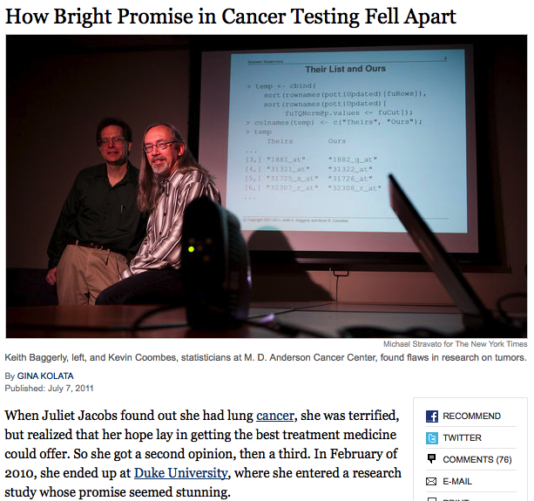
Science and Reproducibility
Notes:
http://en.wikipedia.org/wiki/Scientific_misconduct
http://ori.dhhs.gov/misconduct/cases/

Slide 4
Science and Reproducibility
Reproducibility is the cornerstone of science
If we can’t trust other results, we have to start over from scratch.
Without reproducibility, people die!
John Wilbanks, AMPS Workshop on Reproducibility 2011
Notes:
If a result is not reproducible, it is questionable whether it is actually science
The lack of reproducibility can have dire consequences
http://www.nytimes.com/2011/07/08/health/research/08genes.html
http://en.wikipedia.org/wiki/Scientific_misconduct
http://ori.dhhs.gov/misconduct/cases/
Some seemed careless — moving a row or a column over by one in a giant spreadsheet — while others seemed inexplicable. The Duke team shrugged them off as “clerical errors.”
Nobel Laureate Retracts Two Papers, NYTimes 09/24/2010
But the research at Duke turned out to be wrong. Its gene-based tests proved worthless, and the research behind them was discredited.

Slide 5
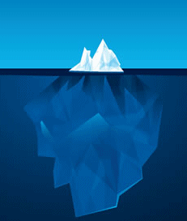









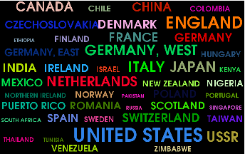
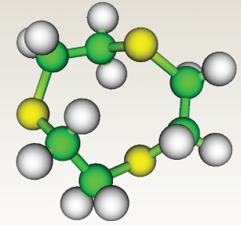
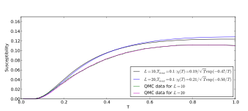
Computational Science and Reproducibility
Many disciplines have been transformed by computation: data and computing-intensive
  Computations can (often) be reproduced!
Authors are being encouraged (or required) to submit reproducible results
  ACM SIGMOD, VLDB, Journal of Biostatistics, Science, IEEE Transactions on Signal Processing, Freedom of Information Act and climate science
Notes:
Simulation, analysis and visualization
Journal of Biostatistics has a reproducibility editor
science now requires code since Feb 2011

Slide 6
Computational Science and Reproducibility
Publications are changing: need to provide a complete and trustworthy scientific record
  ETH’s ethics guidelines http://www.vpf.ethz.ch/services/researchethics/Broschure
  NSF data policies http://www.nsf.gov/nsb/committees/dp/principles.pdf
http://www.sciencemag.org/site/feature/contribinfo/prep/gen_info.xhtml
Notes:
Simulation, analysis and visualization
Journal of Biostatistics has a reproducibility editor
science now requires code since Feb 2011

Slide 7
We’ve Seen the Stick,
Where is the Carrot?
Making your system reproducible forces you to document its execution pathways. Helps newcomers.
Reproducibility forces portability. Helps dissemination.
Preliminary evidence that reproducibility increases impact and visibility.

Slide 8
Reproducibility – what does it mean?
Computational reproducibility: an experiment at time t, done on system s and data d can be performed at time t’ on system s’ on data d to get the same result. The experiment can also be performed on data d’ with “consistent” results.
Much higher standard than natural science.
Notes:
It’s Science, but Not Necessarily Right, people can solve more complex problems
Free online availability substantially increases a paper's impact S. Lawrence, Nature 2001

Slide 9
Reproducibility – what does it mean?
Computational reproducibility not always possible, e.g. lab experiment.
Descriptive reproducibility: an experiment at time t, done on system s and data d can be described in sufficient detail to be reproduced at least approximately.
This is the standard of natural science.
Tools from computational reproducibility may help.
Notes:
It’s Science, but Not Necessarily Right, people can solve more complex problems
Free online availability substantially increases a paper's impact S. Lawrence, Nature 2001

Slide 10
Making Reproducibility Easy
Reproducibility is clearly useful, but seems hard.
Now show tools for computational reproducibility.
Next show protocols for descriptive reproducibility.
Notes:
It’s Science, but Not Necessarily Right, people can solve more complex problems
Free online availability substantially increases a paper's impact S. Lawrence, Nature 2001

Slide 11
Juliana Part: computational reproducibility

Slide 12
Philippe Part: descriptive reproducibility

Slide 13
What to do with the Database of Reproducible Experiments
Manager: Here is a database of reproducible experiments.
Dilbert: Cool. Let’s query it and mine it.
Manager: You don’t even know which queries I want.
Dilbert: So? I like to build databases.

Slide 14
Queries Are Challenging
Find experiments that perform data cleaning using algorithm A followed by image processing using system B.
Find workflows that operate over dataset D.
Will need a query languages over workflows, perhaps similar to business process languages.

Slide 15
Creating New Experiments
If the database is large enough, then it should be possible to query the database, add in extra steps and create a new computational pipeline.
Ex: Create a workflow that uses the analytical tool from some experiment on river water data and combine that with a home-grown visualization tool.

Slide 16
Mining the Repository
Papers describing tools may of course be referenced, but much more significant when they are used.
We can trace usage statistics along with characteristics of the data on which a certain tool is used.
We can develop a kind of repository reference relationship.

Slide 17
Some Dreams
Be able to query for workflows and data using structured and free text data.
Track use of workflows by the community
  Keep the attribution chain
  Combine with citations to the paper
Support for commentaries on workflows (forum).
Support for improvements to published workflows, so workflows can be living documents.

Slide 18
More Dreams
Start with workflows in heterogeneous environments.
Create mashup containing these workflows, running either on separate machines or different virtual machines and make them run together.
Be able to do this very easily!

Slide 19
Summary
Reproducibility helps the community trust and build on previous work.
Reproducibility helps the researcher train new members of a team.
Partial reproducibility is possible even when there are
  Proprietary rights issues: allow testing only at a certain interface
  Difficult-to-reproduce subparts: allow testing only for the computationally reproducible subcomponents, but read the descriptions to make sure full reproducibility is in principle possible.

