Slide 1

Reproducible Experiments as an Afterthought
Introducing ReproZip, the reproducibility packer
Remi Rampin
Dennis Shasha
Fernando Chirigati
Juliana Freire

Slide 2
Use Case: Hallelujah
You’ve just made your program work. Great.
Now someone says “It would be nice to make it reproducible and portable”
“But I haven’t instrumented it!”
“With reprozip, you don’t have to.”

Slide 3
Goals of ReproZip
To create a self-contained package of my experiment that allows it to be reproduced on any machine, and/or archived as a snapshot
Independent of any language/framework, non-intrusive

Slide 4
Two Steps of ReproZip
Packing
currently, ReproZip packs experiments that originally run on Linux.
Un-packing
Using ReproUnzip, reviewers can unpack ReproZip files on any operating system, e.g. Windows.

Slide 5
Demo: zipping on source machine
Reprozip trace myprogram

Slide 6
Demo: unzipping on target machine having same operating system.
Reprounzip …

Slide 7
Demo: zipping on source machine and store into VM
Reprozip trace myprogram
… put inside vagrant

Slide 8
Demo: unzipping on target machine having different operating system.
… open up virtual machine (from Juliana’s laptop)
Reprounzip …

Slide 9
What doe Reprozip Capture
Metadata (command-line, env. vars, architecture, distribution…)
Full trace of what the experiment does
All files that are needed to run the experiment again: libraries, programs, scripts, configuration, data, etc.

Slide 10
Thank You! Questions?
http://vida-nyu.github.io/reprozip/
Installs with Conda, pip, .exe (Windows), .pkg (Mac OS)

Slide 11
The END

Slide 12
Demo
describe experiment (digits_sklearn) trace (multiple steps with --continue) show config load completed config (with correct input/output files) pack reprozip info: runs, input & output files, list of unpackers graph (show that it’s generally too big, mention work on interactive viz, show dataflow, show a simplified graph) unpack for Docker download results, upload something different (!?), download results again run through a VisTrails workflow

Slide 13
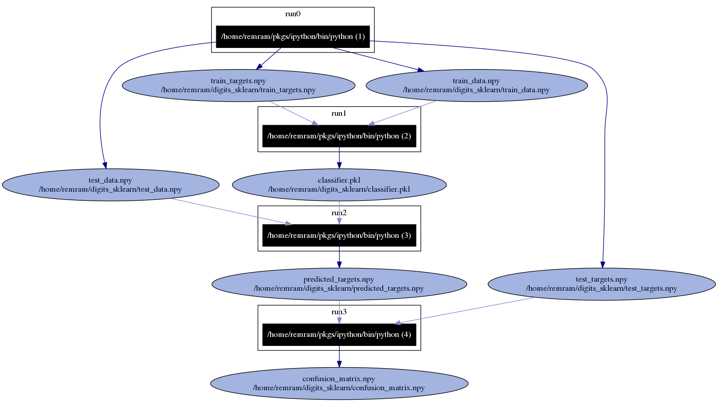

Slide 14
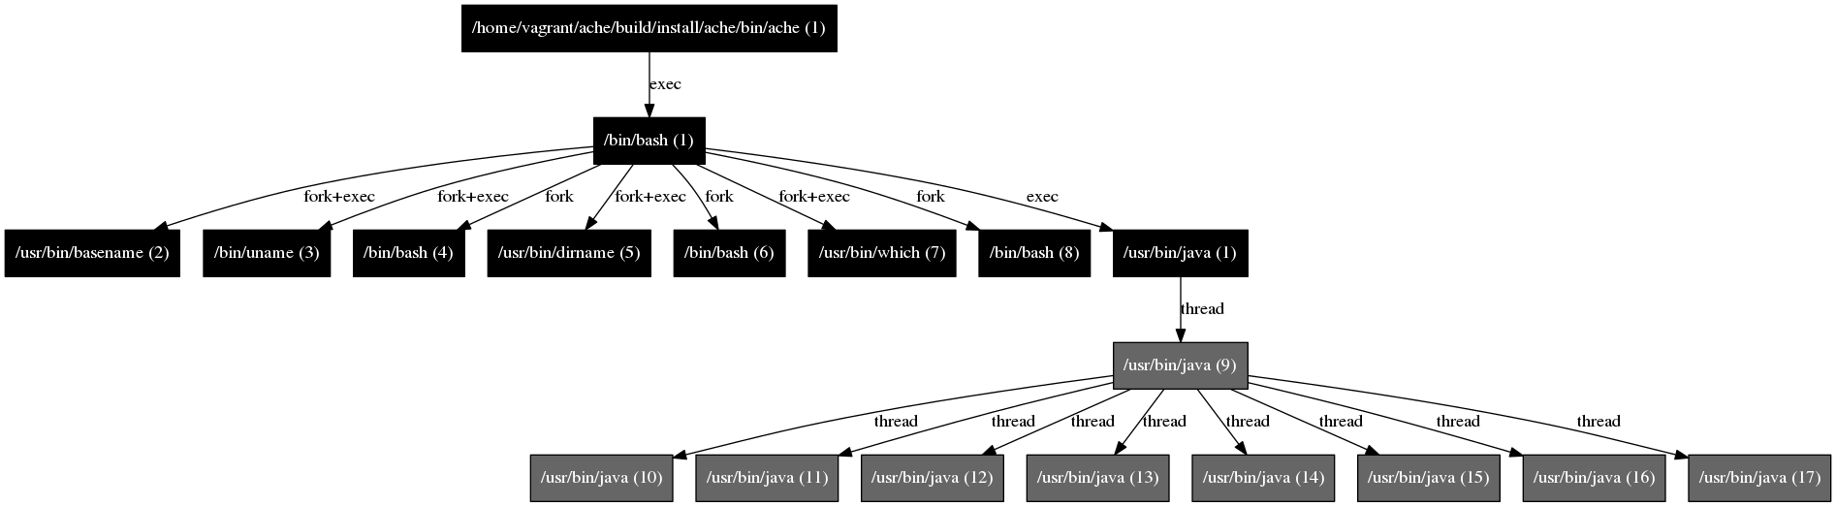

Slide 15
Shortcomings
Client apps: make sure to capture the server
not always possible; web services, etc
Setting up the experiment on your machine
installpkgs: installs the needed packages if you are running the same distrib (versions might not match)
Experiment still needs to be well-behaved to begin with
If you delete or change your data in place, or if you work interactively, ReproZip won’t help

Slide 16
Additional Functionality
Captures multiple runs simply using --continue
ADD MORE

Slide 17
Why Reproducibility?
Demo my software in a different location/years later
Validate my experiment
Run my program on different data
Examine some part of the process, dependency, configuration

Slide 18
Reproducibility is hard
Legal issues
Resource requirements
Dependencies evolve, break or go away
Hard to keep track of whole environment manually (configuration, version, installation instructions, etc.)

Slide 19
Reproducibility is hard
Legal issues
Resource requirements
Dependencies evolve, break or go away
Hard to keep track of whole environment manually (configuration, version, installation instructions, …)

Slide 20
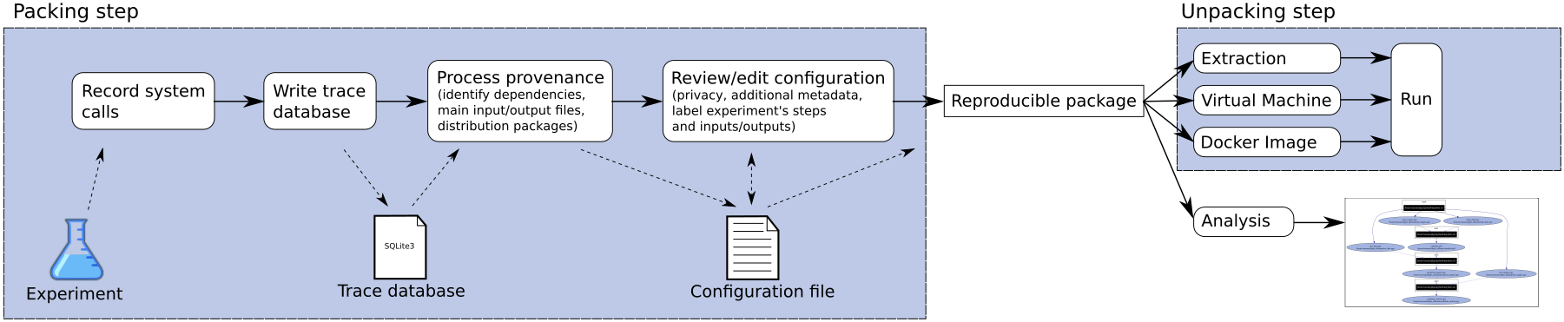
ReproZip, the reproducibility packer

Slide 21
What is ReproZip
A tool aimed at simplifying the process of creating reproducible experiments by packaging all binaries, files, & dependencies required to run it in a .rpz file.

