Slide 1
Learning using TF-families
2015-02-09

Slide 2
All TFs VS TF-families
Further analysis have proven that using TF-families as predictors improves performance compared with using all TFs.
We have compared our actual results of families as predictors with results using all TFs as predictors. And the latter outcomes are much worse.

Slide 3
Example
Run SSM using 12 TFs of G2-family:
NAC-family has 73% of correct signs
Run SSM using all TFs:
12 TFs of G2 family predicts 46% of NAC-family correct signs

Slide 4
12 TFs of G2 Family as Predictors
TERM | Num | % Correct Signs using G2 (title Fam) as Predictors | Pvalue G2 | Pvalue G2 no better than Trend Forecast | Pvalue G2 no better than Inv Trend Forecast
NAC | 7 | 0.73 | 0.01 | 0.05 | 0.004
AP2-EREBP TRANSCRIPTION FACTOR FAMILY | 16 | 0.54 | 0.22 | 0.52 | 0.06
NLP TRANSCRIPTION FACTOR FAMILY | 7 | 0.51 | 0.40 | 0.62 | 0.24
BASIC REGION LEUCINE ZIPPER (BZIP) TRANSCRIPTION FACTOR | 10 | 0.5 | 0.43 | 0.68 | 0.23
TGA3-LIKE | 3 | 0.67 | 0.12 | 0.21 | 0.07
AS2 - LATERAL ORGAN BOUNDARIES | 4 | 0.58 | 0.30 | 0.44 | 0.19
MYB | 4 | 0.22 | 0.97 | 0.99 | 0.94
All N-resp relevant Families Together (includes also 1 gene Rav fam) | 54 | 0.51 | 0.32 | 0.86 | 0.03
BHLH | 6 | 0.28 | 0.95 | 0.98 | 0.90
C2C2_CO | 5 | 0.53 | 0.40 | 0.58 | 0.26
C2C2_DOF | 5 | 0.42 | 0.72 | 0.85 | 0.58
C2C2_GATA | 6 | 0.54 | 0.38 | 0.57 | 0.23
C2H2 | 14 | 0.46 | 0.66 | 0.88 | 0.40
Homeobox | 10 | 0.53 | 0.34 | 0.59 | 0.16
G2-LIKE TRANSCRIPTION FACTOR FAMILY | 12 | 0.51 | 0.42 | 0.70 | 0.21

Slide 5
Dennis to Jacopo
It could be that we were just lucky.
Was trend forecasting ever better than families – with what p-value?
Was all TFs ever better than families – with what p-value?
Explain that the nitrogen influence network is based on p-values.

Slide 6
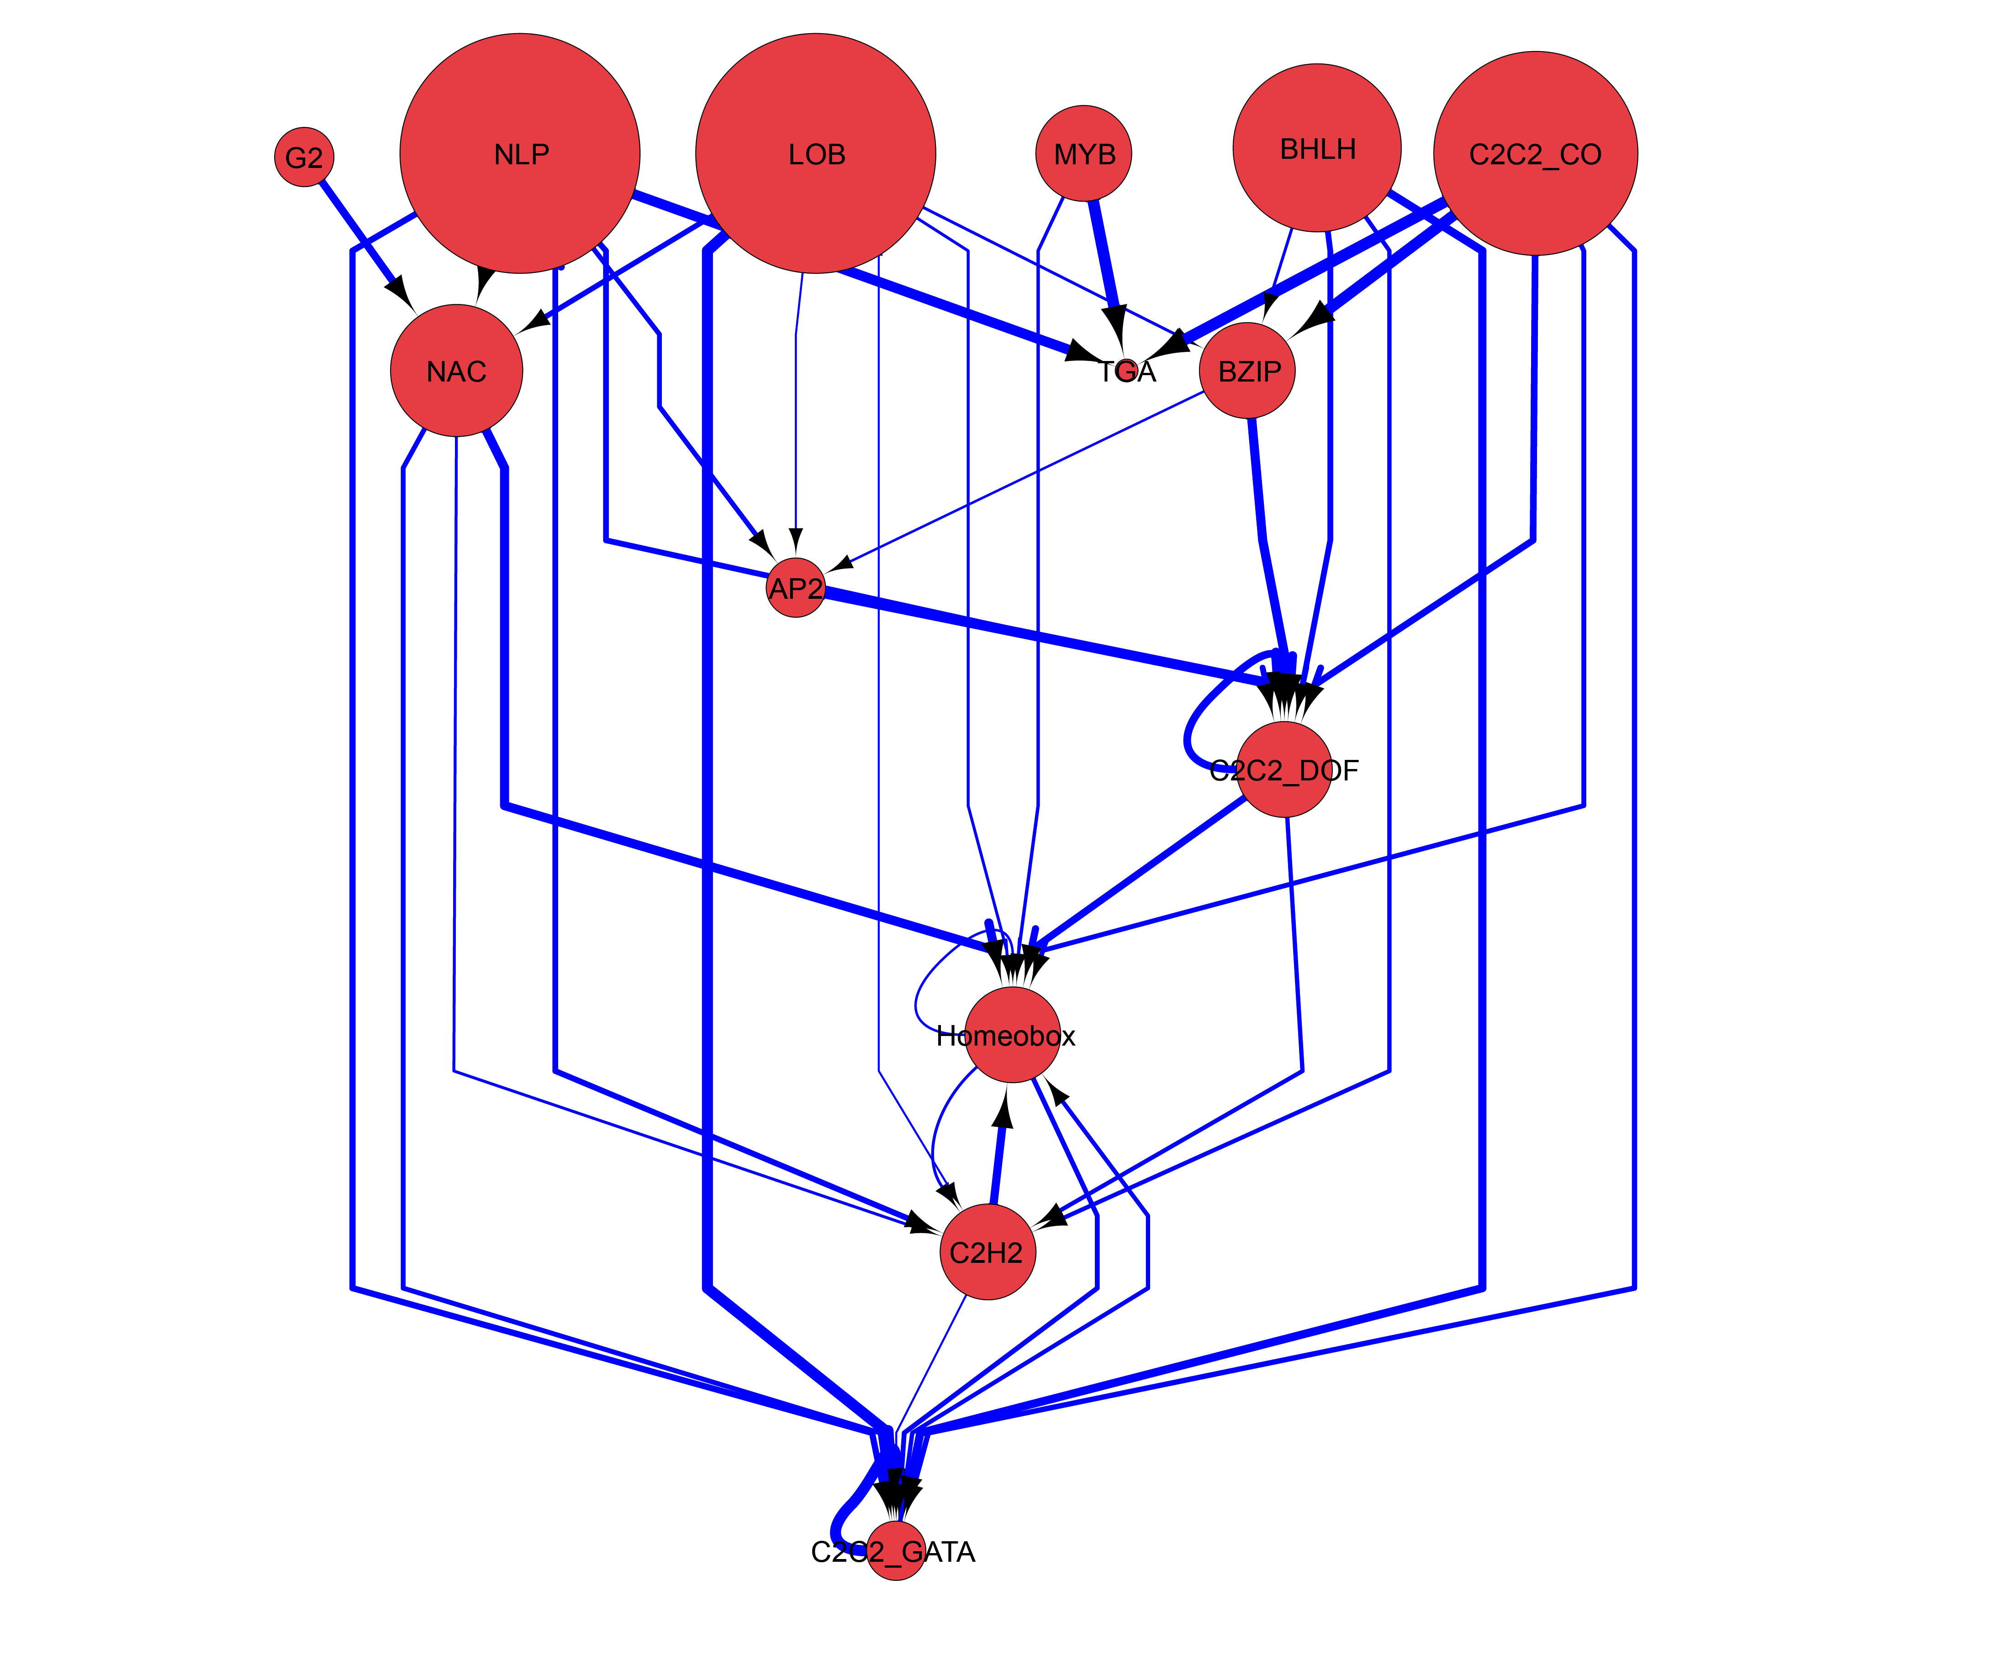
Nitrogen Influence Network
Notes:
which is definitely interesting because now it’s a way to show the hierarchical functions of the transcription factors involved in the nitrogen signaling pathway. Also there are a few back edges

Slide 7
Further validations to do
Cis-analysis for best predicted genes of each TF-family (~200 genes).
For instance regarding G2-Family as predictors, we want to see through cis-analysis whether we find NAC as the “buddy”.
Mips Analysis.
Notes:
The model learnt is validated to be predictive in leave-one-approach. But further validation will be done are

Slide 8
Anna-NLP7 VS SSM-NLP7

Slide 9
7 TFs of NLP Family as Predictors
TERM | Num | % Correct Signs using NLP (title Fam) as Predictors | Pvalue NLP | Pvalue NLP no better than Trend Forecast | Pvalue NLP no better than Inv Trend Forecast
NAC | 7 | 0.71 | 0.02 | 0.07 | 0.007
AP2-EREBP TRANSCRIPTION FACTOR FAMILY | 16 | 0.67 | 0.008 | 0.05 | 0.0008
C2H2 | 14 | 0.69 | 0.003 | 0.03 | 0.0003
C2C2_GATA | 6 | 0.70 | 0.03 | 0.08 | 0.007
TGA3-LIKE | 3 | 0.78 | 0.03 | 0.07 | 0.01
C2C2_DOF | 5 | 0.69 | 0.053 | 0.12 | 0.02
MYB | 4 | 0.56 | 0.29 | 0.44 | 0.17
All N-resp relevant Families Together (includes also 1 gene Rav fam) | 54 | 0.52 | 0.18 | 0.75 | 0.01
BHLH | 6 | 0.33 | 0.91 | 0.97 | 0.83
C2C2_CO | 5 | 0.44 | 0.66 | 0.80 | 0.51
AS2 - LATERAL ORGAN BOUNDARIES | 4 | 0.31 | 0.87 | 0.93 | 0.78
BASIC REGION LEUCINE ZIPPER (BZIP) TRANSCRIPTION FACTOR | 10 | 0.51 | 0.41 | 0.67 | 0.23
NLP TRANSCRIPTION FACTOR FAMILY | 7 | 0.32 | 0.94 | 0.98 | 0.88
Homeobox | 10 | 0.61 | 0.1 | 0.27 | 0.03
G2-LIKE TRANSCRIPTION FACTOR FAMILY | 12 | 0.5 | 0.43 | 0.70 | 0.22

Slide 10
Dennis to Jacopo
The table above – does that have to do with Anna. If not, then it should go before the slide talking about Anna.
It looks to me as if the rest of the slides are trying to show that various intersections are high. Please use genesect to analyze.

Slide 11
Anna - Differentially expressed genes
3 replicates (including library 2 with only few read counts)
Significantly different genes (FDR<0.05)
mCHX
pCHX
34
224
67

Slide 12
{Anna NLP7-targets} ∩ {Shoot-Universe}
76
25
23
mCHX
pCHX

Slide 13
{Anna NLP7-targets} ∩ {Shoot-Universe}
SSM predicts 878 targets for NLP7
SSM predicts 50 out of 76(mCHX).
And 14 of these 50 are
among the 23.
50 predicted by SSM
76
25
23
pCHX
mCHX

Slide 14
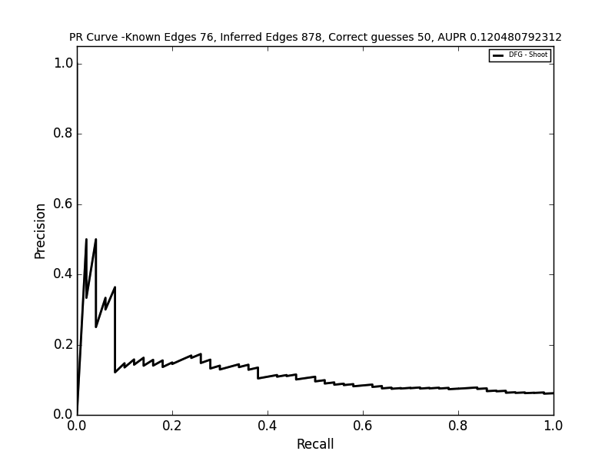
AUPR where NLP7 targets are ranked by logFoldChange from “TARGET” and level of Influence from SSM-Network
Notes:
It’s not great, maybe because Anna did exps in root, instead Im using shoot timeseries.

