Slide 1
Clocked DNA Computation Experiment
Meet and Sam

Slide 2
Vision
Be able to ship DNA “software” to do potentially complex DNA robotics tasks
Receiving lab needs to follow a very simple recipe of adding i) data input (e.g. sample to be analyzed) and ii) “clock” strands (analogous to computer clock) to run the shipped program on the data.
The clock strands release instructions over time that interact with the data. Can implement if/then/else and looping behavior in principle.
Experiments to date test the feasibility of this input/clock strand-driven approach.

Slide 3
How clock strands releases instruction (example)
Utilization of the “Toe-Hold” concept: Clock strands (ticks,tocks) displace instruction strands in the structure (Stack) -> Uncover parts of stack that interact with environment
Output from Stack: Fluorescence
Before: Stack complex containing Fluorescent instruction strands bonded to its corresponding quencher strand
After: (after ticks and tocks added) Stack complex interacts with strands in pot and quencher strand is displaced from complex

Slide 4
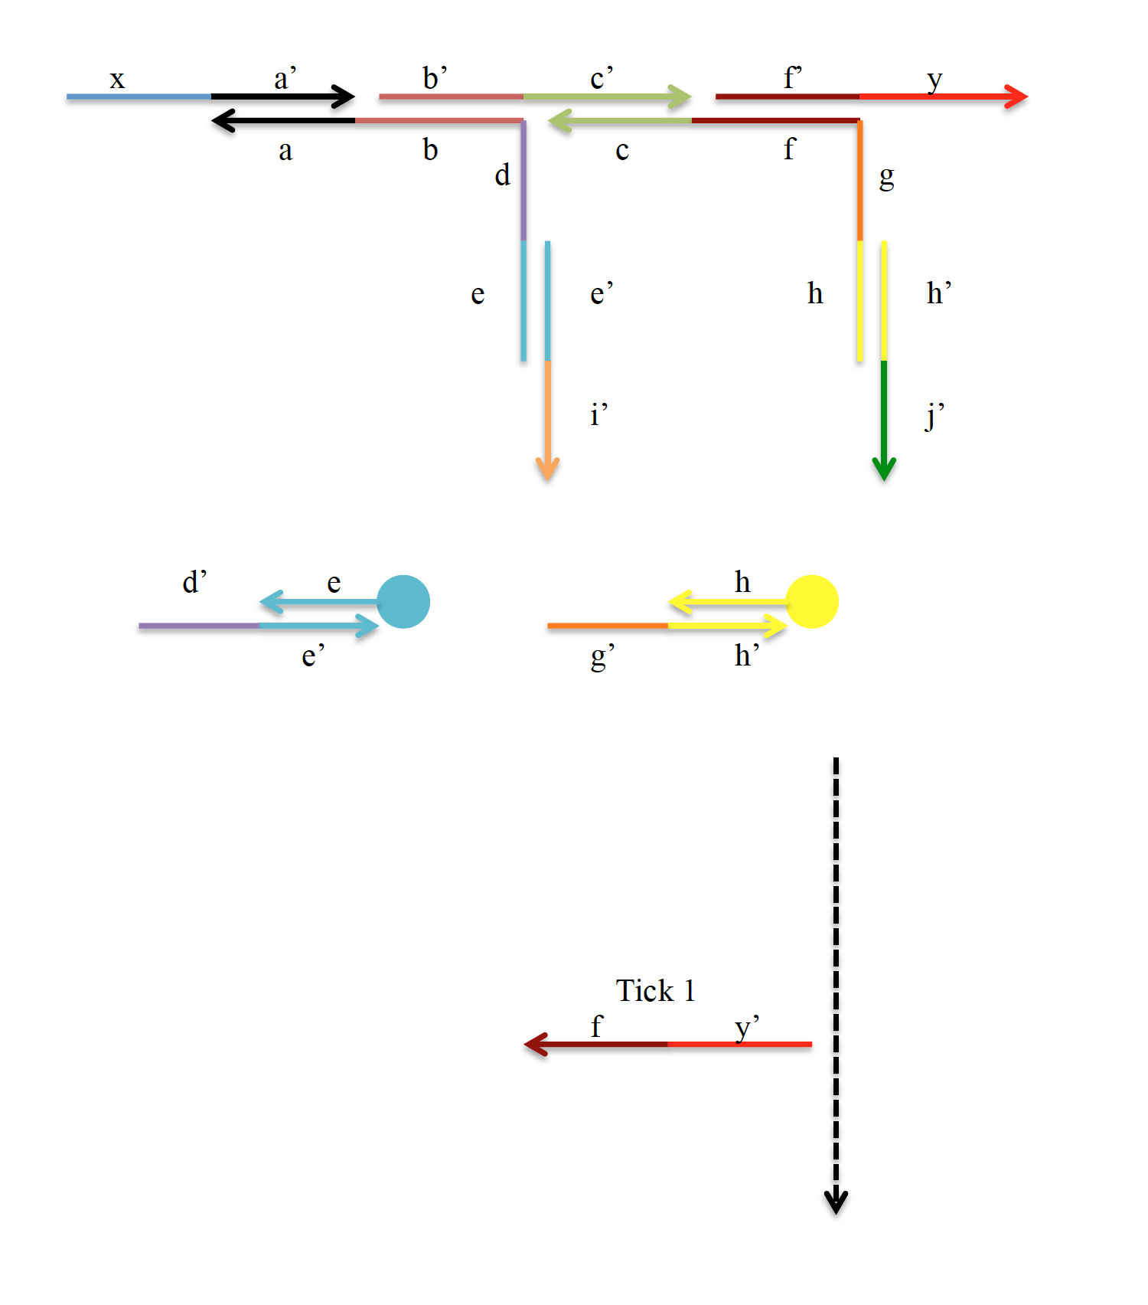
Stack
Fluorescent strands (not present until later)

Slide 5
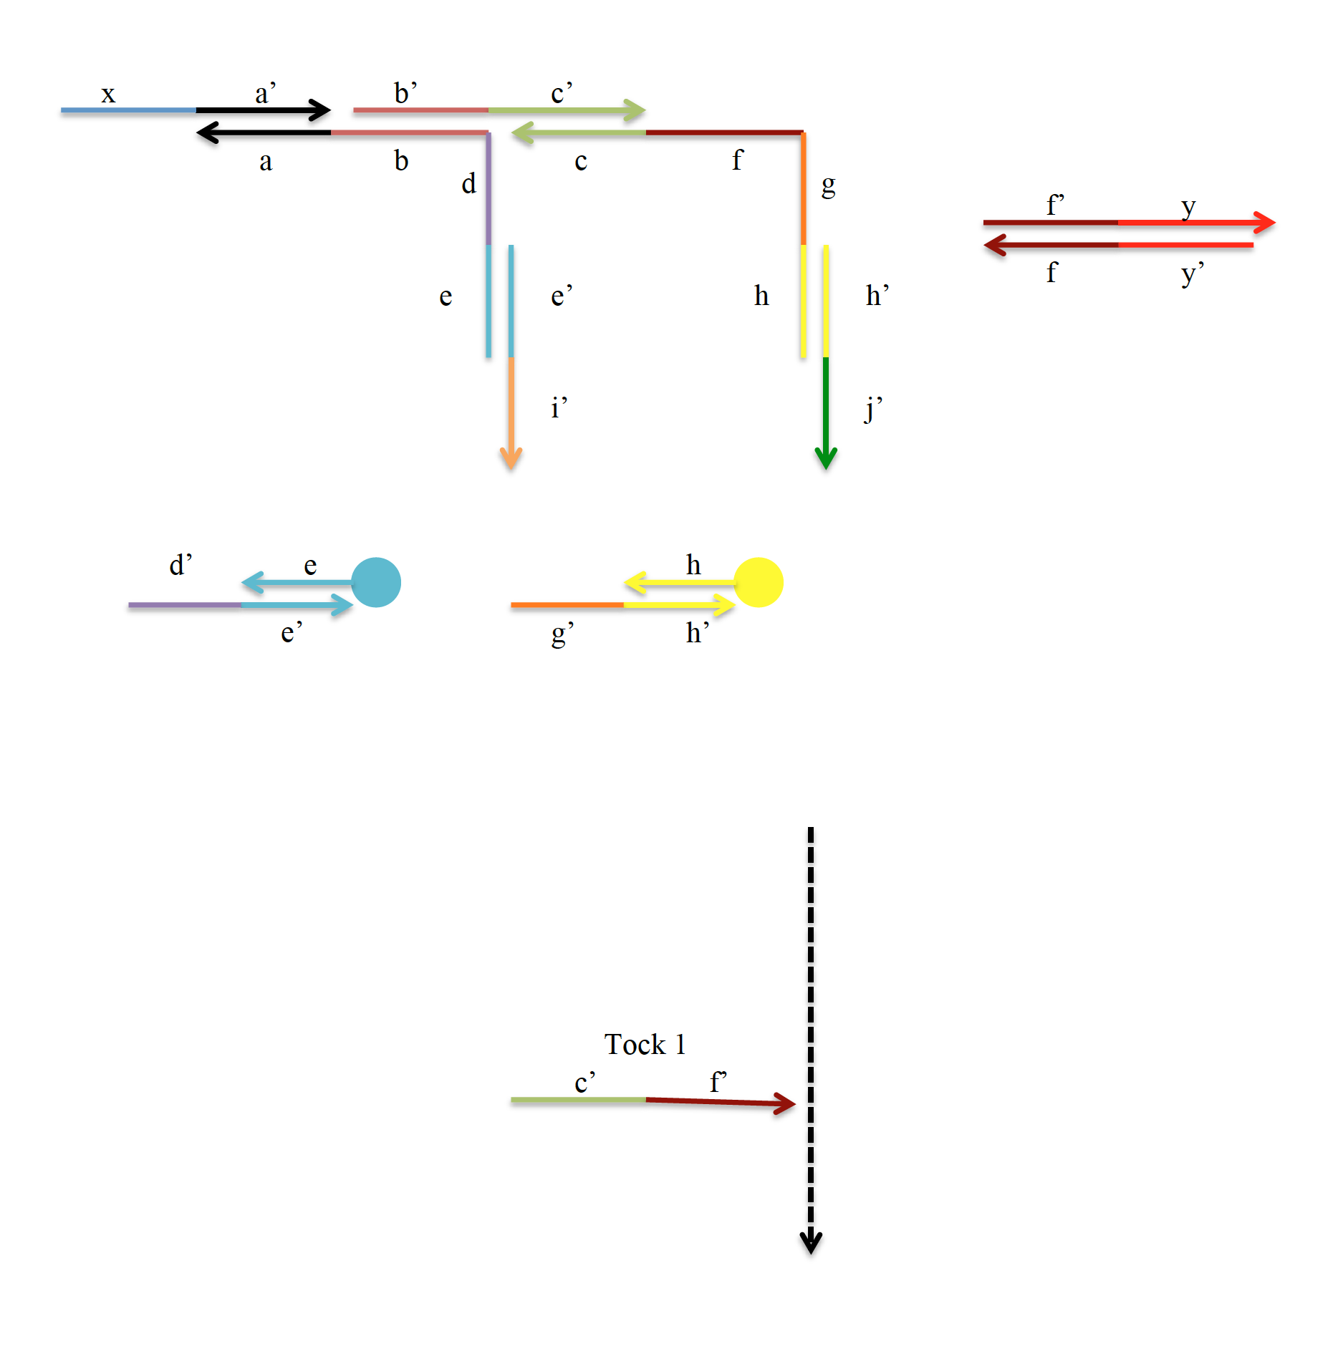
“Step 2”

Slide 6
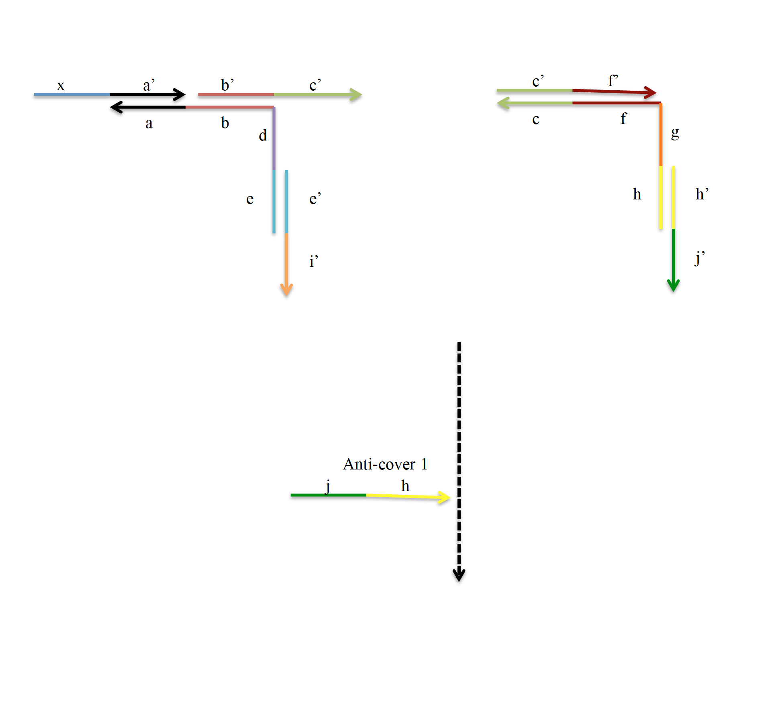
“Step 3”

Slide 7
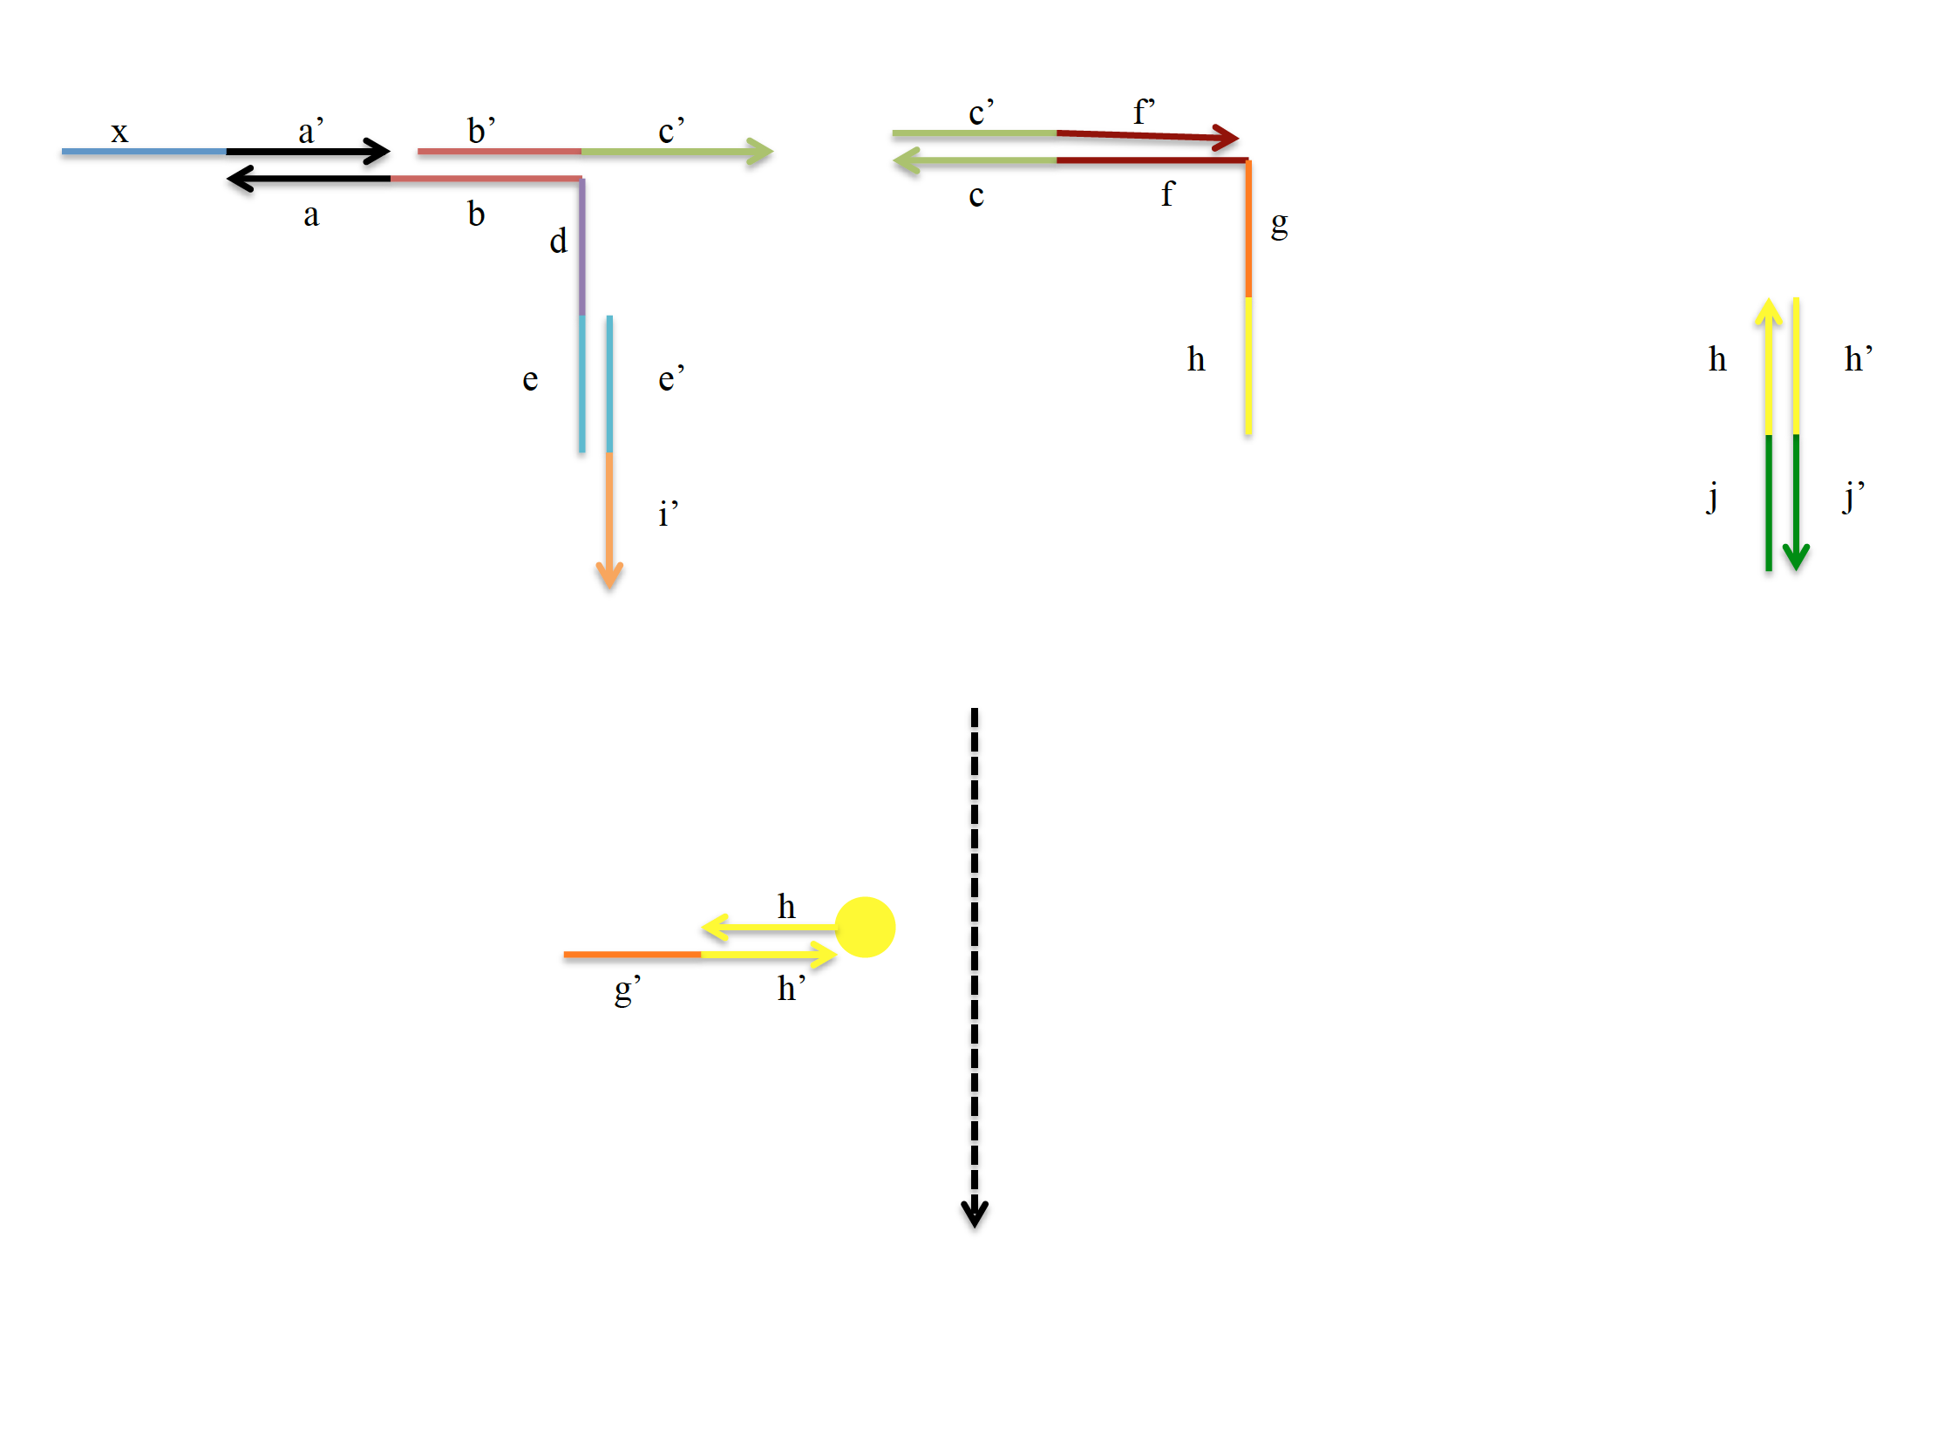

Slide 8
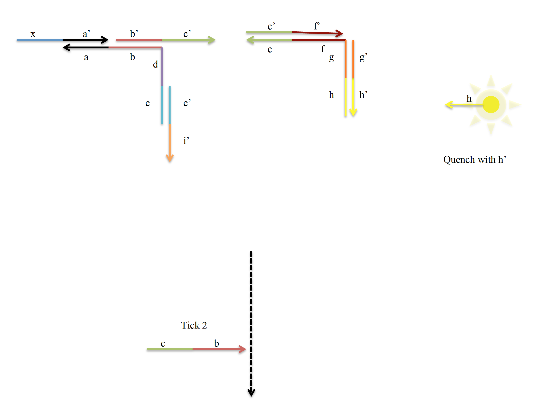

Slide 9
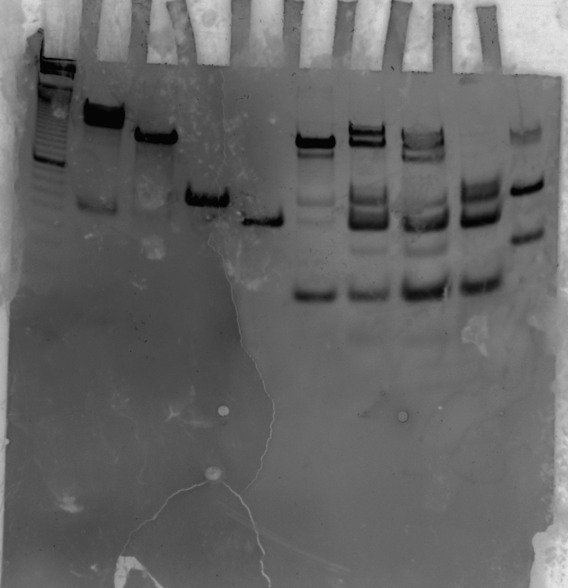
1
2
3
4
5
6
7
8
10
9
Annealed Gel (expected output)
Lanes:
1. 10bp ladder
2. Stack
3. Step 2
4. Step 3
5. Step 4
6. Stack+tick
7. Stack+tick+tock
8. Stack+tick+tock+ anticover
9. Stack with first instruction released and fluorescent strand
10. Stack with c’f’ instead of e’i’
Stack
Step 2
120
120
Step 3
Step 4
75
60
75
60
60
30
30
30
30
Tick+complement
Tick+comp
Tick+comp + anticover+cover
Tick+comp + anticover+cover’

Slide 10
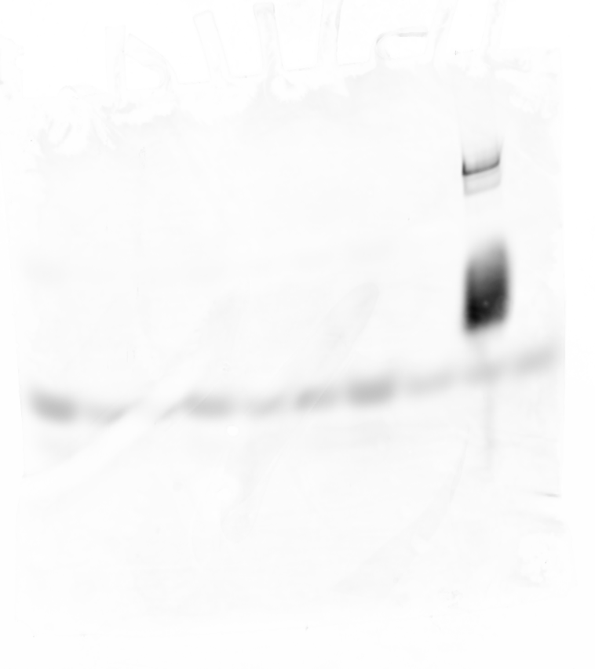

Slide 11
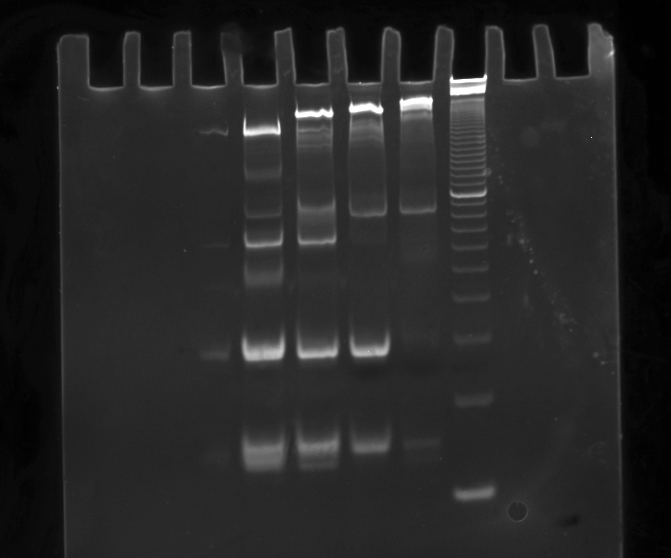

(Starting at the leftmost lane)
Lane 1: 10 bp ladder
Lane 2: Stack
Lane 3: Stack + Tick1
Lane 4: Stack + Tick1+Tock1
Lane 5: Stack + Tick1+Tock1+Anticover1

Slide 12
Next gel: continue to release the second instruction.

Slide 13
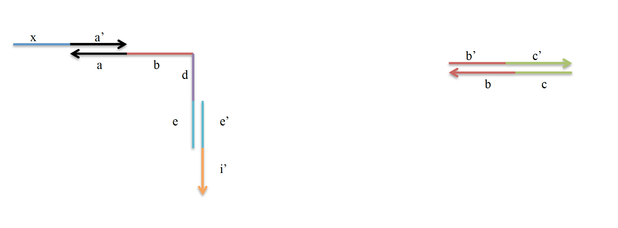
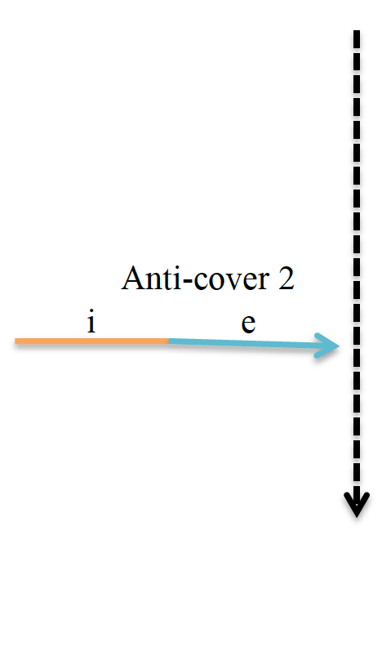
“Step 4”

Slide 14
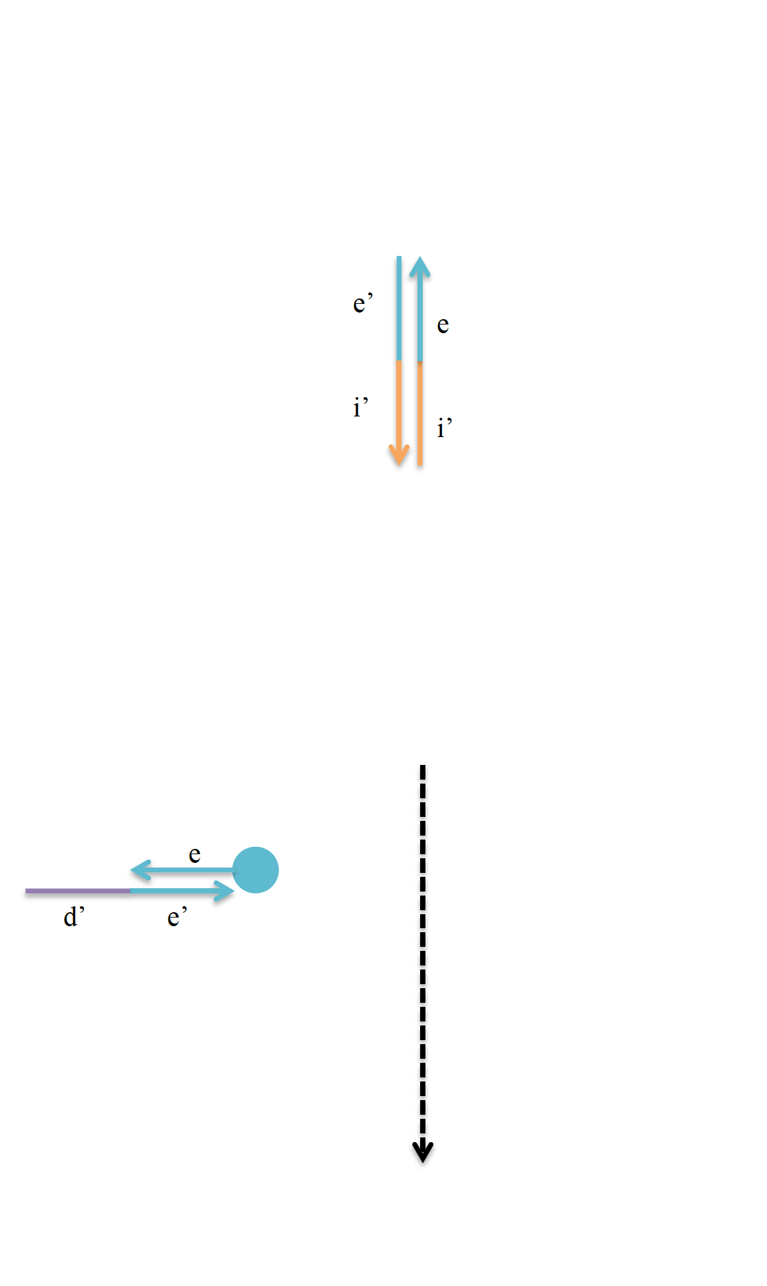
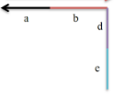

Slide 15
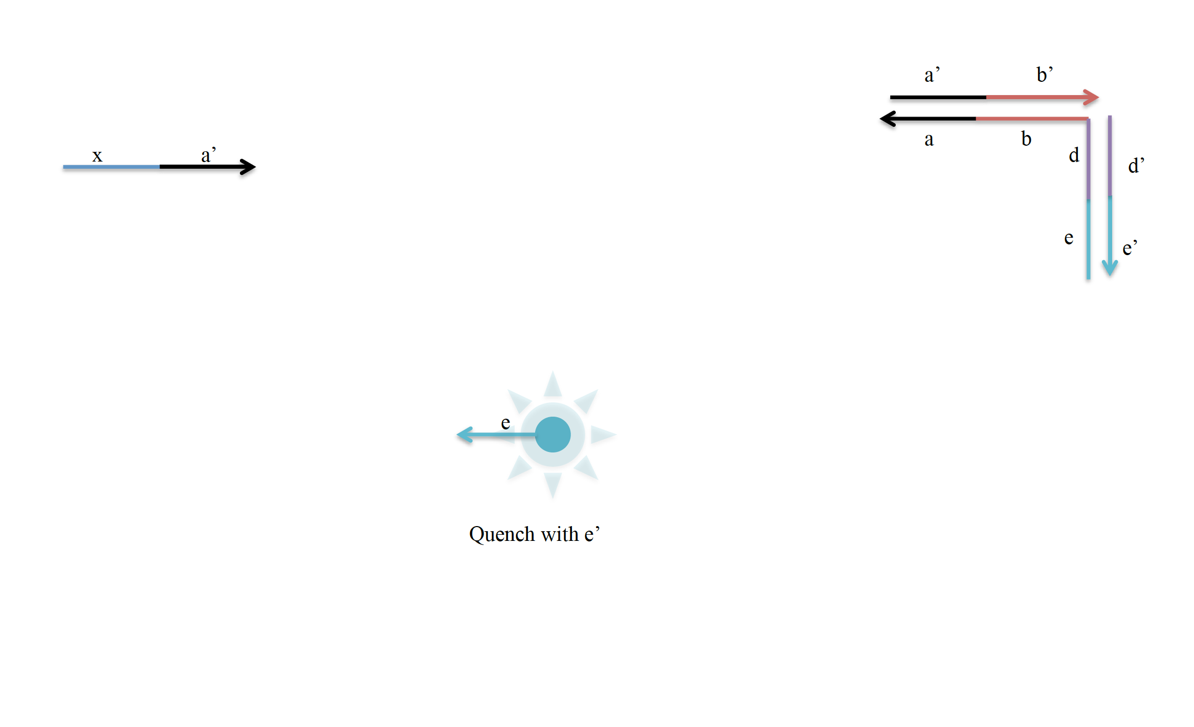

Slide 16
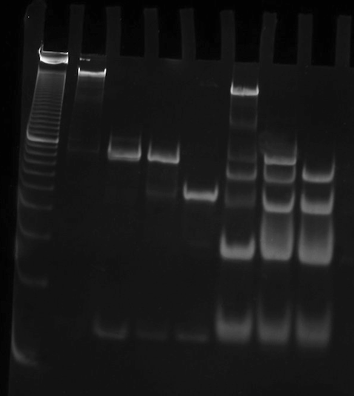
Second Instruction Release
Lane 1: 10 bp ladder
Lane 2: stack
Lane 3: (expected) first instruction release
Lane 4: expected structure at tick 2 (seems to move much slower, maybe some extra strands are connected to structure)
Lane 5: expected structure at anticover 2
Lane 6: first instruction release
Lane 7: tick 2
Lane 8: anticover 2

Slide 17
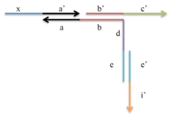
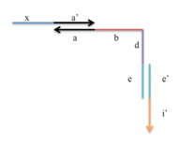
Second Instruction Release
Lane 3 Lane 5
Lane 4

Slide 18
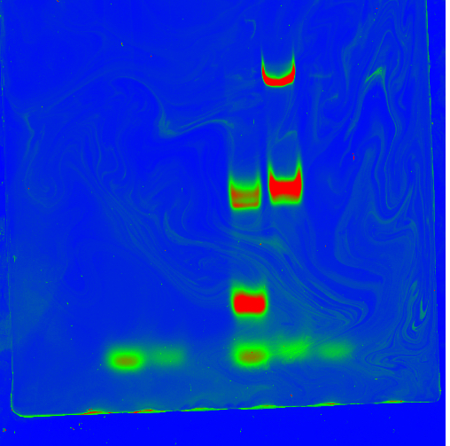
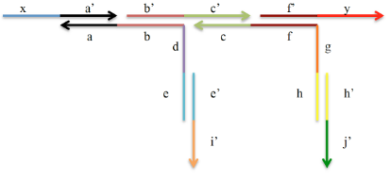

Second instruction (Cy3) didn’t show any fluorescence on Cy3 scanning (low concentration?)
First instruction showed fluorescence on Cy5 scanning:
Right lane: First instruction released + Cy5 fluorescent-quencher complex
Left lane: Cy5 fluorescent-quencher complex

Slide 19
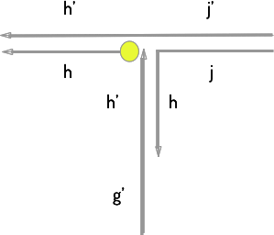
Possible complexes that e could have formed

