Slide 1
Comparing Propagation Effects at
3 GHz and 60 GHz
(a factor of 20)
Size of the Fresnel zone
Radiation and reception for antennas in free space
Atmospheric absorption
Influence of flat earth
Diffraction around corners
Transmission and reflection at walls

Slide 2
Size of the Fresnel Zone
w_{Fn}
r’
r
d
s
Objects outside of the Fresnel zone can reflect or scatter waves that contribute at the receiver, but do not alter the direct ray fields.
Objects that penetrate the Fresnel zone distort the direct ray contribution.
Objects that completely block the Fresnel zone eliminate the direct ray.
The effective diameter of a small receiver is on the order of λ.

Slide 3
Radiation and Reception in Free Space
Z*₂₂
P_{T}
A_{e2}

Slide 4
Radiation and Reception – cont.
a
ϑ_{BW}

Slide 5
Atmospheric Absorption
Clear air absorpltion
Rain attenuation

Slide 6
Influence of Flat Earth
Antenna
r₁
h₁
θ
h₂
α
θ
r₂
R
Image
-40
-50
Brewster’s angle
-60
-70
Path Gain (dB)
-80
-90
-100
Vertical pol.
f = 900MHz
Horizontal pol
Γ = −1
-110
0
1
2
3
10
10
10
10
Distance (m)

Slide 7
Influence of Flat Earth-cont.
Antenna
r₁
h₁
θ
h₂
α
θ
r₂
R
Image

Slide 8
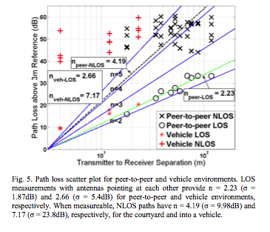
Influence of Flat Earth-cont.
Path loss measured at 60 GHz
E. Ben-Dor, T.S. Rappaport, Y. Qiao and S.J. Laauffenburger, IEEE Globcom 2001

Slide 9
Diffraction Around Corners
r₀ r
ϑ
A factor of 20 in frequency changes PG by 33 dB.

Slide 10
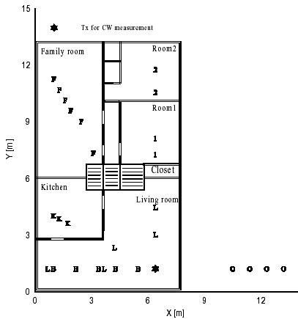
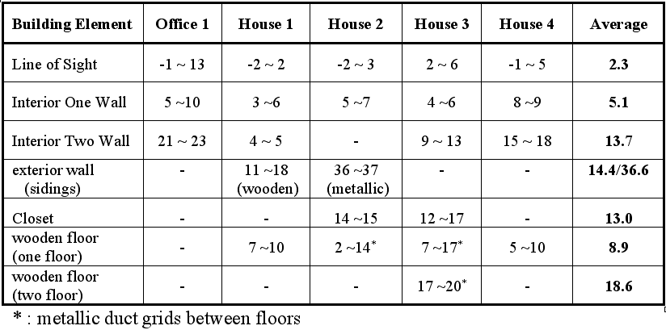
Transmission at Walls
Summary of wall loss at 5.2 GHz

Slide 11
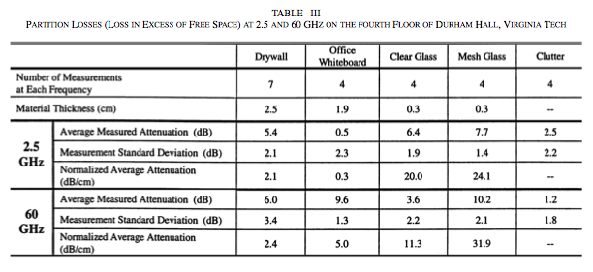
Transmission at Walls – cont.
C.R. Anderson and T.S. Rappaport. IEEE Trans. on Wireless Comm., Vol 3, No 3, May 2004

Slide 12
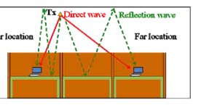
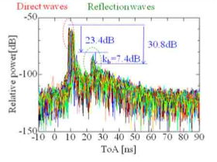
Reflection at Walls
Two reflections, one at desk top and one at the ceiling.
Estimate 9dB for extra path length and 7 dB for each reflection.
H.Sawad, K. Fujita, S. Kato, K. Sato and H. Harada, “Impulse Respons Model for the Cubicle Environments at 60GHz,” Proc. Of Asia-Pacific Microwave Conference 2010
Power delay profile at the Far location

Slide 13
Comments on 60 GHz
Look for possible application
Practical systems must have either / or
  Operation with non-directional antennas
    Requires some combination of improved sources or coding to improve SNR
  Directional antennas that are self aligning
    Requires algorithms for self alignment and phased array technology (or a rotating dish)

Slide 14
Scaling the RF Electronics
Antenna
Assume
Fixed current density
Device dimensions scale with λ = c/f
Then
Antenna current I varies at least as 1/f
Radiated power P_{T} = I²/R varies at least as 1/f²
1 watt at 3GHz scales to 2.5 m-watts at 60GH
RF transistor gate width w_{g}
λ/2
Transmission Line
width w
thickness t
Quick look at 60 GHz Literature finds radiated power levels from about 4 mW to 500 mW

