Slide 1
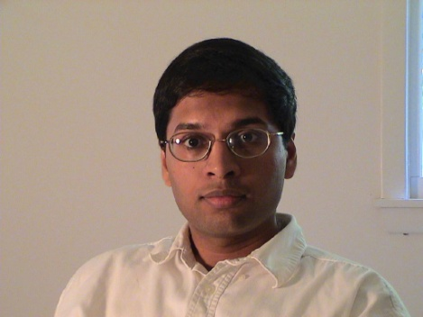
Subhash Khot
Theory Group
Connections between Algorithms, Computational Complexity and Geometry
Algorithms: Can you efficiently compute approximate solutions to NP-hard problems?
How good an approximation can you achieve?
Example: Balanced Partitioning Problem
Given a graph, partition its vertex set into two roughly equal parts
so as to minimize the number of crossing edges.
S
S^{c}

Slide 2
Computational Complexity: Can a proof of a mathematical statement be checked by
reading only a few bits from the proof?
YES!!! Reading only a constant number of bits is enough
with a probabilistic checking procedure (PCP Theorem).
Geometry: What is the least surface area of an n-dimensional body
of a given volume? A sphere, of course.
What about the same question under Gaussian measure?
Answer: a halfspace!
The three questions above are related!
Tools used: Fourier analysis, Semi-definite Programming, Combinatorics,
Coding Therory, ………

