Slide 1
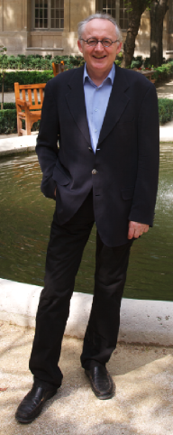
Patrick Cousot
Analysis of Computer Systems Group
Research interests:
Formal methods
Verification
Abstract interpretation
Semantics
Static analysis

Slide 2
Current research topics:
  Automatic proof of liveness properties of computer systems (e.g. your text file eventually gets printed)
  Verification of embedded systems (e.g. pressing the brake pedal eventually brakes)
Courses:
  Spring 2009: Program semantics, analysis and verification by abstract interpretation
Contact Professor Cousot:
  http://cs.nyu.edu/~pcousot/

