Slide 1
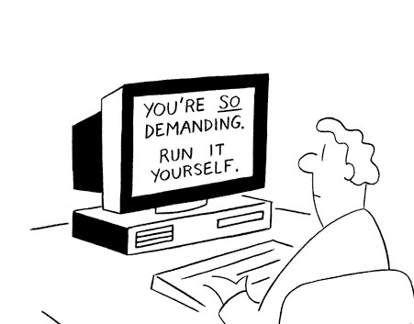
Operating Systems
Introduction
Mohamed Zahran (aka Z)
mzahran@cs.nyu.edu
http://www.mzahran.com

Slide 2
Who Am I?
Mohamed Zahran (aka Z)
Computer architecture/OS/Compilers Interaction
http://www.mzahran.com
Office hours: M-W 12-1 pm [ONLINE]

Slide 3
Formal Goals of This Course
What exactly is an operating systems?
How does the OS interact with the hardware and other software applications?
Main concepts of an OS:
Processes
Threads
Memory Management
Filesystems
I/O

Slide 4
Informal Goals of This Course
To get more than an A
To learn OS and enjoy it
To use what you have learned in MANY different contexts
To be able to develop your own OS, or some parts of it, if you want to
To start your research project in OS

Slide 5
Web Presence
NYU Classes
Course Website
Announcements
Forums
Submissions (of assignments, labs, etc)
Lecture slides
Reading material
The assignments
Useful links
Zoom: Lecture meetings and office hours

Slide 6
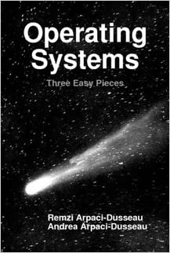
The Textbook
http://www.ostep.org
Available for free online
Required

Slide 7
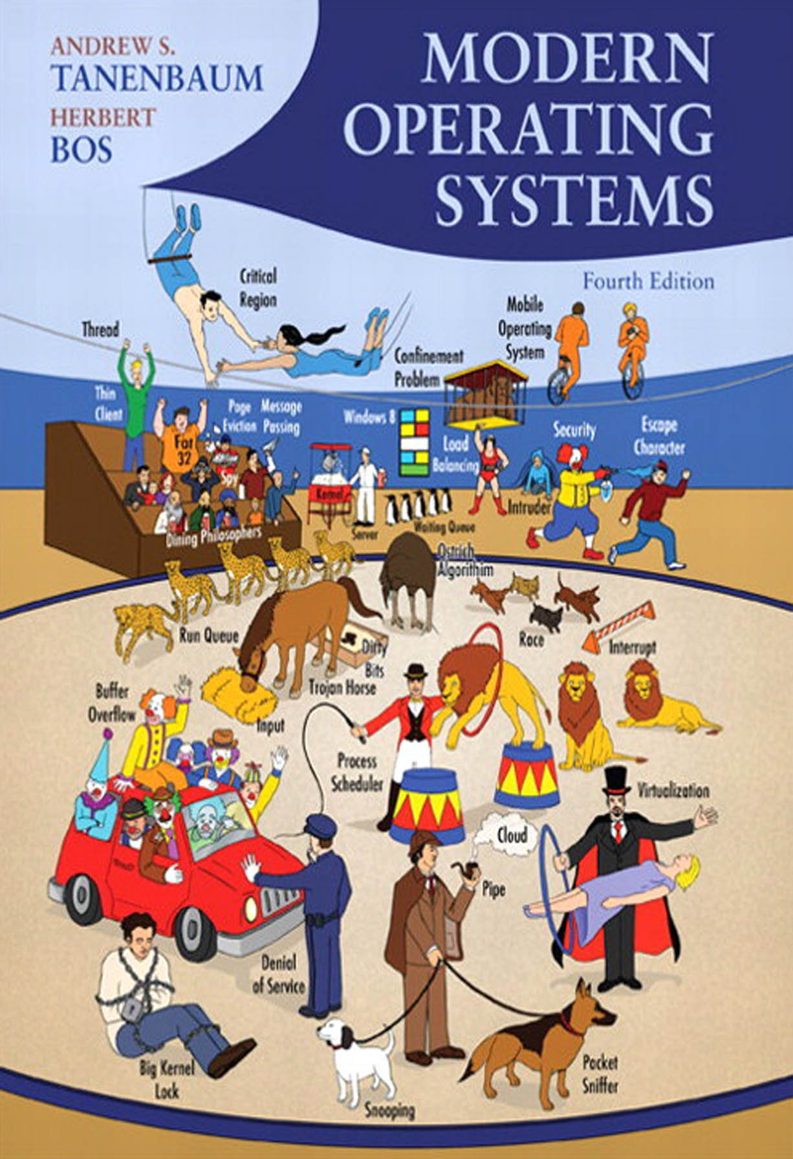
The Textbook
Recommended but not required

Slide 8
Grading
Homework
Lab
Midterm
Final
: 10%
: 30%
: 25%
: 35%

Slide 9
Integrity
Academic integrity
http://www.nyu.edu/about/policies-guidelines-compliance/policies-and-guidelines/academic-integrity-for-students-at-nyu.html
Your homework, labs, and exams must be your own.
Both the cheater and the student who aided the cheater will be held responsible for the cheating

Slide 10
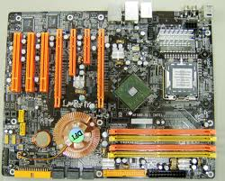
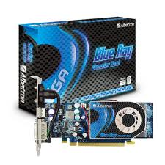
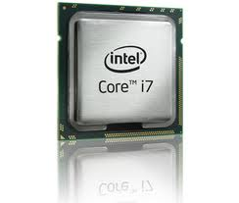
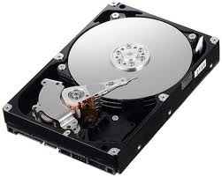
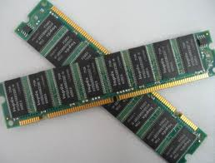
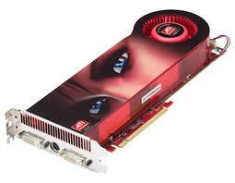

Slide 11
emails
Games
Media Player
Word Processing

Slide 12
emails
Games
Media Player
Word Processing
Does a programmer need to understand all this hardware
in order to write these software programs?

Slide 13
emails
Games
Media Player
Word Processing
Operating System

Slide 14
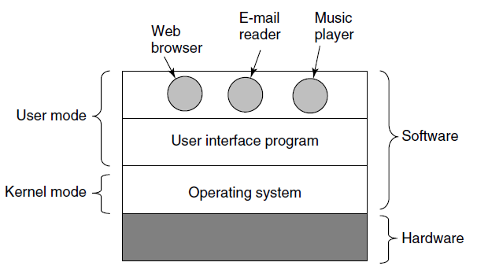

Slide 15
The Two Main Tasks of OS
Provide programmers (and programs) a clean abstract set of resources
Manage the hardware resources

Slide 16
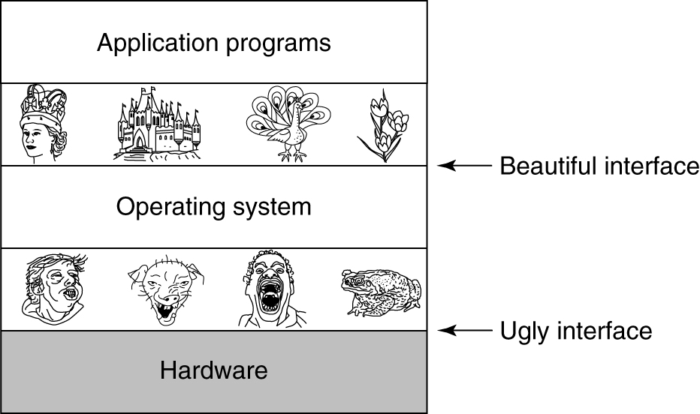

Slide 17
How did the OS evolve? A bit of history …
The first generation (1945-55) vacuum tubes
The second generation (1955-65) transistors and batch systems
The third generation (1965-1980) I Cs and multiprogramming
The fourth generation (1980-present) personal computers
The fifth generation (1990-present) mobile computers

Slide 18
The Three Easy Pieces of the OS
Virtualization
Concurrency
Persistence

Slide 19
The Three Easy Pieces of the OS
Virtualization
of the CPU and Memory
Concurrency
parallel programs
Persistence
the filesystem on the disk

Slide 20
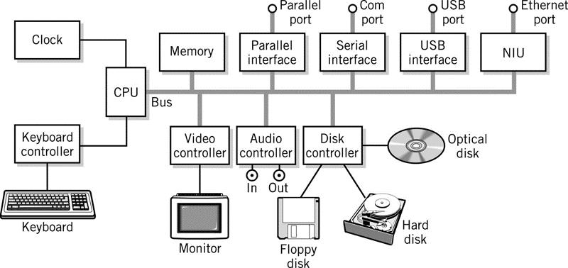
A Typical Computer System

Slide 21
Booting Sequence
BIOS starts
checks how much RAM
keyboard
other basic devices
BIOS determines boot Device
The first sector in boot device is read into memory and executed to determine active partition
Secondary boot loader is loaded from that partition.
This loaders loads the OS from the active partition and starts it.
POST (Power On Self Test)

Slide 22
OS
Types
Concepts
Different Structures

Slide 23
OS
Types
Concepts
Different Structures
Supercomputer OS
Server OS
Multiprocessor OS
PC OS
Embedded OS
Sensor node OS
RTOS
Smart card OS
... etc

Slide 24
OS
Types
Concepts
Different Structures
Supercomputer OS
Server OS
Multiprocessor OS
PC OS
Embedded OS
Sensor node OS
RTOS
Smart card OS
... etc
Processes
Threads
Memory Management
File system
I/O

Slide 25
OS
Types
Concepts
Different Structures
Supercomputer OS
Server OS
Multiprocessor OS
PC OS
Embedded OS
Sensor node OS
RTOS
Smart card OS
... etc
Processes
Threads
Memory Management
File system
I/O
Monolithic
Layered systems
Microkernels
Virtual machines
… others

Slide 26
OS
Types
Concepts
Different Structures
Mainframe OS
batch
transaction processing
timesharing
e.g. OS/390
Server OS
Multiprocessor OS
PC OS
Embedded OS
Sensor node OS
RTOS
Smart card OS
Processes
Threads
Memory Management
File system
I/O
Monolithic
Layered systems
Microkernels
Virtual machines
… others
Main objectives of an OS:
Convenience
Efficiency
Ability to evolve

Slide 27
USER
Processes
OS
Hardware

Slide 28
USER
Processes
Each process thinks:
It has the whole CPU for itself.
It has the whole memory for itself.
This is what we call virtualization.
OS
Hardware

Slide 29
A Process
Key concept in all operating systems
Definition: a program in execution
Process is associated with an address space
Also associated with set of resources
Process can be thought of as a container
Holds all information needed to run program

Slide 30
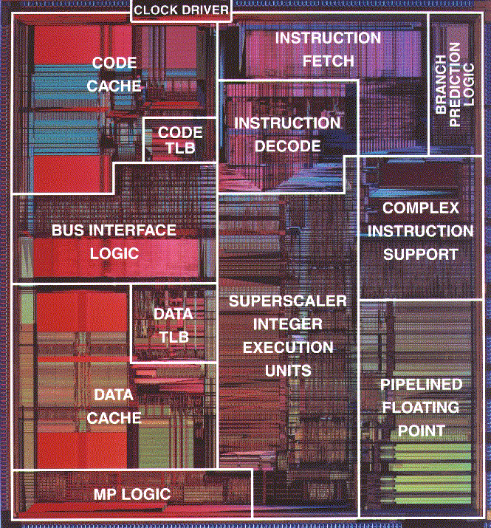
Source Code to Execution
C source
Assembly
Object File
Assembly
Assembly
Object File
Assembly
Compiler
Assembly
Assembler
Object File
Library
Library
Library
Linker
Executable
Loader
DLL
DLL
DLL
Loader is part
of the OS

Slide 31
Hardware and Software Infrastructure

Slide 32
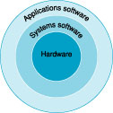
Hardware and Software Infrastructure

Slide 33
Enough for Today
OS is really a manager:
programs, applications, and processes are the customers
The hardware provides the resources
OS works in different environments and under different restrictions (supercomputers, workstations, notebooks, tablets, smartphones, real-time, …)

