Slide 1
Transformations and Fitting
EECS 442 – David Fouhey
Winter 2022, University of Michigan
https://web.eecs.umich.edu/~fouhey/teaching/EECS442_W22/

Slide 2
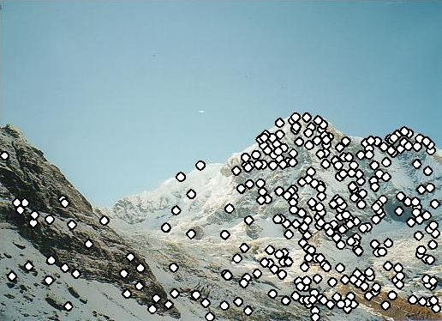
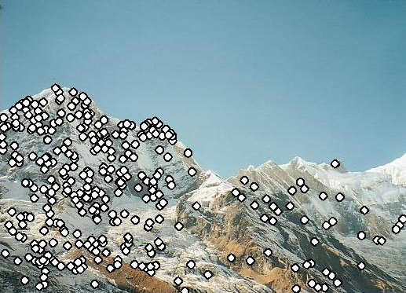
Last Class
How do we find distinctive / easy to locate features? (Harris/Laplacian of Gaussian)
How do we describe the regions around them? (Normalize window, use histogram of gradient orientations)

Slide 3
Earlier I promised
Solving for a Transformation
T
3: Solve for transformation T (e.g. such that p1 ≡ T p2) that fits the matches well

Slide 4

Before Anything Else, Remember
You, with your gigantic brain, see:
The computer
sees:
You should expect noise (not at quite the right pixel) and outliers (random matches)

Slide 5
Today
How do we fit models (i.e., a parametric representation of data that’s smaller than the data) to data?
How do we handle:
  Noise – least squares / total least squares
  Outliers – RANSAC (random sample consensus)
  Multiple models – Hough Transform (can also make RANSAC handle this with some effort)

Slide 6
Working Example: Lines
We’ll handle lines as our models today since you are more familiar with them than others
Next class will cover more complex models. I promise we’ll eventually stitch images together
You can apply today’s techniques on next class’s models

Slide 7
Model Fitting
Need three ingredients
Data: what data are we trying to explain with a model?
Model: what’s the compressed, parametric form of the data?
Objective function: given a prediction, how do we evaluate how correct it is?

Slide 8
Example: Least-Squares
Fitting a line to data
Data: (x₁,y₁), (x₂,y₂), …, (x_{k},y_{k})
Model: (m,b) y_{i}=mx_{i}+b
Or (w) y_{i} = w^{T}x_{i}
Objective function:
(y_{i} - w^{T}x_{i})²

Slide 9

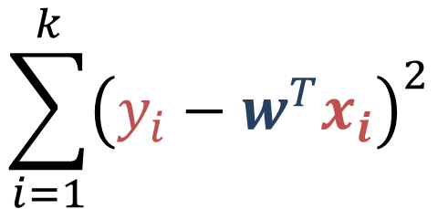
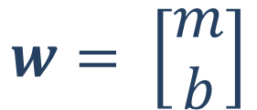
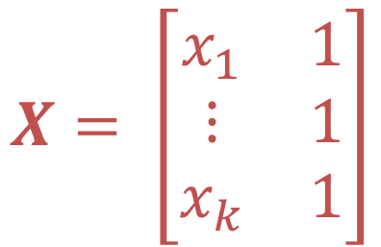
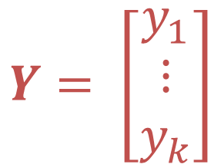
Least-Squares Setup
$$\sum_{i=1}^{k}{{\left(y_{i}−w^{T}x_{i}\right)}^{2}}$$
$${\left\|Y−Xw\right\|}_{2}^{2}$$
$$Y= \left[\begin{matrix}y_{1} \\ ⋮ \\ y_{k}\end{matrix}\right]$$
$$X= \left[\begin{matrix}x_{1} & 1 \\ ⋮ & 1 \\ x_{k} & 1\end{matrix}\right]$$
$$w= \left[\begin{matrix}m \\ b\end{matrix}\right]$$

Slide 10

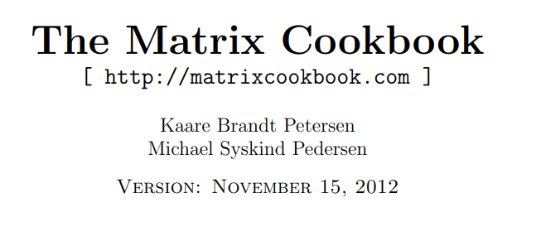


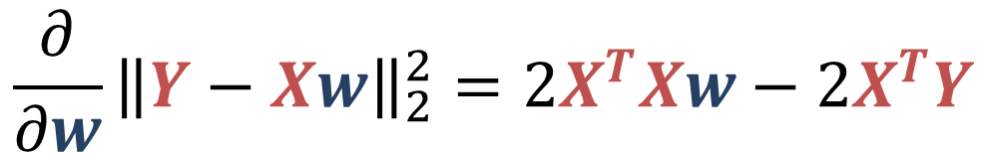
Solving Least-Squares
$${\left\|Y−Xw\right\|}_{2}^{2}$$
Where can I find derivatives + matrix expressions and matrix identies?
$${\frac{∂}{∂w}\left\|Y−Xw\right\|}_{2}^{2}={2X}^{T}Xw−{2X}^{T}Y$$

Slide 11
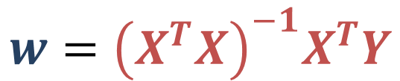


Solving Least-Squares
$${\left\|Y−Xw\right\|}_{2}^{2}$$
$${\frac{∂}{∂w}\left\|Y−Xw\right\|}_{2}^{2}={2X}^{T}Xw−{2X}^{T}Y$$
$$0={2X}^{T}Xw−{2X}^{T}Y$$
Recall: derivative is 0 at a maximum / minimum. Same is true about gradients.
$$X^{T}Xw=X^{T}Y$$
$$w={{\left(X^{T}X\right)}^{−1}X}^{T}Y$$
Aside: 0 is a vector of 0s. 1 is a vector of 1s.

Slide 12


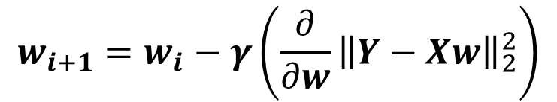

Two Solutions to Getting W
In One Go
Iteratively
Implicit form
(normal equations)
Recall: gradient is also direction that makes function go up the most. What could we do?
$$X^{T}Xw=X^{T}Y$$
Explicit form
(don’t do this)
$$w_{0}=0$$
$$w_{i+1}=w_{i}−γ\left({\frac{∂}{∂w}\left\|Y−Xw\right\|}_{2}^{2}\right)$$
$$w={{\left(X^{T}X\right)}^{−1}X}^{T}Y$$

Slide 13
What’s The Problem?
Vertical lines impossible!
Not rotationally invariant: the line will change depending on orientation of points

Slide 14



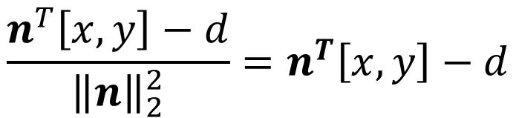
Alternate Formulation
Important part: Any line can be framed in terms of
normal n and offset d
Now:
$$ax+by−d=0$$
$$n^{T}\left[x,y\right]−d=0$$
Point to line distance:
$$\frac{n^{T}\left[x,y\right]−d}{{\left\|n\right\|}_{2}^{2}}=n^{T}\left[x,y\right]−d$$
$$n=\left[a,b\right]$$
$${\left\|\left[a,b\right]\right\|}_{2}^{2}=1$$

Slide 15
Total Least-Squares
Fitting a line to data
Data: (x₁,y₁), (x₂,y₂), …, (x_{k},y_{k})
Model: (n,d), ||n||² = 1
n^{T}[x_{i},y_{i}]-d=0
$$n=\left[a,b\right]$$
$${\left\|\left[a,b\right]\right\|}_{2}^{2}=1$$
Objective function:
(n^{T}[x_{i},y_{i}]-d)²

Slide 16


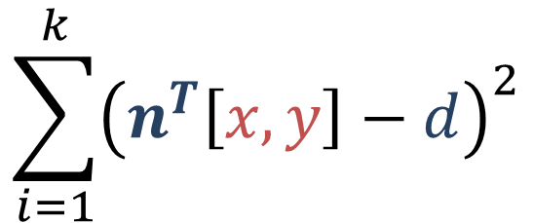
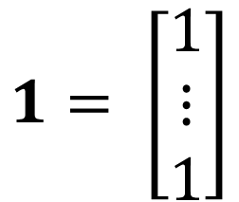
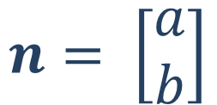
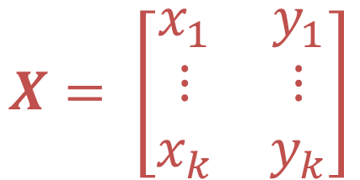
Total Least Squares Setup
Figure out objective first, then figure out ||n||=1
$$\sum_{i=1}^{k}{{\left(n^{T}\left[x,y\right]−d\right)}^{2}}$$
$${\left\|Xn−1d\right\|}_{2}^{2}$$
$$X= \left[\begin{matrix}x_{1} & y_{1} \\ ⋮ & ⋮ \\ x_{k} & y_{k}\end{matrix}\right]$$
$$1= \left[\begin{matrix}1 \\ ⋮ \\ 1\end{matrix}\right]$$
$$n= \left[\begin{matrix}a \\ b\end{matrix}\right]$$
$$μ=\frac{1}{k}1^{T}X$$
The mean / center of mass of the points:
np.sum(X,axis=0). We’ll use it later

Slide 17

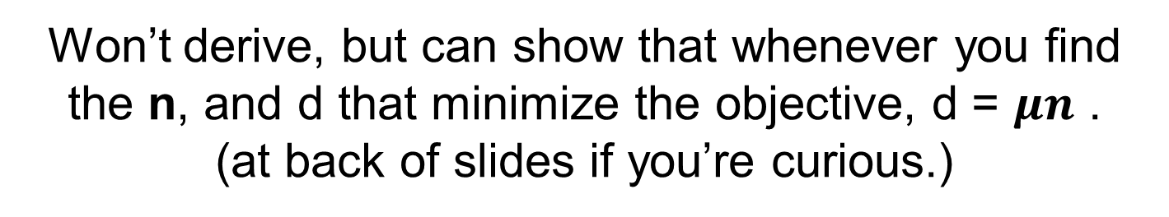
Total Least Squares Setup
Want to make sure that the following is minimized:
$${\left\|Xn−1d\right\|}_{2}^{2}$$
Won’t derive, but can show that whenever you find the n, and d that minimize the objective, d = $μn$ .
(at back of slides if you’re curious.)
$$X= \left[\begin{matrix}x_{1} & y_{1} \\ ⋮ & ⋮ \\ x_{k} & y_{k}\end{matrix}\right]$$
$$1= \left[\begin{matrix}1 \\ ⋮ \\ 1\end{matrix}\right]$$
$$n= \left[\begin{matrix}a \\ b\end{matrix}\right]$$
$$μ=\frac{1}{k}1^{T}X$$
The mean / center of mass of the points:
np.sum(X,axis=0). We’ll use it later

Slide 18


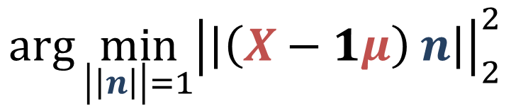

Solving Total Least-Squares
$${\left\|Xn−1d\right\|}_{2}^{2}$$
$$={\left\|Xn−1μn\right\|}_{2}^{2}$$
$$d=μn$$
$$={\left\|{\left(X −1μ\right)}^{ }n\right\|}_{2}^{2}$$
Objective is then:
$$\arg{\min_{\left|\left|n\right|\right|=1}{{\left|\left|{\left(X−1μ\right)}^{ }n\right|\right|}_{2}^{2}}}$$
The thing that makes the expression smallest

Slide 19
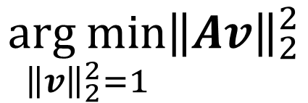
Homogeneous Least Squares
$$\underset{{\left\|v\right\|}_{2}^{2}=1}{arg min}{{\left\|Av\right\|}_{2}^{2}}$$
Eigenvector corresponding to smallest eigenvalue of A^{T}A
Why do we need ||v||² = 1 or
some other constraint?
Applying it in our case:
$${n= smallest_eigenvec(\left(X−1μ\right)}^{T}(X−1μ))$$
Note: technically homogeneous only refers to ||Av||=0 but it’s common shorthand in computer vision to refer to the specific problem of ||v||=1

Slide 20
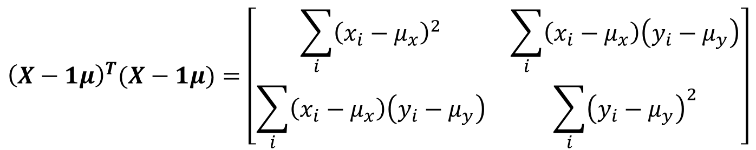
Details For ML-People
Matrix we take the eigenvector of looks like:
$${\left(X−1μ\right)}^{T}(X−1μ)=\left[\begin{matrix}\sum_{i}{{\left(x_{i}−μ_{x}\right)}^{2}} & \sum_{i}{\left(x_{i}−μ_{x}\right)\left(y_{i}−μ_{y}\right)} \\ \sum_{i}{\left(x_{i}−μ_{x}\right)\left(y_{i}−μ_{y}\right)} & \sum_{i}{{\left(y_{i}−μ_{y}\right)}^{2}}\end{matrix}\right]$$
This is a scatter matrix or scalar multiple of the covariance matrix. We’re doing PCA, but taking the least principal component to get the normal.
Note: If you don’t know PCA, just ignore this slide; it’s to help build connections to people with a background in data science/ML.

Slide 21
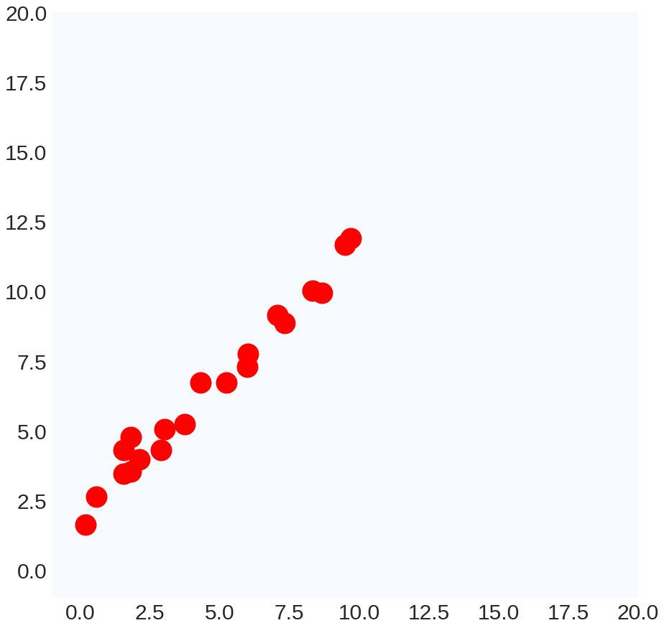
Running Least-Squares

Slide 22
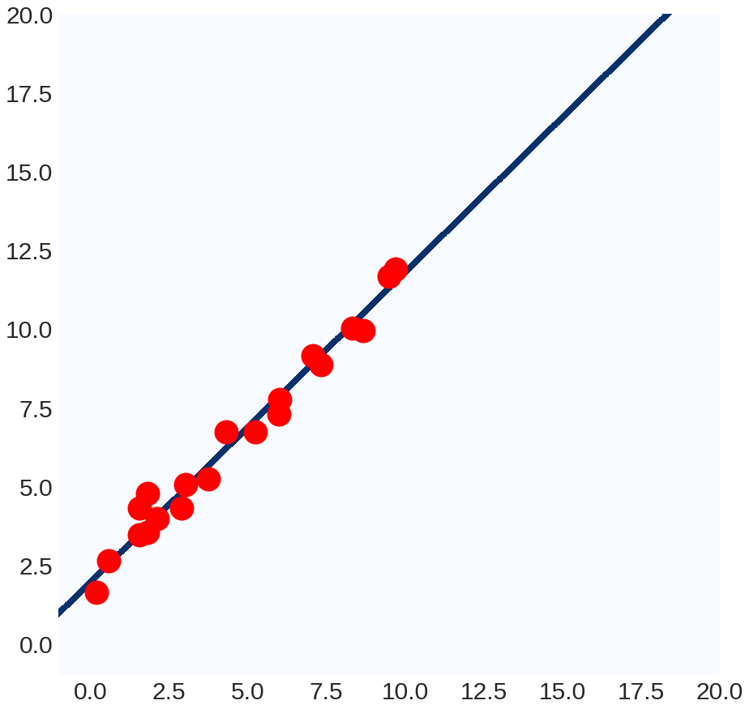
Running Least-Squares

Slide 23
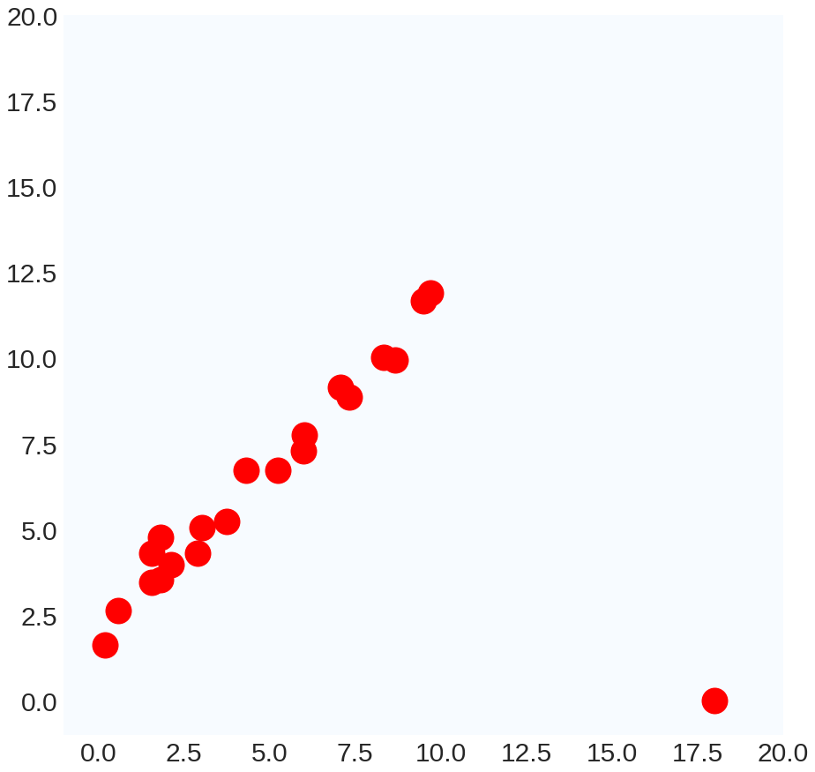
Ruining Least Squares

Slide 24
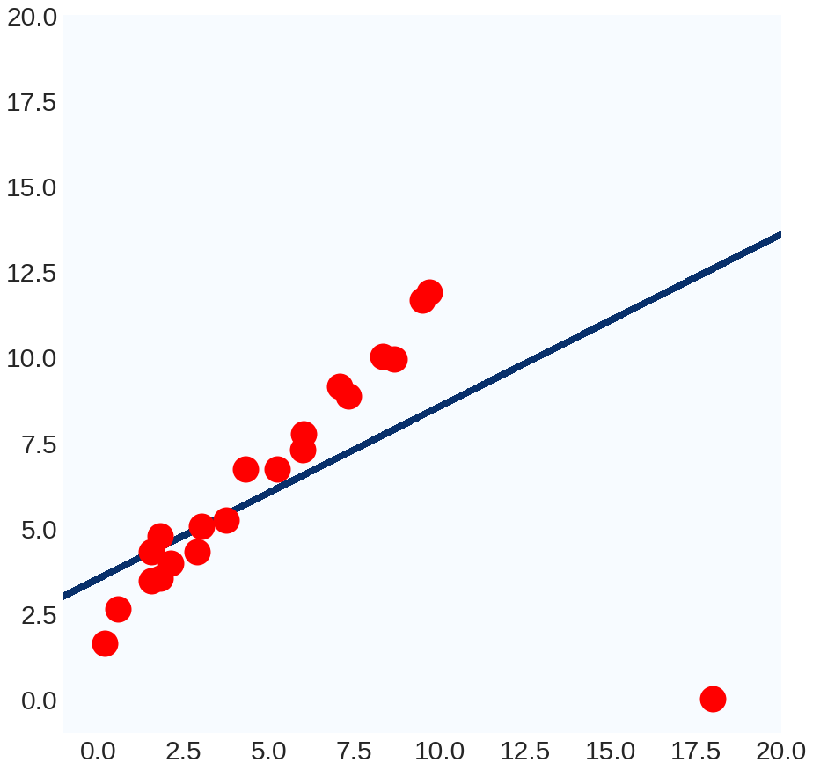
Ruining Least Squares

Slide 25

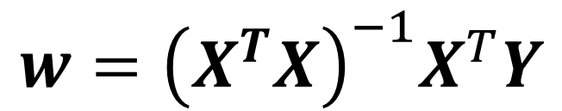
Ruining Least Squares
Way to think of it #1:
$${\left\|Y−Xw\right\|}_{2}^{2}$$
100^2 >> 10^2: least-squares prefers having no large errors, even if the model is useless overall
Way to think of it #2:
$$w={{\left(X^{T}X\right)}^{−1}X}^{T}Y$$
Weights are a linear transformation of the output variable: can manipulate W by manipulating Y.

Slide 26
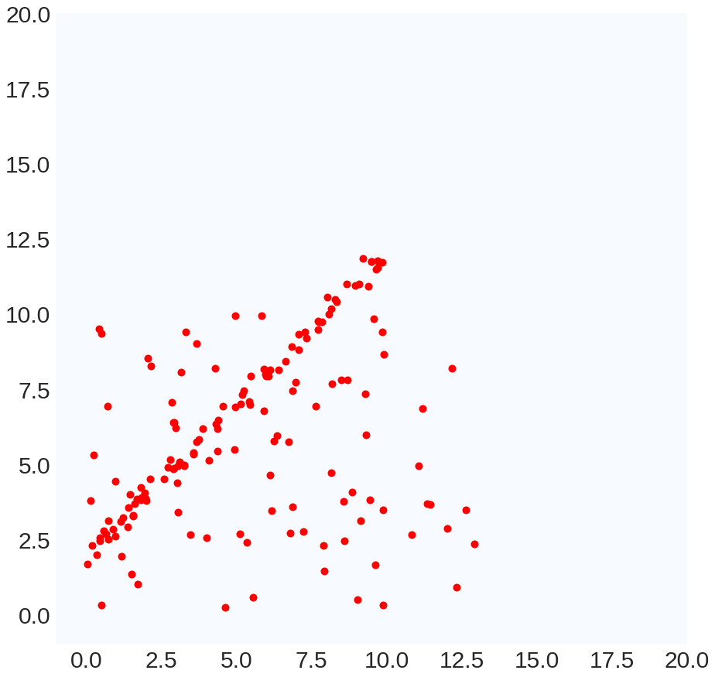
Outliers in Computer Vision
Single outlier:
rare
Many outliers: common

Slide 27
Ruining Least Squares Continued

Slide 28
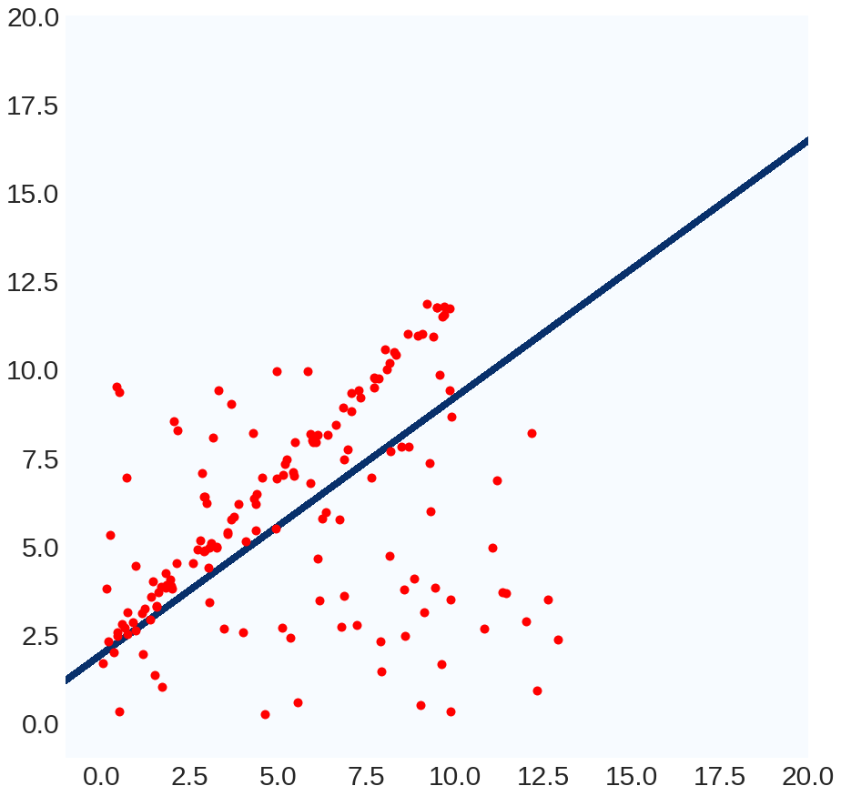
Ruining Least Squares Continued

Slide 29
A Simple, Yet Clever Idea
What we really want: model explains many points “well”
Least Squares: model makes as few big mistakes as possible over the entire dataset
New objective: find model for which error is “small” for as many data points as possible
Method: RANSAC (RAndom SAmple Consensus)
M. A. Fischler, R. C. Bolles. Random Sample Consensus: A Paradigm for Model Fitting with Applications to Image Analysis and Automated Cartography. Comm. of the ACM, Vol 24, pp 381-395, 1981.

Slide 30
RANSAC For Lines
bestLine, bestCount = None, -1
for trial in range(numTrials):
subset = pickPairOfPoints(data)
line = totalLeastSquares(subset)
E = linePointDistance(data,line)
inliers = E < threshold
if #inliers > bestCount:
bestLine, bestCount = line, #inliers

Slide 31
Running RANSAC
Best
Model:
Lots of outliers!
Trial #1
None
Best
Count:
-1

Slide 32
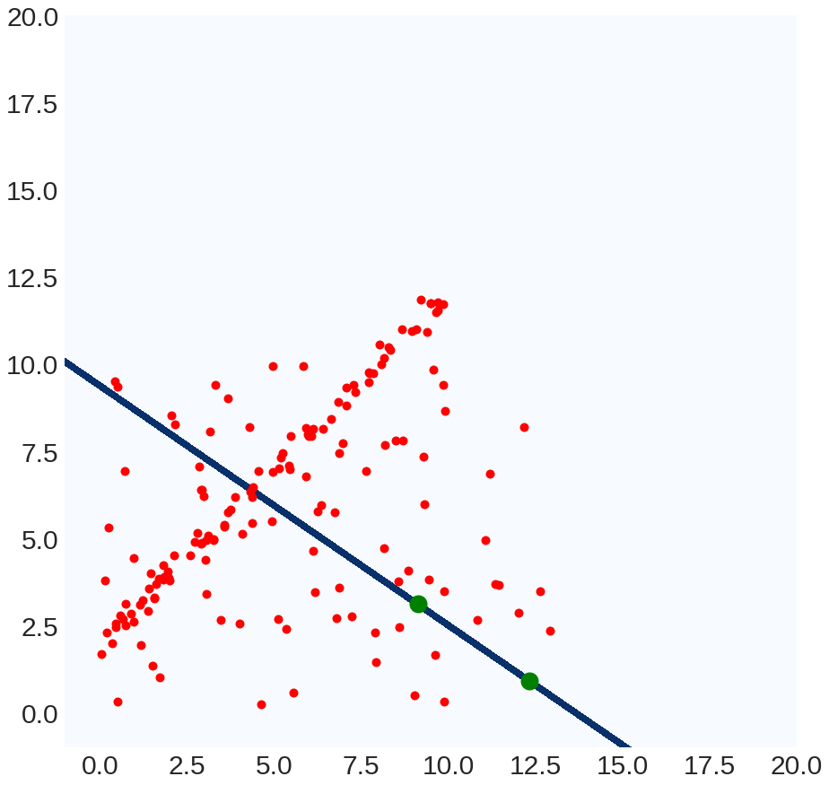
Running RANSAC
Best
Model:
Fit line to 2
random points
Trial #1
None
Best
Count:
-1

Slide 33
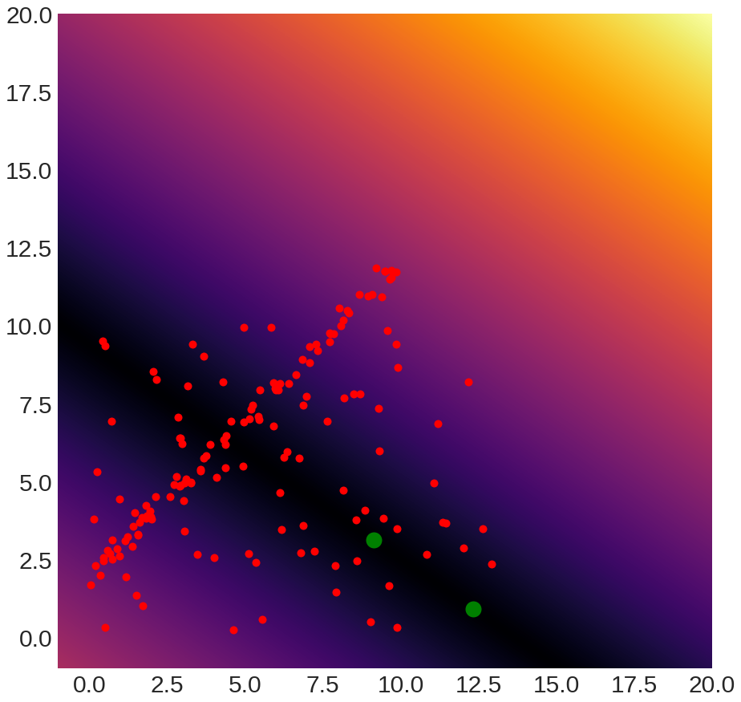
Running RANSAC
Best
Model:
Point/line distance
|n^{T}[x,y] – d|
Trial #1
None
Best
Count:
-1

Slide 34
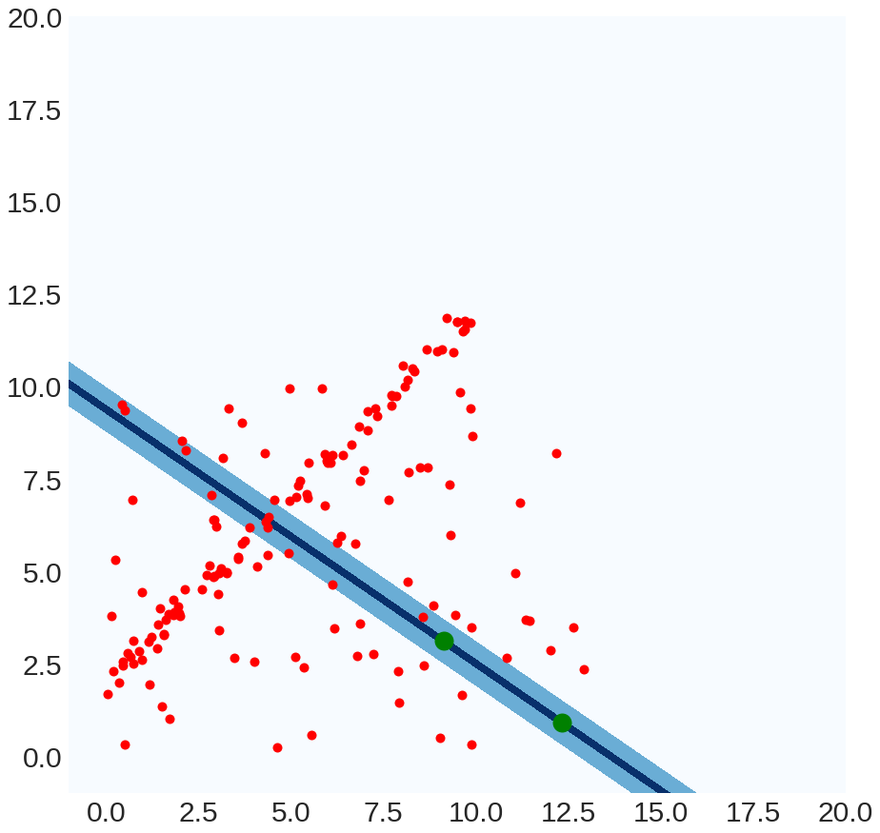
Running RANSAC
Best
Model:
Distance < threshold
14 points satisfy this
Trial #1
None
Best
Count:
-1

Slide 35
Running RANSAC
Best
Model:
Distance < threshold
14 points
Trial #1
Best
Count:
14

Slide 36
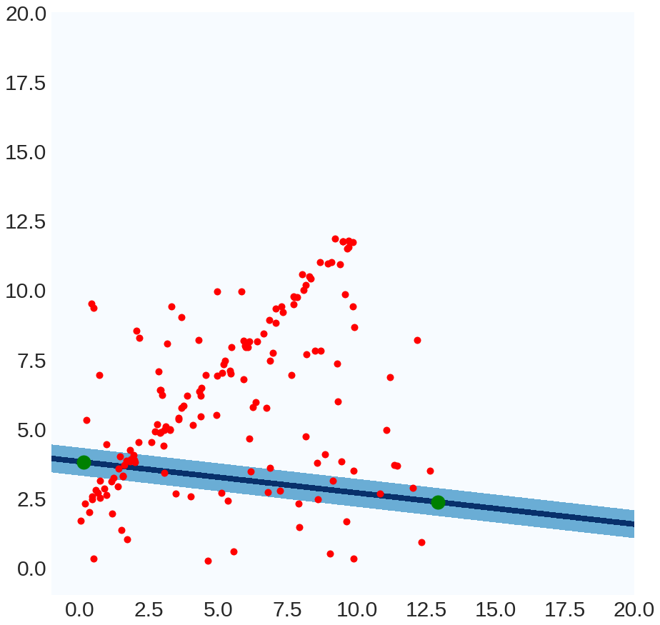
Running RANSAC
Best
Model:
Distance < threshold
22 points
Trial #2
Best
Count:
14

Slide 37
Running RANSAC
Best
Model:
Distance < threshold
22 points
Trial #2
Best
Count:
22

Slide 38
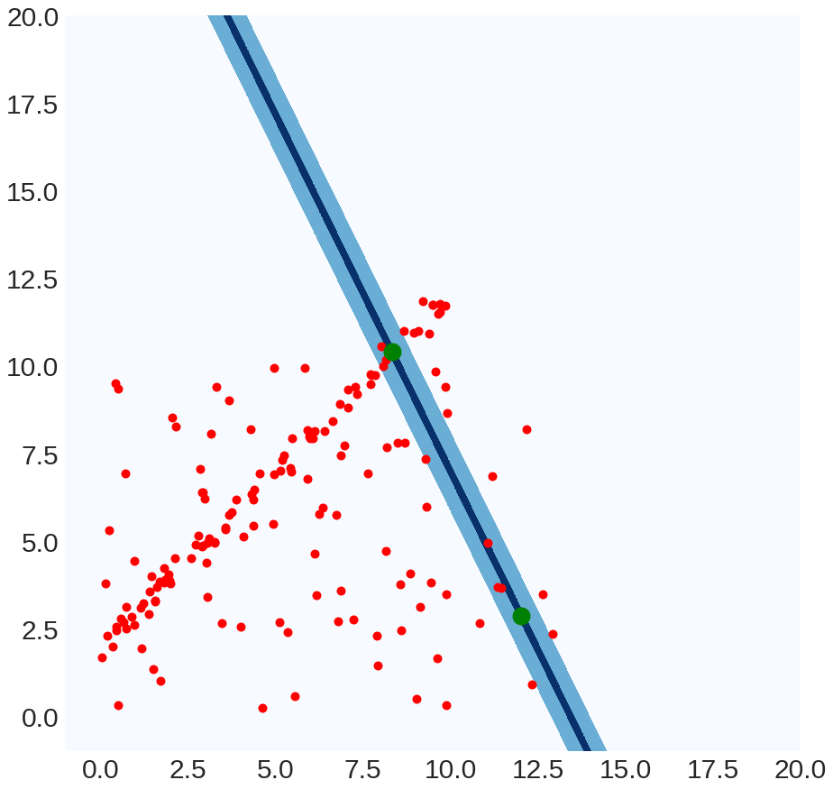
Running RANSAC
Best
Model:
Distance < threshold
10
Trial #3
Best
Count:
22

Slide 39
Running RANSAC
Best
Model:
…
Trial #3
Best
Count:
22

Slide 40
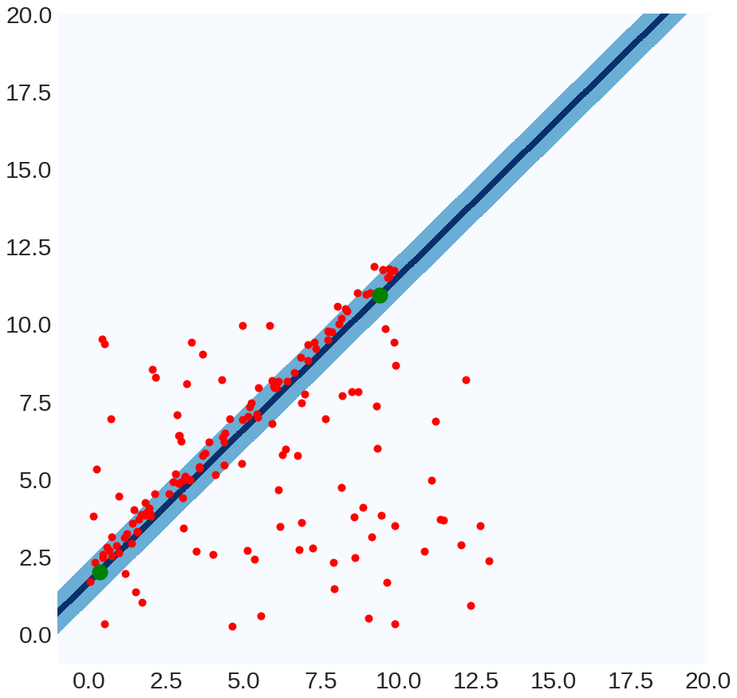
Running RANSAC
Best
Model:
Distance < threshold
76
Trial #9
Best
Count:
22

Slide 41
Running RANSAC
Best
Model:
Distance < threshold
76
Trial #9
Best
Count:
76

Slide 42
Running RANSAC
Best
Model:
…
Trial #9
Best
Count:
76

Slide 43
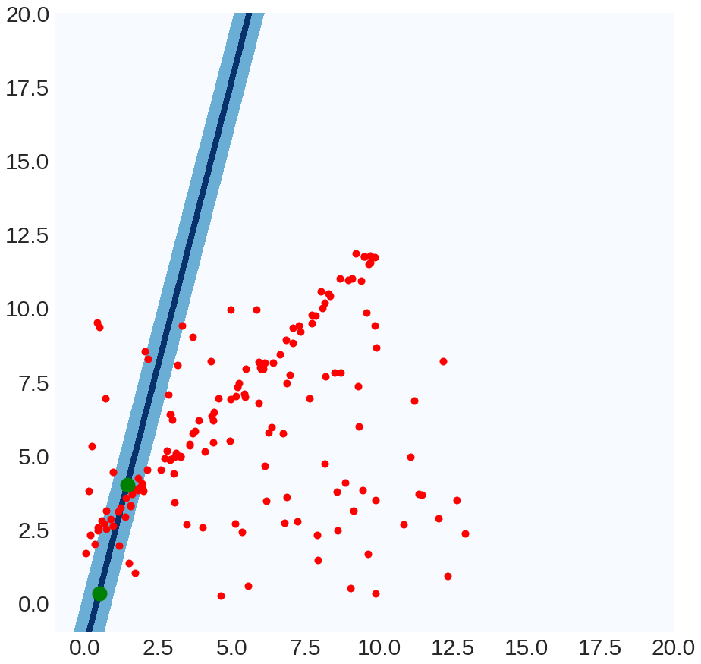
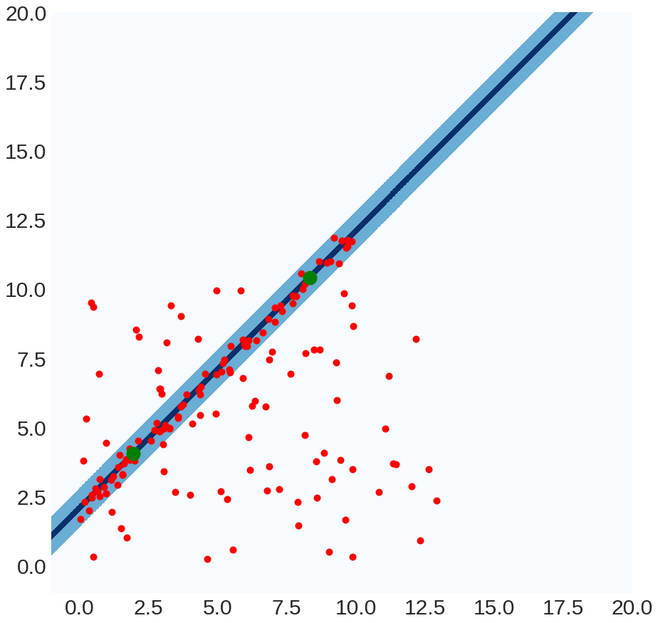
Running RANSAC
Best
Model:
Distance < threshold
22
Trial #100
Best
Count:
85

Slide 44
Running RANSAC
Final Output of
RANSAC: Best Model

Slide 45
RANSAC In General
best, bestCount = None, -1
for trial in range(NUM_TRIALS):
subset = pickSubset(data,SUBSET_SIZE)
model = fitModel(subset)
E = computeError(data,line)
inliers = E < THRESHOLD
if #(inliers) > bestCount:
best, bestCount = model, #(inliers)
Refit on the inliers for best model (keep these!)

Slide 46


Parameters – Num Trials
r is the fraction of outliers (e.g., 80%)
we pick s points (e.g., 2)
we run RANSAC N times (e.g., 500)
Suppose
What’s the probability of picking a sample set with no outliers?
$${≈(1−r)}^{s}$$
(4%)
What’s the probability of picking a sample set with any outliers?
$$1−{(1−r)}^{s}$$
(96%)

Slide 47



Parameters – Num Trials
r is the fraction of outliers (e.g., 80%)
we pick s points (e.g., 2)
we run RANSAC N times (e.g., 500)
Suppose
What’s the probability of picking a sample set with any outliers?
$$1−{(1−r)}^{s}$$
(96%)
What’s the probability of picking only sample sets with outliers?
$${\left(1−{\left(1−r\right)}^{s}\right)}^{N}$$
(10⁻⁷% N=500)
(13% N=50)
What’s the probability of picking any set with inliers?
$${1−\left(1−{\left(1−r\right)}^{s}\right)}^{N}$$

Slide 48

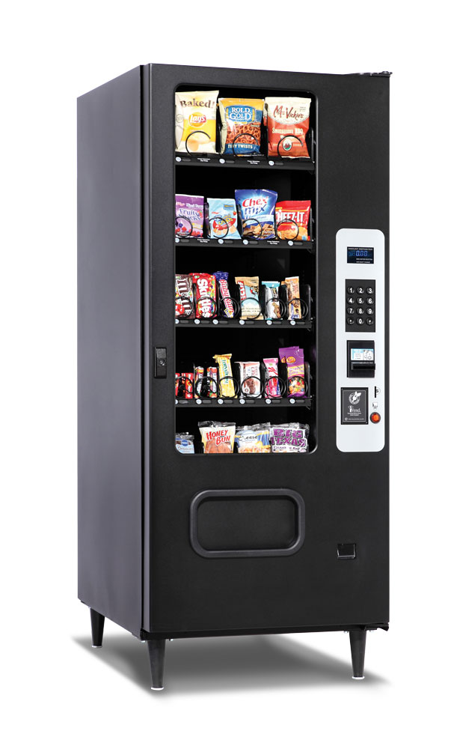
Parameters – Num Trials
P(Jackpot):
1 / 302,575,350
Death by
vending
machine
P(Death):
≈1 / 112,000,000
RANSAC fails to fit a line with 80% outliers after trying only 500 times
P(Failure):
1 / 731,784,961
Odds/Jackpot amount from megamillions.com, unfortunate demise odds from livescience.com

Slide 49
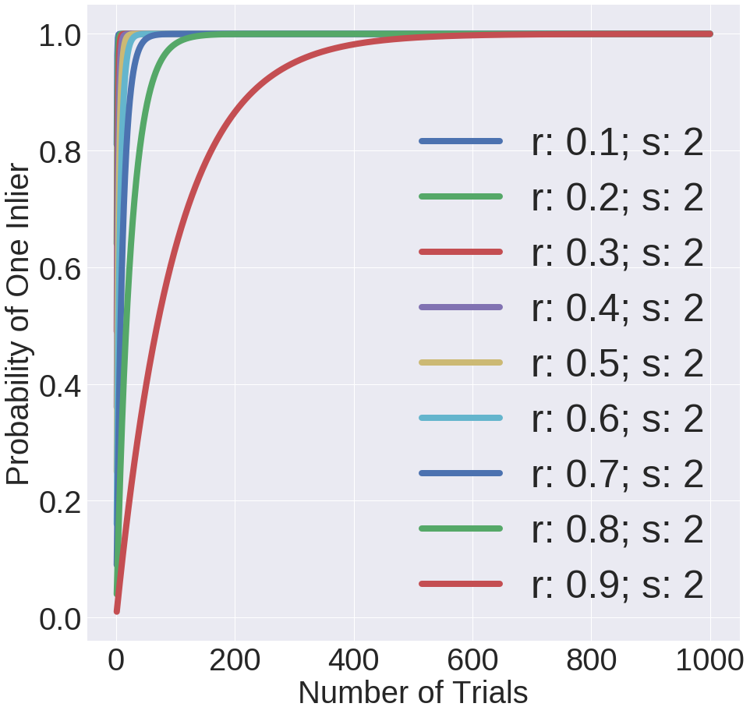
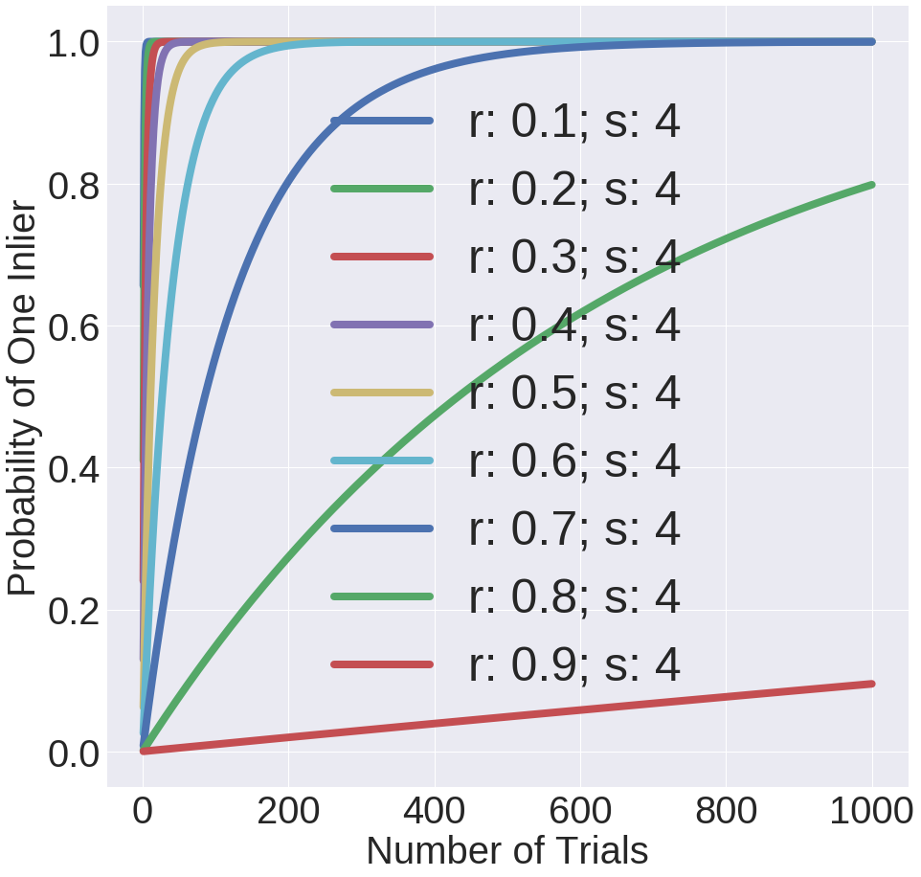
Parameters – Num Trials
r is the fraction of outliers (e.g., 80%)
we pick s points (e.g., 2)
we run RANSAC N times (e.g., 500)
Suppose

Slide 50
Parameters – Subset Size
Always the smallest possible set for fitting the model.
Minimum number for lines: 2 data points
Minimum number for 3D planes: how many?
Why the minimum intuitively?
You’ll find out more precisely in homework 3.

Slide 51
Parameters – Threshold
No magical threshold

Slide 52
RANSAC Pros and Cons
Pros
Cons
Ridiculously simple
Ridiculously effective
Works in general
Have to tune parameters
No theory (so can’t derive parameters via theory)
Not magic, especially with lots of outliers
List credit: S. Lazebnik

Slide 53
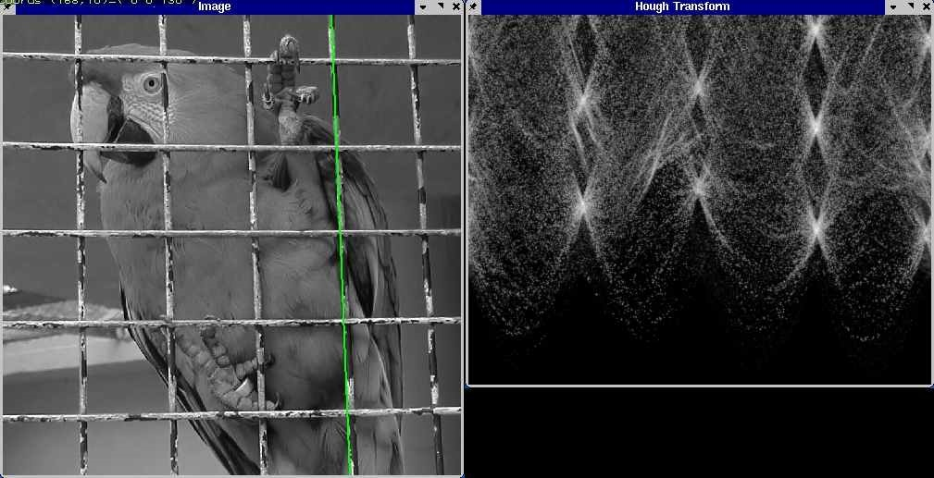
Hough Transform
Image credit: S. Lazebnik

Slide 54
Hough Transform
1. Discretize space of parametric models
2. Each pixel votes for all compatible models
3. Find models compatible with many pixels
Intercept
1
1
0
0
0
2
4
3
Slope
0
1
2
0
0
1
0
1
Image Space
Parameter Space
Image Space
P.V.C. Hough, Machine Analysis of Bubble Chamber Pictures, Proc. Int. Conf. High Energy Accelerators and Instrumentation, 1959
Slide design credit: S. Lazebnik

Slide 55


Hough Transform
Line in image = point in parameter space
y
m
$$y=m_{0}x+b_{0}$$
$$\left(m_{0},b_{0}\right)$$
x
b
Image Space
Parameter Space
Diagram is remake of S. Seitz Slides; these are illustrative and values may not be real

Slide 56



Hough Transform
Point in image = line in parameter space
All lines through the point:
$$b=x_{0}m+y_{0}$$
y
m
$$b=x_{0}m+y_{0}$$
$$\left(x_{0},y_{0}\right)$$
x
b
Image Space
Parameter Space
Diagram is remake of S. Seitz Slides; these are illustrative and values may not be real

Slide 57



Hough Transform
Point in image = line in parameter space
All lines through the point:
$$b=x_{1}m+y_{1}$$
y
m
$$\left(x_{1},y_{1}\right)$$
$$b=x_{1}m+y_{1}$$
x
b
Image Space
Parameter Space
Diagram is remake of S. Seitz Slides; these are illustrative and values may not be real

Slide 58
Hough Transform
Point in image = line in parameter space
All lines through the point:
$$b=x_{1}m+y_{1}$$
If a point is compatible with a line of model parameters, what do two points produce?
y
m
$$\left(x_{1},y_{1}\right)$$
$$b=x_{1}m+y_{1}$$
x
b
Image Space
Parameter Space
Diagram is remake of S. Seitz Slides; these are illustrative and values may not be real

Slide 59
Hough Transform
Line through two points in image = intersection of two lines in parameter space (i.e., solutions to both equations)
y
m
$$\left(x_{1},y_{1}\right)$$
$$b=x_{0}m+y_{0}$$
$$\left(x_{0},y_{0}\right)$$
$$b=x_{1}m+y_{1}$$
x
b
Image Space
Parameter Space
Diagram is remake of S. Seitz Slides; these are illustrative and values may not be real

Slide 60
Hough Transform
Line through two points in image = intersection of two lines in parameter space (i.e., solutions to both equations)
y
m
$$\left(x_{1},y_{1}\right)$$
$$b=x_{0}m+y_{0}$$
$$\left(x_{0},y_{0}\right)$$
$$b=x_{1}m+y_{1}$$
x
b
Image Space
Parameter Space
Diagram is remake of S. Seitz Slides; these are illustrative and values may not be real

Slide 61



Hough Transform
Recall: m, b space is awful
ax+by+c=0 is better, but unbounded
Trick: write lines using angle + offset (normally a mediocre way, but makes things bounded)
y
$$x\cos\left(θ\right)+y\sin\left(θ\right)=ρ$$
$$ρ$$
$$θ$$
x
Diagram is remake of S. Seitz Slides; these are illustrative and values may not be real

Slide 62



Hough Transform Algorithm
Remember:
$$x\cos\left(θ\right)+y\sin\left(θ\right)=ρ$$
Accumulator H = zeros(?,?)
For x,y in detected_points:
For θ in range(0,180,?):
ρ = x cos(θ) + y sin(θ)
H[θ, ρ] += 1
#any local maxima (θ, ρ) of H is a line
#of the form ρ = x cos(θ) + y sin(θ)
$$θ$$
$$ρ$$
Diagram is remake of S. Seitz slides

Slide 63
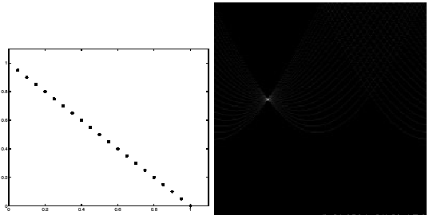
Example
Points (x,y) -> sinusoids
Peak corresponding to the line
Few votes
Image Space
Parameter Space
Slide Credit: S. Lazebnik

Slide 64
Hough Transform Pros / Cons
Pros
Cons
Handles multiple models
Some robustness to noise
In principle, general
Have to bin ALL parameters: exponential in #params
Have to parameterize your space nicely
Details really, really important (a working version requires a lot more than what I showed you)
Slide Credit: S. Lazebnik

Slide 65
Next Time
What happens with fitting more complex transformations?

Slide 67
Details for the Curious

Slide 68
Least Squares

Slide 69

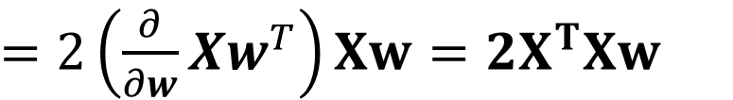
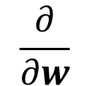


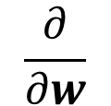
Derivation for the Curious
$${\left\|Y−Xw\right\|}_{2}^{2}$$
$$={\left(Y−Xw\right)}^{T}\left(Y−Xw\right)$$
$$=Y^{T}Y −2w^{T}X^{T}Y+{\left(Xw\right)}^{T}Xw$$
$$\frac{∂}{∂w}$$
$${\left(Xw\right)}^{T}\left(Xw\right)$$
$=$ $2\left(\frac{∂}{∂w}Xw^{T}\right)Xw=2X^{T}Xw$
$$\frac{∂}{∂w}$$
$${\left\|Y−Xw\right\|}_{2}^{2}$$
$$=0 −2X^{T}Y+2X^{T}Xw$$
$$=2X^{T}Xw−2X^{T}Y$$

Slide 70

Total Least Squares
In the interest of less material better, I’m giving that d = $μn$ .
This can be derived by solving for d at the optimum in terms of the other variables.

Slide 71



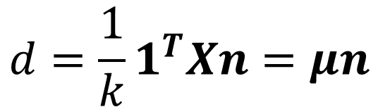
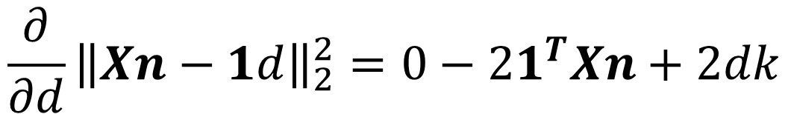

Solving Total Least-Squares
$${\left\|Xn−1d\right\|}_{2}^{2}$$
$$={\left(Xn−1d\right)}^{T}(Xn−1d)$$
$$={\left(Xn\right)}^{T}\left(Xn\right)−{2d1}^{T}Xn+d^{2}1^{T}1$$
First solve for d at optimum (set to 0)
$${\frac{∂}{∂d}\left\|Xn−1d\right\|}_{2}^{2}=0−{21}^{T}Xn+2dk$$
$$0={−21}^{T}Xn+2dk$$
$$0={−1}^{T}Xn+dk$$
$$d=\frac{1}{k}1^{T}Xn=μn$$

Slide 72
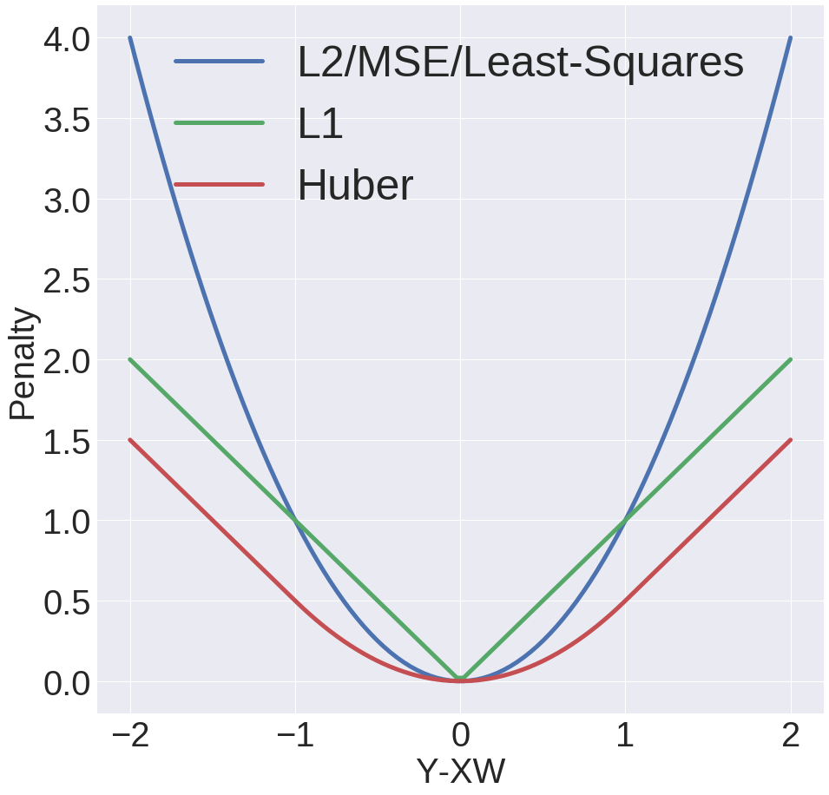

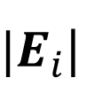





Common Fixes
Replace Least-Squares objective
Let
$$E=Y−XW$$
LS/L2/MSE:
$$E_{i}^{2}$$
L1:
$|E_{i}$|
Huber:
$${|E}_{i}|≤δ:$$
$$\frac{1}{2}E_{i}^{2}$$
$${|E}_{i}|>δ:$$
$$δ\left(\text{|}E_{i}|−\frac{δ}{2}\right)$$

Slide 73
Issues with Common Fixes
Why people in vision don’t really use other peoples’ “robust” methods
Usually complicated to optimize:
  Often no closed form solution
  Typically not something you could write yourself
  Sometimes not convex (local optimum is not necessarily a global optimum)
Not simple to extend more complex objectives to things like total-least squares
Typically don’t handle a ton of outliers (e.g., 80% outliers)

Slide 74






Alternate Formulation
Recall:
$$ax+by+c=0$$
$$l^{T}p=0$$
$$l≡[a,b,c]$$
$$p≡[x,y,1]$$
Can always rescale l.
Pick another a,b,d so
$${{\left\|n\right\|}_{2}^{2}=\left\|\left[a,b\right]\right\|}_{2}^{2}=1$$
$$d=−c$$

