Slide 1
Structure From Motion
EECS 442 – David Fouhey
Winter 2023, University of Michigan
https://web.eecs.umich.edu/~fouhey/teaching/EECS442_W23/

Slide 2
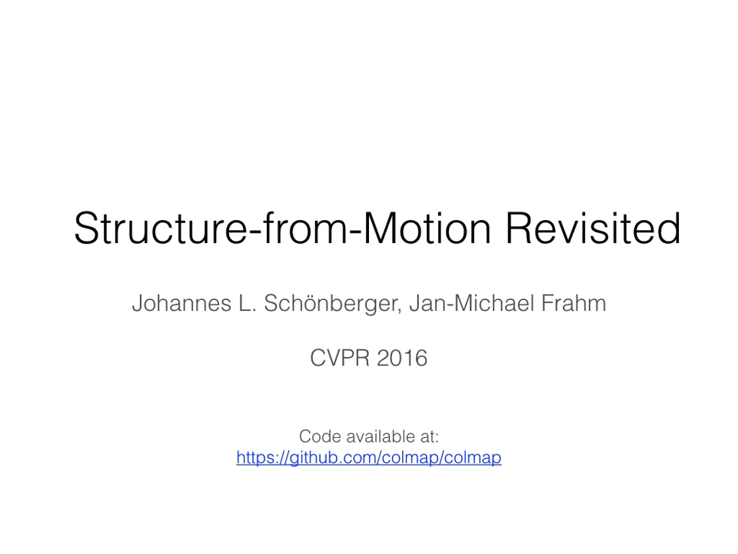
Structure from Motion

Slide 3

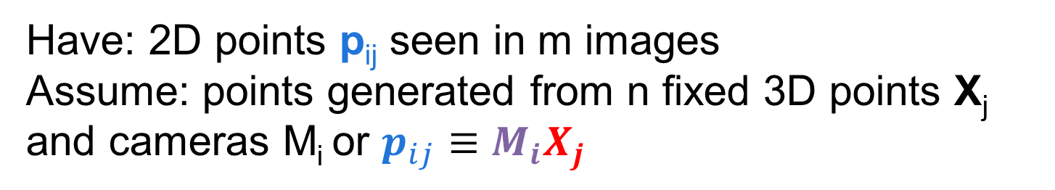
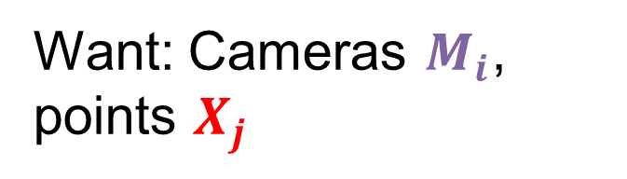

Structure from motion
Have: 2D points p_{ij} seen in m images
Assume: points generated from n fixed 3D points X_{j} and cameras M_{i} or $p_{ij}≡M_{i}X_{j}$
Want: Cameras $M_{i}$, points $X_{j}$
X_{j}
p_{1j}
p_{3j}
(Remember)
p_{2j}
M₁
$$M_{i}≡K_{i}[R_{i},t_{i}]$$
M₃
M₂
$${λp}_{ij}=M_{i}X_{j},λ≠0$$
Known
Unknown
Diagram credit: S. Lazebnik

Slide 4
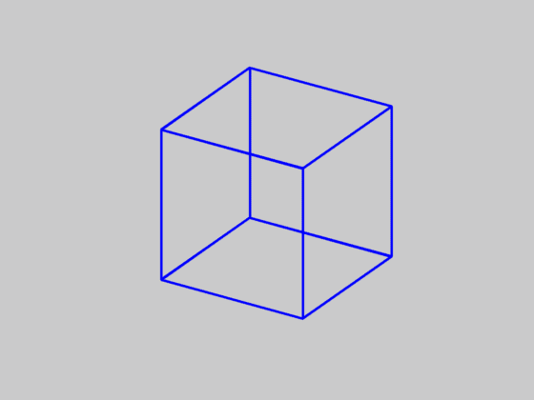
Is SFM always uniquely solvable?
Necker cube
Source: N. Snavely

Slide 5

Structure from motion ambiguities
Let’s first find one easy ambiguity
$$p_{ij}≡M_{i}{ X}_{j}$$
3x1
3x4
4x1

Slide 6
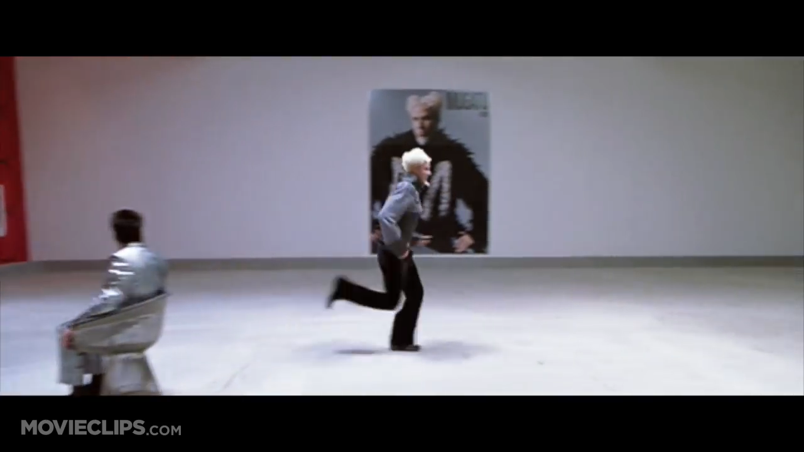
Zoolander, 2001

Slide 7


Structure from motion ambiguities
Let’s first find one easy ambiguity
$$p_{ij}≡M_{i}X_{j}$$
Can pick any arbitrary scaling factor k and adjust the cameras and points
$$p_{ij}≡M_{i}k^{−1}{kX}_{j}$$
(Can usually be fixed in practice: just need a number, obtainable from heights of known objects or an IMU)

Slide 8
Structure from motion ambiguity
Does this diagram change meaning if I use this coordinate system?
X_{j}
x
y
p_{1j}
0
z
p_{3j}
p_{2j}
M₁
Versus this coordinate system?
M₃
M₂
z
Coordinate system irrelevant!
So global R,t also ambiguous
x
0
y

Slide 9

Structure from motion ambiguities
Not just limited to scale. Given:
$$p_{ij}≡M_{i}X_{j}$$
Can insert any global transform H
$$p_{ij}≡M_{i}X_{j}=M_{i}H^{−1}HX_{j}$$
H is a 3D homography / perspective transform / projective transform

Slide 10
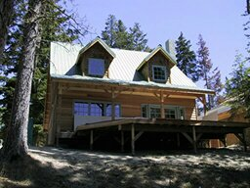
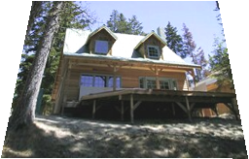
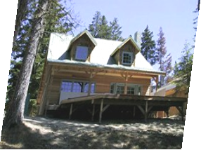
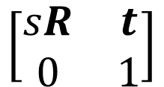
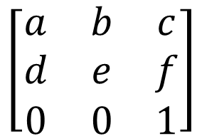
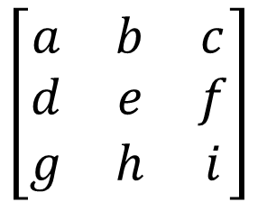
Similarity/Affine/Perspective
Given:
Perspective
Affine
Similarity
Lines
+Parallelism
+Angles
$$\left[\begin{matrix}a & b & c \\ d & e & f \\ g & h & i\end{matrix}\right]$$
$$\left[\begin{matrix}a & b & c \\ d & e & f \\ 0 & 0 & 1\end{matrix}\right]$$
$$\left[\begin{matrix}sR & t \\ 0 & 1\end{matrix}\right]$$
3D: same idea, different dimensions
House image: A. Efros

Slide 11
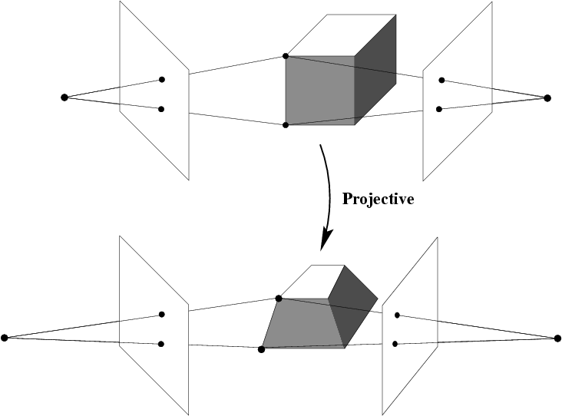

Projective ambiguity
With no constraints on cameras matrices and scene, can only reconstruct up to a perspective ambiguity
H
$$p_{ij}≡M_{i}X_{j}=M_{i}H^{−1}HX_{j}$$
Slide credit: S. Lazebnik

Slide 12
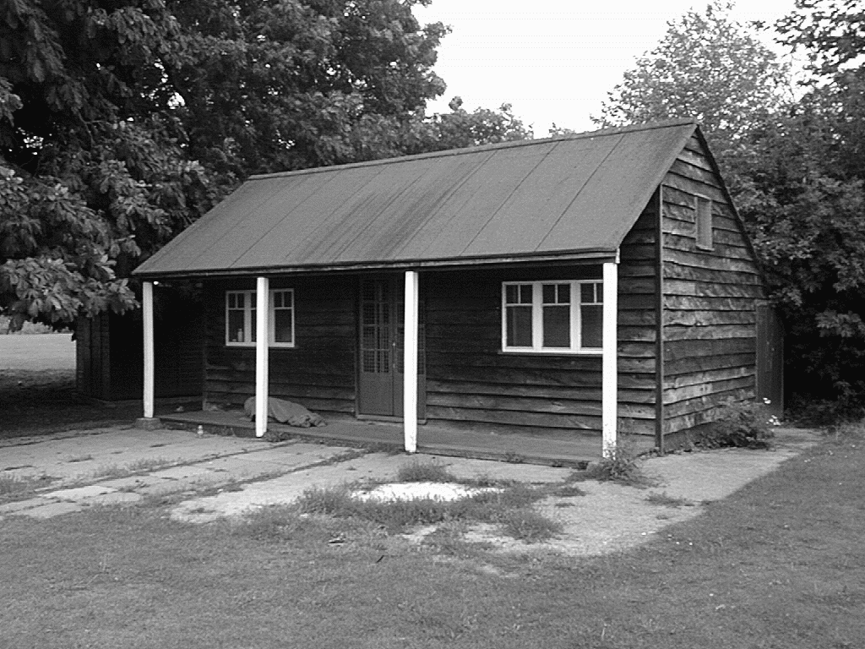
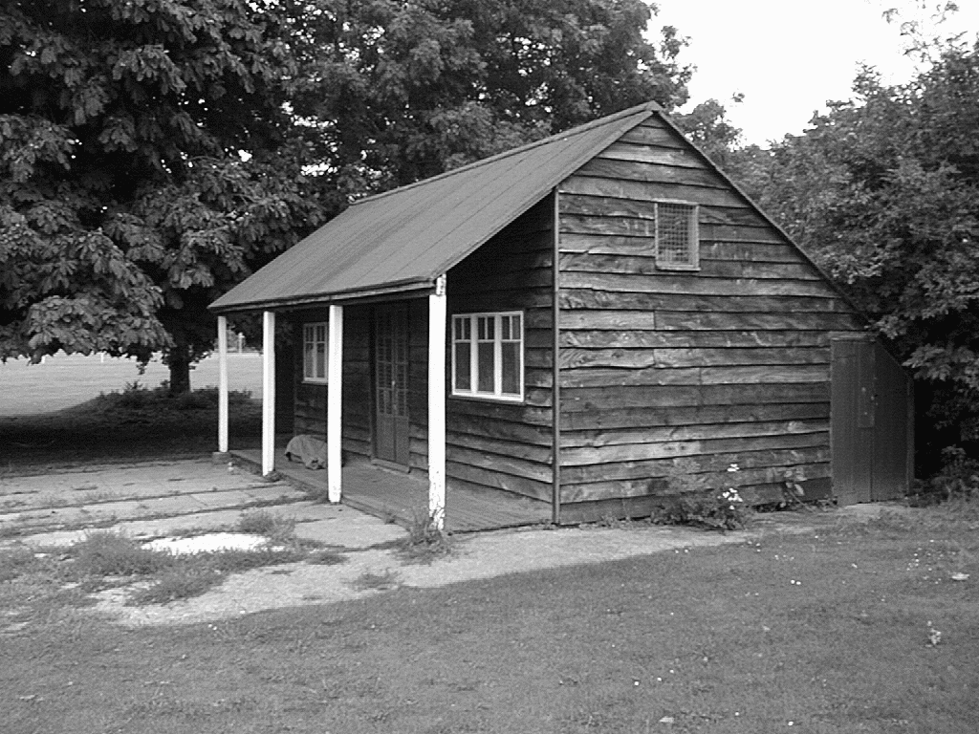
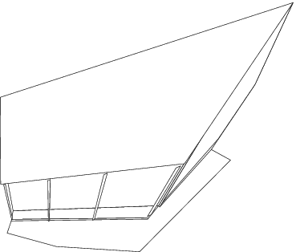
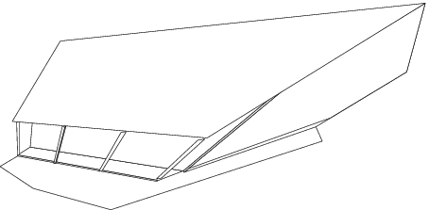
Projective ambiguity
Slide credit: S. Lazebnik

Slide 13
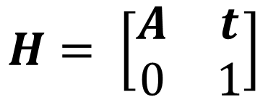
Affine ambiguity
If we have constraints in the form of what lines are parallel, can reduce ambiguity to affine ambiguity.
$$H= \left[\begin{matrix}A & t \\ 0 & 1\end{matrix}\right]$$
Affine
$$p_{ij}≡M_{i}X_{j}=M_{i}H^{−1}HX_{j}$$
Slide credit: S. Lazebnik

Slide 14
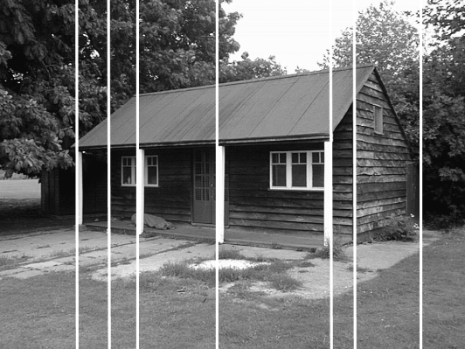
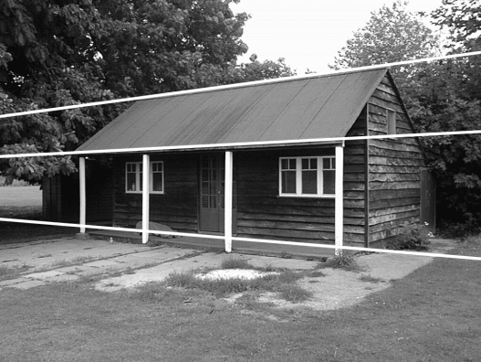
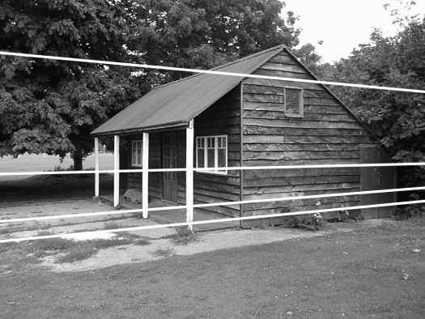
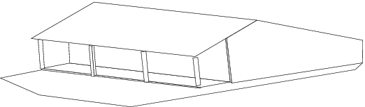
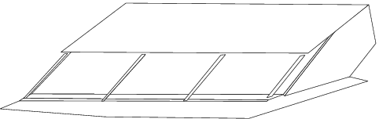
Affine ambiguity
Slide credit: S. Lazebnik

Slide 15
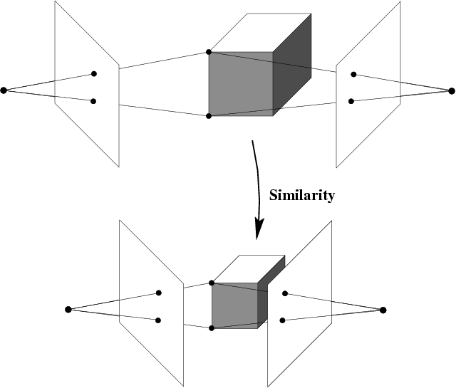
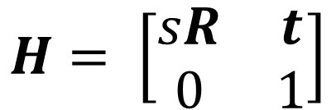
Similarity ambiguity
If we have orthogonality constraints, get up to similarity transform. Really the best we can do.
We get this if we have calibrated cameras.
$$H= \left[\begin{matrix}sR & t \\ 0 & 1\end{matrix}\right]$$
$$p_{ij}≡M_{i}X_{j}=M_{i}H^{−1}HX_{j}$$
Slide credit: S. Lazebnik

Slide 16
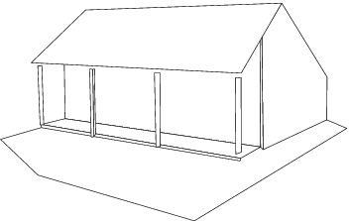
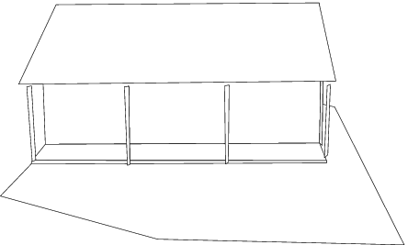
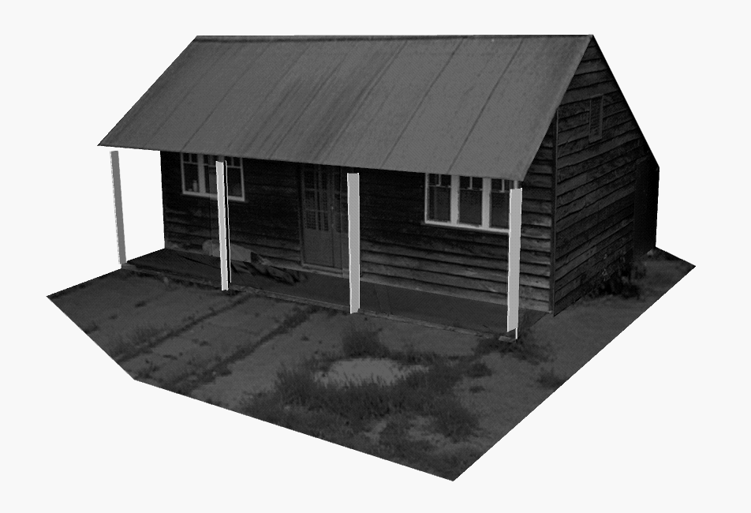
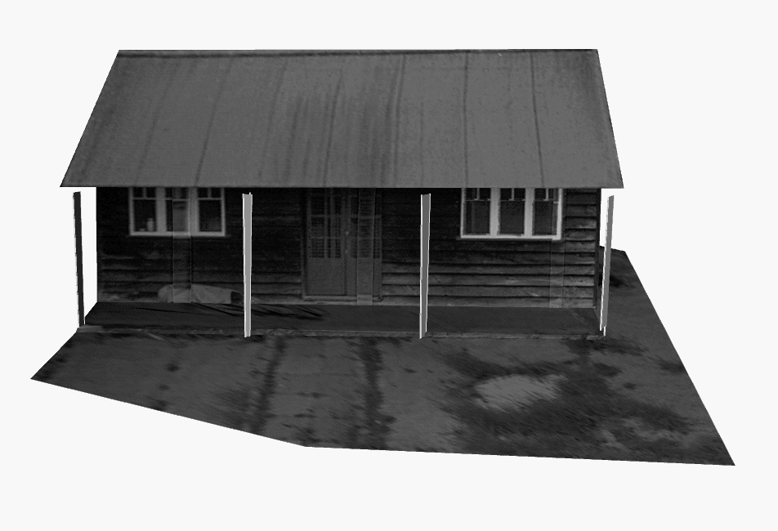
Similarity ambiguity
Slide credit: S. Lazebnik

Slide 17
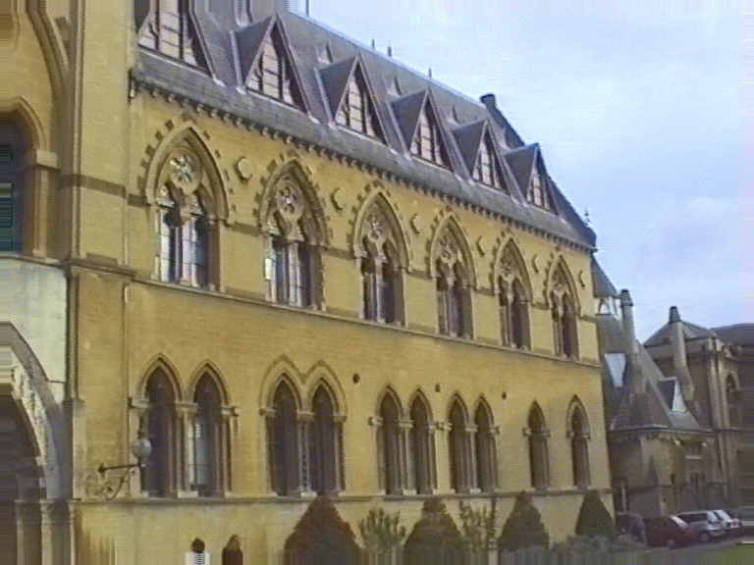
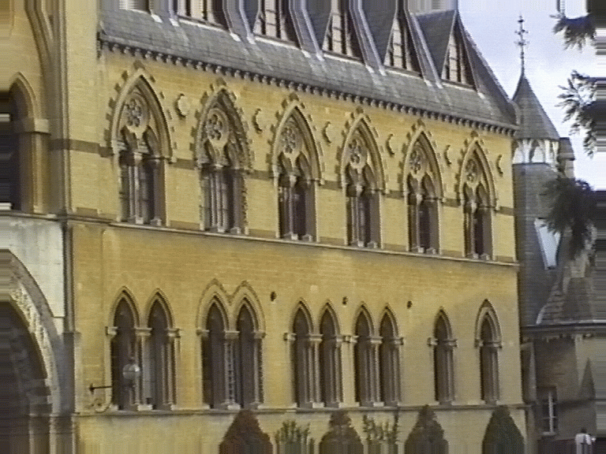
Affine structure from motion
We’ll do the math with affine / weak perspective cameras (math is much easier)
Perspective
Weak Perspective

Slide 18
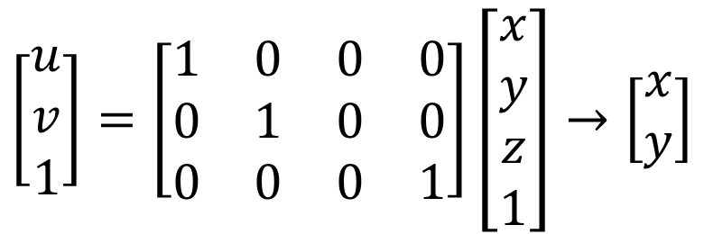
Recall: orthographic projection
Orthographic camera: things infinitely far away but you have an amazing camera
Image
World
Projection along the z direction
$$\left[\begin{matrix}u \\ v \\ 1\end{matrix}\right]=\left[\begin{matrix}1 & 0 & 0 & 0 \\ 0 & 1 & 0 & 0 \\ 0 & 0 & 0 & 1\end{matrix}\right]\left[\begin{matrix}x \\ y \\ z \\ 1\end{matrix}\right]→\left[\begin{matrix}x \\ y\end{matrix}\right]$$

Slide 19
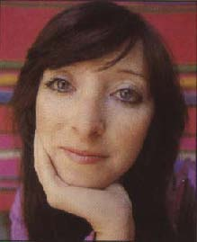

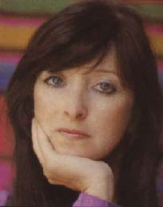
Field of view and focal length
wide-angle
standard
telephoto
Slide Credit: F. Durand

Slide 20
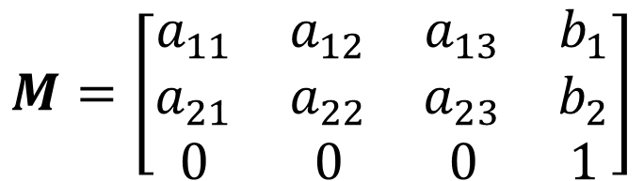
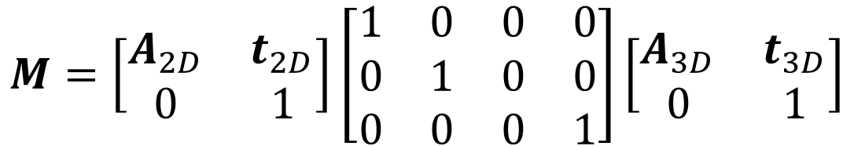
Affine Camera
$$M=\left[\begin{matrix}A_{2D} & t_{2D} \\ 0 & 1\end{matrix}\right]\left[\begin{matrix}1 & 0 & 0 & 0 \\ 0 & 1 & 0 & 0 \\ 0 & 0 & 0 & 1\end{matrix}\right]\left[\begin{matrix}A_{3D} & t_{3D} \\ 0 & 1\end{matrix}\right]$$
3x3 Matrix
Affine 2D
3x4 Ortho.
Proj
4x4 Matrix
Affine 3D
Tedious math…
$$M=\left[\begin{matrix}a_{11} & a_{12} & a_{13} & b_{1} \\ a_{21} & a_{22} & a_{23} & b_{2} \\ 0 & 0 & 0 & 1\end{matrix}\right]$$

Slide 21
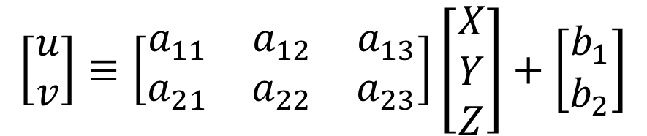
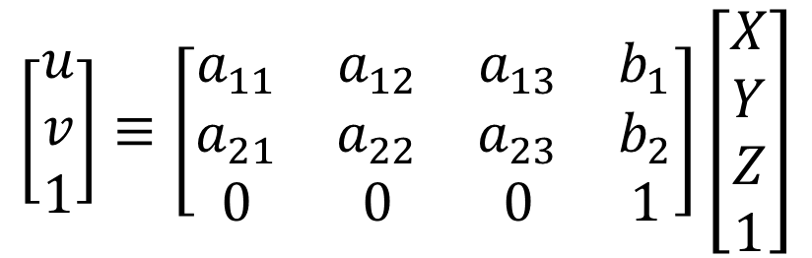
Affine Camera
So what? Who cares?
Examine the projection
$$\left[\begin{matrix}u \\ v \\ 1\end{matrix}\right]≡\left[\begin{matrix}a_{11} & a_{12} & a_{13} & b_{1} \\ a_{21} & a_{22} & a_{23} & b_{2} \\ 0 & 0 & 0 & 1\end{matrix}\right]\left[\begin{matrix}X \\ Y \\ Z \\ 1\end{matrix}\right]$$
Projection becomes linear mapping + translation and doesn’t involve homogeneous coordinates!
$$\left[\begin{matrix}u \\ v\end{matrix}\right]≡\left[\begin{matrix}a_{11} & a_{12} & a_{13} \\ a_{21} & a_{22} & a_{23}\end{matrix}\right]\left[\begin{matrix}X \\ Y \\ Z\end{matrix}\right]+\left[\begin{matrix}b_{1} \\ b_{2}\end{matrix}\right]$$
b is projection of origin. Can anyone see why?

Slide 22


Affine structure from motion
General structure from motion:
$$p_{ij}≡M_{i}X_{j}$$
3x1
3x4
4x1
$$p_{ij}=A_{i}X_{j}+b_{i}$$
Assume M is affine camera:
2x1
2x3
3x1
2x1
mn 2D points, m cameras, n 3D points
up to arbitrary 3D affine (12 DOF)
Need:
2mn ≥ 8m + 3n – 12
(m = 2): n ≥ 4
(for all m!)

Slide 23
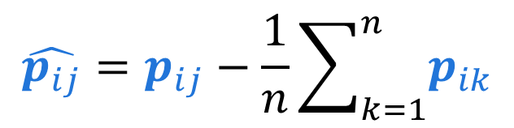


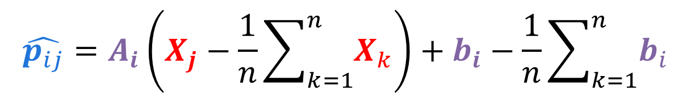
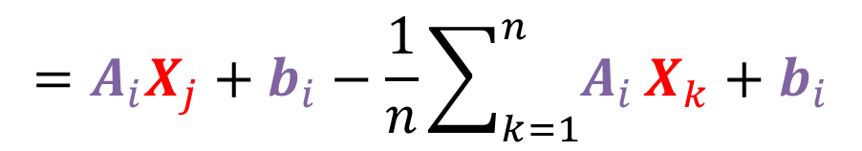
One simplifying trick
$$p_{ij}=A_{i}X_{j}+b_{i}$$
Subtract off the average 2D point
$$\hat{p_{ij}}=p_{ij}−\frac{1}{n}\sum_{k=1}^{n}{p_{ik}}$$
$$=A_{i}X_{j}+b_{i}−\frac{1}{n}\sum_{k=1}^{n}{A_{i}}X_{k}+b_{i}$$
Gather terms involving A_{i} ,push out b_{i}
$$\hat{p_{ij}}=A_{i}\left(X_{j}−\frac{1}{n}\sum_{k=1}^{n}{X_{k}}\right)+b_{i}−\frac{1}{n}\sum_{k=1}^{n}{b_{i}}$$
0
Set origin to mean of 3D points
$$\hat{p_{ij}}=A_{i}X_{j}$$
Can do this entirely in terms of A!

Slide 24
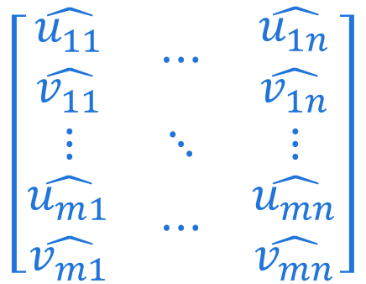
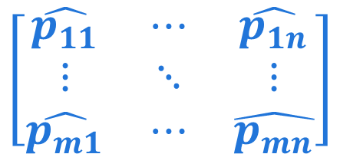
Affine structure from motion
First, make data measurement matrix consisting of all the points stacked together
$$\left[\begin{matrix}\begin{matrix}\hat{u_{11}} \\ \hat{v_{11}}\end{matrix} & ⋯ & \begin{matrix}\hat{u_{1n}} \\ \hat{v_{1n}}\end{matrix} \\ ⋮ & ⋱ & ⋮ \\ \begin{matrix}\hat{u_{m1}} \\ \hat{v_{m1}}\end{matrix} & ⋯ & \begin{matrix}\hat{u_{mn}} \\ \hat{v_{mn}}\end{matrix}\end{matrix}\right]$$
$$\left[\begin{matrix}\hat{p_{11}} & ⋯ & \hat{p_{1n}} \\ ⋮ & ⋱ & ⋮ \\ \hat{p_{m1}} & ⋯ & \hat{p_{mn}}\end{matrix}\right]$$
m
cameras
n points
How big is this matrix?
C. Tomasi and T. Kanade. Shape and motion from image streams under orthography:
A factorization method. IJCV, 9(2):137-154, November 1992.

Slide 25


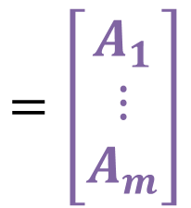
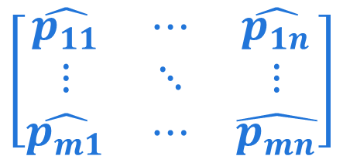
Affine structure from motion
Then, write all the equations in one in terms of product of cameras and points.
$$\left[\begin{matrix}\hat{p_{11}} & ⋯ & \hat{p_{1n}} \\ ⋮ & ⋱ & ⋮ \\ \hat{p_{m1}} & ⋯ & \hat{p_{mn}}\end{matrix}\right]$$
$$=\left[\begin{matrix}A_{1} \\ ⋮ \\ A_{m}\end{matrix}\right]$$
$$D=$$
$$\left[\begin{matrix}X_{1} & ⋯ & X_{n}\end{matrix}\right]$$
2m x n
D
2mx3
M
3xn
S
What’s the rank of D?
3!
C. Tomasi and T. Kanade. Shape and motion from image streams under orthography:
A factorization method. IJCV, 9(2):137-154, November 1992.

Slide 26
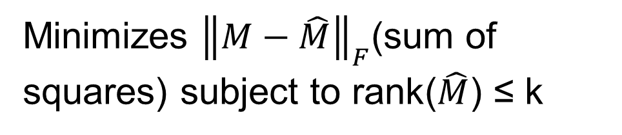



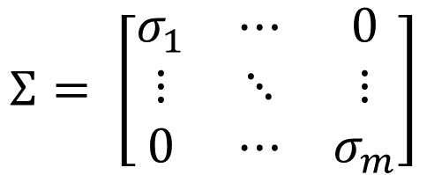


Making Matrices Rank Deficient
Repeat of epipolar geometry class, but important enough to see twice. Given matrix M:
$$U_{m×m},$$
$$V_{n×n}$$
rotation matrices
$$M→ UΣV^{T}$$
$$Σ_{m×n}$$
diagonal scaling matrix
$$Σ= \left[\begin{matrix}σ_{1} & ⋯ & 0 \\ ⋮ & ⋱ & ⋮ \\ 0 & ⋯ & σ_{m}\end{matrix}\right]$$
Keep only k biggest σ; set others to 0
Minimizes ${\left\|M−\hat{M}\right\|}_{F}$(sum of squares) subject to rank($\hat{M}$) ≤ k
$$\hat{M}← U\hat{Σ}V^{T}$$
See Eckart–Young–Mirsky theorem if you’re interested

Slide 27
Affine structure from motion
We’d like to take the measurements and convert them into M, S
D
M
=
x
S
2m
n
3
Remake of M. Hebert diagram

Slide 28
Affine structure from motion
Do SVD (typically you don’t make full U,Σ,V)
n
n
n
n
D
U
Σ
V^{T}
=
x
x
n
2m
Truncate to top 3 singular values
D
U₃
Σ₃
V₃^{T}
=
x
x
Remake of M. Hebert diagram

Slide 29

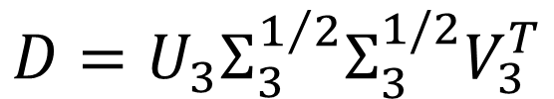

Affine structure from motion
Nearly there apart from this annoying Σ₃.
D
U₃
=
x
x
Σ₃
V₃^{T}
One solution (split Σ₃ in two):
$$D=U_{3}Σ_{3}^{1/2}Σ_{3}^{1/2}V_{3}^{T}$$
$$M$$
$$S$$
D
M
But remember that we can put HH⁻¹ in the middle
=
x
S
Remake of M. Hebert diagram

Slide 30
Reconstruction results
C. Tomasi and T. Kanade, Shape and motion from image streams under orthography:
A factorization method, IJCV 1992

Slide 31
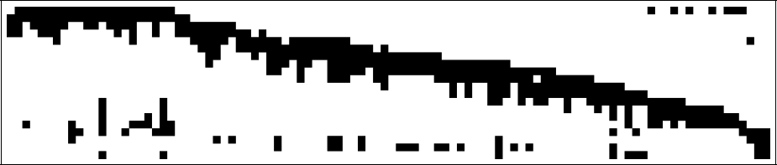
Dealing with missing data
So far, assume we can see all points in all views
In reality, measurement matrix typically looks like this:
cameras
points
Possible solution: find dense blocks, solve in block, fuse.
In general, finding these dense blocks is NP-complete
Figure Credit: S. Lazebnik

Slide 32

But cameras aren’t affine!
Want: m cameras M_{i}, n 3D points X_{j}
Given: mn 2D points p_{ij}
$$p_{ij}≡M_{i}X_{j}=M_{i}H^{−1}HX_{j}$$

Slide 33
When is this Possible?
Want: m cameras M_{i}, n 3D points X_{j}
Given: mn 2D points p_{ij}
$$p_{ij}≡M_{i}X_{j}=M_{i}H^{−1}HX_{j}$$
2D
point (2)
3D point (3)
3x4 camera matrix (11) why?
4x4 homography
(15) why?
Need 2mn ≥ 11m + 3n – 15
(m = 2): n ≥ 7
(m = 3): n ≥ 6 (doesn’t get better after)
(m=1): n ≤ 4

Slide 34




Two Camera Case
For two cameras, we need 7 points. Hmm.
What else (in theory) requires 7 points?
Compute fundamental matrix F and epipole b
s.t. F^{T}b = 0. Then:
X
p
p'
$$M_{1}=[I,0]$$
$$M_{1}$$
b
$$M_{2}$$
$$M_{2}=[−\left[b_{x}\right]F,b]$$
Remember: this is up to a projective ambiguity!

Slide 35
Incremental SFM
Key idea: incrementally add cameras, points
?
?
Cameras
?
?
Points
?
?
?
?
Remake of S. Lazebnik material
Note: numbers of points aren’t to scale.

Slide 36
Incremental SFM
Key idea: incrementally add cameras, points
M₁
Initialize motion M_{i} = [R_{i},t_{i}] with fundamental matrix
?
M₂
?
Cameras
?
?
Points
?
?
?
?
Remake of S. Lazebnik material
Note: numbers of points aren’t to scale.

Slide 37
Incremental SFM
Key idea: incrementally add cameras, points
M₁
Initialize motion M_{i} = [R_{i},t_{i}] with fundamental matrix
Initialize structure X_{j} with triangulation
?
M₂
?
Cameras
?
?
How could we add another camera?
Points
?
X₁
?
X₂
?
X₃
?
Remake of S. Lazebnik material
Note: numbers of points aren’t to scale.

Slide 38
Incremental SFM
Key idea: incrementally add cameras, points
M₁
Solve for camera matrix using visible, known points using calibration
?
M₂
?
Cameras
?
M₃
?
Points
?
X₁
?
X₂
?
X₃
?
Remake of S. Lazebnik material
Note: numbers of points aren’t to scale.

Slide 39
Incremental SFM
Key idea: incrementally add cameras, points
M₁
Solve for camera matrix using visible, known points using calibration
Now we can see the fourth point in two cameras.
?
M₂
?
Cameras
?
M₃
?
Points
?
X₁
?
X₂
?
X₃
?
Remake of S. Lazebnik material
Note: numbers of points aren’t to scale.

Slide 40
Incremental SFM
Key idea: incrementally add cameras, points
M₁
Solve for camera matrix using visible, known points using calibration
Solve for 3D coordinates of newly visible points using triangulation
?
M₂
?
Cameras
?
M₃
?
Points
?
X₁
?
X₂
?
X₃
?
X₄
Remake of S. Lazebnik material
Note: numbers of points aren’t to scale.

Slide 41
Incremental SFM
Key idea: incrementally add cameras, points
M₁
Big problem: don’t ever jointly consider all the 3D points and camera.
Leads to final step, called bundle adjustment.
?
M₂
?
Cameras
?
M₃
?
Points
?
X₁
?
X₂
?
X₃
?
X₄
Remake of S. Lazebnik material
Note: numbers of points aren’t to scale.

Slide 42
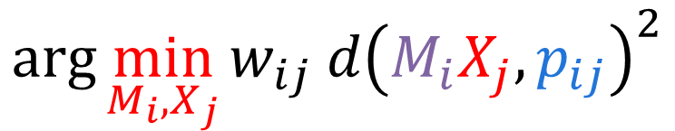
Bundle Adjustment
Do non-linear minimization over cameras M_{i}, points X_{j} to minimize distance between observed points p_{ij} and projections M_{i}X_{j} when they’re visible.
X_{j}
$$\arg{\min_{M_{i},X_{j}}{w_{ij} d{\left(M_{i}X_{j},p_{ij}\right)}^{2}}}$$
Visibility flag
M₁X_{j}
p_{1j}
p_{3j}
M₃X_{j}
M₁
M₂X_{j}
p_{2j}
M₃
M₂
Figure Credit: S. Lazebnik

Slide 43
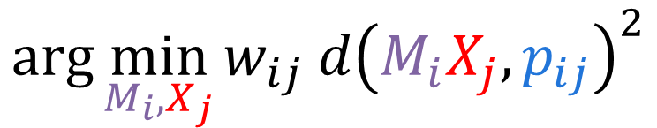
Devil is in the details
$$\arg{\min_{M_{i},X_{j}}{w_{ij} d{\left(M_{i}X_{j},p_{ij}\right)}^{2}}}$$
High-level idea:
In practice:
Have to initialize reasonably well
Should minimize over K,R,t directly
Problem is very sparse: w_{ij} almost always zero
Need to integrate uncertainty information
Probably want to use a system written by experts

Slide 44

Representative SFM pipeline
N. Snavely, S. Seitz, and R. Szeliski, Photo tourism: Exploring photo collections in 3D,
SIGGRAPH 2006.
http://phototour.cs.washington.edu/
Notes:
Here’s how the same set of photos appear in our photo explorer. Our system takes the set of photos and automatically determines the relative positions and orientations from which each photo was taken. We can then load the photos into our immersive 3D browser where the user can visualize and explore the photos using spatial relationships.

Slide 45
















Feature detection
Detect SIFT features
Source: N. Snavely
Notes:
So, we begin by detecting SIFT features in each photo.
[We detect SIFT features in each photo, resulting in a set of feature locations and 128-byte feature descriptors…]

Slide 46







Feature detection
Detect SIFT features
Source: N. Snavely

Slide 47





Feature matching
Match features between each pair of images
Source: N. Snavely
Notes:
Next, we match features across each pair of photos using approximate nearest neighbor matching.

Slide 48


Feature matching
Use RANSAC to estimate fundamental matrix between each pair
Source: N. Snavely
Notes:
The matches are refined by using RANSAC, which is a robust model-fitting technique, to estimate a fundamental matrix between each pair of matching images and keeping only matches consistent with that fundamental matrix.
We then link connected components of pairwise feature matches together to form correspondences across multiple images.
Once we have correspondences, we run structure from motion to recover the camera and scene geometry. Structure from motion solves the following problem:

Slide 49

Image connectivity graph
(graph layout produced using the Graphviz toolkit: http://www.graphviz.org/)
Source: N. Snavely

Slide 50
In practice
Pick a pair of images with lots of inliers
(and preferably, good EXIF data)
  Initialize intrinsic parameters (focal length, principal point) from EXIF
  Estimate extrinsic parameters (R and t) Use triangulation to initialize model points
While remaining images exist
  Find an image with many feature matches with images in the model
  Run RANSAC on feature matches to register new image to model
  Triangulate new points
  Perform bundle adjustment to re-optimize everything
Source: N. Snavely

Slide 51


The devil is in the details
Degenerate configurations (homographies)
Eliminating outliers
Repetition and symmetry
Slide Credit: S. Lazebnik

Slide 52
The devil is in the details
Degenerate configurations (homographies)
Eliminating outliers
Repetition and symmetry
Multiple connected components
Slide Credit: S. Lazebnik

Slide 54


Next Class

Slide 55
Bonus

Slide 56



Eliminating the affine ambiguity
Rows a_{i} of A_{i} give axes of camera. Can multiply each projection A_{i} with C to make A_{i}C that satisfies:
$$a_{1}^{T}a_{2}=0$$
p
$$\left\|a_{1}\right\|=1$$
a₂
$$\left\|a_{2}\right\|=1$$
X
a₁
Gives 3 equations per camera, can set A_{i}C to new camera, and C⁻¹S to new points.
In general, a recipe for eliminating ambiguities
Remake of M. Hebert diagram

Slide 57

Feature matching
Use RANSAC to estimate fundamental matrix between each pair
Image source
Notes:
The matches are refined by using RANSAC, which is a robust model-fitting technique, to estimate a fundamental matrix between each pair of matching images and keeping only matches consistent with that fundamental matrix.
We then link connected components of pairwise feature matches together to form correspondences across multiple images.
Once we have correspondences, we run structure from motion to recover the camera and scene geometry. Structure from motion solves the following problem:

Slide 58
Feature matching
Use RANSAC to estimate fundamental matrix between each pair
Source: N. Snavely
Notes:
The matches are refined by using RANSAC, which is a robust model-fitting technique, to estimate a fundamental matrix between each pair of matching images and keeping only matches consistent with that fundamental matrix.
We then link connected components of pairwise feature matches together to form correspondences across multiple images.
Once we have correspondences, we run structure from motion to recover the camera and scene geometry. Structure from motion solves the following problem:

