Slide 1
(Mainly)
Linear Models
EECS 442 – David Fouhey
Winter 2023, University of Michigan
http://web.eecs.umich.edu/~fouhey/teaching/EECS442_W23/

Slide 2
Roadmap
Basics (Done)
Image Stitching/Warping (Done)
Learning-based Vision (through end of March)
3D (April)
Applications (Last Week)

Slide 3
Next Few Classes
Machine Learning (ML) Crash Course
I can’t cover everything
If you can, take a ML course or learn online
ML really won’t solve all problems and is incredibly dangerous if misused
But ML is a powerful tool and not going away

Slide 4
Terminology
ML is incredibly messy terminology-wise.
Most things have at lots of names.
I will try to write down multiple of them so if you see it later you’ll know what it is.

Slide 5
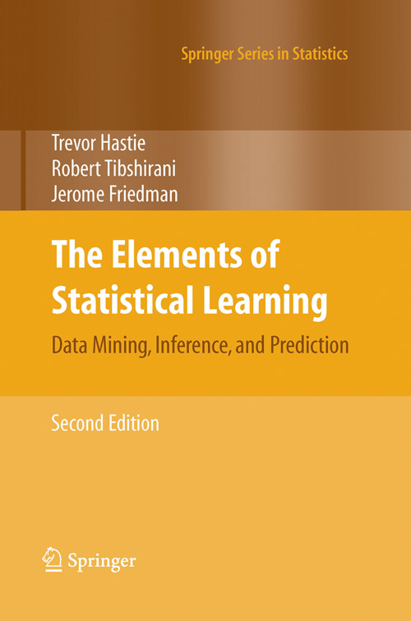

Pointers
Useful book (Free too!):
The Elements of Statistical Learning
Hastie, Tibshirani, Friedman https://web.stanford.edu/~hastie/ElemStatLearn/
Useful set of data:
UCI ML Repository
https://archive.ics.uci.edu/ml/datasets.html

Slide 6
Machine Learning (ML)
Goal: make “sense” of data
Overly simplified version: transform vector x into vector y=T(x) that’s somehow better
Potentially you fit T using pairs of datapoints and desired outputs (x_{i},y_{i}), or just using a set of datapoints (x_{i})
Always are trying to find some transformation that minimizes or maximizes some objective function or goal.

Slide 7
Machine Learning
Input: x
Feature vector/Data point:
Vector representation of datapoint. Each dimension or “feature” represents some aspect of the data.
Output: y
Label / target:
Fixed length vector of desired output. Each dimension represents some aspect of the output data
Supervised: we are given y.
Unsupervised: we are not, and make our own ys.

Slide 8
Example – Health
Input: x in R^{N}
Output: y
50
Blood pressure
P(Has Diabetes)
60
Heart Rate
f(Wx)
P(No Diabetes)
…
0.2
Glucose Level
Intuitive objective function: Want correct category to be likely with our model.

Slide 9
Example – Health
Input: x in R^{N}
Output: y
50
Blood pressure
60
Heart Rate
Wx
Age
…
0.2
Glucose Level
Intuitive objective function: Want our prediction of age to be “close” to true age.

Slide 10
Example – Health
Input: x in R^{N}
Output: discrete y
(unsupervised)
50
Blood pressure
0/1
User group 1
60
Heart Rate
f(x)
0/1
User group 2
…
…
0.2
Glucose Level
0/1
User group K
Intuitive objective function: Want to find K groups that explain the data we see.

Slide 11
Example – Health
Input: x in R^{N}
Output: continuous y (discovered)
50
Blood pressure
0.2
User dimension 1
60
Heart Rate
Wx
1.3
User dimension 2
…
…
0.2
Glucose Level
0.7
User dimension K
Intuitive objective function: Want to K dimensions (often two) that are easier to understand but capture the variance of the data.

Slide 12
Example – Credit Card Fraud
Input: x in R^{N}
Output: y
0
Bought before
P(Fraud)
$12
Amount
f(Wx)
P(No Fraud)
…
Near Billing Address
1
Intuitive objective function: Want correct category to be likely with our model.

Slide 13
Example – Computer Vision
Input: x in R^{N}
Output: y
Pixel at (0,0)
P(Cat)
Pixel at (0,1)
f(Wx)
P(Dog)
…
…
Pixel at (H-1,W-1)
P(Bird)
Intuitive objective function: Want correct category to be likely with our model.

Slide 14
Example – Computer Vision
Input: x in R^{N}
Output: y
f₁(Image)
P(Cat)
f(Wx)
f₂(Image)
P(Dog)
…
…
f_{N}(Image)
P(Bird)
Intuitive objective function: Want correct category to be likely with our model.

Slide 15
Abstractions
Throughout, assume we’ve converted data into a fixed-length feature vector. There are well-designed ways for doing this.
But remember it could be big!
  Image (e.g., 224x224x3): 151K dimensions
  Patch (e.g., 32x32x3) in image: 3072 dimensions

Slide 16
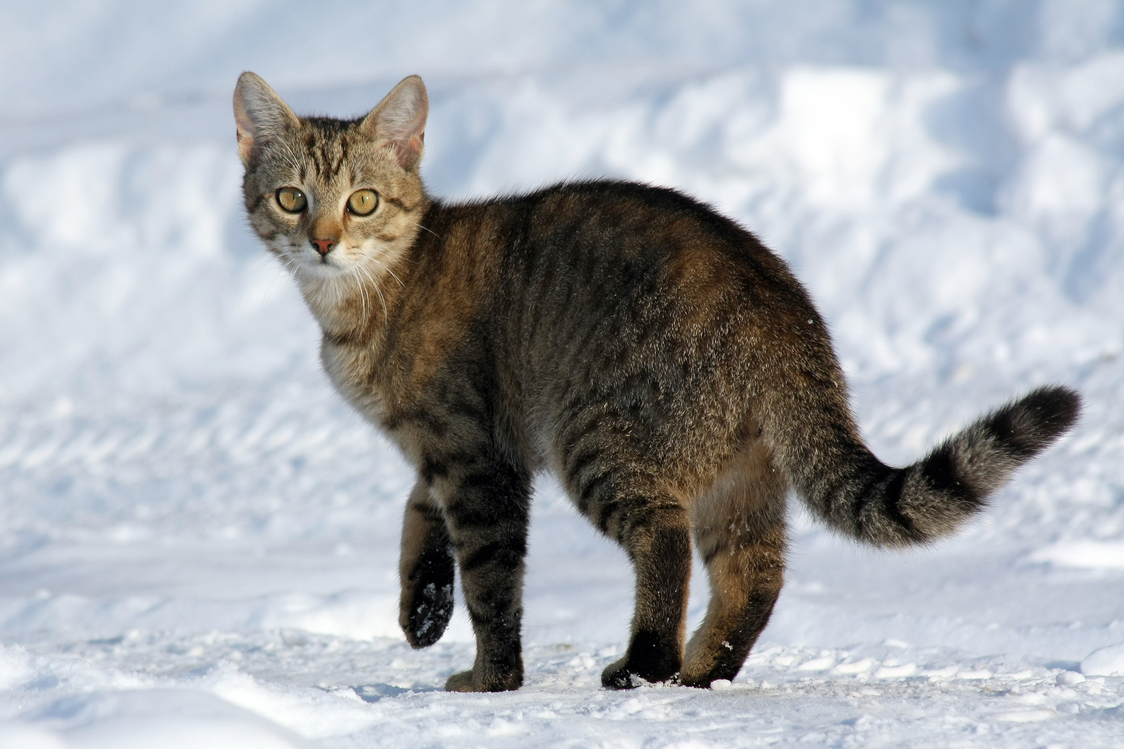
ML Problems in Vision
(Explained via cats)
Image credit: Wikipedia

Slide 17
ML Problem Examples in Vision
Supervised
(Data+Labels)
Unsupervised
(Just Data)
Discrete
Output
Classification/
Categorization
Continuous
Output
Slide adapted from J. Hays

Slide 18
ML Problem Examples in Vision
Categorization/Classification
Binning into K mutually-exclusive categories
0.9
P(Cat)
0.1
P(Dog)
…
0.0
P(Bird)
Image credit: Wikipedia

Slide 19
ML Problem Examples in Vision
Supervised
(Data+Labels)
Unsupervised
(Just Data)
Discrete
Output
Classification/
Categorization
Continuous
Output
Regression
Slide adapted from J. Hays

Slide 20
ML Problem Examples in Vision
Regression
Estimating continuous variable(s)
3.6
kg
Cat weight
Image credit: Wikipedia

Slide 21
ML Problem Examples in Vision
Supervised
(Data+Labels)
Unsupervised
(Just Data)
Discrete
Output
Classification/
Categorization
Clustering
Continuous
Output
Regression
Slide adapted from J. Hays

Slide 22
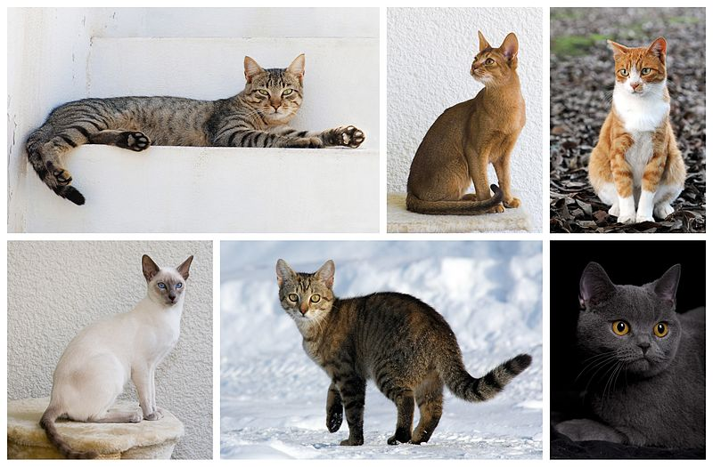
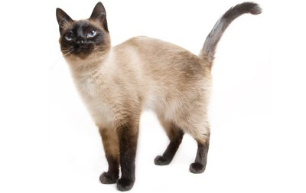

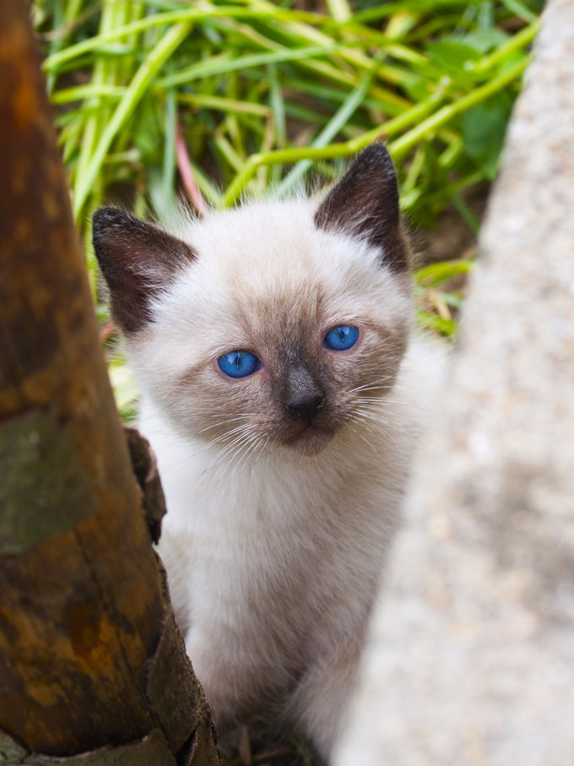
ML Problem Examples in Vision
Clustering
Given a set of cats, automatically discover clusters or categories.
1
2
3
4
5
6
Image credit: Wikipedia, cattime.com

Slide 23
ML Problem Examples in Vision
Supervised
(Data+Labels)
Unsupervised
(Just Data)
Discrete
Output
Classification/
Categorization
Clustering
Continuous
Output
Dimensionality
Reduction
Regression
Slide adapted from J. Hays

Slide 24
ML Problem Examples in Vision
Dimensionality Reduction
Find dimensions that best explain
the whole image/input
Cat size in image
Location of cat in image
For ordinary images, this is currently a totally hopeless task. For certain images (e.g., faces, this works reasonably well)
Image credit: Wikipedia

Slide 25
Practical Example
ML has a tendency to be mysterious
Let’s start with least-squares
One thing to remember:
  N eqns, <N vars = overdetermined (will have errors)
  N eqns, N vars = exact solution
  N eqns, >N vars = underdetermined (infinite solns)

Slide 26
Example – Least Squares
Let’s make the world’s worst weather model
Data: (x₁,y₁), (x₂,y₂), …, (x_{k},y_{k})
Model: (m,b) y_{i}=mx_{i}+b
Or (w) y_{i} = w^{T}x_{i}
Objective function:
(y_{i} - w^{T}x_{i})²

Slide 27
World’s Worst Weather Model
Given latitude (distance above equator), predict temperature by fitting a line
City
Latitude (°)
Temp (F)
Temp
Ann Arbor
42
33
Washington, DC
39
38
Austin, TX
30
62
Mexico City
19
67
Latitude
Panama City
9
83

Slide 28


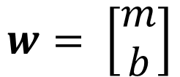
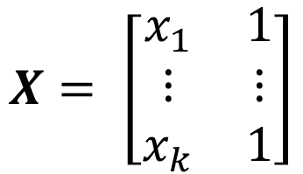
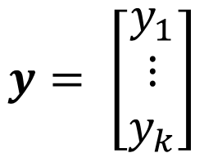
Example – Least Squares
$$\sum_{i=1}^{k}{{\left(y_{i}−w^{T}x_{i}\right)}^{2}}$$
$${\left\|y−Xw\right\|}_{2}^{2}$$
Output:
Temperature
Inputs:
Latitude, 1
Model/Weights:
Latitude, “Bias”
$$y= \left[\begin{matrix}y_{1} \\ ⋮ \\ y_{k}\end{matrix}\right]$$
$$X= \left[\begin{matrix}x_{1} & 1 \\ ⋮ & ⋮ \\ x_{k} & 1\end{matrix}\right]$$
$$w= \left[\begin{matrix}m \\ b\end{matrix}\right]$$

Slide 29
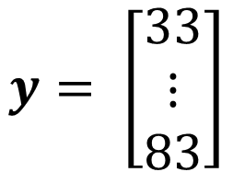
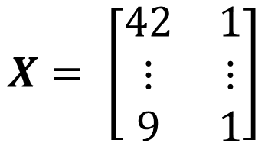
Example – Least Squares
$$\sum_{i=1}^{k}{{\left(y_{i}−w^{T}x_{i}\right)}^{2}}$$
$${\left\|y−Xw\right\|}_{2}^{2}$$
Output:
Temperature
Inputs:
Latitude, 1
Model/Weights:
Latitude, “Bias”
$$y= \left[\begin{matrix}33 \\ ⋮ \\ 83\end{matrix}\right]$$
$$X= \left[\begin{matrix}42 & 1 \\ ⋮ & ⋮ \\ 9 & 1\end{matrix}\right]$$
$$w= \left[\begin{matrix}m \\ b\end{matrix}\right]$$
Intuitively why do we add
a one to the inputs?

Slide 30

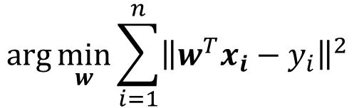

Example – Least Squares
$$\arg{\min_{w}{{\left\|y−Xw\right\|}_{2}^{2}}}$$
or
Training (x_{i},y_{i}):
$$\arg{\min_{w}{\sum_{i=1}^{n}{{\left\|w^{T}x_{i}−y_{i}\right\|}^{2}}}}$$
Loss function/objective: evaluates correctness.
Here: Squared L2 norm / Sum of Squared Errors
Training/Learning/Fitting: try to find model that optimizes/minimizes an objective / loss function
Optimal w* is
$$w^{∗}= {\left(X^{T}X\right)}^{−1}X^{T}y$$

Slide 31
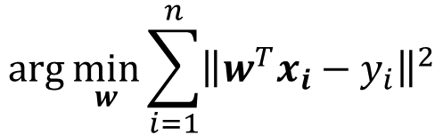

Example – Least Squares
$$\arg{\min_{w}{{\left\|y−Xw\right\|}_{2}^{2}}}$$
or
Training (x_{i},y_{i}):
$$\arg{\min_{w}{\sum_{i=1}^{n}{{\left\|w^{T}x_{i}−y_{i}\right\|}^{2}}}}$$
Inference (x):
$$w^{T}x=w_{1}x_{1}+⋯+w_{F}x_{F}$$
Testing/Inference: Given a new output,
what’s the prediction?

Slide 32
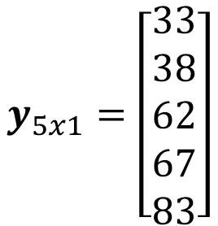
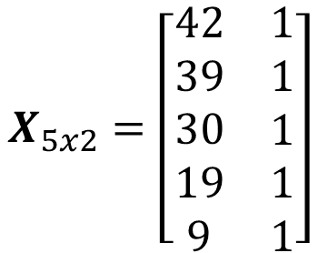
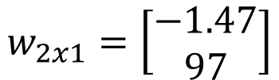

Least Squares: Learning
Data
Model
City
Latitude
Temp
Ann Arbor
42
33
Washington, DC
39
38
Temp =
-1.47*Lat + 97
Austin, TX
30
62
Mexico City
19
67
Panama City
9
83
$$X_{5x2}=\left[\begin{matrix}\begin{aligned}42 \\ 39 \\ 30 \\ 19 \\ 9\end{aligned} & \begin{aligned}1 \\ 1 \\ 1 \\ 1 \\ 1\end{aligned}\end{matrix}\right]$$
$$y_{5x1}=\left[\begin{aligned}33 \\ 38 \\ 62 \\ 67 \\ 83\end{aligned}\right]$$
$${\left(X^{T}X\right)}^{−1}X^{T}y$$
$$w_{2x1}=\left[\begin{aligned}−1.47 \\ 97\end{aligned}\right]$$

Slide 33

Let’s Predict The Weather
EECS 442
City
Latitude
Temp
Temp
Error
Ann Arbor
42
33
35.3
2.3
Washington, DC
39
38
39.7
1.7
Austin, TX
30
62
52.9
10.9
Mexico City
19
67
69.1
2.1
Panama City
9
83
83.8
0.8

Slide 34

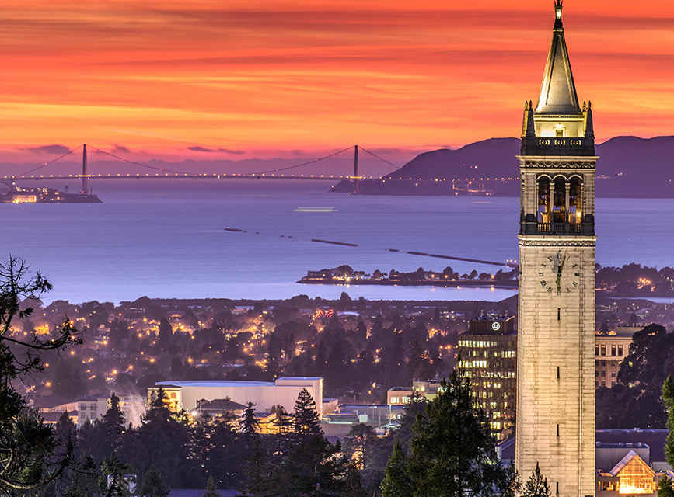

Is This a Minimum Viable Product?
EECS 442
Pittsburgh:
Temp = -1.47*40 + 97 = 38
Actual Pittsburgh:
45
Berkeley:
Temp = -1.47*38 + 97 = 41
Actual Berkeley:
53
Sydney:
Temp = -1.47*-33 + 97 = 146
Actual Sydney:
74
Won’t do so well in the Australian market…

Slide 35
Where Can This Go Wrong?

Slide 36
Where Can This Go Wrong?
Data
Model
City
Latitude
Temp
Temp =
-1.66*Lat + 103
Ann Arbor
42
33
Washington, DC
39
38
How well can we predict Ann Arbor and DC and why?

Slide 37
Always Need Separated Testing
Model might be fit data too precisely “overfitting”
Remember: #datapoints = #params = perfect fit
Model may only work under some conditions (e.g., trained on northern hemisphere).
Sydney:
Temp = -1.47*-33 + 97 = 146

Slide 38
Training and Testing
Fit model parameters on training set;
evaluate on entirely unseen test set.
Training
Test
“It’s tough to make predictions, especially about the future”
-Yogi Berra
Nearly any model can predict data it’s seen. If your model can’t accurately interpret “unseen” data, it’s probably useless. We have no clue whether it has just memorized.

Slide 39


Let’s Improve Things
If one feature does ok, what about more features!?
City
Name
Latitude
(deg)
Avg July
High (F)
Avg
Snowfall
Temp
(F)
Ann Arbor
42
83
58
33
Washington, DC
39
88
15
38
Austin, TX
30
95
0.6
62
Mexico City
19
74
0
67
Panama City
9
93
0
83
$$X_{5x4}$$
4 features + a feature of 1s for intercept/bias
$$y_{5x1}$$

Slide 40




Let’s Improve Things
All the math works out!
Data
$$w^{∗}= {\left(X^{T}X\right)}^{−1}X^{T}y$$
Model
$$X_{5x4}$$
$$y_{5x1}$$
$$w_{4x1}$$
New EECS 442 Weather Rule:
w₁*latitude + w₂*(avg July high) +
w₃*(avg snowfall) + w₄*1
In general called linear regression

Slide 41

Let’s Improve Things More
If one feature does ok, what about LOTS of features!?
City
Name
Latitude
(deg)
Avg July
High (F)
Avg
Snowfall
Day of Year
Elevation
(ft)
% Letter
M
Temp
(F)
Ann Arbor
42
83
58
45
840
100
33
Washington, DC
39
88
15
45
409
3
38
Austin, TX
30
95
0.6
45
489
2
62
Mexico City
19
74
0
45
7200
4
67
Panama City
9
93
0
45
7
1
83
$$X_{5x7}$$
6 features + a feature of 1s for intercept/bias
$$y_{5x1}$$

Slide 42




Let’s Improve Things More
Data
$$w^{∗}= {\left(X^{T}X\right)}^{−1}X^{T}y$$
Model
$$X_{5x7}$$
$$y_{5x1}$$
$$w_{7x1}$$
$$w^{∗}={\left(X^{T}X\right)}^{−1}X^{T}y$$
X^{T}X is a 7x7 matrix but is rank deficient (rank 5) and has no inverse. There are an infinite number of solutions.
Have to express some preference for which of the infinite solutions we want.
Exercise for the mathematically-inclined folks: derive what the space of solutions looks like.

Slide 43


The Fix – Regularized Least Squares
Add regularization to objective that prefers some solutions:
Before:
$$\arg{\min_{w}{{\left\|y−Xw\right\|}_{2}^{2}}}$$
Loss
After:
$$\arg{\min_{w}{{\left\|y−Xw\right\|}_{2}^{2}+λ{\left\|w\right\|}_{2}^{2}}}$$
Loss
Trade-off
Regularization
Want model “smaller”: pay a penalty for w with big norm
Intuitive Objective: accurate model (low loss) but not too complex (low regularization). λ controls how much of each.

Slide 44


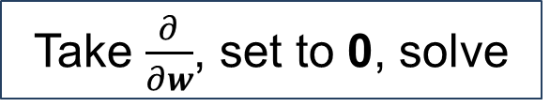
The Fix – Regularized Least Squares
Objective:
$$\arg{\min_{w}{{\left\|y−Xw\right\|}_{2}^{2}+λ{\left\|w\right\|}_{2}^{2}}}$$
Loss
Trade-off
Regularization
Take $\frac{∂}{∂w}$, set to 0, solve
$$w^{∗}={\left(X^{T}X+λI\right)}^{−1}X^{T}y$$
X^{T}X+λI is full-rank (and thus invertible) for λ>0
Called lots of things: regularized least-squares, Tikhonov regularization (after Andrey Tikhonov), ridge regression, Bayesian linear regression with a multivariate normal prior.

Slide 45
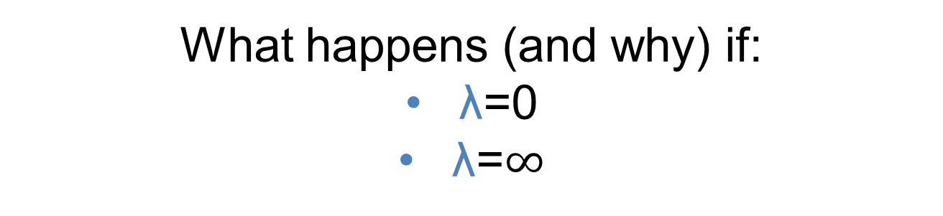


The Fix – Regularized Least Squares
Objective:
$$\arg{\min_{w}{{\left\|y−Xw\right\|}_{2}^{2}+λ{\left\|w\right\|}_{2}^{2}}}$$
Loss
Trade-off
Regularization
What happens (and why) if:
λ=0
λ=$∞$
Least-squares
Something sensible?
w=0
?
$$0$$
$$∞$$

Slide 46
Training and Testing
Fit model parameters on training set;
evaluate on entirely unseen test set.
Training
Test
How do we pick λ?

Slide 47
Training and Testing
Fit model parameters on training set;
find hyperparameters by testing on validation set;
evaluate on entirely unseen test set.
Training
Validation
Test
Use these data
points to fit
w*=(X^{T}X+ λI )⁻¹X^{T}y
Evaluate on these points for different λ, pick the best

Slide 48
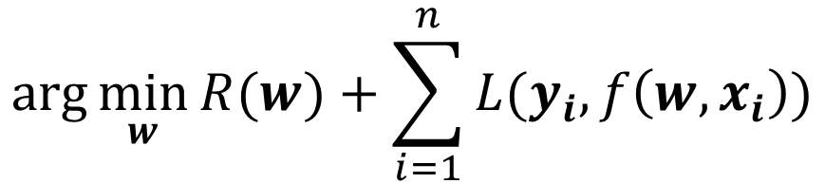
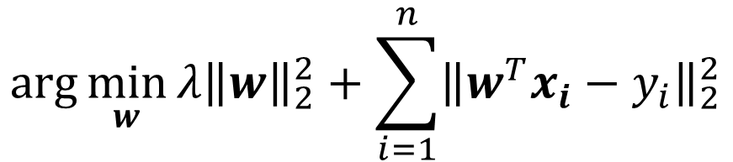
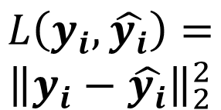


General Formula
Specific
Formulation
$$\arg{\min_{w}{{λ\left\|w\right\|}_{2}^{2}+\sum_{i=1}^{n}{{\left\|w^{T}x_{i}−y_{i}\right\|}_{2}^{2}}}}$$
General
Recipe
$$\arg{\min_{w}{R(w)+\sum_{i=1}^{n}{L(y_{i},f\left({w,x}_{i}\right))}}}$$
Regularization
Evaluation
Loss
$$R\left(w\right)=λ{\left\|w\right\|}_{2}^{2}$$
$$f\left({w,x}_{i}\right)=w^{T}x_{i}$$
$$L\left(y_{i},\hat{y_{i}}\right)=$$
$${\left\|y_{i}−\hat{y_{i}}\right\|}_{2}^{2}$$

Slide 49

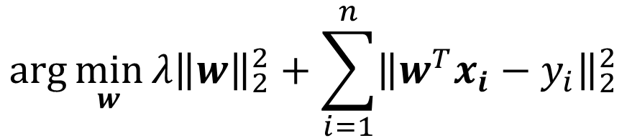



Terminology
$$\arg{\min_{w}{{λ\left\|w\right\|}_{2}^{2}+\sum_{i=1}^{n}{{\left\|w^{T}x_{i}−y_{i}\right\|}_{2}^{2}}}}$$
$$x$$
Inputs, features, Xs, data
$$y$$
Outputs, targets, labels, ys
$$w$$
Weights, weight vector, parameters, params
Trade-off parameters, regularization strength
$$λ$$

Slide 50
Classification
Start with simplest example: binary classification
x₁
x₂
Cat or not cat?
…
x_{N}
Actually: a feature vector representing the image

Slide 51
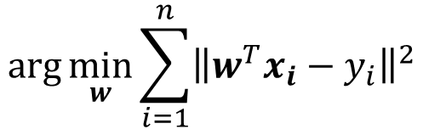

Classification by Least-Squares
Treat as regression: x_{i} is image feature; y_{i} is 1 if it’s a cat, 0 if it’s not a cat. Minimize least-squares loss.
$$\arg{\min_{w}{\sum_{i=1}^{n}{{\left\|w^{T}x_{i}−y_{i}\right\|}^{2}}}}$$
Training (x_{i},y_{i}):
Inference (x):
$$w^{T}x>t$$
Unprincipled in theory, but often effective in practice
The reverse (regression via discrete bins) is also common
Rifkin, Yeo, Poggio. Regularized Least Squares Classification (http://cbcl.mit.edu/publications/ps/rlsc.pdf). 2003
Redmon, Divvala, Girshick, Farhadi. You Only Look Once: Unified, Real-Time Object Detection. CVPR 2016.

Slide 52
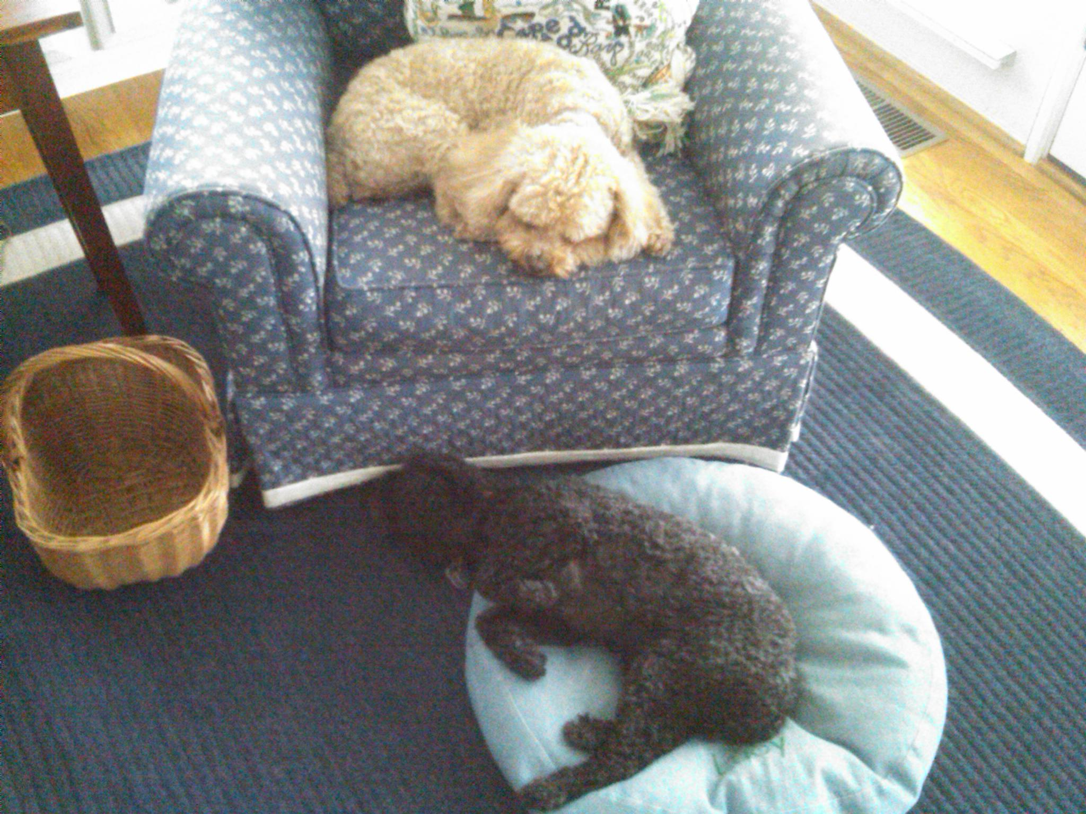
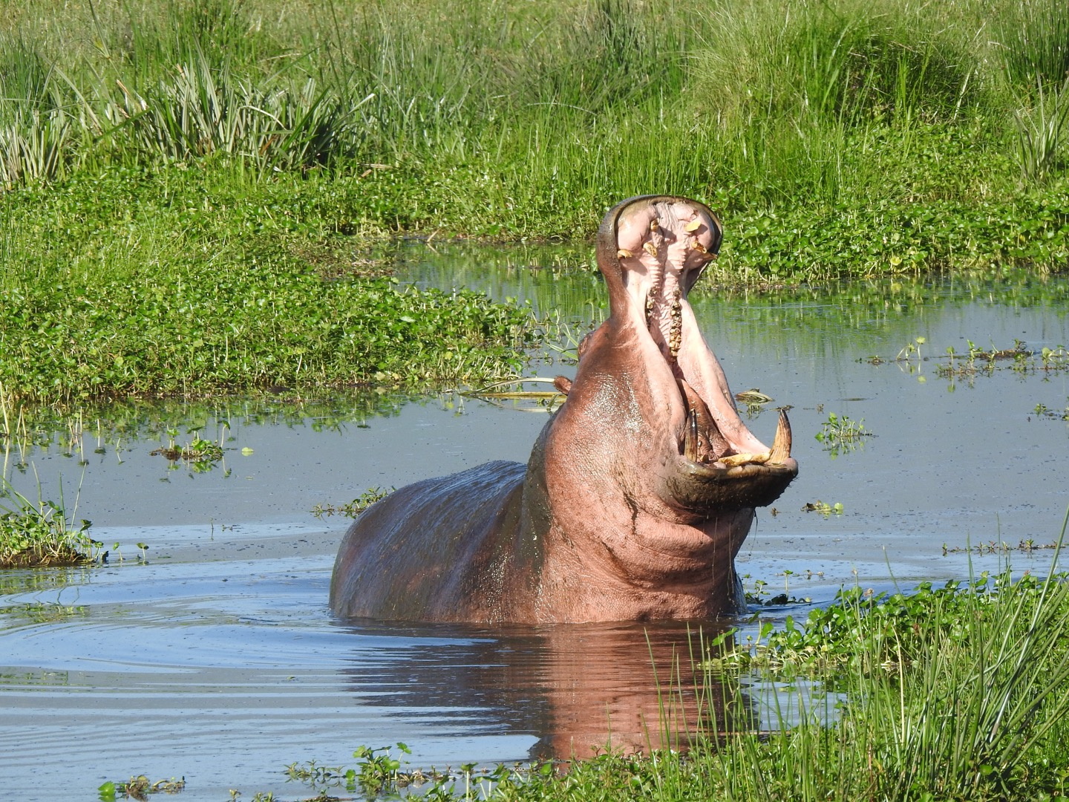
Easiest Form of Classification
Just memorize (as in a Python dictionary)
Consider cat/dog/hippo classification.
If this:
cat.
If this:
dog.
If this:
hippo.

Slide 53

Easiest Form of Classification
Where does this go wrong?
Rule: if this,
then cat
Hmmm. Not quite the same.

Slide 54





Easiest Form of Classification
Known Images
Labels
Test
Image
$$x_{1}$$
$$D(x_{1},x_{T})$$
$$x_{T}$$
Cat
Cat!
…
$$D(x_{N},x_{T})$$
(1) Compute distance between feature vectors (2) find nearest (3) use label.
$$x_{N}$$
Dog

Slide 55
Nearest Neighbor
“Algorithm”
Training (x_{i},y_{i}):
Memorize training set
Inference (x):
bestDist, prediction = Inf, None
for i in range(N):
if dist(x_{i},x) < bestDist:
bestDist = dist(x_{i},x)
prediction = y_{i}

Slide 56
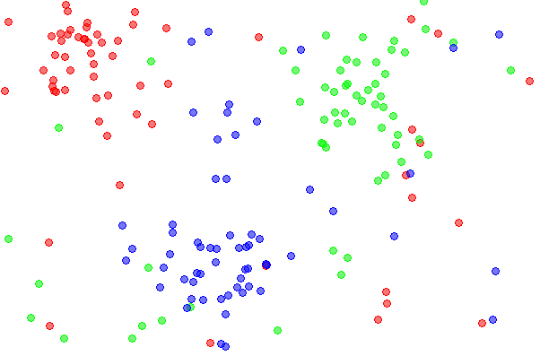
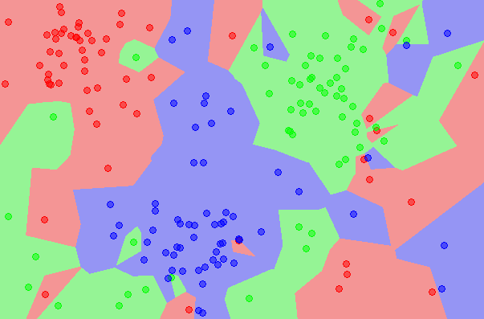
Nearest Neighbor
2D Datapoints
(colors = labels)
2D Predictions
(colors = labels)
Diagram Credit: Wikipedia

Slide 57
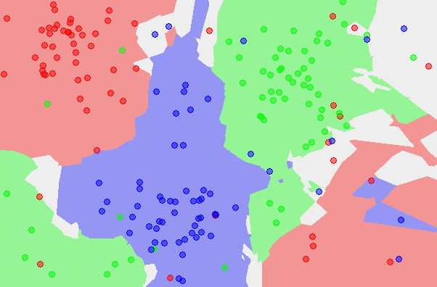
K-Nearest Neighbors
Take top K-closest points, vote
2D Datapoints
(colors = labels)
2D Predictions
(colors = labels)
Diagram Credit: Wikipedia

Slide 58
K-Nearest Neighbors
What distance? What value for K?
Training
Validation
Test
Use these data
points for lookup
Evaluate on these points for different k, distances

Slide 59
K-Nearest Neighbors
No learning going on but usually effective
Same algorithm for every task
As number of datapoints → ∞, error rate is guaranteed to be at most 2x worse than optimal you could do on data

Slide 60





Linear Models
Example Setup: 3 classes
Model – one weight per class:
$$w_{0},w_{1}, w_{2}$$
$$w_{0}^{T}x$$
big if cat
$$w_{1}^{T}x$$
big if dog
$$w_{2}^{T}x$$
big if hippo
Stack together:
$$W_{3xF}$$
where x is in R^{F}

Slide 61



Linear Models
Cat weight vector
0.2
-0.5
0.1
2.0
1.1
56
-96.8
Cat score
Dog weight vector
1.5
1.3
2.1
0.0
3.2
231
437.9
Dog score
Hippo weight vector
0.0
0.3
0.2
-0.3
-1.2
24
61.95
Hippo score
2
$$W$$
$$Wx_{i}$$
1
Weight matrix a collection of scoring functions, one per class
Prediction is vector where jth component is “score” for jth class.
$$x_{i}$$
Diagram by: Karpathy, Fei-Fei

Slide 62
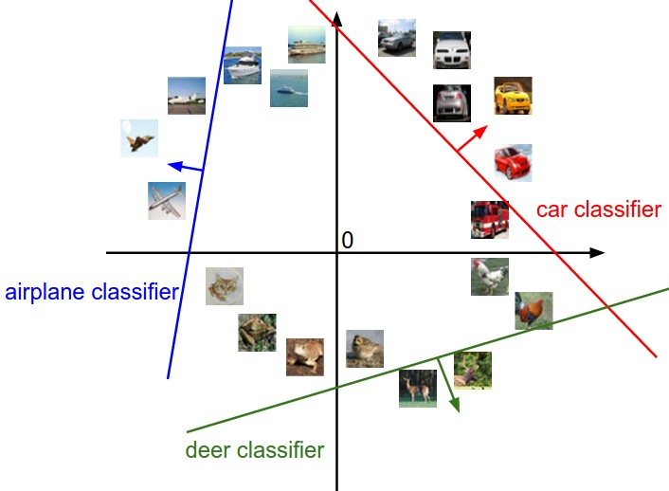
Geometric Intuition*
What does a linear classifier look like* in 2D?
*2D is good for vague intuitions, but ML typically deals with at least dozens if not thousands of dimensions. Your intuitions about space and geometry from living in 3D are completely wrong in high dimensions. Never trust people who show you 2D diagrams and write “Intuition” in the slide title. See: On the Surprising Behavior of Distance Metrics in High Dimensional Space. Charu, Hinneburg, Keim. ICDT 2001
Diagram credit: Karpathy & Fei-Fei. 12-point font mini-rant: me

Slide 63
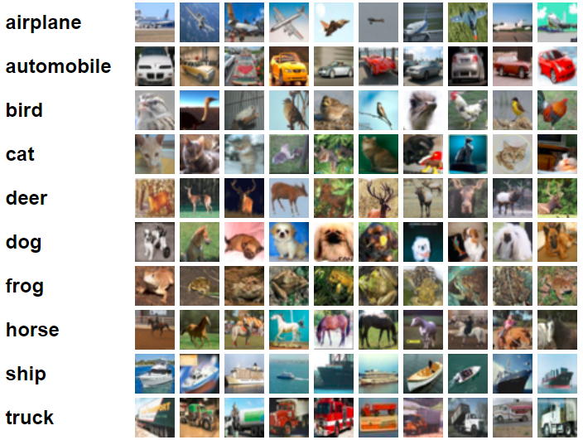
Visual Intuition
CIFAR 10:
32x32x3 Images, 10 Classes
Turn each image into feature by unrolling all pixels
Fit 10 linear models
Slide credit: Karpathy & Fei-Fei

Slide 64

Guess The Classifier
Decision rule is w^{T}x. If w_{i} is big, then big values of x_{i} are indicative of the class.
Deer or Plane?
Diagram credit: Karpathy & Fei-Fei

Slide 65
Guess The Classifier
Decision rule is w^{T}x. If w_{i} is big, then big values of x_{i} are indicative of the class.
Ship or Dog?
Diagram credit: Karpathy & Fei-Fei

Slide 66
Interpreting a Linear Classifier
Decision rule is w^{T}x. If w_{i} is big, then big values of x_{i} are indicative of the class.
Diagram credit: Karpathy & Fei-Fei

Slide 67
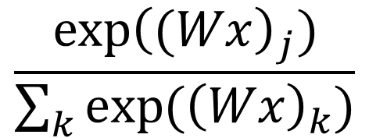
Preliminaries
Converting Scores to “Probability Distribution”
Cat score
-0.9
e^{-0.9}
0.41
0.11
P(cat)
Dog score
0.4
exp(x)
e^{0.4}
1.49
Norm
0.40
P(dog)
Hippo score
0.6
e^{0.6}
1.82
0.49
P(hippo)
∑=3.72
$$\frac{\exp{{\left((Wx\right)}_{j})}}{\sum_{k}{\exp{({\left(Wx\right)}_{k})}}}$$
Generally P(class j):

Slide 68
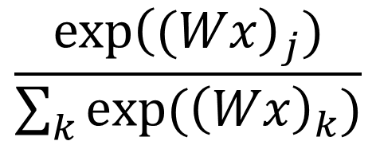

Softmax
(Take the class whose weight vector gives the highest score)
Inference (x):
$$\arg{\max_{k}{ }{\left(Wx\right)}_{k}}$$
$$\frac{\exp{{\left((Wx\right)}_{j})}}{\sum_{k}{\exp{({\left(Wx\right)}_{k})}}}$$
P(class j):
Why can we skip the exp/sum exp
thing to make a decision?

Slide 69
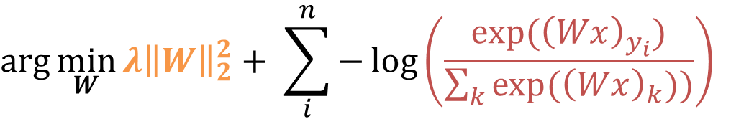
Softmax
(Take the class whose weight vector gives the highest score)
Inference (x):
$$\arg{\max_{k}{ }{\left(Wx\right)}_{k}}$$
Training (x_{i},y_{i}):
P(correct class)
$$\arg{\min_{W}{λ{\left\|W\right\|}_{2}^{2}+ \sum_{i}^{n}{−\log\left(\frac{\exp{({\left(Wx\right)}_{y_{i}})}}{\sum_{k}{exp⁡({\left(Wx\right)}_{k}))}}\right)}}}$$
Regularization
Over all data points
Pay penalty for negative log-likelihood of correct class

Slide 70
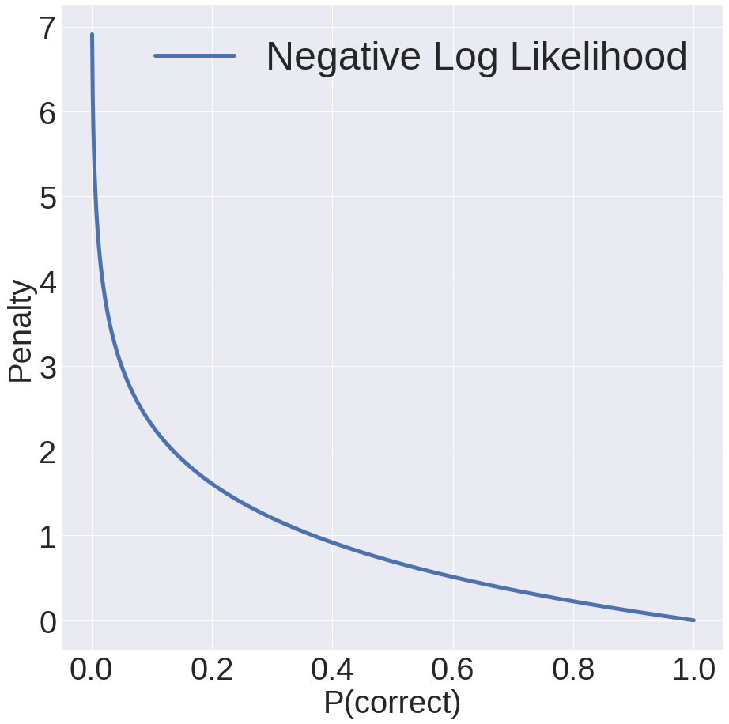
Softmax
P(correct) = 0.05:
3.0 penalty
P(correct) = 0.5:
0.11 penalty
P(correct) = 0.9:
0.11 penalty
P(correct) = 1:
No penalty!

Slide 71
Next Class
How do we optimize more complex stuff?
A bit more ML

Slide 73
Other Stuff
I used to include this objective (multiclass SVM)
It’s worth seeing if you’re curious, but class is a zero-sum game, and I think other things are a better use of your time

Slide 74
Objective 1: Multiclass SVM
(Take the class whose weight vector gives the highest score)
Inference (x):
$$\arg{\max_{k}{ }{\left(Wx\right)}_{k}}$$

Slide 75
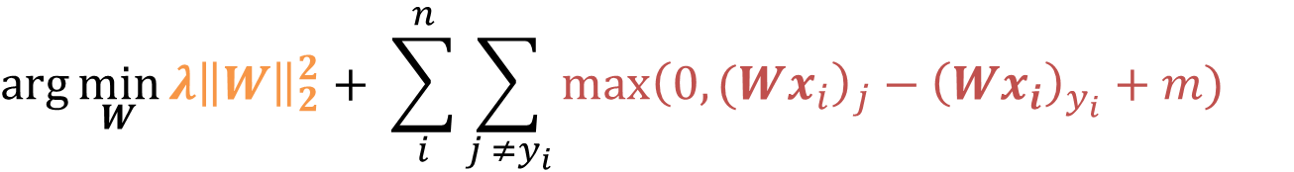
Objective 1: Multiclass SVM
(Take the class whose weight vector gives the highest score)
Inference (x):
$$\arg{\max_{k}{ }{\left(Wx\right)}_{k}}$$
Training (x_{i},y_{i}):
$$\arg{\min_{W}{λ{\left\|W\right\|}_{2}^{2}+ \sum_{i}^{n}{\sum_{j ≠y_{i}}{\max{{\left(0,(Wx_{i}\right)}_{j}−{\left(Wx_{i}\right)}_{y_{i}}+m)}}}}}$$
Regularization
Pay no penalty if prediction for class yi is bigger than j by m (“margin”). Otherwise, pay proportional to the score of the wrong class.
Over all data points
For every class j that’s NOT the correct one (y_{i})

Slide 76
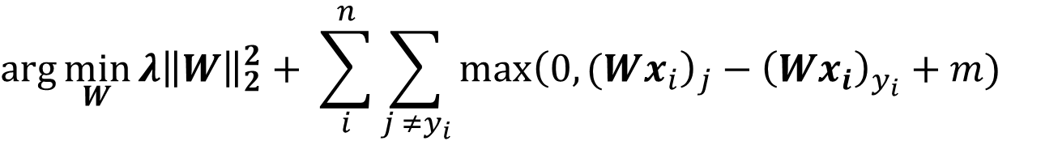
Objective: Multiclass SVM
How on earth do we optimize:
$$\arg{\min_{W}{λ{\left\|W\right\|}_{2}^{2}+ \sum_{i}^{n}{\sum_{j ≠y_{i}}{\max{{\left(0,(Wx_{i}\right)}_{j}−{\left(Wx_{i}\right)}_{y_{i}}+m)}}}}}$$
Hold that thought!

