Slide 1
Intro &
Cameras
EECS 442 – David Fouhey
Winter 2023, University of Michigan
https://web.eecs.umich.edu/~fouhey/teaching/EECS442_W23/

Slide 2
Welcome!

Slide 3
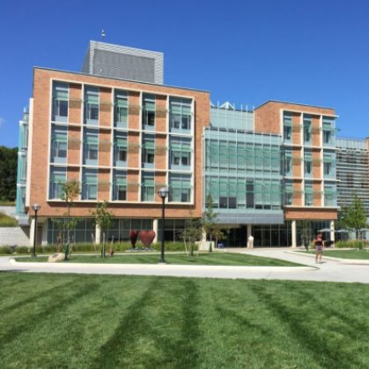
Goals of Computer Vision
Get a computer to understand

Slide 4
Goal: Naming
Building
Person
Grass

Slide 5
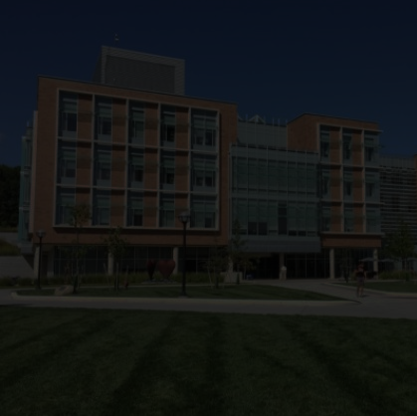
Goal: Naming
The picture shows a building with many windows and grass in front of it. There is a person walking on the right…

Slide 6
Goal: 3D
∞

Slide 7
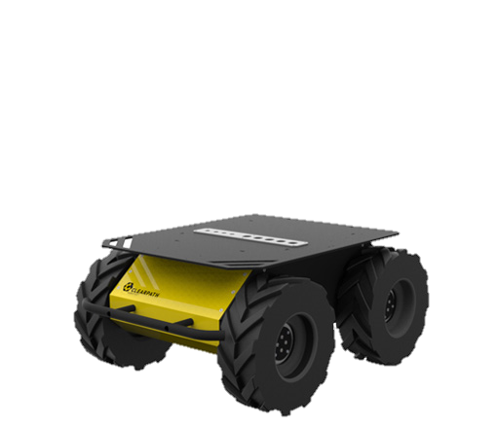
Goal: Actions
What can I
do here?

Slide 8
Seems Obvious, Right?
Key concept to keep in mind throughout the course: you see with both your eyes and your brain.

Slide 9

Why is it Hard?

Slide 11
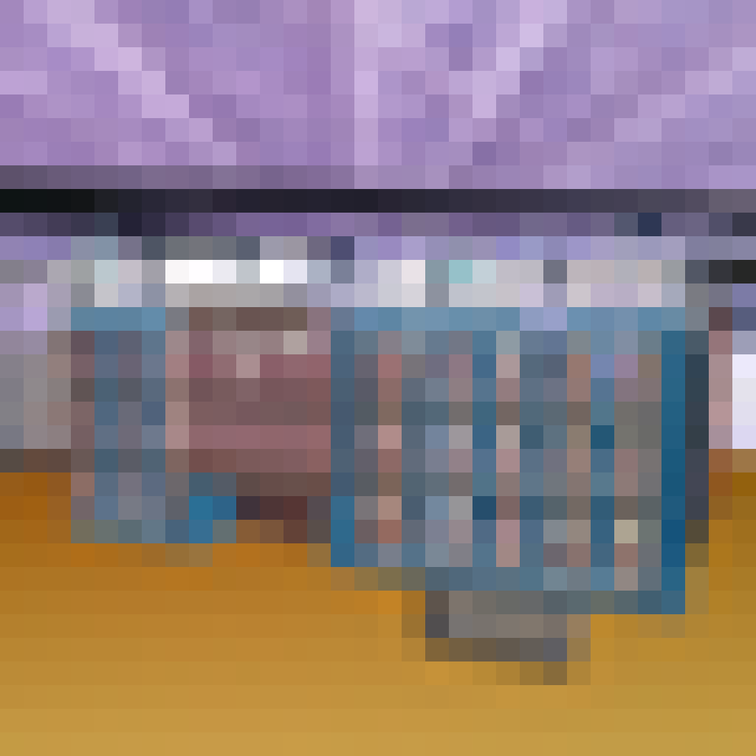
Why is it Hard?

Slide 12

Why is it Hard?

Slide 13
Despite This, We’ve Made Progress
Few of these problems are solved (and there are lots of dangers to pretending things are solved when they aren’t)
But we do have systems with performance ranging from non-embarrassing to super-human (with the right caveats)

Slide 14
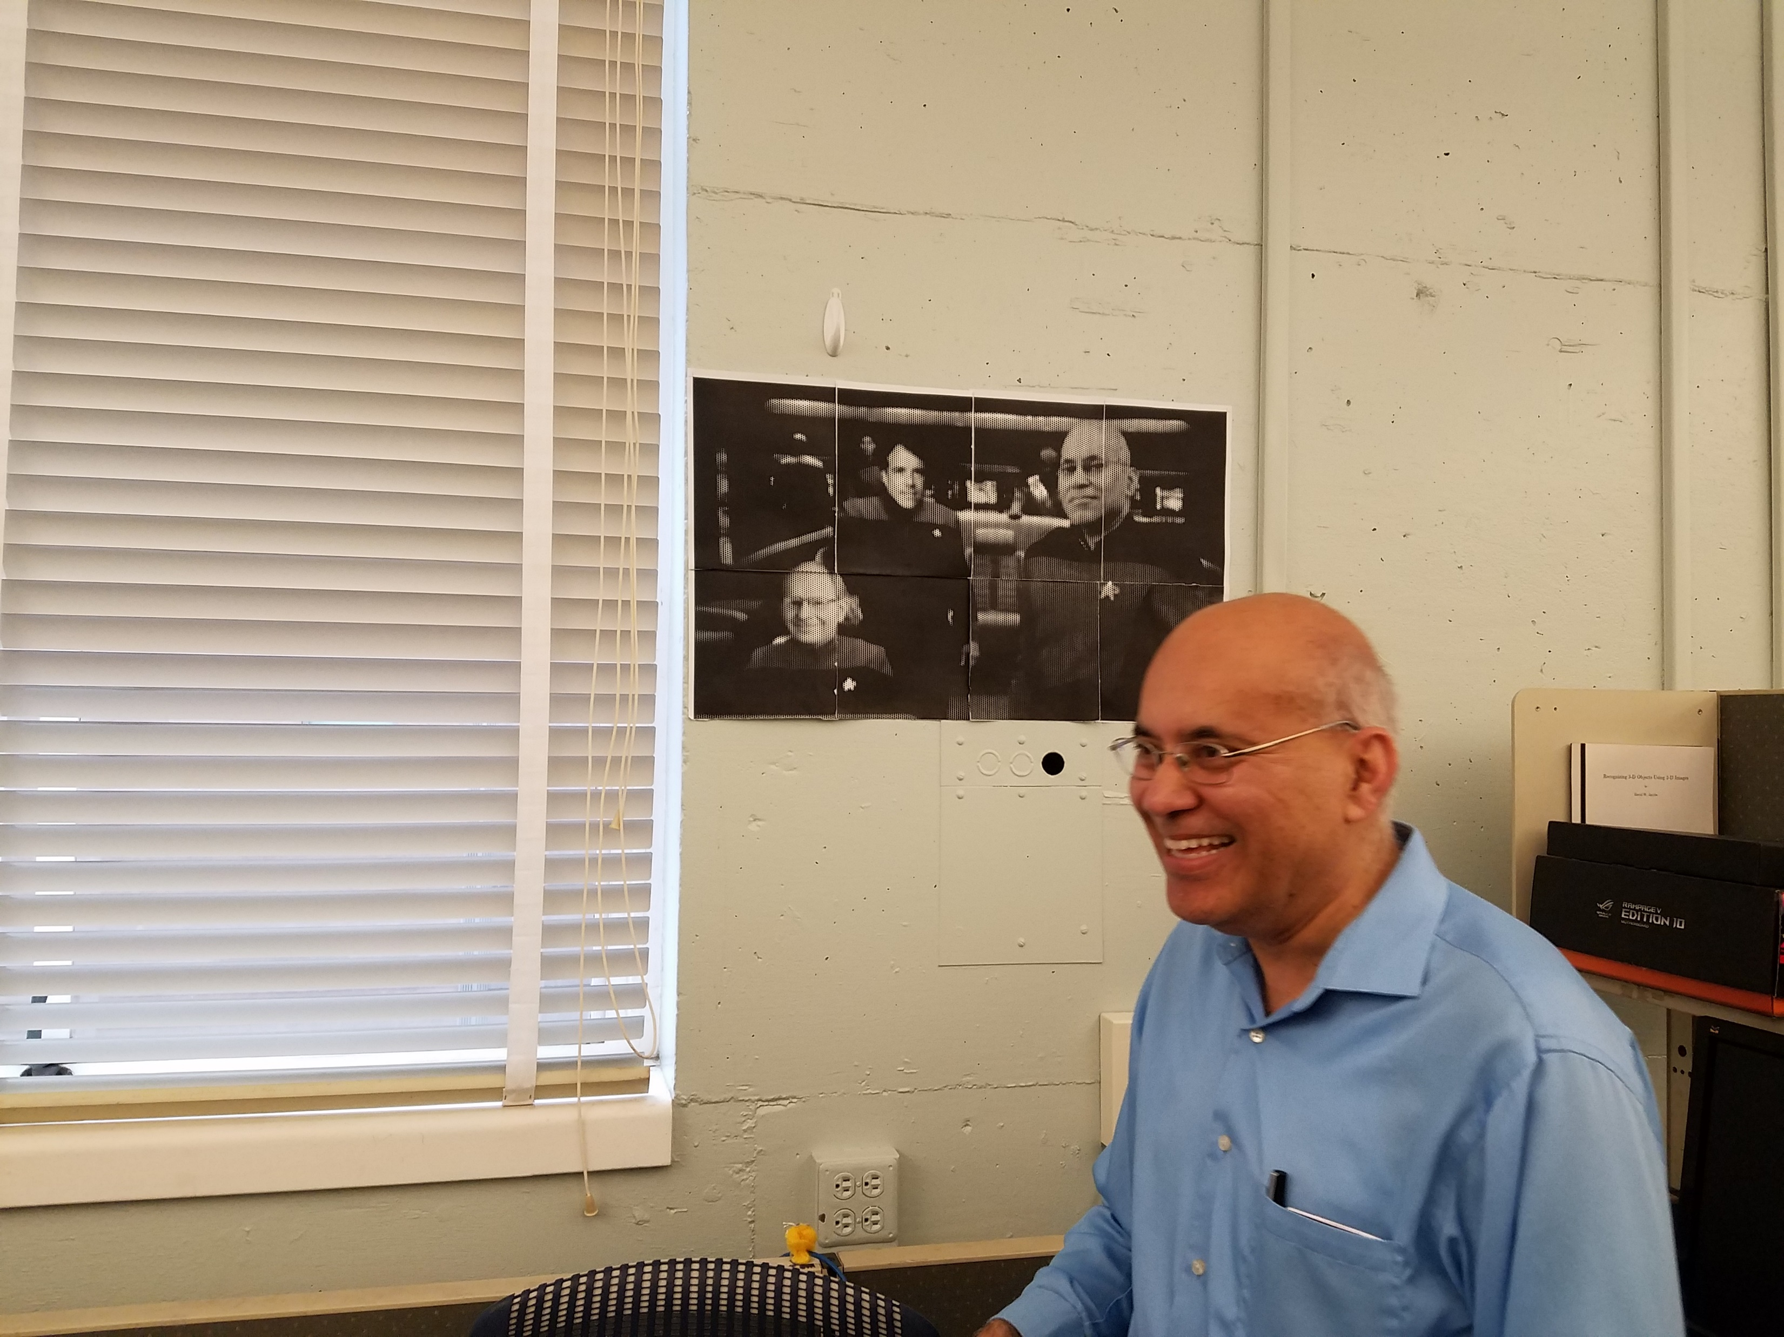
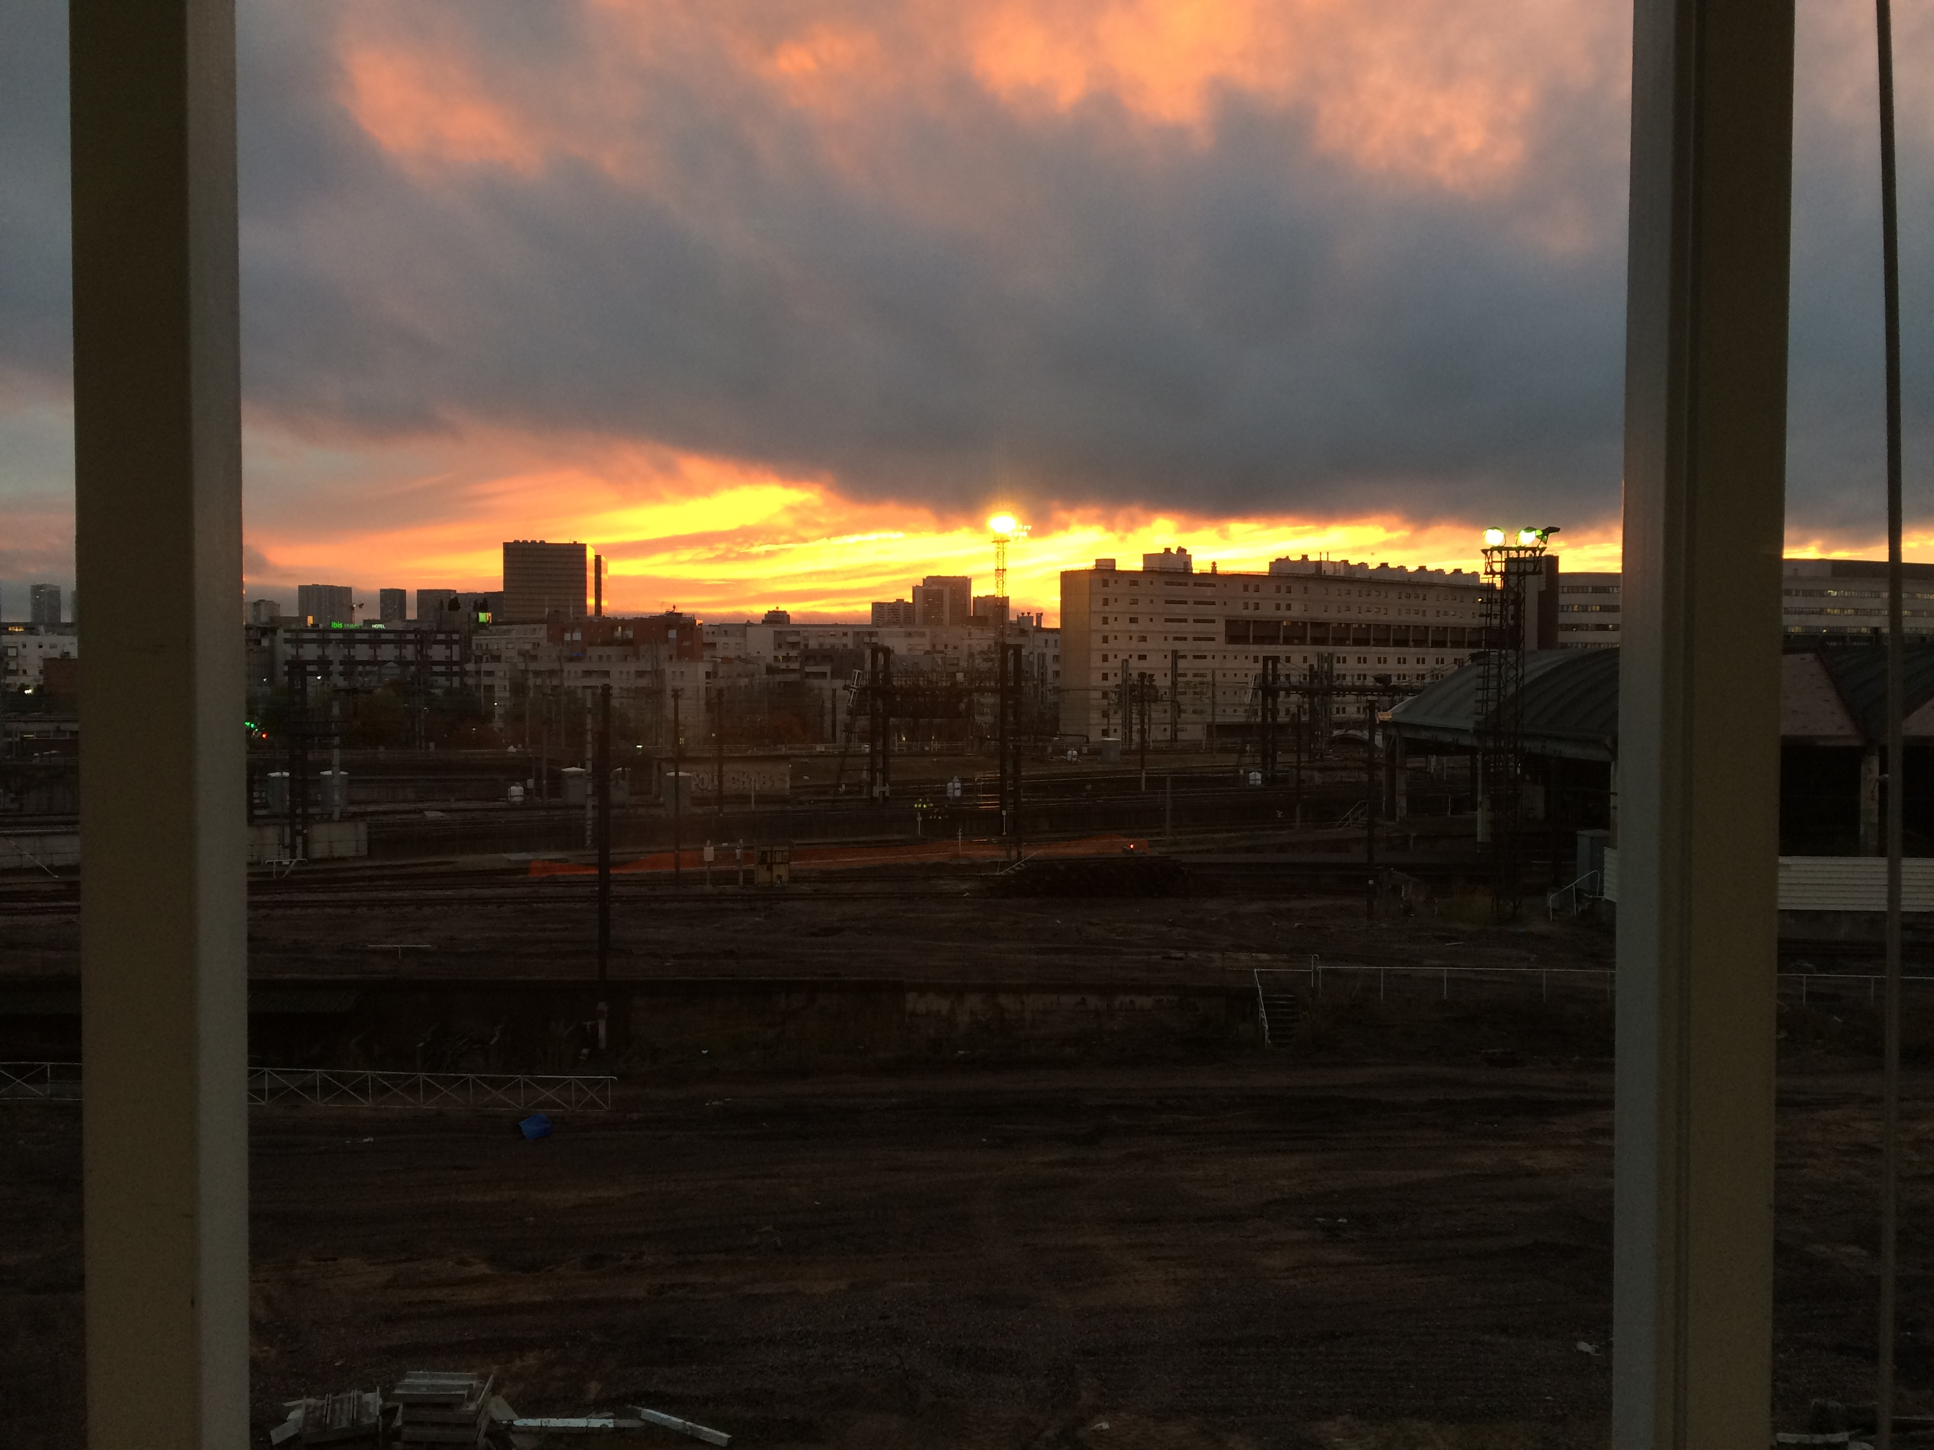
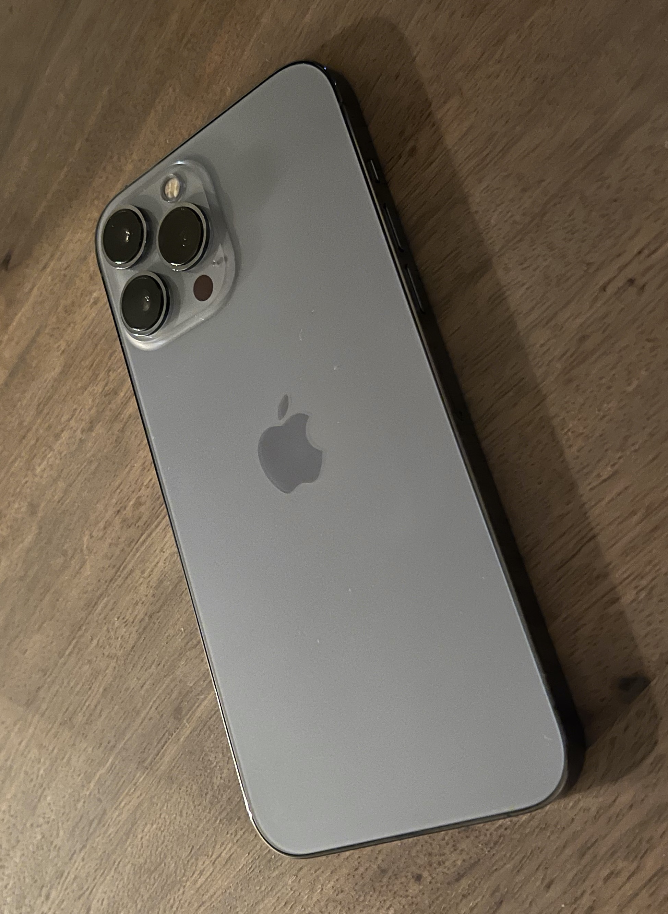
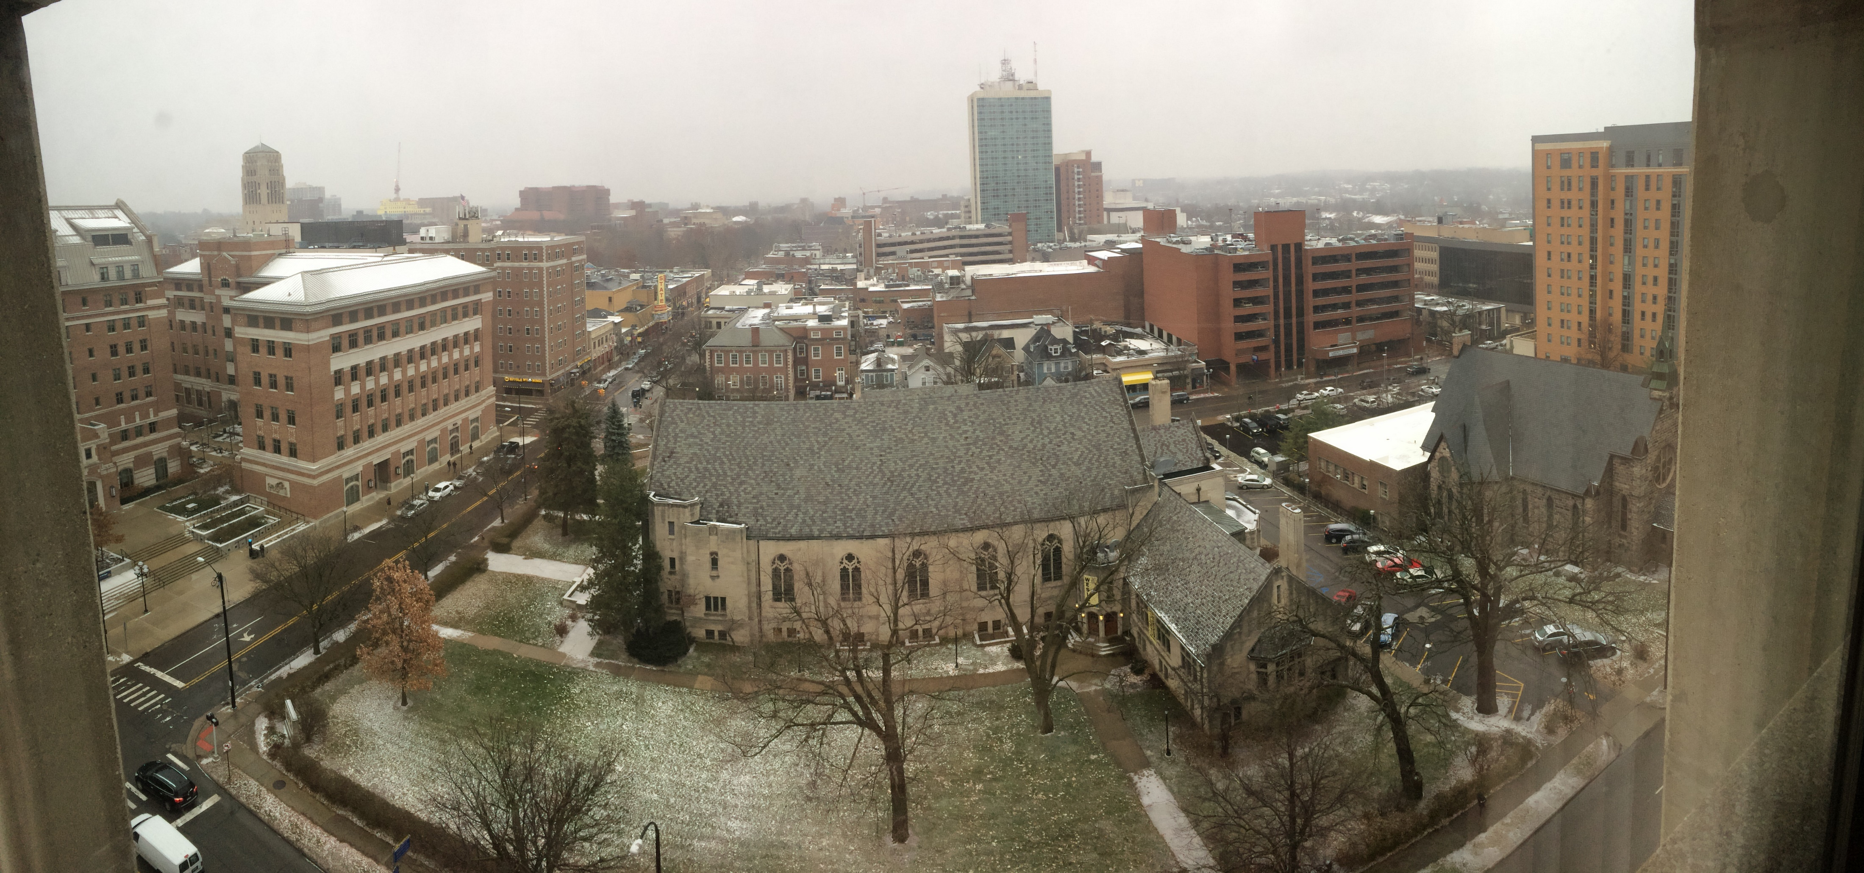
Look at Your Phone
Iphone Image Credit: arstechnica.net

Slide 15
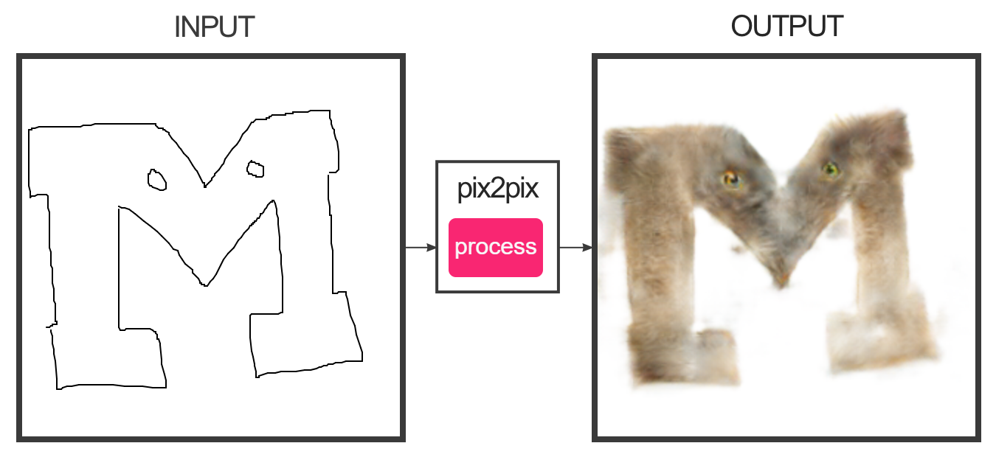
Graphics
https://affinelayer.com/pixsrv/
Isola et al. Image-to-Image Translation with Conditional Adversarial Networks. CVPR 2017

Slide 16
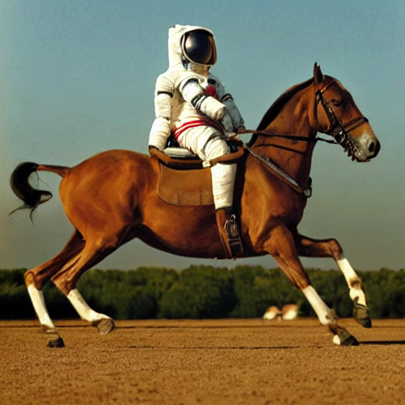
Stable Diffusion

Slide 17
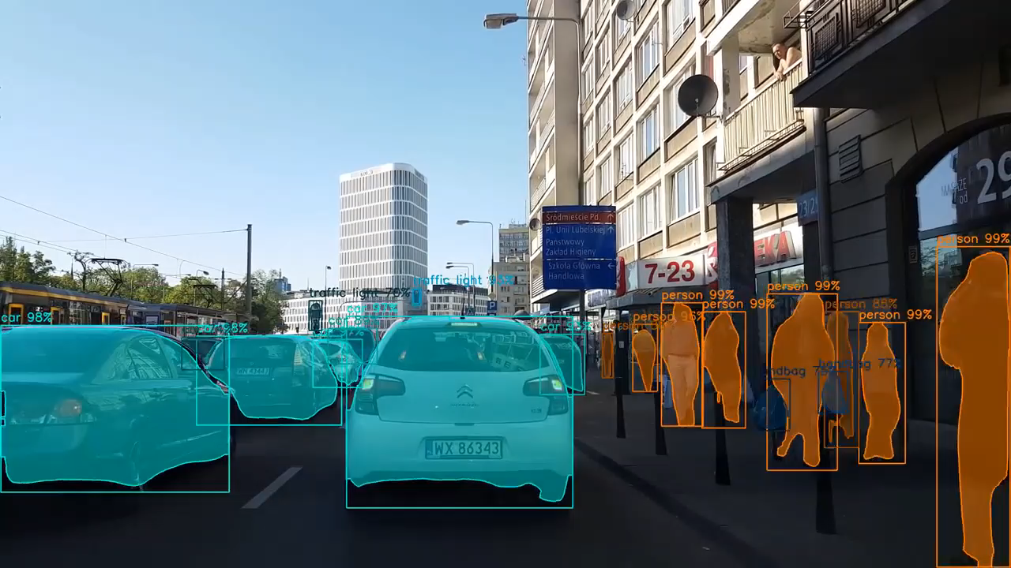
Recognition
He et al. Mask RCNN. ICCV 2017.
Video Credit: Karol Majek (https://www.youtube.com/watch?v=OOT3UIXZztE)

Slide 18
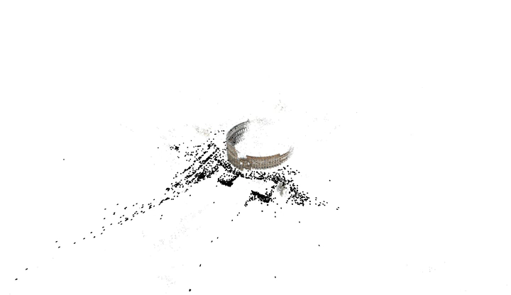
3D
Agarwal et al. Building Rome In A Day. ICCV 2009.

Slide 19
Administrivia

Slide 20
Meeting and Communication
Class: Mon/Wed 10:30AM-Noon, STAMPS and Zoom + Recordings (but please give it a minute!)
Discussions (6), attend any, starting Monday January 9. One will be recorded.
Office Hours (a bunch, mainly in-person): Poll out this afternoon – please fill in
Piazza: Sign up (link on canvas). We monitor but don’t guarantee instant responses.
Direct Email: Avoid. Why?

Slide 21
Class Size, Waitlist, Modalities
Thing to keep in mind: there are 280 students, 1 professor, 6 GSIs and 1 IA
Waitlist: I’m limited by staff. I don’t reorder the waitlist – each person has a good reason and it’s a zero-sum game. Contact the advising office

Slide 22
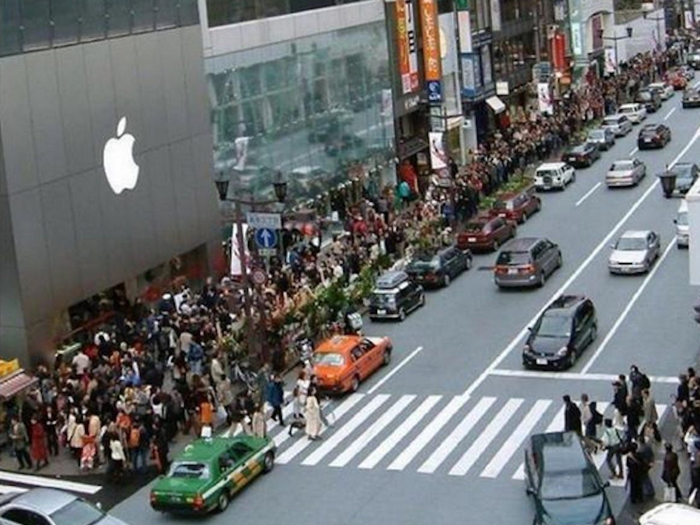
Office Hours + Piazza
Photo credit: Business Insider

Slide 23
Office Hours + Piazza
140 hours of work available for the course across me, GSIs, IAs. Needs to cover:
  Lectures + Discussion: ~10 hours of standing-there time
  Writing, testing, debugging, and setting up grading for HW; preparing for lectures + discussions; conceptual Qs; course administration
  Helping students learn the material + do HW
Lining up for a personal zoom room with a GSI for debugging / debugging via piazza is inefficient and makes everyone want to tear their hair out. Why?

Slide 24
Let’s Work Together
Please watch the lectures + discussions and then do the HWs; please don’t do the reverse.
We’ll try to teach you how to debug better. Debugging well is a hard skill, but it will be important for your career.
Work together from the beginning.
I really want to do and encourage modalities for OH that are more efficient

Slide 25
Zoom, Recordings, etc.
I’ll attempt to monitor zoom and in-person at the same time. It’s trickier than it looks!
Recordings may take a little bit of time to get up.
Anticipate at least one tech screw-up during the semester

Slide 26
Websites
Canvas: Links to other stuff and turning in big files
Course website: slides, assignments, syllabus https://web.eecs.umich.edu/~fouhey/teaching/EECS442_W23/ .
Piazza: ask questions, answer questions https://piazza.com/umich/winter2023/eecs442
Gradescope: details later with release of HW1

Slide 27
Evaluation
Homework (5x12%) – five mini-project homeworks with a writeup and code
Midterm (20%) – One in-class midterm
Project (2% [proposal] +18% [report+presentation]) – a semester-long project done in a team

Slide 28
Homework Philosophy
Tons of fantastic resources for many things so teaching you to setup stable diffusion is a waste
Few components remain the same in the long run. I want to teach these.
Some work may be frustrating or hard to wrap your head around; please expect some of that
This may be your first ULCS. Be patient and build in some transition time
Homework =/= spec. We’ll often ask you to interpolate details, figure things out, etc.

Slide 29
Evaluation: Homework Late Policy
Penalty: 1% per hour, rounded to nearest
Example:
  Due: 5pm Tuesday.
  Submitted 5:15pm Tue: No penalty!
  Submitted 12:15am Wed: 7% penalty (i.e., 90% -> 83%)
Everyone gets 120 free late hours, applied automatically and optimally. These waive late penalties. Assume you will need these
Exceptions for exceptional situations. Contact us.

Slide 30
Copying
Read the syllabus – don’t look at peoples’ code, no pair programming
We will run MOSS
Submit it late (that’s why we have late days), half-working (that’s why we have partial credit), or take the zero on the homework – I guarantee you won’t care about one bad homework in a year
If you’re overwhelmed, talk to us

Slide 31
Evaluation: Term Project
Work in a team of 3-4 to do something cool
There will be a piazza thread for pairing up
Could be:
  Applying vision to a problem you care about
  Independent re-implementation of a paper
  Trying to build and extend an approach
  An idea that we give you
Should be 1 homeworks worth of work per person

Slide 32
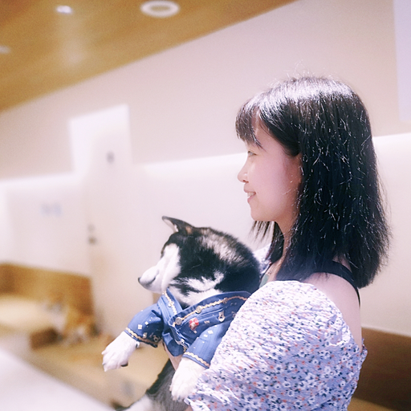
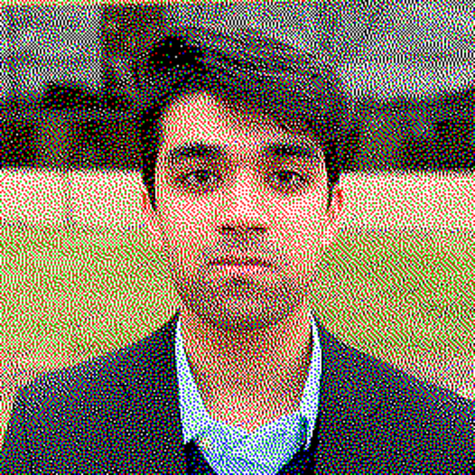
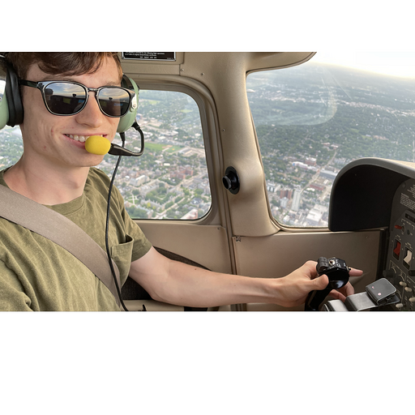
Doing Well in 442 – Work Together
Enjoy each topic like a story. Discuss with friends about homework. Check piazza for similar questions, ask for help or get inspiring ideas on piazza as well. Go to discussions – Siyi Chen
Exchanging advice and discussing concepts with your peers is a valuable learning opportunity and something that we want you to do (as long as it's within the limits of the Honor Code) – Ahmed Khan
+1 on finding people to work with. It made the class much more enjoyable. – Jacob Skwirsk
Don’t have friends in the class?
We’ll introduce you to people (stay tuned)

Slide 33


Doing Well in 442 – Start Early
Start early. – Nikhil Devraj
Start early, especially for any projects using colab and gpus. – Rahul Gupta
We’re trying to figure out how to optimally handle the GPU situation.

Slide 34
How To Have a Bad Time in 442
Bad time: start homeworks with three days to go; have conceptual issues and debugging fun
Bad time: ignore lectures; just-in-time lecture-watching by scrubbing through lectures while doing homeworks
Bad time: debug by piazza + OH queue

Slide 35
Your Todos
Office hours poll if you have preferences
Study buddy matching poll if you’d like us to help you match
Background poll if you’d like to help me tailor the course (and future offerings)
Get to know you poll if you’d like
First homework out next week. No need to do anything. Just relax

Slide 36
Cameras

Slide 37
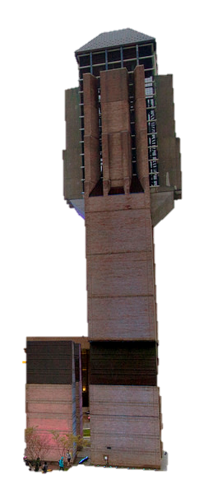
Let’s Take a Picture!
Photosensitive Material
Idea 1: Just use film
Result: Junk
Slide inspired by S. Seitz; image from Michigan Engineering

Slide 38
Let’s Take a Picture!
Photosensitive Material
Idea 2: add a barrier
Slide inspired by S. Seitz; image from Michigan Engineering

Slide 39
Let’s Take a Picture!
Photosensitive Material
Idea 2: add a barrier
Slide inspired by S. Seitz; image from Michigan Engineering

Slide 40
Let’s Take a Picture!
Photosensitive Material
Film captures all the rays going through a point (a pencil of rays).
Result: good in theory!
Slide inspired by S. Seitz; image from Michigan Engineering

Slide 41
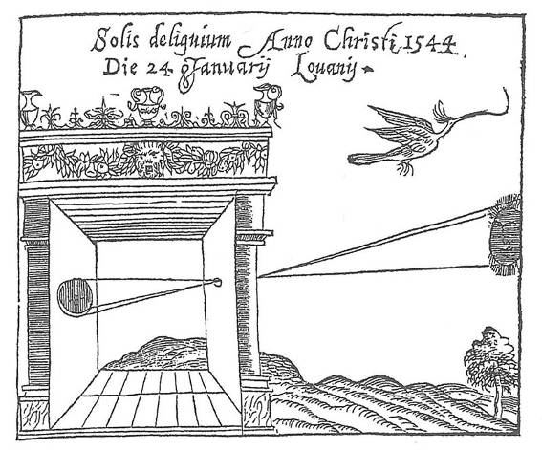
Camera Obscura
Basic principle known to Mozi (470-390 BCE), Aristotle (384-322 BCE)
Drawing aid for artists: described by Leonardo da Vinci (1452-1519)
Gemma Frisius, 1558
Source: A. Efros

Slide 42
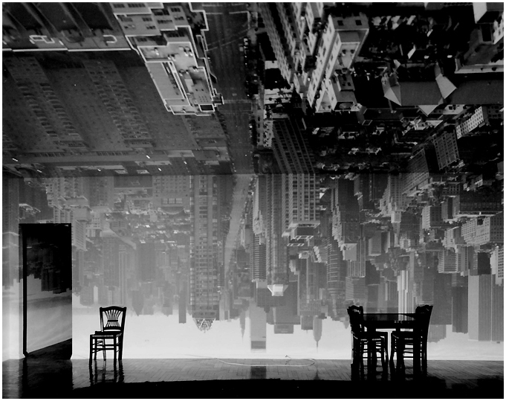
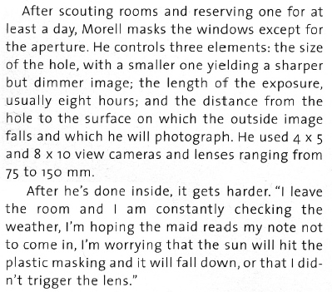
Camera Obscura
From Grand Images Through a Tiny Opening, Photo District News, February 2005
Abelardo Morell, Camera Obscura Image of Manhattan View Looking South in Large Room, 1996

Slide 43
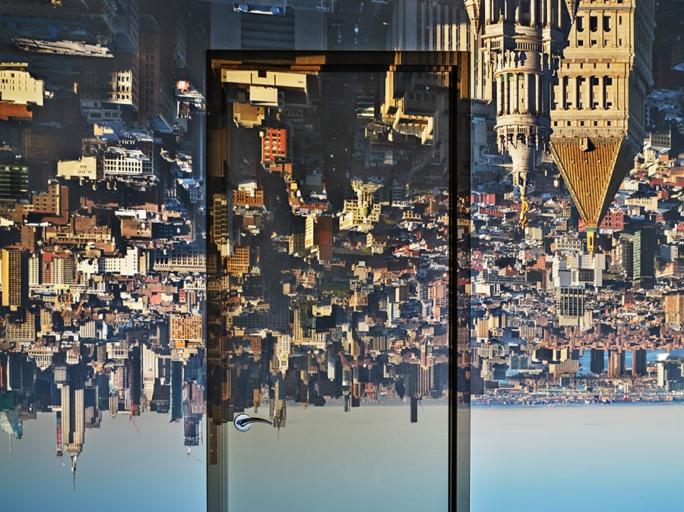
Abelardomorell.com (now gone ☹ )

Slide 44
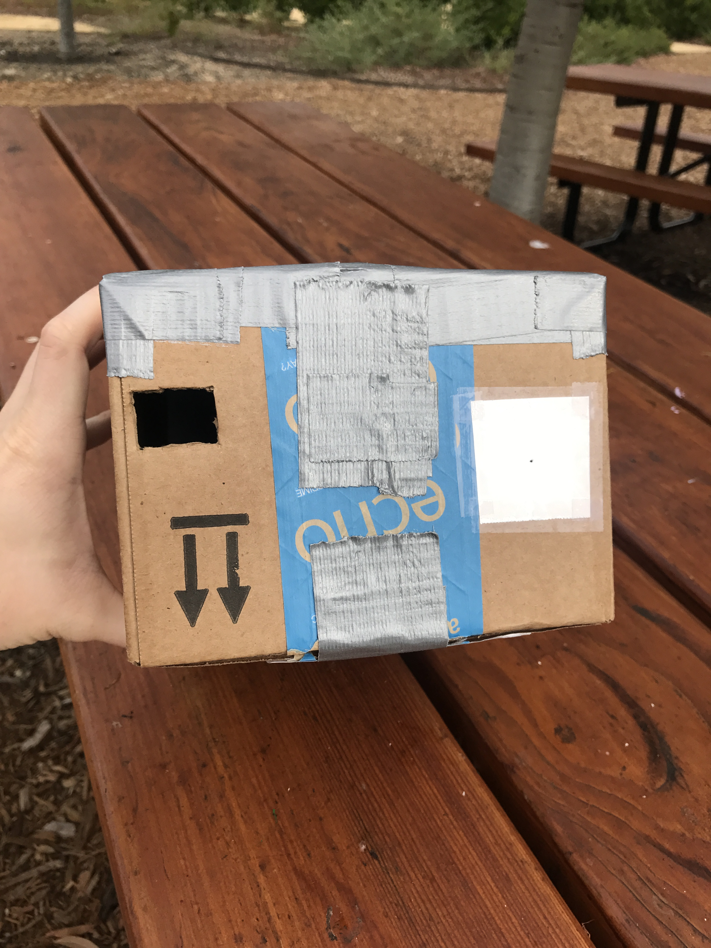
Camera Obscura
Useful for viewing solar eclipses!
Put your eye here
Pinhole: aluminum foil with a tiny hole
Photo Credit: Justin Johnson

Slide 45
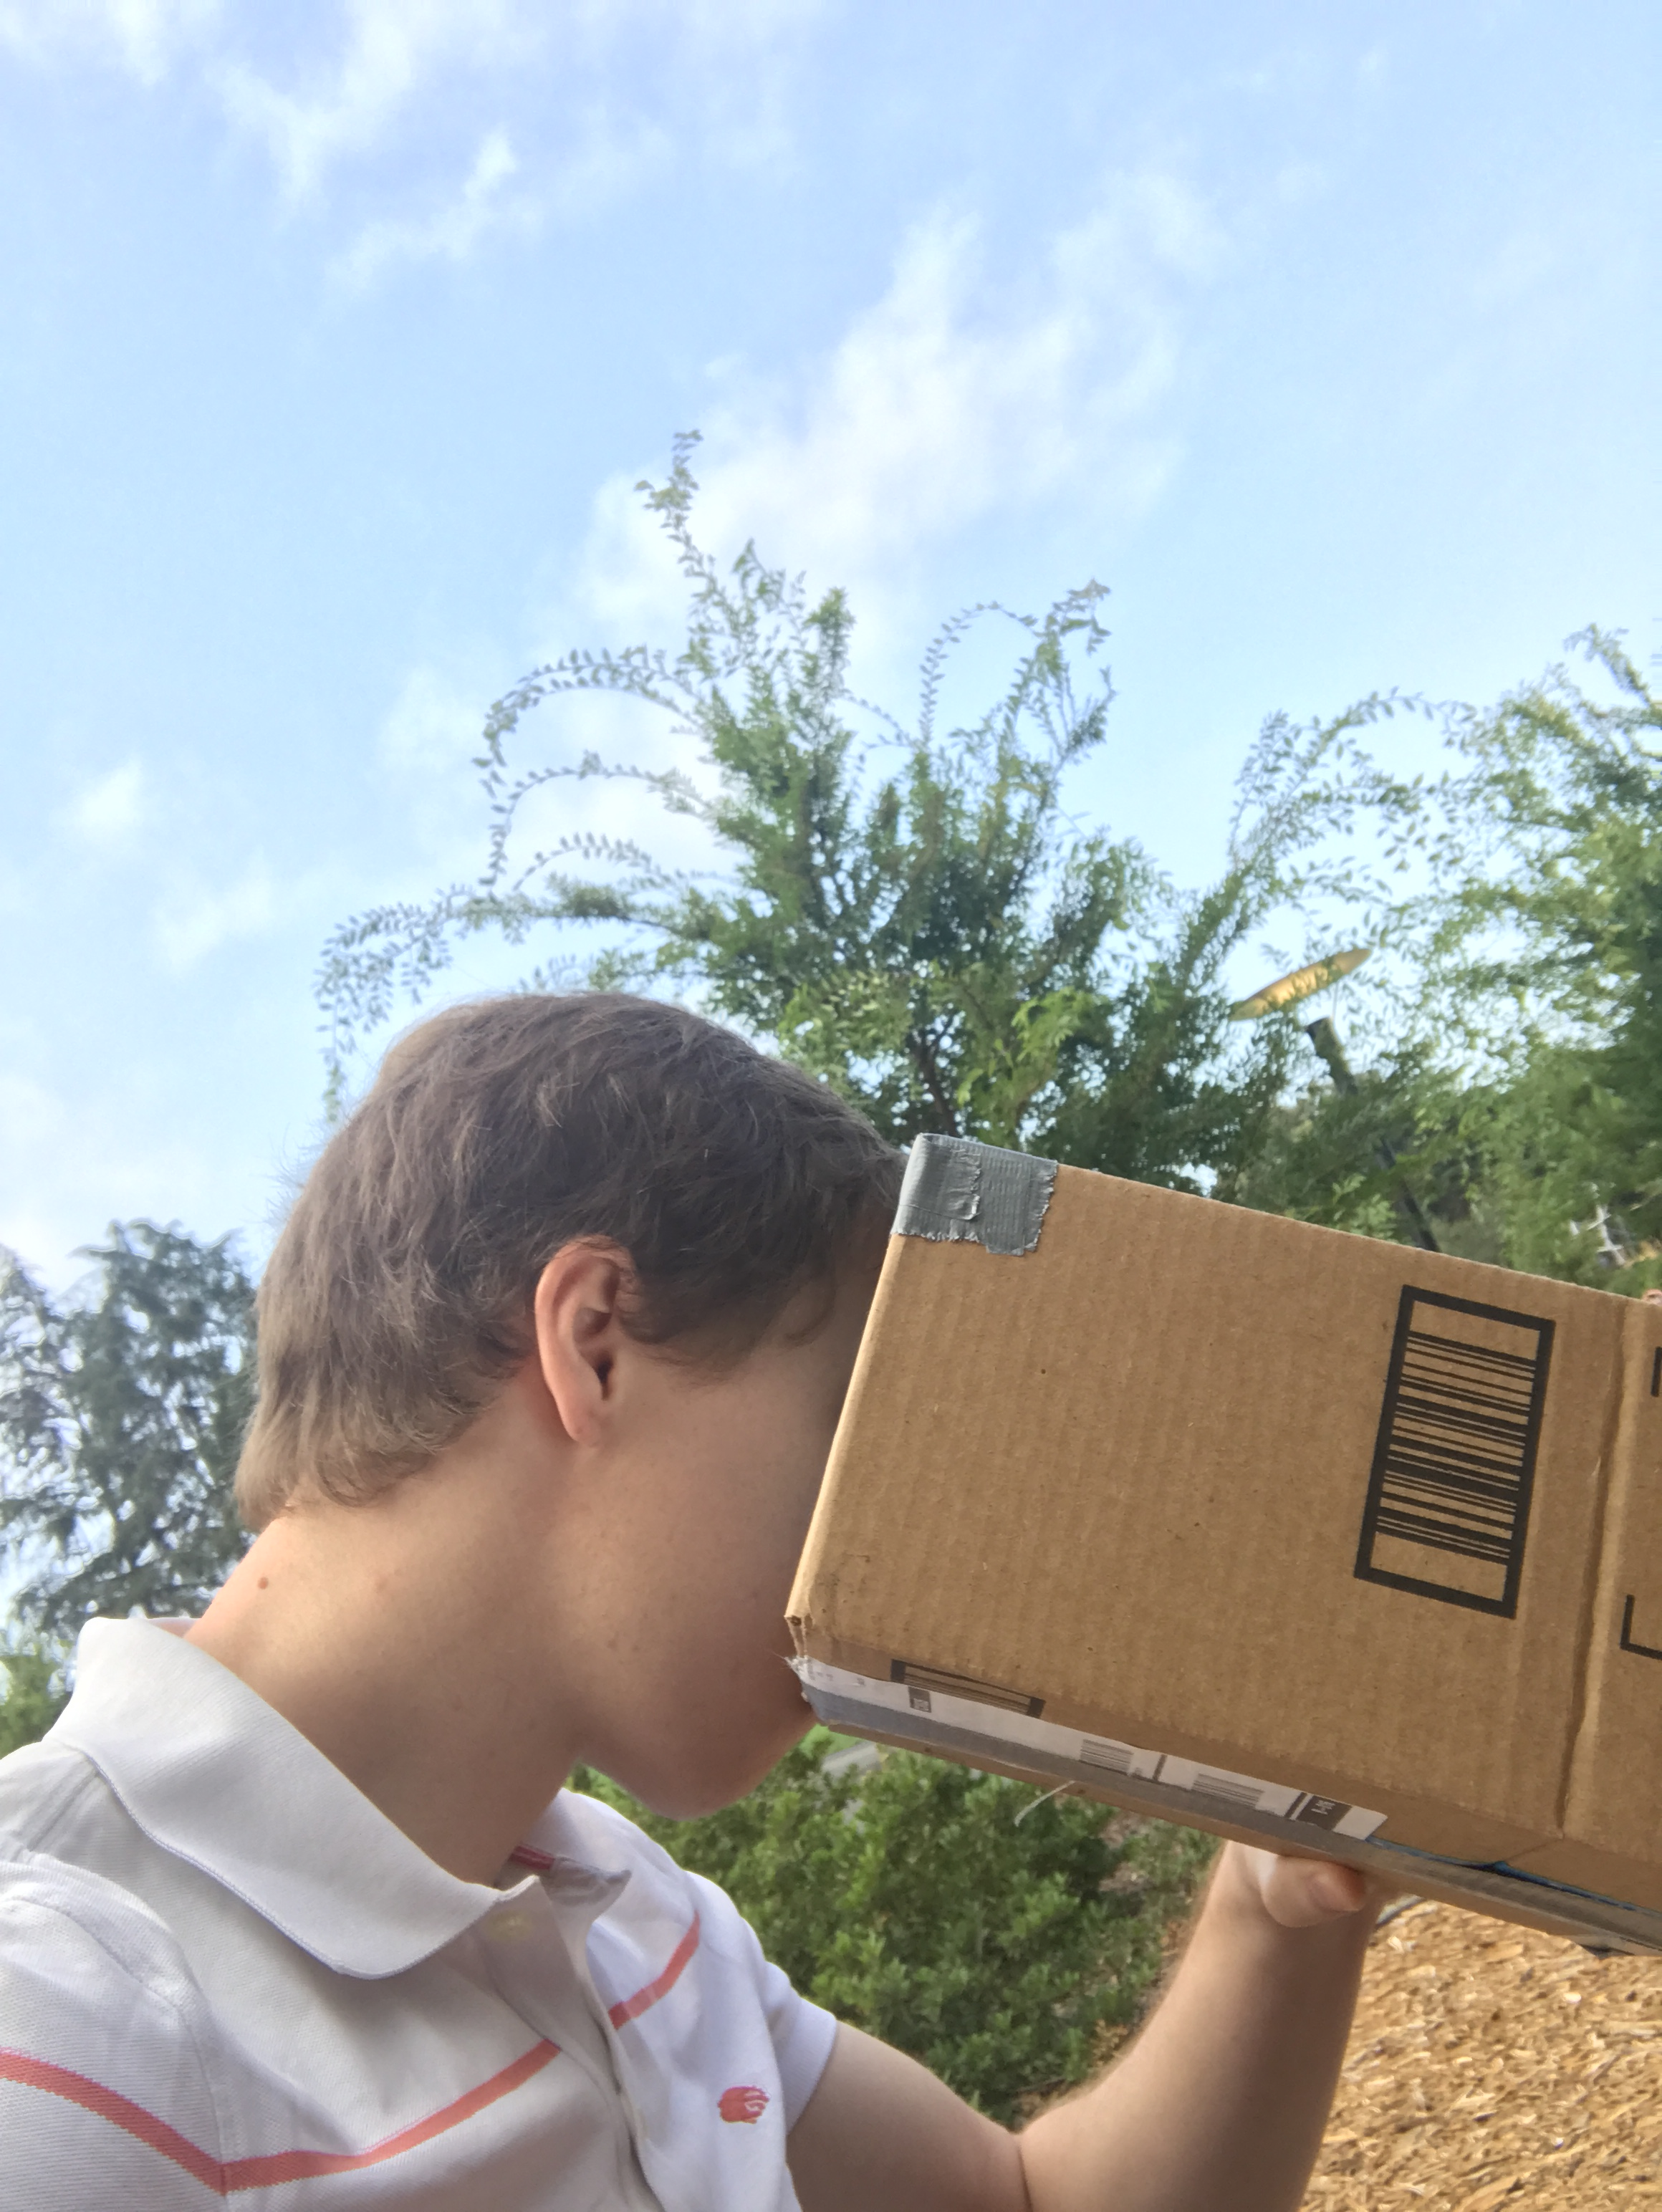
Camera Obscura
Useful for viewing solar eclipses!
Put your eye here
Pinhole: aluminum foil with a tiny hole
Justin on 8/21/2017
Photo Credit: Justin Johnson

Slide 46

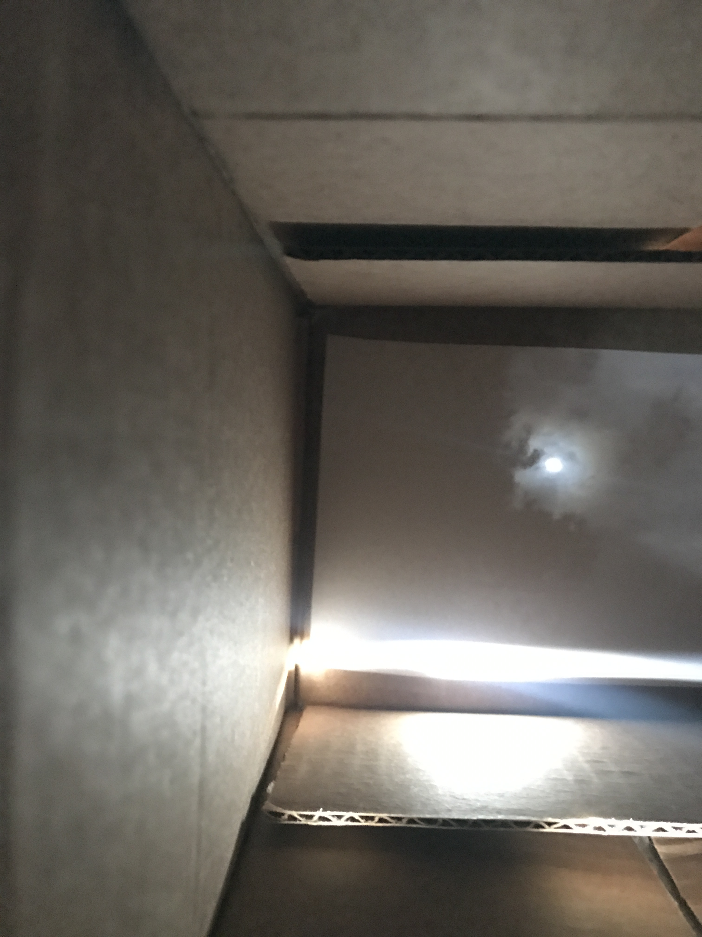
Camera Obscura
Useful for viewing solar eclipses!
Photo of the sun
View in the box
Justin on 8/21/2017
Photo Credit: Justin Johnson

Slide 47
Projection
Source: L Lazebnik

Slide 48
Projection
X
P
O
How do we find the projection P of a point X?
Form visual ray from X to camera center and intersect it with camera plane
Source: L Lazebnik

Slide 49
Projection
X
X’
P
O
Both X and X’ project to P. Which appears in the image?
Are there points for which projection is undefined?
Source: L Lazebnik

Slide 50
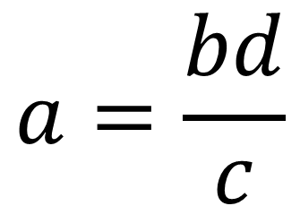
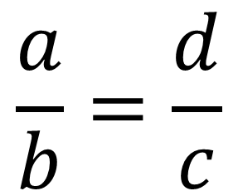
Quick Aside: Remember This?
d
b
θ
θ
c
a
$$\frac{a}{b}=\frac{d}{c}$$
$$a=\frac{bd}{c}$$

Slide 51
Projection Equations
Axes
f
y
X (x,y,z)
y
O
z
P
x
z
Coordinate system: O is origin, XY in image, Z sticks out.
XY is image plane, Z is optical axis.
(x,y,z) projects to (fx/z,fy/z) via similar triangles
Source: L Lazebnik

Slide 52
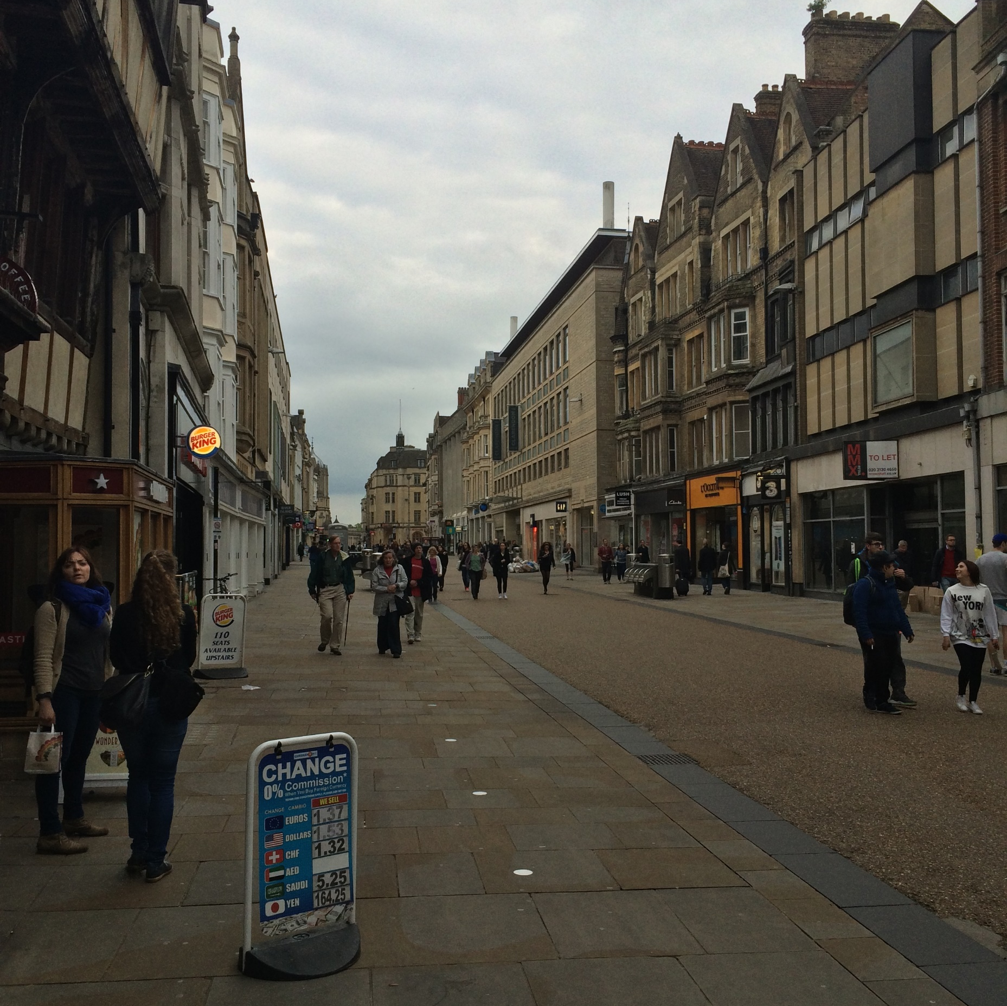



Some Facts About Projection
3D lines project to 2D lines
The projection of any 3D parallel lines converge at a vanishing point
Distant objects are smaller
List of properties from M. Hebert

Slide 53
Some Facts About Projection
Let’s try some fake images

Slide 54




Some Facts About Projection
Slide by Steve Seitz

Slide 55
Some Facts About Projection
Slide by Steve Seitz

Slide 56
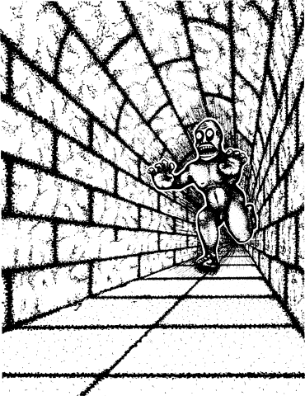

Some Facts About Projection
Illusion Credit: RN Shepard, Mind Sights: Original Visual Illusions, Ambiguities, and other Anomalies

Slide 57
What’s Lost?
Is she shorter or further away?
1
Are the orange lines we see parallel / perpendicular / neither to the red line?
4
2
3
Inspired by D. Hoiem slide

Slide 58
What’s Lost?
Is she shorter or further away?
1
Are the orange lines we see parallel / perpendicular / neither to the red line?
4
2
3
Adapted from D. Hoiem slide

Slide 59
What’s Lost?
Be careful of drawing conclusions:
Projection of 3D line is 2D line; NOT 2D line is 3D line.
Can you think of a counter-example (a 2D line that is not a 3D line)?
Projections of parallel 3D lines converge at VP; NOT any pair of lines that converge are parallel in 3D.
Can you think of a counter-example?

Slide 60
Cameras
EECS 442 – David Fouhey
Winter 2023, University of Michigan
https://web.eecs.umich.edu/~fouhey/teaching/EECS442_W23/

Slide 61
Administrivia
Logistics:
  M 3:30PM Discussion is in 1005 DOW
  No class next Monday
  Will try to repeat questions / answers; please remind me if not and if possible please speak up
Will send out study group stuff, OH info, etc. in the next day or so
If you’re rusty on linear algebra, please look at a linear algebra recap I’ll post

Slide 62
Recap: Projection Equations
Axes
f
y
X (x,y,z)
y
O
z
P
x
z
Coordinate system: O is origin, XY in image, Z sticks out.
XY is image plane, Z is optical axis.
(x,y,z) projects to (fx/z,fy/z) via similar triangles
Source: L Lazebnik

Slide 63
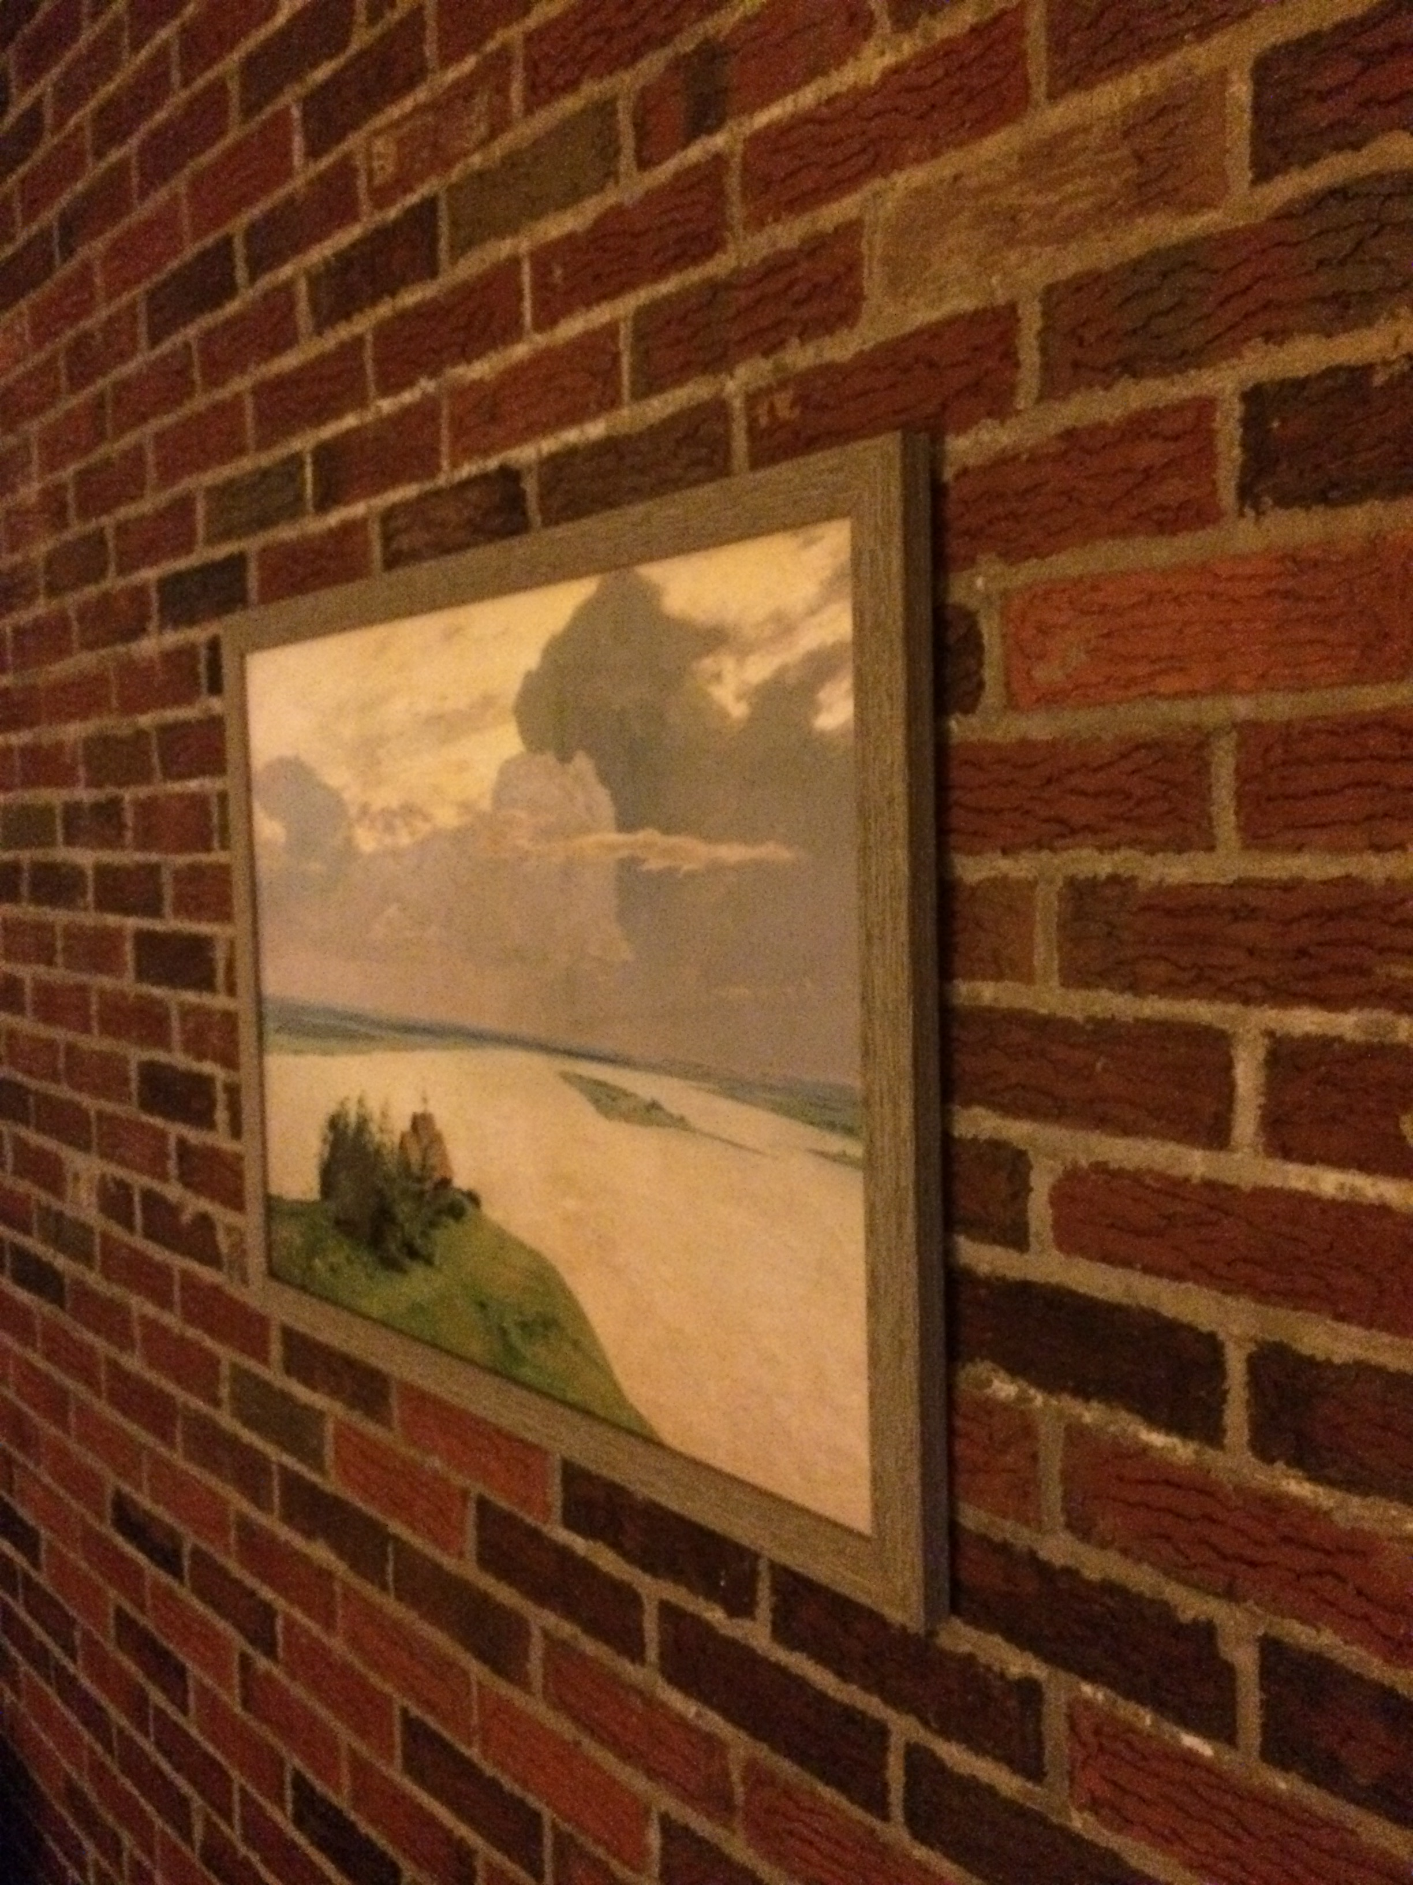
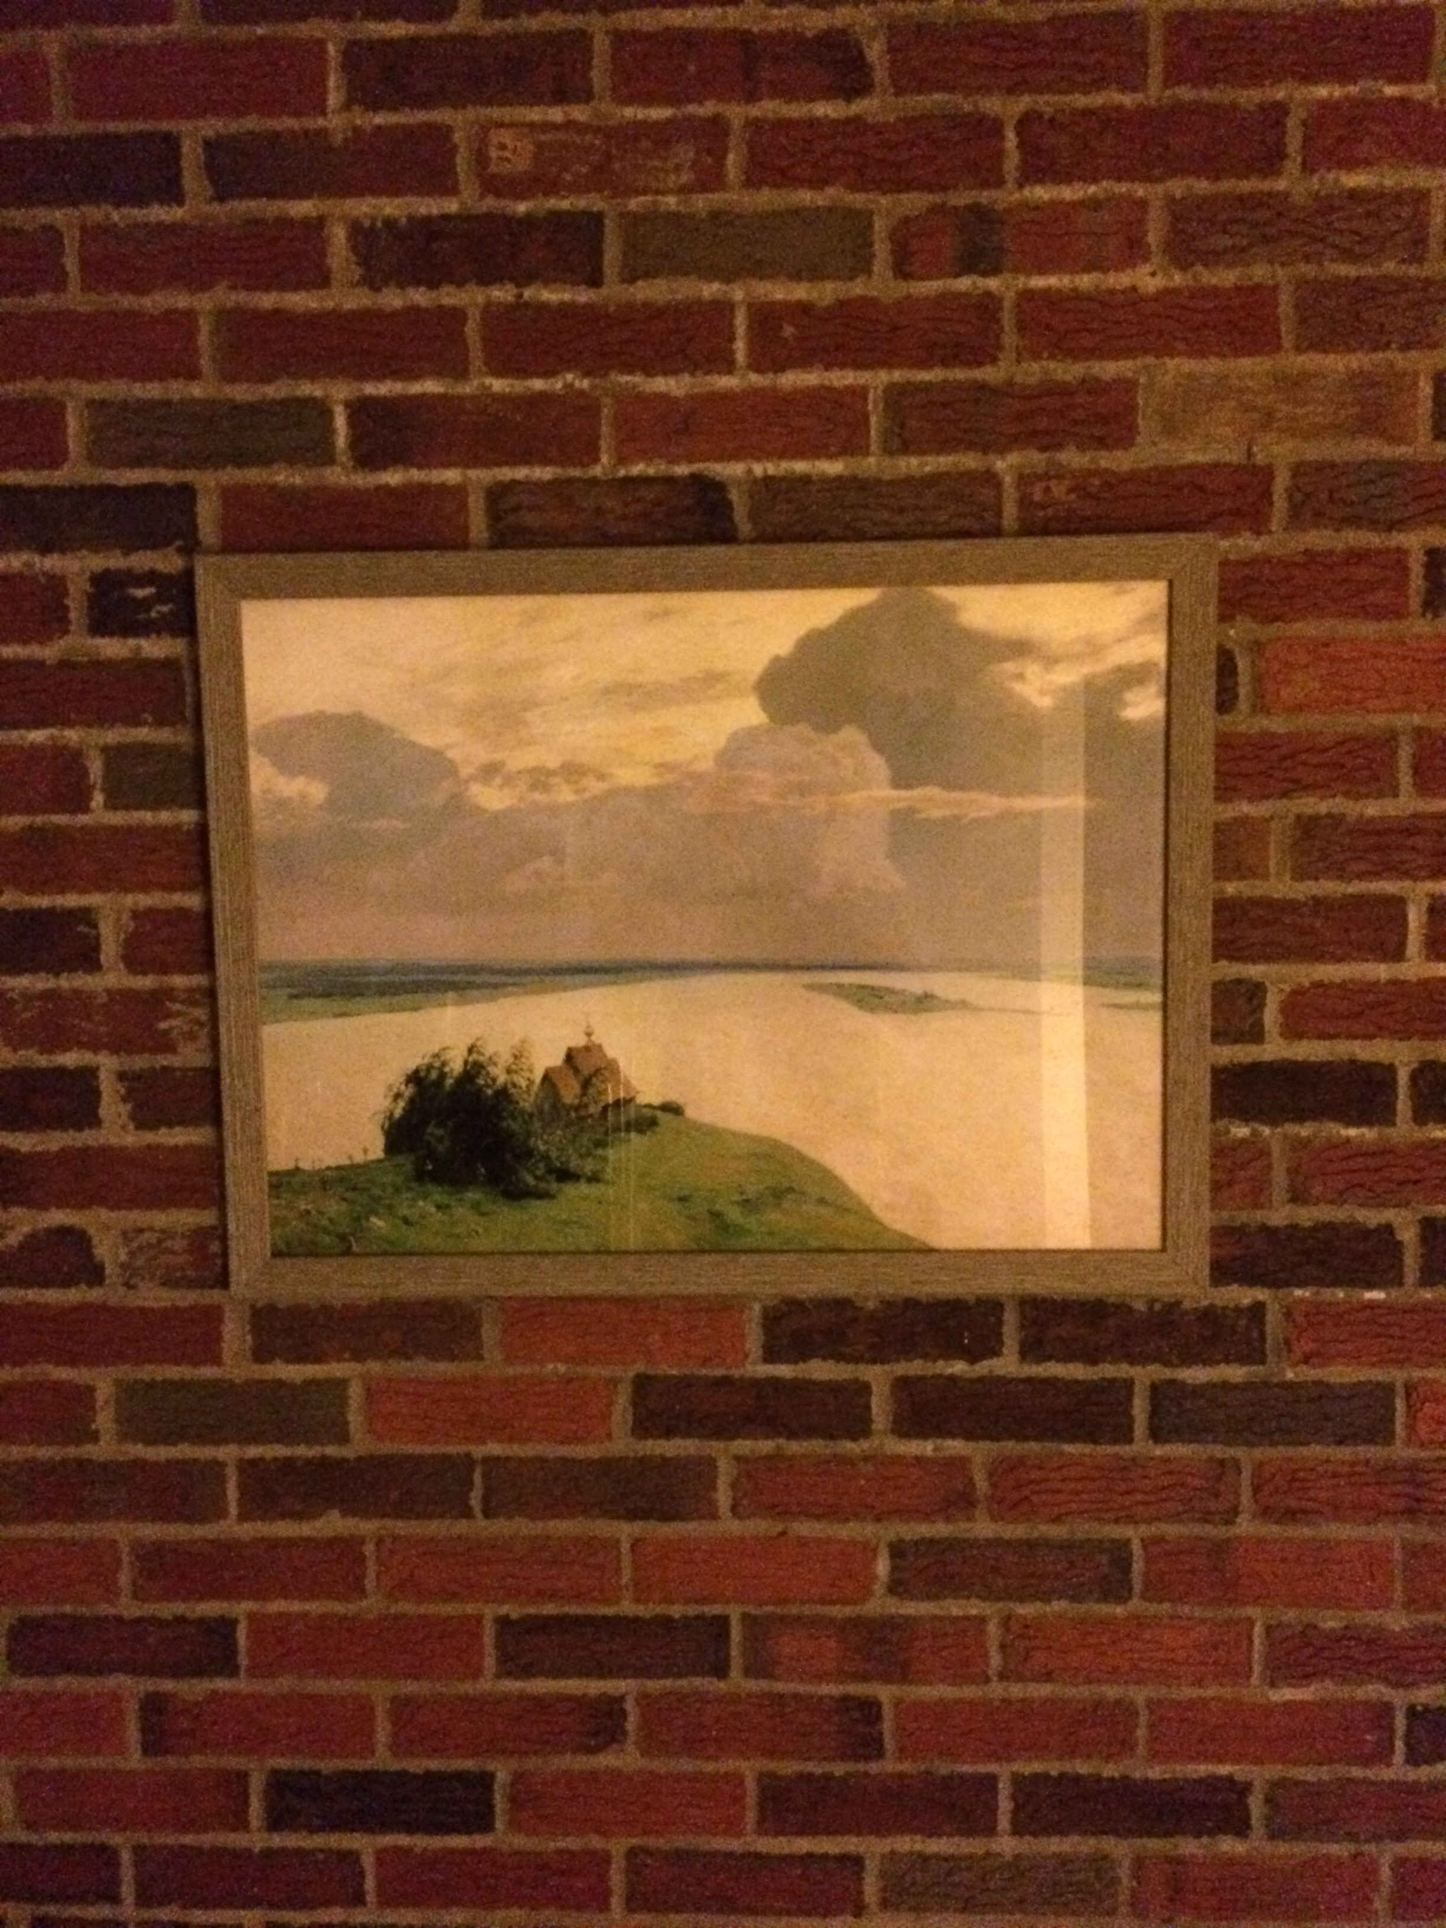
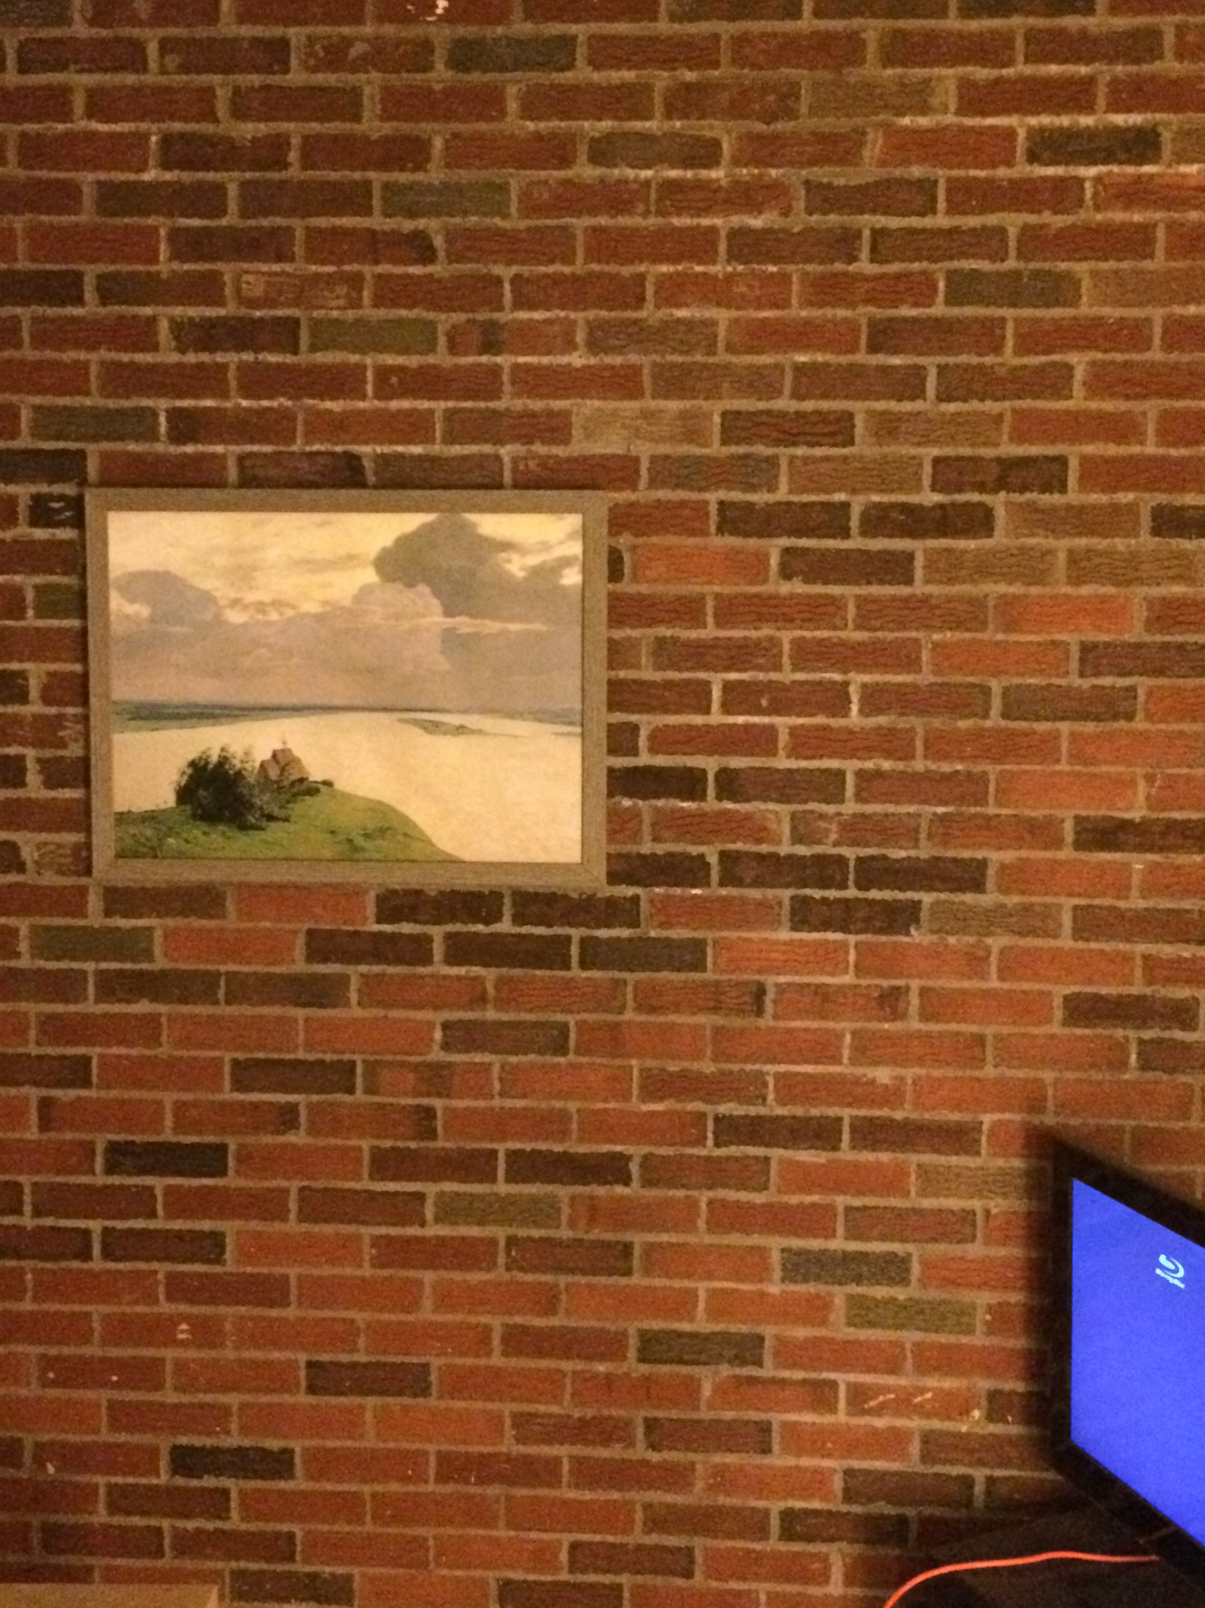
More Perspective
Things looking different when viewed from different angles seems like a nuisance. It’s also a cue. Why?

Slide 64
Do You Always Get Perspective?

Slide 65




Do You Always Get Perspective?
Y location of blue and red dots in image:
$$\frac{fy}{z_{2}}$$
$$\frac{fy}{z_{1}}$$
$$\frac{fy}{z}$$
$$\frac{fy}{z}$$

Slide 66
Do You Always Get Perspective?
When plane is fronto-parallel (parallel to camera plane), everything is:
scaled by f/z
otherwise is preserved.

Slide 67
Projection Equation
Axes
f
y
X
P
O
z
x
(x,y,z) → (fx/z,fy/z)
I promised you linear algebra: is this linear?
Nope: division by z is non-linear
(and risks division by 0)
Adapted from S. Seitz slide

Slide 68
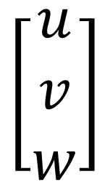
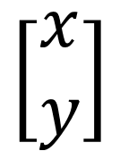
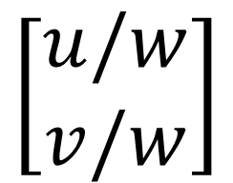
Homogeneous Coordinates (2D)
Trick: add a dimension!
This also clears up lots of nasty special cases
Physical
Point
Homogeneous
Point
Physical
Point
$$\left[\begin{matrix}u \\ v \\ w\end{matrix}\right]$$
$$\left[\begin{matrix}x \\ y\end{matrix}\right]$$
$$\left[\begin{matrix}u/w \\ v/w\end{matrix}\right]$$
Concat
w=1
Divide by w
What if w = 0?
Adapted from M. Hebert slide

Slide 69

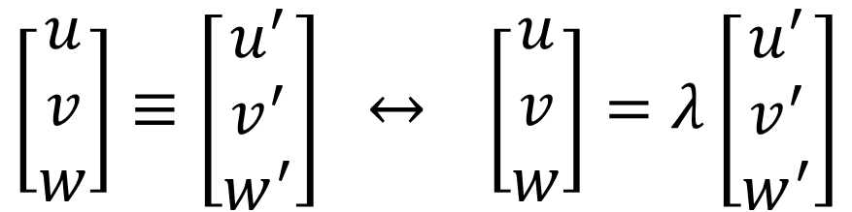
Homogeneous Coordinates
λ[x,y,w]
Triple /
Equivalent
Double /
Equals
[x,y,w]
$$\left[\begin{matrix}u \\ v \\ w\end{matrix}\right]≡\left[\begin{matrix}u^{′} \\ v^{′} \\ w^{′}\end{matrix}\right] ↔ \left[\begin{matrix}u \\ v \\ w\end{matrix}\right]=λ\left[\begin{matrix}u^{′} \\ v^{′} \\ w^{′}\end{matrix}\right]$$
y
$$λ≠0$$
z
Two homogeneous coordinates are equivalent if they are proportional to each other. Not = !
x

Slide 70
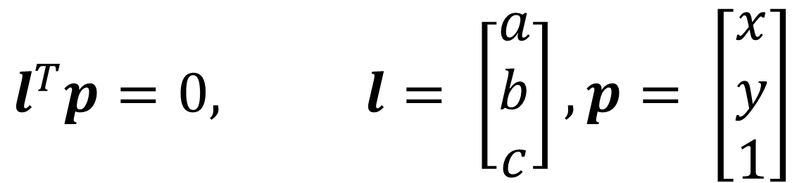
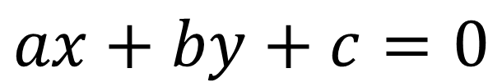
Benefits of Homogeneous Coords
General equation of 2D line:
$$ax+by+c=0$$
Homogeneous Coordinates
$$l^{T}p=0, l= \left[\begin{matrix}a \\ b \\ c\end{matrix}\right], p= \left[\begin{matrix}x \\ y \\ 1\end{matrix}\right]$$
Slide from M. Hebert

Slide 71
Benefits of Homogeneous Coords
Lines (3D) and points (2D → 3D) are now the same dimension.
Use the cross (x) and dot product for:
  Intersection of lines l and m: l x m
  Line through two points p and q: p x q
  Point p on line l: l^{T}p
Parallel lines, vertical lines become easy (compared to y=mx+b)

Slide 72
Benefits of Homogeneous Coords
What’s the intersection?
0x + 1y - 2 = 0
1x + 0y - 1 = 0
[0,1,-2] x [1,0,-1] = [-1,-2,-1]
Converting back (divide by -1)
(1,2)

Slide 73
Benefits of Homogeneous Coords
0x + 1y - 3 = 0
0x + 1y - 2 = 0
0x + 1y - 1 = 0
Intersection of y=2, y=1
[0,1,-2] x [0,1,-1] = [1,0,0]
Do all 3 lines intersect at the same place?
[0,1,-3]^{T}[1,0,0] = 0

Slide 74
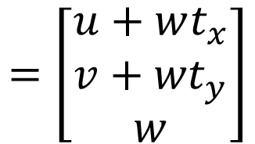
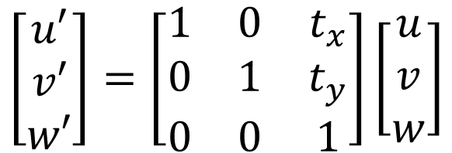
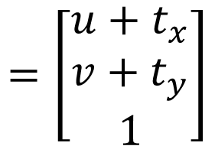
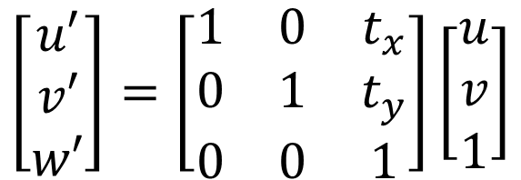
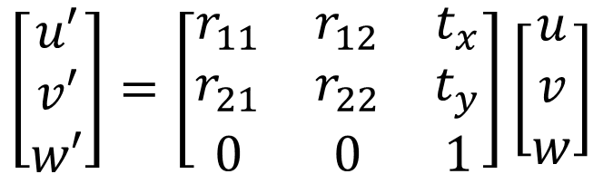
Benefits of Homogeneous Coords
Translation is now linear / matrix-multiply
$$\left[\begin{matrix}u′ \\ v′ \\ w′\end{matrix}\right]=\left[\begin{matrix}1 & 0 & t_{x} \\ 0 & 1 & t_{y} \\ 0 & 0 & 1\end{matrix}\right]\left[\begin{matrix}u \\ v \\ 1\end{matrix}\right]$$
$$=\left[\begin{matrix}u+t_{x} \\ v+t_{y} \\ 1\end{matrix}\right]$$
If w = 1
$$\left[\begin{matrix}u′ \\ v′ \\ w′\end{matrix}\right]=\left[\begin{matrix}1 & 0 & t_{x} \\ 0 & 1 & t_{y} \\ 0 & 0 & 1\end{matrix}\right]\left[\begin{matrix}u \\ v \\ w\end{matrix}\right]$$
$$=\left[\begin{matrix}u+wt_{x} \\ v+{wt}_{y} \\ w\end{matrix}\right]$$
Generically
Rigid body transforms (rot + trans) now linear
$$\left[\begin{matrix}u′ \\ v′ \\ w′\end{matrix}\right]=\left[\begin{matrix}r_{11} & r_{12} & t_{x} \\ r_{21} & r_{22} & t_{y} \\ 0 & 0 & 1\end{matrix}\right]\left[\begin{matrix}u \\ v \\ w\end{matrix}\right]$$

Slide 75



3D Homogeneous Coordinates
Same story: add a coordinate, things are equivalent if they’re proportional
$$\left[\begin{matrix}u \\ v \\ w \\ t\end{matrix}\right]$$
$$\left[\begin{matrix}u/t \\ v/t \\ w/t\end{matrix}\right]$$
$$\left[\begin{matrix}x \\ y \\ z\end{matrix}\right]$$

Slide 76
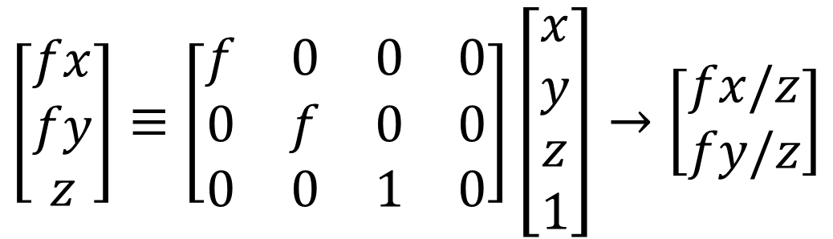
Projection Matrix
Projection (fx/z, fy/z) is matrix multiplication
f
O
dis
$$\left[\begin{matrix}fx \\ fy \\ z\end{matrix}\right]≡\left[\begin{matrix}f & 0 & 0 & 0 \\ 0 & f & 0 & 0 \\ 0 & 0 & 1 & 0\end{matrix}\right]\left[\begin{matrix}x \\ y \\ z \\ 1\end{matrix}\right]→\left[\begin{matrix}fx/z \\ fy/z\end{matrix}\right]$$
Slide inspired from L. Lazebnik

Slide 77
Projection Matrix
Projection (fx/z, fy/z) is matrix multiplication
f
O
$$\left[\begin{matrix}fx \\ fy \\ z\end{matrix}\right]≡\left[\begin{matrix}f & 0 & 0 & 0 \\ 0 & f & 0 & 0 \\ 0 & 0 & 1 & 0\end{matrix}\right]\left[\begin{matrix}x \\ y \\ z \\ 1\end{matrix}\right]→\left[\begin{matrix}fx/z \\ fy/z\end{matrix}\right]$$
Slide inspired from L. Lazebnik

Slide 78
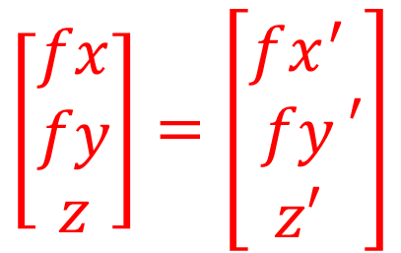
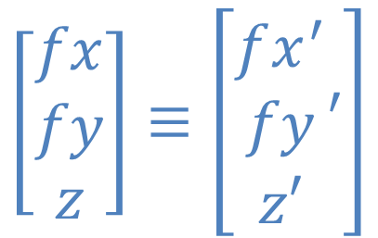
Why ≡ ≠ =
X
X’
P
O
Project X and X’ to the image and compare them
$$\left[\begin{matrix}fx \\ fy \\ z\end{matrix}\right]≡\left[\begin{matrix}fx^{′} \\ fy \\ z′\end{matrix}′\right]$$
$$\left[\begin{matrix}fx \\ fy \\ z\end{matrix}\right]=\left[\begin{matrix}fx^{′} \\ fy \\ z′\end{matrix}′\right]$$
YES
NO

Slide 79
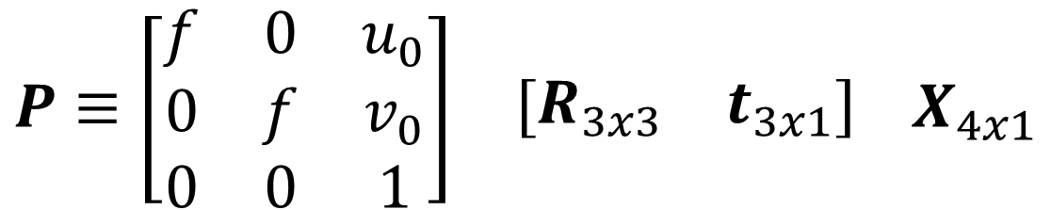
Typical Perspective Model
P: 2D homogeneous point (3D)
X: 3d homogeneous point (4D)
$$P≡\begin{matrix}\left[\begin{matrix}f & 0 & u_{0} \\ 0 & f & v_{0} \\ 0 & 0 & 1\end{matrix}\right] & \left[\begin{matrix}R_{3x3} & t_{3x1}\end{matrix}\right]\end{matrix} X_{4x1}$$

Slide 80
Typical Perspective Model
R: rotation between world system and camera
t: translation between world system and camera
$$P≡\begin{matrix}\left[\begin{matrix}f & 0 & u_{0} \\ 0 & f & v_{0} \\ 0 & 0 & 1\end{matrix}\right] & \left[\begin{matrix}R_{3x3} & t_{3x1}\end{matrix}\right]\end{matrix} X_{4x1}$$

Slide 81
Typical Perspective Model
f focal length
u0,v0: principal point (image coords of camera origin on retina)
$$P≡\begin{matrix}\left[\begin{matrix}f & 0 & u_{0} \\ 0 & f & v_{0} \\ 0 & 0 & 1\end{matrix}\right] & \left[\begin{matrix}R_{3x3} & t_{3x1}\end{matrix}\right]\end{matrix} X_{4x1}$$

Slide 82

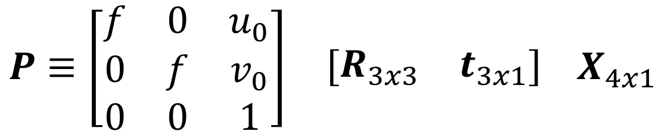
Typical Perspective Model
Intrinsic Matrix K
Extrinsic Matrix [R,t]
$$P≡\begin{matrix}\left[\begin{matrix}f & 0 & u_{0} \\ 0 & f & v_{0} \\ 0 & 0 & 1\end{matrix}\right] & \left[\begin{matrix}R_{3x3} & t_{3x1}\end{matrix}\right]\end{matrix} X_{4x1}$$
$$P≡K\left[R,t\right]X≡M_{3x4}X_{4x1}$$

Slide 83


Other Cameras – Orthographic
Orthographic Camera (z infinite)
$$P=\begin{matrix}\left[\begin{matrix}1 & 0 & 0 \\ 0 & 1 & 0 \\ 0 & 0 & 0\end{matrix}\right] & X_{3x1}\end{matrix}$$
Image Credit: Wikipedia

Slide 84

Other Cameras – Orthographic
Why does this make things easy and why is this popular in old games?
$$P=\begin{matrix}\left[\begin{matrix}1 & 0 & 0 \\ 0 & 1 & 0 \\ 0 & 0 & 0\end{matrix}\right] & \left[\begin{matrix}x \\ y \\ z\end{matrix}\right]\end{matrix}$$

Slide 85
The Big Issue
Photosensitive Material
Film captures all the rays going through a point (a pencil of rays).
How big is a point?
Slide inspired by S. Seitz; image from Michigan Engineering

Slide 86
Math vs. Reality
Math: Any point projects to one point
Reality:
  Don’t image points behind the camera / objects
  Don’t have an infinite amount of sensor material
Other issues
  Light is limited
  Spooky stuff happens with infinitely small holes

Slide 87
Limitations of Pinhole Model
Ideal Pinhole
-1 point generates 1 image
-Low-light levels
Finite Pinhole
-1 point generates region
-Blurry.
Why is it blurry?
Slide inspired by M. Hebert

Slide 88

Limitations of Pinhole Model
Slide Credit: S. Seitz

Slide 89
Adding a Lens
A lens focuses light onto the film
Thin lens model: rays passing through the center are not deviated (pinhole projection model still holds)
Slide Credit: S. Seitz

Slide 90
Adding a Lens
focal point
f
All rays parallel to the optical axis pass through the focal point
Slide Credit: S. Seitz

Slide 91
What’s The Catch?
“circle of
confusion”
There’s a distance where objects are “in focus”
Other points project to a “circle of confusion”
Slide Credit: S. Seitz

Slide 92
Thin Lens Formula
We care about images that are in focus.
When is this true?
When two paths from a point hit the same image location.
object
lens
image plane
Diagram credit: F. Durand

Slide 93
Thin Lens Formula
Let’s derive the relationship between object distance D, image plane distance D’, and focal length f.
D
D′
f
y
y′
object
lens
image plane
Diagram credit: F. Durand

Slide 94


Thin Lens Formula
One set of similar triangles:
$$\frac{y′}{D^{′}−f}=\frac{y}{f}$$
$$\frac{y′}{y}=\frac{D^{′}−f}{f}$$
D
D′
f
y
y′
object
lens
image plane
Diagram credit: F. Durand

Slide 95


Thin Lens Formula
Another set of similar triangles:
$$\frac{y′}{D′}=\frac{y}{D}$$
$$\frac{y′}{y}=\frac{D′}{D}$$
D
D′
f
y
y′
object
lens
image plane
Diagram credit: F. Durand

Slide 96


Thin Lens Formula
Set them
equal:
$$\frac{D′}{D}=\frac{D−f}{f}$$
$$\frac{1}{D}+\frac{1}{D′}=\frac{1}{f}$$
D
D′
f
y
y′
object
lens
image plane
Diagram credit: F. Durand

Slide 97

Thin Lens Formula
Suppose I want to take a picture of a lion with D big?
Which of D, D’, f are fixed?
How do we take pictures of things at different distances?
D
D′
f
$$\frac{1}{D}+\frac{1}{D′}=\frac{1}{f}$$
object
lens
image plane
Diagram credit: F. Durand

Slide 98


Depth of Field
http://www.cambridgeincolour.com/tutorials/depth-of-field.htm
Slide Credit: A. Efros

Slide 99



Controlling Depth of Field
Changing the aperture size affects depth of field
A smaller aperture increases the range in which the object is approximately in focus
Diagram: Wikipedia

Slide 100
Controlling Depth of Field
If a smaller aperture makes everything focused, why don’t we just always use it?
Diagram: Wikipedia

Slide 101


Varying the Aperture
Small aperture = large DOF
Large aperture = small DOF
Slide Credit: A. Efros, Photo: Philip Greenspun

Slide 102
Varying the Aperture

Slide 103




Field of View (FOV)
$$φ$$
$$f$$
$$d$$
Photo. Material
$$φ=\tan^{−1}\left(\frac{d}{2f}\right)$$
tan⁻¹ is monotonic increasing.
How can I get the FOV bigger?

Slide 104
Field of View
Slide Credit: A. Efros

Slide 105
Field of View
Slide Credit: A. Efros

Slide 106



Field of View and Focal Length
Large FOV, small f
Camera close to car
Small FOV, large f
Camera far from the car
Slide Credit: A. Efros, F. Durand

Slide 107



Field of View and Focal Length
wide-angle
standard
telephoto
Slide Credit: F. Durand

Slide 108

Dolly Zoom
Change f and distance at the same time
Video Credit: Goodfellas 1990

Slide 109


More Bad News!
First a pinhole…
Then a thin lens model….
Slide: L. Lazebnik

Slide 110


Lens Flaws: Radial Distortion
Lens imperfections cause distortions as a function of distance from optical axis
Less common these days in consumer devices
Photo: Mark Fiala, U. Alberta

Slide 111
Vignetting
Photo. Material
What happens to the light between the
black and red lines?
Slide inspired by L. Lazebnik Slide

Slide 112

Vignetting
Photo credit: Wikipedia (https://en.wikipedia.org/wiki/Vignetting)

Slide 113


Lens Flaws: Chromatic Abberation
Lens refraction index is a function of the wavelength. Colors “fringe” or bleed
Image credits: L. Lazebnik, Wikipedia

Slide 114

Lens Flaws: Chromatic Abberation
Researchers tried teaching a network about objects by forcing it to assemble jigsaws.
Slide Credit: C. Doersch

Slide 115


From Photon to Photo
Each cell in a sensor array is a light-sensitive diode that converts photons to electrons
  Dominant in the past: Charge Coupled Device (CCD)
  Dominant now: Complementary Metal Oxide Semiconductor (CMOS)
Slide Credit: L. Lazebnik, Photo Credit: Wikipedia, Stefano Meroli

Slide 116

From Photon to Photo
Rolling Shutter: pixels read in sequence
Can get global reading, but $$$

Slide 117



Preview of What’s Next
Bayer grid
Demosaicing:
Estimation of missing components from neighboring values
Slide Credit: S. Seitz
Human Luminance Sensitivity Function

Slide 118
For the Curious
Cut in the interest of time

Slide 119


Radial Distortion Correction
y
f
Photo. Material
r
z
y'
Ideal
Distorted
$$y′=f\frac{y}{z}$$
$$y′=(1+k_{1}r^{2}+…)\frac{y}{z}$$

Slide 120

Lens Flaws: Spherical Abberation
Lenses don’t focus light perfectly!
Rays farther from the optical axis focus closer
Slide: L. Lazebnik

Slide 121



Historic milestones
Pinhole model: Mozi (470-390 BCE),
Aristotle (384-322 BCE)
Principles of optics (including lenses):
Alhacen (965-1039 CE)
Camera obscura: Leonardo da Vinci
(1452-1519), Johann Zahn (1631-1707)
First photo: Joseph Nicephore Niepce (1822)
Daguerréotypes (1839)
Photographic film (Eastman, 1889)
Cinema (Lumière Brothers, 1895)
Color Photography (Lumière Brothers, 1908)
Television (Baird, Farnsworth, Zworykin, 1920s)
First consumer camera with CCD
Sony Mavica (1981)
First fully digital camera: Kodak DCS100 (1990)
Alhacen’s notes
Niepce, “La Table Servie,” 1822
Slide Credit: S. Lazebnik
Old television camera

Slide 122

First digitally scanned photograph
1957, 176x176 pixels
Slide Credit: http://listverse.com/history/top-10-incredible-early-firsts-in-photography/
Notes:
From the website: “Russell Kirsch was a computer pioneer at the National Institute of Standards and Technology in the USA when he developed the system by which a camera could be fed into a computer. The photo is of Kirsch’s three month old son Walden and it measured a mere 176×176 pixels. Baby Walden now works in communications for Intel.”

Slide 123


Historic Milestone
Sergey Prokudin-Gorskii (1863-1944)
Photographs of the Russian empire (1909-1916)
Slide Credit: S. Maji

Slide 124

Historic Milestone
Slide Credit: S. Maji

Slide 125
Future Milestone
Your job in homework 1:
Make the left look like the right.
Note: it won’t quite look like this – this was done by a professional human. But it should look similar

Slide 128
Old Slides

Slide 129
Benefits of Homogeneous Coords
What about parallel lines?
0x + 1y - 2 = 0
0x + 1y - 1 = 0
[0,1,-2] x [0,1,-1] = [1,0,0]
Any point [x,y,0] is at infinity
All operations generate valid results!

Slide 130

What’s This Useful For?
O’Brien and Farid, SIGGRAPH 2012, Exposing Photo Manipulation with Inconsistent Reflections

Slide 131
What’s This Useful For?
Mirror

Slide 132

What’s This Useful For?
O’Brien and Farid, SIGGRAPH 2012, Exposing Photo Manipulation with Inconsistent Reflections

Slide 133

Typical Perspective Model
θ: 90°, cot = 0, sin = 1
α: f
u0,v0: principal point (image coords of camera origin on retina)
$$P≡\begin{matrix}\left[\begin{matrix}α & −α\cot{θ} & u_{0} \\ 0 & \frac{β}{\sin{θ}} & v_{0} \\ 0 & 0 & 1\end{matrix}\right] & \left[\begin{matrix}R_{3x3} & t_{3x1}\end{matrix}\right]\end{matrix} X_{4x1}$$
β:f

Slide 134










3D Homogeneous Coordinates
Vector Coordinates
Homogeneous Coordinates
$$y= \left[\begin{matrix}I_{3x3} & t \\ \begin{matrix}0 & 0 & 0\end{matrix} & 1\end{matrix}\right]x$$
Translation
$$y=x+t$$
$$y= \left[\begin{matrix}R_{3x3} & 0 \\ \begin{matrix}0 & 0 & 0\end{matrix} & 1\end{matrix}\right]x$$
Rotation
$$y=Rx$$
$$R^{T}R=RR^{T}=I$$
$$det\left(R\right)=1$$
$$y= \left[\begin{matrix}R_{3x3} & t \\ \begin{matrix}0 & 0 & 0\end{matrix} & 1\end{matrix}\right]x$$
Rigid Body
$$y=Rx+t$$
$$y= \left[\begin{matrix}A_{3x3} & t \\ \begin{matrix}0 & 0 & 0\end{matrix} & 1\end{matrix}\right]x$$
Affine
$$y=Ax+t$$

Slide 135
Typical Perspective Model
P: 2D homogeneous point (3D)
X: 3d homogeneous point (4D)
$$P≡\begin{matrix}\left[\begin{matrix}α & −α\cot{θ} & u_{0} \\ 0 & \frac{β}{\sin{θ}} & v_{0} \\ 0 & 0 & 1\end{matrix}\right] & \left[\begin{matrix}R_{3x3} & t_{3x1}\end{matrix}\right]\end{matrix} X_{4x1}$$

Slide 136
Typical Perspective Model
R: rotation between world system and camera
t: translation between world system and camera
$$P≡\begin{matrix}\left[\begin{matrix}α & −α\cot{θ} & u_{0} \\ 0 & \frac{β}{\sin{θ}} & v_{0} \\ 0 & 0 & 1\end{matrix}\right] & \left[\begin{matrix}R_{3x3} & t_{3x1}\end{matrix}\right]\end{matrix} X_{4x1}$$

Slide 137
Standard Full Perspective Model
α scale between world and image x coords
θ skew of camera axes
u0,v0: principal point (image coords of camera origin on retina)
$$P≡\begin{matrix}\left[\begin{matrix}α & −α\cot{θ} & u_{0} \\ 0 & \frac{β}{\sin{θ}} & v_{0} \\ 0 & 0 & 1\end{matrix}\right] & \left[\begin{matrix}R_{3x3} & t_{3x1}\end{matrix}\right]\end{matrix} X_{4x1}$$
β scale between world and image y coords

Slide 138
Standard Full Perspective Model
3x1
3x3
3x4
4x1
$$P≡\begin{matrix}\left[\begin{matrix}α & −α\cot{θ} & u_{0} \\ 0 & \frac{β}{\sin{θ}} & v_{0} \\ 0 & 0 & 1\end{matrix}\right] & \left[\begin{matrix}R_{3x3} & t_{3x1}\end{matrix}\right]\end{matrix} X_{4x1}$$

Slide 139
Prerequisites
You absolutely need: EECS 281 and corresponding programming ability.
You will struggle continuously without: Basic knowledge of linear algebra, calculus. Linear algebra is a prerequisite for future iterations. I will teach a two-class refresher course in it.
You’ll have to learn: Numpy+PyTorch, a little tiny bit of continuous optimization

Slide 140

Prerequisites
Suppose $K∈ℝ^{3x3}, x∈ℝ^{3}$
How do I calculate $Kx$?
When is $K$ invertible?
What is $x$ if $Kx=λx$for some $λ≠0$?
What is the set $\{y:{ x}^{T}y=0\}$ geometrically?
You should also be able to remember some notion of a derivative

