Slide 1
Descriptors
EECS 442 – David Fouhey
Winter 2023, University of Michigan
https://web.eecs.umich.edu/~fouhey/teaching/EECS442_W23/

Slide 2
Administrivia
Extra OH on zoom on Tuesday. Post HW topics you think are challenging; will try to cover top-voted questions.
What we want in a proof: rigor (everything logically follows) not fancy words
Problem 2: make sigma bigger if you want a bigger effect
Will mark all follow-ups from HW1 resolved so we can see new ones better; private post if it’s not resolved, we’ll take a look.

Slide 3
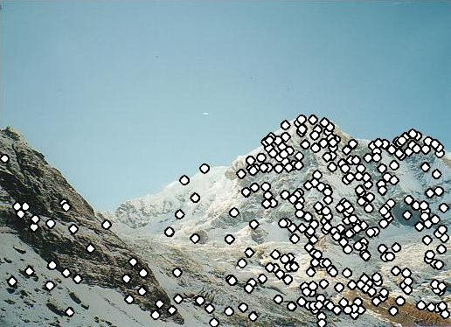
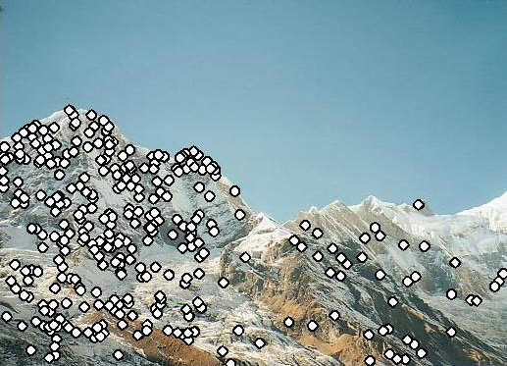
Recap: Motivation
1: find corners+features
Image credit: M. Brown

Slide 4
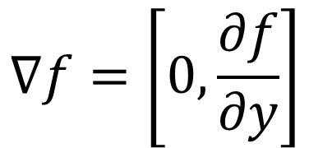
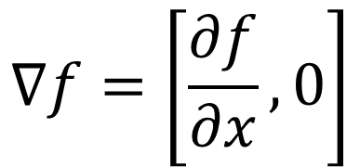
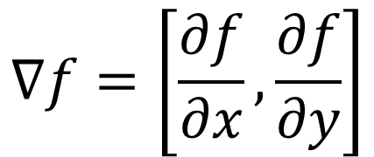
Last Time – Gradients
Image gradients – treat image like function of x,y – gives edges, corners, etc.
$$∇f=\left[\frac{∂f}{∂x}, 0\right]$$
$$∇f=\left[0,\frac{∂f}{∂y}\right]$$
$$∇f=\left[\frac{∂f}{∂x}, \frac{∂f}{∂y}\right]$$
Figure credit: S. Seitz

Slide 5

Last Time – Corner Detection
Can localize the location, or any shift →
big intensity change.
“flat” region: no change in all directions
“edge”: no change along the edge direction
“corner”: significant change in all directions
Diagram credit: S. Lazebnik

Slide 6
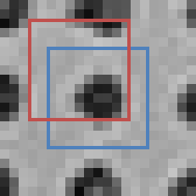


Last Time – Corner Detection
Zoom-In at x,y
Window with and w/o Offset
“Window”
At x+u, y+v
Here: u=-2,v=-3
“Window”
At x, y

Slide 7
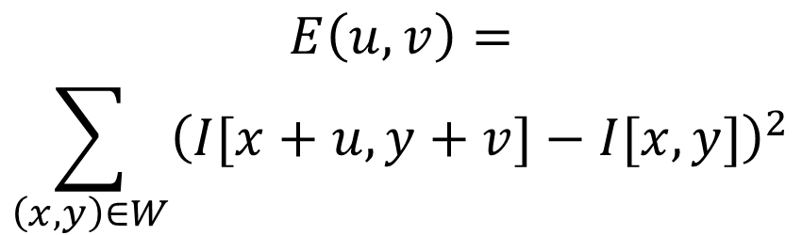
Last Time – Corner Detection
Zoom-In at x,y
Error (Sum Sqs) for u,v offset
$$E\left(u,v\right)=$$
$$\sum_{\left(x,y\right)∈W}{{\left(I[x+u,y+v]−I[x,y]\right)}^{2}}$$
(
)²
-

Slide 8
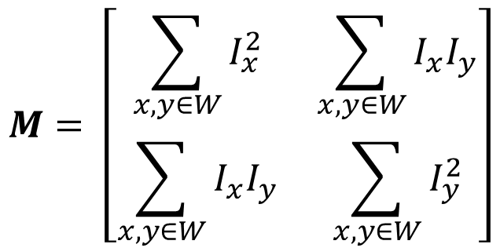
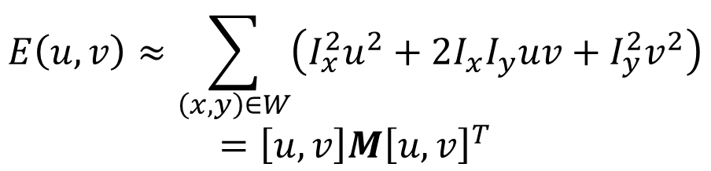
Formalizing Corner Detection
By linearizing image, we can approximate E(u,v) with quadratic function of u and v
$$E\left(u,v\right)≈\sum_{\left(x,y\right)∈W}{\left(I_{x}^{2}u^{2}+2I_{x}I_{y}uv+I_{y}^{2}v^{2}\right)}$$
$$=\left[u,v\right]M{\left[u,v\right]}^{T}$$
$$M= \left[\begin{matrix}\sum_{x,y∈W}{I_{x}^{2}} & \sum_{x,y∈W}{I_{x}I_{y}} \\ \sum_{x,y∈W}{I_{x}I_{y}} & \sum_{x,y∈W}{I_{y}^{2}}\end{matrix}\right]$$

Slide 9
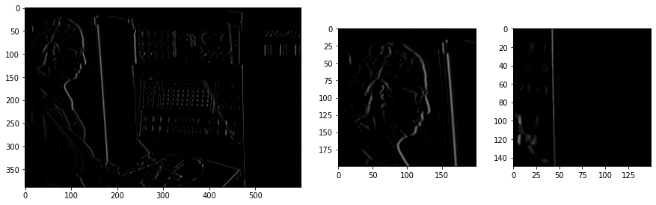
Formalizing Corner Detection
Ix = x derivative
By linearizing image, we can approximate E(u,v) with quadratic function of u and v
$$E\left(u,v\right)≈\sum_{\left(x,y\right)∈W}{\left(I_{x}^{2}u^{2}+2I_{x}I_{y}uv+I_{y}^{2}v^{2}\right)}$$
$$=\left[u,v\right]M{\left[u,v\right]}^{T}$$
$$M= \left[\begin{matrix}\sum_{x,y∈W}{I_{x}^{2}} & \sum_{x,y∈W}{I_{x}I_{y}} \\ \sum_{x,y∈W}{I_{x}I_{y}} & \sum_{x,y∈W}{I_{y}^{2}}\end{matrix}\right]$$

Slide 10

Formalizing Corner Detection
Iy = y derivative
By linearizing image, we can approximate E(u,v) with quadratic function of u and v
$$E\left(u,v\right)≈\sum_{\left(x,y\right)∈W}{\left(I_{x}^{2}u^{2}+2I_{x}I_{y}uv+I_{y}^{2}v^{2}\right)}$$
$$=\left[u,v\right]M{\left[u,v\right]}^{T}$$
$$M= \left[\begin{matrix}\sum_{x,y∈W}{I_{x}^{2}} & \sum_{x,y∈W}{I_{x}I_{y}} \\ \sum_{x,y∈W}{I_{x}I_{y}} & \sum_{x,y∈W}{I_{y}^{2}}\end{matrix}\right]$$

Slide 11
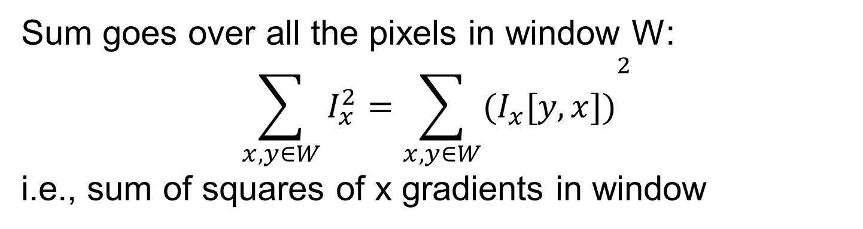
Formalizing Corner Detection
Sum goes over all the pixels in window W:
$${\sum_{x,y∈W}{I_{x}^{2}=\sum_{x,y∈W}{{(I}_{x}[y,x])}}}^{2}$$
i.e., sum of squares of x gradients in window
By linearizing image, we can approximate E(u,v) with quadratic function of u and v
$$E\left(u,v\right)≈\sum_{\left(x,y\right)∈W}{\left(I_{x}^{2}u^{2}+2I_{x}I_{y}uv+I_{y}^{2}v^{2}\right)}$$
$$=\left[u,v\right]M{\left[u,v\right]}^{T}$$
$$M= \left[\begin{matrix}\sum_{x,y∈W}{I_{x}^{2}} & \sum_{x,y∈W}{I_{x}I_{y}} \\ \sum_{x,y∈W}{I_{x}I_{y}} & \sum_{x,y∈W}{I_{y}^{2}}\end{matrix}\right]$$

Slide 12
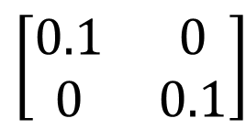
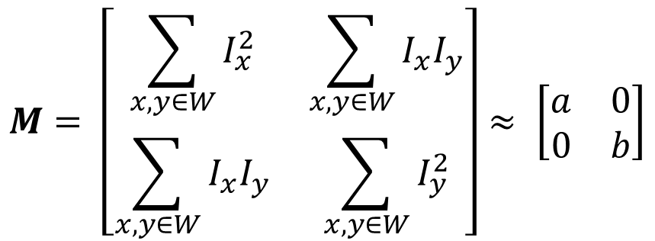
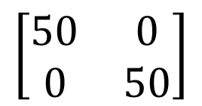
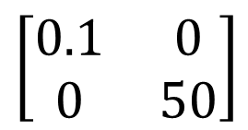
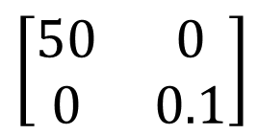
Intuitively what is M?
Pretend gradients are either vertical or horizontal at a pixel (so Ix Iy = 0)
Obviously Wrong!
$$M= \left[\begin{matrix}\sum_{x,y∈W}{I_{x}^{2}} & \sum_{x,y∈W}{I_{x}I_{y}} \\ \sum_{x,y∈W}{I_{x}I_{y}} & \sum_{x,y∈W}{I_{y}^{2}}\end{matrix}\right]≈ \left[\begin{matrix}a & 0 \\ 0 & b\end{matrix}\right]$$
$$\left[\begin{matrix}0.1 & 0 \\ 0 & 0.1\end{matrix}\right]$$
a,b both small:
flat
One big,
other small:
$$\left[\begin{matrix}50 & 0 \\ 0 & 0.1\end{matrix}\right]$$
$$\left[\begin{matrix}0.1 & 0 \\ 0 & 50\end{matrix}\right]$$
edge
or
$$\left[\begin{matrix}50 & 0 \\ 0 & 50\end{matrix}\right]$$
corner
a,b both big:

Slide 13
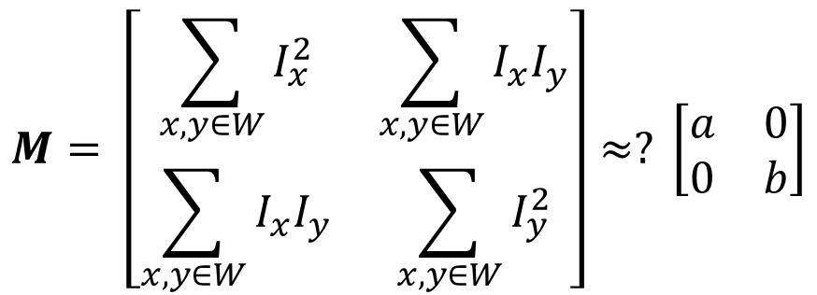
Intuitively what is M?
Pretend gradients are either vertical or horizontal at a pixel (so Ix Iy = 0)
$$M= \left[\begin{matrix}\sum_{x,y∈W}{I_{x}^{2}} & \sum_{x,y∈W}{I_{x}I_{y}} \\ \sum_{x,y∈W}{I_{x}I_{y}} & \sum_{x,y∈W}{I_{y}^{2}}\end{matrix}\right]≈? \left[\begin{matrix}a & 0 \\ 0 & b\end{matrix}\right]$$
Image might be rotated by rotation θ!
a,b both small:
flat
One big,
other small:
edge
corner
a,b both big:

Slide 14
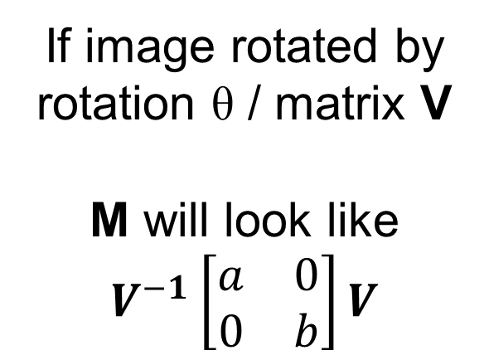
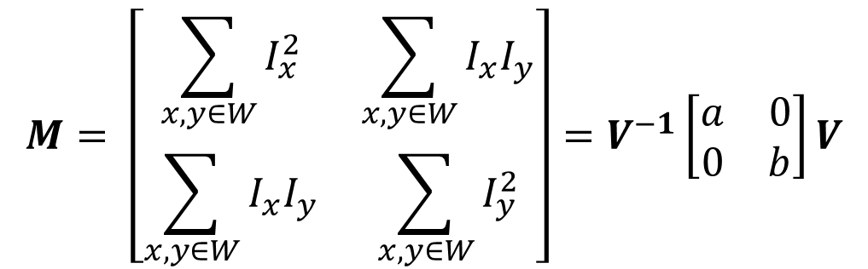
Intuitively what is M?
Pretend gradients are either vertical or horizontal at a pixel (so Ix Iy = 0)
$$M= \left[\begin{matrix}\sum_{x,y∈W}{I_{x}^{2}} & \sum_{x,y∈W}{I_{x}I_{y}} \\ \sum_{x,y∈W}{I_{x}I_{y}} & \sum_{x,y∈W}{I_{y}^{2}}\end{matrix}\right]=V^{−1}\left[\begin{matrix}a & 0 \\ 0 & b\end{matrix}\right]V$$
a,b both small:
If image rotated by rotation θ / matrix V
M will look like
$$V^{−1}\left[\begin{matrix}a & 0 \\ 0 & b\end{matrix}\right]V$$
flat
One big,
other small:
edge
corner
a,b both big:

Slide 15
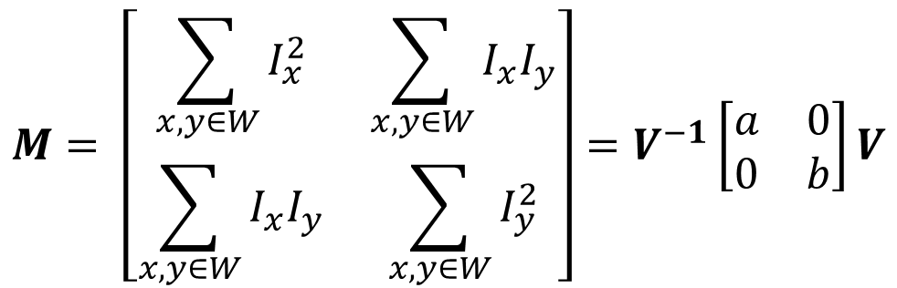
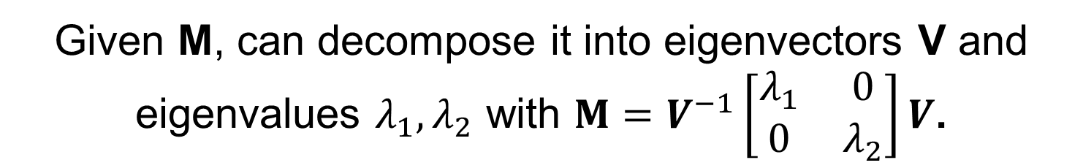
So What Now?
Can calculate M at pixel, by summing nearby gradients, but need access to a and b.
$$M= \left[\begin{matrix}\sum_{x,y∈W}{I_{x}^{2}} & \sum_{x,y∈W}{I_{x}I_{y}} \\ \sum_{x,y∈W}{I_{x}I_{y}} & \sum_{x,y∈W}{I_{y}^{2}}\end{matrix}\right]=V^{−1}\left[\begin{matrix}a & 0 \\ 0 & b\end{matrix}\right]V$$
Given M, can decompose it into eigenvectors V and eigenvalues $λ_{1},λ_{2}$ with $M=V^{−1}\left[\begin{matrix}λ_{1} & 0 \\ 0 & λ_{2}\end{matrix}\right]V$.
Really slow. Why?

Slide 16
So What Now?
Can calculate M at pixel, by summing nearby gradients, but need access to a and b.
$$M= \left[\begin{matrix}\sum_{x,y∈W}{I_{x}^{2}} & \sum_{x,y∈W}{I_{x}I_{y}} \\ \sum_{x,y∈W}{I_{x}I_{y}} & \sum_{x,y∈W}{I_{y}^{2}}\end{matrix}\right]=V^{−1}\left[\begin{matrix}a & 0 \\ 0 & b\end{matrix}\right]V$$
Instead: compute quantity R from M
$$R= det\left(M\right)−α trace{\left(M\right)}^{2}=λ_{1}λ_{2}−α {\left(λ_{1}+λ_{2}\right)}^{2}$$
Easy fast formula
for 2x2
Fast – sum the diagonal
Empirical value,
usually 0.04-0.06

Slide 17
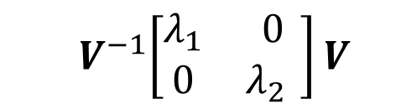

The tl;dr
TL;DR: Taylor expansion for error E(u,v). All terms in equation are sums of image gradients and in M
Should know
Optional
Can compute at each pixel
Directions
Amounts
$$M= \left[\begin{matrix}\sum_{x,y∈W}{I_{x}^{2}} & \sum_{x,y∈W}{I_{x}I_{y}} \\ \sum_{x,y∈W}{I_{x}I_{y}} & \sum_{x,y∈W}{I_{y}^{2}}\end{matrix}\right]=$$
$${ V}^{−1}\left[\begin{matrix}λ_{1} & 0 \\ 0 & λ_{2{ }}\end{matrix}\right]V$$
Ix = Ix at point (x,y), Iy = Iy at point (x,y)

Slide 18



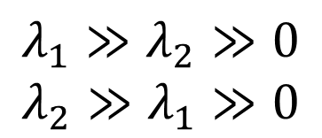

Putting It Together
$$R= det\left(M\right)−α trace{\left(M\right)}^{2}=λ_{1}λ_{2}−α {\left(λ_{1}+λ_{2}\right)}^{2}$$
det, trace are fast
R << 0
R >> 0
flat
$$λ_{1},λ_{2}≈0$$
$$λ_{1}$$
$$λ_{1}≫λ_{2}≫0$$
$$λ_{2}≫λ_{1}≫0$$
edge
corner
$$λ_{1}≈λ_{2}≫0$$
|R|≈0
R << 0
$$λ_{2}$$
Remake of standard diagram from S. Lazebnik from original Harris paper.

Slide 19
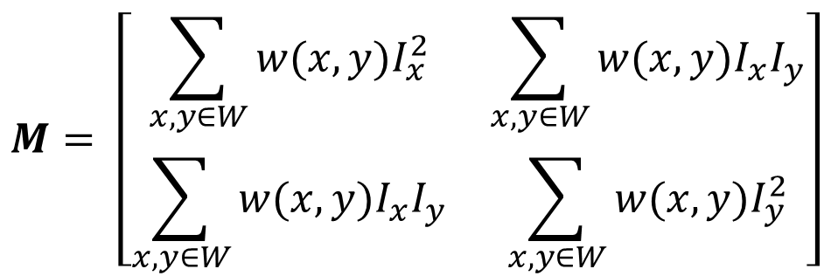
In Practice
Compute partial derivatives Ix, Iy per pixel
Compute M at each pixel, using Gaussian weighting w
$$M= \left[\begin{matrix}\sum_{x,y∈W}{{w(x,y)I}_{x}^{2}} & \sum_{x,y∈W}{{w(x,y)I}_{x}I_{y}} \\ \sum_{x,y∈W}{{w(x,y)I}_{x}I_{y}} & \sum_{x,y∈W}{{w(x,y)I}_{y}^{2}}\end{matrix}\right]$$
C.Harris and M.Stephens. “A Combined Corner and Edge Detector.” Proceedings of the 4th Alvey Vision Conference: pages 147—151, 1988.
Slide credit: S. Lazebnik

Slide 20
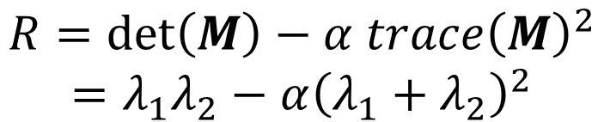
In Practice
Compute partial derivatives Ix, Iy per pixel
Compute M at each pixel, using Gaussian weighting w
Compute response function R
$$R=\det\left(M\right)−α trace{\left(M\right)}^{2}$$
$$=λ_{1}λ_{2}−α{\left(λ_{1}+λ_{2}\right)}^{2}$$
C.Harris and M.Stephens. “A Combined Corner and Edge Detector.” Proceedings of the 4th Alvey Vision Conference: pages 147—151, 1988.
Slide credit: S. Lazebnik

Slide 21
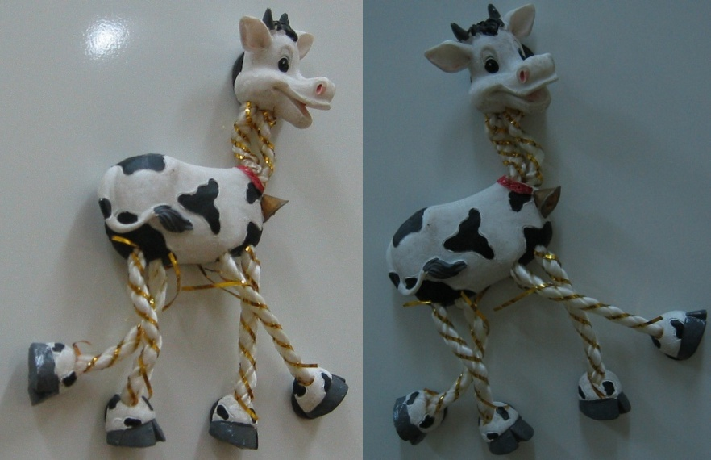
Computing R
Slide credit: S. Lazebnik

Slide 22
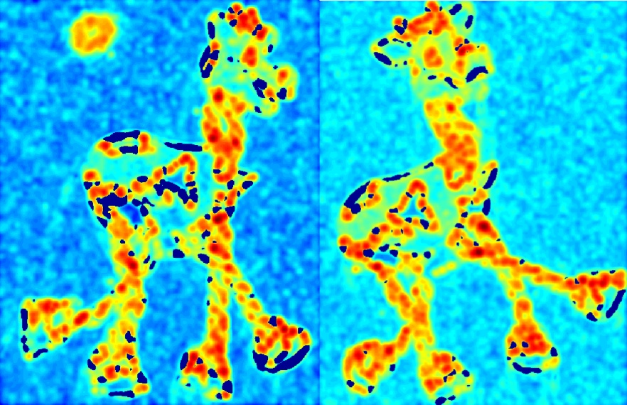
Computing R
Slide credit: S. Lazebnik

Slide 23
In Practice
Compute partial derivatives Ix, Iy per pixel
Compute M at each pixel, using Gaussian weighting w
Compute response function R
Threshold R
C.Harris and M.Stephens. “A Combined Corner and Edge Detector.” Proceedings of the 4th Alvey Vision Conference: pages 147—151, 1988.
Slide credit: S. Lazebnik

Slide 24
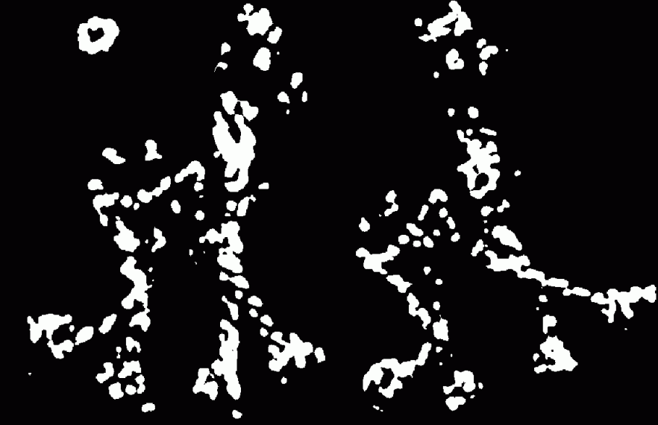
Thresholded R
Slide credit: S. Lazebnik

Slide 25
In Practice
Compute partial derivatives Ix, Iy per pixel
Compute M at each pixel, using Gaussian weighting w
Compute response function R
Threshold R
Take only local maxima (called non-maxima suppression)
C.Harris and M.Stephens. “A Combined Corner and Edge Detector.” Proceedings of the 4th Alvey Vision Conference: pages 147—151, 1988.
Slide credit: S. Lazebnik

Slide 26
Thresholded
Slide credit: S. Lazebnik

Slide 27

Final Results
Slide credit: S. Lazebnik

Slide 28
Desirable Properties
If our detectors are repeatable, they should be:
Invariant to some things: image is transformed and corners remain the same
Covariant/equivariant with some things: image is transformed and corners transform with it.
Slide credit: S. Lazebnik

Slide 29
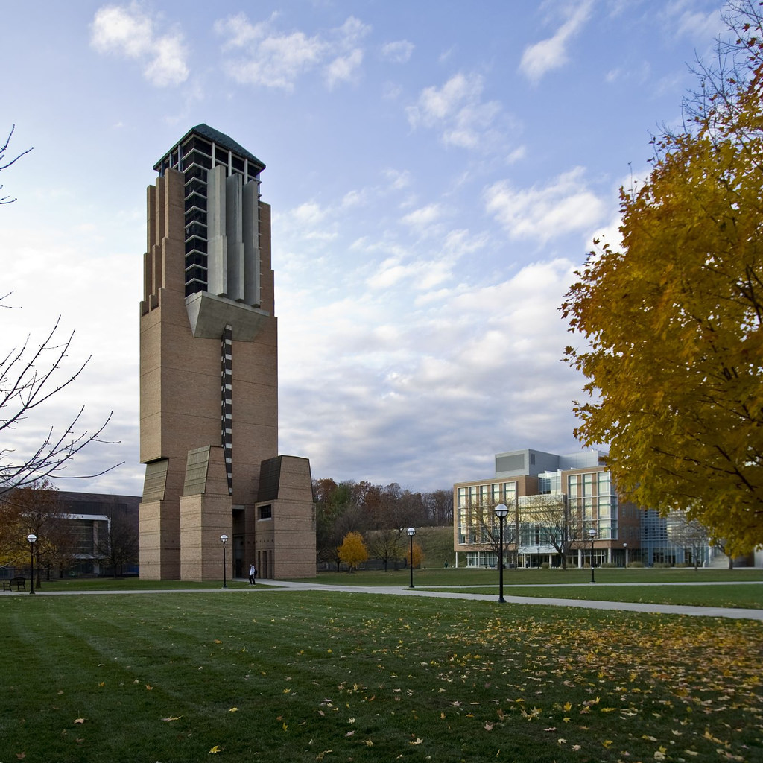
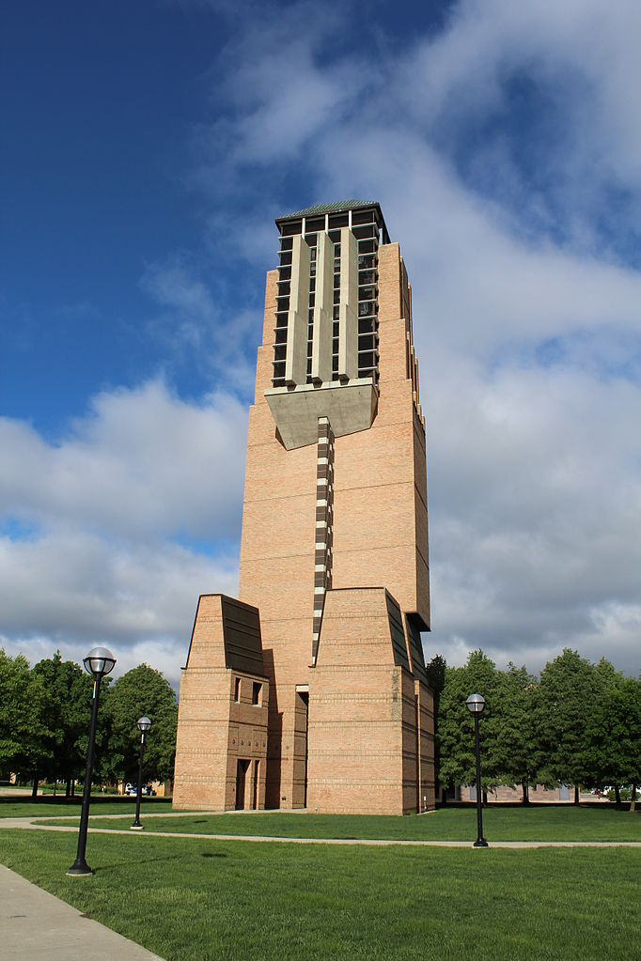
Recall Motivating Problem
Images may be different in lighting and geometry

Slide 30

Affine Intensity Change
$$I_{new}=aI_{old}+b$$
M only depends on derivatives, so b is irrelevant
But a scales derivatives and there’s a threshold
R
R
threshold
x (image coordinate)
x (image coordinate)
Partially invariant to affine intensity changes
Slide credit: S. Lazebnik

Slide 31
Image Translation
All done with convolution. Convolution is translation equivariant.
Equivariant with translation
Slide credit: S. Lazebnik

Slide 32
Image Rotation
Rotations just cause the corner rotation matrix to change. Eigenvalues remain the same.
Equivariant with rotation
Slide credit: S. Lazebnik

Slide 33
Image Scaling
Corner
One pixel can become many pixels and
vice-versa.
Not equivariant with scaling
How do we fix this?
Slide credit: S. Lazebnik

Slide 34
Recap: Motivation
1: find corners+features
2: match based on local image data
How?
Image credit: M. Brown

Slide 35
Today
Fixing scaling by making detectors in both location and scale
Enabling matching between features by describing regions

Slide 36
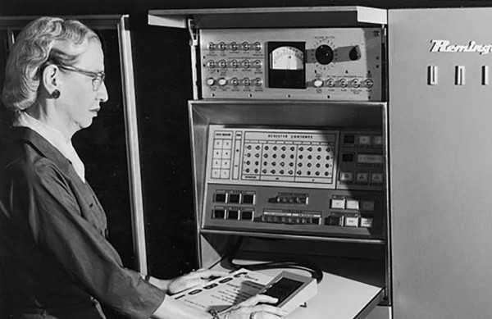





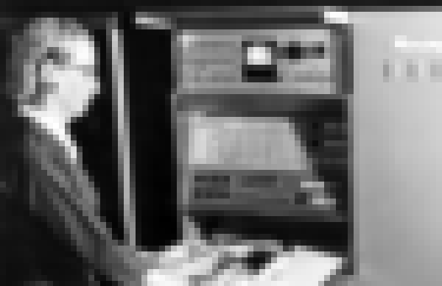
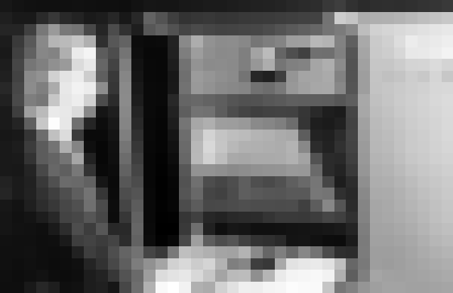
Key Idea: Scale Space
Left to right: each image is half-sized
Upsampled with big pixels below
1/2
1/2
1/2
Note: I’m also slightly blurring to prevent aliasing (https://en.wikipedia.org/wiki/Aliasing)

Slide 37
Key Idea: Scale Space
Left to right: each image is half-sized
If I apply a KxK filter, how much of the original image does it see in each image?
1/2
1/2
1/2
A
B
C
Note: I’m also slightly blurring to prevent aliasing (https://en.wikipedia.org/wiki/Aliasing)

Slide 38
Solution to Scales
Try them all!
Harris Detection
Harris Detection
Harris Detection
Harris Detection
See: Multi-Image Matching using Multi-Scale Oriented Patches, Brown et al. CVPR 2005

Slide 39
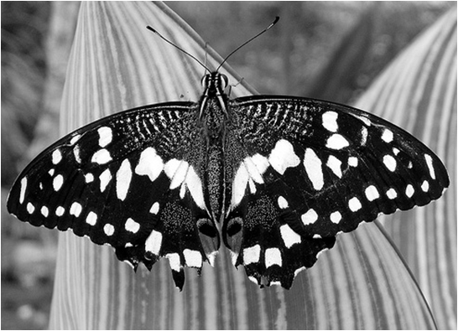
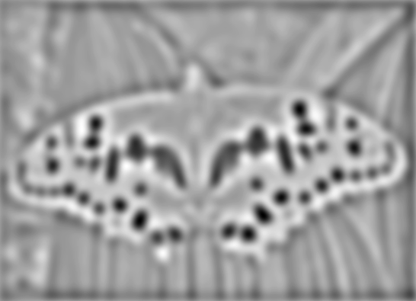



Blob Detection
Another detector (has some nice properties)
Minima
$$∗$$
$$=$$
Maxima
Find maxima and minima of blob filter response in scale and space
Slide credit: N. Snavely

Slide 40


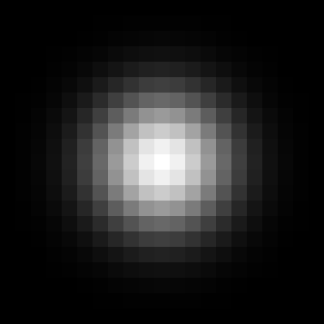


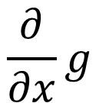
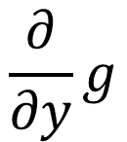
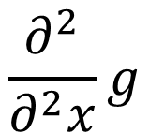
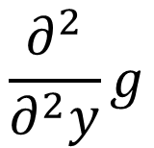
Gaussian Derivatives
1st Deriv
2nd Deriv
Gaussian
$$\frac{∂}{∂y}g$$
$$\frac{∂^{2}}{∂^{2}y}g$$
$$\frac{∂}{∂x}g$$
$$\frac{∂^{2}}{∂^{2}x}g$$

Slide 41

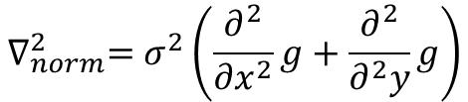
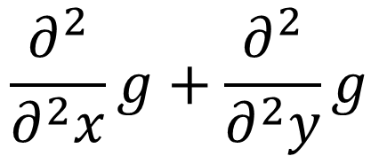
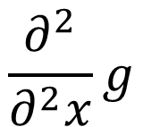
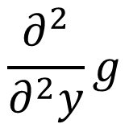
Laplacian of Gaussian (LoG)
$$\frac{∂^{2}}{∂^{2}x}g+\frac{∂^{2}}{∂^{2}y}g$$
$$\frac{∂^{2}}{∂^{2}y}g$$
+
$$\frac{∂^{2}}{∂^{2}x}g$$
Slight detail: for technical reasons, you need to scale the Laplacian of Gaussian if you want to compare across sigmas.
$$∇_{norm}^{2}=σ^{2}\left(\frac{∂^{2}}{∂x^{2}}g+\frac{∂^{2}}{∂^{2}y}g\right)$$

Slide 42
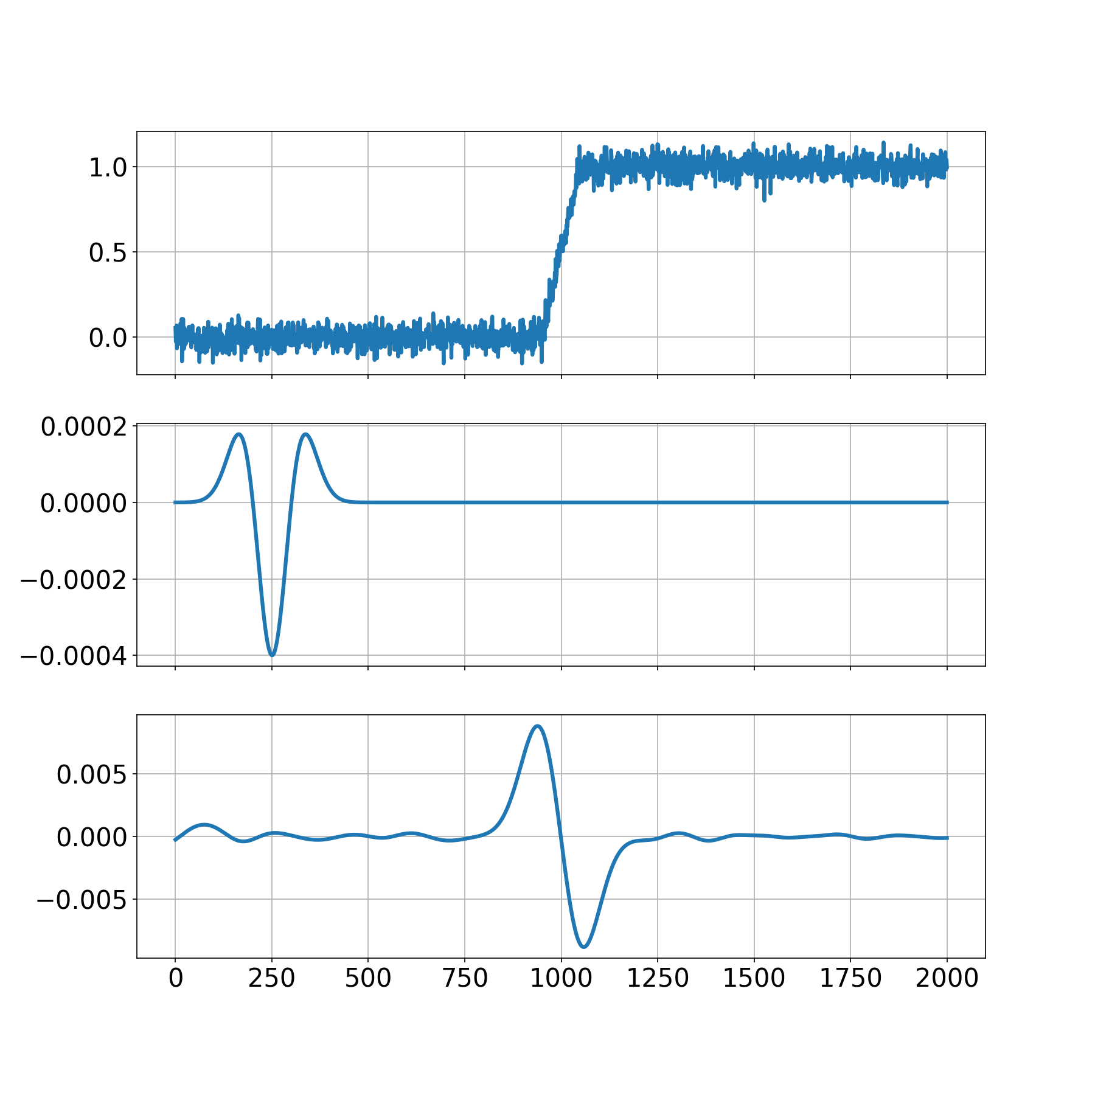

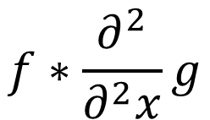
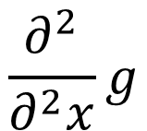
Edge Detection with LoG
$$f$$
Edge
Laplacian
Of Gaussian
(LoG)
$$\frac{∂^{2}}{∂^{2}x}g$$
$$f∗\frac{∂^{2}}{∂^{2}x}g$$
Edge =
Zero-crossing
Modern remake of classic S. Seitz slide

Slide 43
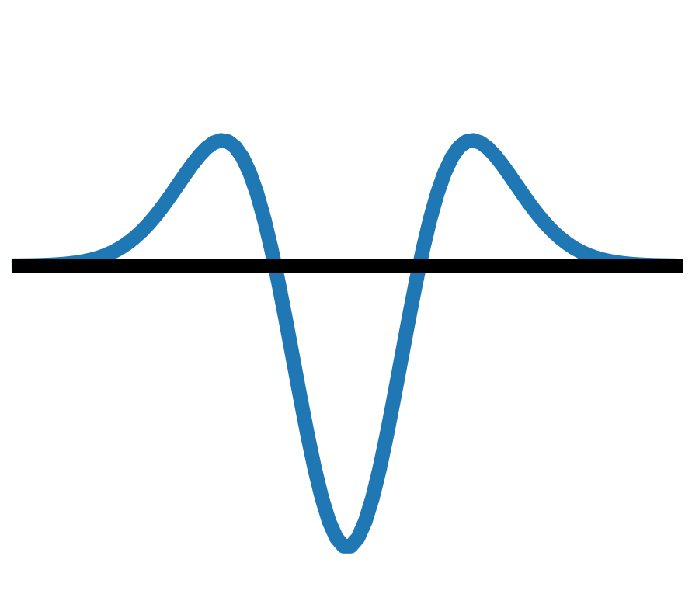
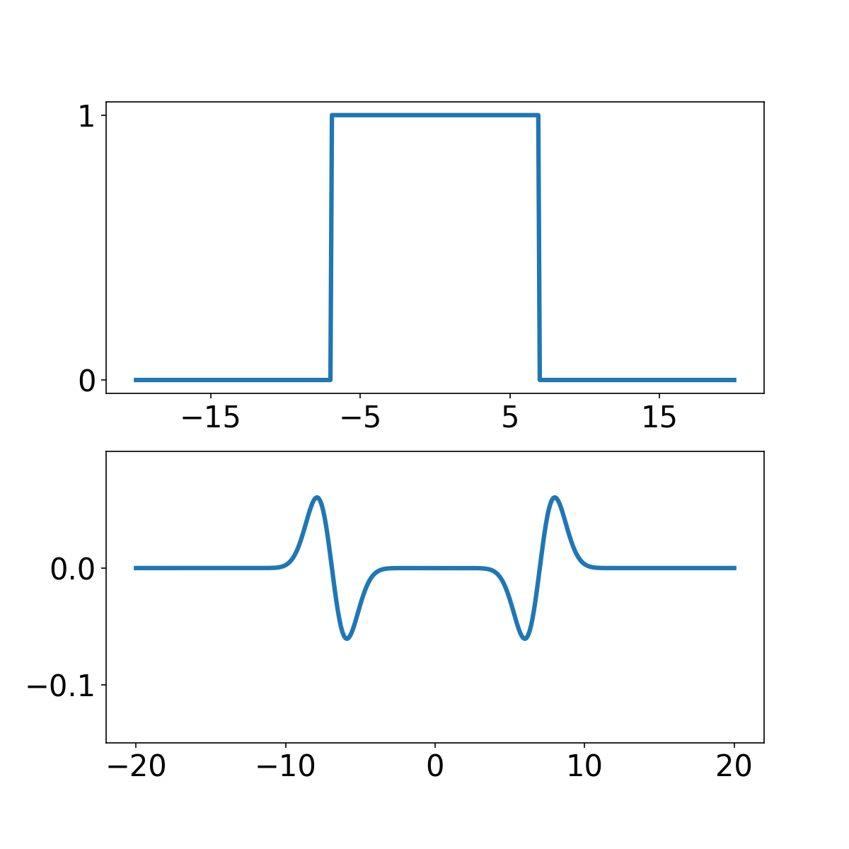


Edge Detection with LoG
$$f$$
Edges
Edges *
LoG =
Zero-crossings
$$f∗\frac{∂^{2}}{∂^{2}x}g$$
Modern remake of classic S. Seitz slide

Slide 44

Edge Detection with LoG
$$f$$
Edges
What happens if we make input 1 unit wide?
Edges *
LoG =
Zero-crossings
$$f∗\frac{∂^{2}}{∂^{2}x}g$$
Modern remake of classic S. Seitz slide

Slide 45

Edge Detection with LoG
$$f$$
Edge
Edge *
LoG =
Zero-crossing
$$f∗\frac{∂^{2}}{∂^{2}x}g$$
Modern remake of classic S. Seitz slide

Slide 46








Scale Selection
Given binary circle and Laplacian filter of scale σ, we can compute the response as a function of the scale.
$$Image$$
$$σ=2$$
$$σ=6$$
$$σ=10$$
Radius: 8
R: 0.02
R: 2.9
R: 1.8

Slide 47

Characteristic Scale
Characteristic scale of a blob is the scale
that produces the maximum response
Image
Abs. Response
Slide credit: S. Lazebnik. For more, see: T. Lindeberg (1998). "Feature detection with automatic scale selection." International Journal of Computer Vision 30 (2): pp 77--116.

Slide 48
Scale-space blob detector
Convolve image with scale-normalized Laplacian at several scales
Slide credit: S. Lazebnik

Slide 49

Scale-space blob detector: Example
Slide credit: S. Lazebnik

Slide 50










Scale-space blob detector: Example
Slide credit: S. Lazebnik

Slide 51

Scale-space blob detector
Convolve image with scale-normalized Laplacian at several scales
Find maxima of squared Laplacian response in scale-space
Slide credit: S. Lazebnik

Slide 52
Finding Maxima
Point i,j is maxima (minima if you flip sign) in image I if it’s bigger than all neighbors
for y=range(i-1,i+1+1):
for x in range(j-1,j+1+1):
if y == i and x== j: continue
#below has to be true
I[y,x] < I[i,j]

Slide 53
Scale Space
Blue lines are image-space neighbors (should be just one pixel over but that’s impossible to draw)
$$Image$$
$$σ=2$$
$$σ=6$$
$$σ=10$$
Radius: 8
R: 0.02
R: 2.9
R: 1.8

Slide 54
Scale Space
Red lines are the scale-space neighbors
$$Image$$
$$σ=2$$
$$σ=6$$
$$σ=10$$
Radius: 8
R: 0.02
R: 2.9
R: 1.8

Slide 55
Finding Maxima
Suppose I[:,:,k] is image at scale k. Point i,j,k is maxima (minima if you flip sign) in image I if:
for y=range(i-1,i+1+1):
for x in range(j-1,j+1+1):
for c in range(k-1,k+1+1):
if y == i and x== j and c==k: continue
#below has to be true
I[y,x,c] < I[i,j,k]

Slide 56

Scale-space blob detector: Example
Slide credit: S. Lazebnik

Slide 57

Efficient implementation
Approximating the Laplacian with a difference of Gaussians:
(Laplacian)
(Difference of Gaussians)
Slide credit: S. Lazebnik

Slide 58

Efficient implementation
David G. Lowe. "Distinctive image features from scale-invariant keypoints.” IJCV 60 (2), pp. 91-110, 2004.
Slide credit: S. Lazebnik

Slide 59

Problem 1 Solved
How do we deal with scales: try them all
Why is this efficient?
Vast majority of effort is in the first and second scales
$$1+ \frac{1}{4}+\frac{1}{16}+\frac{1}{64}+\frac{1}{4^{i}}…=\frac{4}{3}$$
Notes:
1 + 1/4

Slide 60




Problem 2 – Describing Features
Image – 40
1/2 size, rot. 45°
Lightened+40
Full
Image
100x100 crop at Glasses

Slide 61
Problem 2 – Describing Features
Once we’ve found a corner/blobs, we can’t just use the image nearby. What about:
Scale?
Rotation?
Additive light?

Slide 62
Handling Scale
Given characteristic scale (maximum Laplacian response), we can just rescale image
Slide credit: S. Lazebnik

Slide 63

Handling Rotation
Given window, can compute “dominant orientation” and then rotate image
“y”
0
2
π
“x”
Slide credit: S. Lazebnik

Slide 64

Scale and Rotation
SIFT features at characteristic scales and dominant orientations
Picture credit: S. Lazebnik. Paper: David G. Lowe. "Distinctive image features from scale-invariant keypoints.” IJCV 60 (2), pp. 91-110, 2004.

Slide 65
Scale and Rotation
Rotate and set to common scale
j
Rotate and set to common scale
Picture credit: S. Lazebnik. Paper: David G. Lowe. "Distinctive image features from scale-invariant keypoints.” IJCV 60 (2), pp. 91-110, 2004.

Slide 66

SIFT Descriptors
j
Compute gradients
Build histogram (2x2 here, 4x4 in practice)
Gradients ignore global illumination changes
Figure from David G. Lowe. "Distinctive image features from scale-invariant keypoints.” IJCV 60 (2), pp. 91-110, 2004.

Slide 67
SIFT Descriptors
In principle: build a histogram of the gradients
In reality: quite complicated
Gaussian weighting: smooth response
Normalization: reduces illumination effects
Clamping
Tons of more stuff

Slide 68


Properties of SIFT
Can handle: up to ~60 degree out-of-plane rotation, changes of illumination
Fast, efficient, code available (but was patented)
Slide credit: N. Snavely

Slide 69
Feature Descriptors
Think of feature as some non-linear filter that maps pixels to 128D feature
128D vector x
Photo credit: N. Snavely

Slide 70







Instance Matching
$$\left\|x_{1}−x_{3}\right\|=1.22$$
$$x_{1}$$
$$x_{3}$$
$$x_{2}$$
$$\left\|x_{1}−x_{2}\right\|=0.61$$
Example credit: J. Hays

Slide 71







Instance Matching
$$\left\|x_{4}−x_{5}\right\|=0.34$$
$$\left\|x_{4}−x_{6}\right\|=0.30$$
$$\left\|x_{4}−x_{6}\right\|=0.40$$
$$x_{4}$$
$$x_{5}$$
$$x_{6}$$
$$x_{7}$$
Example credit: J. Hays

Slide 72

2nd Nearest Neighbor Trick
Given a feature x_{q}, nearest neighbor to x is a good match, but distances can’t be thresholded.
Instead, find nearest neighbor (x_{1NN}) and second nearest neighbor (x_{2NN}). This ratio is a good test for matches:
$$r=\frac{\left\|x_{q}−x_{1NN}\right\|}{\left\|x_{q}−x_{2NN}\right\|}$$

Slide 73
So Far; What’s Next?
1: find corners+features
2: match based on local image data
3: next time: compute offsets from matches

Slide 75
Extra Reading for the Curious

Slide 76

Aside: This Trick is Common
Given a 50x16 person detector, how do I detect:
(a) 250x80 (b) 150x48 (c) 100x32 (d) 25x8 people?
Sample people from image

Slide 77
Aside: This Trick is Common
Detecting all the people
The red box is a fixed size
Sample people from image

Slide 78
Aside: This Trick is Common
Detecting all the people
The red box is a fixed size
Sample people from image

Slide 79

Aside: This Trick is Common
Detecting all the people
The red box is a fixed size
Sample people from image

Slide 80
Affine adaptation
Consider the second moment matrix of the window containing the blob:
direction of the fastest change
Recall:
direction of the slowest change
(λ_{max})^{-1/2}
(λ_{min})^{-1/2}
This ellipse visualizes the “characteristic shape” of the window
Slide: S. Lazebnik

Slide 81
Affine adaptation example
Scale-invariant regions (blobs)
Slide: S. Lazebnik

Slide 82

Affine adaptation example
Affine-adapted blobs
Slide: S. Lazebnik

Slide 83

2nd Nearest Neighbor Trick
Figure from David G. Lowe. "Distinctive image features from scale-invariant keypoints.” IJCV 60 (2), pp. 91-110, 2004.

