Slide 1
Convolutional Neural Nets II
EECS 442 – David Fouhey
Winter 2023, University of Michigan
http://web.eecs.umich.edu/~fouhey/teaching/EECS442_W23/

Slide 2
Fully Connected Network
a₁
h₁
y₁
x₁
a₂
h₂
y₂
x₂
a₃
h₃
y₃
a₄
h₄
W₁
b₁
W₂
b₂
W₃
b₃
x
L
f(n)
L
f(n)
L
f(n)

Slide 3
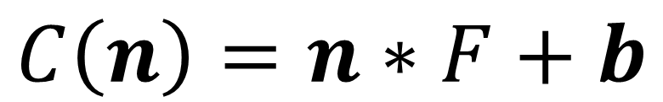
Convolutional Layer
New Block: 2D Convolution
W
b
$$C\left(n\right)=n∗F+b$$
n
C

Slide 4
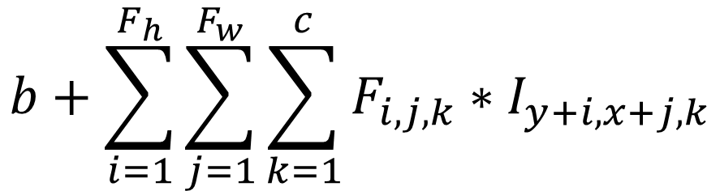
Convolution Layer
F_{w}
32
F_{h}
c
$$b+\sum_{i=1}^{F_{h}}{\sum_{j=1}^{F_{w}}{\sum_{k=1}^{c}{F_{i,j,k}∗I_{y+i,x+j,k}}}}$$
32
3
Slide credit: Karpathy and Fei-Fei

Slide 5
Convolutional Neural Network (CNN)
W₁
b₁
W₂
b₂
W₃
b₃
x
C
f(n)
C
f(n)
C
f(n)

Slide 6
Today
C
W
1
F
CNN
1
H
Convert HxW image into a F-dimensional vector
What’s the probability this image is a cat (F=1)
Which of 1000 categories is this image? (F=1000)
At what GPS coord was this image taken? (F=2)
Identify the X,Y coordinates of 28 body joints of an image of a human (F=56)

Slide 7
Today’s Running Example: Classification
C
W
1
F
CNN
1
H
Running example:
image classification
P(image is class #1)
P(image is class #2)
P(image is class #F)

Slide 8
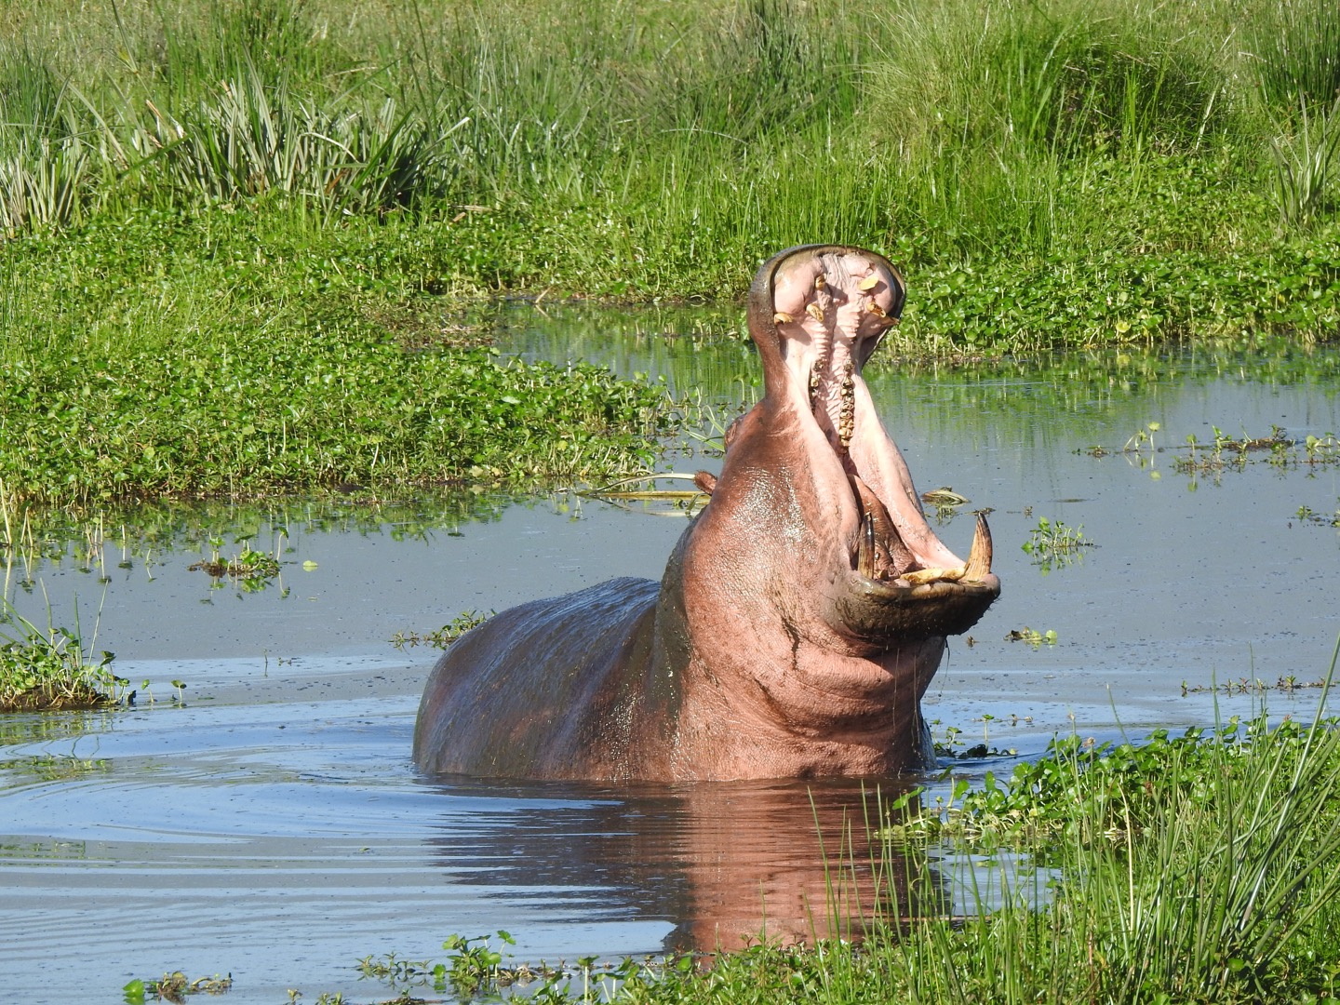
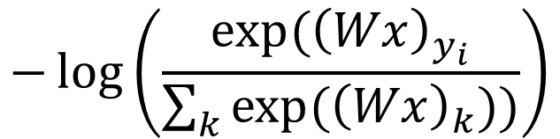
Today’s Running Example: Classification
C
Hippo
Cat
Dog
W
Baboon
1
CNN
1
0.5
0.2
0.1
0.2
H
y_{i}: class #0
Loss function
“Hippo”
$$−\log\left(\frac{exp⁡({\left(Wx\right)}_{y_{i}}}{\sum_{k}{exp⁡({\left(Wx\right)}_{k}))}}\right)$$

Slide 9
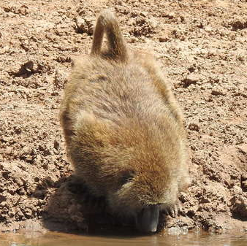
Today’s Running Example: Classification
C
Hippo
Cat
Dog
W
Baboon
1
CNN
1
0.5
0.2
0.1
0.2
H
y_{i}: class #3
Loss function
“Baboon”
$$−\log\left(\frac{exp⁡({\left(Wx\right)}_{y_{i}}}{\sum_{k}{exp⁡({\left(Wx\right)}_{k}))}}\right)$$

Slide 10
Model For Your Head
C
W
1
F
CNN
1
H
Provide:
  Examples of images and desired outputs
  Sequence of layers producing a 1x1xF output
  A loss function that measures success
Train the network -> network figures out the parameters that makes this work

Slide 11
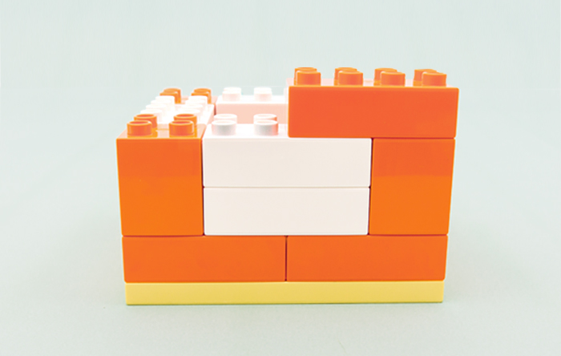
Layer Collection
You can construct functions out of layers. The only requirement is the layers “fit” together. Optimization figures out what the parameters of the layers are.
Image credit: lego.com

Slide 12
Review – Pooling
Idea: just want spatial resolution of activations / images smaller; applied per-channel
1
1
2
4
Max-pool
2x2 Filter
Stride 2
5
6
7
8
6
8
3
2
1
0
3
4
1
1
3
4
Slide credit: Karpathy and Fei-Fei

Slide 13
Review – Pooling
Max-pool
2x2 Filter
Stride 2
1
1
2
4
6
8
5
6
7
8
3
2
1
0
3
4
1
1
3
4

Slide 14
Other Layers – Fully Connected
1x1xC
1x1xF
Map C-dimensional feature to F-dimensional feature using linear transformation
W (FxC matrix) + b (Fx1 vector)
How can we write this as a convolution?

Slide 15
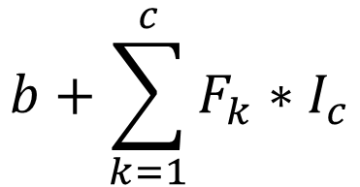
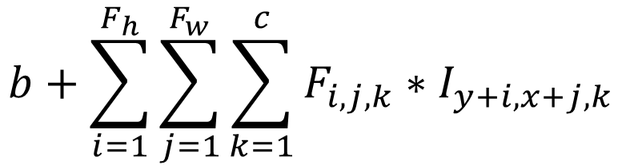
Everything’s a Convolution
1x1xC
1x1xF
Set Fh=1, Fw=1
1x1 Convolution with F Filters
$$b+\sum_{i=1}^{F_{h}}{\sum_{j=1}^{F_{w}}{\sum_{k=1}^{c}{F_{i,j,k}∗I_{y+i,x+j,k}}}}$$
$$b+\sum_{k=1}^{c}{F_{k}∗I_{c}}$$

Slide 16
Converting to a Vector
HxWxC
1x1xF
How can we do this?

Slide 17
Converting to a Vector* – Pool
HxWxC
1x1xF
1
1
2
4
Avg Pool
HxW Filter
Stride 1
5
6
7
8
3.1
3
2
1
0
1
1
3
4
*(If F == C)

Slide 18

Converting to a Vector – Convolve
HxWxC
1x1xF
HxW Convolution with F Filters
Single value
Per-filter
$$∗$$

Slide 19
Looking At Networks
We’ll look at 3 landmark networks, each trained to solve a 1000-way classification output (Imagenet)
  Alexnet (2012)
  VGG-16 (2014)
  Resnet (2015)

Slide 20
AlexNet
Input
Conv
1
Conv
2
Conv
3
Conv
4
Conv
5
FC
6
FC
7
Output
227x2273
55x5596
27x27256
13x13384
13x13
384
13x13
256
1x1
4096
1x1
4096
1x1
1000
Each block is a HxWxC volume.
You transform one volume to another with convolution

Slide 21
CNN Terminology
Input
Conv
1
Conv
2
Conv
3
Conv
4
Conv
5
FC
6
FC
7
Output
227x2273
55x5596
27x27256
13x13384
13x13
384
13x13
256
1x1
4096
1x1
4096
1x1
1000
Each entry is called an
“activation”/“neuron”/“feature”

Slide 22
AlexNet
Input
Conv
1
Conv
2
Conv
3
Conv
4
Conv
5
FC
6
FC
7
Output
227x2273
55x5596
27x27256
13x13384
13x13
384
13x13
256
1x1
4096
1x1
4096
1x1
1000

Slide 23
AlexNet
Input
Conv
1
227x2273
55x5596
227x227
3
55x55
96
55x55
96
ReLU
11x11 filter, stride of 4
(227-11)/4+1 = 55

Slide 24
AlexNet
Input
Conv
1
Conv
2
Conv
3
Conv
4
Conv
5
FC
6
FC
7
Output
227x2273
55x5596
27x27256
13x13384
13x13
384
13x13
256
1x1
4096
1x1
4096
1x1
1000
All layers followed by ReLU
Red layers are followed by maxpool
Early layers have “normalization”

Slide 25
AlexNet – Details
Input
Conv
1
Conv
2
Conv
3
Conv
4
Conv
5
FC
6
FC
7
Output
227x2273
55x5596
27x27256
13x13384
13x13
384
13x13
256
1x1
4096
1x1
4096
1x1
1000
C: 11
P: 3
C:5
P:3
C:3
C:3
C:3
P:3
C: Size of conv
P: Size of pool

Slide 26
AlexNet
Input
Conv
1
Conv
2
Conv
3
Conv
4
Conv
5
FC
6
FC
7
Output
227x2273
55x5596
27x27256
13x13384
13x13
384
13x13
256
1x1
4096
1x1
4096
1x1
1000
13x13 Input, 1x1 output. How?

Slide 27
Alexnet – How Many Parameters?
Input
Conv
1
Conv
2
Conv
3
Conv
4
Conv
5
FC
6
FC
7
Output
227x2273
55x5596
27x27256
13x13384
13x13
384
13x13
256
1x1
4096
1x1
4096
1x1
1000

Slide 28
Alexnet – How Many Parameters?
Input
Conv
1
Conv
2
Conv
3
Conv
4
Conv
5
FC
6
FC
7
Output
227x2273
55x5596
27x27256
13x13384
13x13
384
13x13
256
1x1
4096
1x1
4096
1x1
1000
96 11x11 filters on 3-channel input
11x11x3x96+96 = 34,944

Slide 29
Alexnet – How Many Parameters?
Input
Conv
1
Conv
2
Conv
3
Conv
4
Conv
5
FC
6
FC
7
Output
227x2273
55x5596
27x27256
13x13384
13x13
384
13x13
256
1x1
4096
1x1
4096
1x1
1000
Note: max pool to 6x6
4096 6x6 filters on 256-channel input
6x6x256x4096+4096 = 38 million

Slide 30
Alexnet – How Many Parameters?
Input
Conv
1
Conv
2
Conv
3
Conv
4
Conv
5
FC
6
FC
7
Output
227x2273
55x5596
27x27256
13x13384
13x13
384
13x13
256
1x1
4096
1x1
4096
1x1
1000
4096 1x1 filters on 4096-channel input
1x1x4096x4096+4096 = 17 million

Slide 31
Alexnet – How Many Parameters
How long would it take you to list the parameters of Alexnet at 4s / parameter?
1 year?
4 years?
8 years?
16 years?
62.4 million parameters
Vast majority in fully connected layers
But... paper notes that removing the convolutions is disastrous for performance.

Slide 32
Dataset – ILSVRC
Imagenet Largescale Visual Recognition Challenge
1.4M images
1000 Categories, often ridiculously precise

Slide 33
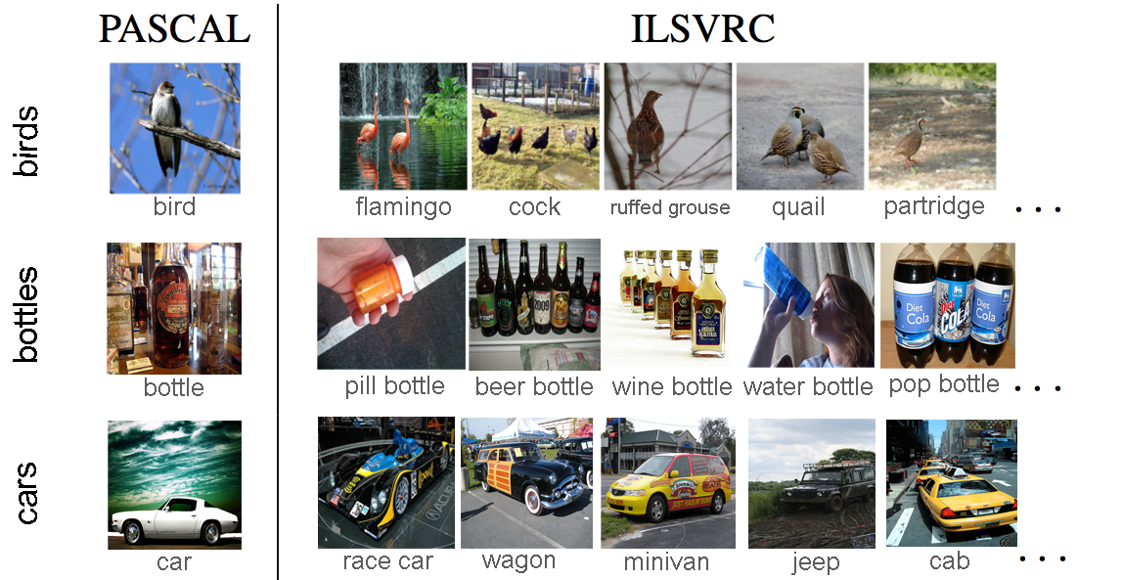
Dataset – ILSVRC
Figure Credit: O. Russakovsky

Slide 34
Visualizing Filters
Input
Conv
1
227x2273
55x5596
Conv 1 Filters
Q. How many input dimensions?
A: 3
What does the input mean?
R, G, B, duh.

Slide 35
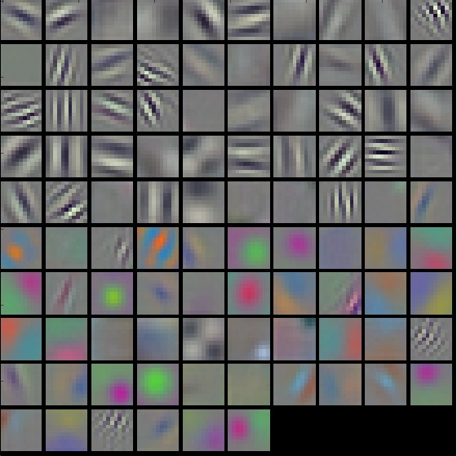
What’s Learned – Recap
First layer filters of a network trained to distinguish 1000 categories of objects
Remember these filters go over color.
Figure Credit: Karpathy and Fei-Fei

Slide 36
Visualizing Later Filters
Input
Conv
1
Conv
2
227x2273
55x5596
27x27256
Conv 2 Filters
Q. How many input dimensions?
A: 96…. hmmm
What does the input mean?
Uh, the uh, previous slide

Slide 37
Visualizing Later Filters
Understanding the meaning of the later filters from their values is typically impossible: too many input dimensions, not even clear what the input means.

Slide 38
Understanding Later Filters
Input
Conv
1
Conv
2
Conv
3
Conv
4
Conv
5
FC
6
FC
7
Output
227x2273
55x5596
27x27256
13x13384
13x13
384
13x13
256
1x1
4096
1x1
4096
1x1
1000
CNN that extracts a 13x13x256 output
2-hidden layer Neural network

Slide 39
Understanding Later Filters
Input
Conv
1
Conv
2
Conv
3
Conv
4
Conv
5
FC
6
FC
7
Output
227x2273
55x5596
27x27256
13x13384
13x13
384
13x13
256
1x1
4096
1x1
4096
1x1
1000
CNN that extracts a
1x1x4096 feature
1-hidden layer NN

Slide 40
Understanding Later Filters
Input
Conv
1
Conv
2
Conv
3
Conv
4
Conv
5
227x2273
55x5596
27x27256
13x13384
13x13
384
13x13
256
CNN that extracts a 13x13x256 output

Slide 41
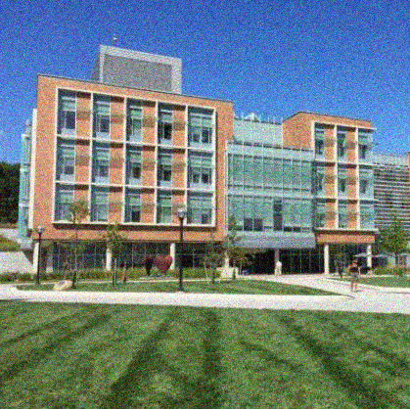
Understanding Later Filters
Feed an image in, see what score the filter gives it. A more pleasant version of a real neuroscience procedure.
13x13
256
Which one’s bigger? What image makes the output biggest?
13x13
256

Slide 42
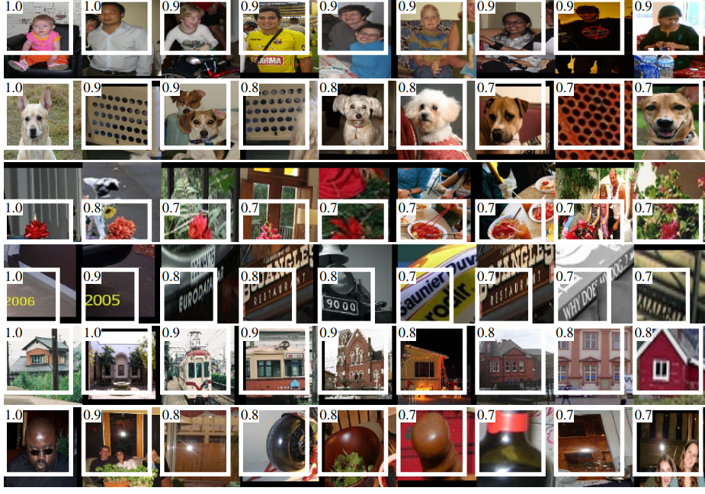
Figure Credit: Girschick et al. CVPR 2014.

Slide 43
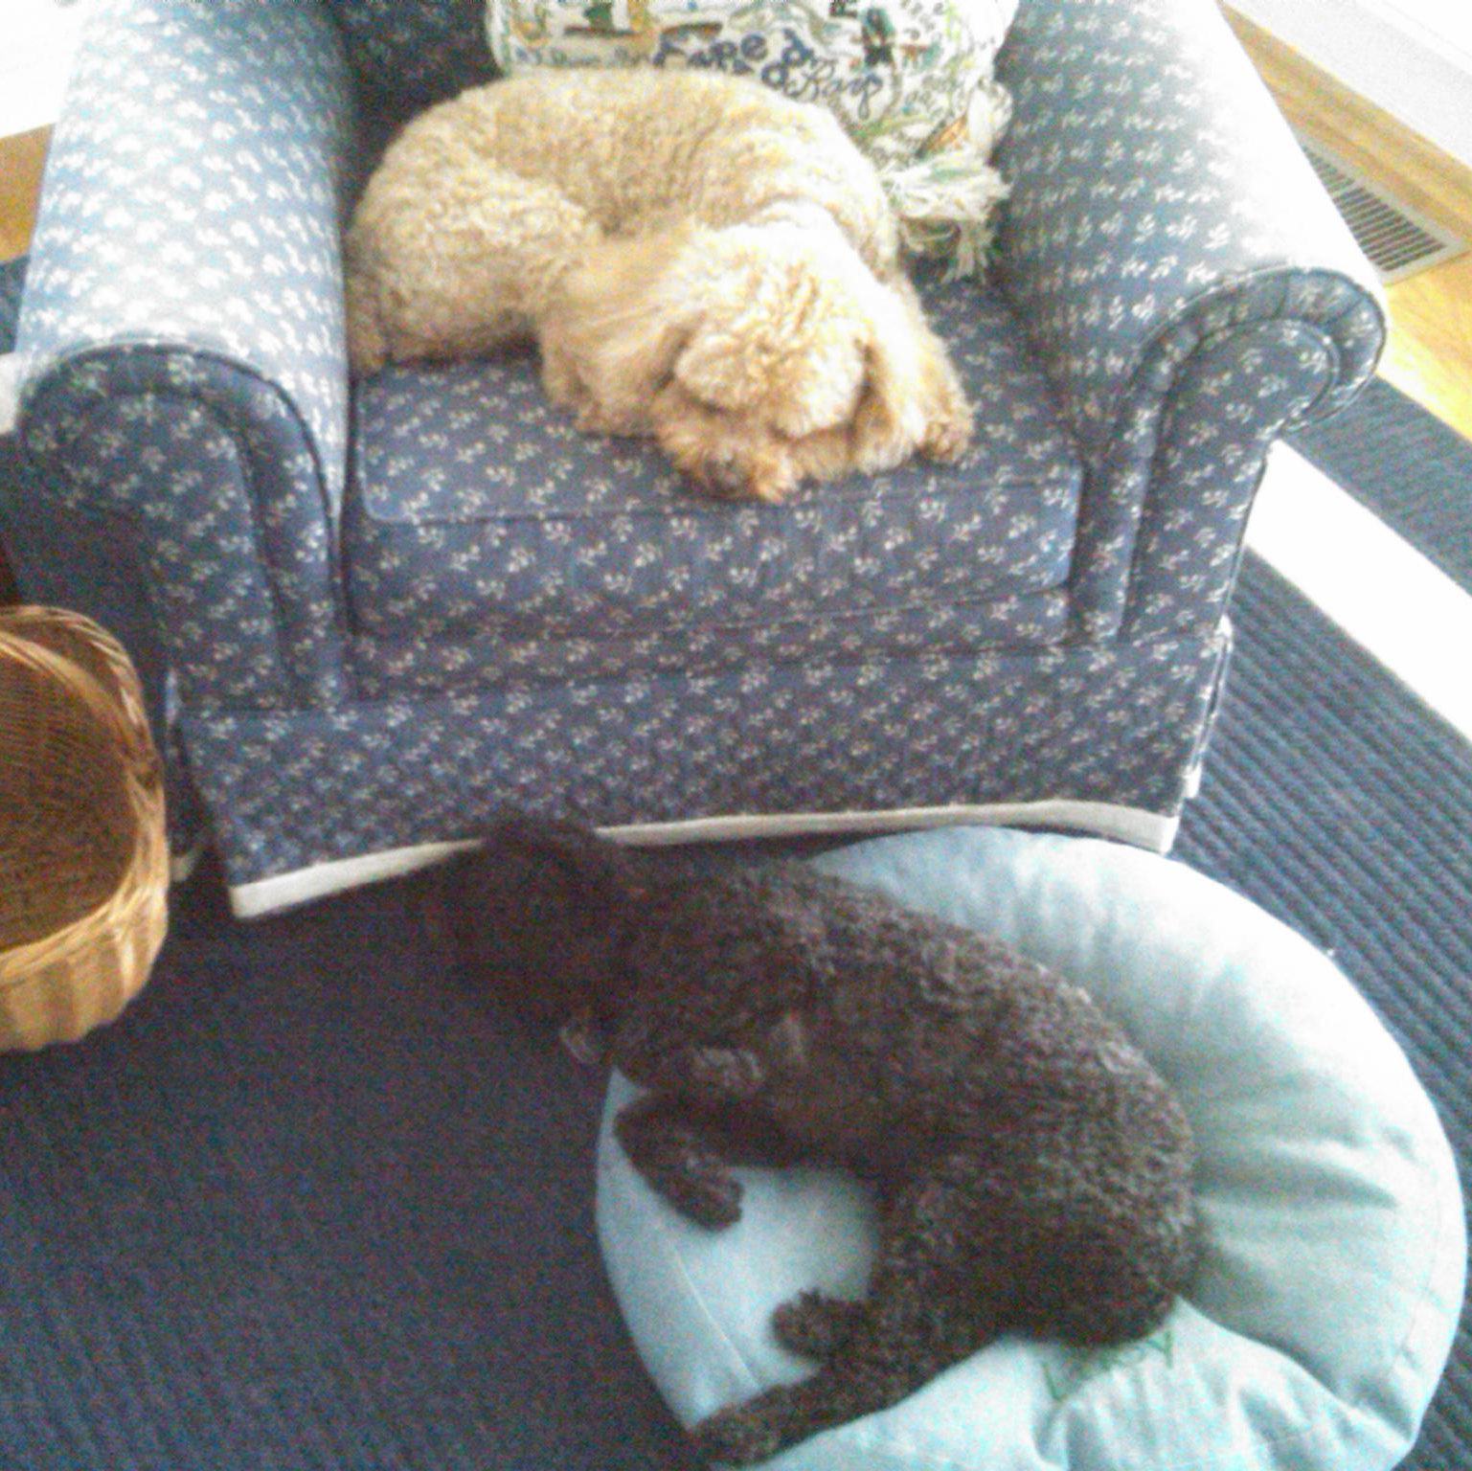
What’s Up With the White Boxes?
3
384
227
13
227
13

Slide 44
What’s Up With the White Boxes?
3
384
Receptive
Field
1
227
13
Due to convolution, each later layer’s value depends on / “sees” only a fraction of the input image.
227
13

Slide 45
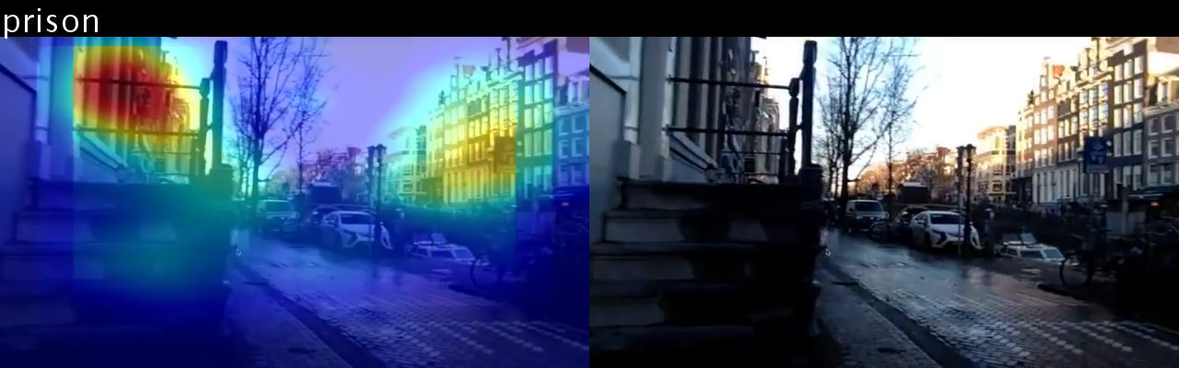
Can use receptive fields to see where the network is “looking” to make its decisions
A very active area of research
(lots of great work done by Bolei Zhou, MIT now UCLA)
B. Zhou et al. Learning Deep Features for Discriminative Localization. CVPR 2016.

Slide 46
3 Tricks
3x3 Filters
Batch Normalization
Residual Learning

Slide 47
Key Idea – 3x3 Filters
2
1
2
→5
3x3 filter followed by
3x3 filter
→
Filter with 5x5 receptive field

Slide 48
Key Idea – 3x3 Filters
3
1
3
→7
3x3 filter followed by
3x3 filter followed by
3x3 filter
→
Filter with 7x7
receptive field

Slide 49
Why Does This Make A Difference?
Empirically, repeated 3x3 filters do better compared to a 7x7 filter.
Why?

Slide 50
Key Idea – 3x3 Filters
Receptive Field: 7x7 pixels
Parameters/channel: 49
Number of ReLUs: 1
Receptive Field: 7x7 pixels
Parameters/channel: 3x3x3=27
Number of ReLUs: 3

Slide 51
We Want More Non-linearity!
-
Can they implement xor?
+
-
+
-
+
-
+
-
+
+
-
+
+
-
-
x₁
x₁
h₂
y₁
No
y₁
Yes
x₂
x₂
h₃

Slide 52
VGG16
Input
Conv
1
Conv
2
Conv
3
Conv
4
Conv
5
FC
6
FC
7
Output
224x2243
224x224
64
112x112
128
56x56
256
28x28
512
14x14
512
1x1
4096
1x1
4096
1x1
1000
All filters 3x3
All filters followed by ReLU

Slide 53
Training Deeper Networks
Why not just stack continuously?
What will happen to gradient going back?
…

Slide 54
Backprop
Every backpropagation step multiplies the gradient by the local gradient
What if d << 1, n big?
1 *d * d * d … * d = d^{n-1}
Vanishing Gradients
…

Slide 55
Backprop
Every backpropagation step multiplies the gradient by the local gradient
What if d >> 1, n big?
1 *d * d * d … * d = d^{n-1}
Exploding Gradients
…

Slide 56
Solution 1 – Batch Normalization
Learning algorithms work far better when data looks like the right as opposed to the left
Y
Data
Y
Data
X
X
Mean(x) != Mean(Y) != 0
Var(x) != Var(y) != 0
Cov(x,y) != 0
Mean(x) = Mean(Y) = 0
Var(x) = Var(y) = 1
Cov(x,y) = 0

Slide 57
Solution 1 – Batch Normalization
Y
Idea: make layer (Batch Norm) that normalizes things going through it based on estimates of Var(x_{i}) in each batch.
Stick in between other layers
Source of tons of bugs
Data
X
Mean(x) = Mean(Y) = 0
Var(x) = Var(y) = 1
S. Ioffe and C. Szegedy. Batch Normalization: Accelerating Deep Network Training by Reducing Internal Covariate Shift.

Slide 58
Classification
C
W
1
F
CNN
1
H
Running example:
image classification
P(image is class #1)
P(image is class #2)
P(image is class #F)

Slide 59
What We Talked About
Some layers
Some networks
Some tricks:
  3x3 convolution
  Normalizing things so they end up mean 0, variance 1.

Slide 60
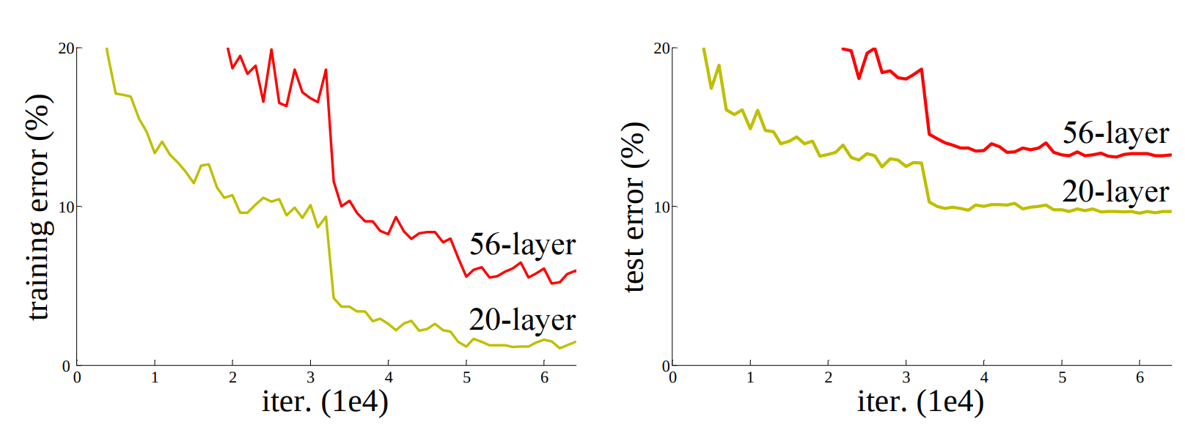
There exists vs. We Can Find
Still can’t fit models to the data: Deeper model fits worse than shallower model on the training data.
There exists a deeper model that’s identical to the shallow model. Why?
K. He et al. Deep Residual Learning for Image Recognition. CVPR 2016

Slide 61

Residual Learning
New Building Block:
$$x+F\left(x\right)$$
Lets you train networks with 100s of layers.
+
x
F(x)
x+F(x)

Slide 62
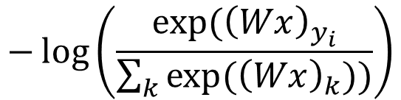
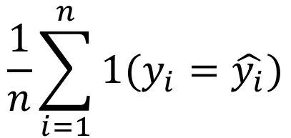
Evaluating Results
$$−\log\left(\frac{exp⁡({\left(Wx\right)}_{y_{i}}}{\sum_{k}{exp⁡({\left(Wx\right)}_{k}))}}\right)$$
At training time, we minimize:
At test time, we evaluate, given predicted class $\hat{y_{i}}$:
$$\frac{1}{n}\sum_{i=1}^{n}{1(y_{i}=\hat{y_{i}})}$$
Accuracy:

Slide 63
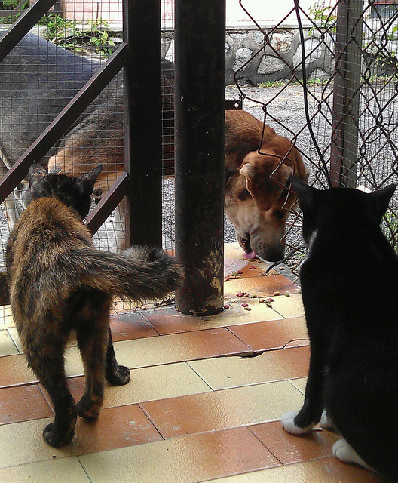
Evaluating Many Categories
Does this image depict a cat or a dog?
To avoid penalizing ambiguous images, many challenges let you make five guesses (top-5 accuracy):
Your prediction is correct if one of the guesses is right.
Image credit: Coco dataset

Slide 64
Accuracy over the Years
Top 1 Error
Top 5 Error
Best Pre-Deep (~2012)
-
26.2%
Alexnet, 2012
43.5%
20.9%
VGG-16, 2014
28.4%
9.6%
ResNet-50, 2015
24.7%
7.8%
ResNet-152, 2015
21.7%
5.9%
ResNet-50 done better, 2018
20.7%
5.4%
Swin Transf., 2021
15.5%
-
ConvNeXt, 2022
14.5%
-
CoAtNet-7* 2021 (2B params!)
9.1%
-
Human*
-
5.1%
Many results from https://paperswithcode.com/sota/image-classification-on-imagenet . I am missing loads of great papers, and the numbers depend on tons of practical details. *Human – this number is from Andrej Karpathy and isn’t really human performance with training but a ballpark. Resnet-50 one better = “Bag of Tricks for Image Classification with Convolutional Neural Networks”, He et al.

Slide 65
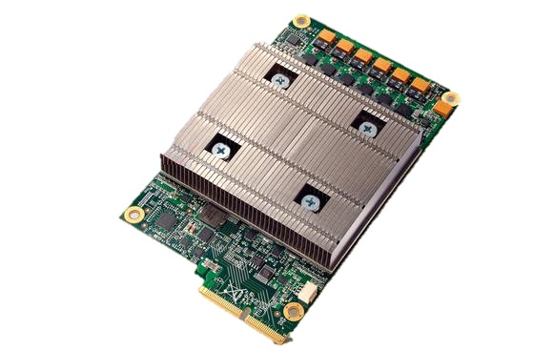
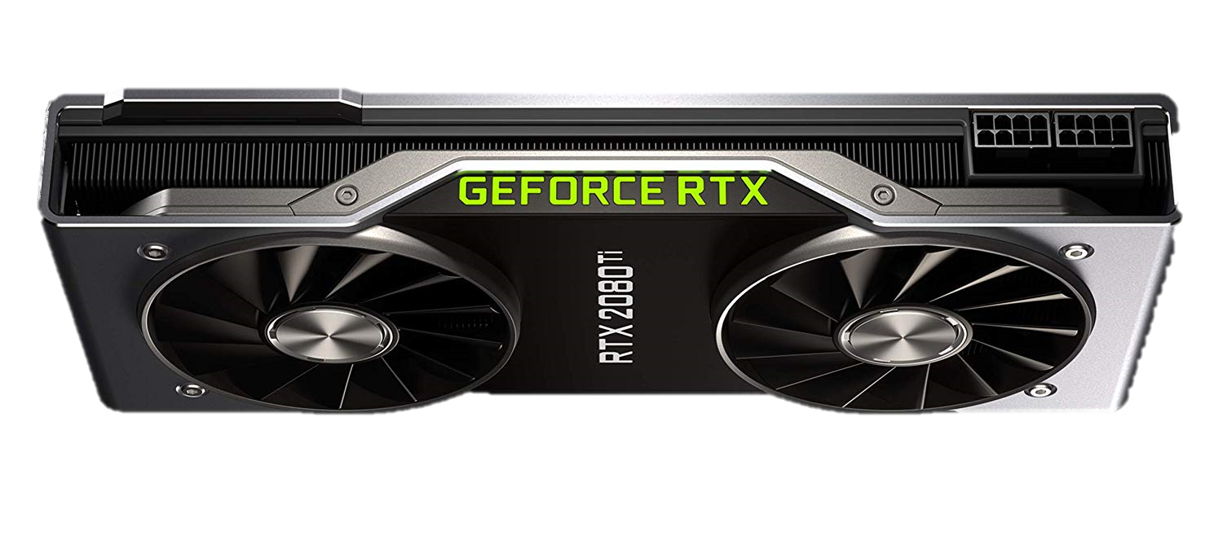
A Practical Aside
People usually use hardware specialized for matrix multiplies (the card below does 13.4T flops if it’s matrix multiplies).
The real answer to why we love homogeneous coordinates?
  Makes rendering matrix multiplies →
  leads to matrix multiplication hardware →
  deep learning.

Slide 66
Training a CNN
Download a big dataset
Initialize network weights randomly
for epoch in range(epochs):
  Shuffle dataset
  for each minibatch in datsaet.:
    Put data on GPU
    Compute gradient
    Update gradient with SGD

Slide 67
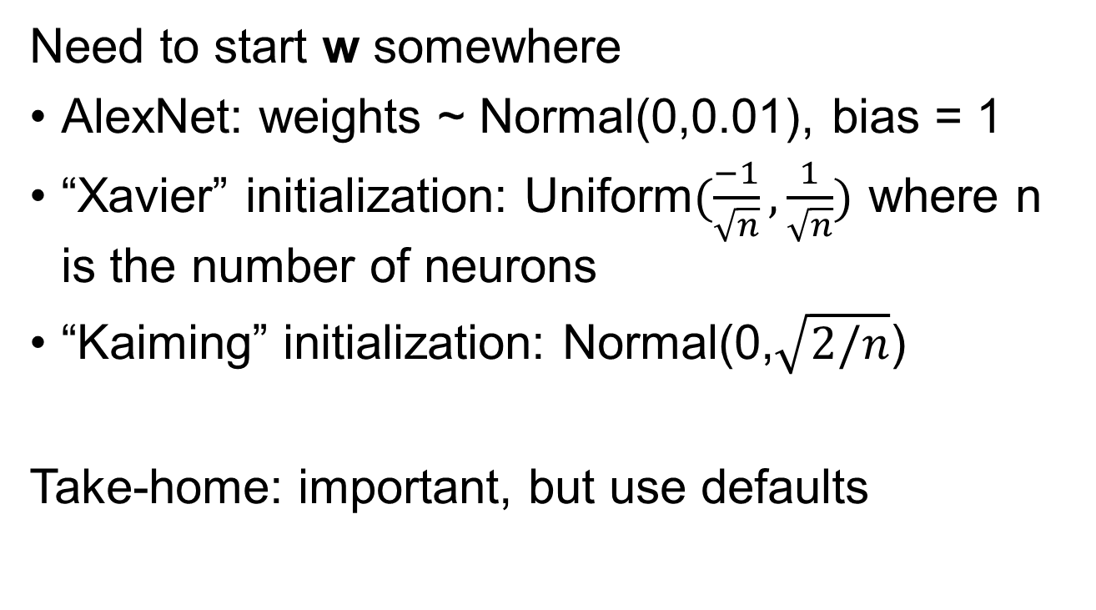
Training a CNN from Scratch
Need to start w somewhere
AlexNet: weights ~ Normal(0,0.01), bias = 1
“Xavier” initialization: Uniform$(\frac{−1}{\sqrt{n}},\frac{1}{\sqrt{n}})$ where n is the number of neurons
“Kaiming” initialization: Normal(0,$\sqrt{2/n}$)
Take-home: important, but use defaults

Slide 68
Training a ConvNet
Convnets typically have millions of parameters:
  AlexNet: 62 million
  VGG16: 138 million
  ConvNeXt-L: 198M
Convnets typically fit on ~1.2 million images
Remember least squares: if we have fewer data points than parameters, we’re in trouble
Solution: need regularization / more data

Slide 69
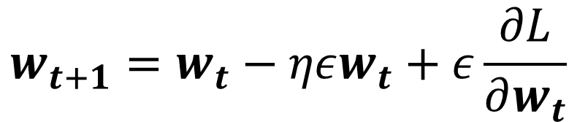
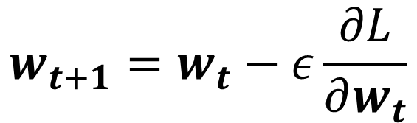
Training a CNN – Weight Decay
SGD
Update
$$w_{t+1}=w_{t}−ε\frac{∂L}{∂w_{t}}$$
+Weight
Decay
$$w_{t+1}=w_{t}−ηεw_{t}+ε\frac{∂L}{∂w_{t}}$$
What does this remind you of?
Weight decay is similar to regularization but is not be the same for more complex optimization techniques.
See “Decoupled Weight Decay Regularization”, Loshchilov and Hutter.

Slide 70
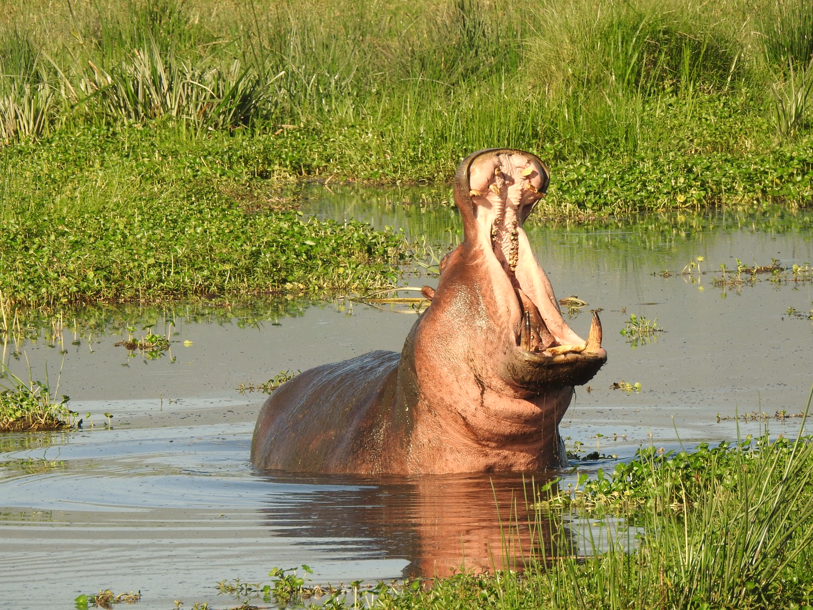
Quick Quiz
Raise your hand if it’s a hippo
Horizontal
Flip
Color
Jitter
Image Cropping

Slide 71
Training a CNN –Augmentation
Apply transformations that don’t affect the output
Produces more data but you have to be careful that it doesn’t change the meaning of the output

Slide 72
Training a CNN – Fine-tuning
What if you don’t have data?

Slide 73
Fine-Tuning: Pre-trained Features
Extract some layer from an existing network
Use as your new feature.
Learn a linear model.
Surprisingly effective
Convolutions that extract a
1x1x4096 feature (Fixed/Frozen/Locked)
Wx+b

Slide 74
Fine-Tuning: Transfer Learning
Rather than initialize from random weights, initialize from some “pre-trained” model that does something else.
Most common model is trained on ImageNet.
Other pretraining tasks exist but are less popular.

Slide 75
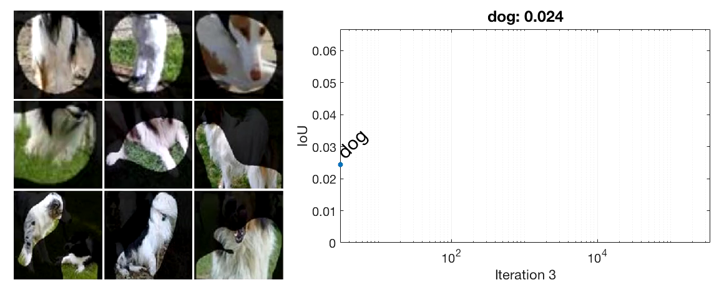
Fine-Tuning: Transfer Learning
Why should this work?
Transferring from objects (dog) to scenes (waterfall)
Bau and Zhou et al. Network Dissection: Quantifying Interpretability of Deep Visual Representations. CVPR 2017.

Slide 76
Recommendations
<10K images: features
Always try fine-tuning
>100K images: consider trying from scratch

Slide 77
Summary
We learned about converting an image into a vector output (e.g., which of K classes is this image, or predict K continuous outputs)
We learned about some building blocks for doing this

Slide 79
Extras if You’re Curious

Slide 80
Classic Recognition
Input
227x2273

Slide 81
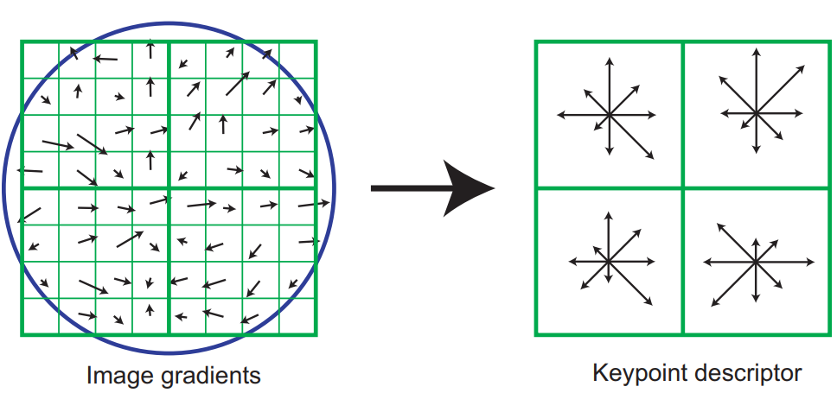
Classic Recognition
Input
SIFT
Recall: can compute a descriptor based on histograms of image gradients. Do it densely (at each pixel).
227x2273
227x227128
Dense
SIFT
(a few layers)

Slide 82
Classic Recognition
Input
SIFT
Bag of Words
227x2273
227x227128
HxW
#codewords
Dense
SIFT
(a few layers)
Can do bag-of-words-like techniques on SIFT, taking into consideration spatial location.

Slide 83
Classic Recognition
Input
SIFT
Bag of Words
Output
227x2273
227x227128
HxW
#codewords
1x1
1000
Dense
SIFT
(a few layers)
BOW
Classifier

Slide 84
Classic Recognition
Input
SIFT
Bag of Words
Output
227x2273
227x227128
HxW
#codewords
1x1
1000
Dense
SIFT
(a few layers)
BOW
Classifier

Slide 85
Classic vs Deep Recognition
SIFT
BOW
Classifier
Pipeline of hand-engineered steps
Classic
Pipeline of learned convolutions + simple operations
Deep
What are some differences?
The classic steps don’t: talk to each other or have many parameters that are learned from data.

