Slide 1
Convolutional Neural Nets
EECS 442 – David Fouhey
Winter 2023, University of Michigan
http://web.eecs.umich.edu/~fouhey/teaching/EECS442_W23/

Slide 2
Administrivia
HW3 Due Date SNAFU: It was up for long enough, and there’s some flexibility, so it’s now due March 6 and the same extra 72 late hours apply.

Slide 3




Previously – Backpropagation
$$f\left(x\right)={\left(−x+3\right)}^{2}$$
x
-x
-x+3
(-x+3)²
-n
n+3
n²
1
$$2x−6$$
$$−2x+6$$
$$−2x+6$$
Forward pass: compute function
Backward pass: compute derivative of all parts of the function

Slide 4
Setting Up A Neural Net
Input
Hidden
Output
h₁
y₁
x₁
h₂
y₂
x₂
h₃
y₃
h₄

Slide 5
Setting Up A Neural Net
Input
Hidden 1
Hidden 2
Output
a₁
h₁
y₁
x₁
a₂
h₂
y₂
x₂
a₃
h₃
y₃
a₄
h₄

Slide 6
Fully Connected Network
a₁
h₁
y₁
x₁
a₂
h₂
Each neuron connects to each neuron in the previous layer
y₂
x₂
a₃
h₃
y₃
a₄
h₄

Slide 7

























Fully Connected Network
a₁
h₁
y₁
$$a$$
All layer a values
x₁
a₂
h₂
y₂
$$w_{i},b_{i}$$
Neuron i weights, bias
x₂
a₃
h₃
$$f$$
Activation function
y₃
a₄
h₄
$$h=f(Wa+b)$$
$$h_{1}$$
$$($$
$$w_{1}^{T}$$
$$a_{1}$$
$$b_{1}$$
$$)$$
$$h_{2}$$
$$=$$
$$f$$
$$w_{2}^{T}$$
$$a_{2}$$
$$+$$
$$b_{2}$$
$$h_{3}$$
$$w_{3}^{T}$$
$$a_{3}$$
$$b_{3}$$
$$h_{4}$$
$$w_{4}^{T}$$
$$a_{4}$$
$$b_{4}$$

Slide 8
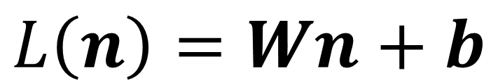
Fully Connected Network
Define New Block: “Linear Layer”
(It’s Technically Affine)
W
b
$$L\left(n\right)=Wn+b$$
n
L
Can get gradient with respect to all the inputs
(do on your own; useful trick: have to be able to do matrix multiply)

Slide 9
Fully Connected Network
a₁
h₁
y₁
x₁
a₂
h₂
y₂
x₂
a₃
h₃
y₃
a₄
h₄
W₁
b₁
W₂
b₂
W₃
b₃
x
L
f(n)
L
f(n)
L
f(n)

Slide 10
Fully Connected Network
a₁
h₁
y₁
Backpropagation lets us calculate derivative of the output/error with respect to all the Ws at a given point x
x₁
a₂
h₂
y₂
x₂
a₃
h₃
y₃
a₄
h₄
W₁
b₁
W₂
b₂
W₃
b₃
x
L
f(n)
L
f(n)
L
f(n)

Slide 11
Putting It All Together – 1
Function: NN(x; W_{i},b_{i})
Parameterized by W = {W_{i},b_{i}}
W₁
b₁
W₂
b₂
W₃
b₃
x
L
f(n)
L
f(n)
L
f(n)

Slide 12
Putting It All Together
Function: Loss(NN(x; W_{i},b_{i}),y)
Function: NN(x; W_{i},b_{i})
W₁
b₁
W₂
b₂
W₃
b₃
x
L
f(n)
L
f(n)
L
f(n)
Loss
y

Slide 13
Putting It All Together
W = initializeWeights()
for i in range(numIterations):
#sample a batch
batch = random.subset(0,#datapoints,K)
batchX, batchY = dataX[batch], dataY[batch]
#compute gradient with batch
gradW = backprop(Loss(NN(batchX,W),batchY))
#update W with gradient step
W += -stepsize*gradW
return W

Slide 14
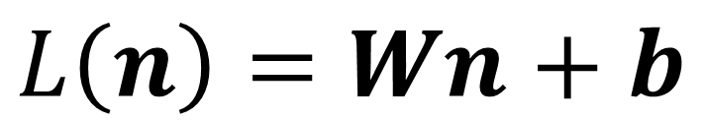
What Can We Represent?
h₁
h₂
y₁
h₃
h₄
$$L\left(n\right)=Wn+b$$
W
b
x
L
f(n)

Slide 15
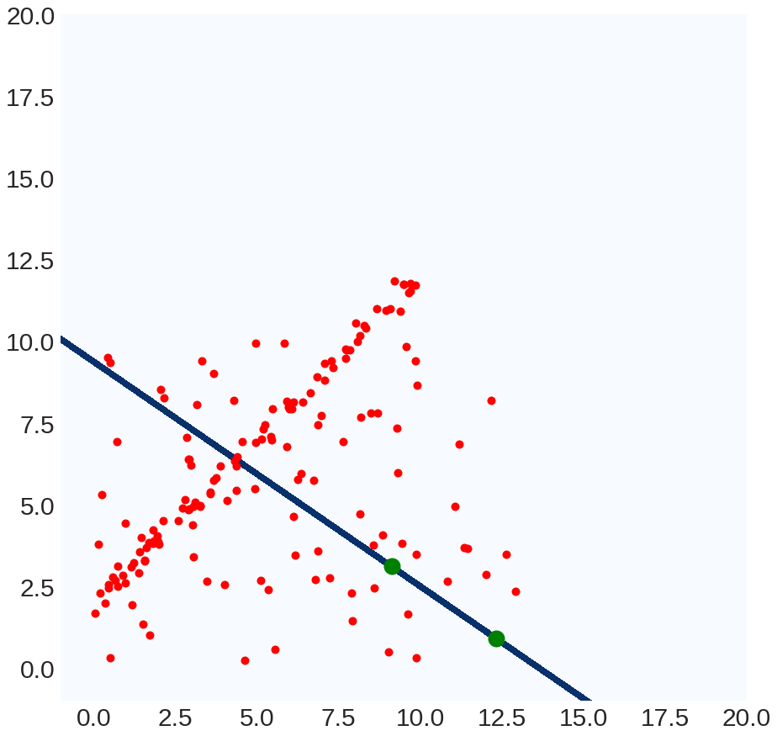
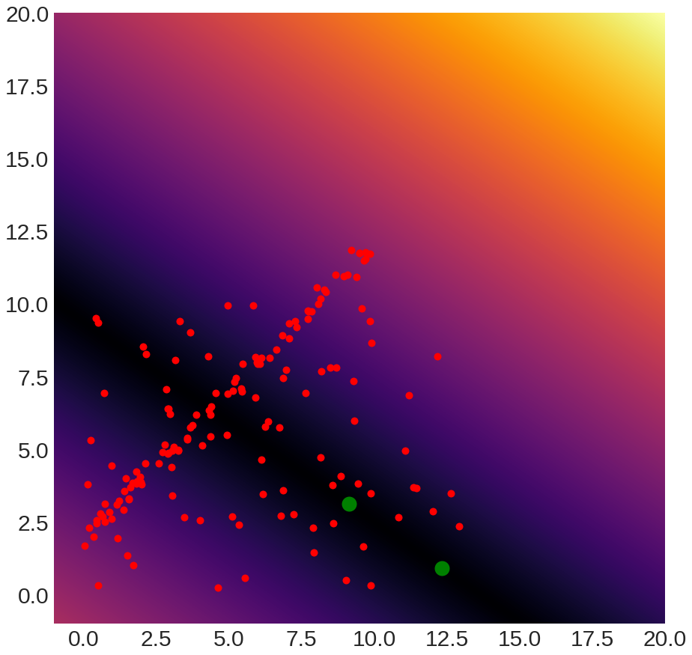
What Can We Represent
Recall: ax+by+z is
  proportional to signed distance to line
  equal to signed distance if you do it right
Generalization to N-D: hyperplane w^{T}x+b

Slide 16
Can We Train a Network To Do It?
-
+
-
+
-
x₁
+
-
y₁
+
x₂
+
+
-
-
+
+
-
-

Slide 17
Can We Train a Network To Do It?
-
h₁
+
-
+
-
+
-
x₁
h₂
+
y₁
x₂
h₃
+
+
-
-
+
h₄
+
-
-

Slide 18
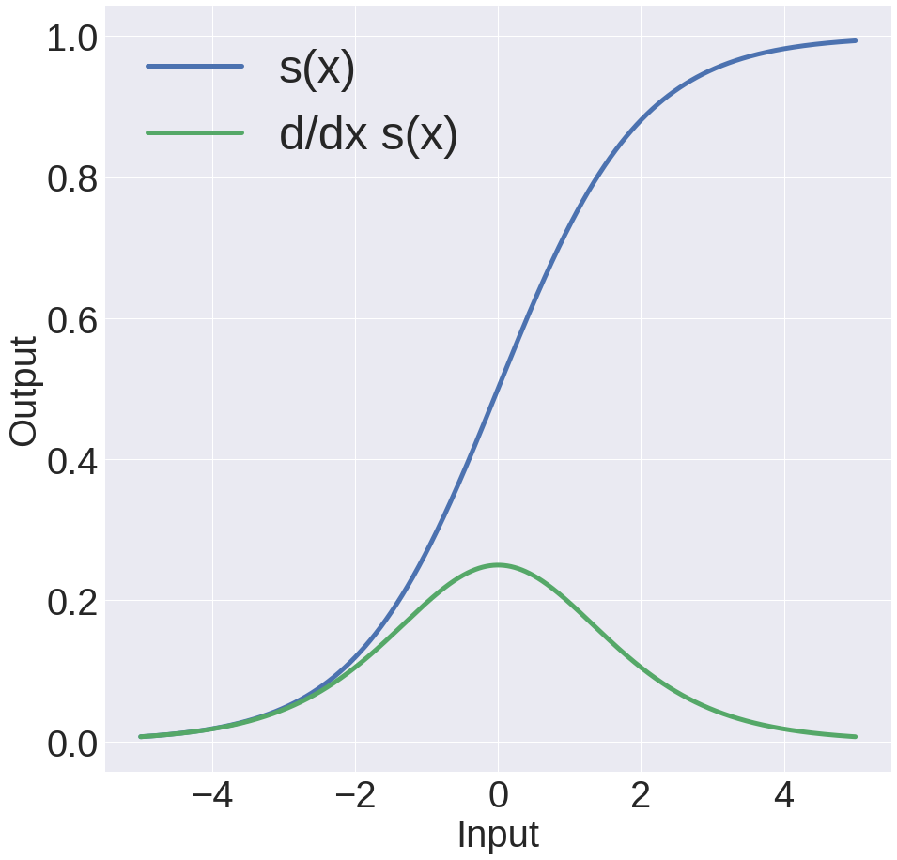
Can We Train a Network To Do It?
+
-
-
+
+
-
-
0
+
-
+
+
-
+
1
-
+
x₁
-
Compute signed distance; pass through sigmoid
x₂

Slide 19
Can We Train a Network To Do It?
+
-
-
+
+
-
-
0
+
2
+
+
1
-
-
+
1
+1
-
+
-
x₁
-
+
-
+
+
-
-
+
x₂
-
+
+
-
+
+
2
-
+1
-
-
+
-
1
+
+
-
-
+
+
1
-
+
-
+
+
-
-
0

Slide 20
Can We Train a Network To Do It?
+
-
-
max(w₁^{T}x+b,0)
+
+
-
-
+
max(w₁^{T}x+b,0)+
max(-w₁^{T}x+b,0) =
Distance to line defined by w₁
-
-
+
+
-
+
+
-
+
-
-
max(-w₁^{T}x+b,0)
+
+
-
-
+
x₁
-
-
+
+
-
+
+
-
+
-
-
max(w₂^{T}x+b,0)
x₂
+
+
-
-
+
max(w₂^{T}x+b,0)+
max(-w₂^{T}x+b,0) =
Distance to line defined by w₂
-
-
+
+
-
+
+
-
+
-
-
max(-w₂^{T}x+b,0)
+
+
-
-
+
-
-
+
+
-
+
+
-

Slide 21
Can We Train a Network To Do It?
+
-
-
+
+
-
-
+
-
-
+
+
-
+
+
-
Distance to w₁
+
-
-
+
+
-
-
+
x₁
-
-
+
+
-
+
+
-
Next layer computes:
w₁ Distance - w₂ Distance > 0
+
-
-
x₂
+
+
-
-
+
-
-
+
+
-
+
+
-
Distance to w₂
+
-
-
+
+
-
-
+
-
-
+
+
-
+
+
-

Slide 22
Can We Train a Network To Do It?
Result: feedforward neural networks with a finite number of neurons in a hidden layer can approximate any continuous function with a bounded domain
Cybenko (1989) for neural networks with sigmoids; Hornik (1991) more generally
In practice, doesn’t give a practical guarantee. Why?

Slide 23
Developing Intuitions
There is no royal road to geometry. – Euclid
Best way: play with data, be skeptical of everything you do, be skeptical of everything you are told
Remember: this is linear algebra, not magic
Technique: How would you set the weights by hand if you were forced to be a deep net

Slide 24
Parameters
How many parameters does this network have?
x₁
y₁
Weights: 1x2
Parameters: 3 (bias!)
x₂

Slide 25
Parameters
How many parameters does this network have?
h₁
x₁
h₂
y₁
Weights: 1x4+4x2 = 12
Parameters: 12+5 = 17
x₂
h₃
h₄

Slide 26
Parameters
How many parameters does this network have?
a₁
h₁
y₁
x₁
a₂
h₂
Weights: 3x4+4x4+4x2 = 36
Parameters: 36+11 = 47
y₂
x₂
a₃
h₃
y₃
a₄
h₄

Slide 27
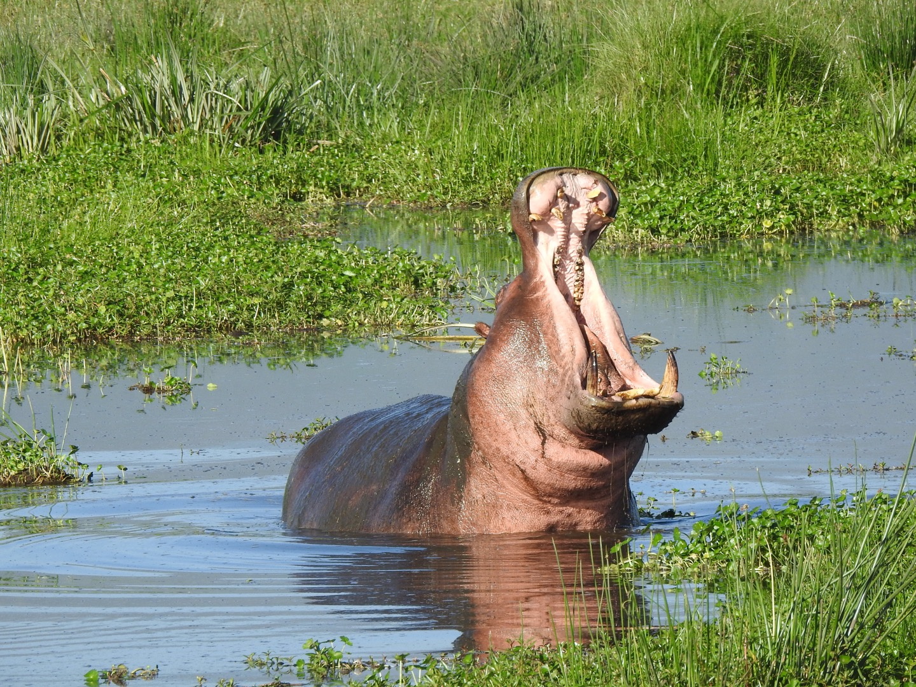
Parameters
H*P+
H
H*H
+H
H*H
+H
O*H
+O
H
neurons
H
neurons
H
neurons
O
neurons
Make Px1 vector
h
h
h
o
x
…
…
…
…
h
h
h
o
P: 285x350 picture (terrible!), H: 1000, O: 3
102 million parameters (400MB)

Slide 28
Parameters
H
neurons
First layer converts all visual information into a single N dimensional vector.
Suppose you want a neuron to represent dx/dy at each pixel. How many neurons do you need?
2P!
Make Px1 vector
h
x
…
h

Slide 29
Parameters
H*P+
H
H*H
+H
H*H
+H
O*H
+O
H
neurons
H
neurons
H
neurons
O
neurons
Make Px1 vector
h
h
h
o
x
…
…
…
…
h
h
h
o
P: 285x350, H: 2P, O: 3
100 billion parameters (400GB)

Slide 30
Convnets
Keep Spatial Resolution Around
Neural net:
Data: vector Fx1
Transform: matrix-multiply
Convnet:
Data: image HxWxF
Transform: convolution
Make Px1 vector
Keep
Image
Dims
x

Slide 31
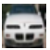
Convnet
Height: 300
Width: 500
Depth: 3
Height
Height: 32
Width: 32
Depth: 3
Width
Depth

Slide 32
Convnet
Fully connected:
Connects to everything
Convnet:
Connects locally
32
32
neuron
neuron
32
32
3
3
Slide credit: Karpathy and Fei-Fei

Slide 33
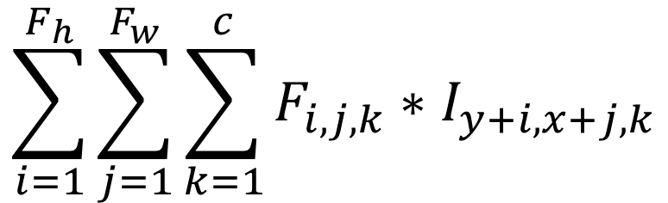
Convnet
Neuron is the same: weighted linear average
F_{w}
32
F_{h}
neuron
c
$$\sum_{i=1}^{F_{h}}{\sum_{j=1}^{F_{w}}{\sum_{k=1}^{c}{F_{i,j,k}∗I_{y+i,x+j,k}}}}$$
32
3
Slide credit: Karpathy and Fei-Fei

Slide 34
Convnet
Neuron is the same: weighted linear average
F_{w}
32
Filter is local in space: sum only over F_{h} x F_{w} pixels
Filter is global over channels/depth: sum over all channels
F_{h}
neuron
c
$$\sum_{i=1}^{F_{h}}{\sum_{j=1}^{F_{w}}{\sum_{k=1}^{c}{F_{i,j,k}∗I_{y+i,x+j,k}}}}$$
32
3
Slide credit: Karpathy and Fei-Fei

Slide 35
Convnet
Get spatial output by sliding filter over image
F_{w}
32
F_{h}
c
$$\sum_{i=1}^{F_{h}}{\sum_{j=1}^{F_{w}}{\sum_{k=1}^{c}{F_{i,j,k}∗I_{y+i,x+j,k}}}}$$
32
3
Slide credit: Karpathy and Fei-Fei

Slide 36
Differences From Earlier Filtering
#input channels can be greater than one
forget you learned the difference between convolution and cross-correlation
F11
F12
F13
I15
I16
I11
I12
I13
I14
Output[1,2]
= I[1,2]*F[1,1] + I[1,3]*F[1,2] + … + I[3,4]*F[3,3]
F21
F22
F23
I25
I26
I21
I22
I23
I24
F31
F32
F33
I35
I36
I31
I32
I33
I34
I41
I42
I43
I44
I45
I46
I51
I52
I53
I54
I55
I56

Slide 37
Convnet
How big is the output?
32
Height? 32-5+1=28
Width? 32-5+1=28
Channels? 1
5
5
One filter not very useful by itself
32
3
Slide credit: Karpathy and Fei-Fei

Slide 38
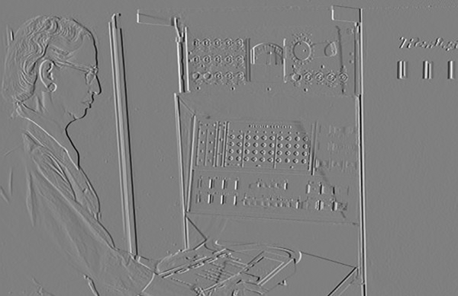
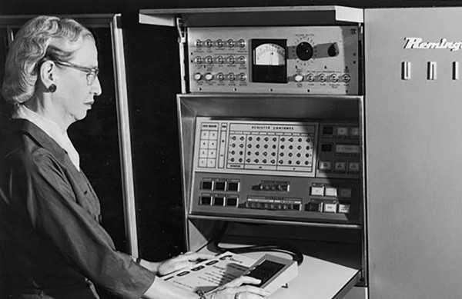
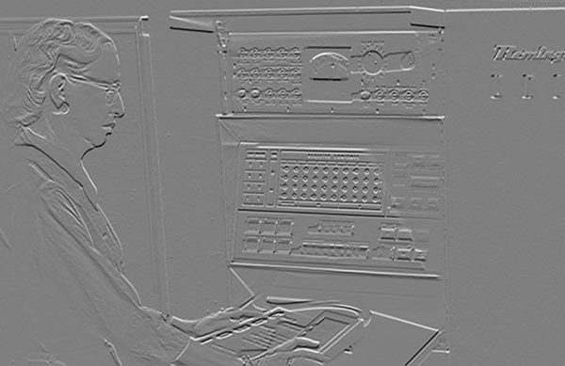
Multiple Filters
You’ve already seen this before
Input: 400x600x1
Output:
400x600x2

Slide 39
Convnet
Multiple out channels via multiple filters.
How big is the output?
Depth
Dimension
32
Height? 32-5+1=28
Width? 32-5+1=28
Channels? 200
5
5
200
32
3
Slide credit: Karpathy and Fei-Fei

Slide 40
Convnet
Multiple out channels via multiple filters.
How big is the output?
32
Height? 32-5+1=28
Width? 32-5+1=28
Channels? 200
5
5
32
3
Slide credit: Karpathy and Fei-Fei

Slide 41
Convnet, Summarized
Neural net:
series of matrix-multiplies parameterized by W,b + nonlinearity/activation
Fit by gradient descent
Convnet:
series of convolutions parameterized by F,b + nonlinearity/activation
Fit by gradient descent
x

Slide 42
One Additional Subtlety – Stride
Warmup: how big is the output spatially?
I11
I12
I13
I14
I15
I16
I17
Normal (Stride 1):
5x5 output
F11
F12
F13
I21
I22
I23
I24
I25
I26
I27
F21
F22
F23
I31
I32
I33
I34
I35
I36
I37
F31
F32
F33
I41
I42
I43
I44
I45
I46
I47
I51
I52
I53
I54
I55
I56
I57
I61
I62
I63
I64
I65
I66
I67
I71
I72
I73
I74
I75
I76
I77
Example credit: Karpathy and Fei-Fei

Slide 43
One Additional Subtlety – Stride
Stride: skip a few (here 2)
I11
I12
I13
I14
I15
I16
I17
Normal (Stride 1):
5x5 output
F11
F12
F13
I21
I22
I23
I24
I25
I26
I27
F21
F22
F23
I31
I32
I33
I34
I35
I36
I37
F31
F32
F33
I41
I42
I43
I44
I45
I46
I47
I51
I52
I53
I54
I55
I56
I57
I61
I62
I63
I64
I65
I66
I67
I71
I72
I73
I74
I75
I76
I77
Example credit: Karpathy and Fei-Fei

Slide 44
One Additional Subtlety – Stride
Stride: skip a few (here 2)
I11
I12
I13
I14
I15
I16
I17
Normal (Stride 1):
5x5 output
F11
F12
F13
I21
I22
I23
I24
I25
I26
I27
F21
F22
F23
I31
I32
I33
I34
I35
I36
I37
F31
F32
F33
I41
I42
I43
I44
I45
I46
I47
I51
I52
I53
I54
I55
I56
I57
I61
I62
I63
I64
I65
I66
I67
I71
I72
I73
I74
I75
I76
I77
Example credit: Karpathy and Fei-Fei

Slide 45
One Additional Subtlety – Stride
Stride: skip a few (here 2)
I11
I12
I13
I14
I15
I16
I17
Normal (Stride 1):
5x5 output
F11
F12
F13
I21
I22
I23
I24
I25
I26
I27
F21
F22
F23
I31
I32
I33
I34
I35
I36
I37
F31
F32
F33
Stride 2 convolution:
3x3 output
I41
I42
I43
I44
I45
I46
I47
I51
I52
I53
I54
I55
I56
I57
I61
I62
I63
I64
I65
I66
I67
I71
I72
I73
I74
I75
I76
I77
Example credit: Karpathy and Fei-Fei

Slide 46
One Additional Subtlety – Stride
What about stride 3?
I11
I12
I13
I14
I15
I16
I17
Normal (Stride 1):
5x5 output
F11
F12
F13
I21
I22
I23
I24
I25
I26
I27
F21
F22
F23
I31
I32
I33
I34
I35
I36
I37
F31
F32
F33
Stride 2 convolution:
3x3 output
I41
I42
I43
I44
I45
I46
I47
I51
I52
I53
I54
I55
I56
I57
I61
I62
I63
I64
I65
I66
I67
I71
I72
I73
I74
I75
I76
I77
Example credit: Karpathy and Fei-Fei

Slide 47
One Additional Subtlety – Stride
What about stride 3?
I11
I12
I13
I14
I15
I16
I17
Normal (Stride 1):
5x5 output
F11
F12
F13
I21
I22
I23
I24
I25
I26
I27
F21
F22
F23
I31
I32
I33
I34
I35
I36
I37
F31
F32
F33
Stride 2 convolution:
3x3 output
I41
I42
I43
I44
I45
I46
I47
I51
I52
I53
I54
I55
I56
I57
I61
I62
I63
I64
I65
I66
I67
Stride 3 convolution:
Doesn’t work!
I71
I72
I73
I74
I75
I76
I77
Example credit: Karpathy and Fei-Fei

Slide 48
One Additional Subtlety
Zero padding is extremely common, although other forms of padding do happen
Symm: fold sides over
g
? ? ? ?
g
f
Circular/Wrap: wrap around
pad/fill: add value, often 0
g
g

Slide 49
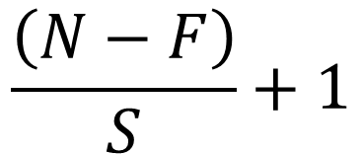
In General
N
Output Size
F
$$\frac{\left(N−F\right)}{S}+1$$
S
N
F
Slide credit: Karpathy and Fei-Fei

Slide 50
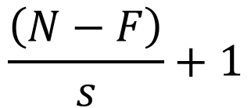
More Examples
Input volume: 32x32x3
Receptive fields: 5x5, stride 1
Number of neurons: 5
$$\frac{\left(N−F\right)}{s}+1$$
Output volume size?
Slide credit: Karpathy and Fei-Fei

Slide 51
More Examples
Input volume: 32x32x3
Receptive fields: 5x5, stride 1
Number of neurons: 5
$$\frac{\left(N−F\right)}{s}+1$$
Output volume: (32 - 5) / 1 + 1 = 28, so: 28x28x5
Number of Parameters?
Slide credit: Karpathy and Fei-Fei

Slide 52
More Examples
Input volume: 32x32x3
Receptive fields: 5x5, stride 1
Number of neurons: 5
$$\frac{\left(N−F\right)}{s}+1$$
Output volume: (32 - 5) / 1 + 1 = 28, so: 28x28x5
How many parameters? 5x5x3x5 + 5 = 380
Slide credit: Karpathy and Fei-Fei

Slide 53
More Examples
Input volume: 32x32x3
Receptive fields: 5x5, stride 3
Number of neurons: 5
$$\frac{\left(N−F\right)}{s}+1$$
Output volume size?
Slide credit: Karpathy and Fei-Fei

Slide 54
More Examples
Input volume: 32x32x3
Receptive fields: 5x5, stride 3
Number of neurons: 5
Output volume: (32 - 5) / 3 + 1 = 10, so: 10x10x5
Number of Parameters?
Slide credit: Karpathy and Fei-Fei

Slide 55
More Examples
Input volume: 32x32x3
Receptive fields: 5x5, stride 3
Number of neurons: 5
Output volume: (32 - 5) / 3 + 1 = 10, so: 10x10x5
How many parameters? 5x5x3x5 + 5 = 380. Same!
Slide credit: Karpathy and Fei-Fei

Slide 56
Thought Problem
How do you write a normal neural network as a convnet?

Slide 57
Other Layers – Pooling
Idea: just want spatial resolution of activations / images smaller; applied per-channel
1
1
2
4
Max-pool
2x2 Filter
Stride 2
5
6
7
8
6
8
3
2
1
0
3
4
1
1
3
4
Slide credit: Karpathy and Fei-Fei

Slide 58
Other Layers – Pooling
Idea: just want spatial resolution of activations / images smaller; applied per-channel
1
1
2
4
Avg-pool
2x2 Filter
Stride 2
5
6
7
8
3.25
5.25
3
2
1
0
1.75
2.0
1
1
3
4
Slide credit: Karpathy and Fei-Fei

Slide 59
Other Layers – Pooling
Idea: just want spatial resolution of activations / images smaller; applied per-channel
I11
I12
I13
I14
I15
I16
I17
I21
I22
I23
I24
I25
I26
I27
Max-pool
3x3 Filter
Stride 2
I31
I32
I33
I34
I35
I36
I37
O11
I41
I42
I43
I44
I45
I46
I47
I51
I52
I53
I54
I55
I56
I57
O11 = maximum value in blue box
I61
I62
I63
I64
I65
I66
I67
I71
I72
I73
I74
I75
I76
I77

Slide 60
Other Layers – Pooling
Idea: just want spatial resolution of activations / images smaller; applied per-channel
I11
I12
I13
I14
I15
I16
I17
I21
I22
I23
I24
I25
I26
I27
Max-pool
3x3 Filter
Stride 2
I31
I32
I33
I34
I35
I36
I37
O11
O12
I41
I42
I43
I44
I45
I46
I47
I51
I52
I53
I54
I55
I56
I57
O12 = maximum value in blue box
I61
I62
I63
I64
I65
I66
I67
I71
I72
I73
I74
I75
I76
I77

Slide 61
Other Layers – Pooling
Idea: just want spatial resolution of activations / images smaller; applied per-channel
I11
I12
I13
I14
I15
I16
I17
I21
I22
I23
I24
I25
I26
I27
Max-pool
3x3 Filter
Stride 2
I31
I32
I33
I34
I35
I36
I37
O11
O12
O13
I41
I42
I43
I44
I45
I46
I47
I51
I52
I53
I54
I55
I56
I57
O13 = maximum value in blue box
I61
I62
I63
I64
I65
I66
I67
I71
I72
I73
I74
I75
I76
I77

Slide 62
Other Layers – Pooling
Idea: just want spatial resolution of activations / images smaller; applied per-channel
I11
I12
I13
I14
I15
I16
I17
I11
I12
I13
I14
I15
I16
I17
I21
I22
I23
I24
I25
I26
I27
Max-pool
3x3 Filter
Stride 2
I11
I12
I13
I14
I15
I16
I17
I21
I22
I23
I24
I25
I26
I27
I31
I32
I33
I34
I35
I36
I37
I21
I22
I23
I24
I25
I26
I27
I31
I32
I33
I34
I35
I36
I37
I41
I42
I43
I44
I45
I46
I47
I31
I32
I33
I34
I35
I36
I37
I41
I42
I43
I44
I45
I46
I47
I51
I52
I53
I54
I55
I56
I57
I41
I42
I43
I44
I45
I46
I47
O11
O12
O13
I51
I52
I53
I54
I55
I56
I57
O11
O12
O13
I61
I62
I63
I64
I65
I66
I67
O11
O12
O13
I51
I52
I53
I54
I55
I56
I57
O21
O22
O23
I61
I62
I63
I64
I65
I66
I67
O21
O22
O23
I71
I72
I73
I74
I75
I76
I77
I61
I62
I63
I64
I65
I66
I67
O21
O22
O23
O33
I71
I72
I73
I74
I75
I76
I77
O31
O32
O31
O32
O33
I71
I72
I73
I74
I75
I76
I77
O31
O32
O33

Slide 63
Squeezing a Loaf of Bread
Max-pool
2x2 Filter
Stride 2
1
1
2
4
6
8
5
6
7
8
3
2
1
0
3
4
1
1
3
4

Slide 64
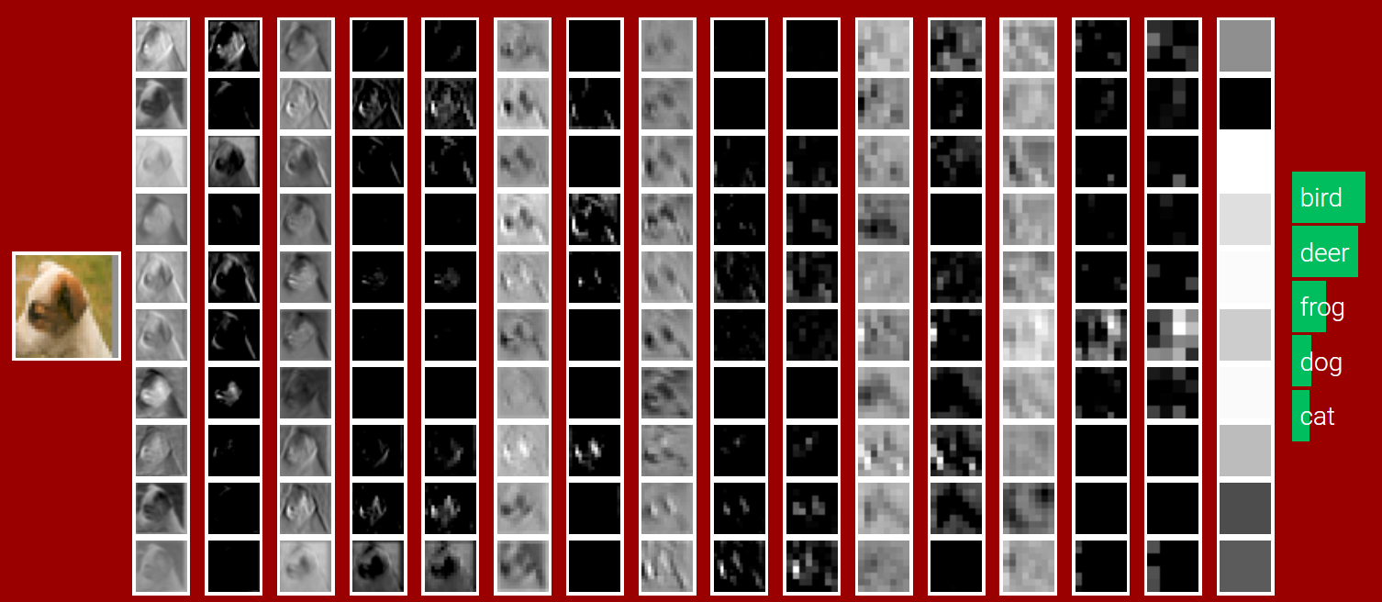
Example Network
Suppose we want to convert a 32x32x3 image into a 10x1 vector of classification results
Figure Credit: Karpathy and Fei-Fei; see http://cs231n.stanford.edu/

Slide 65
Example Network
input: [32x32x3]
CONV with 10 3x3 filters, stride 1, pad 1:
gives: [32x32x10]
new parameters: (3*3*3)*10 + 10 = 280
RELU
CONV with 10 3x3 filters, stride 1, pad 1:
gives: [32x32x10]
new parameters: (3*3*10)*10 + 10 = 910
RELU
POOL with 2x2 filters, stride 2:
gives: [16x16x10]
parameters: 0
Slide credit: Karpathy and Fei-Fei

Slide 66
Example Network
Previous output: [16x16x10]
CONV with 10 3x3 filters, stride 1:
gives: [16x16x10]
new parameters: (3*3*10)*10 + 10 = 910
RELU
CONV with 10 3x3 filters, stride 1:
gives: [16x16x10]
new parameters: (3*3*10)*10 + 10 = 910
RELU
POOL with 2x2 filters, stride 2:
gives: [8x8x10]
parameters: 0
Slide credit: Karpathy and Fei-Fei

Slide 67
Example Network
Conv, Relu, Conv, Relu, Pool continues until it’s [4x4x10]
Fully-Connected FC layer to 10 neurons
(which are our class scores)
Number of parameters:
10 * 4 * 4 * 10 + 10 = 1610
done!
Slide credit: Karpathy and Fei-Fei

Slide 68
An Alternate Conclusion
Conv, Relu, Conv, Relu, Pool continues until it’s [4x4x10]
Average POOL 4x4x10 to 10 neurons
Fully-Connected FC layer to 10 neurons
(which are our class scores)
Number of parameters:
10 * 10 + 10 = 110
done!
Slide credit: Karpathy and Fei-Fei

Slide 69
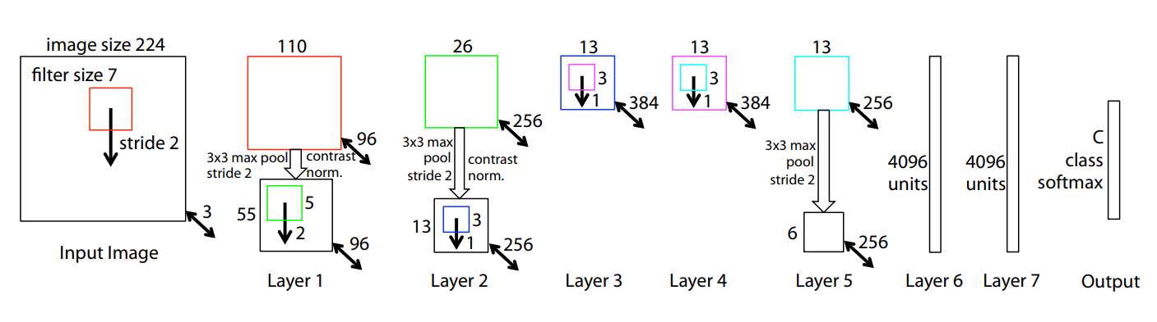
Example Network
Figure Credit: Zeiler and Fergus, Visualizing and Understanding Convolutional Networks. ECCV 2014

Slide 70
Example Network
filter image with 96 7x7 filters
(2) ReLU
(3) 3x3 max pool with stride 2 (and contrast normalization – now ignored)
Figure Credit: Zeiler and Fergus, Visualizing and Understanding Convolutional Networks. ECCV 2014

Slide 71

What Do The Filters Represent?
Recall: filters are images and we can look at them

Slide 72
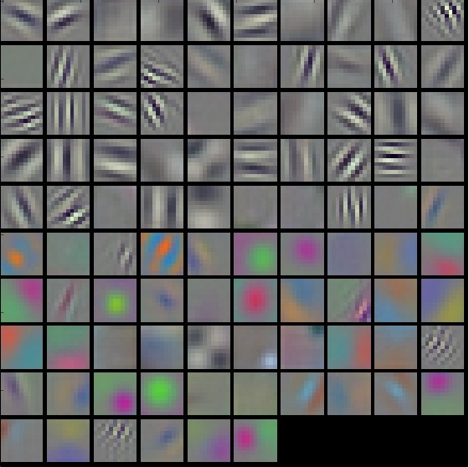
What Do The Filters Represent?
First layer filters of a network trained to distinguish 1000 categories of objects
Remember these filters go over color.
For the interested:
Gabor filter
Figure Credit: Karpathy and Fei-Fei

Slide 73
What Do The Filters Do?
FC
(Fully-connected)
CONV
CONV
POOL
CONV
CONV
POOL
CONV
CONV
POOL
ReLU
ReLU
ReLU
ReLU
ReLU
ReLU
Figure Credit: Karpathy and Fei-Fei; see http://cs231n.stanford.edu/

