Slide 1
Backpropagation and Neural Nets
EECS 442 – David Fouhey
Winter 2023, University of Michigan
http://web.eecs.umich.edu/~fouhey/teaching/EECS442_W23/

Slide 2
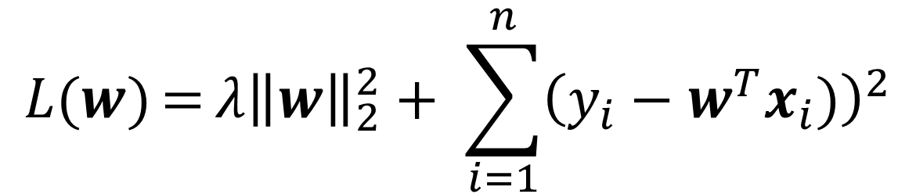
So Far: Linear Models
$$L(w){={λ{\left\|w\right\|}_{2}^{2}+ \sum_{i=1}^{n}{{\left(y_{i}−w^{T}x_{i})\right)}^{2}}}}$$
Example: find w minimizing squared error over data
Each datapoint represented by some vector x
Can find optimal w with ~10 line derivation

Slide 3

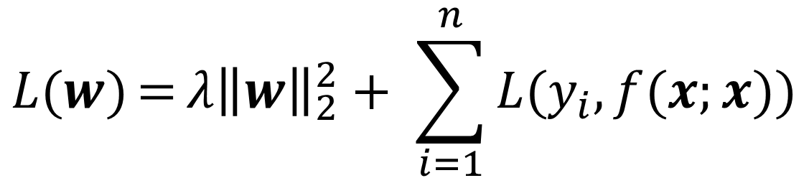
Last Class
$$L(w){={λ{\left\|w\right\|}_{2}^{2}+ \sum_{i=1}^{n}{L(y_{i},f(x;x)}}})$$
What about an arbitrary loss function L?
What about an arbitrary parametric function f?
Solution: take the gradient, do gradient descent
$$w_{i+1}=w_{i}−α∇_{w}L(f(w_{i}))$$
What if L(f(w)) is complicated?
Today!

Slide 4









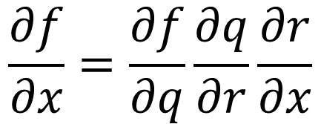
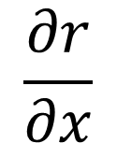



Taking the Gradient – Review
$$f\left(x\right)={\left(−x+3\right)}^{2}$$
$$f=q^{2}$$
$$q=r+3$$
$$r=−x$$
$$\frac{∂f}{∂q}$$
$$\frac{∂q}{∂r}$$
$$\frac{∂r}{∂x}$$
$$=2q$$
$$=1$$
$$=−1$$
$$\frac{∂f}{∂x}=\frac{∂f}{∂q}\frac{∂q}{∂r}\frac{∂r}{∂x}$$
$$=2q∗1∗−1$$
$$=−2\left(−x+3\right)$$
Chain rule
$$=2x−6$$

Slide 5
Supplemental Reading
Lectures can only introduce you to a topic
You will solidify your knowledge by doing
I highly recommend working through everything in the Stanford CS213N resources
http://cs231n.github.io/optimization-2/
These slides follow the general examples with a few modifications. The primary difference is that I define local variables n, m per-block.

Slide 6
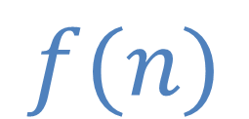

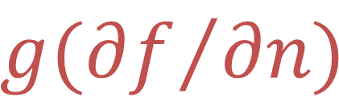

Let’s Do This Another Way
Suppose we have a box representing a function f.
This box does two things:
Forward: Given forward input n, compute f(n)
Backwards: Given backwards input g, return g*df/dn
$$n$$
f
$$f(n)$$
$$g({∂f}/{∂n)}$$
$$g$$

Slide 7
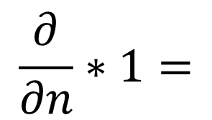

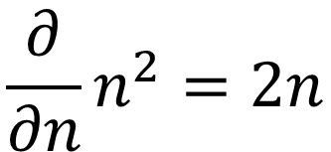


Let’s Do This Another Way
$$f\left(x\right)={\left(−x+3\right)}^{2}$$
x
-x
-x+3
(-x+3)²
-n
n+3
n²
1
$$\frac{∂}{∂n}n^{2}=2n$$
$$=2\left(−x+3\right)$$
$$=−2x+6$$
$$\frac{∂}{∂n}∗1=$$
$$(−2x+6) ∗1$$

Slide 8
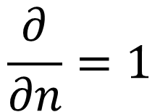


Let’s Do This Another Way
$$f\left(x\right)={\left(−x+3\right)}^{2}$$
x
-x
-x+3
(-x+3)²
-n
n+3
n²
1
$$−2x+6$$
$$\frac{∂}{∂n}=1$$
$$1 ∗(−2x+6)$$

Slide 9
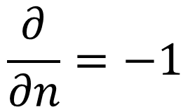



Let’s Do This Another Way
$$f\left(x\right)={\left(−x+3\right)}^{2}$$
x
-x
-x+3
(-x+3)²
-n
n+3
n²
1
$$−2x+6$$
$$−2x+6$$
$$\frac{∂}{∂n}=−1$$
$$−1 ∗(−2x+6)$$
$$2x−6$$

Slide 10

Let’s Do This Another Way
$$f\left(x\right)={\left(−x+3\right)}^{2}$$
x
-x
-x+3
(-x+3)²
-n
n+3
n²
1
$$2x−6$$
$$−2x+6$$
$$−2x+6$$

Slide 11






Two Inputs
Given two inputs, just have two input/output wires
Forward: the same
Backward: the same – send gradients with respect to each variable
$$n$$
f
$$g({∂f}/{∂n)}$$
$$f(n,m)$$
$$m$$
$$g$$
$$g({∂f}/{∂m)}$$

Slide 12
f(x,y,z) = (x+y)z
x
n+m
x+y
y
n*m
(x+y)z
z
Example Credit: Karpathy and Fei-Fei

Slide 13

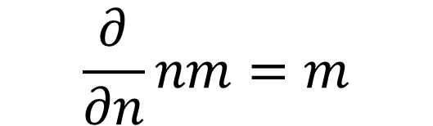

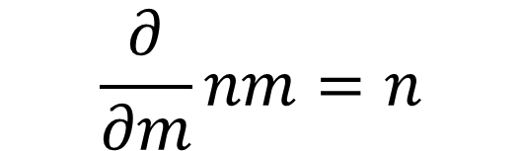
f(x,y,z) = (x+y)z
x
n+m
Multiplication swaps inputs, multiplies gradient
x+y
y
n*m
(x+y)z
z*1
z
(x+y)*1
1
$$\frac{∂}{∂n}nm=m$$
$$\frac{∂}{∂m}nm=n$$
$$→z∗1$$
$$→(x+y)∗1$$
Example Credit: Karpathy and Fei-Fei

Slide 14
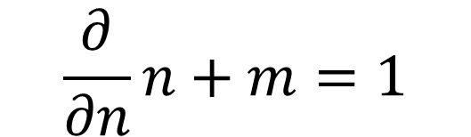

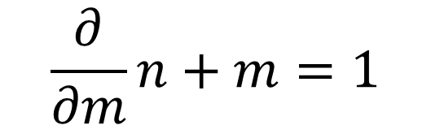

f(x,y,z) = (x+y)z
x
n+m
Addition sends gradient through unchanged
1*z*1
x+y
y
1*z*1
n*m
z*1
(x+y)z
z
(x+y)*1
1
$$\frac{∂}{∂n}n+m=1$$
$$\frac{∂}{∂m}n+m=1$$
$$→1∗z∗1$$
$$→1∗z∗1$$
Example Credit: Karpathy and Fei-Fei

Slide 15
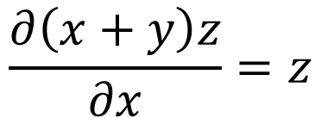
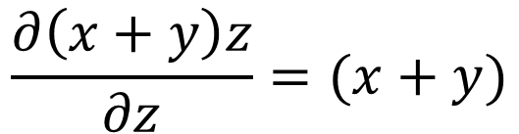
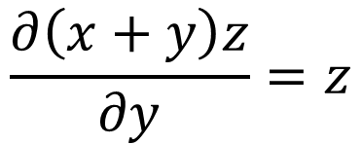
f(x,y,z) = (x+y)z
x
n+m
z
x+y
y
z
n*m
z*1
(x+y)z
z
x+y
1
$$\frac{∂\left(x+y\right)z}{∂x}=z$$
$$\frac{∂\left(x+y\right)z}{∂y}=z$$
$$\frac{∂\left(x+y\right)z}{∂z}=(x+y)$$
Example Credit: Karpathy and Fei-Fei

Slide 16
Once More, With Numbers!

Slide 17
f(x,y,z) = (x+y)z
1
n+m
5
4
n*m
50
10
Example Credit: Karpathy and Fei-Fei

Slide 18


f(x,y,z) = (x+y)z
1
n+m
5
4
n*m
50
10
10
5
1
$$\frac{∂}{∂n}nm=m$$
$$\frac{∂}{∂m}nm=n$$
$$→10∗1$$
$$→5∗1$$
Example Credit: Karpathy and Fei-Fei

Slide 19


f(x,y,z) = (x+y)z
1
n+m
10
5
4
10
n*m
10
50
u
10
5
1
$$\frac{∂}{∂n}n+m=1$$
$$\frac{∂}{∂m}n+m=1$$
$$→1∗10∗1$$
$$→1∗10∗1$$
Example Credit: Karpathy and Fei-Fei

Slide 20

Think You’ve Got It?
$$L\left(x\right)={\left(w−6\right)}^{2}$$
We want to fit a model w that just will equal 6.
World’s most basic linear model / neural net: no inputs, just constant output.

Slide 21

I’ll Need a Few Volunteers
$$L\left(x\right)={\left(w−6\right)}^{2}$$
n
n-6
n
n²
n-6
n²
g
g
2ng
g
Job #1 (n-6):
Job #2 (n²):
Job #3:
Forward:
Compute n-6
Forward:
Compute n²
Backwards:
Multiply by 1
Backwards:
Multiply by 2n
Backwards:
Give me a 1

Slide 22

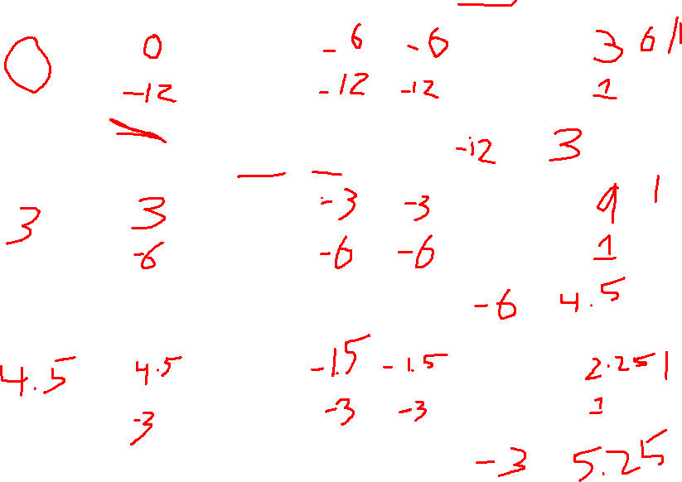
n
n-6
n
n²
n-6
n²
$$L\left(x\right)={\left(w−6\right)}^{2}$$
g
g
2ng
g
__
__
__
__
w0: ___
n-6
n²
__
__
__
__
w1 = w0 - (1/4) ___ =
__
__
__
__
w1: ___
n-6
n²
__
__
__
__
w2 = w1 - (1/4) ___ =
__
__
__
__
w2: ___
n-6
n²
__
__
__
__
w3 = w2 - (1/4) ___ =

Slide 23
Preemptively
The diagrams look complex but that’s since we’re covering the details together

Slide 24
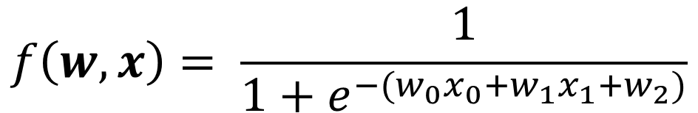
Something More Complex
$$f\left(w,x\right)= \frac{1}{1+e^{−(w_{0}x_{0}+w_{1}x_{1}+w_{2})}}$$
w₀
n*m
x₀
n+m
w₁
n*m
n+m
n*-1
e^{n}
n+1
1/n
x₁
w₂
Example Credit: Karpathy and Fei-Fei

Slide 25

$$f\left(w,x\right)= \frac{1}{1+e^{−(w_{0}x_{0}+w_{1}x_{1}+w_{2})}}$$
w₀
2
*
-2
x₀
-1
+
4
6
w₁
-3
*
+
1
-1
0.37
1.37
0.73
*-1
e^{n}
+1
n⁻¹
x₁
-2
w₂
-3

Slide 26
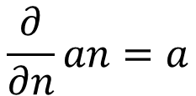
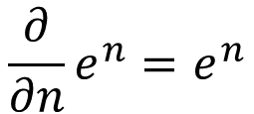
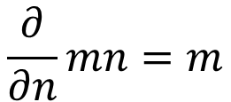
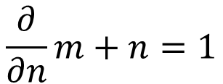
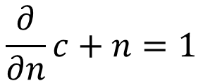
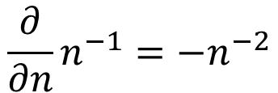
0
$$\frac{∂}{∂n}m+n=1$$
1
$$f\left(w,x\right)= \frac{1}{1+e^{−(w_{0}x_{0}+w_{1}x_{1}+w_{2})}}$$
$$\frac{∂}{∂n}mn=m$$
w₀
2
*
2
3
$$\frac{∂}{∂n}e^{n}=e^{n}$$
$$\frac{∂}{∂n}n^{−1}=−n^{−2}$$
-2
x₀
-1
4
5
$$\frac{∂}{∂n}an=a$$
$$\frac{∂}{∂n}c+n=1$$
+
4
6
w₁
-3
*
+
1
-1
0.37
1.37
0.73
*-1
e^{n}
+1
n⁻¹
x₁
-2
w₂
-3
Example Credit: Karpathy and Fei-Fei

Slide 27
0
$$\frac{∂}{∂n}m+n=1$$
1
$$f\left(w,x\right)= \frac{1}{1+e^{−(w_{0}x_{0}+w_{1}x_{1}+w_{2})}}$$
$$\frac{∂}{∂n}mn=m$$
w₀
2
*
2
3
$$\frac{∂}{∂n}e^{n}=e^{n}$$
$$\frac{∂}{∂n}n^{−1}=−n^{−2}$$
-2
x₀
-1
4
5
$$\frac{∂}{∂n}an=a$$
$$\frac{∂}{∂n}c+n=1$$
+
4
6
w₁
-3
*
+
1
-1
0.37
1.37
0.73
*-1
e^{n}
+1
n⁻¹
x₁
-2
1
w₂
-3
Example Credit: Karpathy and Fei-Fei

Slide 28

0
$$\frac{∂}{∂n}m+n=1$$
1
$$f\left(w,x\right)= \frac{1}{1+e^{−(w_{0}x_{0}+w_{1}x_{1}+w_{2})}}$$
$$\frac{∂}{∂n}mn=m$$
w₀
2
*
2
3
$$\frac{∂}{∂n}e^{n}=e^{n}$$
$$\frac{∂}{∂n}n^{−1}=−n^{−2}$$
-2
x₀
-1
4
5
$$\frac{∂}{∂n}an=a$$
$$\frac{∂}{∂n}c+n=1$$
+
4
6
w₁
-3
*
+
1
-1
0.37
1.37
0.73
*-1
e^{n}
+1
n⁻¹
x₁
-2
1
$$−{\left(1.37\right)}^{−2}∗1=−0.53$$
w₂
-3
Where does 1.37 come from?
Example Credit: Karpathy and Fei-Fei

Slide 29

0
$$\frac{∂}{∂n}m+n=1$$
1
$$f\left(w,x\right)= \frac{1}{1+e^{−(w_{0}x_{0}+w_{1}x_{1}+w_{2})}}$$
$$\frac{∂}{∂n}mn=m$$
w₀
2
*
2
3
$$\frac{∂}{∂n}e^{n}=e^{n}$$
$$\frac{∂}{∂n}n^{−1}=−n^{−2}$$
-2
x₀
-1
4
5
$$\frac{∂}{∂n}an=a$$
$$\frac{∂}{∂n}c+n=1$$
+
4
6
w₁
-3
*
+
1
-1
0.37
1.37
0.73
*-1
e^{n}
+1
n⁻¹
x₁
-2
-0.53
1
w₂
-3
$$1∗−0.53=−0.53$$
Example Credit: Karpathy and Fei-Fei

Slide 30

0
$$\frac{∂}{∂n}m+n=1$$
1
$$f\left(w,x\right)= \frac{1}{1+e^{−(w_{0}x_{0}+w_{1}x_{1}+w_{2})}}$$
$$\frac{∂}{∂n}mn=m$$
w₀
2
*
2
3
$$\frac{∂}{∂n}e^{n}=e^{n}$$
$$\frac{∂}{∂n}n^{−1}=−n^{−2}$$
-2
x₀
-1
4
5
$$\frac{∂}{∂n}an=a$$
$$\frac{∂}{∂n}c+n=1$$
+
4
6
w₁
-3
*
+
1
-1
0.37
1.37
0.73
*-1
e^{n}
+1
n⁻¹
x₁
-2
-0.53
-0.53
1
w₂
-3
$$e^{−1}∗−0.53=−0.2$$
Example Credit: Karpathy and Fei-Fei

Slide 31

0
$$\frac{∂}{∂n}m+n=1$$
1
$$f\left(w,x\right)= \frac{1}{1+e^{−(w_{0}x_{0}+w_{1}x_{1}+w_{2})}}$$
$$\frac{∂}{∂n}mn=m$$
w₀
2
*
2
3
$$\frac{∂}{∂n}e^{n}=e^{n}$$
$$\frac{∂}{∂n}n^{−1}=−n^{−2}$$
-2
x₀
-1
4
5
$$\frac{∂}{∂n}an=a$$
$$\frac{∂}{∂n}c+n=1$$
+
4
6
w₁
-3
*
+
1
-1
0.37
1.37
0.73
*-1
e^{n}
+1
n⁻¹
x₁
-2
-0.2
-0.53
-0.53
1
w₂
-3
$$−1∗−0.2=0.2$$
Example Credit: Karpathy and Fei-Fei

Slide 32

0
$$\frac{∂}{∂n}m+n=1$$
1
$$f\left(w,x\right)= \frac{1}{1+e^{−(w_{0}x_{0}+w_{1}x_{1}+w_{2})}}$$
$$\frac{∂}{∂n}mn=m$$
w₀
2
*
2
3
$$\frac{∂}{∂n}e^{n}=e^{n}$$
$$\frac{∂}{∂n}n^{−1}=−n^{−2}$$
-2
x₀
-1
4
5
$$\frac{∂}{∂n}an=a$$
$$\frac{∂}{∂n}c+n=1$$
+
4
6
w₁
-3
*
+
1
-1
0.37
1.37
0.73
*-1
e^{n}
+1
n⁻¹
x₁
-2
0.2
-0.2
-0.53
-0.53
1
w₂
-3
$$1∗0.2=0.2$$
Gets sent back both directions
Example Credit: Karpathy and Fei-Fei

Slide 33
0
$$\frac{∂}{∂n}m+n=1$$
1
$$f\left(w,x\right)= \frac{1}{1+e^{−(w_{0}x_{0}+w_{1}x_{1}+w_{2})}}$$
$$\frac{∂}{∂n}mn=m$$
w₀
2
*
2
3
$$\frac{∂}{∂n}e^{n}=e^{n}$$
$$\frac{∂}{∂n}n^{−1}=−n^{−2}$$
-2
x₀
-1
4
5
$$\frac{∂}{∂n}an=a$$
$$\frac{∂}{∂n}c+n=1$$
+
4
6
w₁
-3
*
+
1
-1
0.37
1.37
0.73
0.2
*-1
e^{n}
+1
n⁻¹
x₁
-2
0.2
-0.2
-0.53
-0.53
1
w₂
-3
$$1∗0.2=0.2$$
0.2
Gets sent back both directions
Example Credit: Karpathy and Fei-Fei

Slide 34


0
$$\frac{∂}{∂n}m+n=1$$
1
$$f\left(w,x\right)= \frac{1}{1+e^{−(w_{0}x_{0}+w_{1}x_{1}+w_{2})}}$$
$$\frac{∂}{∂n}mn=m$$
w₀
2
*
2
3
$$\frac{∂}{∂n}e^{n}=e^{n}$$
$$\frac{∂}{∂n}n^{−1}=−n^{−2}$$
-2
x₀
-1
4
5
$$\frac{∂}{∂n}an=a$$
$$\frac{∂}{∂n}c+n=1$$
0.2
+
4
6
w₁
-3
*
+
1
-1
0.37
1.37
0.73
0.2
*-1
e^{n}
+1
n⁻¹
x₁
-2
0.2
0.2
-0.2
-0.53
-0.53
1
w₂
-3
$$−1∗0.2=−0.2$$
0.2
$$2∗0.2=0.4$$
Example Credit: Karpathy and Fei-Fei

Slide 35


0
$$\frac{∂}{∂n}m+n=1$$
1
$$f\left(w,x\right)= \frac{1}{1+e^{−(w_{0}x_{0}+w_{1}x_{1}+w_{2})}}$$
$$\frac{∂}{∂n}mn=m$$
w₀
2
*
2
3
$$\frac{∂}{∂n}e^{n}=e^{n}$$
$$\frac{∂}{∂n}n^{−1}=−n^{−2}$$
-0.2
-2
x₀
-1
4
5
0.4
$$\frac{∂}{∂n}an=a$$
$$\frac{∂}{∂n}c+n=1$$
0.2
+
4
6
w₁
-3
*
+
1
-1
0.37
1.37
0.73
0.2
*-1
e^{n}
+1
n⁻¹
x₁
-2
0.2
0.2
-0.2
-0.53
-0.53
1
w₂
-3
$$−2∗0.2=−0.4$$
0.2
$$−3∗0.2=−0.6$$
Example Credit: Karpathy and Fei-Fei

Slide 36
0
$$\frac{∂}{∂n}m+n=1$$
1
$$f\left(w,x\right)= \frac{1}{1+e^{−(w_{0}x_{0}+w_{1}x_{1}+w_{2})}}$$
$$\frac{∂}{∂n}mn=m$$
w₀
2
*
2
3
$$\frac{∂}{∂n}e^{n}=e^{n}$$
$$\frac{∂}{∂n}n^{−1}=−n^{−2}$$
-0.2
-2
x₀
-1
4
5
0.4
$$\frac{∂}{∂n}an=a$$
$$\frac{∂}{∂n}c+n=1$$
0.2
+
4
6
w₁
-3
*
+
1
-1
0.37
1.37
0.73
-0.4
0.2
*-1
e^{n}
+1
n⁻¹
x₁
-2
0.2
-0.6
0.2
-0.2
-0.53
-0.53
1
w₂
-3
0.2
Example Credit: Karpathy and Fei-Fei

Slide 37
0
$$\frac{∂}{∂n}m+n=1$$
1
$$f\left(w,x\right)= \frac{1}{1+e^{−(w_{0}x_{0}+w_{1}x_{1}+w_{2})}}$$
$$\frac{∂}{∂n}mn=m$$
w₀
2
*
2
3
$$\frac{∂}{∂n}e^{n}=e^{n}$$
$$\frac{∂}{∂n}n^{−1}=−n^{−2}$$
-0.2
-2
x₀
-1
4
5
0.4
$$\frac{∂}{∂n}an=a$$
$$\frac{∂}{∂n}c+n=1$$
+
4
6
w₁
-3
*
+
1
-1
0.37
1.37
0.73
-0.4
*-1
e^{n}
+1
n⁻¹
x₁
-2
-0.6
PHEW!
w₂
-3
0.2
Example Credit: Karpathy and Fei-Fei

Slide 38








Summary
Each block computes backwards (g) * local gradient (df/dx_{i}) at the evaluation point
$$x_{1}$$
f
$$g({∂f}/{∂x_{1})}$$
$$x_{2}$$
$$g({∂f}/{∂x_{2})}$$
$$f(x_{1},…,x_{n})$$
…
$$g$$
$$x_{n}$$
$$g({∂f}/{∂x_{n})}$$

Slide 39
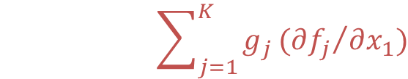




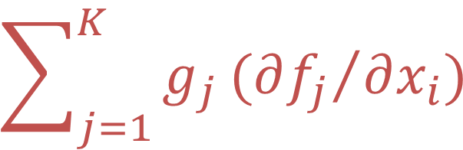

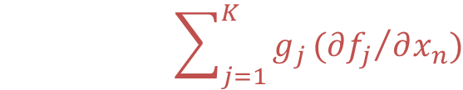
Multiple Outputs Flowing Back
Gradients from different backwards sum up
$$\sum_{j=1}^{K}{g_{j}}({∂f_{j}}/{∂x_{i})}$$
$$x_{1}$$
f
$$f_{1}(x_{1},…,x_{n})$$
$$\sum_{j=1}^{K}{g_{j}}({∂f_{j}}/{∂x_{1})}$$
…
$$g_{1}$$
$$f_{K}(x_{1},…,x_{n})$$
$$x_{n}$$
$$\sum_{j=1}^{K}{g_{j}}({∂f_{j}}/{∂x_{n})}$$
$$g_{K}$$

Slide 40
Multiple Outputs Flowing Back
$$f\left(x\right)={\left(−x+3\right)}^{2}$$
-x
(-x+3)²
x
-x+3
-n
n+3
m*n
-x+3
-x+3
x-3
1
x
x
-x
-x+3
-n
n+3
x-3
-x+3
-x+3

Slide 41
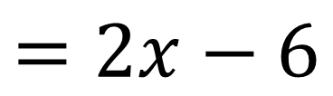
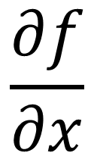
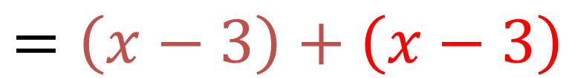
Multiple Outputs Flowing Back
$$f\left(x\right)={\left(−x+3\right)}^{2}$$
x
$$\frac{∂f}{∂x}$$
$$=\left(x−3\right)+\left(x−3\right)$$
x-3
x
$$=2x−6$$
x
x-3

Slide 42
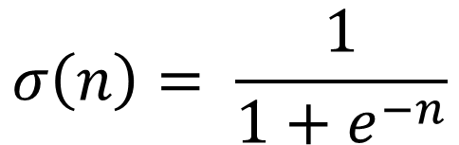
Does It Have To Be So Painful?
$$f\left(w,x\right)= \frac{1}{1+e^{−(w_{0}x_{0}+w_{1}x_{1}+w_{2})}}$$
w₀
n*m
x₀
n+m
w₁
n*m
n+m
n*-1
e^{n}
n+1
1/x
x₁
$$σ\left(n\right)= \frac{1}{1+e^{−n}}$$
w₂
Example Credit: Karpathy and Fei-Fei

Slide 43
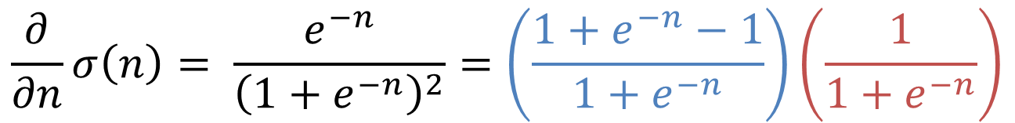
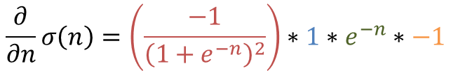
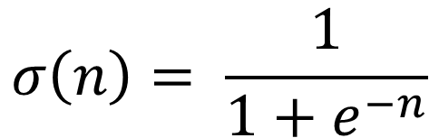


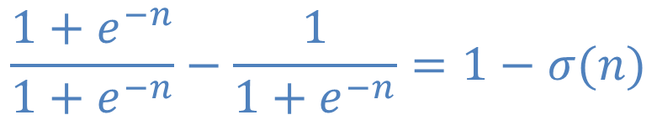
Does It Have To Be So Painful?
$$σ\left(n\right)= \frac{1}{1+e^{−n}}$$
$$\frac{∂}{∂n}σ\left(n\right)= \frac{e^{−n}}{{\left(1+e^{−n}\right)}^{2}}=\left(\frac{1+e^{−n}−1}{1+e^{−n}}\right)\left(\frac{1}{1+e^{−n}}\right)$$
$$\frac{1+e^{−n}}{1+e^{−n}}−\frac{1}{1+e^{−n}}=1−σ(n)$$
$$σ(n)$$
$$=\left(1−σ\left(n\right)\right)σ(n)$$
For the curious
Line
1 to 2:
$$\frac{∂}{∂n}σ\left(n\right)=\left(\frac{−1}{{\left(1+e^{−n}\right)}^{2}}\right)∗1∗e^{−n}∗−1$$
Chain rule: d/dx (1/x)*d/dx (1+x)*
d/dx (e*x)*d/dx (-x)
Example Credit: Karpathy and Fei-Fei

Slide 44
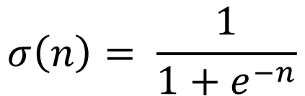
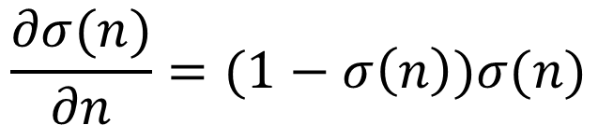
Does It Have To Be So Painful?
$$f\left(w,x\right)= \frac{1}{1+e^{−(w_{0}x_{0}+w_{1}x_{1}+w_{2})}}$$
w₀
n*m
x₀
n+m
w₁
n*m
n+m
σ(n)
x₁
w₂
$$σ\left(n\right)= \frac{1}{1+e^{−n}}$$
$$\frac{∂σ(n)}{∂n}=(1−σ\left(n\right))σ(n)$$
Example Credit: Karpathy and Fei-Fei

Slide 45
Does It Have To Be So Painful?
Can compute for any function
Pick your functions carefully: existing code is usually structured into sensible blocks

Slide 46
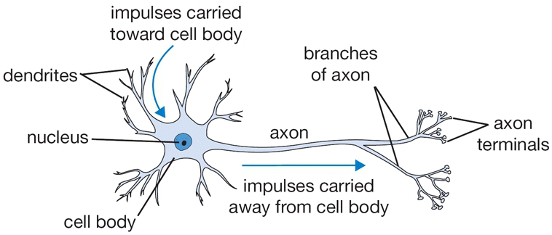
Building Blocks
Takes signals from other cells, processes, sends out
Input from
other cells
Output to
other cells
Neuron diagram credit: Karpathy and Fei-Fei

Slide 47
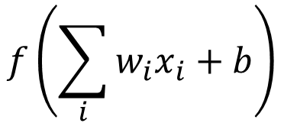

Artificial Neuron
Weighted average of other neuron outputs passed through an activation function
$$\sum_{i}{w_{i}x_{i}+b}$$
$$f\left(\sum_{i}{w_{i}x_{i}+b}\right)$$
Activation

Slide 48

Artificial Neuron
Can differentiate whole thing e.g., dNeuron/dx₁.
What can we now do?
w₁
w₂
w₃
b
x₁
*
$$∑$$
x₂
*
f
x₃
*

Slide 49

Artificial Neuron
Each artificial neuron is a linear model + an activation function f
Can find w, b that minimizes a loss function with gradient descent
w,b
$$∑$$
x
f

Slide 50




Artificial Neurons
Connect neurons to make a more complex function; use backprop to compute gradient
w,b
$$∑$$
x
f
w,b
w,b
$$∑$$
$$∑$$
x
f
x
f
w,b
$$∑$$
x
f

Slide 51
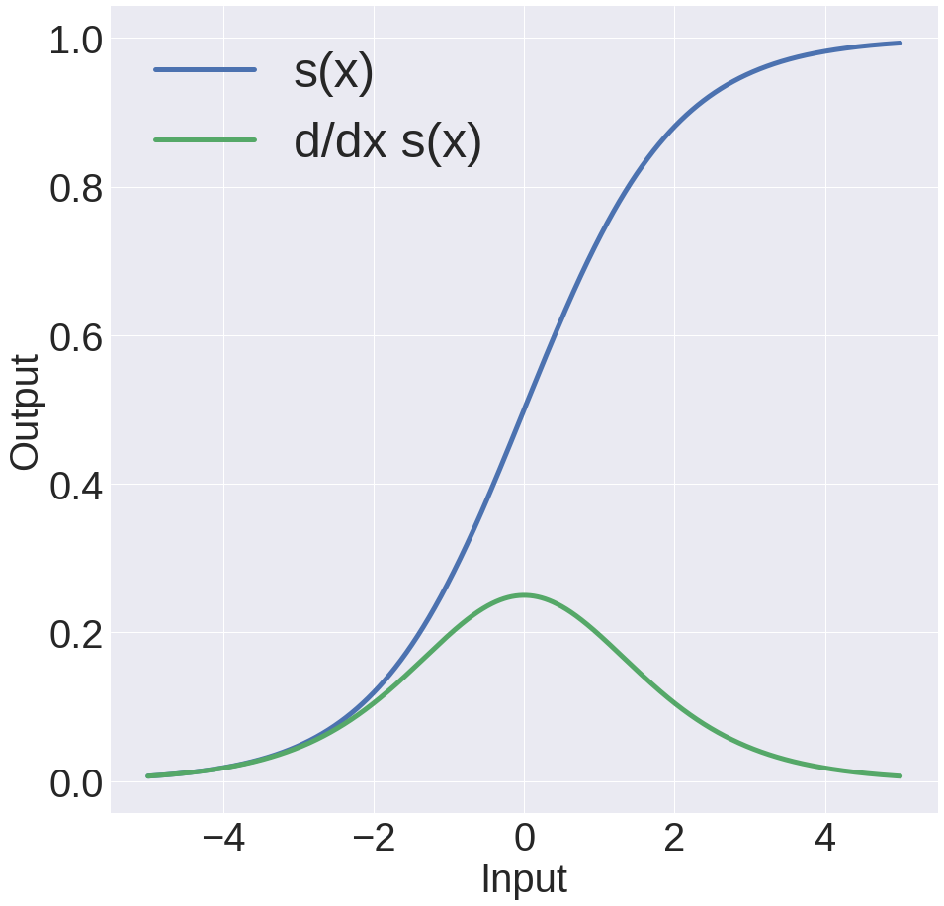
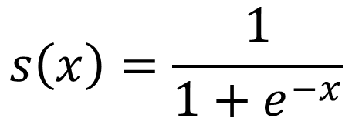
What’s The Activation Function
Sigmoid
$$s\left(x\right)=\frac{1}{1+e^{−x}}$$
Nice interpretation
Squashes things to (0,1)
Gradients are near zero if neuron is high/low

Slide 52
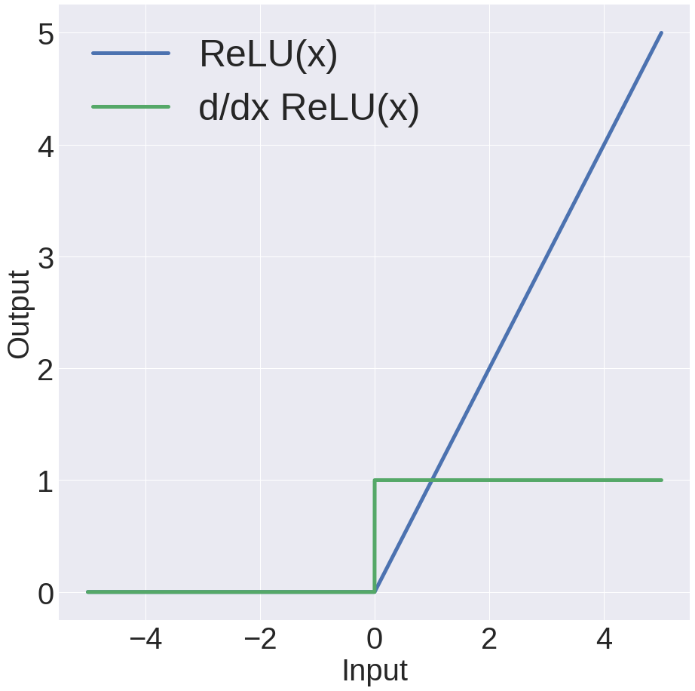

What’s The Activation Function
ReLU
(Rectifying Linear Unit)
$$max⁡(0,x)$$
Constant gradient
Converges ~6x faster
If neuron negative, zero gradient. Be careful!

Slide 53
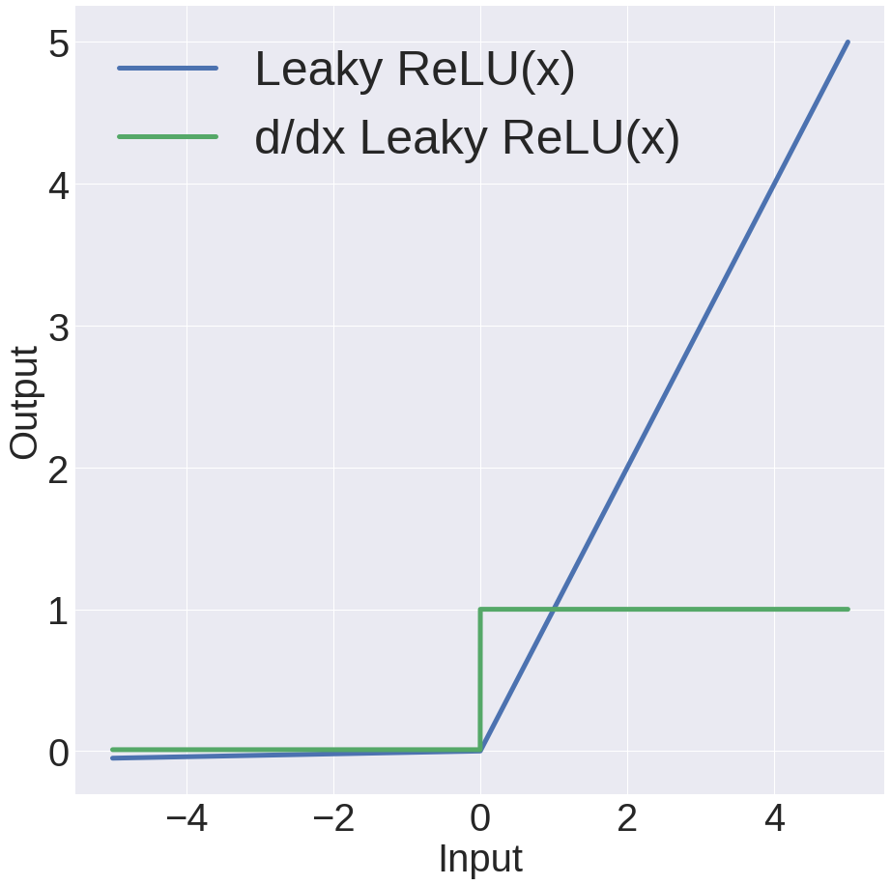


What’s The Activation Function
Leaky ReLU
(Rectifying Linear Unit)
$$x :x≥0$$
$$0.01x :x<0$$
ReLU, but allows some small gradient for negative vales

Slide 54
Setting Up A Neural Net
Input
Hidden
Output
h₁
y₁
x₁
h₂
y₂
x₂
h₃
y₃
h₄

Slide 55
Setting Up A Neural Net
Input
Hidden 1
Hidden 2
Output
a₁
h₁
y₁
x₁
a₂
h₂
y₂
x₂
a₃
h₃
y₃
a₄
h₄

Slide 56
Fully Connected Network
a₁
h₁
y₁
x₁
a₂
h₂
Each neuron connects to each neuron in the previous layer
y₂
x₂
a₃
h₃
y₃
a₄
h₄

Slide 57




Fully Connected Network
a₁
h₁
y₁
$$a$$
All layer a values
x₁
a₂
h₂
y₂
$$w_{i},b_{i}$$
Neuron i weights, bias
x₂
a₃
h₃
$$f$$
Activation function
y₃
a₄
h₄
$$h_{i}=f(w_{i}^{T}a+b_{i})$$
How do we do all the neurons all at once?

Slide 58






















Fully Connected Network
a₁
h₁
y₁
$$a$$
All layer a values
x₁
a₂
h₂
y₂
$$w_{i},b_{i}$$
Neuron i weights, bias
x₂
a₃
h₃
$$f$$
Activation function
y₃
a₄
h₄
$$h=f(Wa+b)$$
$$h_{1}$$
$$($$
$$w_{1}^{T}$$
$$a_{1}$$
$$b_{1}$$
$$)$$
$$h_{2}$$
$$=$$
$$f$$
$$w_{2}^{T}$$
$$a_{2}$$
$$+$$
$$b_{2}$$
$$h_{3}$$
$$w_{3}^{T}$$
$$a_{3}$$
$$b_{3}$$
$$h_{4}$$
$$w_{4}^{T}$$
$$a_{4}$$
$$b_{4}$$

Slide 59
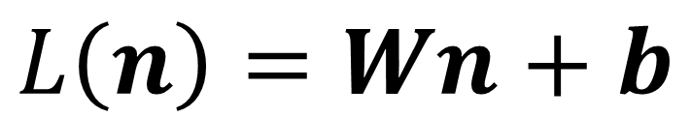
Fully Connected Network
Define New Block: “Linear Layer”
(Ok technically it’s Affine)
W
b
$$L\left(n\right)=Wn+b$$
n
L
Can get gradient with respect to all the inputs
(do on your own; useful trick: have to be able to do matrix multiply)

Slide 60
Fully Connected Network
a₁
h₁
y₁
x₁
a₂
h₂
y₂
x₂
a₃
h₃
y₃
a₄
h₄
W
b
W
b
W
b
x
L
f(n)
L
f(n)
L
f(n)

Slide 61
Fully Connected Network
a₁
h₁
y₁
x₁
a₂
h₂
What happens if we remove the activation functions?
y₂
x₂
a₃
h₃
y₃
a₄
h₄
W
b
W
b
W
b
x
L
L
L

Slide 62
Demo Time
https://cs.stanford.edu/people/karpathy/convnetjs/demo/classify2d.html

