Slide 1
Neural Networks
Lecture 6
Rob Fergus

Slide 2
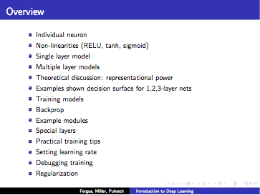

Slide 3
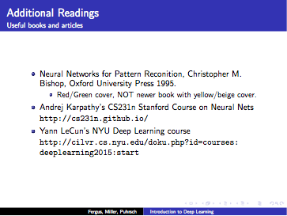

Slide 4
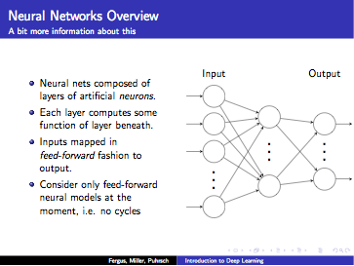

Slide 5
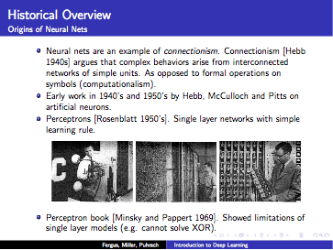

Slide 6


Slide 7
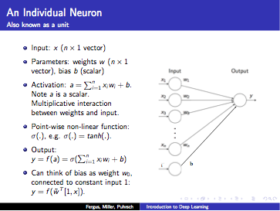

Slide 8
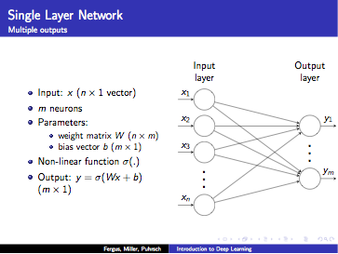

Slide 9
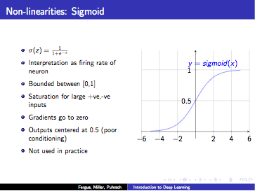

Slide 10
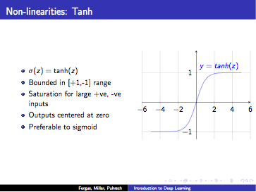

Slide 11
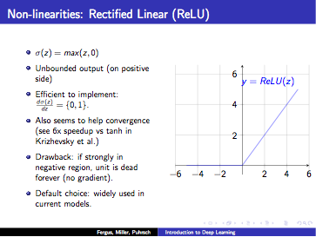

Slide 12
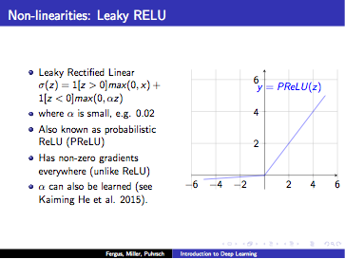

Slide 13
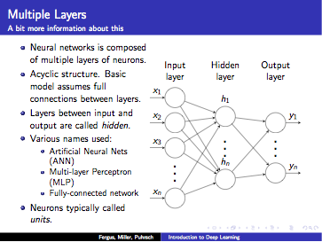

Slide 14
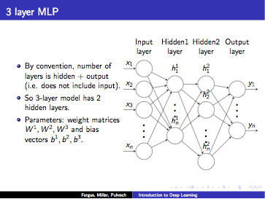

Slide 15
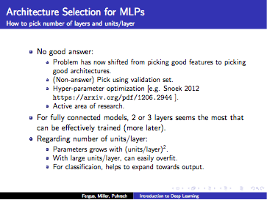

Slide 16
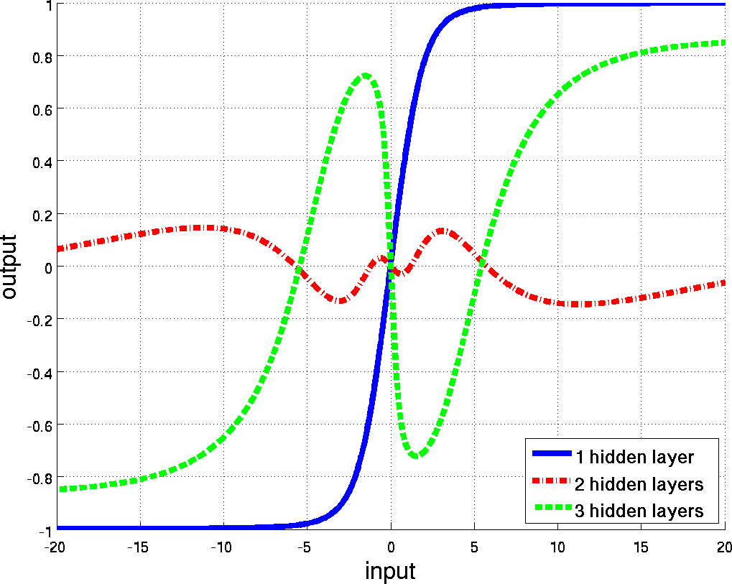

TOY EXAMPLE: SYNTHETIC DATA
1 input & 1 output
100 hidden units in each layer
Ranzato

Slide 17
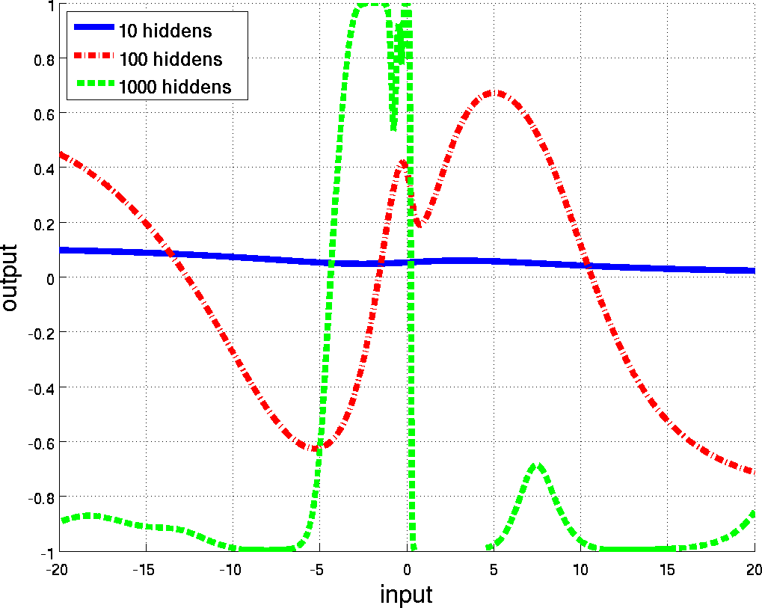
TOY EXAMPLE: SYNTHETIC DATA
1 input & 1 output
3 hidden layers
Ranzato

Slide 18
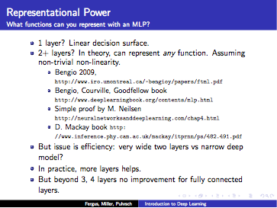

Slide 19
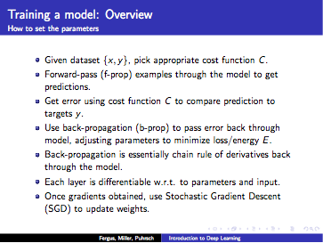

Slide 20
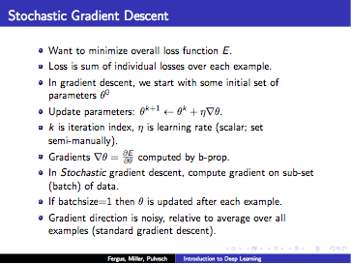

Slide 21
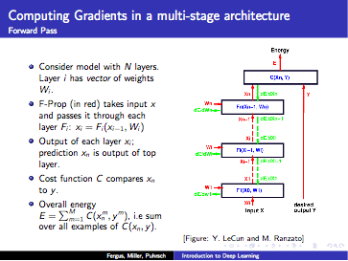

Slide 22
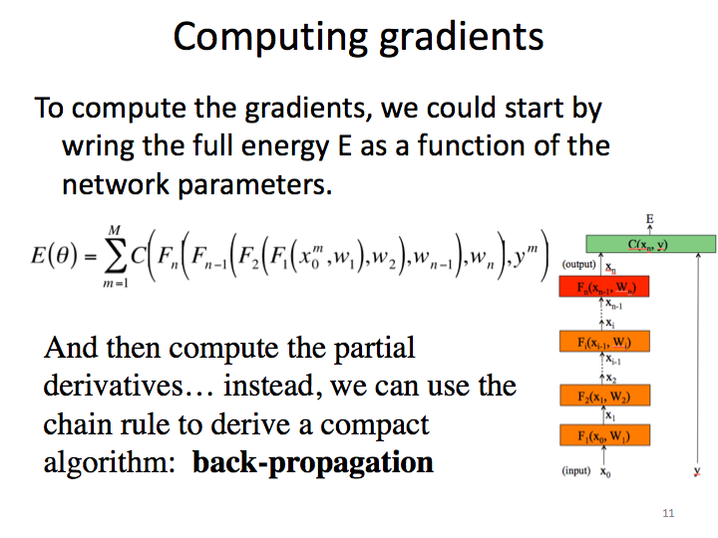

Slide 23
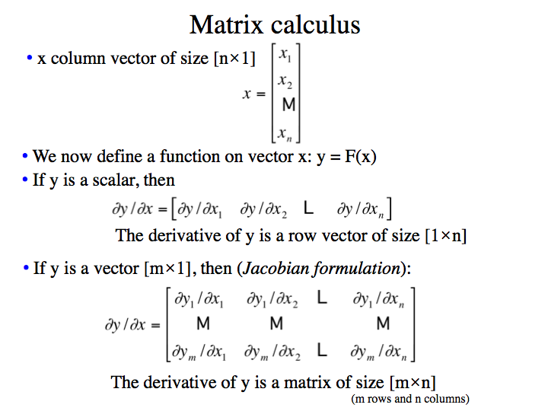

Slide 24
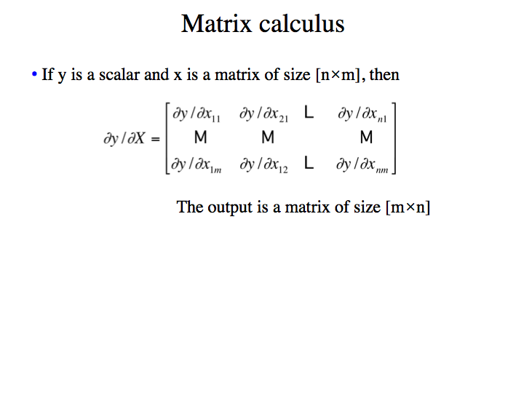

Slide 25
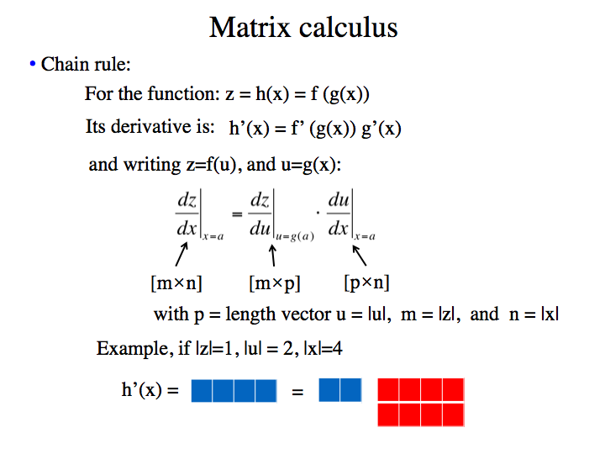

Slide 26
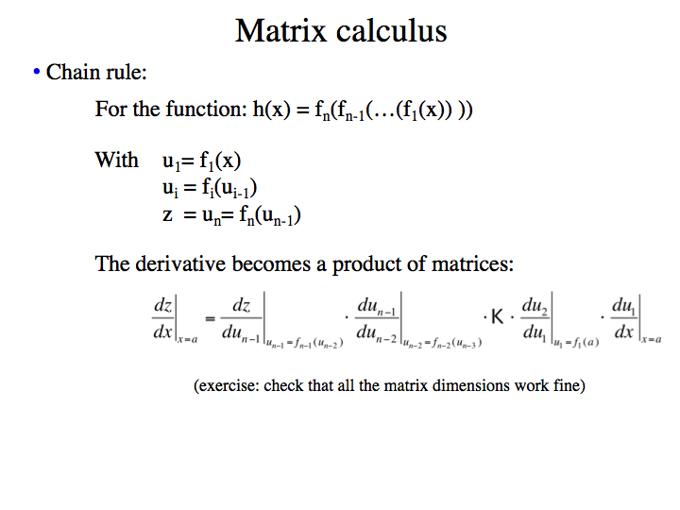

Slide 27


Computing gradients
The energy E is the sum of the costs associated to each training example x^{m}, y^{m}
Its gradient with respect to the networks parameters is:
is how much E varies when the parameter θ_{i} is varied.

Slide 28

Computing gradients
We could write the cost function to get the gradients:
with
If we compute the gradient with respect to the parameters of
the last layer (output layer) w_{n}, using the chain rule:
(how much the cost changes when we change w_{n}: is the product between how much the cost changes when we change the output of the last layer and how much the output changes when we change the layer parameters.)

Slide 29
Computing gradients: cost layer
If we compute the gradient with respect to the parameters of
the last layer (output layer) w_{n}, using the chain rule:
Will depend on the
layer structure and
non-linearity.
For example, for an Euclidean loss:
The gradient is:

Slide 30

Computing gradients: layer i
We could write the full cost function to get the gradients:
If we compute the gradient with respect to w_{i}, using the chain rule:
And this can be
computed iteratively!
This is easy.

Slide 31

Backpropagation
If we have the value of we can compute the gradient at the
layer bellow as:
Gradient
layer i-1
Gradient
layer i

Slide 32
Backpropagation: layer i
Layer i has two inputs (during training)
x_{i-1}
F_{i+1}
For layer i, we need the derivatives:
x_{i}
Hidden layer i
F_{i}(x_{i-1}, W_{i})
x_{i-1}
We compute the outputs
F_{i-1}
Forward
pass
Backward
pass
The weight update equation is:
(sum over all
training examples
to get E)
Notes:
During training, each layer will have three outputs:
the forward pass. To compute the operating point for each layer and training example
the backwards pass to propagate the energy derivative with respect to the input of the layer
- and the derivative of the energy with respect to the weights.

Slide 33
Backpropagation: summary
E
Forward pass: for each training example. Compute the outputs for all layers
Backwards pass: compute cost derivatives iteratively from top to bottom:
Compute gradients and update weights.
C(X_{n},Y)
(output)
x_{n}
F_{n}(x_{n-1}, W_{n})
x_{n-1}
…
x_{i}
F_{i}(x_{i-1}, W_{i})
x_{i-1}
…
x₂
F₂(x₁, W₂)
x₁
F₁(x₀, W₁)
(input)
x₀
y

Slide 34
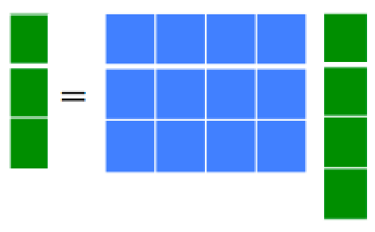


Linear Module
x_{out}
Forward propagation:
F(x_{in}, W)
x_{in}
With W being a
matrix of size
|x_{out}|×|x_{in}|
Backprop to input:
If we look at the j component of output x_{out}, with respect to the i component of the input, x_{in}:
Therefore:

Slide 35



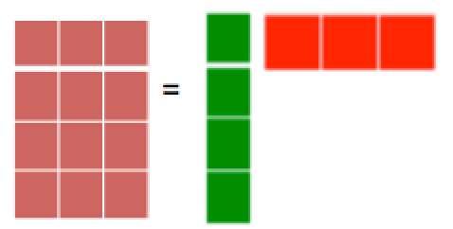

Linear Module
x_{out}
Forward propagation:
F(x_{in}, W)
x_{in}
Backprop to weights:
If we look at how the parameter W_{ij} changes the cost, only the i component of the output
will change, therefore:
And now we can update the weights (by summing over all the training examples):
(sum over all
training examples
to get E)
Notes:
Things to notice: dC/dW is the derivative of a scalar by a matrix. So it is well defined.
If there is a single training example, then E = C.

Slide 36

Linear Module
x_{out}
Weight updates
x_{in}
Notes:
Things to notice: dC/dW is the derivative of a scalar by a matrix. So it is well defined.
If there is a single training example, then E = C.

Slide 37


Pointwise function
x_{out}
Forward propagation:
F(x_{in}, W)
x_{in}
h = an arbitrary function, b_{i} is a bias term.
Backprop to input:
Backprop to bias:
We use this last expression to update the bias.
Some useful derivatives:
For hyperbolic tangent:
For ReLU: h(x) = max(0,x) h’(x) = 1 [x>0]

Slide 38


Pointwise function
x_{out}
Weight updates
x_{in}
Notes:
Things to notice: dC/dW is the derivative of a scalar by a matrix. So it is well defined.
If there is a single training example, then E = C.

Slide 39
Euclidean cost module
C
x_{in}
y

Slide 40
Back propagation example
node 1
w13=1
node 3
1
0.2
tanh
node 5
input
output
-3
linear
node 2
node 4
-1
1
tanh
Learning rate = -0.2 (because we used positive increments)
Euclidean loss
Training data:
input
desired output
node 1
node 2
node 5
1.0 0.1 0.5
Exercise: run one iteration of back propagation

Slide 41
Back propagation example
node 1
w13=1
node 3
1
0.2
tanh
node 5
input
output
-3
linear
node 2
node 4
-1
1
tanh
After one iteration (rounding to two digits):
node 1
w13=1.02
node 3
1.02
0.17
tanh
node 5
input
output
-3
linear
node 2
node 4
-0.99
1
tanh

Slide 42
Toy Code: Neural Net Trainer in MATLAB
% F-PROP
for i = 1 : nr_layers - 1
[h{i} jac{i}] = logistic(W{i} * h{i-1} + b{i});
end
h{nr_layers-1} = W{nr_layers-1} * h{nr_layers-2} + b{nr_layers-1};
prediction = softmax(h{l-1});
% CROSS ENTROPY LOSS
loss = - sum(sum(log(prediction) .* target));
% B-PROP
dh{l-1} = prediction - target;
for i = nr_layers – 1 : -1 : 1
Wgrad{i} = dh{i} * h{i-1}';
bgrad{i} = sum(dh{i}, 2);
dh{i-1} = (W{i}' * dh{i}) .* jac{i-1};
end
% UPDATE
for i = 1 : nr_layers - 1
W{i} = W{i} – (lr / batch_size) * Wgrad{i};
b{i} = b{i} – (lr / batch_size) * bgrad{i};
end
Ranzato

Slide 43
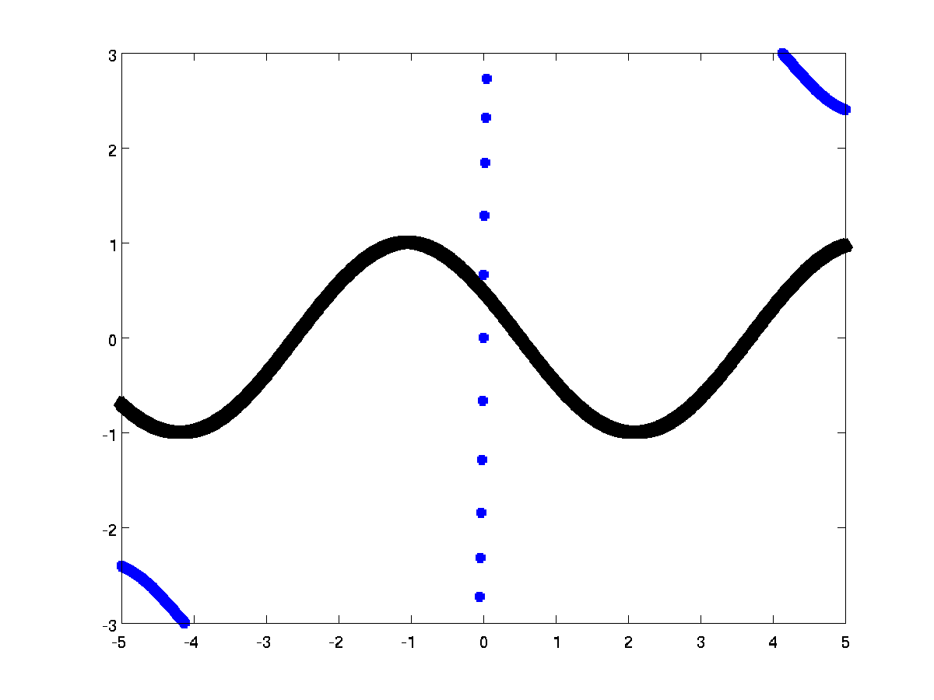
TOY EXAMPLE: SYNTHETIC DATA
1 input & 1 output
3 hidden layers, 1000 hiddens
Regression of cosine
Ranzato

Slide 44
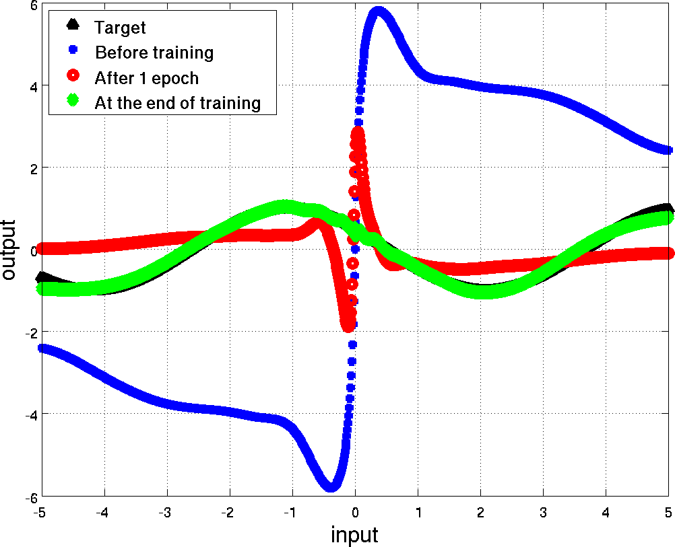
TOY EXAMPLE: SYNTHETIC DATA
1 input & 1 output
3 hidden layers, 1000 hiddens
Regression of cosine
Ranzato

Slide 45
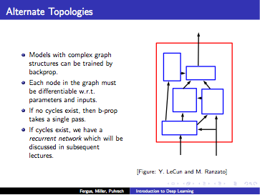

Slide 46
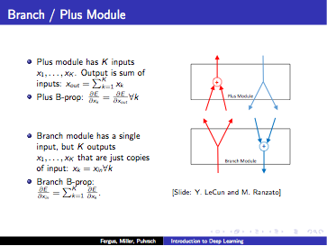

Slide 47
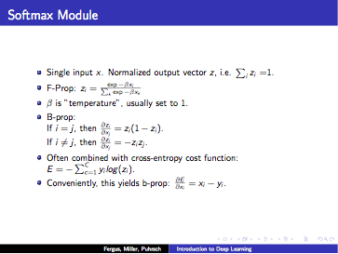

Slide 48
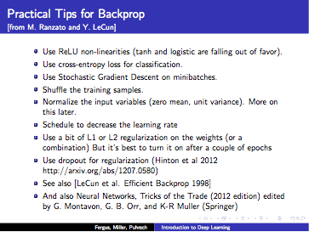

Slide 49
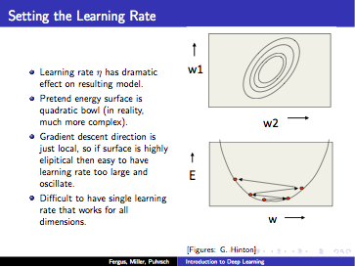

Slide 50
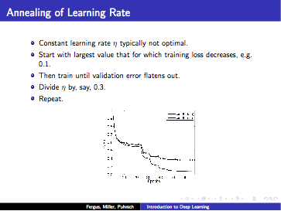

Slide 51
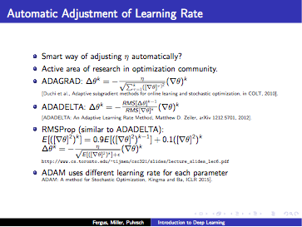

Slide 52
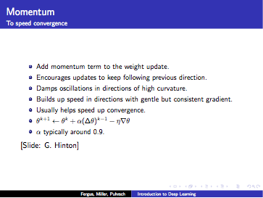

Slide 53
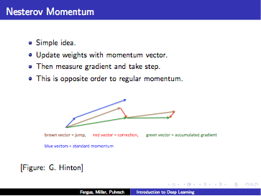

Slide 54
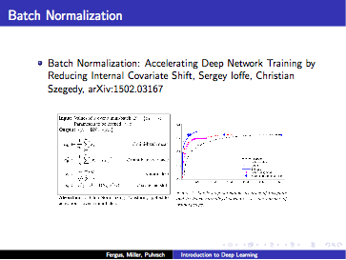

Slide 55
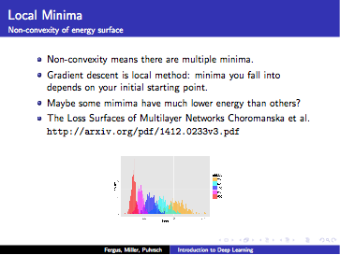

Slide 56
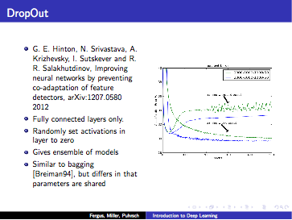

Slide 57
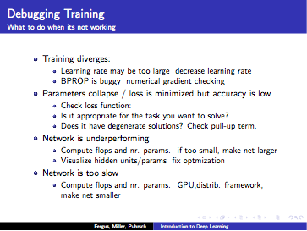

Slide 58
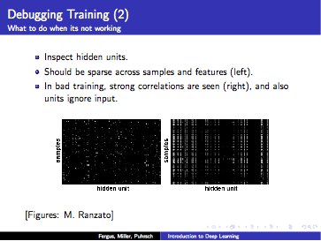

Slide 59
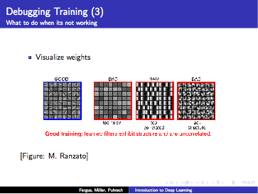

Slide 60
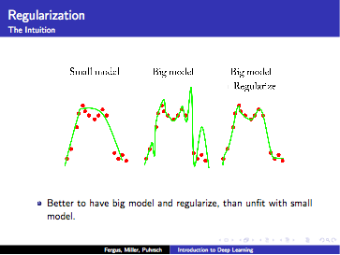

Slide 61
