Slide 1
Lecture 4:
Light &
Color
Prof. Rob Fergus
Slides: S. Lazebnik, S. Seitz, W. Freeman, F. Durand, D. Forsyth, D. Lowe, B. Wandell, S.Palmer, K. Grauman

Slide 2
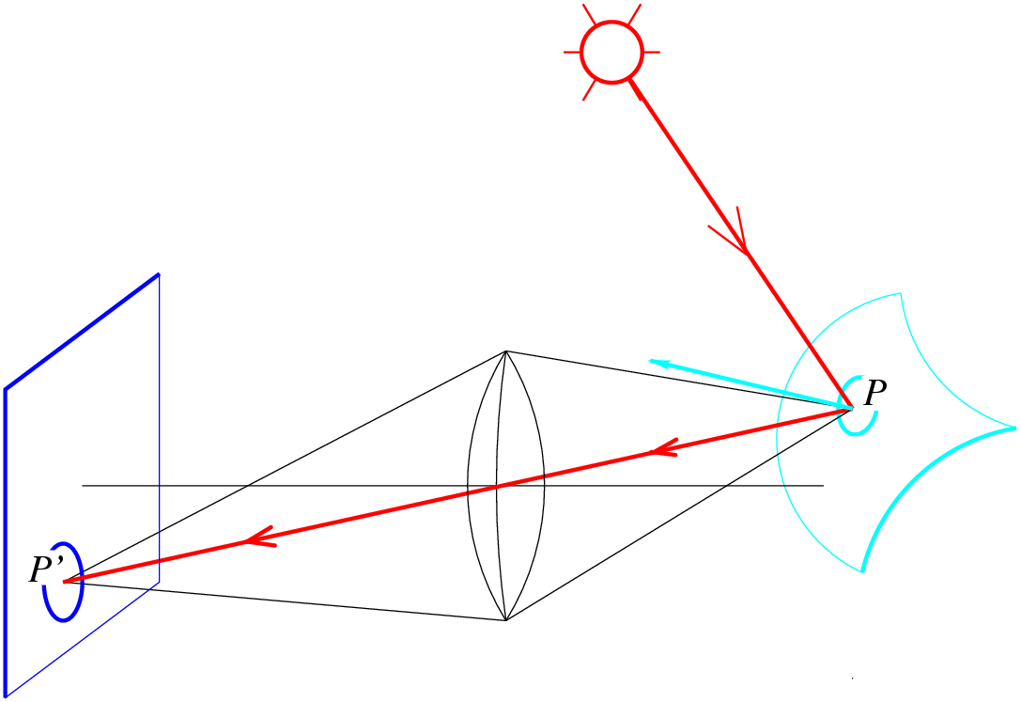
Image formation

Slide 3
From light rays to pixel values
Camera response function: the mapping f from irradiance to pixel values
  Useful if we want to estimate material properties
  Enables us to create high dynamic range images
Source: S. Seitz, P. Debevec

Slide 4
Image formation

Slide 5
The interaction of light and surfaces
What happens when a light ray hits a point on an object?
  Some of the light gets absorbed
    converted to other forms of energy (e.g., heat)
  Some gets transmitted through the object
    possibly bent, through “refraction”
    Or scattered inside the object (subsurface scattering)
  Some gets reflected
    possibly in multiple directions at once
  Really complicated things can happen
    fluorescence
Let’s consider the case of reflection in detail
  Light coming from a single direction could be reflected in all directions. How can we describe the amount of light reflected in each direction?
Slide by Steve Seitz

Slide 6
Bidirectional reflectance distribution function (BRDF)
Model of local reflection that tells how bright a surface appears when viewed from one direction when light falls on it from another
Definition: ratio of the radiance L in the emitted direction to irradiance E in the incident direction
Notes:
The main purpose of the BRDF is to enable us to compute the radiance leaving the surface in a particular direction (e.g., towards the camera), given the distribution of the radiances received by that surface point over the incoming hemisphere. These kinds of computations are done in graphics by raytracing and global illumination algorithms.

Slide 7
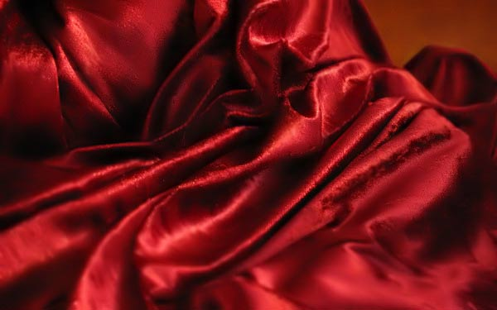
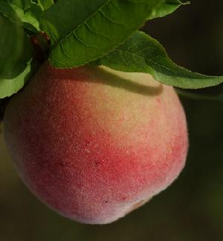
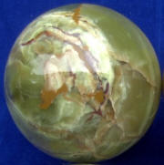
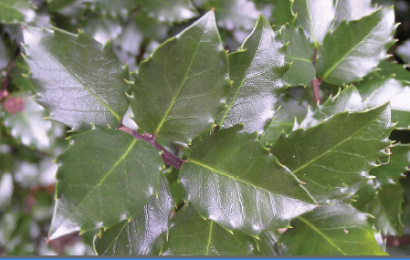
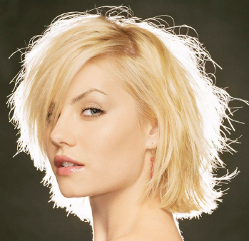
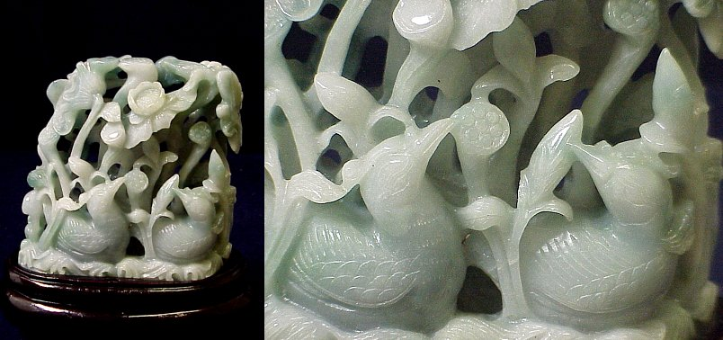
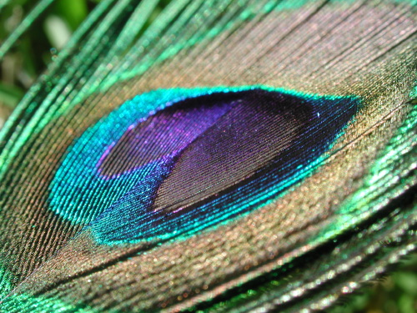
BRDFs can be incredibly complicated…

Slide 8
Diffuse reflection
Light is reflected equally in all directions
  Dull, matte surfaces like chalk or latex paint
  Microfacets scatter incoming light randomly
BRDF is constant
  Albedo: fraction of incident irradiance reflected by the surface

Slide 9
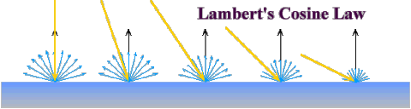
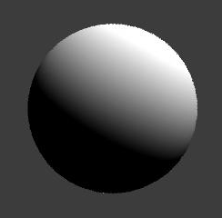
Diffuse reflection: Lambert’s law
Viewed brightness does not depend on viewing direction, but it does depend on direction of illumination
B: radiosity
ρ: albedo
N: unit normal
S: source vector (magnitude proportional to intensity of the source)
N
S
x

Slide 10
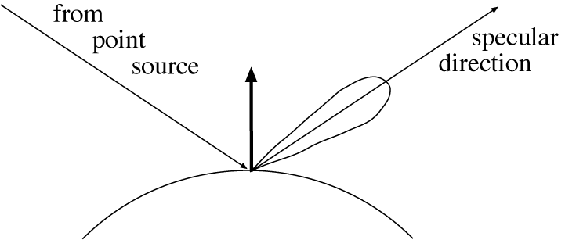
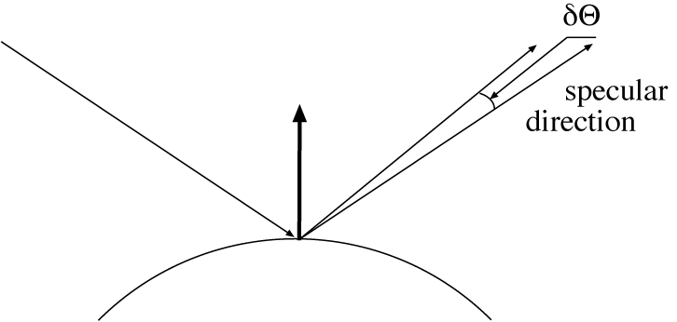
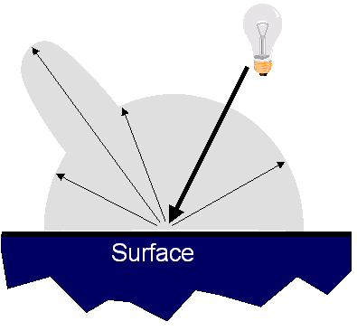
Specular reflection
Radiation arriving along a source direction leaves along the specular direction (source direction reflected about normal)
Some fraction is absorbed, some reflected
On real surfaces, energy usually goes into a lobe of directions
Phong model: reflected energy falls of with
Lambertian + specular model: sum of diffuse and specular term

Slide 11
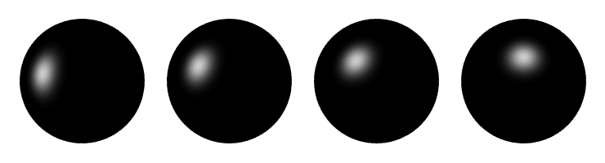
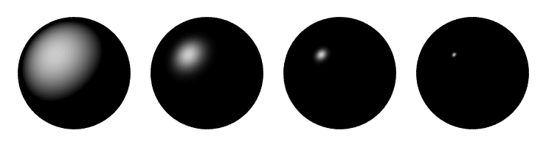
Specular reflection
Moving the light source
Changing the exponent

Slide 12
Color

Slide 13
What is color?
Color is a psychological property of our visual experiences when we look at objects and lights,
not a physical property of those objects or lights
(S. Palmer, Vision Science: Photons to Phenomenology)
Color is the result of interaction between physical light in the environment and our visual system

Slide 14
Overview of Color
Physics of color
Human encoding of color
Color spaces
White balancing

Slide 15
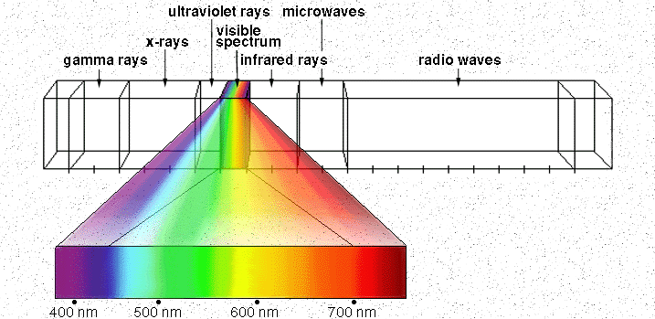
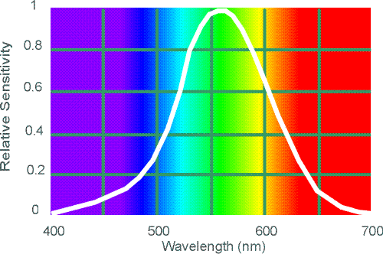
Electromagnetic Spectrum
Human Luminance Sensitivity Function
http://www.yorku.ca/eye/photopik.htm
Notes:
15
At least 3 spectral bands required (e.g. R,G,B)

Slide 16
Visible Light
Plank’s law for Blackbody radiation
Surface of the sun: ~5800K
Why do we see light of these wavelengths?
…because that’s where the
Sun radiates EM energy
© Stephen E. Palmer, 2002

Slide 17
The Physics of Light
Any source of light can be completely described
physically by its spectrum: the amount of energy emitted
(per time unit) at each wavelength 400 - 700 nm.
Relative
spectral
power
© Stephen E. Palmer, 2002

Slide 18
The Physics of Light
Some examples of the spectra of light sources
Rel. power
Rel. power
Rel. power
Rel. power
© Stephen E. Palmer, 2002

Slide 19
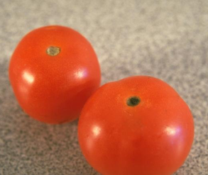
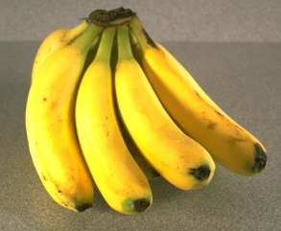
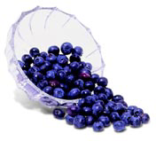
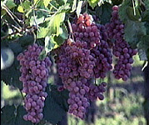
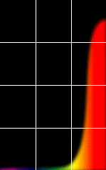
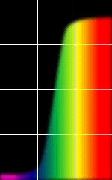
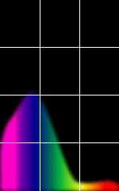
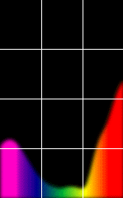
The Physics of Light
Some examples of the reflectance spectra of surfaces
Red
Yellow
Blue
Purple
% Light Reflected
400 700
400 700
400 700
400 700
Wavelength (nm)
© Stephen E. Palmer, 2002

Slide 20
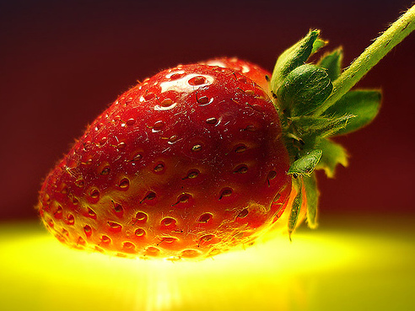
Interaction of light and surfaces
Reflected color is the result of interaction of light source spectrum with surface reflectance
Spectral radiometry
  All definitions and units are now “per unit wavelength”
  All terms are now “spectral”
From Foundation of Vision by Brian Wandell, Sinauer Associates, 1995

Slide 21
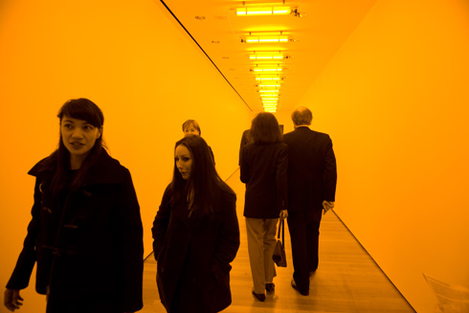
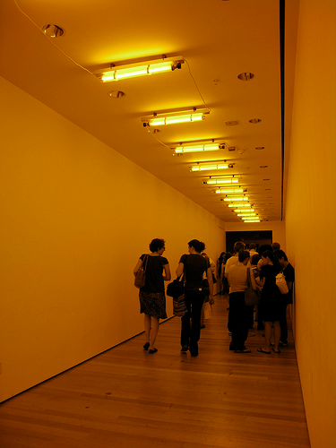
Interaction of light and surfaces
What is the observed color of any surface under monochromatic light?
Olafur Eliasson, Room for one color
Slide by S. Lazebnik

Slide 22
Overview of Color
Physics of color
Human encoding of color
Color spaces
White balancing

Slide 23
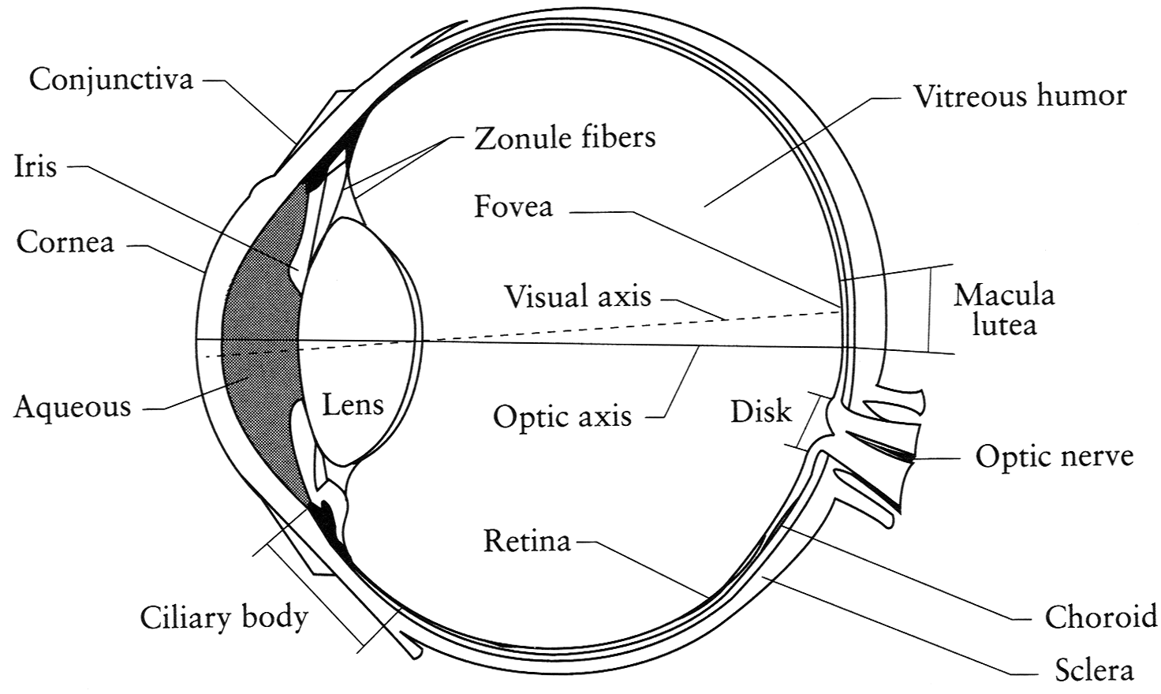
The Eye
The human eye is a camera!
  Iris - colored annulus with radial muscles
  Pupil - the hole (aperture) whose size is controlled by the iris
  What’s the “film”?
    photoreceptor cells (rods and cones) in the retina
Slide by Steve Seitz

Slide 24
The Retina

Slide 25
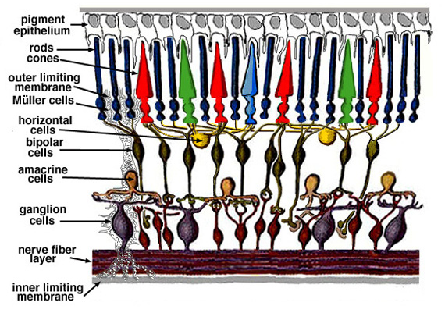
Retina up-close
Light

Slide 26
Two types of light-sensitive receptors
Cones
cone-shaped
less sensitive
operate in high light
color vision
Rods
rod-shaped
highly sensitive
operate at night
gray-scale vision
© Stephen E. Palmer, 2002

Slide 27
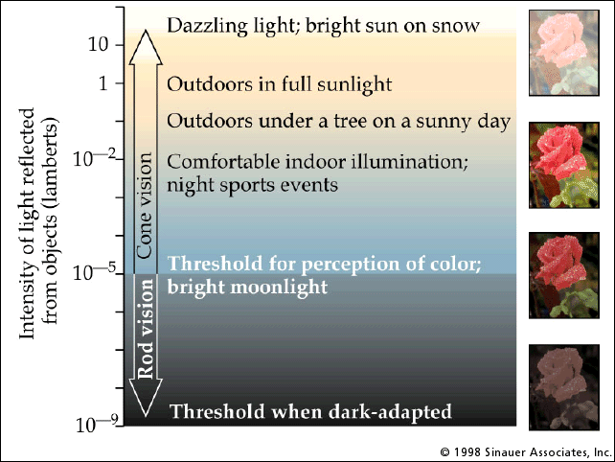
Rod / Cone sensitivity
The famous sock-matching problem…

Slide 28
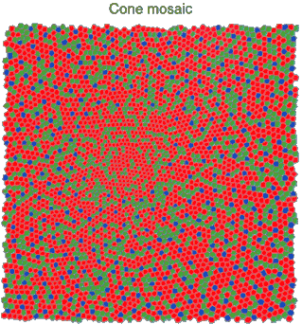
Physiology of Color Vision
Three kinds of cones:
Why are M and L cones so close?
Are are there 3?
© Stephen E. Palmer, 2002

Slide 29
Color perception
M
L
Power
S
Wavelength
Rods and cones act as filters on the spectrum
  To get the output of a filter, multiply its response curve by the spectrum, integrate over all wavelengths
    Each cone yields one number
  Q: How can we represent an entire spectrum with 3 numbers?
  A: We can’t! Most of the information is lost.
    As a result, two different spectra may appear indistinguishable
      such spectra are known as metamers
Slide by Steve Seitz

Slide 30
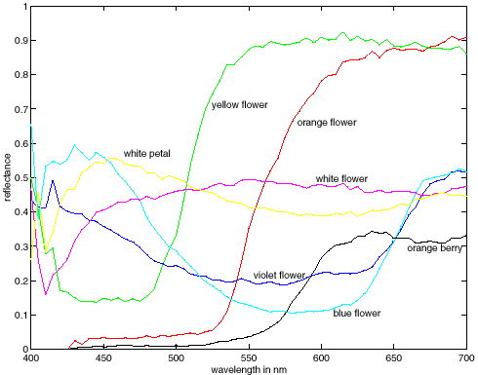
Spectra of some real-world surfaces
metamers

Slide 31
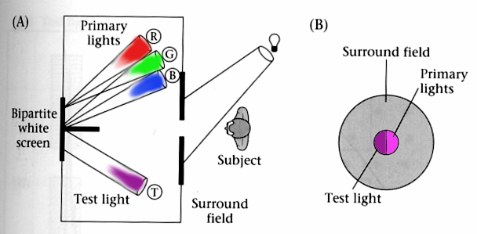
Standardizing color experience
We would like to understand which spectra produce the same color sensation in people under similar viewing conditions
Color matching experiments
Foundations of Vision, by Brian Wandell, Sinauer Assoc., 1995

Slide 32
Color matching experiment 1
Source: W. Freeman

Slide 33
Color matching experiment 1
p₁ p₂ p₃
Source: W. Freeman

Slide 34
Color matching experiment 1
p₁ p₂ p₃
Source: W. Freeman

Slide 35
Color matching experiment 1
The primary color amounts needed for a match
p₁ p₂ p₃
Source: W. Freeman

Slide 36
Color matching experiment 2
Source: W. Freeman

Slide 37
Color matching experiment 2
p₁ p₂ p₃
Source: W. Freeman

Slide 38
Color matching experiment 2
p₁ p₂ p₃
Source: W. Freeman

Slide 39
Color matching experiment 2
The primary color amounts needed for a match:
We say a “negative” amount of p₂ was needed to make the match, because we added it to the test color’s side.
p₁ p₂ p₃
p₁ p₂ p₃
p₁ p₂ p₃
Source: W. Freeman

Slide 40
Trichromacy
In color matching experiments, most people can match any given light with three primaries
  Primaries must be independent
For the same light and same primaries, most people select the same weights
  Exception: color blindness
Trichromatic color theory
  Three numbers seem to be sufficient for encoding color
  Dates back to 18th century (Thomas Young)
Notes:
Linear matching: suppose A = u1 P1 + u2 P2 + u3 P3 and B = v1 P1 + v2 P2 + v3 P3. Then A+B = (u1+v1)P1 + (u2+v2)P2 + (u3+v3)P3.
Also, suppose A = u1 P1 + u2 P2 + u3 P3. Then kA = (k u1) P1 + (k u2) P2 + (k u3) P3.

Slide 41
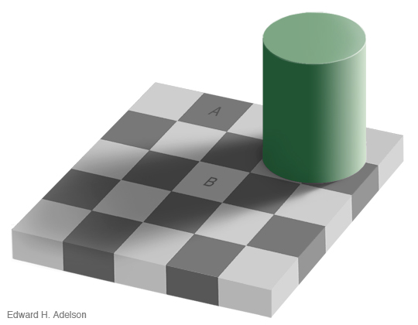
Lightness constancy
http://web.mit.edu/persci/people/adelson/checkershadow_illusion.html

Slide 42
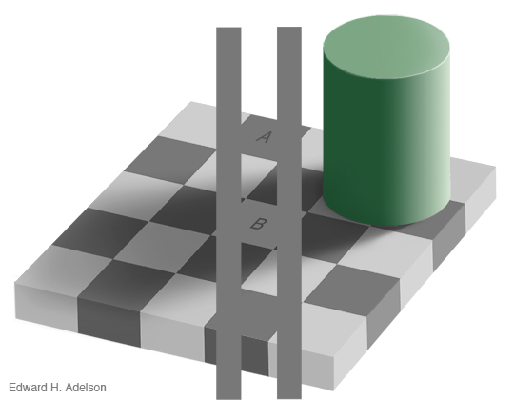
Lightness constancy
Possible explanations
  Simultaneous contrast
  Reflectance edges vs. illumination edges
http://web.mit.edu/persci/people/adelson/checkershadow_illusion.html

Slide 43
Overview of Color
Physics of color
Human encoding of color
Color spaces
White balancing

Slide 44
Linear color spaces
Defined by a choice of three primaries
The coordinates of a color are given by the weights of the primaries used to match it
mixing two lights produces
colors that lie along a straight
line in color space
mixing three lights produces
colors that lie within the triangle
they define in color space

Slide 45
How to compute the weights of the primaries to match any spectral signal
p₁ p₂ p₃
Matching functions: the amount of each primary needed to match a monochromatic light source at each wavelength
Source: W. Freeman

Slide 46

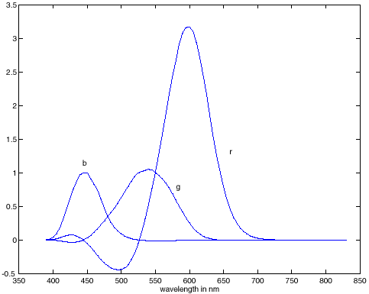
RGB space
Primaries are monochromatic lights (for monitors, they correspond to the three types of phosphors)
Subtractive matching required for some wavelengths
RGB primaries
RGB matching functions

Slide 47
How to compute the weights of the primaries to match any spectral signal
Let c(λ) be one of the matching functions, and let t(λ) be the spectrum of the signal. Then the weight of the corresponding primary needed to match t is
Matching functions, c(λ)
Signal to be matched, t(λ)
λ

Slide 48
Linear color spaces: CIE XYZ
Primaries are imaginary, but matching functions are everywhere positive
The Y parameter corresponds to brightness or luminance of a color
2D visualization: draw (x,y), where
x = X/(X+Y+Z), y = Y/(X+Y+Z)
Matching functions
http://en.wikipedia.org/wiki/CIE_1931_color_space

Slide 49
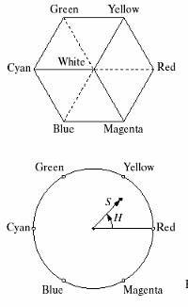
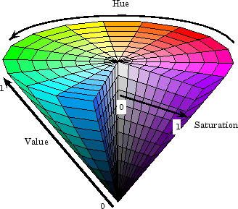
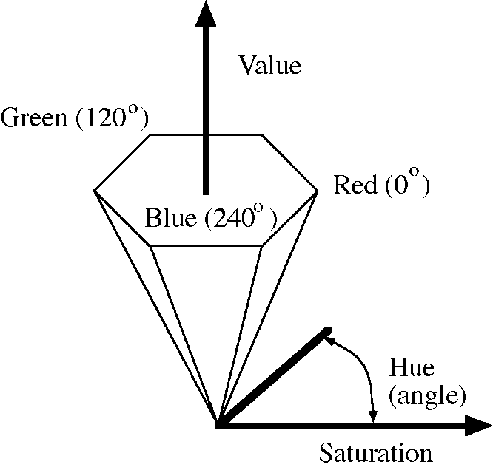
Nonlinear color spaces: HSV
Perceptually meaningful dimensions:
Hue, Saturation, Value (Intensity)
RGB cube on its vertex

Slide 50
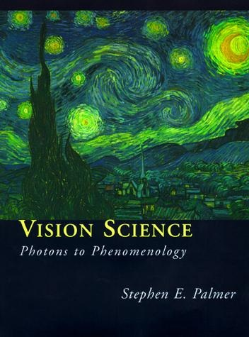
Useful reference
Stephen E. Palmer, Vision Science: Photons to Phenomenology, MIT Press, 1999

Slide 51
Overview of Color
Physics of color
Human encoding of color
Color spaces
White balancing

Slide 52
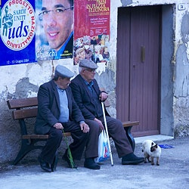
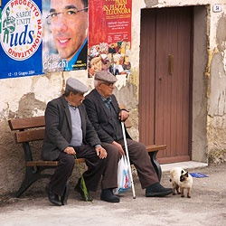
White balance
When looking at a picture on screen or print, we adapt to the illuminant of the room, not to that of the scene in the picture
When the white balance is not correct, the picture will have an unnatural color “cast”
incorrect white balance
correct white balance
http://www.cambridgeincolour.com/tutorials/white-balance.htm

Slide 53
White balance
Film cameras:
  Different types of film or different filters for different illumination conditions
Digital cameras:
  Automatic white balance
  White balance settings corresponding to
  several common illuminants
  Custom white balance using a reference
  object
http://www.cambridgeincolour.com/tutorials/white-balance.htm
Slide: F. Durand

Slide 54
White balance
Von Kries adaptation
  Multiply each channel by a gain factor
  A more general transformation would correspond to an arbitrary 3x3 matrix
Slide: F. Durand

Slide 55
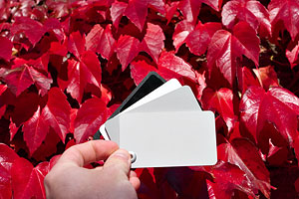
White balance
Von Kries adaptation
  Multiply each channel by a gain factor
  A more general transformation would correspond to an arbitrary 3x3 matrix
Best way: gray card
  Take a picture of a neutral object (white or gray)
  Deduce the weight of each channel
    If the object is recoded as r_{w}, g_{w}, b_{w}
    use weights 1/r_{w}, 1/g_{w}, 1/b_{w}
Slide: F. Durand

Slide 56
White balance
Without gray cards: we need to “guess” which pixels correspond to white objects
Gray world assumption
  The image average r_{ave}, g_{ave}, b_{ave} is gray
  Use weights 1/r_{ave}, 1/g_{ave}, 1/b_{ave}
Brightest pixel assumption (non-staurated)
  Highlights usually have the color of the light source
  Use weights inversely proportional to the values of the brightest pixels
Gamut mapping
  Gamut: convex hull of all pixel colors in an image
  Find the transformation that matches the gamut of the image to the gamut of a “typical” image under white light
Use image statistics, learning techniques
Slide: F. Durand

Slide 57
Uses of color in computer vision
Color histograms for indexing and retrieval
Swain and Ballard, Color Indexing, IJCV 1991.

Slide 58
Uses of color in computer vision
Skin detection
M. Jones and J. Rehg, Statistical Color Models with Application to Skin Detection, IJCV 2002.
Source: S. Lazebnik

Slide 59
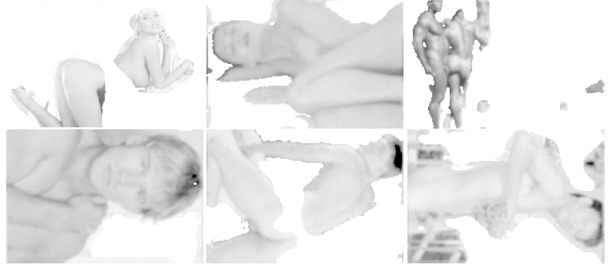
Uses of color in computer vision
Nude people detection
Forsyth, D.A. and Fleck, M. M., ``Automatic Detection of Human Nudes,'' International Journal of Computer Vision , 32 , 1, 63-77, August, 1999

Slide 60
Uses of color in computer vision
Image segmentation and retrieval
C. Carson, S. Belongie, H. Greenspan, and Ji. Malik, Blobworld: Image segmentation using Expectation-Maximization and its application to image querying, ICVIS 1999.
Source: S. Lazebnik

Slide 61
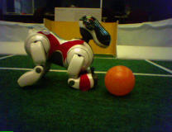
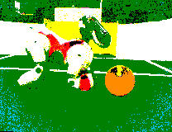
Uses of color in computer vision
Robot soccer
M. Sridharan and P. Stone, Towards Eliminating Manual Color Calibration at RoboCup. RoboCup-2005: Robot Soccer World Cup IX, Springer Verlag, 2006
Source: K. Grauman

Slide 62
Uses of color in computer vision
Building appearance models for tracking
D. Ramanan, D. Forsyth, and A. Zisserman. Tracking People by Learning their Appearance. PAMI 2007.
Source: S. Lazebnik

