Slide 1
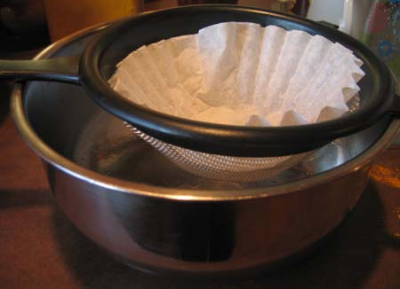
Image Filtering

Slide 2
Overview of Filtering
Convolution
Gaussian filtering
Median filtering

Slide 3
Overview of Filtering
Convolution
Gaussian filtering
Median filtering

Slide 4
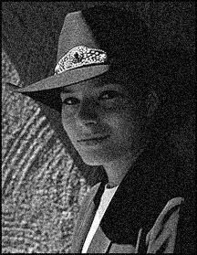
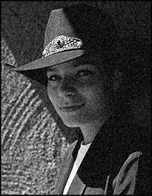

Motivation: Noise reduction
Given a camera and a still scene, how can you reduce noise?
Take lots of images and average them!
What’s the next best thing?
Source: S. Seitz
Notes:
Answer: take lots of images, average them

Slide 5

Moving average
Let’s replace each pixel with a weighted average of its neighborhood
The weights are called the filter kernel
What are the weights for the average of a 3x3 neighborhood?
1
1
1
1
1
1
1
1
1
“box filter”
Source: D. Lowe

Slide 6


Defining Convolution
Let f be the image and g be the kernel. The output of convolving f with g is denoted f * g.
f
Convention: kernel is “flipped”
MATLAB: conv2 (also imfilter)
Source: F. Durand

Slide 7
Key properties
Linearity: filter(f₁ + f₂ ) = filter(f₁) + filter(f₂)
Shift invariance: same behavior regardless of pixel location: filter(shift(f)) = shift(filter(f))
Theoretical result: any linear shift-invariant operator can be represented as a convolution

Slide 8
Properties in more detail
Commutative: a * b = b * a
Conceptually no difference between filter and signal
Associative: a * (b * c) = (a * b) * c
Often apply several filters one after another: (((a * b₁) * b₂) * b₃)
This is equivalent to applying one filter: a * (b₁ * b₂ * b₃)
Distributes over addition: a * (b + c) = (a * b) + (a * c)
Scalars factor out: ka * b = a * kb = k (a * b)
Identity: unit impulse e = […, 0, 0, 1, 0, 0, …], a * e = a

Slide 9
Annoying details
What is the size of the output?
MATLAB: conv2(f, g,shape)
shape = ‘full’: output size is sum of sizes of f and g
shape = ‘same’: output size is same as f
shape = ‘valid’: output size is difference of sizes of f and g
full
same
valid
g
g
g
g
f
f
f
g
g
g
g
g
g
g
g

Slide 10
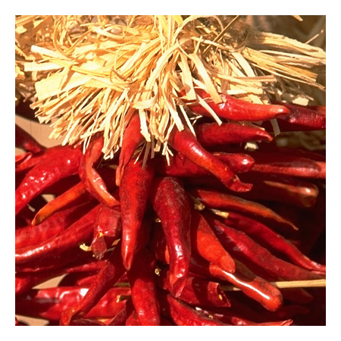





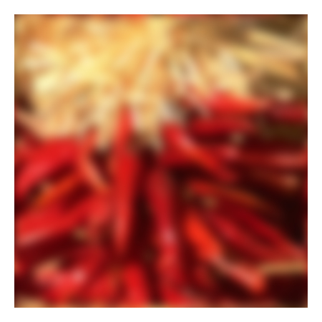






Annoying details
What about near the edge?
the filter window falls off the edge of the image
need to extrapolate
methods:
clip filter (black)
wrap around
copy edge
reflect across edge
Source: S. Marschner

Slide 11
Annoying details
What about near the edge?
the filter window falls off the edge of the image
need to extrapolate
methods (MATLAB):
clip filter (black): imfilter(f, g, 0)
wrap around: imfilter(f, g, ‘circular’)
copy edge: imfilter(f, g, ‘replicate’)
reflect across edge: imfilter(f, g, ‘symmetric’)
Source: S. Marschner

Slide 12
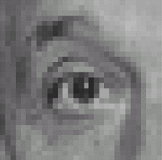
Practice with linear filters
0
0
0
?
0
1
0
0
0
0
Original
Source: D. Lowe

Slide 13
Practice with linear filters
0
0
0
0
1
0
0
0
0
Original
Filtered
(no change)
Source: D. Lowe

Slide 14
Practice with linear filters
0
0
0
?
0
0
1
0
0
0
Original
Source: D. Lowe

Slide 15
Practice with linear filters
0
0
0
0
0
1
0
0
0
Original
Shifted left
By 1 pixel
Source: D. Lowe

Slide 16
Practice with linear filters
1
1
1
?
1
1
1
1
1
1
Original
Source: D. Lowe

Slide 17
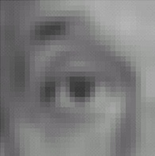
Practice with linear filters
1
1
1
1
1
1
1
1
1
Original
Blur (with a
box filter)
Source: D. Lowe

Slide 18
Practice with linear filters
0
0
0
-
1
1
1
?
0
2
0
1
1
1
0
0
0
1
1
1
(Note that filter sums to 1)
Original
Source: D. Lowe

Slide 19
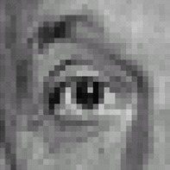
Practice with linear filters
0
0
0
-
1
1
1
0
2
0
1
1
1
0
0
0
1
1
1
Original
Sharpening filter
Accentuates differences with local average
Source: D. Lowe

Slide 20
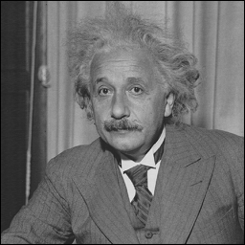
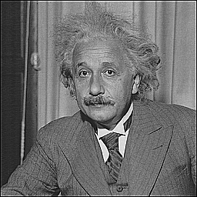
Sharpening
before
after
Slide credit: Bill Freeman

Slide 21
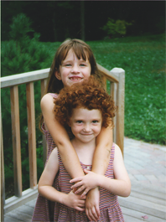
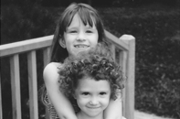
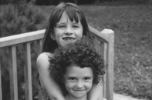
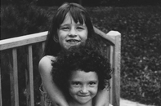
Spatial resolution and color
R
G
B
original
Slide credit: Bill Freeman

Slide 22


Blurring the G component
R
G
B
original
processed
Slide credit: Bill Freeman

Slide 23


Blurring the R component
R
G
B
original
processed
Slide credit: Bill Freeman

Slide 24
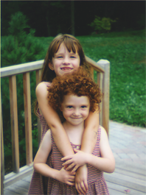

Blurring the B component
R
G
B
original
processed
Slide credit: Bill Freeman

Slide 25
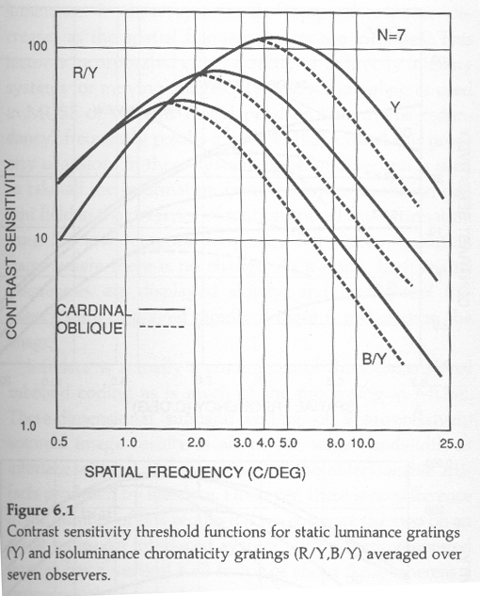
From W. E. Glenn, in Digital Images and Human Vision, MIT Press, edited by Watson, 1993
Slide credit: Bill Freeman

Slide 26
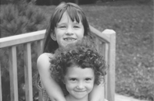
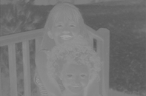
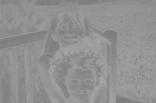
Lab color components
L
A rotation of the color coordinates into directions that are more perceptually meaningful:
L: luminance,
a: red-green,
b: blue-yellow
a
b
Slide credit: Bill Freeman

Slide 27

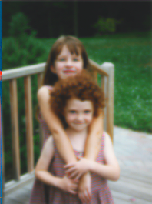
Blurring the L Lab component
L
a
b
original
processed
Slide credit: Bill Freeman

Slide 28

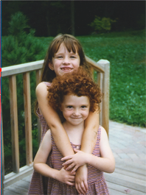
Blurring the a Lab component
L
a
b
original
processed
Slide credit: Bill Freeman

Slide 29


Blurring the b Lab component
L
a
b
original
processed
Slide credit: Bill Freeman

Slide 30
Overview of Filtering
Convolution
Gaussian filtering
Median filtering

Slide 31
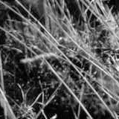
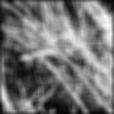
Smoothing with box filter revisited
Smoothing with an average actually doesn’t compare at all well with a defocused lens
Most obvious difference is that a single point of light viewed in a defocused lens looks like a fuzzy blob; but the averaging process would give a little square
Source: D. Forsyth
Notes:
I always walk through the argument on the left rather carefully; it gives some insight into the
significance of impulse responses or point spread functions.

Slide 32
Smoothing with box filter revisited
Smoothing with an average actually doesn’t compare at all well with a defocused lens
Most obvious difference is that a single point of light viewed in a defocused lens looks like a fuzzy blob; but the averaging process would give a little square
Better idea: to eliminate edge effects, weight contribution of neighborhood pixels according to their closeness to the center, like so:
“fuzzy blob”
Source: D. Forsyth
Notes:
I always walk through the argument on the left rather carefully; it gives some insight into the
significance of impulse responses or point spread functions.

Slide 33
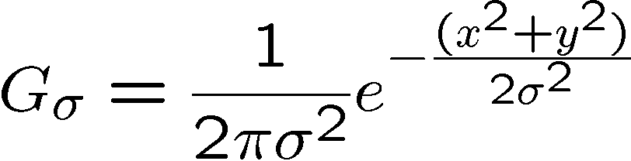
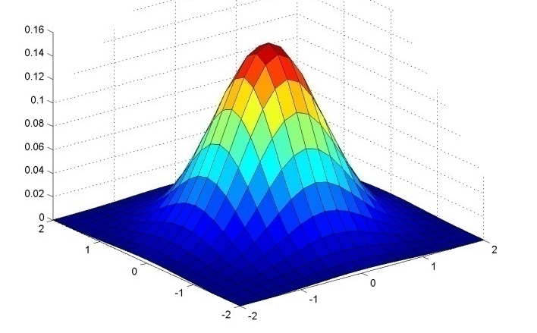
Gaussian Kernel
0.003 0.013 0.022 0.013 0.003
0.013 0.059 0.097 0.059 0.013
0.022 0.097 0.159 0.097 0.022
0.013 0.059 0.097 0.059 0.013
0.003 0.013 0.022 0.013 0.003
5 x 5, σ = 1
Constant factor at front makes volume sum to 1 (can be ignored, as we should re-normalize weights to sum to 1 in any case)
Source: C. Rasmussen

Slide 34
Choosing kernel width
Gaussian filters have infinite support, but discrete filters use finite kernels
Source: K. Grauman

Slide 35
Choosing kernel width
Rule of thumb: set filter half-width to about 3 σ

Slide 36

Example: Smoothing with a Gaussian

Slide 37
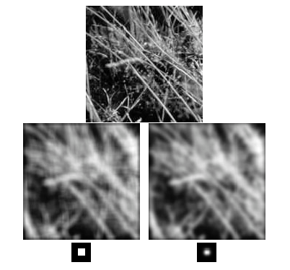
Mean vs. Gaussian filtering

Slide 38
Gaussian filters
Remove “high-frequency” components from the image (low-pass filter)
Convolution with self is another Gaussian
So can smooth with small-width kernel, repeat, and get same result as larger-width kernel would have
Convolving two times with Gaussian kernel of width σ is same as convolving once with kernel of width σ√2
Separable kernel
Factors into product of two 1D Gaussians
Source: K. Grauman
Notes:
Linear vs. quadratic in mask size

Slide 39
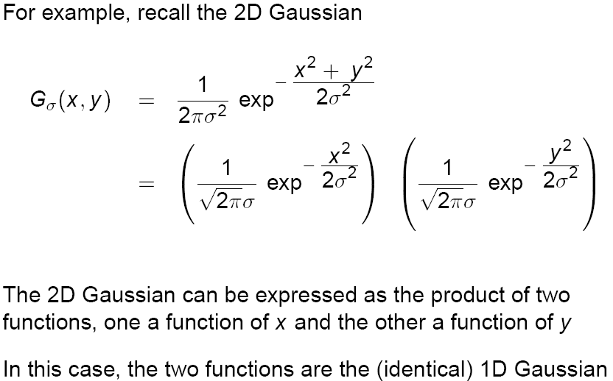
Separability of the Gaussian filter
Source: D. Lowe

Slide 40
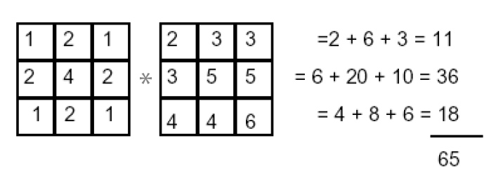
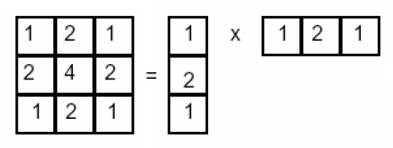
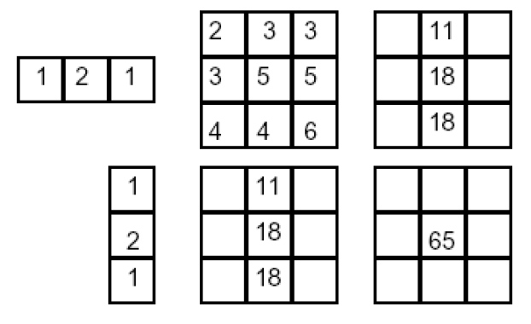
Separability example
2D convolution (center location only)
The filter factors into a product of 1D filters:
Perform convolution along rows:
*
=
Followed by convolution along the remaining column:
*
=
For MN image, PQ filter: 2D takes MNPQ add/times, while 1D takes MN(P + Q)
Source: K. Grauman

Slide 41
Overview of Filtering
Convolution
Gaussian filtering
Median filtering

Slide 42
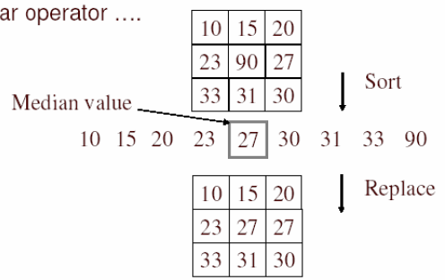
Alternative idea: Median filtering
A median filter operates over a window by selecting the median intensity in the window
Is median filtering linear?
Source: K. Grauman
Notes:
Linearity of median filter: try filter([0 0 0; 0 1 0; 0 0 0] + [1 1 1; 1 1 2; 2 2 2])

Slide 43
Median filter
Replace each pixel by the median over N pixels (5 pixels, for these examples). Generalizes to “rank order” filters.
Median([1 7 1 5 1]) = 1
Mean([1 7 1 5 1]) = 2.8
In:
Out:
Spike noise is removed
5-pixel neighborhood
Monotonic edges remain unchanged
In:
Out:

Slide 44
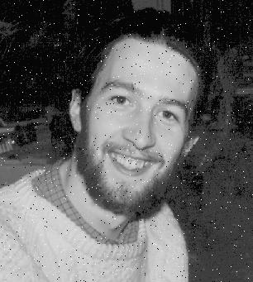

Median filtering results
Best for salt and pepper noise
http://homepages.inf.ed.ac.uk/rbf/HIPR2/mean.htm#guidelines

Slide 45
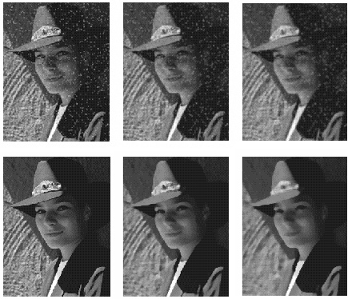
Median vs. Gaussian filtering
3x3
5x5
7x7
Gaussian
Median

Slide 46
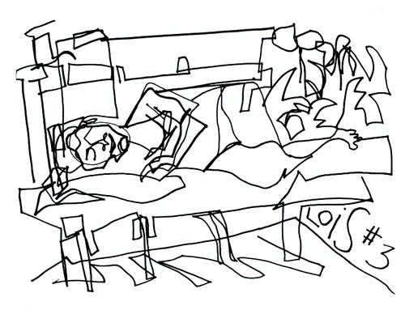
Edges
http://todayinart.com/files/2009/12/500x388xblind-contour-line-drawing.png.pagespeed.ic.DOli66Ckz1.png

Slide 47
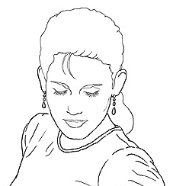
Edge detection
Goal: Identify sudden changes (discontinuities) in an image
Intuitively, most semantic and shape information from the image can be encoded in the edges
More compact than pixels
Ideal: artist’s line drawing (but artist is also using object-level knowledge)
Source: D. Lowe

Slide 48
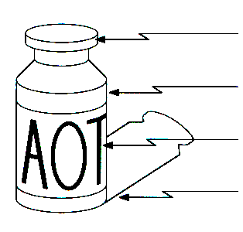
Origin of edges
Edges are caused by a variety of factors:
surface normal discontinuity
depth discontinuity
surface color discontinuity
illumination discontinuity
Source: Steve Seitz

Slide 49
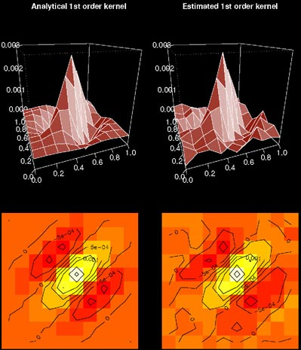
Edges in the Visual Cortex
Extract compact, generic, representation of image that carries sufficient information for higher-level processing tasks
Essentially what area V1 does in our visual cortex.
http://www.usc.edu/programs/vpl/private/photos/research/retinal_circuits/figure_2.jpg

Slide 50
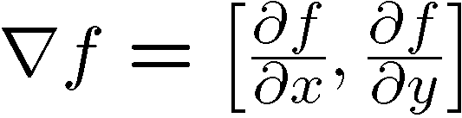
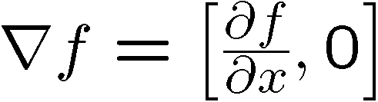
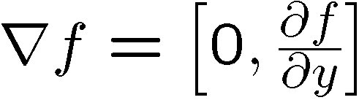
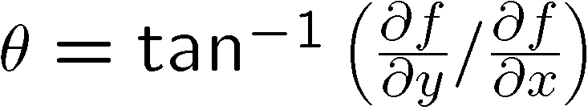
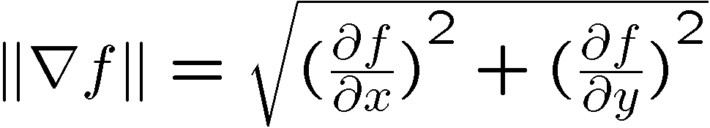
Image gradient
The gradient of an image:
The gradient points in the direction of most rapid increase in intensity
How does this direction relate to the direction of the edge?
The gradient direction is given by
The edge strength is given by the gradient magnitude
Source: Steve Seitz
Notes:
give definition of partial derivative: lim h->0 [f(x+h,y) – f(x,y)]/h

Slide 51
Differentiation and convolution
Recall, for 2D function, f(x,y):
This is linear and shift invariant, so must be the result of a convolution.
We could approximate this as
(which is obviously a convolution)
-1 | 1
Source: D. Forsyth, D. Lowe

Slide 52
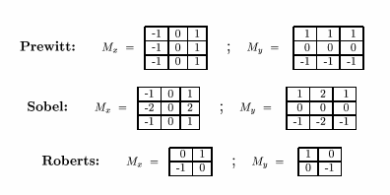
Finite difference filters
Other approximations of derivative filters exist:
Source: K. Grauman

Slide 53
Finite differences: example
Which one is the gradient in the x-direction (resp. y-direction)?

Slide 54
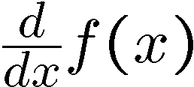
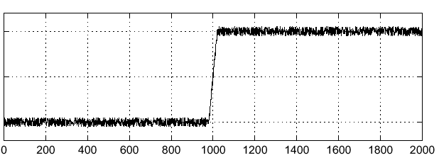
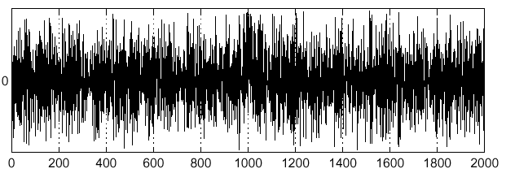
Effects of noise
Consider a single row or column of the image
Plotting intensity as a function of position gives a signal
Where is the edge?
Source: S. Seitz
Notes:
How to fix?

Slide 55
Effects of noise
Finite difference filters respond strongly to noise
Image noise results in pixels that look very different from their neighbors
Generally, the larger the noise the stronger the response
What is to be done?
Smoothing the image should help, by forcing pixels different from their neighbors (=noise pixels?) to look more like neighbors
Source: D. Forsyth

Slide 56
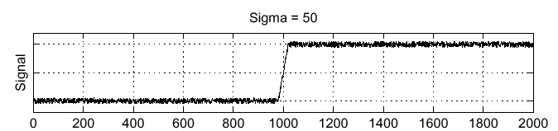
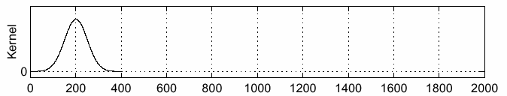
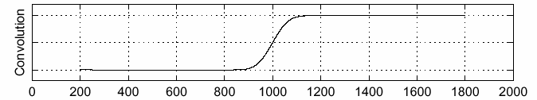
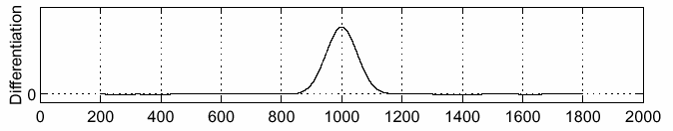
Solution: smooth first
f
g
f * g
To find edges, look for peaks in
Source: S. Seitz

Slide 57

Derivative theorem of convolution
Differentiation is convolution, and convolution is associative:
This saves us one operation:
f
Source: S. Seitz

Slide 58


Derivative of Gaussian filter
x-direction
y-direction
Which one finds horizontal/vertical edges?

Slide 59



Scale of Gaussian derivative filter
1 pixel
3 pixels
7 pixels
Smoothed derivative removes noise, but blurs edge. Also finds edges at different “scales”.
Source: D. Forsyth

Slide 60

Implementation issues
The gradient magnitude is large along a thick “trail” or “ridge,” so how do we identify the actual edge points?
How do we link the edge points to form curves?
Source: D. Forsyth
Notes:
Figures show gradient magnitude of zebra at two different scales

Slide 61

Designing an edge detector
Criteria for an “optimal” edge detector:
Good detection: the optimal detector must minimize the probability of false positives (detecting spurious edges caused by noise), as well as that of false negatives (missing real edges)
Good localization: the edges detected must be as close as possible to the true edges
Single response: the detector must return one point only for each true edge point; that is, minimize the number of local maxima around the true edge
Source: L. Fei-Fei

Slide 62
Canny edge detector
This is probably the most widely used edge detector in computer vision
Theoretical model: step-edges corrupted by additive Gaussian noise
Canny has shown that the first derivative of the Gaussian closely approximates the operator that optimizes the product of signal-to-noise ratio and localization
MATLAB: edge(image, ‘canny’)
J. Canny, A Computational Approach To Edge Detection, IEEE Trans. Pattern Analysis and Machine Intelligence, 8:679-714, 1986.
Source: L. Fei-Fei

Slide 63
Canny edge detector
Filter image with derivative of Gaussian
Find magnitude and orientation of gradient
Non-maximum suppression:
Thin multi-pixel wide “ridges” down to single pixel width
Source: D. Lowe, L. Fei-Fei

Slide 64


Non-maximum suppression
At q, we have a maximum if the value is larger than those at both p and at r. Interpolate to get these values.
Source: D. Forsyth

Slide 65

Example
original image (Lena)

Slide 66

Example
norm of the gradient

Slide 67

Example
thresholding

Slide 68

Example
Non-maximum suppression

Slide 69
Canny edge detector
Filter image with derivative of Gaussian
Find magnitude and orientation of gradient
Non-maximum suppression
Thin multi-pixel wide “ridges” down to single pixel width
Linking of edge points
Source: D. Lowe, L. Fei-Fei

Slide 70
Edge linking
Assume the marked point is an edge point. Then we construct the tangent to the edge curve (which is normal to the gradient at that point) and use this to predict the next points (here either r or s).
Source: D. Forsyth

Slide 71
Canny edge detector
Filter image with derivative of Gaussian
Find magnitude and orientation of gradient
Non-maximum suppression
Thin multi-pixel wide “ridges” down to single pixel width
Linking of edge points
Hysteresis thresholding: use a higher threshold to start edge curves and a lower threshold to continue them
Source: D. Lowe, L. Fei-Fei

Slide 72
Hysteresis thresholding
Use a high threshold to start edge curves and a low threshold to continue them
Reduces drop-outs
Source: S. Seitz

Slide 73
Hysteresis thresholding
original image
high threshold
(strong edges)
low threshold
(weak edges)
hysteresis threshold
Source: L. Fei-Fei

Slide 74




Effect of σ (Gaussian kernel spread/size)
original
Canny with
Canny with
The choice of σ depends on desired behavior
large σ detects large scale edges
small σ detects fine features
Source: S. Seitz

Slide 75






Edge detection is just the beginning…
image
human segmentation
gradient magnitude
Berkeley segmentation database: http://www.eecs.berkeley.edu/Research/Projects/CS/vision/grouping/segbench/

