Slide 1
Projective Geometry
Ernest Davis
Csplash
April 29, 2017

Slide 2
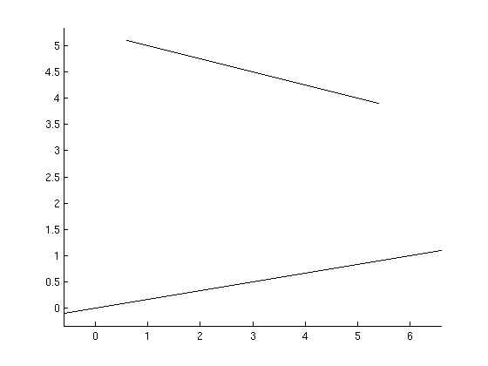
Pappus’ theorem:
Draw two lines

Slide 3
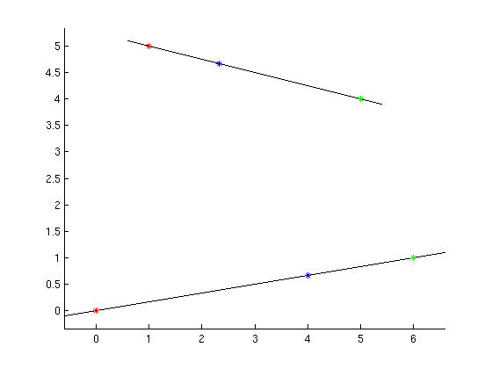
Draw red, green, and blue points on each line
.

Slide 4
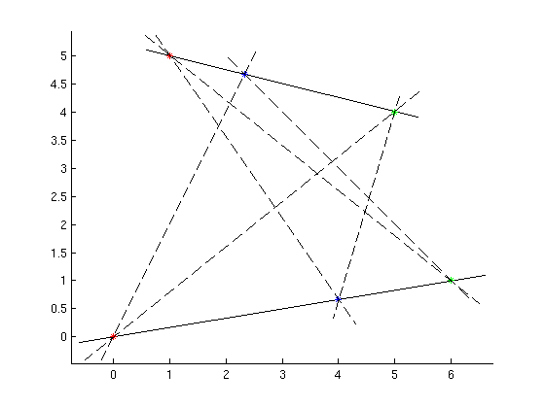
Connect all pairs of points with different colors.

Slide 5
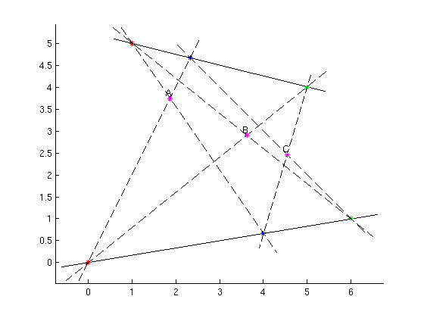
A = crossing of two red-green lines. B = crossing of red-blues. C=crossing of green-blues.

Slide 6
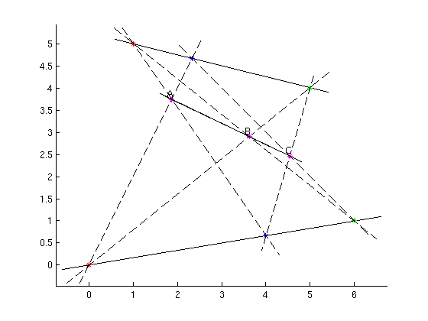
Theorem: A, B, and C are collinear.

Slide 7
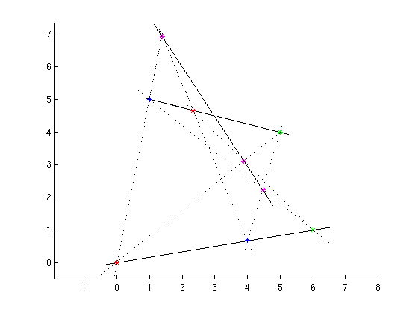
More Pappus diagrams

Slide 8
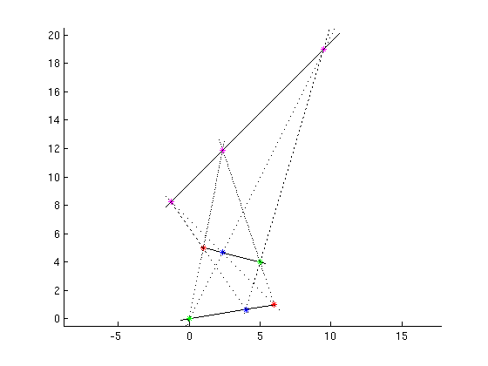
and more

Slide 9
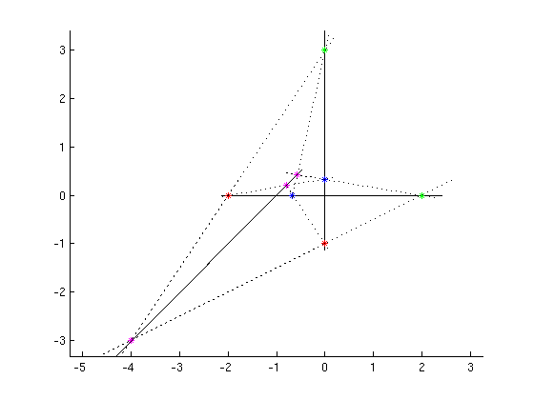
and more

Slide 10
Pappus’ theorem
The theorem has only to do with points lying on lines.
No distances, no angles, no right angles, no parallel lines.
You can draw it with a straight-edge with no compass.
The simplest non-trivial theorem of that kind.

Slide 11
Outline
The projective plane =
Euclidean plane + a new line of points
Projection
  Fundamental facts about projection
  The projective plane fixes an bug in projection.
Pappus’ theorem
Time permitting:
Perspective in art
Point/line duality

Slide 12
Part I: The Projective plane

Slide 13
Euclidean geometry is unfair and lopsided!
Any two points are connected by a line.
Most pairs of lines meet in a point.
But parallel lines don’t meet in a point!

Slide 14
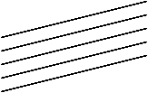
To fix this unfairness
Definition: A sheaf of parallel lines is all the lines that are parallel to one another.
Obvious comment: Every line L belongs to exactly one sheaf (the set of lines parallel to L).

Slide 15
Projective plane
For each sheaf S of parallel lines, construct a new point p “at infinity”. Assert that p lies on every line in S.
All the “points at infinity” together comprise the “line at infinity”
The projective plane is the regular plane plus the line at infinity.

Slide 16
Injustice overcome!
Every pair of points U and V is connected by a single line.
Case 1: If U and V are ordinary points, they are connected in the usual way.
Case 2. If U is an ordinary point and V is the point on sheaf S, then the line in S through U connects U and V.
Case 3. If U and V are points at infinity they lie on the line at infinity.

Slide 17
Injustice overcome (cntd)
If L and M are any two lines, then they meet at a single point.
Case 1: L and M are ordinary, non-parallel lines: as usual.
Case 2: L and M are ordinary, parallel lines: they meet at the corresponding point at infinity.
Case 3: L is an ordinary line and M is the line at infinity: they meet at the point at infinity for L.

Slide 18
Topology
As far as the projective plane is concerned, there is no particular difference between the points at infinity and ordinary points; they are all just points.
If you follow line L out to the point at infinity, and then continue, you come back on L from the other direction. (Note: there is a single point at infinity for each sheaf, which you get to in both directions.)

Slide 19
The price you pay
No distances. There is no reasonable way to define the distance between two points at infinity.
No angles

Slide 20

More price to pay:
No idea of “between”
B is between A and C; i.e. you can go from A to B to C.
Or you can start B, pass C, go out to the point at infinity, and come back to A the other way. So C is between B and A.

Slide 21
Non-Euclidean Geometry
The projective plane is a non-Euclidean geometry.
(Not the famous one of Bolyai and Lobachevsky. That differs only in the parallel postulate --- less radical change in some ways, more in others.)

Slide 22
Part II: Projection

Slide 23
Projection
Two planes: a source plane S and an image plane G. (Which is which doesn’t matter.)
A focal point f which is not on either S or G.
For any point x in S, the projection of x onto G, P_{f,G}(x) is the point where the line fx intersects G.

Slide 24
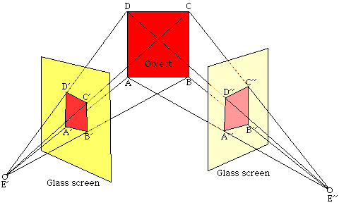
Examples
From http://www.math.utah.edu/~treiberg/Perspect/Perspect.htm

Slide 25
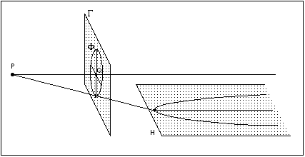
From Stanford Encyclopedia of Philosophy, “Nineteenth Century Geometry”, http://plato.stanford.edu/entries/geometry-19th/

Slide 26
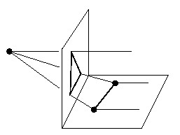
From http://www.math.poly.edu/~alvarez/teaching/projective-geometry/Inaugural-Lecture/page_2.html

Slide 27
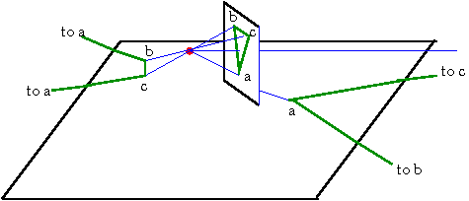

Slide 28
Properties of projection
For any point x in S, there is at most projection P_{f,G}(x).
  Proof: The line fx intersects G in at most 1 point.
For any point y in G, there is at most one point x in S such that y = P_{f,G}(x).
  Proof: x is the point where fy intersects S.

Slide 29
  3. If L is a line in S, then P_{f,G}(L) is a line in G.
    Proof: P_{f,G}(L) is the intersection of G with the plane containing f and L.
4. If x is a point on line L in S, then P_{f,G}(x) is a point on line P_{f,G}(L).
  Proof: Obviously.
Therefore, if you have a diagram of lines intersecting at points and you project it, you get a diagram of the same structure.
E.g. the projection of a Pappus diagram is another Pappus diagram.

Slide 30
More properties of projection
5. If S and G are not parallel, then there is one line in S which has no projection in G.
  Proof: Namely, the intersection of S with the plane through f parallel to G.
6. If S and G are not parallel, then there is one line in G which has no projection in S.
    Proof: Namely, the intersection of G with the plane through f parallel to S.
Call these the “lonely lines” in S and G.

Slide 31
Using the projective planes takes care of the lonely lines!
Suppose H is a sheaf in S.
The images of H in G all meet at one point h on the lonely line of G.
Any two different sheaves meet at different points on the lonely line of G.
So we define the projection of the point at infinity for H in S to be the point on the lonely line where the images meet.

Slide 32
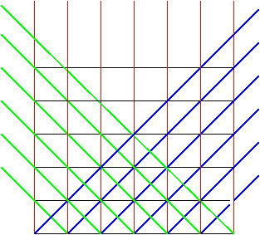
Sheaves in the source plane, viewed head on

Slide 33
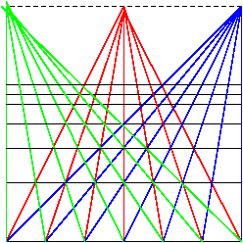
Projection of sheaves in the image plane

Slide 34
And vice versa
Suppose H is a sheaf in G.
The images of H in S all meet at one point h on the lonely line of S.
Any two different sheaves meet at different points on the lonely line of S.
So we define the projection of the point at infinity for H in G to be the point on the lonely line of S where the images meet.

Slide 35
So projection works perfectly for projective planes.
For every point x in the projective plane of S there exists exactly one point y in the projective plane of G such that y = P_{f,G}(x). And vice versa.

Slide 36
Redoing property 3
If L is a line in the projective plane of S, then P_{f,G}(L) is a line in the projective plane of G.
Proof by cases:
L is an ordinary line in S, not the lonely line of S. x is a point in L. We proved above that P_{f,G}(L) is a line M in G.
  If x is an ordinary point in L, not on the lonely line, then P_{f,G}(x) is on M.

Slide 37
Proof, cntd.
  B. If x is the intersection of L with the lonely line, then P_{f,G}(x) is the point at infinity for M
  C. If x is the point at infinity for L, then P_{fGI}(x) is the intersection of M with the lonely line in G.
2. If L is the lonely line in S, then P_{f,G}(L) is the line at infinity in G.
3. If L is the line at infinity in S, then P_{f,G}(L) is the lonely line in G.

Slide 38
One more fact
If L is any line in S, you can choose a plane G and a focus f such that P_{f,G}(L) is the line at infinity in G.
Proof: Choose f to be any point not in S. Let Q be the plane containing f and L. Choose G to be a plane parallel to Q.

Slide 39
Part 3: NOW WE Can PROVE PAPPUS’ Theorem!

Slide 40
Now we can prove Pappus’ theorem!
Proof: Start with a Pappus diagram

Slide 41
We’re going to project the line AB to the line at infinity. That means that the two red-blue lines are parallel and the two red-green lines are parallel. We want to prove that C lies on the line AB. That means that the projection of C lies on the line at infinity. That means that the two blue-green lines are parallel.

Slide 42
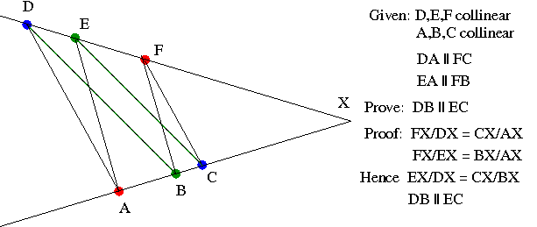
But this is a simple proof in Euclidean geometry.

Slide 43
Part 3: Perspective

Slide 44
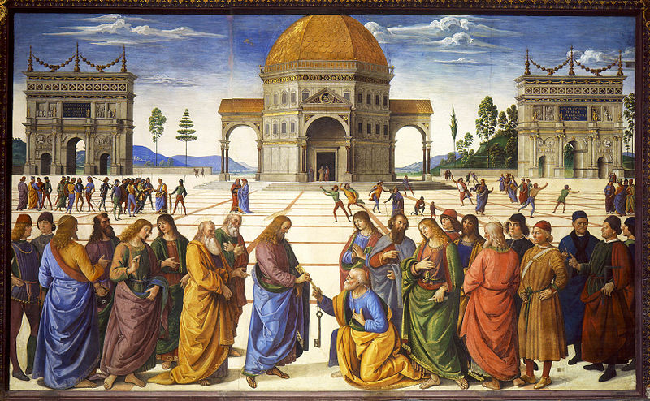
One point perspective (Image plane is perpendicular to x axis)
Perugino, Delivery of the keys to St. Peter, 1481. From Wikipedia, Perspective

Slide 45
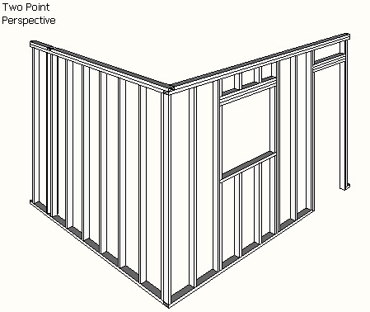
Two-point perspective:
Image plane is parallel to z axis.
(From Wikipedia, “Perspective”)

Slide 46
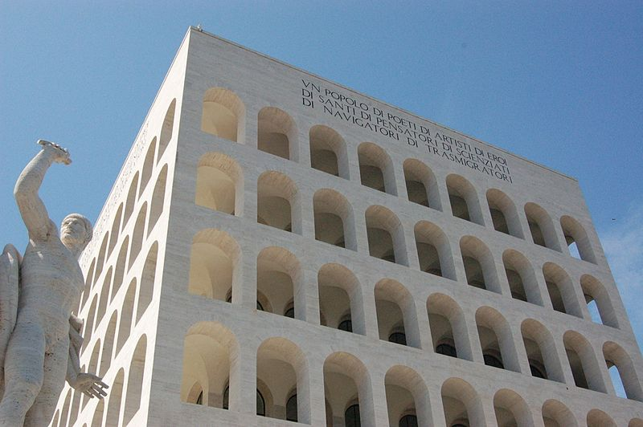
3-point perspective
Image plane is not parallel to any coordinate axis
From Wikipedia, “Perspective”

Slide 47
Part 4: Point-Line Duality

Slide 48
Numerical representation for ordinary points and lines
A point is represented by a pair of Cartesian coordinates: <p,q>. e.g. <1,3>
A line is an equation of the form Ax+By+C = 0 where A,B, and C are constants. E.g. 2x+y-5=0. A point <p,q> falls on the line if it satisfies the equation.

Slide 49
Multiple equation for lines
The same line can be represented by multiple equations. Multiply by a constant factor.
    2x + y – 5=0
    4x + 2y – 10 = 0
    6x + 3y – 15 = 0
are all the same line.

Slide 50
Homogeneous coordinates for lines
Represent the line Ax+By+C =0 by the triple <A,B,C> with the understanding that any two triples that differ by a constant factor are the same line.
So, the triples <2,1,-5>, <4,2,-10>, <-6,-3,15>, <1, 1/2, -5/2> and so on all represent the line 2x+y-5=0.

Slide 51
Homogeneous coordinates for points
We want a representation for points that works the same way.
We will represent a point <p,q> by any triple <u,v,w> such that w ≠ 0, u=p*w and v=q*w.
E.g. the point <1,3> can be represented by any of the triples <1,3,1>, <2,6,2>, <-3,9,-3>, <1/3,1,1/3> and so on.
So again any two triples that differ by a constant multiple represent the same point.

Slide 52
Point lies on a line
Point <u,v,w> lies on line <A,B,C> if Au+Bv+Cw=0.
Proof: <u,v,w> corresponds to the point <u/w, v/w>. If A*(u/w) + B*(v/w) + C = 0, then Au + Bv + Cw = 0.

Slide 53
Homogeneous coordinates for a point at infinity
Parallel lines differ in their constant term.
2x + y – 5 = 0
2x + y – 7 = 0
2x + y + 21 = 0
The point at infinity for all these has homogeneous coordinates <u,v,w> that satisfy
2u + v – Cw = 0 for all C
Clearly v = -2u and w = 0.

Slide 54
Homogeneous coordinates for a point at infinity
Therefore, a point at infinity lying on the line
Ax + By + C = 0
has homogeneous coordinates <-Bt, At, 0> where t ≠ 0.
E.g. the triples <-2,1,0>, <4,-2,0> and so on all represent the point at infinity for the line
x + 2y – 5 = 0.

Slide 55
Homogeneous coordinates for a point at infinity
Note that the points
Homogeneous Natural
< -2, 1, 1> <-2, 1>
< -2, 1, 0.1> <-20, 10>
< -2, 1, 0.0001> <-20000, 10000>
lie further and further out on the line x+2y=0,
so it “makes sense” that <-2, 1, 0> lies infinitely
far out on that line.

Slide 56
Homogeneous coordinates for the line at infinity
The line at infinity contains all points of the form
<u,v,0>. So if the homogeneous coordinates of the line at infinity are <A,B,C> we have
Au + Bv + 0C = 0, for all u and v. So A=B=0 and C can have any non-zero value.

Slide 57
Points in homogeneous coordinates
Any triple <x,y,z>, not all equal to 0, with the rule that <xr,yr,zr> represents the same point for any r ≠ 0.
Point <x,y,z> lies on line <a,b,c> if ax+by+cz=0.

Slide 58
Lines in homogeneous coordinates
Any triple <x,y,z>, not all equal to 0, with the rule that <xr,yr,zr> represents the same line for any r ≠ 0.
Line <x,y,z> contains point <a,b,c> if ax+by+cz=0.

Slide 59
Point/Line duality
Therefore:
If you have any diagram of points and lines, you can replace every point with coordinates <a,b,c> with the line of coordinates <a,b,c> and vice versa, and you still have a valid diagram.
If you do this to Pappus’ theorem, you get another version (called the “dual” version) of Pappus’ theorem.

Slide 60
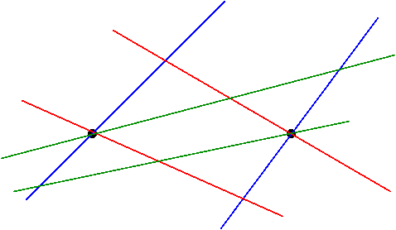
Pappus’ theorem: Dual formulation
Pick any two points. Through each, draw a red line, a blue line, and a green line.

Slide 61
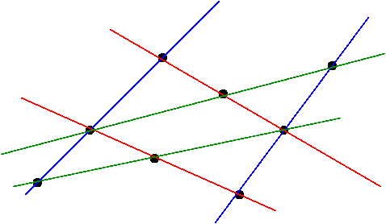
Find the intersection of the lines of different color.

Slide 62
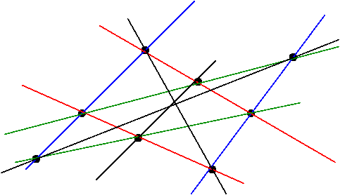
Draw the lines that connects the two red-blue crossings, the two red-green crossings, and the two blue-green crossings.

Slide 63

These lines are coincident

Slide 64
Pappus’ theorem: Original and dual
Draw two lines with red, blue and green points.
Draw the lines connecting points of different colors.
Find the intersections of the two red-blue, the two red-green, and the two blue-green lines.
These points are collinear.
Draw two points with red, blue, and green lines.
Find the intersection of lines of different colors.
Draw the lines connecting the two red-blue, the two red-green, and the two blue-green points.
These lines are coincident.

