Slide 1
Zero Knowledge and $Σ$-protocols
CSCI-GA 3033-107
https://brightspace.nyu.edu/d2l/home/353819
Benedikt Bünz
New York University
Next week class moved to Wednesday 10:15am

Slide 2
How to define “knowledge soundness” and “zero knowledge”?

Slide 3
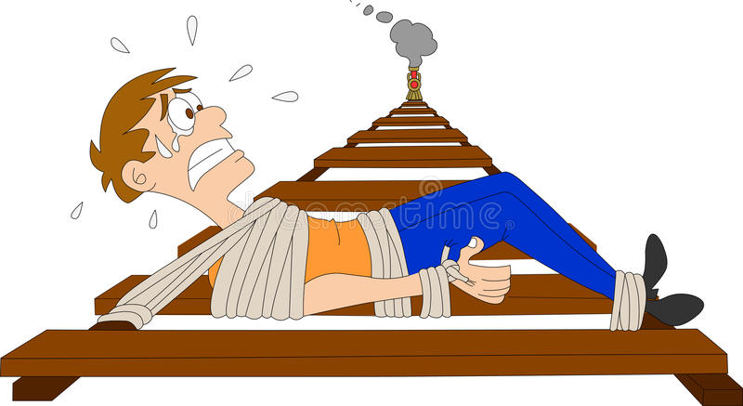
Definitions: (1) knowledge sound
Goal: if V accepts then P “knows” $w$ s.t. $C(x, w) =0$
What does it mean to ”know” $w$ ??
informal def: P knows $w$, if $w$ can be “extracted” from P
P

Slide 4
Definitions: (1) knowledge sound (simplified)
Formally: a universal SNARK (S, P, V) is knowledge sound if
for every poly. time adversary A = (A₀, A₁) there exists a poly. time extractor $Ext$ (that uses A as a black box) s.t.
if $gp$ ⇽ S_{init}( ), ($C,$ $x$, state) ⇽ A₀($gp$), ($pp$, $vp$) ⇽ S_{index}($gp,C$),
$π$ ⇽ A₁($pp$, $x$, state), $w$ ⇽ $Ext$($gp$, $C$, $x$)
Then
Pr[ V(vp, $x$, $π$) = accept ⇒ $C(x,w)=0$ ] ≥ 1 $− ε$ (for a negl. $ε$)
extracted witness

Slide 5
Definitions: (2) Zero knowledge

Slide 6
Zero-Knowledge SUDOKU
Open Row 4

Slide 7
Definitions: (2) Zero knowledge (simplified)
(S, P, V) is zero knowledge if for every $x∈𝔽_{}^{n}$
proof $π$ “reveals nothing” about $w$, other than its existence
What does it mean to “reveal nothing” ??
Informal def: $π$ “reveals nothing” about $w$ if the verifier can generate $π$ by itself ⟹ it learned nothing new from $π$
(S, P, V) is zero knowledge if there is an efficient alg. Sim s.t. ($pp$, $vp$, $π$) ⇽ Sim($C,x$) “look like” the real $pp$,$vp$ and $π$.
Main point: Sim($C$,x) simulates $π$ without knowledge of $w$
Notes:
Honest verifier because we are assuming S is honest (treating S as part o the verifier).
Note: this definition means that (Sp, Sv) are only good for a single proof. The correct definition gives (Sp, Sv) as input to Sim, but then it is not clear what is Sim’s advantage. Sim can program the random oracle, but we are not at a point where we can explain that.

Slide 8
Definitions: (2) Zero knowledge (simplified)
Formally: (S, P, V) is (honest verifier) zero knowledge for a circuit $C$ if there is an efficient simulator Sim such that for all $x∈𝔽_{}^{n}$ s.t. $∃w:C\left(x,w\right)=0$ the distribution:
($C$, $pp$, $vp$ , $x$, $π$): where ($pp$,$vp$) ⇽ S($C$) , $π$ ⇽ P($pp$ $,x$, $w$)
is indistinguishable from the distribution:
($C$, $pp$, $vp$, $x$, $π$): where ($pp$,$vp$, $π$) ⇽ Sim($C,x$)
Main point: Sim($C$,x) simulates $π$ without knowledge of $w$
Notes:
Honest verifier because we are assuming S is honest (treating S as part o the verifier)

Slide 9
How to build a zk-SNARK?
Recall: prover generates a short proof that is fast to verify
How to build a zk-SNARK ??
Later today and next lecture

Slide 10
Applications of SNARKs: (1) Tornado cash: a zk-based mixer
Launched on the Ethereum blockchain on May 2020 (v2)

Slide 11
Tornado Cash: a ZK-mixer
A common denomination (1000 DAI) is needed to prevent linking Alice to her fresh address using the deposit/withdrawal amount
1000 DAI
MIX
NFT
market
???
1000 DAI
1000 DAI
buy NFT
privately
account
fresh
address
(1000 DAI)
1000 DAI
Tornado.cash
contract
Notes:
If Alice deposits and withdraws 1547.3 DAI then that creates a link between the deposit and the withdrawal events.

Slide 12
The tornado cash contract (simplified)
H₁, H₂: R ⇾ {0,1}²⁵⁶
CRHF
100 DAI pool:
each coin = 100 DAI
Treasury: 300 DAI
nf₁
Coins Merkle root
coins
Merkle
root
nf₂
(32 bytes)
tree of
height 20
(2²⁰ leaves)
Currently:
three coins in pool
contract has 300 DAI
two nullifiers stored
next = 4
nullifiers
C₁ C₂ C₃ 0 0 … 0
contract state
public list of coins
explicit list:
one entry per spent coin

Slide 13
Tornado cash: deposit (simplified)
H₁, H₂: R ⇾ {0,1}²⁵⁶
100 DAI pool:
each coin = 100 DAI
Treasury: 300 DAI
nf₁
Coins Merkle root
coins
Merkle
root
nf₂
Alice deposits 100 DAI:
(32 bytes)
tree of
height 20
(2²⁰ leaves)
100 DAI
C₄ , MerkleProof(4)
next = 4
nullifiers
C₁ C₂ C₃ 0 0 … 0
Build Merkle proof for leaf #4:
MerkleProof(4) (leaf=0)
choose random k, r in R
set C₄ = H₁(k, r)
contract state
public list of coins
explicit list:
one entry per spent coin
Notes:
Note: one Tx per block. Alice needs to know what leaf her coin will occupy.

Slide 14
Tornado cash: deposit (simplified)
H₁, H₂: R ⇾ {0,1}²⁵⁶
coins
Merkle
root
100 DAI
C₄ , $\text{MerkleProof}\text{(4)}$
Coins Merkle root
(32 bytes)
Tornado contract does:
verify $\text{MerkleProof}\text{(4)}$ with respect to current stored root
use C₄ and MerkleProof(4) to compute updated Merkle root
update state
tree of
height 20
(2²⁰ leaves)
next = 4
Tornado contract
C₁ C₂ C₃ 0 0 … 0
public list of coins

Slide 15
Tornado cash: deposit (simplified)
H₁, H₂: R ⇾ {0,1}²⁵⁶
coins
Merkle
root
100 DAI
C₄ , $\text{MerkleProof}\text{(4)}$
updated Merkle root
(32 bytes)
Tornado contract does:
verify $\text{MerkleProof}\text{(4)}$ with respect to current stored root
use C₄ and MerkleProof(4) to compute updated Merkle root
update state
tree of
height 20
(2²⁰ leaves)
next = 4
Tornado contract
C₁ C₂ C₃ C₄ 0 … 0
public list of coins

Slide 16
Tornado cash: deposit (simplified)
100 DAI pool:
each coin = 100 DAI
Treasury: 400 DAI
nf₁
updated Merkle root
updated
Merkle
root
nf₂
Alice deposits 100 DAI:
(32 bytes)
tree of
height 20
(2²⁰ leaves)
100 DAI
C₄ , MerkleProof(4)
next = 5
nullifiers
C₁ C₂ C₃ C₄ 0 … 0
updated contract state
public list of coins
note: (k, r)
Alice keeps secret (one note per coin)
Every deposit: new Coin added sequentially to tree
an observer sees who owns which leaves
Notes:
Observer: Alice owns C4.

Slide 17
Tornado cash: withdrawal (simplified)
H₁, H₂: R ⇾ {0,1}²⁵⁶
100 DAI pool:
each coin = 100 DAI
Treasury: 400 DAI
Merkle root
coins
Merkle
root
nf₁
nf₂
Withdraw coin #3 to addr A:
tree of
height 20
(2²⁰ leaves)
(32 bytes)
has note= (k’, r’)
next = 5
C₁ C₂ C₃ C₄ 0 … 0
nullifiers
set nf = H₂(k’)
contract state
public list of coins
Bob proves “I have a note for some leaf in the coins tree, and its nullifier is nf”
(without revealing which coin)
Notes:
Bob does not reveal which coin is being spent.

Slide 18
Tornado cash: withdrawal (simplified)
H₁, H₂: R ⇾ {0,1}²⁵⁶
Withdraw coin #3 to addr A:
Merkle root
has note= (k’, r’)
set nf = H₂(k’)
tree of
height 20
(2²⁰ leaves)
Bob builds zk-SNARK proof $π$ for
public statement x = (root, nf, A)
secret witness w = (k’, r’, C₃ , MerkleProof(C₃) )
where Circuit(x,w)=0 iff:
C₃ = (leaf #3 of root), i.e. MerkleProof(C₃) is valid,
C₃ = H₁(k’, r’), and
nf = H₂(k’).
C₁ C₂ C₃ C₄ 0 … 0
(address A not used in Circuit)
Notes:
Bob proves “I know some leaf in the coins tree whose nullifier is nf”. He does not which coin is being spent, which is why C3 is part of the secret witness.
Tornado uses Groth16. Lava.cash (same thing on Solana) uses zk-STARKs.

Slide 19
Tornado cash: withdrawal (simplified)
H₁, H₂: R ⇾ {0,1}²⁵⁶
Withdraw coin #3 to addr A:
The address A is part of the statement to ensure that a miner cannot change A to its own address and steal funds
Assumes the SNARK is non-malleable: adversary cannot use proof $π$ for x to build a proof $π’$ for some “related” x’ (e.g., where in x’ the address A is replaced by some A’)
Merkle root
has note= (k’, r’)
set nf = H₂(k’)
tree of
height 20
(2²⁰ leaves)
C₁ C₂ C₃ C₄ 0 … 0
Bob builds zk-SNARK proof $π$ for
public statement x = (root, nf, A)
secret witness w = (k’, r’, C₃ , MerkleProof(C₃) )
Notes:
Bob proves “I know some leaf in the coins tree whose nullifier is nf”. He does not which coin is being spent, which is why C3 is part of the secret witness.

Slide 20
Tornado cash: withdrawal (simplified)
H₁, H₂: R ⇾ {0,1}²⁵⁶
100 DAI pool:
each coin = 100 DAI
Treasury: 400 DAI
Merkle root
coins
Merkle
root
nf₁
Withdraw coin #3 to addr A:
nf₂
tree of
height 20
(2²⁰ leaves)
nf, proof $π$, A
(over Tor)
(32 bytes)
next = 5
C₁ C₂ C₃ C₄ 0 … 0
Bob’s ID and coin C₃ are not revealed
nullifiers
contract state
public list of coins
Contract checks (i) proof $π$ is valid for (root, nf, A), and
(ii) nf is not in the list of nullifiers
Notes:
Gas can be payed by a relayer, so that Bob’s account is not recorded.

Slide 21
Tornado cash: withdrawal (simplified)
H₁, H₂: R ⇾ {0,1}²⁵⁶
100 DAI pool:
each coin = 100 DAI
Treasury: 300 DAI
Merkle root
coins
Merkle
root
nf₁
Withdraw coin #3 to addr A:
nf₂
tree of
height 20
(2²⁰ leaves)
(32 bytes)
nf
nf, proof $π$, A
(over Tor)
next = 5
C₁ C₂ C₃ C₄ 0 … 0
100 DAI
nullifiers
to address A
contract state
public list of coins
… but observer does not know which are spent
nf and $π$ reveal nothing about which coin was spent.
But, coin #3 cannot be spent again, because nf = H₂(k’) is now nullified.
Notes:
Stress that H1 is collision resistant.

Slide 22
Who pays the withdrawal gas fee?
Problem: how does Bob pay for gas for the withdrawal Tx?
If paid from Bob’s address, then fresh address is linked to Bob
Tornado’s solution: Bob uses a relay
nf, proof $π$, A
and gas
nf, proof $π$, A
(over Tor)
(100-gas) DAI
to address A
gas
relay
tornado
contract
Note: relay and Tornado also charge a fee

Slide 23
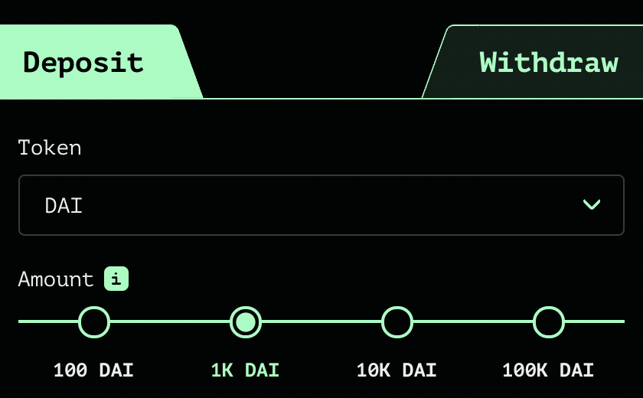
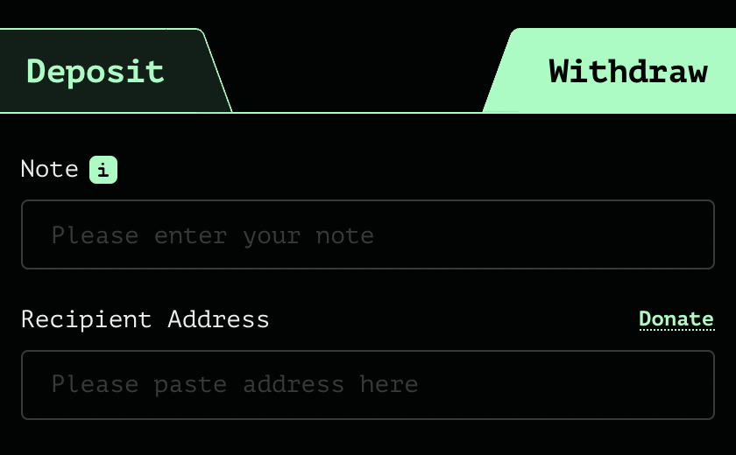
Tornado Cash: the UI
enter note here
address
After deposit: get a note
Later, use note to withdraw
(wait before withdrawing)

Slide 24
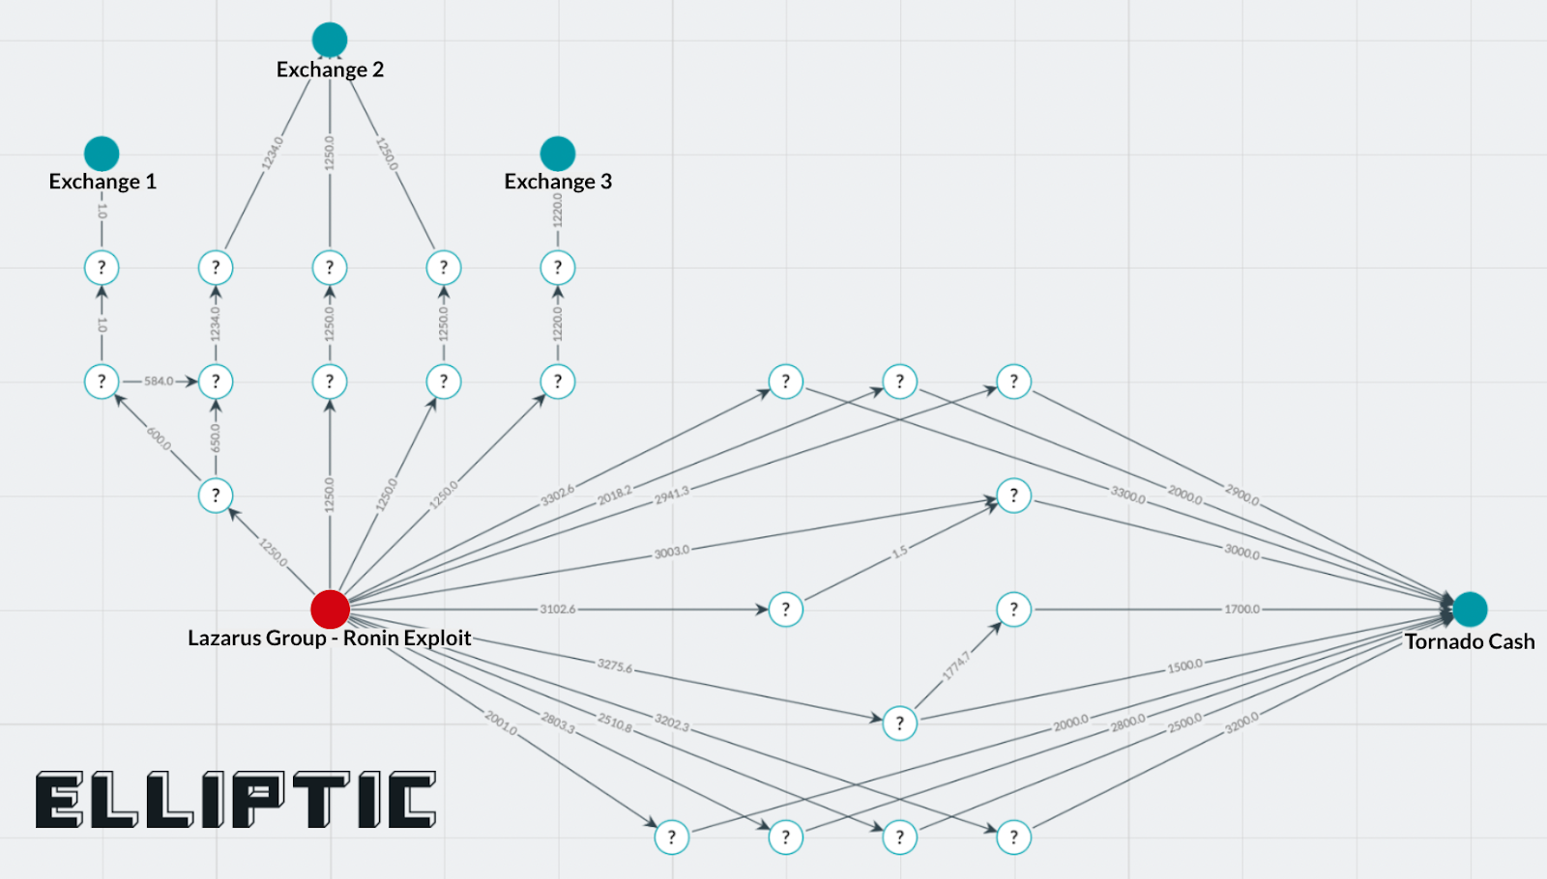
Tornado trouble … U.S. sanctions
The Ronin-bridge hack (2022):
In late March: ≈600M USD stolen … $80M USD sent to Tornado
April: Lazarus Group suspected of hack
August: “U.S. Treasury Sanctions Virtual Currency Mixer Tornado Cash”
Lots of collateral damage … and two lawsuits
Tornado
The lesson: complete anonymity in the
payment system is problematic

Slide 25
Sanctions
“U.S. persons would not be prohibited by U.S. sanctions regulations from copying the open-source code and making it available online for others to view, as well as discussing, teaching about, or including open-source code in written publications, such as textbooks, absent additional facts”
U.S. Treasury FAQ, Sep. 2022

Slide 26
Designing a compliant Tornado??
deposit filtering: ensure incoming funds are not sanctioned
Chainalysis SanctionsList contract:
function isSanctioned(address addr) public view returns (bool) {
return sanctionedAddresses[addr] == true ;
}
Reject funds coming from a sanctioned address.
Difficulties: (1) centralization, (2) slow updates

Slide 27
Designing a compliant Tornado??
Withdrawal filtering: at withdrawal, require a ZK proof that the source of funds is not currently on sanctioned list.
How?
modify the way Tornado computes Merkle leaves during deposit to include msg.sender.
in our example Alice sets: C₄ = [ H₁(k, r), msg.sender ]
During withdrawal Bob proves in ZK that msg.sender in his leaf is not currently on sanctions list.
Notes:
Discourages bad behavior in Tornado: the funds of sanctioned addressed become trapped inside Tornado.

Slide 28
Designing a compliant Tornado??
(3) Viewing keys: at withdrawal, require nullifier to include an encryption of deposit msg.sender under government public key.
How? Merkle leaf C₄ is computed as on previous slide.
During withdrawal Bob sets nullifier nf = [ H₂(k’), $ct$, $π$ ] where (i) $ct$ = Enc(pk, msg.sender) and (ii) $π$ is ZK proof that $ct$ is computed correctly
⇒ As needed, government can trace funds through Tornado
lots of problems with this design …
Notes:
Which pk to use. How to control access to the secret key sk? What if sk is lost or stolen?

Slide 29
Other private Tx projects
Zcash / Monero/IronFISH: private payments
L1 blockchains that extend Bitcoin, similar use of Nullifiers.
Support for any value Tx and in-system transfers.
Aztec / Aleo:
Support for private Tx interacting with a public smart contract.
Aleo: an L1 blockchain. Aztec: runs on top of Ethereum.

Slide 30
$$Σ−Protocols$$
Three message protocols (1 round)
Two prover messages
One verifier message (random challenge)
First Message (Nonce)
Challenge
Response

Slide 31
Schnorr Protocol
DLOG group $𝔾$ with generator G
Relation $R_{DLOG},\left(Y;x\right)∈R_{DLOG}↔x⋅G=Y$
Prover state $x,Y$
Verifier state $Y$
$$R=r⋅G$$
$$c←^{\$}Z_{p}$$
$$s=r+c⋅x$$
$$r←^{\$}Z_{p}$$
$$sG=^{?}R+c⋅Y$$
$$s←r+c⋅x$$

Slide 32
Security: Special Soundness
A $Σ$-protocol has $k−$special soundness if
Given any k accepting transcripts with the first prover message the same and distinct challenges and responses: $\left\{\left(R,c_{1},s_{1}\right),…,\left(R,c_{k},s_{k}\right)\right\},c_{1}≠c_{2},…≠c_{k}$
There exists an algorithm E (extractor) that can compute a valid witness for the relation
Theorem: k-special-soundness= knowledge soundness with knowledge error $ε=\frac{k}{\left|C\right|}$, for challenge space $|C|$

Slide 33
Schnorr is 2-Special-Sound
Transcripts $\left(R,c_{1},s_{1}\right),\left(R,c_{2},s_{2}\right)$
$s_{1}G=R+c_{1}Y,$ $s_{2}G=R+c_{2}Y$
$x=\frac{{s_{1}−s}_{2}}{c_{1}−c_{2}}$ and $xG=Y$
Challenge space $\left|F_{p}\right|=p$, knowledge error $\frac{2}{p}$

Slide 34
Zero-Knowledge Simulator
Simulator (without witness) needs to output transcripts that look identical to original transcript
But Simulator can cheat and sample the challenge before the nonce!
Idea: If transcripts look identical then they cannot contain additional information (outside observer can’t distinguish between real and simulated transcripts)
Variants of ZK:
Perfect ZK: Transcripts are identical
Statistical ZK: Transcripts are statistically close (Same in 1-$ε$ cases)
Computational ZK: Distinguishing transcripts is as hard as breaking assumption.

Slide 35
Schnorr is perfect zero-knowledge
Simulator samples random challenge $c$ and random value $s$
Then it computes $R←s⋅G−c⋅Y$
Transcript $(R,c,s)$ is identical to real transcript as $s,c$ are uniform and random and the relation between R,s and c is determined by the verification check.

Slide 36
Making the proof non-interactive
The Fiat-Shamir transform:
public-coin interactive protocol ⇒ non-interactive protocol
public coin: all verifier randomness is public (no secrets)
Prover P(pp, $x, w$)
Verifier V(vp, $x$)
msg1
r
choose random bits r
msg2
accept or reject

Slide 37
Making the proof non-interactive
Fiat-Shamir transform: $H:M⇾R$ a cryptographic hash function
idea: prover generates random bits on its own (!)
Prover P(pp, $x, w$)
Verifier V(vp, $x$)
generate msg1
r ⇽ H($x$, msg1)
$π$ = (msg1, msg2)
$|π|$ = O($λ log |C|)$
r ⇽ H($x$, msg1)
accept or reject
generate msg2
Fiat-Shamir: special-sound interactive protocols with negl. error
⟹ non-interactive secure NARKs

Slide 38
Review: arithmetic circuits
Fix a finite field $𝔽=\left\{0, …, p−1\right\}$ for some prime p>2.
Arithmetic circuit: $C: 𝔽n ⇾ 𝔽$
directed acyclic graph (DAG) where
internal nodes are labeled +, −, or ×
inputs are labeled 1, $x1, …, xn$
defines an n-variate polynomial with an evaluation recipe
$|C| =$ # gates in $C$
$$x1(x1+x2+1)(x2−1)$$
$$\text{×}$$
$$+$$
$$−$$
$$x1$$
$$x2$$
$$1$$

Slide 39
Proving a Circuit with Sigma protocols
Peddersen commitment $aG+kH$to every wire value a for random k
Additions for free (use homomorphism)
Multiplication gates (see whiteboard)

Slide 40
Protocol is not a SNARK
Protocol is zero-knowledge
And has 2-special-soundness under the DLOG assumption
Not a SNARK: proof as large as the circuit

Slide 41
END OF LECTURE
Next week: succinctness

Slide 42
SUDOKU
2 1 3 8
5
7 6
1 3
9 8 1 2 5 7
3 1 8
9 8 2
5 6 9 7 8 4
4 2 5

Slide 43
SUDOKU
2 4 9 5 7 1 6 3 8
8 6 1 4 3 2 9 7 5
5 7 3 9 8 6 1 4 2
7 2 5 6 9 8 4 1 3
6 9 8 1 4 3 2 5 7
3 1 4 7 2 5 8 6 9
9 3 7 8 1 4 2 5 6
1 5 2 3 6 9 7 8 4
4 8 6 2 5 7 3 9 1

Slide 44
Zero-Knowledge SUDOKU
”Can you help me with this Sudoku?”
“If you pay me!”
“Prove that you know the solution first”
“Ok”

Slide 45
Zero-Knowledge SUDOKU
2 4 9 5 7 1 6 3 8
8 6 1 4 3 2 9 7 5
5 7 3 9 8 6 1 4 2
7 2 5 6 9 8 4 1 3
6 9 8 1 4 3 2 5 7
3 1 4 7 2 5 8 6 9
9 3 7 8 1 4 2 5 6
1 5 2 3 6 9 7 8 4
4 8 6 2 5 7 3 9 1
1 5
2 6
3 7
4 1
5 3
6 9
7 4
8 8
9 2
6 1 2 3 4 5 9 7 8
8 9 5 1 7 6 2 4 3
3 4 7 2 8 9 5 1 6
4 6 3 9 2 8 1 5 7
9 2 8 5 1 7 6 3 4
7 5 1 4 6 3 8 9 2
2 7 4 8 5 1 6 3 9
5 3 6 7 9 2 4 8 1
1 8 9 6 3 4 7 2 5

Slide 46
Zero-Knowledge SUDOKU
Open Row 4

Slide 47
Zero-Knowledge SUDOKU
Open Column 2

Slide 48
Zero-Knowledge SUDOKU
Open Box 1

Slide 49
Zero-Knowledge SUDOKU
Show original puzzle

Slide 50
Zero-Knowledge SUDOKU Analysis
P[Cheating]≤$\frac{9}{10}$
Open Row/Column/Box/Original

Slide 51
Zero-Knowledge SUDOKU Amplifying
1 try: 0.9
2 tries: 0.81
10 tries: 0.349
100 tries: 0.002%
1000 tries: $2^{−152}$
Open Row/Column/Box/Original
Repeat

Slide 52
Problem: Bob learns solution
1 try: 0.9
2 tries: 0.81
10 tries: 0.349
100 tries: 0.002%
1000 tries: $2^{−152}$
Open Row/Column/Box/Original
Repeat
New permutation in every round

Slide 53
Zero-Knowledge
1 try: 0.9
2 tries: 0.81
10 tries: 0.349
100 tries: 0.002%
1000 tries: $2^{−152}$
Open Row 1
Repeat
New permutation in every round

Slide 54
Zero-Knowledge
1 try: 0.9
2 tries: 0.81
10 tries: 0.349
100 tries: 0.002%
1000 tries: $2^{−152}$
Open Row 1
Repeat
New permutation in every round

Slide 55
Zero-Knowledge
1 try: 0.9
2 tries: 0.81
10 tries: 0.349
100 tries: 0.002%
1000 tries: $2^{−152}$
Open Box 2
Repeat
New permutation in every round

