Slide 1
Privacy and Zero Knowledge
CSCI-GA 3033-107
https://brightspace.nyu.edu/d2l/home/353819
Benedikt Bünz
New York University

Slide 2
Moving Class and Feedback form

Slide 3
The need for privacy in the financial system
Supply chain privacy:
A manufacturer does not want to reveal how much it pays its supplier for parts.
Payment privacy:
A company that pays its employees in crypto wants to keep list of employees and salaries private.
Endusers need privacy for rent, donations, purchases
Business logic privacy: Can the code of a smart contract be private?

Slide 4
The need for privacy in the financial system
The bottom line:
Blockchains cannot reach their full potential
without some form of private transactions

Slide 5
Types of Privacy
Pseudonymity: (weak privacy)
Every user has a long-term consistent pseudonym (e.g. reddit)
Pros: reputation
Cons: link to real-world identity can leak over time
Full anonymity: User’s transactions are unlinkable
No one can tell if two transactions are from the same address
Notes:
Example: User timezone can be inferred. My travel schedule can result in linking.

Slide 6
A difficult question: privacy from who?
No privacy: Everyone can see all transactions
Privacy from the public: Only a trusted operator can see transactions
Semi-full privacy: only “local” law enforcement can see transactions
full privacy: no one can see transactions

Slide 7
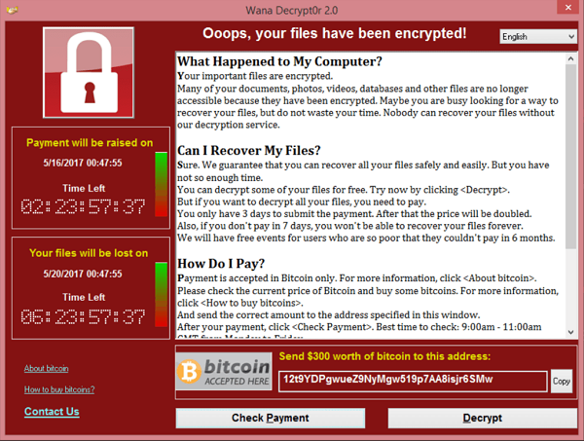
Negative aspects of complete privacy
How to prevent criminal activity?
The challenge:
How to support positive applications of private payments, but prevent the negative ones?
Can we ensure legal compliance while preserving privacy?
Yes! The key technology: zero knowledge proofs

Slide 8
Are Bitcoin and Ethereum Private?
The base systems are definitely not …

Slide 9
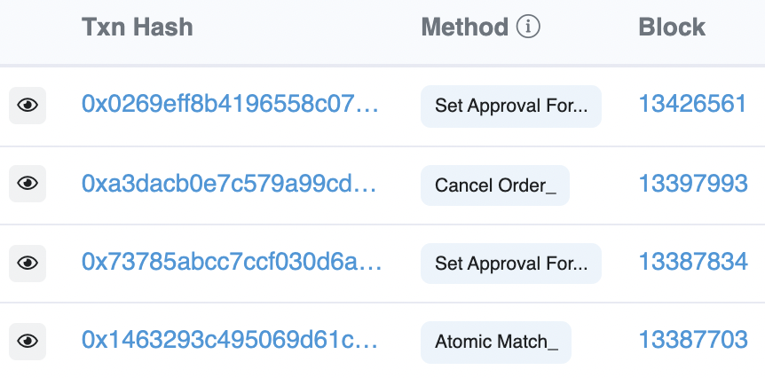
Privacy in Ethereum?
Every account balance is public
For Dapps: code and internal state are public
All account transactions are linked to account
etherscan.io:
Address 0x1654b0c3f62902d7A86237…

Slide 10
Privacy in Bitcoin?
from addresses amounts
to addresses amounts
Alice can have many addresses (creating address is free)
Transaction data can be used to link an address to a physical identity
(chainalysis)
Inputs: A1:4, A2: 5 out: B:6, A3:3
Change address
Alice’s addresses
Bob’s address
Notes:
Can build clusters of linked addresses.

Slide 11
Linking an addresses to an identity
inputs: A1: 4, A2: 5 outputs: B: 6, A3: 3
Alice buys a book from a merchant:
Alice learns one of merchant’s address (B)
Merchant links three addresses to Alice (A1, A2, A3)
Alice uses an exchange (ETH ↔︎ USD)
BSA: a US exchange must do KYC (know your customer)
… collect and verify Alice’s ID
Exchange links Alice to her addresses (A1, A2, A3)

Slide 12
At the network layer …
Miners/validators learn Alice’s IP address
end users
sk_{A}
signed Tx
sk_{B}
sk_{C}
P2P network
Solution:

Slide 13
De-anonymization strategy: Idioms of use
A general strategy for de-anonymizing Bitcoin addresses
Heuristic 1:
Two addresses are input to a TX
⇒ both addresses are controlled by same entity

Slide 14
De-anonymization strategy: Idioms of use
Heuristic 2:
Change address is controlled by the same user as input address
Which is the change address?
Heuristic: a new address that receives less than every input

Slide 15
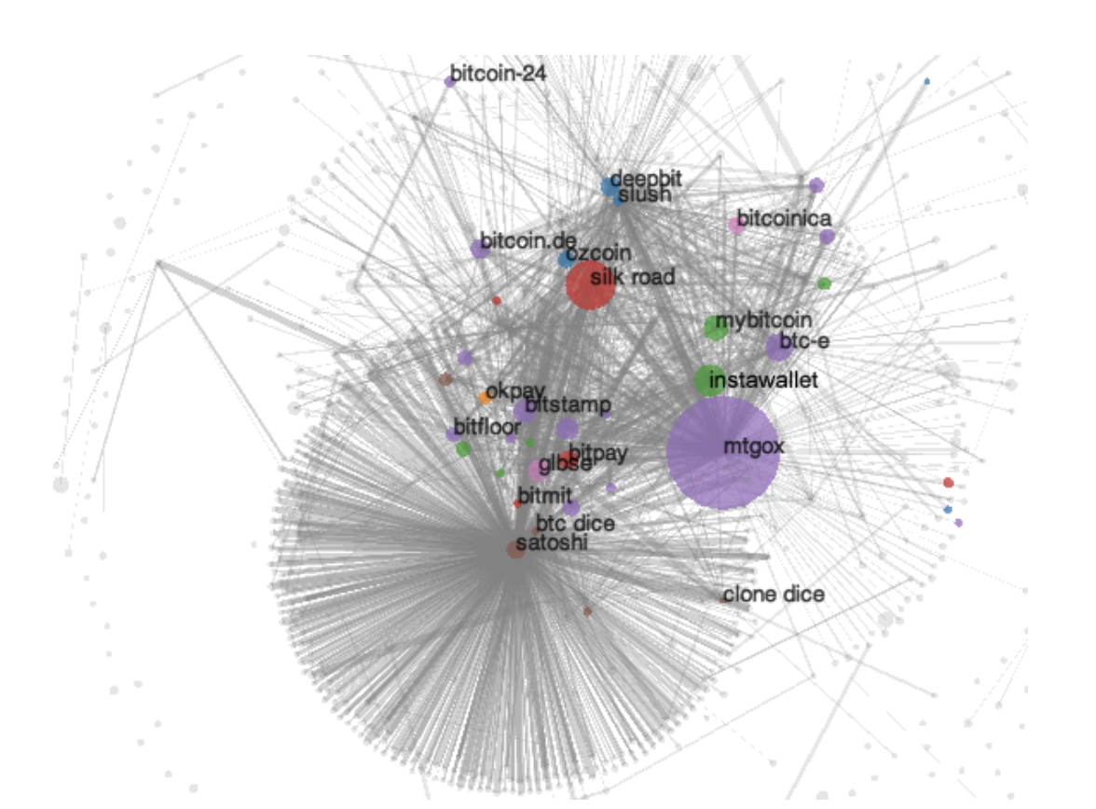
A Bitcoin experiment [Meiklejohn, et al.]
step 1: Heuristic 1 and 2 ⇒ 3.3M clusters
step 2: 1070 addresses identified by interacting with merchants
Coinbase, Kraken, …
step 3: now 15% of all addresses identified
Learn total assets for all clusters
Commercial efforts: Chainalysis, Elliptic, …
Notes:
https://arxiv.org/abs/2205.13882

Slide 16
Private coins on a Public Blockchain

Slide 17
Attempt 1: simple mixing
mixer
address: M
1 ETH to M
from Alice
fresh addr X
from Alice
TLS
Send:
1 ETH to X
1 ETH to Y
1 ETH to Z
1 ETH to M
from Bob
fresh addr Y
from Bob
TLS
1 ETH to M
from Carol
fresh addr Z
from Carol
has 3 ETH
blockchain
TLS
Observer knows Y belongs to one of {Alice, Bob, Carol} but does not know which one
⟹ anonymity set of size 3.
Problems: (i) mixer M knows shuffle, (ii) mixer can abscond with 3 ETH !!

Slide 18
Increasing the anonymity set
Mixer
M1
Mixer
M2
addr X
X’
X’’
M1: mix $n$ inputs from $n$ users ⇒ X’ has anonymity set size = $n$
M2: mix output from $m$ mixers ⇒ X’’ has anonymity set size = $n×m$
Privacy: as long as one of M1 or M2 are honest

Slide 19
Secure mixing without a mixer?
Problem: Mixer can abscond with funds or reveal the shuffle.
Can we securely mix without a trusted mixer? Answer: yes!
on Bitcoin: CoinJoin (used by, e.g., Wasabi wallet)
on Ethereum: Tornado cash, Privacy Pools, …
… a single mixer using ZK proofs – next lecture

Slide 20
CoinJoin: Bitcoin Mixing without Mixer
The setup: Alice, Bob, and Carol want to mix together.
Alice owns UTXO A1:5, Bob owns UTXO B1:3, Carol owns C1:2
A1: 5, A3 (change addr)
A2 (post mix address over Tor)
A1: 5, A3
B1: 3, B3
C1: 2, C3
B2, A2, C2
B1: 3, B3 (change addr)
mix
addresses
B2 (post mix address over Tor)
(same as Alice and Bob)
public forum
Notes:
Each participants knows which mix address is theirs, but knows nothing about the other mix addresses.

Slide 21
CoinJoin: Bitcoin Mixing without Mixer
CoinJoin TX: all three prepare and sign the following Tx:
inputs (not private): A1: 5, B1: 3, C1: 2
outputs (private): B2: 2, A2: 2, C2: 2
outputs (not private): A3: 3, B3: 1
mix addresses
Mixed UTXOs all have same value = min of inputs (2 in this case)
All three post sigs on Pastebin ⇒ one of them posts Tx on chain.

Slide 22
Coinjoin drawbacks
In practice: each CoinJoin Tx mixes about 40 inputs
Large Tx: 40 inputs, 80 outputs
All participants must sign CoinJoin Tx for it to be valid
⇒ ensures all of them approve the CoinJoin Tx
… but any one of them can disrupt the process

Slide 23
Beyond simple mixing
Private Tx on a public blockchain

Slide 24
Can we have private transactions on a public blockchain?
Naïve reasoning:
universal verifiability ⇒ transaction data must be public
otherwise, how we can verify Tx ??
crypto magic ⇒ private Tx on a publicly verifiable blockchain
Crypto tools: commitments and zero knowledge proofs

Slide 25
A paradigm for Private Tx
public blockchain
committed state
Tx
$$π$$
updated committed state
anyone can verify $π$
committed Tx data
(reveals nothing about Tx data or state)
Committed data: short (hiding) commitment on chain
Proof $π$: succinct zero-knowledge proof that
committed Tx data is consistent with committed current state, and
committed updated state is correct

Slide 26
Review: cryptographic commitments
Cryptographic commitment: emulates an envelope
data
data
Many applications: e.g., a DAPP for a sealed bid auction
Every participant commits to its bid,
Once all bids are in, everyone opens their commitment

Slide 27
Cryptographic Commitments
Syntax: a commitment scheme is two algorithms
commit(msg, r) ⇾ com
verify(msg, com, r) ⇾ accept or reject
anyone can verify that commitment was opened correctly
secret randomness
commitment string

Slide 28
Commitments: security properties
binding: Bob cannot produce two valid openings for com
More precisely: no efficient adversary can produce
com, (m₁, r₁), (m₂, r₂)
such that verify(m₁, com, r₁) = verify(m₂, com, r₂) = accept
and m₁ ≠ m₂.
hiding: com reveals nothing about committed data
commit(m, r) ⇾ com, and r is sampled uniformly in a set $R$, then com is statistically independent of m

Slide 29
Example: hash-based commitment
Fix a hash function $H: M × R ⇾ C$(e.g., SHA256)
where $H$ is collision resistant, and |$R|≫|C|$
commit($m∈M, r⇽R$): com$=H(m,r)$
verify($m,$com$, r$): accept if com $=H(m,r)$
binding: follows from collision resistance of $H$
hiding: follows from a mild assumption on $H$

Slide 30
What is a SNARK?

Slide 31
Review: arithmetic circuits
Fix a finite field $𝔽=\left\{0, …, p−1\right\}$ for some prime p>2.
Arithmetic circuit: $C: 𝔽n ⇾ 𝔽$
directed acyclic graph (DAG) where
internal nodes are labeled +, −, or ×
inputs are labeled 1, $x1, …, xn$
defines an n-variate polynomial with an evaluation recipe
$|C| =$ # gates in $C$
$$x1(x1+x2+1)(x2−1)$$
$$\text{×}$$
$$+$$
$$−$$
$$x1$$
$$x2$$
$$1$$

Slide 32
(preprocessing) NARK: Non-interactive ARgument of Knowledge
Public arithmetic circuit: $C( x, w ) ⇾ 𝔽$
public statement in $𝔽_{}^{n}$
secret witness in $𝔽_{}^{m}$
Preprocessing (setup): S($C$) ⇾ public parameters ($pp$, $vp$ )
$pp$, $x,$ $w$
$vp$, $x$
proof $π$ that $C(x,w)=0$
Prover
Verifier
accept or reject
Notes:
Knowledge is stronger the soundness.

Slide 33
(preprocessing) NARK: Non-interactive ARgument of Knowledge
A preprocessing NARK is a triple (S, P, V):
S($C$) ⇾ public parameters ($pp$, $vp$) for prover and verifier
P($pp$, $x, w$) ⇾ proof $π$
V($vp$, $x, π$) ⇾ accept or reject
all algs. and adversary have
access to a random oracle

Slide 34
NARK: requirements (informal)
Prover P($pp$, $x, w$)
Verifier V ($vp$, $x$, $π$)
proof $π$
accept or reject
Complete: $∀x, w: C(x, w) =0$ ⇒ Pr[ V($vp$, $x$, P($pp$, $x$, $w$)) = accept ] = 1
Adaptively knowledge sound: V accepts ⇒ P “knows” $w$ s.t. $C\left(x, w\right)=0$
(an extractor $E$ can extract a valid $w$ from P)
Optional: Zero knowledge: ($C,$ $pp,vp ,x$, $π$) “reveal nothing new” about $w$
(witness exists ⇒ can simulate the proof)

Slide 35
SNARK: a Succinct ARgument of Knowledge
A succinct preprocessing NARK is a triple (S, P, V):
S($C$) ⇾ public parameters ($pp$, $vp$) for prover and verifier
P($pp$, $x, w$) ⇾ short proof $π$ ; len$(π)=O_{λ}( \operatorname{polylog}\left(\left|C\right|\right))$
V($vp$, $x, π$) fast to verify ; time(V) = $O_{λ}(\left|x\right|, \operatorname{polylog}\left(\left|C\right|\right))$
short “summary” of circuit
V has no time to read $C$ !!
[ for some SNARKs, $len\left(π\right)=time\left(V\right)=O_{λ}\left(1\right)$ ]
Notes:
log |C| is bigger than log |w|, so this is not as strict as requiring proof size to be log |w|. In many SNARKs, proof size and verify time is independent of |C| or |w|.

Slide 36
SNARK: a Succinct ARgument of Knowledge
SNARK: a NARC (complete and knowledge sound) that is succinct
zk-SNARK: a SNARK that is also zero knowledge

Slide 37
Types of preprocessing Setup
Recall setup for circuit $C$: S($C;r$) ⇾ public parameters $(pp, vp)$
Types of setup:
trusted setup per circuit: S($C;r$) random $r$ must be kept secret from prover
prover learns $r$ ⇒ can prove false statements
trusted but universal (updatable) setup: secret $r$ is independent of $C$
$S=\left(S_{init}, S_{index}\right): S_{init}\left(λ;r\right)⇾gp$, $S_{index}(gp,C)⇾(pp, vp)$
transparent setup: S($C$) does not use secret data (no trusted setup)
random bits
better
one-time
no secret data from prover

Slide 38
Significant progress in recent years (partial list)
 | size of proof $π$ | verifier time | Setup | post-quantum?
Groth’16 | $≈200$ Bytes $$O_{λ}(1)$$ | $≈$ 1.5 ms $$O_{λ}(1)$$ | trusted per circuit | no
Plonk / Marlin | $≈400$ Bytes $$O_{λ}(1)$$ | $≈$ 3 ms $$O_{λ}(1)$$ | universal trusted setup | no
Bulletproofs | $≈1.5$ KB $$O_{λ}(log⁡|C|)$$ | $≈$ 3 sec⁡ $$O_{λ}(|C|)$$ | DLOG | no
STARK | $≈$ 100 KB $$O_{λ}(\log^{2}⁡|C|)$$ | $≈$ 10 ms $$O_{λ}(log⁡|C|)$$ | collision resistance | yes
(for a circuit with 2²⁰ gates)
Notes:
no trusted setup: log-size proof. but shorter Sp.

Slide 39
Significant progress in recent years (partial list)
 | size of proof $π$ | verifier time | setup | post-quantum?
Groth’16 | $≈200$ Bytes $$O_{λ}(1)$$ | $≈$ 1.5 ms $$O_{λ}(1)$$ | trusted per circuit | no
Plonk / Marlin | $≈400$ Bytes $$O_{λ}(1)$$ | $≈$ 3 ms $$O_{λ}(1)$$ | universal trusted setup | no
Bulletproofs | $≈1.5$ KB $$O_{λ}(log⁡|C|)$$ | $≈$ 3 sec⁡ $$O_{λ}(|C|)$$ | transparent | no
STARK | $≈$ 100 KB $$O_{λ}(\log^{2}⁡|C|)$$ | $≈$ 10 ms $$O_{λ}(log⁡|C|)$$ | transparent | yes
⋮
⋮
(for a circuit with 2²⁰ gates)
Notes:
no trusted setup: log-size proof. but shorter Sp.

Slide 40
Significant progress in recent years (partial list)
 | size of proof $π$ | verifier time | setup | post-quantum?
Groth’16 | $≈200$ Bytes $$O_{λ}(1)$$ | $≈$ 1.5 ms $$O_{λ}(1)$$ | trusted per circuit | no
Plonk / Marlin | $≈400$ Bytes $$O_{λ}(1)$$ | $≈$ 3 ms $$O_{λ}(1)$$ | universal trusted setup | no
Bulletproofs | $≈1.5$ KB $$O_{λ}(log⁡|C|)$$ | $≈$ 3 sec⁡ $$O_{λ}(|C|)$$ | transparent | no
STARK | $≈$ 100 KB $$O_{λ}(\log^{2}⁡|C|)$$ | $≈$ 10 ms $$O_{λ}(log⁡|C|)$$ | transparent | yes
Prover time is almost linear in $|C|$
⋮
⋮
(for a circuit with 2²⁰ gates)
Notes:
no trusted setup: log-size proof. but shorter Sp.

Slide 41
How to define “knowledge soundness” and “zero knowledge”?

Slide 42
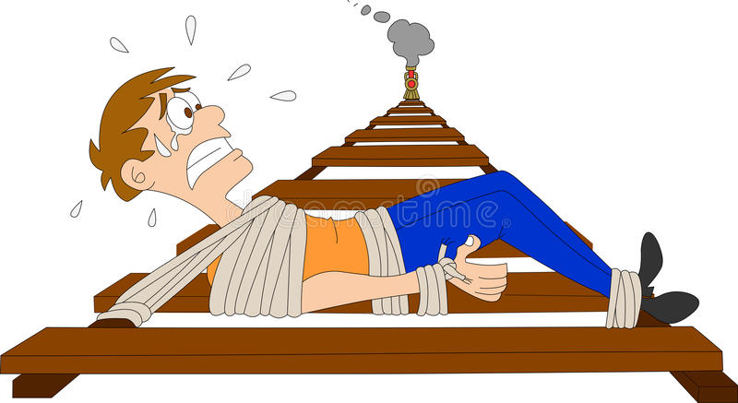
Definitions: (1) knowledge sound
Goal: if V accepts then P “knows” $w$ s.t. $C(x, w) =0$
What does it mean to ”know” $w$ ??
informal def: P knows $w$, if $w$ can be “extracted” from P
P

Slide 43
Definitions: (1) knowledge sound (simplified)
Formally: a universal SNARK (S, P, V) is knowledge sound if
for every poly. time adversary A = (A₀, A₁) there exists a poly. time extractor $Ext$ (that uses A as a black box) s.t.
if $gp$ ⇽ S_{init}( ), ($C,$ $x$, state) ⇽ A₀($gp$), ($pp$, $vp$) ⇽ S_{index}($gp,C$),
$π$ ⇽ A₁($pp$, $x$, state), $w$ ⇽ $Ext$($gp$, $C$, $x$)
Then
Pr[ V(vp, $x$, $π$) = accept ⇒ $C(x,w)=0$ ] ≥ 1 $− ε$ (for a negl. $ε$)
extracted witness

Slide 44
Definitions: (2) Zero knowledge
Where is Waldo?

Slide 45
Definitions: (2) Zero knowledge (simplified)
(S, P, V) is zero knowledge if for every $x∈𝔽_{}^{n}$
proof $π$ “reveals nothing” about $w$, other than its existence
What does it mean to “reveal nothing” ??
Informal def: $π$ “reveals nothing” about $w$ if the verifier can generate $π$ by itself ⟹ it learned nothing new from $π$
(S, P, V) is zero knowledge if there is an efficient alg. Sim s.t. ($pp$, $vp$, $π$) ⇽ Sim($C,x$) “look like” the real $pp$,$vp$ and $π$.
Main point: Sim($C$,x) simulates $π$ without knowledge of $w$
Notes:
Honest verifier because we are assuming S is honest (treating S as part o the verifier).
Note: this definition means that (Sp, Sv) are only good for a single proof. The correct definition gives (Sp, Sv) as input to Sim, but then it is not clear what is Sim’s advantage. Sim can program the random oracle, but we are not at a point where we can explain that.

Slide 46
Definitions: (2) Zero knowledge (simplified)
Formally: (S, P, V) is (honest verifier) zero knowledge for a circuit $C$ if there is an efficient simulator Sim such that for all $x∈𝔽_{}^{n}$ s.t. $∃w:C\left(x,w\right)=0$ the distribution:
($C$, $pp$, $vp$ , $x$, $π$): where ($pp$,$vp$) ⇽ S($C$) , $π$ ⇽ P($pp$ $,x$, $w$)
is indistinguishable from the distribution:
($C$, $pp$, $vp$, $x$, $π$): where ($pp$,$vp$, $π$) ⇽ Sim($C,x$)
Main point: Sim($C$,x) simulates $π$ without knowledge of $w$
Notes:
Honest verifier because we are assuming S is honest (treating S as part o the verifier)

Slide 47
How to build a zk-SNARK?
Recall: prover generates a short proof that is fast to verify
How to build a zk-SNARK ??
Next lecture

Slide 48
Applications of SNARKs: (1) Tornado cash: a zk-based mixer
Launched on the Ethereum blockchain on May 2020 (v2)

Slide 49
Tornado Cash: a ZK-mixer
A common denomination (1000 DAI) is needed to prevent linking Alice to her fresh address using the deposit/withdrawal amount
1000 DAI
MIX
NFT
market
???
1000 DAI
1000 DAI
buy NFT
privately
account
fresh
address
(1000 DAI)
1000 DAI
Tornado.cash
contract
Notes:
If Alice deposits and withdraws 1547.3 DAI then that creates a link between the deposit and the withdrawal events.

Slide 50
The tornado cash contract (simplified)
H₁, H₂: R ⇾ {0,1}²⁵⁶
CRHF
100 DAI pool:
each coin = 100 DAI
Treasury: 300 DAI
nf₁
Coins Merkle root
coins
Merkle
root
nf₂
(32 bytes)
tree of
height 20
(2²⁰ leaves)
Currently:
three coins in pool
contract has 300 DAI
two nullifiers stored
next = 4
nullifiers
C₁ C₂ C₃ 0 0 … 0
contract state
public list of coins
explicit list:
one entry per spent coin

Slide 51
Tornado cash: deposit (simplified)
H₁, H₂: R ⇾ {0,1}²⁵⁶
100 DAI pool:
each coin = 100 DAI
Treasury: 300 DAI
nf₁
Coins Merkle root
coins
Merkle
root
nf₂
Alice deposits 100 DAI:
(32 bytes)
tree of
height 20
(2²⁰ leaves)
100 DAI
C₄ , MerkleProof(4)
next = 4
nullifiers
C₁ C₂ C₃ 0 0 … 0
Build Merkle proof for leaf #4:
MerkleProof(4) (leaf=0)
choose random k, r in R
set C₄ = H₁(k, r)
contract state
public list of coins
explicit list:
one entry per spent coin
Notes:
Note: one Tx per block. Alice needs to know what leaf her coin will occupy.

Slide 52
Tornado cash: deposit (simplified)
H₁, H₂: R ⇾ {0,1}²⁵⁶
coins
Merkle
root
100 DAI
C₄ , $\text{MerkleProof}\text{(4)}$
Coins Merkle root
(32 bytes)
Tornado contract does:
verify $\text{MerkleProof}\text{(4)}$ with respect to current stored root
use C₄ and MerkleProof(4) to compute updated Merkle root
update state
tree of
height 20
(2²⁰ leaves)
next = 4
Tornado contract
C₁ C₂ C₃ 0 0 … 0
public list of coins

Slide 53
Tornado cash: deposit (simplified)
H₁, H₂: R ⇾ {0,1}²⁵⁶
coins
Merkle
root
100 DAI
C₄ , $\text{MerkleProof}\text{(4)}$
updated Merkle root
(32 bytes)
Tornado contract does:
verify $\text{MerkleProof}\text{(4)}$ with respect to current stored root
use C₄ and MerkleProof(4) to compute updated Merkle root
update state
tree of
height 20
(2²⁰ leaves)
next = 4
Tornado contract
C₁ C₂ C₃ C₄ 0 … 0
public list of coins

Slide 54
Tornado cash: deposit (simplified)
100 DAI pool:
each coin = 100 DAI
Treasury: 400 DAI
nf₁
updated Merkle root
updated
Merkle
root
nf₂
Alice deposits 100 DAI:
(32 bytes)
tree of
height 20
(2²⁰ leaves)
100 DAI
C₄ , MerkleProof(4)
next = 5
nullifiers
C₁ C₂ C₃ C₄ 0 … 0
updated contract state
public list of coins
note: (k, r)
Alice keeps secret (one note per coin)
Every deposit: new Coin added sequentially to tree
an observer sees who owns which leaves
Notes:
Observer: Alice owns C4.

Slide 55
Tornado cash: withdrawal (simplified)
H₁, H₂: R ⇾ {0,1}²⁵⁶
100 DAI pool:
each coin = 100 DAI
Treasury: 400 DAI
Merkle root
coins
Merkle
root
nf₁
nf₂
Withdraw coin #3 to addr A:
tree of
height 20
(2²⁰ leaves)
(32 bytes)
has note= (k’, r’)
next = 5
C₁ C₂ C₃ C₄ 0 … 0
nullifiers
set nf = H₂(k’)
contract state
public list of coins
Bob proves “I have a note for some leaf in the coins tree, and its nullifier is nf”
(without revealing which coin)
Notes:
Bob does not reveal which coin is being spent.

Slide 56
Tornado cash: withdrawal (simplified)
H₁, H₂: R ⇾ {0,1}²⁵⁶
Withdraw coin #3 to addr A:
Merkle root
has note= (k’, r’)
set nf = H₂(k’)
tree of
height 20
(2²⁰ leaves)
Bob builds zk-SNARK proof $π$ for
public statement x = (root, nf, A)
secret witness w = (k’, r’, C₃ , MerkleProof(C₃) )
where Circuit(x,w)=0 iff:
C₃ = (leaf #3 of root), i.e. MerkleProof(C₃) is valid,
C₃ = H₁(k’, r’), and
nf = H₂(k’).
C₁ C₂ C₃ C₄ 0 … 0
(address A not used in Circuit)
Notes:
Bob proves “I know some leaf in the coins tree whose nullifier is nf”. He does not which coin is being spent, which is why C3 is part of the secret witness.
Tornado uses Groth16. Lava.cash (same thing on Solana) uses zk-STARKs.

Slide 57
Tornado cash: withdrawal (simplified)
H₁, H₂: R ⇾ {0,1}²⁵⁶
Withdraw coin #3 to addr A:
The address A is part of the statement to ensure that a miner cannot change A to its own address and steal funds
Assumes the SNARK is non-malleable: adversary cannot use proof $π$ for x to build a proof $π’$ for some “related” x’ (e.g., where in x’ the address A is replaced by some A’)
Merkle root
has note= (k’, r’)
set nf = H₂(k’)
tree of
height 20
(2²⁰ leaves)
C₁ C₂ C₃ C₄ 0 … 0
Bob builds zk-SNARK proof $π$ for
public statement x = (root, nf, A)
secret witness w = (k’, r’, C₃ , MerkleProof(C₃) )
Notes:
Bob proves “I know some leaf in the coins tree whose nullifier is nf”. He does not which coin is being spent, which is why C3 is part of the secret witness.

Slide 58
Tornado cash: withdrawal (simplified)
H₁, H₂: R ⇾ {0,1}²⁵⁶
100 DAI pool:
each coin = 100 DAI
Treasury: 400 DAI
Merkle root
coins
Merkle
root
nf₁
Withdraw coin #3 to addr A:
nf₂
tree of
height 20
(2²⁰ leaves)
nf, proof $π$, A
(over Tor)
(32 bytes)
next = 5
C₁ C₂ C₃ C₄ 0 … 0
Bob’s ID and coin C₃ are not revealed
nullifiers
contract state
public list of coins
Contract checks (i) proof $π$ is valid for (root, nf, A), and
(ii) nf is not in the list of nullifiers
Notes:
Gas can be payed by a relayer, so that Bob’s account is not recorded.

Slide 59
Tornado cash: withdrawal (simplified)
H₁, H₂: R ⇾ {0,1}²⁵⁶
100 DAI pool:
each coin = 100 DAI
Treasury: 300 DAI
Merkle root
coins
Merkle
root
nf₁
Withdraw coin #3 to addr A:
nf₂
tree of
height 20
(2²⁰ leaves)
(32 bytes)
nf
nf, proof $π$, A
(over Tor)
next = 5
C₁ C₂ C₃ C₄ 0 … 0
100 DAI
nullifiers
to address A
contract state
public list of coins
… but observer does not know which are spent
nf and $π$ reveal nothing about which coin was spent.
But, coin #3 cannot be spent again, because nf = H₂(k’) is now nullified.
Notes:
Stress that H1 is collision resistant.

Slide 60
Who pays the withdrawal gas fee?
Problem: how does Bob pay for gas for the withdrawal Tx?
If paid from Bob’s address, then fresh address is linked to Bob
Tornado’s solution: Bob uses a relay
nf, proof $π$, A
and gas
nf, proof $π$, A
(over Tor)
(100-gas) DAI
to address A
gas
relay
tornado
contract
Note: relay and Tornado also charge a fee

Slide 61
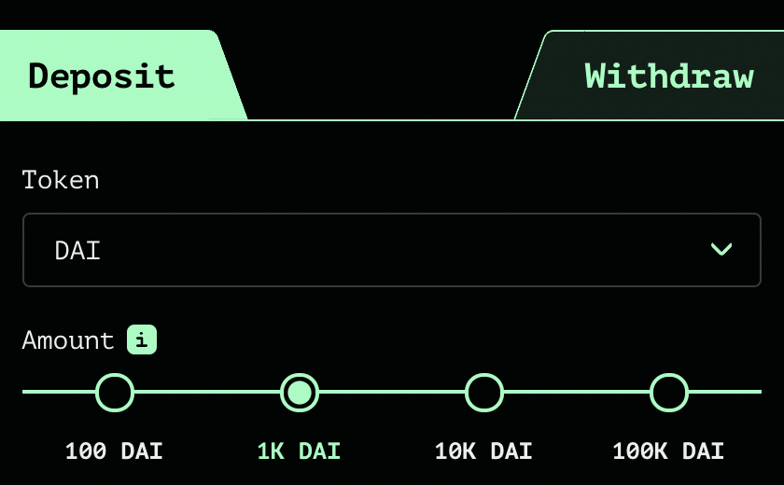
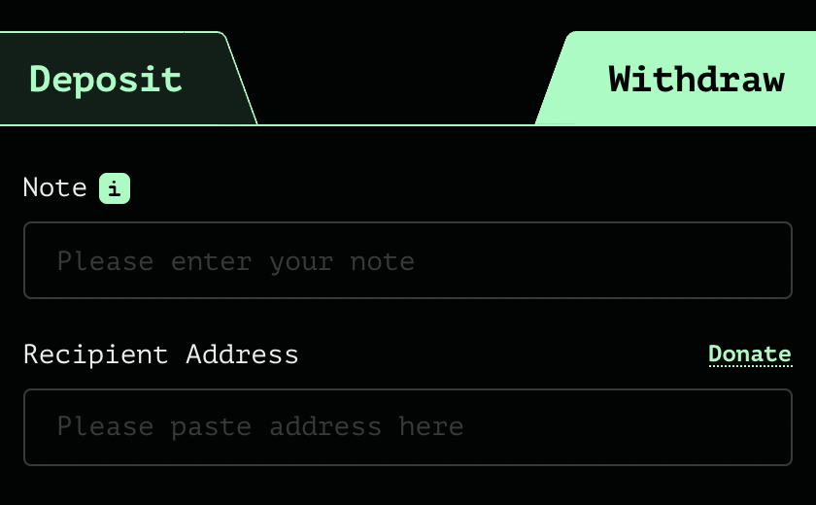
Tornado Cash: the UI
enter note here
address
After deposit: get a note
Later, use note to withdraw
(wait before withdrawing)

Slide 62
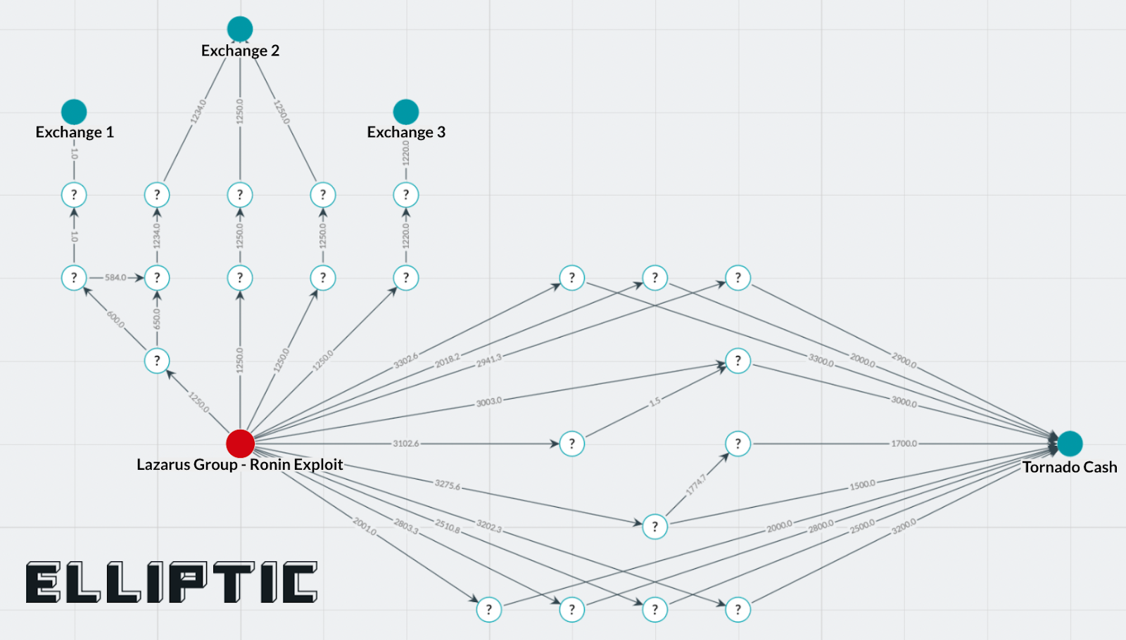
Tornado trouble … U.S. sanctions
The Ronin-bridge hack (2022):
In late March: ≈600M USD stolen … $80M USD sent to Tornado
April: Lazarus Group suspected of hack
August: “U.S. Treasury Sanctions Virtual Currency Mixer Tornado Cash”
Lots of collateral damage … and two lawsuits
Tornado
The lesson: complete anonymity in the
payment system is problematic

Slide 63
Sanctions
“U.S. persons would not be prohibited by U.S. sanctions regulations from copying the open-source code and making it available online for others to view, as well as discussing, teaching about, or including open-source code in written publications, such as textbooks, absent additional facts”
U.S. Treasury FAQ, Sep. 2022

Slide 64
Designing a compliant Tornado??
deposit filtering: ensure incoming funds are not sanctioned
Chainalysis SanctionsList contract:
function isSanctioned(address addr) public view returns (bool) {
return sanctionedAddresses[addr] == true ;
}
Reject funds coming from a sanctioned address.
Difficulties: (1) centralization, (2) slow updates

Slide 65
Designing a compliant Tornado??
Withdrawal filtering: at withdrawal, require a ZK proof that the source of funds is not currently on sanctioned list.
How?
modify the way Tornado computes Merkle leaves during deposit to include msg.sender.
in our example Alice sets: C₄ = [ H₁(k, r), msg.sender ]
During withdrawal Bob proves in ZK that msg.sender in his leaf is not currently on sanctions list.
Notes:
Discourages bad behavior in Tornado: the funds of sanctioned addressed become trapped inside Tornado.

Slide 66
Designing a compliant Tornado??
(3) Viewing keys: at withdrawal, require nullifier to include an encryption of deposit msg.sender under government public key.
How? Merkle leaf C₄ is computed as on previous slide.
During withdrawal Bob sets nullifier nf = [ H₂(k’), $ct$, $π$ ] where (i) $ct$ = Enc(pk, msg.sender) and (ii) $π$ is ZK proof that $ct$ is computed correctly
⇒ As needed, government can trace funds through Tornado
lots of problems with this design …
Notes:
Which pk to use. How to control access to the secret key sk? What if sk is lost or stolen?

Slide 67
Other private Tx projects
Zcash / Monero/IronFISH: private payments
L1 blockchains that extend Bitcoin, similar use of Nullifiers.
Support for any value Tx and in-system transfers.
Aztec / Aleo:
Support for private Tx interacting with a public smart contract.
Aleo: an L1 blockchain. Aztec: runs on top of Ethereum.

Slide 68
END OF LECTURE
Second half of course: Zero-knowledge

