Slide 1
PoW light clients and threshold signatures
CSCI-GA 3033-107
https://brightspace.nyu.edu/d2l/home/353819
Benedikt Bünz
New York University

Slide 2
Kate PCS
Pairing $e:𝔾×𝔾→𝔾_{T}$
The trusted setup chooses a secret $s←𝔽$ that is not shared with anyone and outputs crs = $\left(G,s⋅G,s^{2}G,…,s^{n}G\right)=(H_{0},…,H_{n})$for $G∈𝔾$
Commit$\left(crs,f\left(X\right)=\sum_{i=0}^{n}{f_{i}X^{i}}\right):\sum_{i=0}^{n}{f_{i}H_{i}=f\left(s\right)⋅G}$
Evaluation protocol: to prove $C_{f}$ is a commitment to $f$ such that $f\left(z\right)=y$:
compute quotient $Q\left(X\right)=\frac{f\left(X\right)−y}{X−z}$. Output commitment $C_{Q}=Q\left(s\right)G$.
Verifier computes $A=\left(s−z\right)⋅G$ and $B=y⋅G$and checks the pairing equation: $e\left(C_{Q}, A\right)=e(C_{f}−B,G)$

Slide 3
Verifiable Information Disperal
Use KZG to prove that shares of ECC were correct
Prover encodes message using reed Solomon encoding and commits to it using KZG
Each party receives it’s share (n/T evaluations of the polynomial), the KZG commitment and a KZG proof that it’s shares were correct.
Can generate one KZG proof for many openings (Homework).
Can generate all KZG proofs at once.

Slide 4
Danksharding

Slide 5
Light Clients

Slide 6
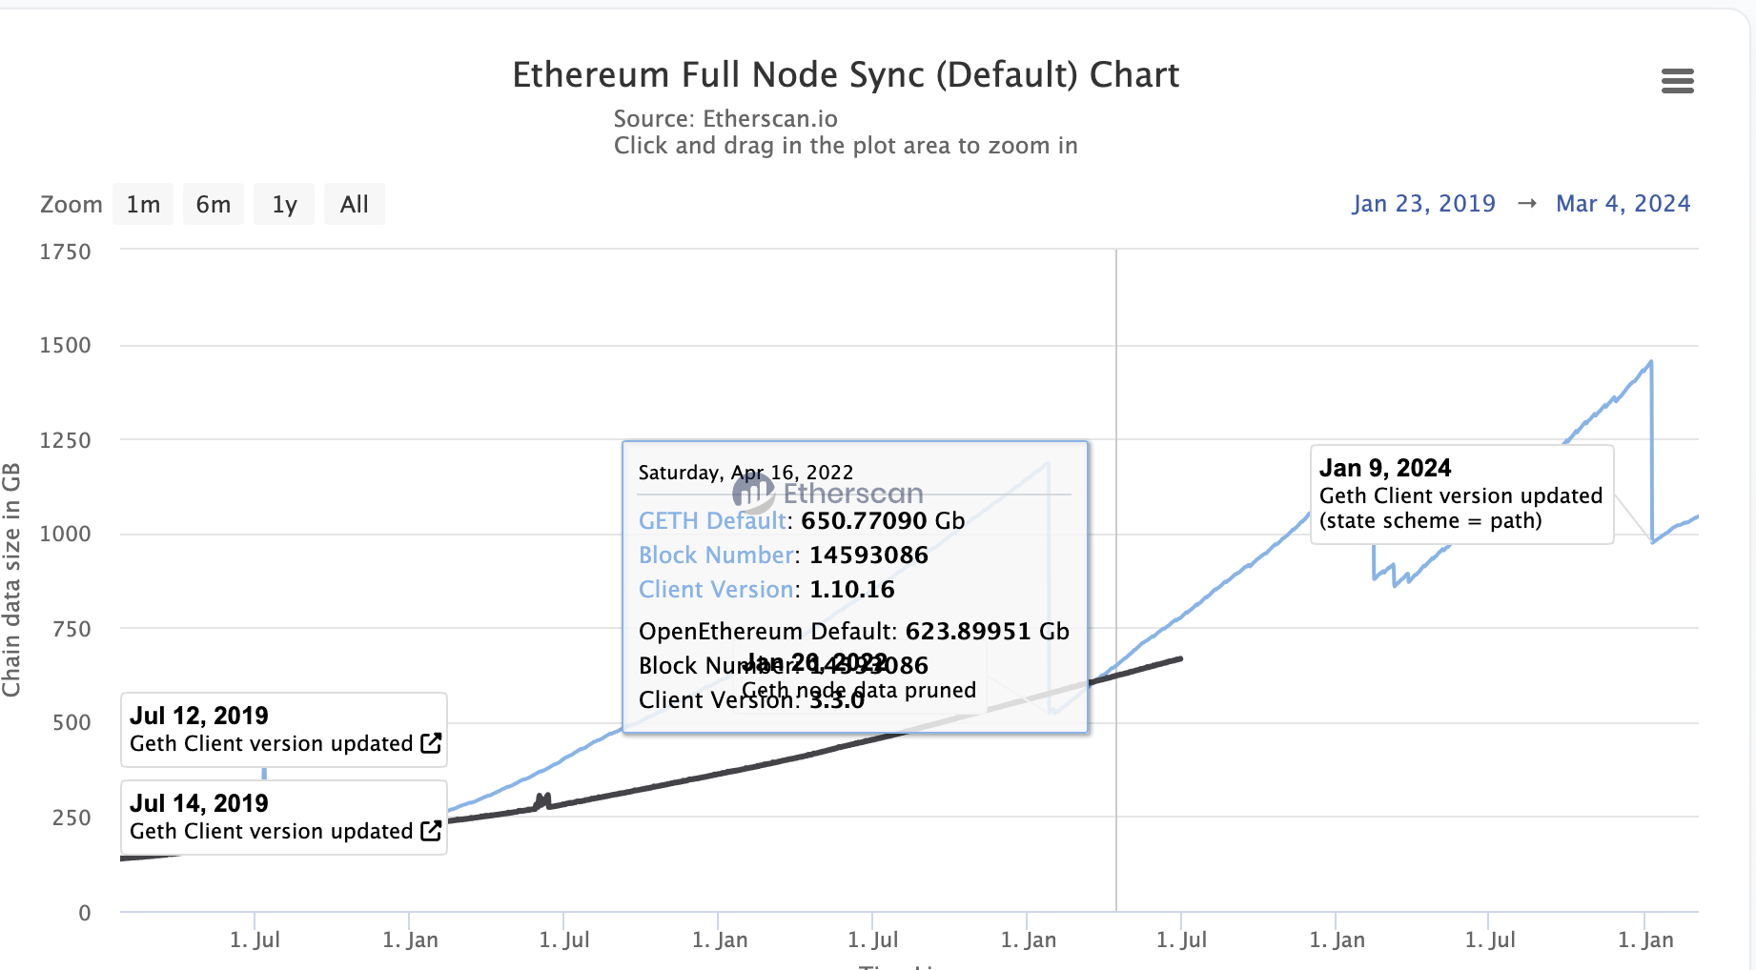
Full nodes, Archival Nodes, Light Clients
Full node
Executes transactions
Stores current state
Participates in consensus
About 1TB in size

Slide 7
Light Clients
Does not execute
Can check TX inclusion
Can get state proofs with state commitment
Minimal storage (runs as an app)
Goes online and offline

Slide 8
Bitcoin Light Client: SVP
Hash chain of blocks
prev: H( )
prev: H( )
prev: H( )
trans: H( )
trans: H( )
trans: H( )
H( ) H( )
Merkle Tree of transactions in each block
H( ) H( )
H( ) H( )
transaction
transaction
transaction
transaction

Slide 9
Validity of a blockchain
Hash chain of blocks
prev: H( )
prev: H( )
prev: H( )
trans: H( )
trans: H( )
trans: H( )
✅
H( ) H( )
Transactions are valid
Merkle tree correct
✅
H( ) H( )
H( ) H( )
✅
✅
✅
✅
transaction
transaction
transaction
transaction

Slide 10
Validity of a Block Header
prev: H( )
prev: H( )
prev: H( )
mrkl_root: H( )
mrkl_root: H( )
mrkl_root: H( )
✅
nonce: 0x0001...
nonce: 0xffff...
nonce: 0x0000...
nonce: 0x0001...
nonce: 0x0002...
nonce: 0xf77e...
nonce: 0x0001...
nonce: 0xffff...
nonce: 0x0000...
nonce: 0x0001...
nonce: 0x0002...
nonce: 0x7a83
nonce: 0x0000...
nonce: 0xf77e...
nonce: 0x0000...
hash: 0xd0c7...
hash: 0xd0c7...
hash: 0x6a1f...
hash: 0x300c...
hash:
hash: 0x0224...
hash: 0xc9c8...
hash: 0x0000...
hash: 0x6a1f...
hash: 0x300c...
hash:
hash: 0x0224...
hash: 0xc9c8...
hash: 0x3485...
hash: 0x0000...
hash: 0x0000
hash:
hash: 0x3485...
hash:
Hash
≤ 00000000000000001FB893000000000000000000000000000000000000000000
70+ leading zeroes required
✅

Slide 11
Two Valid Blockchains?
❓
This is the blockchain
No this is the blockchain

Slide 12
Longest Chain Rule
❗️
Take the longest chain!
Harder to produce.

Slide 13
Simple Payment Verifying Client [Satoshi’08]
prev: H( )
prev: H( )
prev: H( )
trans: H( )
trans: H( )
trans: H( )
H( ) H( )
Just store the block headers
H( ) H( )
H( ) H( )
transaction
transaction
transaction
transaction

Slide 14
Verify Block Headers
prev: H( )
prev: H( )
prev: H( )
mrkl_root: H( )
mrkl_root: H( )
mrkl_root: H( )
✅
nonce: 0x0001...
nonce: 0xffff...
nonce: 0x0000...
nonce: 0x0001...
nonce: 0x0002...
nonce: 0xf77e...
nonce: 0x0001...
nonce: 0xffff...
nonce: 0x0000...
nonce: 0x0001...
nonce: 0x0002...
nonce: 0x7a83
nonce: 0x0000...
nonce: 0xf77e...
nonce: 0x0000...
hash: 0xd0c7...
hash: 0xd0c7...
hash: 0x6a1f...
hash: 0x300c...
hash:
hash: 0x0224...
hash: 0xc9c8...
hash: 0x0000...
hash: 0x6a1f...
hash: 0x300c...
hash:
hash: 0x0224...
hash: 0xc9c8...
hash: 0x3485...
hash: 0x0000...
hash: 0x0000
hash:
hash: 0x3485...
hash:
Hash
≤ 00000000000000001FB893000000000000000000000000000000000000000000
70+ leading zeroes required...
✅

Slide 15
Use the Longest Chain Rule
❗️

Slide 16
Can’t verify all transactions (but that’s ok)
prev: H( )
prev: H( )
prev: H( )
trans: H( )
trans: H( )
trans: H( )
❓
Assumption:
Longest chain is produced honestly
H( ) H( )
❓
H( ) H( )
H( ) H( )
❓
❓
❓
❓
transaction
transaction
transaction
transaction

Slide 17
Can verify specific transactions (with help)
prev: H( )
prev: H( )
prev: H( )
trans: H( )
trans: H( )
trans: H( )
❓
transaction

Slide 18
Can verify specific transactions (with help)
prev: H( )
prev: H( )
prev: H( )
trans: H( )
trans: H( )
trans: H( )
H( )
$${ π}_{2}$$
Merkle proof $π$
$$\log_{2}(\# trans.)$$
H( )${ π}_{1}$
✅
transaction

Slide 19
SPV Properties and Problems
Can determine the longest chain
Can verify transaction inclusion
Does not grow with #transactions
80 bytes * #blocks (Bitcoin)
508 bytes * #blocks (Ethereum)
Sufficient for sidechains and swaps
No long range attacks possible
Can’t verify all transactions
Grows with #blocks
Less block time-> larger SPV client
60 MB in Bitcoin
3.2 GB in Ethereum
Especially bad for multi-chain clients

Slide 20
Flyclient: A super-light clients
prev: H( )
prev: H( )
prev: H( )
trans: H( )
trans: H( )
trans: H( )

Slide 21
Flyclient: A super-light clients
Store just the head
root: H( )
root: H( )
root: H( )
trans: H( )
trans: H( )
trans: H( )

Slide 22
Flyclient: A super-light clients
Store just the head
Merkle Tree (MMR)
root: H( )
root: H( )
trans: H( )
trans: H( )

Slide 23
Verifying Transaction
MMR proof $π$
$$\log_{2}(\# blocks.)$$
root: H( )
root: H( )
trans: H( )
trans: H( )
Chain head
$${ π}_{2}$$
H( )
Merkle proof $π$
$$\log_{2}(\# trans.)$$
H( )${ π}_{1}$
✅
transaction

Slide 24
Flyclient: Two Heads?
❓
This is the head
Assumption:
At least one chain is honest
Other one has at most a c fraction of the mining power (c fraction blocks are valid)
Ex: c=1/3
No this is the head

Slide 25
Flyclient Strawman 1
Give me k blocks: 7,13,210…

Slide 26
Flyclient Strawman 1: sample constant # of blocks
Head 1
Honest chain
Sample k blocks + MMR inclusion proof for each
Malicious chain (only 1/3 of the blocks have a PoW)
Head 2

Slide 27
Flyclient Strawman 1: sample constant # of blocks
Head 1
Honest chain
k samples and $\frac{1}{3}$ mining power →Advers. wins with ${\frac{1}{3}}^{k}$
$$k=81→P\left[Cheating\right]<2^{−128}$$
Malicious chain (only 1/3 of the blocks have a PoW)
Head 2

Slide 28
Flyclient Strawman 1 problem: Forking
Head 1
Honest chain
Malicious Fork
Head 2

Slide 29
Flyclient idea: Find Fork Point
Head 1
Honest chain
Malicious Fork
Knowing this point suffices
Head 2
︸
Sample blocks after fork

Slide 30
Flyclient: Idea bound forking point
Head 1
Honest chain
Head 2
Step 1: Sample enough blocks
Such that at least $\frac{2}{3}$ of them were created

Slide 31
Flyclient: Idea bound forking point
Head 1
Honest chain
$\frac{1}{2}$ of the chain
Head 2
Step 2: Calculate min fork point
$\frac{1}{2}$honest blocks + $\frac{1}{2}$ blocks at rate $\frac{1}{3}$= $\frac{2}{3}$ of total blocks

Slide 32
Flyclient: Idea bound forking point
Head 1
Honest chain
$\frac{3}{4}$ of the chain
Head 2
Step 3: Repeat

Slide 33
Flyclient: Idea bound forking point
Head 1
Honest chain
$\frac{7}{8}$ of the chain
Head 2
Step 3: Repeat

Slide 34
Flyclient: Idea bound forking point
Head 1
Honest chain
Head 2
Step 4: Check final L blocks (to prevent short forks)

Slide 35
Flyclient
Each step bounds the fork point by half
Log n steps
Sample “enough blocks” in each step
Sampling $O(λ)$ blocks suffices
Syncing n blocks only requires $O(λ\log{n})$ blocks
Proof size for 10 million blocks
500kb vs. 5GB for SPV client
Long range forks not possible (would have to redo PoW)

Slide 36
The ultra light client
Ideally, we would have a light client protocol that enables verifying that all transactions are valid and that the entire consensus was correct while minimizing synchronization time and data storage
Possible: Using SNARKs! Lecture 8 onwards ☺

Slide 37
Managing crypto assets: Wallets and keys

Slide 38
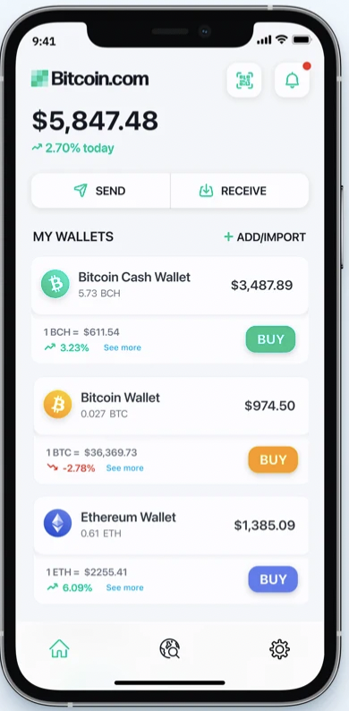
Managing secret keys
Users can have many PK/SK:
one per Bitcoin address, Ethereum address, …
Wallets:
Generates PK/SK, and stores SK,
Post and verify Tx,
Show balances
Notes:
How much Bitcoin do I own?

Slide 39
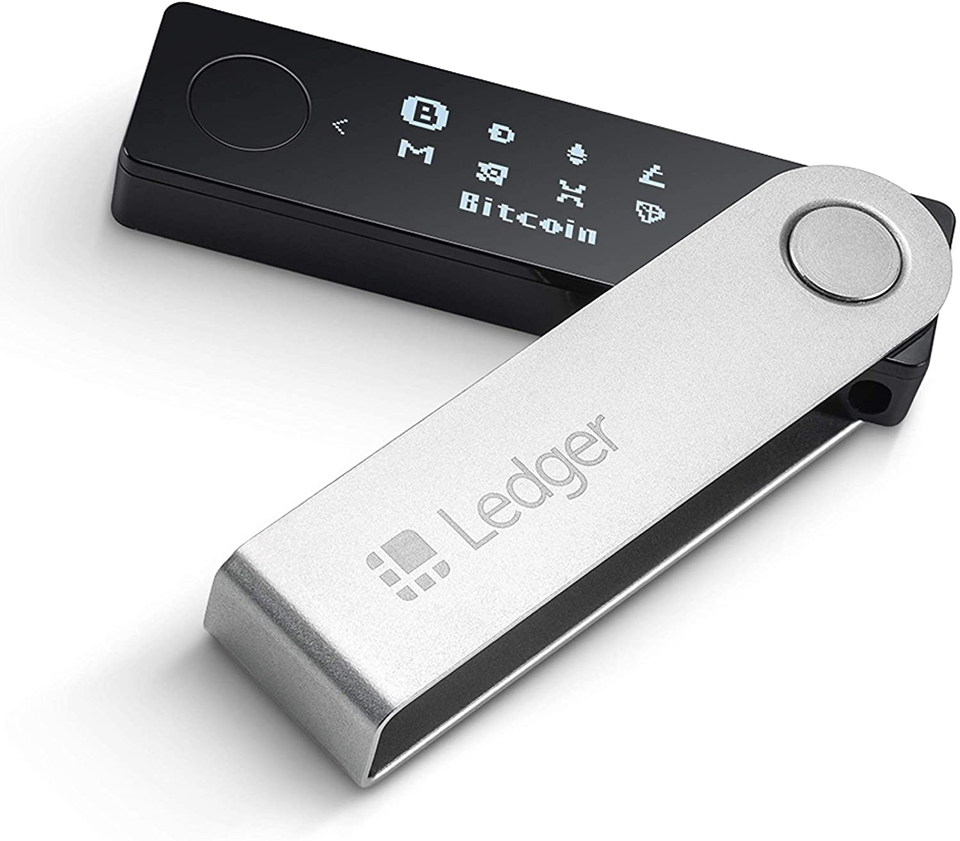
Managing lots of secret keys
Types of wallets:
cloud (e.g., Coinbase): cloud holds secret keys … like a bank.
laptop/phone: Electrum, MetaMask, …
hardware: Trezor, Ledger, Keystone, …
paper: print all sk on paper
brain: memorize sk (bad idea)
Hybrid: non-custodial cloud wallet (using threshold signatures)
client stores secret keys
Not your keys, not your coins …
but lose key ⇒ lose funds
Notes:
Threshold signatures in section.

Slide 40
Hardware wallet: Ledger, Trezor, …
End user can have lots of secret keys. How to store them ???
Hardware wallet (e.g., Ledger Nano X)
- connects to laptop or phone wallet using Bluetooth or USB
manages many secret keys
Bolos OS: each coin type is an app on top of OS
PIN to unlock HW (up to 48 digits)
screen and buttons to verify and confirm Tx

Slide 41
Hardware wallet: backup
Lose hardware wallet ⇒ loss of funds. What to do?
Idea 1: generate a secret seed k₀ ∈ {0,1}²⁵⁶
for i=1,2,…: sk_{i} ⇽ H(k₀, i) , pk_{i} ⇽ $sk_{i}⋅G$
$pk1, pk2, pk3, …:$ random unlinkable addresses (without k₀)
k₀ is stored on HW device and in offline storage (as 24 words)
⇒ in case of loss, buy new device, restore k₀, recompute keys
BLS/Schnorr public key

Slide 42
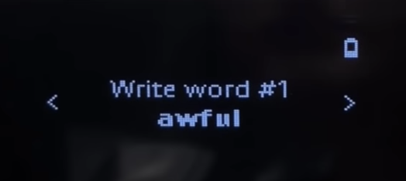
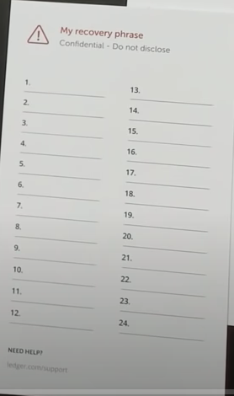
On Ledger
When initializing ledger:
user asked to write down the 24 words
each word encodes 11 bits (24 ×11 = 268 bits)
list of 2048 words in different languages (BIP 39)
Notes:
pre-initialized wallet purchased on eBay.

Slide 43
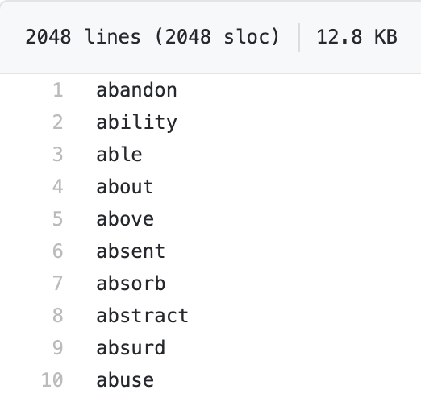
Example: English word list
⋮
save list of 24 words
Notes:
https://github.com/trezor/python-mnemonic/blob/master/mnemonic/wordlist/english.txt

Slide 44
On Ledger
When initializing ledger:
user asked to write down the 24 words
each word encodes 11 bits (24 ×11 = 268 bits)
list of 2048 words in different languages (BIP 39)
Beware of “pre-initialized HW wallet”
2018: funds transferred to wallet promptly stolen
Notes:
pre-initialized wallet purchased on eBay.

Slide 45
How to securely check balances?
With Idea1: need k₀ just to check my balance:
k₀ needed to generate my addresses ($pk1, pk2, pk3, …)$
… but k₀ can also be used to spend funds
Can we check balances without the spending key ??
Goal: two seeds
k₀ lives on Ledger: can generate all secret keys (and addresses)
k_{pub}: lives on laptop/phone wallet: can only generate addresses (for checking balance)

Slide 46
Idea 2: (used in HD wallets)
secret seed: k₀ ∈ {0,1}²⁵⁶ ; $(k1, k2)$ ⇽ H(k₀, “init”), H secure hash
balance seed: k_{pub} = $(k2, h=k_{1}⋅G)$
for all i=1,2,…: sk_{i} ⇽ $k1$ + H($k2$, i)
pk_{i} ⇽ $sk_{i}⋅G=k_{1}G+H\left(k_{2},i\right)G=h$ $+H\left(k_{2},i\right)G$
k_{pub} does not reveal sk₁, sk₂, …
computed from k_{pub}
k_{pub}: on laptop/phone, generates unlinkable addresses $pk1, pk2, …$
k₀: on ledger
Notes:
HD wallet: hierarchical deterministic wallet

Slide 47
Paper wallet (be careful when generating)
signing key (cleartext)
Bitcoin address = base58(hash(PK))
base58 = a-zA-Z0-9 without {0,O,l,1}
Notes:
base58: 62 – 4 = 58. Javascript that generated secret key can easily steal it.

Slide 48
Managing crypto assets in the cloud
How exchanges store assets

Slide 49
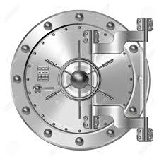
Hot/cold storage
Coinbase: holds customer assets
Design: 98% of assets (SK) are held in cold storage
cold storage (98%)
hot wallet (2%)
$$k_{0}^{(1)}$$
$$h, k2$$
used to verify cold storage balances
SK_{hot}
2% of assets
$$k0$$
customers
$$k_{0}^{(2)}$$
$$k_{0}^{(3)}$$
t-out-of-n secret sharing of $k0$
Notes:
Vault is used when need to reconstruct K0 and move funds out of cold storage. Otherwise, K0 is split into shares all over the world.

Slide 50
Problems
Can’t prove ownership of assets in cold storage, without accessing cold storage:
To prove ownership (e.g., in audit or in a proof of solvency)
To participate in proof-of-stake consensus
How to do secret sharing?
Solutions:
Keep everything in hot wallet (e.g, Anchorage)
Proxy keys: keys that prove ownership of assets, but cannot spend assets

Slide 51
Secret Sharing/Threshold signing
Goal: Have n keys such that any subset of k keys can be used to sign
k-1 keys cannot sign
t is the threshold. Example: 2 out of 3 or 10 out of 30
Ideally: outside observer can’t distinguish threshold

Slide 52
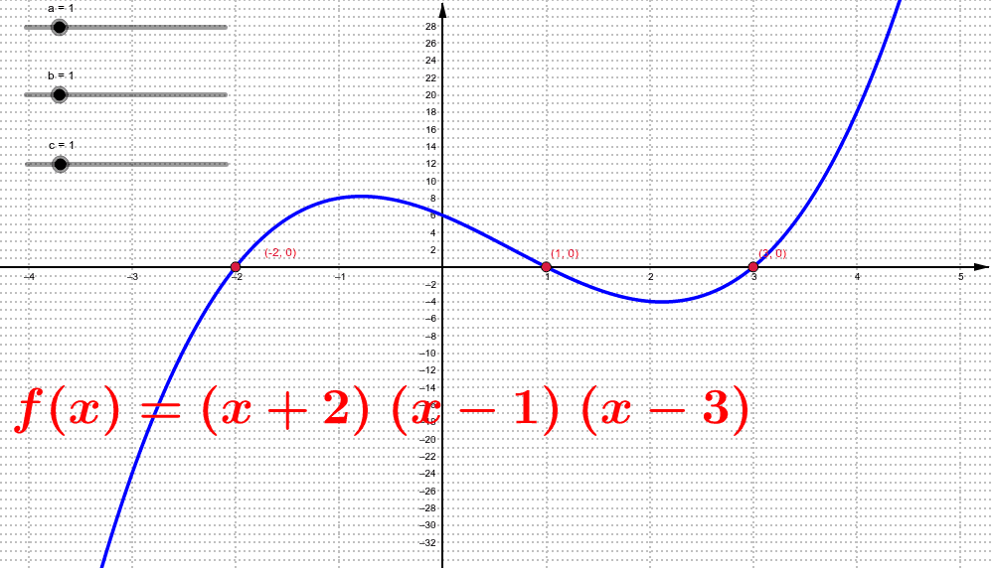
Shamir Secret Sharing insight
Let $𝔾$ be a group of order p for a BLS scheme (works for other signature schemes)
“Dealer” picks a random degree t-1 polynomial: $f\left(X\right)=\sum_{i=0}^{t}{r_{i}X^{i}}$ over field $𝔽_{p}$
Parties have ids 1,…,n. Dealer sends party i, f(i)
P$ublic key pk=f\left(0\right)⋅G$
$t$ parties can reconstruct f, t-1 can’t

Slide 53
Shamir Secret Sharing
Use Lagrange interpolation to compute $f(0)$ from shares
Let $S⊂[n]$ be the set of signers such that $\left|S\right|=t$
$f\left(X\right)=\sum_{i∈S}{L_{i}^{S}}\left(X\right)⋅f(i),$ such that
$L_{i}^{S}\left(X\right)=\prod_{j∈S∖i}{\frac{X−j}{i−j}}$, called the lagrange polynomial.
Note that $L_{i}^{S}\left(i\right)=1$ and $L_{i}\left(j\right)=0$ for all $j∈S$
Thus $\sum_{i∈S}{L_{i}^{S}}\left(j\right)⋅f\left(i\right)=f(j)$ on all $j∈S$ and thus
$\sum_{i∈S}{L_{i}^{S}}\left(X\right)⋅f\left(i\right)=f(X)$ as the polynomials are deg. t-1

Slide 54
BLS Threshold signature
Generate $s_{1},…,s_{n}$ as secret shares using Shamir Secret Sharing from polynomial $f$
Each party computes $pk_{i}=s_{i}G$
Let S be the set of t signers
Compute $pk=\sum_{i∈S}{L_{i}^{S}(0)}pk_{i}=f\left(0\right)G$
Each party computes signature share on message m: $σ_{i}=s_{i}⋅H_{G}(m)$
Compute $σ=\sum_{i∈S}{L_{i}^{S}(0)}σ_{i}$ (normal BLS signature)

Slide 55
END OF LECTURE
Second half of course: Zero-knowledge

