Slide 1
Aggregate Signatures, Beacons and large scale consensus
CSCI-GA 3033-107
https://brightspace.nyu.edu/d2l/home/353819
Benedikt Bünz
New York University
[second homework out soon]

Slide 2
Aggregate signatures

Slide 3
Aggregate signatures
Aggregate
Problem: Can’t be accountable
Solution: Add bitvector (n bits)

Slide 4
Aggregate signatures: syntax
Def: an aggregate signature scheme is a quintuple of algorithms:
(Gen, Sign, Verify) : is a signature scheme
Aggregate(${\left[pk_{i},m_{i},σ_{i}\right]}_{i=1}^{k}$)-> outputs $σ_{A}$
VerifyAgg$({\left[pk, m\right]}_{i=1}^{k}, σ_{A}$) outputs ‘accept’ or ‘reject’
Correctness: (Security later)
Verify($pk_{i},m_{i},σ_{i}$)= ‘accept’ for all i ->
VerifyAgg$({\left[pk_{i}, m_{i}\right]}_{i=1}^{k},$ Aggregate(${\left[pk_{i},m_{i},σ_{i}\right]}_{i=1}^{k}$))= ’accept’
Efficiency: Ideally $σ_{A}$ is short

Slide 5
BLS aggregate sig scheme (Attempt 1)
Gen($λ$)$:𝔾$ group of order p, generator G
$x←^{\$}ℤ_{p},Y←x⋅G∈𝔾$
Sign ($x,m$):
Output $σ=x⋅H_{𝔾}(m)$
Verify($y,m,σ∈𝔾)$
$e\left(σ,G\right)=e(H_{𝔾}(m),Y)$

Slide 6
Modelling security
For all polynomial-time (and query) adversaries A with access to a signing oracle $O:$
$$P\left[\begin{matrix}AV({\left[pk,msg\right]}_{i=1}^{k},σ_{A}) & | & \left(pk,sk\right)←Gen(λ) \\ ∧ & | & ∧ \\ \begin{aligned}∃i^{∗} pk_{i^{∗}}=pk \\ msg_{i^{∗}}∉O.M\end{aligned} & | & \left({\left[pk_{i},msg_{i}\right]}_{i=1}^{k},σ_{A}\right)←A^{O}(1^{λ},pk)\end{matrix}\right]=negl(λ)$$
$O$ on input m returns a valid signature on m. $O.M$ is the set of messages signed by $O$
Intuition: Adv. Can create rouge keys but includes pk in agg. sig

Slide 7
BLS Agg signature
Method 1: Proofs of possession
For each key generate signature on itself.
$σ_{POP}=sk⋅H_{G}(pk)$
Check once per key
Ensures attacker knows sk for each pk.
One signature per key
Afterwards simple sum aggregation

Slide 8
BLS Agg signature
Method 2: Random linear combination
Assume $m_{1}=m_{2},…=m^{∗}$
H: $𝔾^{k}→𝔽$ modeled as random oracle
$c_{1},…,c_{k}←H(pk_{1},…,pk_{k})$; random challenges
Aggregate: $\sum_{i}{c^{i−1}⋅σ_{i}}$
VerifyAgg: $e\left(σ_{A},G\right)=\sum_{i}{c_{i}}⋅e(H_{G}\left(m_{i}\right), pk_{i})$
One signature but one scalar mult per key

Slide 9
Random linear comb security
Intuition:
Rouge key attack canceled out Bob’s key:
$pk_{adv}=αG−pk_{B}$
Given that $c$ is chosen after the keys the adversary cannot cancel out key as $pk_{adv}+c pk_{B}≠αG$ even if $pk_{adv}+pk=αG$.
For security proof we need to show that given k sets of challenges ${[c}_{i}^{(1)}] ,{[c}_{i}^{(2)}],…,{[c}_{i}^{(k)}]$and aggregate signatures $σ_{A,1 },σ_{A,2},…,σ_{A,k}$ we can compute individual (non aggregate) signatures $σ_{1},…,σ_{k}$
Homework!

Slide 10
Making the scheme accountable
For slashing we need that signature identifies who signed
Aggregate signature provides this but requires list of public keys
Can be compressed using a bitmap (indicates which keys signed).
Size <= n bits

Slide 11
Merkle Tree based QC
Say we don’t need to know who signed only that sufficient number signed (not slashable)
Can we get a scheme without pairings/BLS
Assume that instead of 2/3rd , 5/6th signed
Idea: Subsample signatures

Slide 12
Merkle based QC [MRVWZ20]
Assume a list of k claimed signers (say $\frac{5}{6}th$of all nodes)
Produce a Merkle Tree of all signatures
Sample (using a hash function) a random index i in 1,…,k
Open path to ith signature
Repeat $ℓ$ times
Verifier checks all $ℓ$ signatures

Slide 13
Merkle based QC analysis
Assume there are less than $\frac{2}{3}rd$ real signatures on the message.
This means that at least $\frac{5}{6}−\frac{2}{3}=\frac{1}{6}$ signatures must be invalid
Every random sample has a $\frac{1}{6}th$ chance of catching an adversary
The probability an adversary succeeds on $ℓ$ challenges is ${\left(\frac{5}{6}\right)}^{ℓ}$
For $ℓ≥456$ the probability is <$2^{−120}$
Independent of k or n
Useful if n (total nodes) is huge
$ℓ$ can be reduced using beacons (next lecture)

Slide 14
Proof of Stake
Replace Sybill resistance of PoW with money
Staking pool
💸
Stakes coins (through transaction)
Can’t use staked coins for anything else!
💸
💸
💸
💸
💸
Incentives: Get’s rewards/fees. Can use punishments/slashing
Voting Power: Proportional to relative stake

Slide 15
Scaling Byzantine Consensus
Sub select a set of participants to run BC
Many stake weighted participants

Slide 16
Committee selection
Sub select a set of participants to run BC
What fraction of committee will be corrupted?

Slide 17
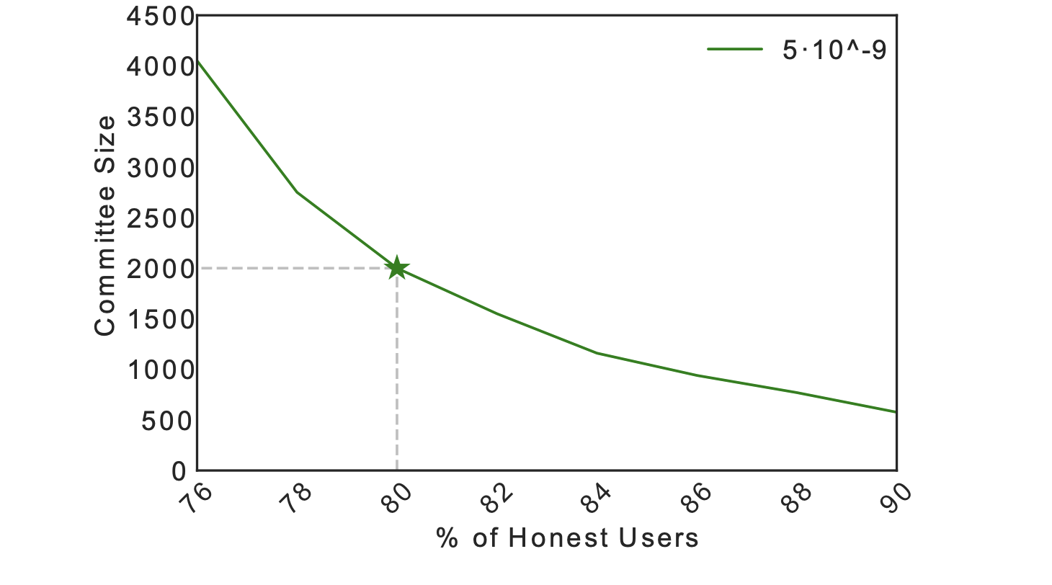
Committee selection
Sub committee roughly looks like general population
100s of nodes
>67% Honest
>1000s of nodes
80% Honest

Slide 18
Random Selection
How to choose committee?
Proposal:
Each staker computes H(block number,PK)
If H(block number,PK)< target
Become part of committee for round
If BC succeeds add Block to chain
Target such that ~1000 nodes win
Broken! Attacker can choose PK such that they win

Slide 19
Randomness beacon
An ideal service that regularly publishes random value which no party can predict or manipulate
01010001 01101011 10101000 11110000

Slide 20
Random Selection with Beacon
How to choose committee?
Each Block wait for beacon randomness
Each staker computes H(block number beacon, PK)
If H(block number beacon,PK)< target
Become part of committee for round
If BC succeeds add Block to chain
Beacon unpredictable so can’t choose PK
Even better: Compute deterministic (BLS) signature on Beacon and use as ticket (prevents others from seeing who won) VRF

Slide 21
Leader Selection
We can also make leader election random with a beacon!
Can make BC resilient vs. adversary that corrupts adaptively
(Bribing)
See Algorand reading

Slide 22
Lotteries
``Public displays” can be corrupted
A beacon can be used to run a fair lottery

Slide 23
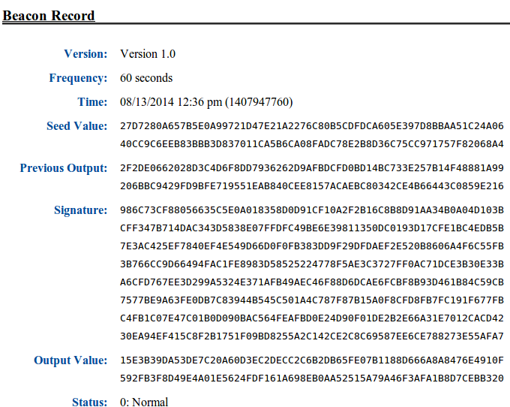
How to build a Beacon?
NIST (NSA) Beacon

Slide 24
Collect randomness approach
Alice
Bob
Claire
Zoe
Mildly synchronous
r_{a}
r_{b}
r_{c}
r_{z}
Blockchain
output beacon = Hash(r_{a} || r_{b} || ⋯ || r_{z} ) ∈ {0,1}²⁵⁶
Problem: Zoe controls the final seed !!
Notes:
VDFs solve the bias issue at the expense of synchrony
“Resurrect the most simple approach to multiparty randomness generation”

Slide 25
Commit and Reveal
Alice
Bob
Claire
Zoe
R1:
H(r_{a})
H(r_{b})
H(r_{c})
H(r_{z})
Mildly synchronous
R2:
r_{a}
r_{b}
r_{c}
r_{z}
Blockchain
output beacon = Hash(r_{a} || r_{b} || ⋯ || r_{z} ) ∈ {0,1}²⁵⁶
Problem: Beacon can be biased by not opening!!
K parties, k bits of influence
Notes:
VDFs solve the bias issue at the expense of synchrony
“Resurrect the most simple approach to multiparty randomness generation”

Slide 26
Verifiable Delay Function (VDF)
$$F$$
Function – unique output for every input
Delay – can be evaluated in time T
cannot be evaluated in time (1-$ε$)T on parallel machine
Verifiable – correctness of output can be verified efficiently
X
Y
$$F\left(x\right)=y$$
$$x, y, π$$
Verifier

Slide 27
Security Properties (Informal)
Setup(λ, T) ⟶ public parameters pp
Eval(pp, x) ⟶ output y, proof π (requires T steps)
Verify(pp, x, y, π) ⟶ { yes, no }
“Soundness”: if Verify(pp, x, y, π) = Verify(pp, x, y’, π’) = yes
then y = y’
“$σ$-Sequentiality”: if $A$ is a PRAM algorithm, time(A) $≤$ $σ(T)$,
e.g. $σ(T)=\left(1−ε\right)T$ then Pr[ A(pp, x) = y ] < negligible(λ)
Notes:
T is required to be subexponential in lambda
sigma sequentiality is stated informally for now, describe formal game-based definition in several slides

Slide 28
Collect randomness approach
Alice
Bob
Claire
Zoe
Mildly synchronous
r_{a}
r_{b}
r_{c}
r_{z}
Blockchain
output beacon = Hash(r_{a} || r_{b} || ⋯ || r_{z} ) ∈ {0,1}²⁵⁶
Problem: Zoe controls the final seed !!
Notes:
VDFs solve the bias issue at the expense of synchrony
“Resurrect the most simple approach to multiparty randomness generation”

Slide 29
Solution: slow things down with a VDF [LW’15]
Alice
Bob
Claire
Zoe
r_{a}
r_{b}
r_{c}
r_{z}
Public Bulletin Board (blockchain)
Hash(r_{a} || r_{b} || ⋯ || r_{z} ) ∈ {0,1}²⁵⁶
VDF
H
beacon, π
Notes:
VDF is longer than time from ra to rz

Slide 30
Solution: slow things down with a VDF [LW’15]
VDF delay ≫ max-Δ-time(Alice ⟶ Zoe)
Uniqueness: ensures no ambiguity about output
Public Bulletin Board (blockchain)
Hash(r_{a} || r_{b} || ⋯ || r_{z} ) ∈ {0,1}²⁵⁶
VDF
H
beacon, π
Notes:
Hash function at the end ensures A cannot distinguish seed from random until after the time delay

Slide 31
VDF Beacon in a blockchain
Block i
Block i+1
Initializes VDF Beacon
Committee i+1
Committee i

Slide 32
How to build a VDF
Choose a “Group of unknown order”:
Pick two primes p,q, Let $N=p⋅q$
Computing $g^{2^{T}} mod N$ takes T repeated squarings
Can’t be parallelized
Unless factorization of N is known
Let $H$ be a hash function that maps to $[0,N−1]$
Eval(pp, x): output $H{\left(x\right)}^{2^{T}}$
How to verify?

Slide 33
VDF Proof
Efficiency: Bob runs in time O(log(T))
Security: If Bob accepts then $y=H{\left(x\right)}^{2^{T}}$
Computes $y=H{\left(x\right)}^{2^{T}}$
Produces a small proof $π$
Sends $y,π$ to Bob
Takes as input $x,y,π$
Outputs “accept” or “reject”

Slide 34
Group Exponentiation Proof 1 [Pietrzak’18]
$$G$$
$$z=x^{2^{T/2}}$$
Break into two statements of lower complexity
x
z
$$T/2$$
y
$$T/2$$
$$y=z^{2^{T/2}}$$

Slide 35
Group Exponentiation Proof 1 [Pietrzak’18]
$$G$$
$${\left(xz\right)}^{2^{T/2}}={yz}^{}$$
xz
Combine recursion branches
$$T/2$$
zy

Slide 36
Group Exponentiation Proof 1 [Pietrzak’18]
$$G$$
$${\left(xz^{r}\right)}^{2^{T/2}}=zy^{r}$$
xy^{r}
Add randomization term for soundness
$$r←[{0,2}^{λ}]$$
$$T/2$$
yz^{r}

Slide 37
Group Exponentiation Proof 1 [Pietrzak’18]
$$\left(x,y,T\right):x^{2^{T}}=y$$
$$z=x^{2^{T/2}}$$
$$r←[{0,2}^{λ}]$$
Peggy
Victor
Computes $u=xz^{r}$
$$and v=zy^{r}$$
If T = 4, checks:
$$u^{2}=v$$
Accepts if true
Computes${u=xz}^{r} and$
$$v=zy^{r}$$
$$\left(u,v,T/2\right):u^{2^{T/2}}=v$$
Recurse
Notes:
Fiat-Shamir to make it non-interactive

Slide 38
Security: Low Order Assumption
GGen($λ)$ outputs the description of a group
Assumption: No efficient algorithm that samples $G←GGen(λ)$ and outputs $(μ, d)$ s.t. $μ^{d}=1$ and $1<d<2^{λ}$ and $μ≠1$
Theorem [BBF’18]: Low order assumption for GGen $⇒$Pietrzak’s succinct argument has negligible soundness error

Slide 39
VDF Proof 2 [Wesolowski’18]
$$\left(x,y,T\right):x^{2^{T}}=y$$
y
Random $λ$ bit prime l
$\log{(T)}$steps
Computes
q,r s.t.
$2^{T}=q⋅l+r$ and $0≤r<l$
Computes
$r=2^{T} mod l$
Checks:
$$π^{l}x^{r}=y$$
$$x^{q⋅l}x^{r}=x^{2^{T}}$$
$$π=x^{q}$$

Slide 40
Security intuition
$$\left(x,y,T\right):x^{2^{T}}=y$$
Must compute $π$
s.t. $π={\left(\frac{y}{x^{r}}\right)}^{\frac{1}{l}}$
Taking roots is hard
See reading
y
Random $λ$ bit prime l
Computes
q,r s.t.
$2^{T}=q⋅l+r$ and $0≤r<l$
Computes
$r=2^{T} mod l$
Checks:
$$π^{l}x^{r}=y$$
$$x^{q⋅l}x^{r}=x^{2^{T}}$$
$$π=x^{q}$$

Slide 41
VDF Proof 2 [Wesolowski’18]
$$\left(x,y,T\right):x^{2^{T}}=y$$
y
$$l=H\left(x,y,T\right)∈Primes$$
Computes
q,r s.t.
$2^{T}=q⋅l+r$ and $0≤r<l$
Computes
$r=2^{T} mod l$
Checks: $l=H\left(x,y,T\right)$
$$π^{l}x^{r}=y$$
$$x^{q⋅l}x^{r}=x^{2^{T}}$$
$$π=x^{q},l$$

Slide 42
END OF LECTURE
Next week: off, then threshold crypto

