Slide 1
Merkle Trees, Accumulators and Blockchain Mechanics
CSCI-GA 3033-107
https://brightspace.nyu.edu/d2l/home/353819
Benedikt Bünz
New York University
[discussion on brightspace]
[first homework – online due 11/2/24]

Slide 2
Recap Digital Signatures
How to authorize a transaction

Slide 3
Digital signatures: syntax
Def: a signature scheme is a triple of algorithms:
Gen($λ$): outputs a key pair (pk, sk)
Sign(sk, msg) outputs sig. σ
Verify(pk, msg, σ) outputs ‘accept’ or ‘reject’
Secure signatures: (informal)
Adversary who sees signatures on many messages of his choice, cannot forge a signature on a new message.

Slide 4
Pairings
Assume group $𝔾$ has a so called pairing
$e:𝔾×𝔾→𝔾_{T}$ is a bilinear map:
$e\left(G_{1}+G_{2},H\right)=e\left(G_{1},H\right)+e(G_{2},H)$
$e\left(G,H_{1}+H_{2}\right)=e\left(G,H_{1}\right)+e(G,H_{2})$
$𝔾,𝔾_{T}$ are prime order groups of order p
Implies $e\left(a⋅G,b⋅H\right)=a⋅b⋅e(G,H)$

Slide 5
BLS signature
Assume group $𝔾$ has a so called pairing
Let $H_{𝔾}$ be a hash function that maps to $𝔾$ (modeled as RO)
Gen($λ$)$:𝔾$ group of order p, generator G
$x←^{\$}ℤ_{p},Y←x⋅G∈𝔾$
Sign ($x,m$):
Output $σ=x⋅H_{𝔾}(m)$ //Only one element in $𝔾$
Verify($Y,m,σ∈𝔾)$
$e\left(σ,G\right)=$ $e\left(H\left(m\right),Y\right)$
$$e\left(x⋅H_{𝔾}(m),G\right)=x⋅e(H_{𝔾}\left(m\right),G)=e\left(H_{𝔾}\left(m\right),x⋅G\right)$$

Slide 6
BLS Security: CDH assumption
Given a prime-order group $𝔾$, the computational Diffie Hellman (CDH) assumption holds in $𝔾$ if for all polynomial-time adversaries $A$, $Adv_{CDH}\left(λ\right)$ is negligble:
$$P\left[\begin{matrix} & | & G,H←^{\$}𝔾 \\ U=α⋅H & | & α←^{\$}ℤ_{p}/\{0\} \\ & | & U←A(1^{λ},G,H,αG)\end{matrix}\right]=Adv_{CDH}(λ)$$
Note: that if A could compute DLOGs then computing $α$, and thus U would be easy

Slide 7
Proving that BLS is secure
Gen($λ$)$:𝔾$ group of order p, generator G
$x←^{\$}ℤ_{p},Y←x⋅G∈𝔾$
Sign ($x,m$):
Output $σ=x⋅H_{𝔾}(m)$
Verify($y,m,σ∈𝔾)$
$e\left(σ,G\right)=e(H_{𝔾}(m),Y)$
Theorem: Assuming the CDH assumption holds in $Adv_{CDH}(λ)$
Proof idea:
Adversary outputs signature $σ$ on $m^{∗}$ such that $e\left(σ,G\right)=e\left(H_{𝔾}\left(m^{∗}\right),Y\right)$
Implies $σ=DLOG_{G}\left(Y\right)⋅$ $H_{𝔾}\left(m^{∗}\right)$
Built CDH adversary that ouputs $σ$ on input $(G,H_{𝔾}\left(m^{∗}\right),Y)$

Slide 8
Proving that BLS is secure
Gen($λ$)$:𝔾$ group of order p, generator G
$x←^{\$}ℤ_{p},Y←x⋅G∈𝔾$
Sign ($x,m$):
Output $σ=x⋅H_{𝔾}(m)$
Verify($y,m,σ∈𝔾)$
$e\left(σ,G\right)=e(H_{𝔾}(m),Y)$
Theorem: Assuming the CDH assumption holds in $Adv_{CDH}(λ)$
Built CDH adversary $A_{CDH}$ from BLS adversary $A_{BLS}$:
Strategy:
Get CDH query tuple $G,H,Y$ and set $Y$ as public key
Must respond to signing oracle queries
Emulate RO such that DLOG between G and${ H}_{𝔾}(m)$ is known
Must get adversary to ”sign” H
Pick one out of $Q$ RO query at random and set output to H
Hope this is the “forgery” query
Probability of success is $1/Q$ $⋅Adv_{CDH}(λ)$, i.e. there is a factor $Q$ loss

Slide 9
Proving that BLS is secure
Gen($λ$)$:𝔾$ group of order p, generator G
$x←^{\$}ℤ_{p},Y←x⋅G∈𝔾$
Sign ($x,m$):
Output $σ=x⋅H_{𝔾}(m)$
Verify($y,m,σ∈𝔾)$
$e\left(σ,G\right)=e(H_{𝔾}(m),Y)$
Theorem: Assuming the CDH assumption holds in $Adv_{CDH}(λ)$
Built CDH adversary $A_{CDH}$ from BLS adversary $A_{BLS}$:
Let (G,T, $Y$) be the CDH challenge (input to $A_{CDH}$ )
Send $Y=αG$ to $A_{BLS}$
For signing query $m_{i}$, program the RO such that $H_{𝔾}\left(m_{i}\right)=α_{i}G$ and respond with
$α_{i}⋅Y=α_{i}⋅α⋅G=α⋅H_{𝔾}\left(m_{i}\right)$
Program the random oracle $H_{𝔾}$ such that on one of the queries outputs H. //Impossible to guess which one
When $A_{BLS}$ outputs a forgery $(m,σ)$ and $H_{𝔾}$ $\left(m\right)=T$ then $A_{CDH}$ outputs $σ$ (Probability $1/Q$ where Q is queries to RO)
Since $e\left(σ,G\right)=e\left(H_{𝔾}\left(m\right),Y\right)=e\left(T,αG\right)→σ=αT$
$A_{CDH}$ succeeds with $Adv_{CDH}(λ)/Q$

Slide 10
BLS cool features
BLS signature is just one group element (32 bytes)
The signature is unique (see homework)
You can add two valid signatures ($σ_{1},σ_{2}$):
$Verify\left(Y_{1}+Y_{2},m,σ_{1}+σ_{2}\right)=1$
Let’s you aggregate signatures (more later)

Slide 11
Recap: Hash Functions
cryptographic hash functions
An efficiently computable function $H: M ⇾ T$
where $|M|≫|T|$
32 bytes
megabytes
hash value
$$T = {\left\{0,1\right\}}^{256}$$

Slide 12
Recap: Connecting the Blockchain
Only 80 bytes
prev: H( )
prev: H( )
prev: H( )
Metadata
Metadata
Metadata
Metadata
trans: H( )
trans: H( )
trans: H( )
trans: H( )
Blocks are connected through hash pointers.
The head of the chain commits to entire history
But you can’t recover history from
transaction
transaction
transaction
transaction
Notes:
Alice posts hash h on the blockchain.

Slide 13
Committing to the transactions
32 bytes
Alice has $S=(m1,m2, …,mn)$
Goal:
- Alice posts a short binding commitment to $S$, $h=commit(S)$
Bob reads $h$. Given $\left(mi, proof πi\right)$ can check that $S[i]=m_{i}$
Bob runs $verify\left(h, i, mi, πi\right)$ ⇾ accept/reject
security: adv. cannot find $(S, i, m, π)$s.t. $m≠S[i]$ and $verify(h,i,m,π)=accept$where $h=commit(S)$

Slide 14
Trivial list commitment
$commit\left(S\right):SHA256\left(S\right)$
Proof $π_{i}=S$
Verify(h,i,$m_{i},S):S\left[i\right]=m_{i}∧SHA256\left(S\right)=h$
Problem proof is as large as S

Slide 15
Merkle tree (Merkle 1989)
commitment
$$h$$
Goal:
commit to list S of size n
Later prove $S[i]=m_{i}$
Merkle tree commitment
$$m1$$
$$m2$$
$$m3$$
$$m_{4}$$
$$m_{5}$$
$$m_{6}$$
$$m_{7}$$
$$m_{8}$$
list of values S

Slide 16
Merkle tree (Merkle 1989) [simplified]
commitment
$$h$$
Goal:
commit to list S of size n
Later prove $S[i]=m_{i}$
$$y_{5}$$
H
$$y_{6}$$
H
H
$$y1$$
$$y_{2}$$
$$y_{3}$$
$$y_{4}$$
To prove ${S\left[4\right]= m}_{4}$ ,
proof $π= \left(m_{3}, y_{1}, y_{6}\right)$
H
H
H
H
$$m1$$
$$m_{2}$$
$$m_{3}$$
$$m_{4}$$
$$m_{5}$$
$$m_{6}$$
$$m_{7}$$
$$m_{8}$$
length of proof: $log2 n$
list of values S

Slide 17
Merkle tree (Merkle 1989) [simplified]
commitment
$$h$$
To prove ${S\left[4\right]= m}_{4}$ ,
proof $π= \left(m_{3}, y_{1}, y_{6}\right)$
$$y_{5}$$
H
$$y_{6}$$
H
H
Bob does:
$y2 ⇽ H(m3,m4)$
$$y5 ⇽ H(y1, y2)$$
$$h’ ⇽ H(y5, y6)$$
accept if $h=h’$
$$y1$$
$$y_{2}$$
$$y_{3}$$
$$y_{4}$$
H
H
H
H
$$m1$$
$$m_{2}$$
$$m_{3}$$
$$m_{4}$$
$$m_{5}$$
$$m_{6}$$
$$m_{7}$$
$$m_{8}$$
list of values S

Slide 18
Merkle tree (Merkle 1989)
Thm: For a given $n$: if $H$ is a CRF then
adv. cannot find $(S, i, m, π)$s.t. $\left|S\right|=n,$ $m≠S[i]$,
$h=commit\left(S\right)$, and $verify(h,i,m,π)=accept$
(See homework)
How is this useful? To post a block of transactions $S$ on chain suffices to only write commit($S$) to chain. Keeps chain small.
⇒ Later, can prove contents of every Tx.

Slide 19
Abstract block chain
blockchain
block header
block header
block header
⊥
Merkle root
other data
hash
Merkle root
other data
hash
Merkle root
other data
Merkle tree
Merkle tree
Merkle tree
Tx₁ Tx₂ … Tx_{n}
Tx₁ Tx₂ … Tx_{n}
Tx₁ Tx₂ … Tx_{n}
Merkle proofs are used to prove that a Tx is “on the block chain”

Slide 20
Bitcoin blockchain: a sequence of block headers, 80 bytes each
genesis block
BH₃
BH₁
BH₂
version (4 bytes)
prev (32 bytes)
time (4 bytes)
bits (4 bytes)
nonce (4 bytes)
Tx root (32 bytes)
prev
Tx root
prev
Tx root
H
H
H
…
80 bytes
coinbase Tx
coinbase Tx
Notes:
The London Times front page from 03/Jan/2009.

Slide 21
Bitcoin blockchain: a sequence of block headers, 80 bytes each
time: time miner assembled the block. Self reported. (block rejected if too far in past or future)
bits: proof of work difficulty
nonce: proof of work solution
Merkle tree: payer can give a short proof that Tx is in the block
new block every ≈10 minutes.
for choosing a leader (next week)

Slide 22
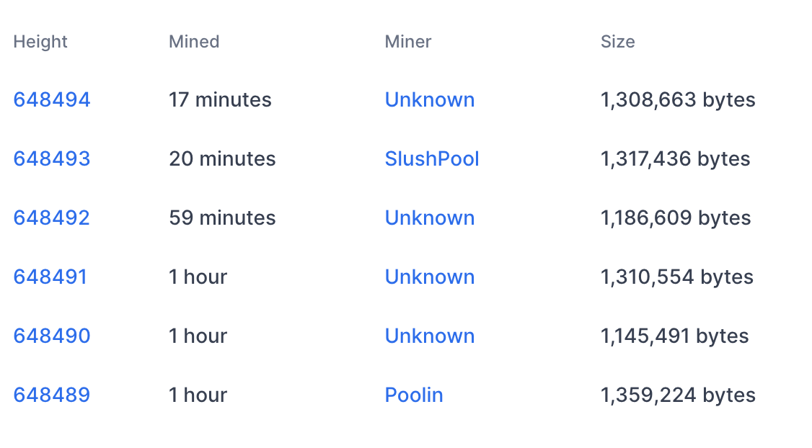
An example
Tx data
#Tx
1855
2826
1128
2774
2075
2622

Slide 23
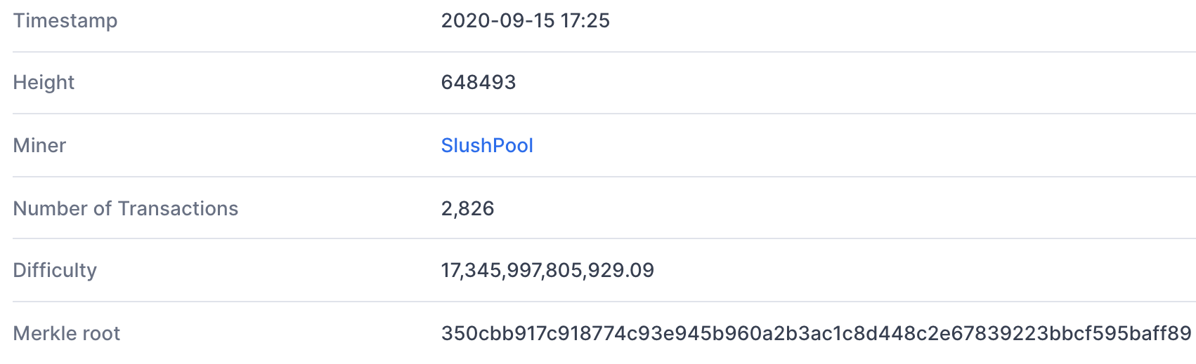
Block 648493
(from coinbase Tx)
(D)
(adjusts every two weeks)
(Tx fees given to miner in coinbase Tx)

Slide 24
This lecture: Transactions and their crypto
View the blockchain as a sequence of Tx (append-only)
…
Valid tx?
coinbase Tx

Slide 25
A simple account transaction model
Tx: Send 2 from A to B
Sig: $σ_{A}$
Account A: 3,$Y_{A}$
Account B: 4, $Y_{B}$
Transaction validity:
Validity of signature (under $Y_{A}$)
Transacted amount less than than sender balance
Account C: 5, $Y_{C}$

Slide 26
A simple account transaction model
Tx: Send 2 from A to B
Sig: $σ_{A}$
Account A: 3 1,$Y_{A}$
Account B: 4 6, $Y_{B}$
Transaction validity:
Validity of signature (under $Y_{A}$)
Transacted amount less than than sender balance
Requires knowing all balances
Account C: 5, $Y_{C}$

Slide 27
Nodes verify all blocks/all tx
blockchain
signed
I am the leader
6.25 BTC
sk_{A}
verify
block
verify
block
sk_{B}
sk_{C}
Requires large memory

Slide 28
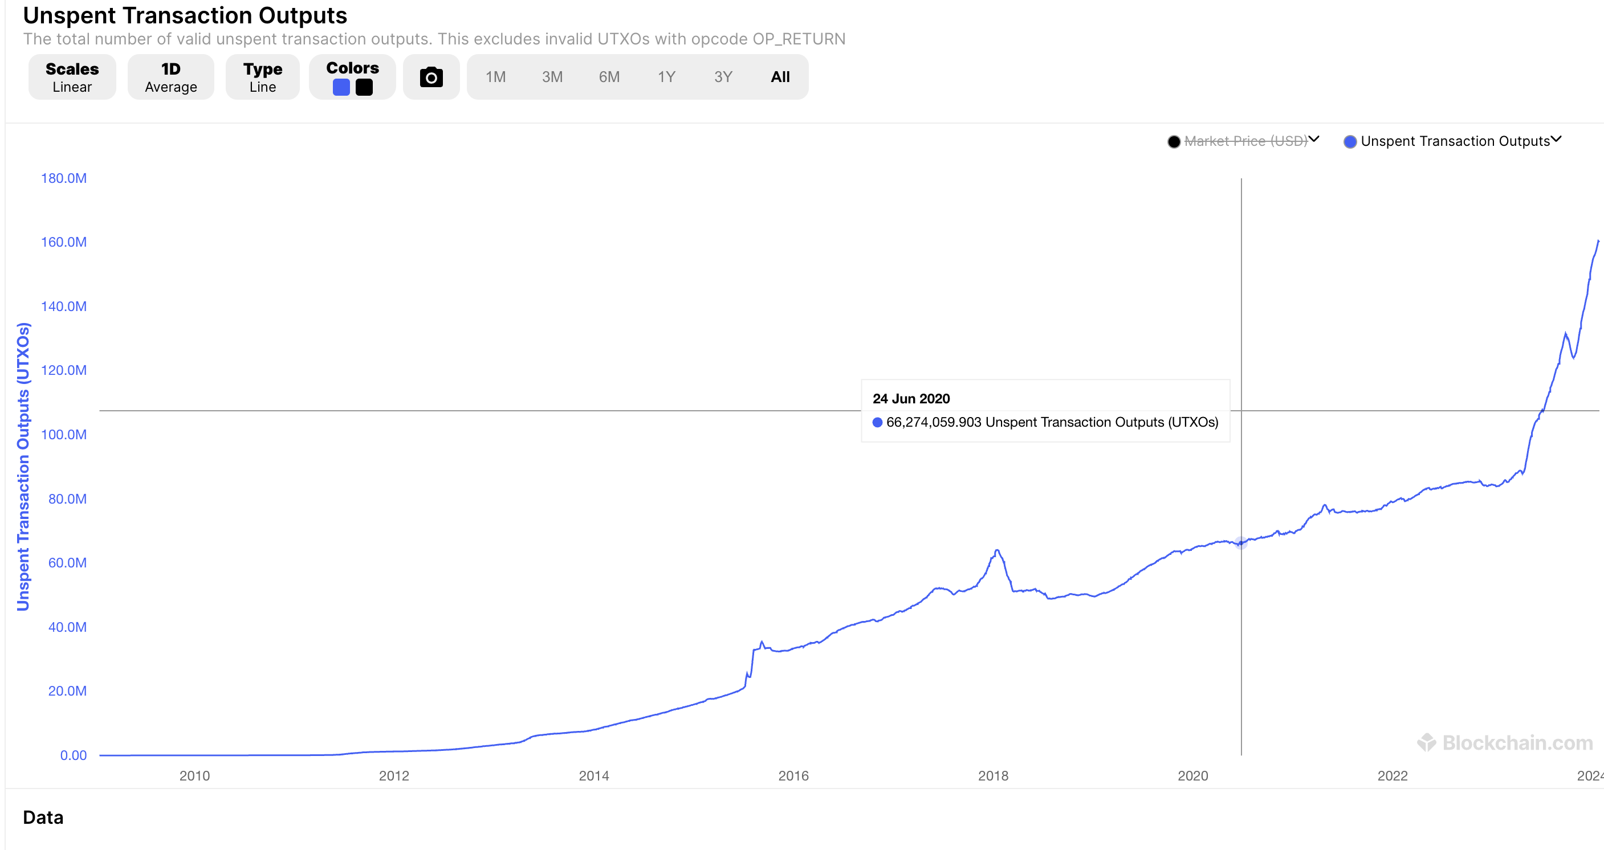
Blockchain State: A Growing Problem
~10GB for Bitcoin, >200GB for ETH
Notes:
We heard a talk this morning on UTXO dust

Slide 29
The Proof Paradigm
Data
Large & revealing
Proof protocol
Verify protocol
Data
Small & private
Data

Slide 30
Idea: State commitment
Commitment of state
Attaches proof “tx uses correct state”
$$π$$

Slide 31
Idea: State commitment
Checks proof + tx
Commitment of state
$$π$$
Commitment can be very small!
Each TX has additional proof

Slide 32
Merkle Tree State Commitment
Tx: Send 2 from A to B
Sig: $σ_{A}$
Merkle Proof that ($3,Y_{A})∈rt$
State commitment rt
(added to blockheader)
Merkle tree
Transaction validity:
Validity of signature (under $Y_{A}$)
Transacted amount less than than sender balance
Check that balance, pk in rt using Merkle Proof
Acc₁ Acc₂ … Acc_{n}

Slide 33
Merkle Tree State Commitment
State commitment
(added to each blockheader)
New State
Merkle tree
Merkle tree
Transactions
Acc₁ Acc₂ … Acc_{n}
Acc’₁ Acc’₂ … Acc’_{n}

Slide 34
Merkle tree: Inclusion proof
commitment
$$h$$
To prove ${S\left[4\right]= m}_{4}$ ,
proof $π= \left(m_{3}, y_{1}, y_{6}\right)$
$$y_{5}$$
H
$$y_{6}$$
H
H
Bob does:
$y2 ⇽ H(m3,m4)$
$$y5 ⇽ H(y1, y2)$$
$$h’ ⇽ H(y5, y6)$$
accept if $h=h’$
$$y1$$
$$y_{2}$$
$$y_{3}$$
$$y_{4}$$
H
H
H
H
$$m1$$
$$m_{2}$$
$$m_{3}$$
$$m_{4}$$
$$m_{5}$$
$$m_{6}$$
$$m_{7}$$
$$m_{8}$$
list of values S

Slide 35
Merkle tree: Update
commitment
$$h′$$
To update ${S\left[4\right]= m′}_{4}$ ,
use proof $π= \left(m_{3}, y_{1}, y_{6}\right)$
$${y′}_{5}$$
H
$$y_{6}$$
H
H
Update MT($m_{4}^{′},π)$:
$y′2 ⇽ H(m3,m′4)$
$$y′5 ⇽ H(y1, y′2)$$
$$h’ ⇽ H(y′5, y6)$$
return $h’$
$$y1$$
$${y′}_{2}$$
$$y_{3}$$
$$y_{4}$$
H
H
H
H
$$m1$$
$$m_{2}$$
$$m_{3}$$
$${m′}_{4}$$
$$m_{5}$$
$$m_{6}$$
$$m_{7}$$
$$m_{8}$$
list of values S
Append in homework!

Slide 36
Issues with simple Merkle Trees
What if MT contains two accounts with the same public key?
Not a big issue for transfers but very problematic if account represents program (smart contract)
No exclusion proofs (showing an account does not exist)

Slide 37
Key Value commitment
Let $K=\{k_{1}→v_{1},k_{2}→v_{2},…\}$ be a key value map with unique keys
A key value commitment consists of the following algorithms
Commit($K)→cm$
Prove ($K,k^{∗})→π$
Verify $\left(cm,k^{∗},v,π\right)→accept/reject$
Update$\left(cm,k^{∗},v,v^{′},π\right)→cm′$
Security:
Verify $\left(cm,k^{∗},v,π\right)=\text{Verify} \left(cm,k^{∗},v′,π\right)=accept$
Implies $v=v′$

Slide 38
Key Value Tree from Merkle Trees
Imagine a MT with $2^{256}$ entries.
Map every key to an index using Hash function
Implements key value map
Problem: Can’t be constructed
Idea: tree is very sparse (cut off unsued branches)

Slide 39
Merkle Patricia Tree
Special value $⊥$
Denotes no leaves beyond node
Inclusion proofs as before ($λ$ in length)
Exclusion proofs: Show $⊥$ at position
Update: Possibly insert nodes
commitment
$$h′$$
$${y′}_{5}$$
H
$$y_{6}$$
H
$$⊥$$
$$y1$$
$${y′}_{2}$$
Used in Ethereum
Problem: $>1kb$ proofs
H
H
$$m1$$
$$m_{2}$$
$$⊥$$
$${m′}_{4}$$
Sparse list of values S

Slide 40
Simplified Bitcoin UTXO model
☓
Simplified Bitcoin transactions
State:
Coin₁ : {PK: y₁, Value: 13}
Coin₂ : {y₂, 7}
Coin_{i}
Coin_{j}
Coin_{j+1}
Added
Tx:
Coin₂
sig
Coin_{new,j} :{y_{j},3}
Coin_{new,j+1}:{y_{j+1},4}
Spent
Created
Created

Slide 41
An example (block 648493) [2826 Tx]
Tx0
6.25 + Tx fees =
input
(input UTXO value)
Tx1
outputs
(Tx fee)
Tx2
(Tx fee)
sum of fees in block added to coinbase Tx
Notes:
Fees: Tx1 0.00005 BTC ≈ .5$,
Fees: Tx2 0.002 BTC ≈ 20$.
Low Tx fee in Tx means Tx will remain unconfirmed (sit in mempool).
To frontrun a Tx: submit a Tx with a higher Tx fee.

Slide 42
UTXO Set Accumulators
Set S={$utxo_{1},utxo_{2},…\}$
Transaction validity checks $utxo_{i}∈S$
Accumulator:
Commit(S)$→cm$
ProveIn ($cm,S,x)→π_{I}$ //If $x∈S$
ProveEx ($cm,S,x)→π_{E}$//If $x∉S$
Verify($cm,x,π,In/Ex)→accept/reject$
Security: Can’t generate $π_{I},π_{E}, s.t.$
Verify($cm,x,π_{I},In)=$Verify($cm,x,π_{E},Ex)$

Slide 43
RSA Accumulators [CL02, LiLiXue07,BBF19]
Setup:
Choose N=pq where p, q are secret primes
$H$: Hash function to primes in [0, $2^{λ}$]
$A_{0}=g∈Z_{N}$ (initial state)
Taking roots in $Z_{N}$ is hard
Add($A_{i},x$)
$A_{i+1}=A_{i}^{H(x)}$
Del($A_{i},x$)
$A_{i+1}=A_{i}^{1/H(x)}$
State after set S added:
u= $\prod_{s∈S}{s}$
$$A_{t}=g^{u}$$
Notes:
We’ll omit H

Slide 44
Accumulator Proofs
InclusionProof(A,x):
$π=A^{\frac{1}{x}}∈𝔾$
Computed using trapdoor(p,q) Or $O(\left|S\right|)$
Verify($A,x,π$)
$π^{x}=A$
Exclusion($A,x$)
$A=g^{u}$
$a⋅x+b⋅u=gcd⁡(x,u$)=1
$π={(g}^{a}, b)⇒$ Verify $π_{}^{x}⋅A^{b}=g$
Efficient stateless updates to (non)-membership witnesses:
[LiLiXue07]

Slide 45
RSA Acc Security
Accumulator $A∈Z_{N}$, element $x∈Primes[λ]$
Inclusion proof: $π_{I},s.t. π_{I}^{x}=A$
Exclusion proof: $(U=g^{a},b)$, s.t. $U^{x}⋅A^{b}=g$
Implies $U^{x}⋅π_{I}^{x⋅b}=g→U⋅π_{I}^{b}$ is $x$th root of g.
But taking roots is hard -> contradiction!

Slide 46
Aggregating membership witnesses
$$π_{I}$$
$${π′}_{I}$$
$${π′′}_{I}$$
UTXO accumulator
Normally: k transactions k proofs

Slide 47
Aggregating membership witnesses
$$π_{I}$$
$$π_{I}^{A}$$
$${π′}_{I}$$
$${π′′}_{I}$$
UTXO accumulator
Aggregate proofs into one: Saves space

Slide 48
Aggregate Membership Witnesses
$Shamir^{′}s Trick$:
$$a⋅x+b⋅y=1$$
$$π_{1,2}=π_{1}^{b}π_{2}^{a}$$
$$π_{1}^{x}=A,π_{2}^{y}=A$$
$$π_{1,2}^{x⋅y}=A$$
All membership witnesses per transaction block: ~3000 bits
Notes:
Remember if merkle trees than 160gb

Slide 49
Stateless Deletion
Delete with trapdoor($A_{t},x$):
$A_{t+1}=A_{t}^{\frac{1}{x}}$
Delete with inclusion proof($A_{t},x,π$)
$A_{t+1}=π$;
BatchDelete($A_{t},x,y,π_{1},π_{2}$)
Compute $π_{1,2}$ s.t. $π_{1,2}^{x⋅y}=A_{t}$
$A_{t+1}=π_{1,2}$
Using knowledge of p, q
$$π=g^{\frac{u}{x}}$$
No State,
no Trapdoor,
asynchronous
Notes:
Unclear

Slide 50
Much more accumulators
Many more accumulator and list commitment constructions
E.g. from polynomial commitments (later lectures)
Active research area

Slide 51
END OF LECTURE
Next lecture: Consensus, aggregate signatures, VID

