Slide 1
Bulletproofs
Short Proofs for Confidential Transactions and More
Benedikt Bünz, Jonathan Bootle, Dan Boneh,
Andrew Poelstra, Pieter Wuille, Greg Maxwell

Slide 2
Stanford Blockchain Conference (Formerly BPASE)
Conference: Jan. 30 - Feb 1, 2019. (three days)
Only academic submissions
Submission: October 16th, 2018
https://cyber.stanford.edu/sbc19
Videos: https://tinyurl.com/bpasevideos
Part of the Stanford Center for Blockchain Research (https://cbr.stanford.edu)

Slide 3
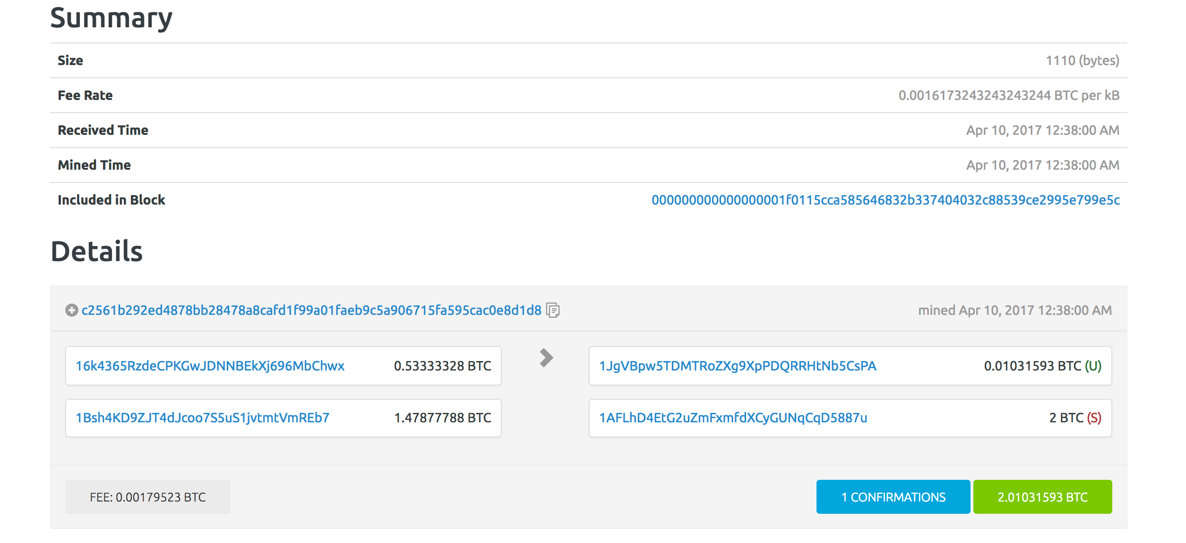
Bitcoin Transactions
2+0.0103≤ 0.5333+1.478

Slide 4
Validity of a Bitcoin transaction
Signature Is Correct
Inputs are unspent
∑ (input values) = ∑ (output values) + fee

Slide 5
Bitcoin is neither confidential or anonymous

Slide 6
Transaction amounts available in the clear
Everyone can see the payer, payee, and value
Business implications:
Company pays employees in Bitcoin ⇒ all salaries are public
Public supply chain prices:
How much does Ford pay its supplier for tires?

Slide 7
Confidential Transactions
∑ (input values) = ∑ (output values) + fee
Outputs positive?
g⁵³³h^{r1}
g¹⁰h^{r3}
g¹⁴⁷⁸h^{r2}
g²⁰⁰⁰h^{r4}
Pedersen commitment:
Commit(x;r)=g^{x}h^{r}
1
Notes:
Fee still public

Slide 8
Confidential Transactions [Maxwell 2016]
Confidential Transactions are structured like Bitcoin transactions
Transaction amounts are hidden
Compatible with Bitcoin
Transaction graph is still public
Public verifiability of transaction validity

Slide 9
Zero Knowledge Proof of Knowledge
No idea what $x$ is
But it’s positive and Peggy must know it
aka. Range Proof $x∈[{0,2}^{52}−1]$
“c$=g^{x}h^{r}$ is a commitment to a positive number $x$”
“Prove it”
Peggy
Challenge
Victor
Response

Slide 10
Non-Interactive Zero Knowledge Proof of Knowledge (NIZK)
CRS
c$,π$
Peggy creates $π$
Using $x,r,c =g^{x}h^{r}$
Victor checks $π$
for c and is convinced that $x$
is positive

Slide 11
Zerocash (BCGGMTV14)
Zerocash Spend:
“I know two Merkle tree path to two unspent coin and here is are two new coins such that ∑ old coins= ∑ new coins”
Hides sender, receiver and amounts!
Commit( )

Slide 12
Concrete Range Proof using bit commitments
$c_{i}=commit\left(b_{i},r_{i}\right)∧x=\sum_{i−0}^{n−1}{b_{i}∗2^{i}}∧b_{i}∈[0,1]$
$c,c_{0},…,c_{n−1} π$
$$x=\left(b_{0},…,b_{n−1}\right), b_{i}∈\left[0,1\right]$$
$$r_{i}←ℤ_{q}∀ i∈[0,n−1]$$
$$c_{i}=commit\left(b_{i};r_{i}\right)∀ i∈[0,n−1]$$

Slide 13
Current linear-size range proofs using $Σ$-protocols
Based on Sigma-Protocols with Fiat-Shamir heuristic
Recent optimizations by Poelstra et al. 17 2x improvement
4kb for 64bit range proof
Linear in the bit-length of range
No trusted setup

Slide 14
Preprocessing SNARKs with Trusted Setup
Groth10
BCCT
GGPR
BCIOP
Groth16
Encrypted
Queries
Short
Encrypted
Answers
Setup slow
Computes s$hort π$
Verify $π$
Using encrypted
answers
Compressed response: $π$
Proving slow
Verification fast

Slide 15
Preprocessing SNARK: Malicious Setup
Encrypted
Queries
Short
Encrypted
Answers
Can create cheating proofs
Computes s$hort π$
Verify $π$
Using encrypted
answers
Compressed response: $π$

Slide 16
The problems with trusted setup in cryptocurrencies
If subverted prover can create fake proofs
Undetectable subversion -> Undetectable inflation
Even the fear of undetectable inflation is dangerous
Can be alleviated through distributed setup
Expensive and difficult but done for ZCash
Low flexibility: New functionality-> New setup
HAWK: Every smart contract has a new setup

Slide 17
Bulletproofs
Builds on [Bootle, Cerulli, Chaidos, Groth and Petit 16]
No trusted setup
Only discrete log assumption
Uses an improved inner product argument
$P=Hash(\vec{a}||\vec{b}||c)$
Argument that $⟨\vec{a},\vec{b}⟩=c$
$2\log{n}$ elements for $n=\left|\vec{a}\right|=|\vec{b}|$, BCCGP16 was $6\log_{2}{n}$
Verification is 1 multi-exponentiation of size $2(n+\log_{2}{n})$
Proofs on committed values (Important for range proofs)
MPC for proof creation
Batched verification
$2\log_{2}{(n)}+9$ elements for the range proof (n: bit’s in range)
$2\log_{2}{(n)}+13$ elements for arithmetic circuit proof (n: multiplication gates)

Slide 18
Bulletproofs proof size (1 Range Proof)

Slide 19
Bulletproofs proof size (2 Proofs)

Slide 20
Bulletproofs proof size (10 Proofs)

Slide 21
Proof size for circuits vs. SNARKs/STARKs
ZCash new circuit
Verification ~10x slower

Slide 22
Comparing Proof Systems
 | Bulletproofs | $Σ$Protocols | STARKs | SNARKs
Pros: | 1-2kb proofs (log growth) No trusted setup. Batch verification | Simple Proofs for discrete log setting | log^2 proof size and verification time. No trusted setup Only Hashes | Constant proof size Constant verification time
Cons: | Linear Verification time Public Key crypto | Linear Proof size/Verification time | Large prover, Proof sizes in >100kb | Trusted setup, Strong assumptions
The tradeoff space is large and there are many more points in it:
Hyrax, vSQL, Ligero…

Slide 23
Improving Verification
1 Big Multiexponentiation
$$\prod_{i=1}^{n}{g_{i}^{l_{i}}}h_{i}^{r_{i}}\prod_{j=1}^{\log_{2}{n}}{L_{i}^{x^{2}}}R_{i}^{x^{−2}}=1$$

Slide 24
Batch Verification (Bellare, Garray, Rabin 98)
Verifying 2 Proofs: 2 Multiexponentiations
$$A=\prod_{i=1}^{n}{g_{i}^{l_{i}}}h_{i}^{r_{i}}\prod_{j=1}^{\log_{2}{n}}{L_{i}^{x^{2}}}R_{i}^{x^{−2}}=1$$
$$B=\prod_{i=1}^{n}{g_{i}^{l_{i}^{′}}}h_{i}^{r_{i}^{′}}\prod_{j=1}^{\log_{2}{n}}{{L_{i}^{′}}_{}^{{x^{′}}^{2}}}{R_{i}^{′}}_{}^{x^{′ −2}}=1$$
Verify $A=1∧B=1$
Sample $α$ from large space
$$A⋅B^{α}=1$$
1 Big Multiexponentiation
$$\prod_{i=1}^{n}{g_{i}^{l_{i}+α l_{i}^{′}}}h_{i}^{r_{i}+r_{i}^{′}}\prod_{j=1}^{\log_{2}{n}}{L_{i}^{x^{2}}}R_{i}^{x^{−2}}{L_{i}^{′}}^{{{αx}^{′}}^{2}}{R_{i}^{′}}_{}^{{{αx}^{′}}^{−2}}=1$$
6.2 ms first verification + 550 $μ$s for each additional proof
Fixed in CRS
Proof dependent

Slide 25
Non-Interactive Zero Knowledge Proof of Knowledge (NIZK)
$c_{1},c_{2},c_{3}$ are commitments to values in some range
$$π$$
Peggies create $π$ without having to reveal secrets to each other
Victor checks small $π$
Trivial solution:
Concatenate proofs

Slide 26
Bulletproofs MPC
Custom MPC to generate proofs
Works if circuits are disjoint, e.g. n range proofs for n provers
Simply aggregate proofs in each round and compute Fiat-Shamir challenge
Either log(n) rounds and log(n) communication
Or 3 rounds and linear O(n) communication

Slide 27
Construction

Slide 28
Bulletproof tools: Vector commitments/Peddersen Hash
Commit: $ℤ_{p}^{n}×ℤ_{p}^{}→G$
Commit(x;r)=$g_{1}^{x_{1}}g_{2}^{x_{2}}…g_{n}^{x_{n}}h^{r}$,
$g_{1},g_{2},…,g_{n},h$ independent and random
Perfectly hiding
Binding under the discrete log assumption
As Hash function H(x)=$g_{1}^{x_{1}}g_{2}^{x_{2}}…g_{n}^{x_{n}}$

Slide 29
Improved inner product argument
Statement: For $P∈G ∃\vec{a},\vec{b} s.t. \left|\vec{a}\right|=\left|\vec{b}\right|=n∧P=H(\vec{a},\vec{b},⟨\vec{a},\vec{b}⟩$)
$P=H( , , )$
$$\vec{a}$$
$$\vec{b}$$
$$⟨\vec{a} ,\vec{b}⟩$$
$$P=H( , , + )$$
$${\vec{a}}_{L}$$
$${\vec{a}}_{R}$$
$${\vec{b}}_{L}$$
$${\vec{b}}_{R}$$
$$⟨{\vec{a}}_{L},{\vec{b}}_{L}⟩$$
$$⟨{\vec{a}}_{R},{\vec{b}}_{R}⟩$$
$$L=H( , , )$$
$$\vec{0}$$
$${\vec{a}}_{L}$$
$${\vec{b}}_{R}$$
$$\vec{0}$$
$$⟨{\vec{a}}_{L},{\vec{b}}_{R}⟩$$
$$R=H( , , )$$
$${\vec{a}}_{R}$$
$$\vec{0}$$
$$\vec{0}$$
$${\vec{b}}_{L}$$
$$⟨{\vec{a}}_{R},{\vec{b}}_{L}⟩$$

Slide 30
Improved inner product argument
$$P=H( , , + )$$
$${\vec{a}}_{L}$$
$${\vec{a}}_{R}$$
$${\vec{b}}_{L}$$
$${\vec{b}}_{R}$$
$$⟨{\vec{a}}_{L},{\vec{b}}_{L}⟩$$
$$⟨{\vec{a}}_{R},{\vec{b}}_{R}⟩$$
$$L=H( , , )$$
Communication:
n+2 vs. 2n
Recurse for
$$2\log_{2}{n}+2$$
$$\vec{0}$$
$${\vec{a}}_{L}$$
$${\vec{b}}_{R}$$
$$\vec{0}$$
$$⟨{\vec{a}}_{L},{\vec{b}}_{R}⟩$$
$$R=H( , , )$$
$${\vec{a}}_{R}$$
$$\vec{0}$$
$$\vec{0}$$
$${\vec{b}}_{L}$$
$$⟨{\vec{a}}_{R},{\vec{b}}_{L}⟩$$
$$x←ℤ_{p}$$
$=x⋅ +x^{−1}⋅$
$$\vec{a′}$$
$${\vec{a}}_{L}$$
$${\vec{a}}_{R}$$
Verification: linear
$=x⋅ +x^{−1}⋅$
$$\vec{b′}$$
$${\vec{b}}_{R}$$
$${\vec{b}}_{L}$$
$$L^{x^{2}}PR^{x^{−2}}=^{?} H(x^{−1}⋅ , x⋅ ,x⋅ , x^{−1} , )$$
$$\vec{a′}$$
$$\vec{a′}$$
$$\vec{b′}$$
$$\vec{b′}$$
$$⟨\vec{a^{′}} ,\vec{b′}⟩$$
$$H′( , , )=H(x^{−1} ,x ,x ,x^{−1} , )$$
$$\vec{a′}$$
$$\vec{b′}$$
$$⟨\vec{a^{′}} ,\vec{b′}⟩$$
$$\vec{a′}$$
$$\vec{a′}$$
$$\vec{b′}$$
$$\vec{b′}$$
$$⟨\vec{a^{′}} ,\vec{b′}⟩$$

Slide 31
Using the inner product argument (Range proof)
$$C=g^{v}h^{r}, v∈[{0,2}^{n}−1]$$
$$v=\sum_{i=0}^{n−1}{a_{i}⋅2^{i}},a_{i}∈\{0,1\}$$
$$v=⟨\vec{a},\vec{2}⟩$$
$$\vec{2}=(1,2,4,…,2^{n−1})$$
Use linearity of commitment scheme
$$∀ a_{i}, a_{i}∈\{0,1\}$$
$$\vec{a}∘(\vec{a}−\vec{1})=\vec{0}$$
$$⟨\vec{a},\vec{y}∘\left(\vec{a}−\vec{1}\right)⟩=0$$
$$\vec{y}=(1,y,y^{2},…,y^{n−1})$$
Random challenge y

Slide 32
Applications

Slide 33
Bulletproofs for Confidential Transactions/Mimblewimble
670 bytes instead of 4 KB per range proof (64 bit range)
Aggregation: Two range proofs 736 bytes vs. 8 KB
16 range proofs 928 bytes vs. 61KB
Doubling precision adds 64 bytes
UTXO set/Mimblewimble size: 17 GB vs 160 GB
Built in: simple CoinJoin protocol for combining confidential transactions

Slide 34
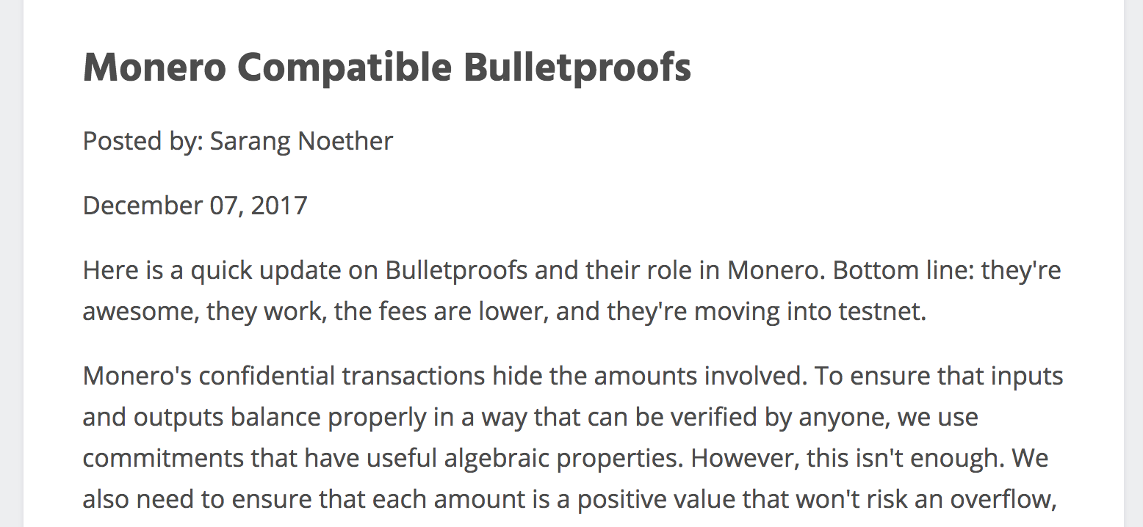
Bulletproofs for Monero Confidential Transactions
Show Quote

Slide 35
Bulletproofs for Solvency Proofs (Dagher et al. 15)
With Bulletproofs:
62 MB instead of 18GB

Slide 36
Bulletproofs for Verifiable Shuffles
n NIZKs that inputs and outputs are the same
Bulletproofs:
First log(n) verifiable shuffle without trusted setup

Slide 37
Bulletproofs for Smart Contracts
Short proofs for arbitrary computation (like SNARKs)
No trusted setup
Easy to adapt for arbitrary computation
BUT: verification is linear
Verifying Zcash transaction$≈$Generating Zcash
Problem for slow Smart contracts
Refereed delegation model

Slide 38
Refereed model
[Canetti,Riva, Rothblum, 2011]
$$π$$
V₁
V₂
V₃
...
V_{n/2}
...
V_{n}
0,1
Send to Smart Contract: $π$,V_{n/2}
Challenge protocol:
Prover claims $π$ is correct, i.e. V($π$)=1
Lay out verification circuit and name the ith gate V_{i}
Challenger claims $π$is invalid
Binary search to find divergence point
Smart verifies final gate
Cost:
lg t round
lg t communication, 1 gate computation

Slide 39
Bulletproofs Implementation
Integration into libsecp256k1 (Bitcoin library)
Constant time prover
Optimized verifier
Multiple other implementations (Java, Rust …)
Rust implementation by Chain: Even faster using Curve25519 and AVX2

Slide 40
Notes:
3.7 ms and 450mus

Slide 41
Notes:
3.7 ms and 450mus

Slide 42
Notes:
3.7 ms and 450mus

Slide 43
ZCash estimates on 2GHZ single threaded machine:
Proving: 30s
Verification 1s+100ms * #transactions
Proof size: ~1.3kb
Probably more improvements possible
Notes:
3.7 ms and 450mus

Slide 44
Thank you!
https://crypto.stanford.edu/bulletproofs
https://crypto.stanford.edu/~buenz

