Slide 1

Online Algorithms using Samples
(a biased sample)
Anupam Gupta (NYU)

Slide 2
analysis of algorithms
Ideally: want to get algorithms that are good for
worst-case and best-case and …. all cases.
Worst-case: robustness when data is unpredictable
Best-case: efficiency when data follows anticipated patterns
How to model these?
let’s see glimpse of ideas/techniques in context of online algos

Slide 3
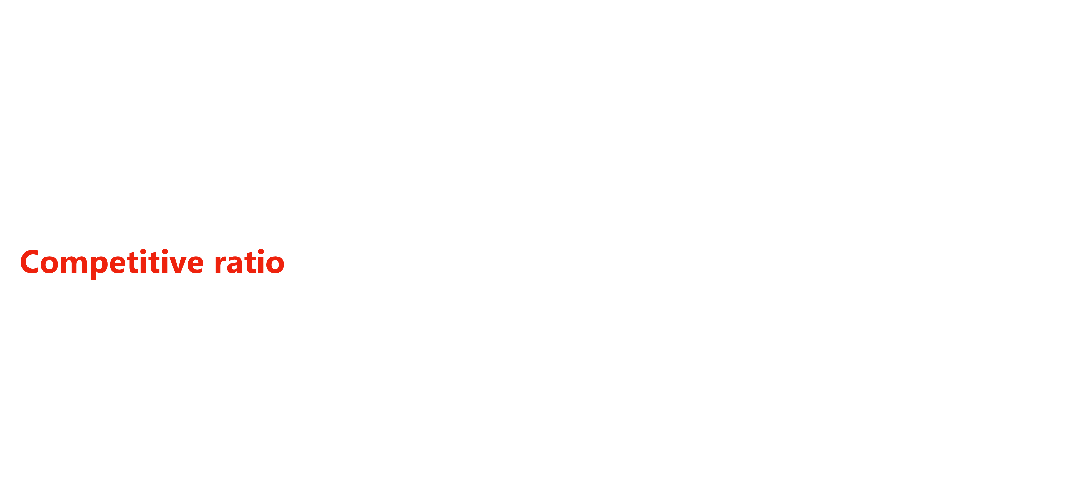
Online Algorithms
[Graham 66, Sleator Tarjan 85]
Requests arrive over time, must be served immediately/irrevocably
Goal: (say) minimize cost of the decisions taken
Competitive ratio of algorithm $A$:
$\max_{ instances I}{ \frac{cost of algorithm A on instance I}{optimal cost to serve I}}$
Want to minimize the competitive ratio.
worst case!

Slide 4

Online Load Balancing
[Azar Naor Rom FOCS 92]
$m$ machines. Jobs arrive over time, can be assigned to subset of machines.
Goal: minimize maximum load of machines

Slide 5
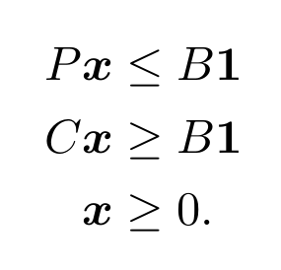
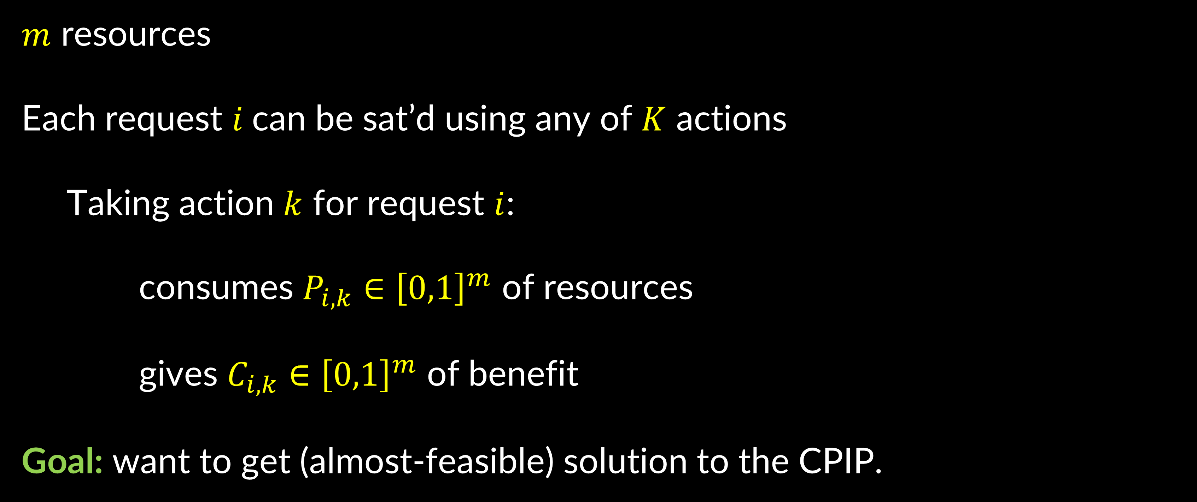
Online Packing-Covering
[Awerbuch Azar Plotkin FOCS 93]
$m$ resources
Each request $i$can be sat’d using any of $K$ actions
Taking action $k$ for request $i$:
consumes $P_{i,k}∈{\left[0,1\right]}^{m}$ of resources
gives $C_{i,k}∈{\left[0,1\right]}^{m}$ of benefit
Goal: want to get (almost-feasible) solution to the CPIP.

Slide 6






the price of uncertainty
Offline
Online
Steiner tree
Facility location
$$O(1)$$
$$\tilde{Θ}(\log{n})$$
Load Balancing
(related m/c)
$$1$$
$$Θ(\log{m})$$
$$(1+ε)$$
if $B=Ω(log m/ε^{2})$
CPIPs
$$Ω(\log{m})$$

Slide 7

Model: Online with a Sample
recent interest in using (machine learned) predictions
Question: where do predictions come from?
Answer #1: instances i.i.d. from some distribution $𝒟$
then use PAC learning to obtain predictions
Answer #2: online with a sample
Adversary fixes an instance $I$.
Today see $p$-sample $S$ from $I$, see rest of instance tomorrow.
no distributional assumptions on the instance itself
[Campbell Samuels 1981]
[P. Azar Kleinberg Weinberg SODA 2014]
[Kaplan Naori Raz 2019]

Slide 8


A Learning Viewpoint
The sample $S$ is “training data”
learn a good strategy using this training data
Use it on the “test data” $I∖S$.
Does the strategy generalize?

Slide 9


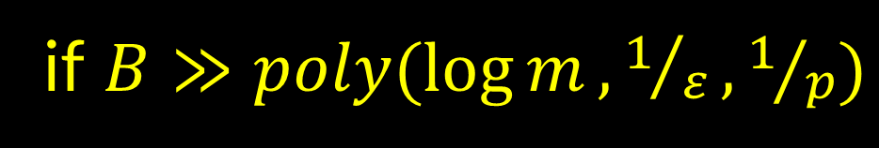


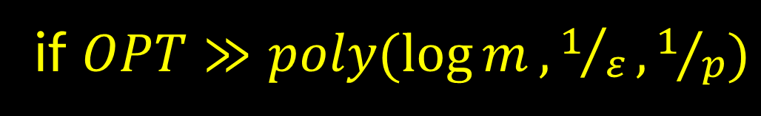
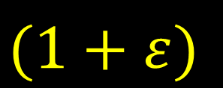

some results
Offline
Online
OwaS
Load Balancing
(related m/c)
$$1$$
$$Θ(\log{m})$$
$$(1+ε)$$
[Argue Frieze
G. Seiler
Neurips 22]
if $OPT≫poly(\log{m},1/ε,1/p)$
$$(1+ε)$$
if $B=Ω(log m/ε^{2})$
$(1+ε)$-feasible
CPIPs
$$Ω(\log{m})$$
[G. Molinaro
SODA 26]
if $B≫poly(\log{m},1/ε,1/p)$

Slide 10
Load Balancing

Slide 11



load balancing (parallel machines, unit sizes)
$m$ (identical) machines
job $j$arrives online
must assign job $j$ to some “valid” machine
Load of machine $i$ = number of jobs assigned to it
Goal: minimize maximum load over all machines
Thm 1: Greedy is $O\left(\log{m}\right)$ competitive algorithm.
[Azar Naor Rom 92]

Slide 12

load balancing (parallel machines, unit sizes)
$m$ (identical) machines
job $j$arrives online
must assign job $j$ to some “valid” machine
Load of machine $i$ = number of jobs assigned to it
Goal: minimize maximum load over all machines
Thm 1: Greedy is $O\left(\log{m}\right)$ competitive algorithm.
Thm 2: worst case $Ω\left(\log{m}\right)$ lower bound.
[Azar Naor Rom 92]

Slide 13
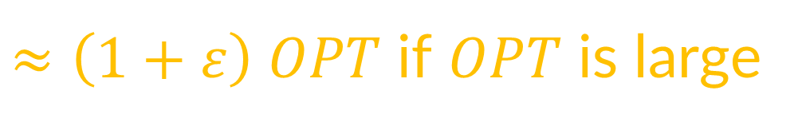
load balancing with sample
Recall model: online with a sample
Tomorrow: instance $I$ will arrive. Today: given epsilon (i.i.d.) sample from $I$.
Theorem: Can get load $\left(1+ε\right) OPT+1/ppoly\left(\frac{\log{m}}{ε}\right)$
$≈\left(1+ε\right) OPT$ if $OPT$ is large
Using Uniform convergence: load $\left(1+ε\right) OPT+1/ppoly\left(\frac{m}{ε}\right)$
explicitly learn a good strategy from samples!
Not possible with worst-case arrivals
[Argue Frieze G. Seiler Neurips 2022]

Slide 14



three algorithmic ideas
Fact 1: if OPT large, then integer assignment $≈$ fractional assignment
$$1/7$$
1
Chernoff bound
2
$$2/7$$
3
Theorem 2: Exist machine “weights” so that proportional assignment is $OPT+ε$
2
Convex duality
$$4/7$$
1
Theorem 3: Exists algorithm to find machine weights using small sample
4
1
5

Slide 15
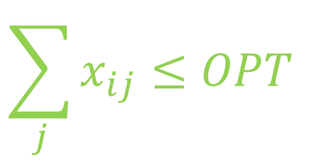




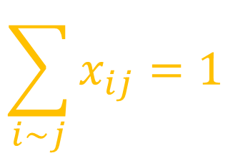

idea #1: convex opt
Theorem 2: Exist machine weights $\left(θ_{1},…, θ_{m}\right)$ so that proportional assignment is $OPT+ε$
$$\min{\sum_{ij}{x_{ij}}\log{x_{ij}}}$$
at optimality,
$x_{ij}=\frac{e^{μ_{i}}}{\sum_{k\sim j}{e^{μ_{k}}}}$ if $i\sim j$
$$\sum_{i\sim j}{x_{ij}}=1$$
$$=\frac{θ_{i}}{\sum_{k\sim j}{θ_{k}}}$$
$$\sum_{j}{x_{ij}}≤OPT$$
$$\sum_{j}{x_{ij}}≤OPT+ε$$
$$x_{ij}≥0$$
Lagrangian $ℒ=\sum_{ij}{x_{ij}}\log{x_{ij}}+\sum_{j}{λ_{j}} \left( \sum_{i}{x_{ij}} −1\right)+\sum_{i}{μ_{i}} \left(\sum_{j}{x_{ij}}−OPT\right)−\sum_{i,j}{ν_{ij}{ x}_{ij}}$
[Agrawal Mirrokni Zadimoghaddam ICML 18]

Slide 16


compute weights?
Theorem 3: Different algo to find machine weights $\left(θ_{1},…, θ_{m}\right)$ using small sample (offline!!)
Suppose we had entire instance!
1
1$−ε$
1
Algorithm: start with all weights 1
1
1
1
Compute machine loads on instance, w.r.t current weights
1
1
if exist machines with load $≫OPT$, reduce their weights by $\left(1−ε\right)$
1
1$−ε$
1
1
1
1
N.b. guarantee good load,
not necc good soln to convex program
1
1
[Argue Frieze G. Seiler Neurips 2022]

Slide 17
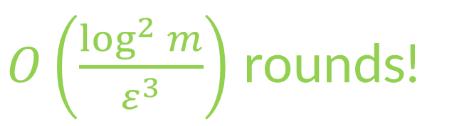
compute weights?
Theorem 3: Different algo to find machine weights $\left(θ_{1},…, θ_{m}\right)$ using small sample (offline!!)
Suppose we had entire instance!
1
1$−ε$
1
Algorithm: start with all weights 1
1
1
1
Compute machine loads on instance, w.r.t current weights
1
1
if exist machines with load $≫OPT$, reduce their weights by $\left(1−ε\right)$
1
1$−ε$
1
1
Does this terminate?
Yes, cute MW analysis!
1
1
$O\left(\frac{\log^{2}{m}}{ε^{3}}\right)$ rounds!
1
How many rounds do we need?
1
But don’t we need entire instance?!
Use samples to estimate loads!
[Argue Frieze G. Seiler Neurips 2022]

Slide 18

proof of termination
ALG
Lemma: algorithm terminates.
For simplicity: reduce if load > 2$OPT$, reduce weights by ½
OPT
Let optimal weights $θ^{∗}$ be powers of 2
Algo is invariant to scaling, so imagine we start with equal weights $≥θ_{\max{}}^{∗}$
[Lattanzi Lavastida Moseley Vassilvitskii SODA 20]

Slide 19


proof of termination
Lemma: algorithm terminates.
$$k$$
For simplicity: reduce if load > 2$OPT$, reduce weights by ½
Let optimal weights $θ^{∗}$ be powers of 2
Algo is invariant to scaling, so imagine we start with equal weights $≥θ_{\max{}}^{∗}$
Claim: $θ_{j}$ never dips below $θ_{j}^{∗}$ for all $j$
Proof: Suppose some $θ_{k}=θ_{k}^{∗}$, every other $θ_{j}≥θ_{j}^{∗}$.
By algo, $k$ receives less load than in OPT. So will never reduce $θ_{k}$. ☺
So finitely many iterations.
[Lattanzi Lavastida Moseley Vassilvitskii SODA 20]

Slide 20


compute weights?
Theorem 3: Different algo to find machine weights $\left(θ_{1},…, θ_{m}\right)$ using small sample (offline!!)
Suppose we had entire instance!
1$−ε$
Algorithm: start with all weights 1
1
1
Compute machine loads on instance, w.r.t current weights
1
if exist machines with load $≫OPT$, reduce their weights by $\left(1−ε\right)$
1$−ε$
1
Does this terminate?
Yes, cute MW analysis!
1
How many rounds do we need?
$O\left(\frac{\log^{2}{m}}{ε^{3}}\right)$ rounds!
1
But don’t we need entire instance?!
Use samples to estimate loads!

Slide 21



idea #2b: how many parallel rounds?
Expansion Lemma: Suppose $A(t)$ = #machines whose weights lowered at least $t$ times in $T$ rounds
Then $A\left(t+O(\log{m})\right)≤(1−ε) A(t)$
$$⇒ A\left(O(\log^{2}{m})\right)≤ 1/{2m} A(0)$$
$$≤ 1/{2m}⋅m<1$$
why is this good?

Slide 22
idea #2b: how many parallel rounds?
Expansion Lemma: Suppose $A(t)$ = #machines whose weights lowered at least $t$ times in $T$ rounds
Then $A\left(t+O(\log{m})\right)≤(1−ε) A(t)$
Monotonicity Fact:
(i) if machine weight not reduced at least once, load $≤$ $\left(1+2ε\right) OPT$ at all times after
(ii) if machine weight reduced at least once, load $≥$ $\left(1+ε\right) OPT$ at all times after
$⇒$ after $O\left(\log^{2}{m}\right)+1$ rounds, each weight not reduced at least once. So load is good.

Slide 23



proof of expansion lemma
Expansion Lemma: Suppose $A(t)$ = #machines whose weights lowered at least $t$ times in $T$ rounds
Then $A\left(t+O(\log{m})\right)≤(1−ε) A(t)$
weight $≤2^{−t−O(\log{m)}}=2^{−t}/poly(m)$
weight $≥2^{−t+1}$
B
weight $≤2^{−t}$
A

Slide 24



proof of expansion lemma
Expansion Lemma: Suppose $A(t)$ = #machines whose weights lowered at least $t$ times in $T$ rounds
Then $A\left(t+O(\log{m})\right)≤(1−ε) A(t)$
weights reduced at least once $⇒$ ALG load $≥\left(1+ε\right) OPT$
$⇒$ $≥\left(1+ε\right) OPT |B|$ jobs
all jobs loading machines in $B$
only see machines in $A∪B=A$
$⇒ ≤$ $|A| OPT$jobs
B
OPT load $≤$ OPT
A

Slide 25
compute weights?
Theorem 3: Different algo to find machine weights $\left(θ_{1},…, θ_{m}\right)$ using small sample (offline!!)
Suppose we had entire instance!
1$−ε$
Algorithm: start with all weights 1
1
1
Compute machine loads on instance, w.r.t current weights
1
if exist machines with load $≫OPT$, reduce their weights by $\left(1−ε\right)$
1$−ε$
1
Does this terminate?
Yes, cute MW analysis!
1
How many rounds do we need?
$O\left(\frac{\log^{2}{m}}{ε^{3}}\right)$ rounds!
1
But don’t we need entire instance?!
Use samples to estimate loads!

Slide 26

idea #3: estimate using the sample
Theorem 3: Algorithm to find machine weights $\left(θ_{1},…, θ_{m}\right)$ using small sample
Start with all weights 1
Break sample into $O\left(\frac{\log^{2}{m}}{ε^{3}}\right)$ chunks
Estimate machine loads w.r.t. current weights, using next chunk
calculate machine loads w.r.t. current weights
if exist machines with load $≫OPT$, reduce their weights by $\left(1+ε\right)$
Use these weights on actual instance

Slide 27

…which completes the proof
Fact 1: if OPT large, then integer $≈$ fractional assignment
Theorem 2: Exist machine weights so that proportional assignment is $OPT+ε$
Theorem 3: Algorithm to find machine weights using small sample
Theorem: load $\left(1+ε\right) OPT+1/ppoly\left(\frac{\log{m}}{ε}\right)$

Slide 28
Extending to
Covering/Packing
Problems

Slide 29
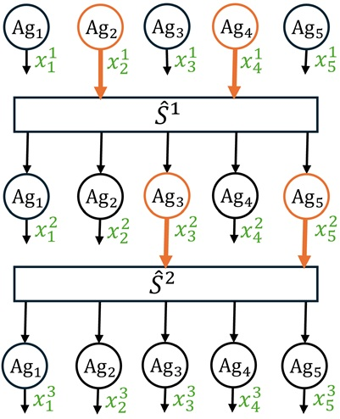

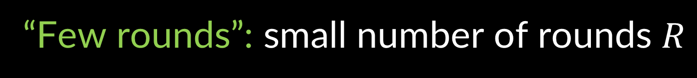


deeper connection to parallel algos
Consider parallel algo with form:
Local rounds: each agent does computation using private data
Global rounds: coordinator collects data from agents
L/G rounds alternate
“Few rounds”: small number of rounds $R$
“Sample robust”: coordinator can work
just using data of some random $q$ fraction of agents
sample $pR$ fraction of agents and simulate global coordinator
[G. Molinaro SODA 2026]

Slide 30
deeper connection to parallel algos
Consider parallel algo with form:
Local rounds: each agent does computation using private data
Global rounds: coordinator collects data from agents
L/G rounds alternate
“Few rounds”: small number of rounds $R$
“Sample robust”: coordinator can work
just using data of some random $q$ fraction of agents
sample $pR$ fraction of agents and simulate global coordinator
Run algo for each other agent as they come in
[G. Molinaro SODA 2026]

Slide 31
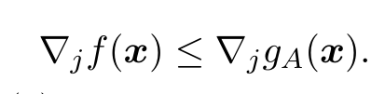


Young’s Parallel Algo for Packing/Covering
$$∃j$$
raise this coordinate $j$
it covers faster than it consumes packing resources
our contribution: implement in “sample-robust” “local-global” framework
[Young FOCS 01, G. Molinaro SODA 2026]

Slide 32
Comparison of two “parallel-based” ideas
both approaches uses low-depth parallel algorithms
approach #1: use samples to learn good model parameters (machine weights)
approach #2: use samples to implement “good” global actions
each agent then replays the transcript to implement its actions

Slide 33
some results
Offline
Online
OwaS
Load Balancing
(related m/c)
$$1$$
$$Θ(\log{m})$$
$$(1+ε)$$
[Argue Frieze
G. Seiler
Neurips 22]
if $OPT≫poly(\log{m},1/ε,1/p)$
$$(1+ε)$$
if $B=Ω(log m/ε^{2})$
$(1+ε)$-feasible
CPIPs
$$Ω(\log{m})$$
[G. Molinaro
SODA 26]
if $B≫poly(\log{m},1/ε,1/p)$

Slide 34
online with a sample
Given a sample of the instance, explicitly learn good strategy
Model makes less stochastic assumptions than random order, or IID
Open Questions: Can we use samples to get better algos for other problems?
other scheduling problems
network design: e.g., Steiner forest, 2-connectivity
optimal results for set cover
Thanks!

