Slide 1
Dynamic and Online Algorithms:
Anupam Gupta
Carnegie Mellon University
Based on joint works with:
Albert Gu, Guru Guruganesh, Ravishankar Krishnaswamy, Amit Kumar, Debmalya Panigrahi, Cliff Stein, and David Wajc

Slide 2
Dynamic (and) Online Algorithms: a little change will do you good
Anupam Gupta
Carnegie Mellon University
Based on joint works with:
Albert Gu, Guru Guruganesh, Ravishankar Krishnaswamy, Amit Kumar, Debmalya Panigrahi, Cliff Stein, and David Wajc

Slide 3
Dynamic Approximation Algorithms: a little change will do you good
Anupam Gupta
Carnegie Mellon University
Based on joint works with:
Albert Gu, Guru Guruganesh, Ravishankar Krishnaswamy, Amit Kumar, Debmalya Panigrahi, Cliff Stein, and David Wajc

Slide 4
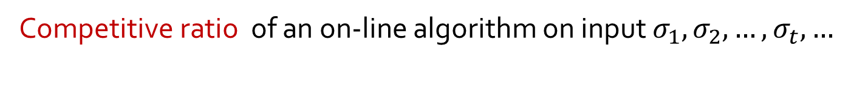
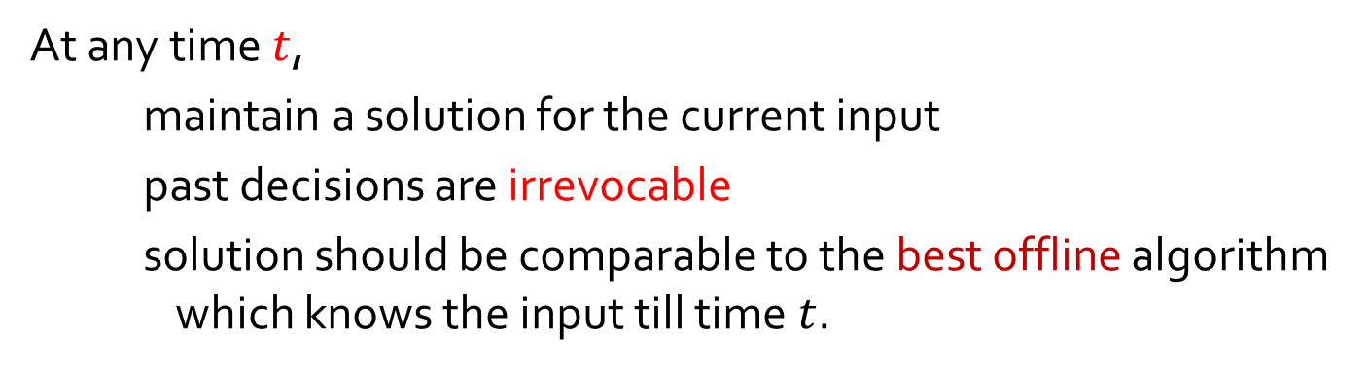
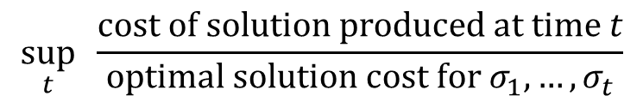
online algorithms and competitive analysis
At any time $t$,
maintain a solution for the current input
past decisions are irrevocable
solution should be comparable to the best offline algorithm which knows the input till time $t$.
Competitive ratio of an on-line algorithm on input $σ_{1}, σ_{2}, …, σ_{t}, …$
$$\sup_{t} \frac{\text{cost} \text{of} \text{solution} \text{produced} \text{at} \text{time} t}{\text{optimal} \text{solution} \text{cost} \text{for} σ_{1},…, σ_{t}}$$

Slide 5
problem 1: load balancing
At each time, a unit size job arrives – can be processed by a subset of machines.
Jobs already assigned cannot be reassigned to another machine.
Goal: Minimize the maximum load on any machine.

Slide 6
problem 1: load balancing
At each time, a unit size job arrives – can be processed by a subset of machines.
Jobs already assigned cannot be reassigned to another machine.
Goal: Minimize the maximum load on any machine.
Greedy has competitive ratio $Θ(log⁡m)$, where m = #machines. [Azar Naor Rom ’92]

Slide 7
problem 1b: edge orientation
Edges (say, of a tree) arrive online, must orient each arriving edge.
Minimize the maximum in-degree of any vertex.
Special case of load balancing, where each job can go to two machines.
Can make in-degree of one vertex $Ω(\log{m)}$. [Azar, Naor, Rom ‘92]

Slide 8
problem 1b: edge orientation
Edges (of a tree) arrive online, a solution should orient each arriving edge.
Minimize the maximum in-degree of any vertex.
A special case of load balancing, where each job can go to exactly two machines.
Can make in-degree of one vertex $Ω(\log{m)}$. [Azar, Naor, Rom ‘92]

Slide 9
problem 2: online spanning tree
v₁
v₀
v₄
v₃
v₂
Theorem: cost(Greedy tree) ≤ O(log $n$) × MST($v0, …, vn$) Matching lower bound of Ω(log $n$). [Imase Waxman ‘91]

Slide 10
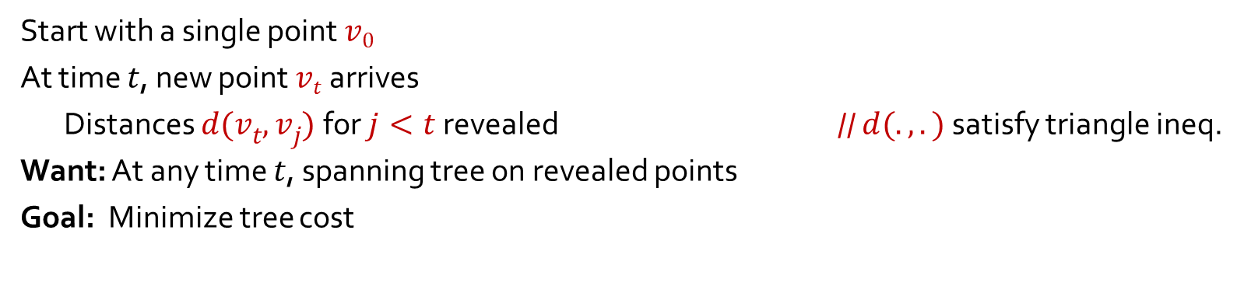
problem 2: online spanning tree
v₁
v₀
v₄
v₃
v₂
Start with a single point $v0$
At time $t$, new point $vt$ arrives
Distances $d(vt, vj)$for $j<t$revealed // $d(.,.)$satisfy triangle ineq.
Want: At any time $t$, spanning tree on revealed points
Goal: Minimize tree cost
Theorem: cost(Greedy tree) ≤ O(log $n$) × MST($v0, …, vn$) Matching lower bound of Ω(log $n$). [Imase Waxman ‘91]

Slide 11
problem 2: online spanning tree
Theorem: cost(Greedy tree) ≤ O(log $n$) × MST($v0, …, vn$) Matching lower bound of Ω(log $n$). [Imase Waxman ‘91]

Slide 12


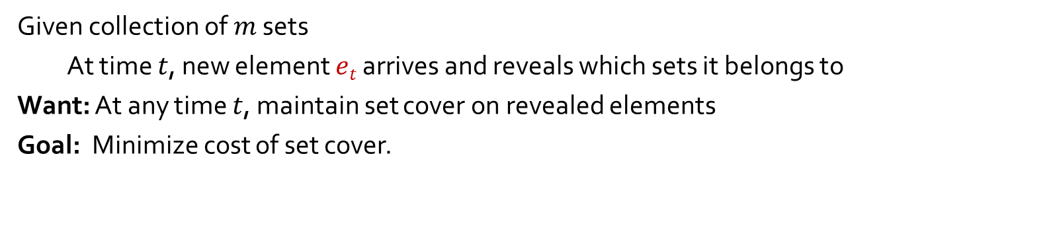



problem 3: set cover
$$e_{5}$$
$$e_{4}$$
$$e_{3}$$
$$e_{2}$$
$e_{1}$
Given collection of $m$ sets
At time $t$, new element $et$ arrives and reveals which sets it belongs to
Want: At any time $t$, maintain set cover on revealed elements
Goal: Minimize cost of set cover.
Theorem: cost(algorithm) ≤ O(log m log $n$) × OPT($e_{1}, …, en$)
Matching lower bound on deterministic algos. [Alon Awerbuch Azar Buchbinder Naor ‘05]

Slide 13
competitive analysis: pros and cons
Concrete model, allows for rigorous analysis of online algorithms
Very successful in many settings
— paging/caching, routing, network design, scheduling, resource allocation…
— tight competitive ratios
The model is very rigid, and the worst-case bounds we get
— basis of today’s talk

Slide 14
(dynamic) online algorithms
At any time $t$,
maintain a solution for the current input
past decisions are irrevocable
solution should be comparable to the best offline algorithm which knows the input till time $t$.
Relax this requirement. Still compare to clairvoyant OPT.
Measure number of changes (“recourse”) per arrival
- e.g., at most O(1) changes per arrival (worst-case)
- or, at most t changes over first t arrivals (amortized)
Competitive ratio of an on-line algorithm on input $σ_{1}, σ_{2}, …, σ_{t}, …$
$$\sup_{t} \frac{\text{cost} \text{of} \text{solution} \text{produced} \text{at} \text{time} t}{\text{optimal} \text{solution} \text{cost} \text{for} σ_{1},…, σ_{t}}$$
a.k.a. dynamic (graph) algorithms:
traditionally measure the update time instead of #changes, we measure recourse.
traditionally focused on (exact) graph algorithms, now for appox.algos too.

Slide 15
consider edge orientation…
Edges (of a tree) arrive online, a solution should orient each arriving edge.
Minimize the maximum in-degree of any vertex.
What if we change orientation of few edges upon each arrival?

Slide 16
consider edge orientation…
Edges (of a tree) arrive online, a solution should orient each arriving edge.
Minimize the maximum in-degree of any vertex.
What if we change orientation of few edges upon each arrival?

Slide 17
or load balancing…
1
2
3
4
5
6
i.e., allowed to re-assign some of the jobs.
trade-off between number of reassignments and max load

Slide 18
or spanning tree…
v₃
v₀
v₂
v₅
v₄
v₁
i.e., allowed to delete some old edges, pick new ones instead.
trade-off between #swaps and cost of tree

Slide 19



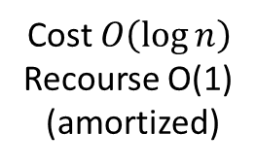


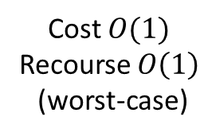

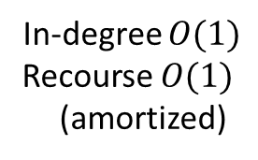


a glimpse of some results…
v₁
v₀
v₄
v₃
$$e_{5}$$
$$e_{4}$$
$$e_{3}$$
$$e_{2}$$
$e_{1}$
v₂
In-degree $O(log⁡n)$
Cost $O(log⁡n)$
Cost $O(\log{m}log⁡n)$
In-degree $O(1)$
Recourse $O(1)$ (amortized)
Cost $O(1)$
Recourse $O\left(1\right)$
(worst-case)
Cost $O\left(\log{n}\right)$
Recourse O(1)
(amortized)
extend to load-balancing
and single-sink flows
extend to fully-dynamic
O(1) amortized
extend to fully-dynamic
O(1) amortized

Slide 20
a glimpse of some results…
v₁
v₀
v₄
v₃
$$e_{5}$$
$$e_{4}$$
$$e_{3}$$
$$e_{2}$$
$e_{1}$
v₂
In-degree $O(log⁡n)$
Cost $O(log⁡n)$
Cost $O(\log{m}log⁡n)$
In-degree $O(1)$
Recourse $O(1)$ (amortized)
Cost $O(1)$
Recourse $O\left(1\right)$
(worst-case)
Cost $O\left(\log{n}\right)$
Recourse O(1)
(amortized)
extend to load-balancing
and single-sink flows
extend to fully-dynamic
O(1) amortized
extend to fully-dynamic
O(1) amortized

Slide 21
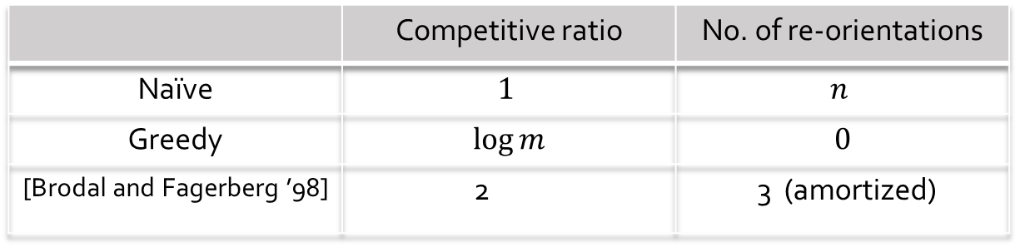
consider edge orientation…
Recourse vs in-degree trade-off:
 | Competitive ratio | No. of re-orientations
Naïve | $$1$$ | $$n$$
Greedy | $$\log{m}$$ | $$0$$
[Brodal and Fagerberg ’98] | 2 | 3 (amortized)
Amortized: after $n$ edge insertions, at most $3n$ edge reorientations.

Slide 22
the Brodal-Fagerberg algorithm
When a new edge arrives, orient it arbitrarily.
If the in-degree of a vertex becomes 3, flip all the incoming edges.

Slide 23
the Brodal-Fagerberg algorithm
When a new edge arrives, orient it arbitrarily.
If the in-degree of a vertex becomes 3, flip all the incoming edges.
Could lead to cascade of edge flips.
In fact, a single edge addition could cause $Ω\left(n\right)$ edge flips!

Slide 24



analysis
Algorithm
Optimal (has in-degree 1)
Theorem: total number of flips till time $T$ is at most $3T$.
“bad” edge = oriented oppositely from the optimal tree.
$Φ(t)$ : number of bad edges at time $t$
When a new edge arrives, $Φ(t)$ may increase by 1.
What happens to $Φ(t)$ when we flip three 3 incoming edges for some vertex?
$Φ(t)$ must decrease by at least 1 !
Total increase in $Φ$ is $≤T$, so total decrease $≤T$.

Slide 25
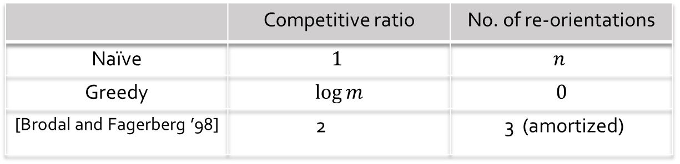
open problems and extensions
Recourse vs in-degree trade-off:
 | Competitive ratio | No. of re-orientations
Naïve | $$1$$ | $$n$$
Greedy | $$\log{m}$$ | $$0$$
[Brodal and Fagerberg ’98] | 2 | 3 (amortized)
Extensions:
Theorem: O(1)-competitive load balancing with O(1) amortized recourse
Theorem: O(1)-competitive single-sink flows with O(1) amortized recourse
Open: get a O(1) competitive algorithm with O(1) re-orientations worst-case.
Open: get a O(1) competitive algorithm with O(1) re-orientations (even amortized) for fully-dynamic case.

Slide 26
a glimpse of some results…
v₁
v₀
v₄
v₃
$$e_{5}$$
$$e_{4}$$
$$e_{3}$$
$$e_{2}$$
$e_{1}$
v₂
In-degree $O(log⁡n)$
Cost $O(log⁡n)$
Cost $O(\log{m}log⁡n)$
In-degree $O(1)$
Recourse $O(1)$ (amortized)
Cost $O(1)$
Recourse $O\left(1\right)$
(worst-case)
Cost $O\left(\log{n}\right)$
Recourse O(1)
(amortized)
extend to load-balancing
and single-sink flows
extend to fully-dynamic
O(1) amortized
extend to fully-dynamic
O(1) amortized

Slide 27
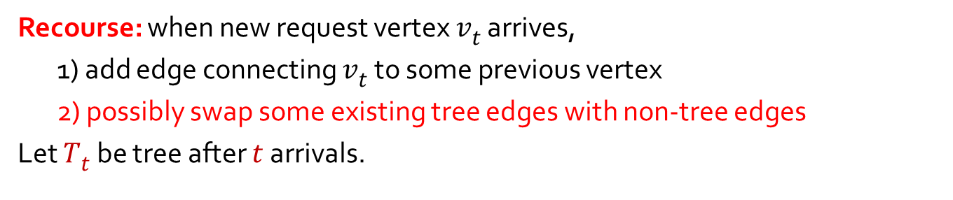
online spanning tree (with recourse)
Recourse: when new request vertex $vt$ arrives,
1) add edge connecting $vt$ to some previous vertex
2) possibly swap some existing tree edges with non-tree edges
Let $Tt$ be tree after $t$ arrivals.
v₃
v₀
v₂
v₅
v₄
v₁

Slide 28
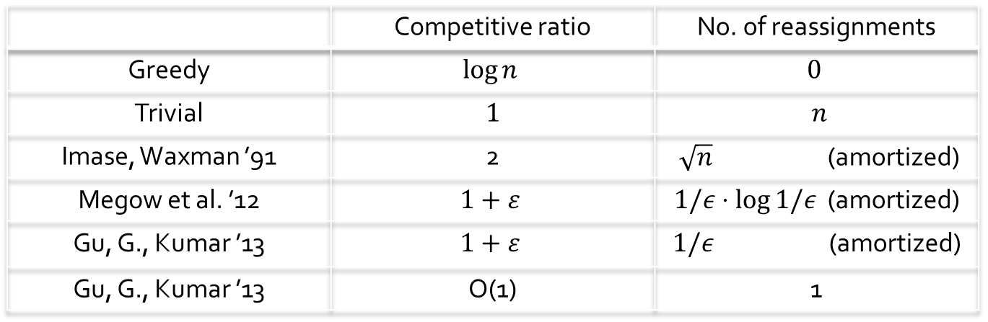
results
 | Competitive ratio | No. of reassignments
Greedy | $$log⁡n$$ | $$0$$
Trivial | $$1$$ | $$n$$
Imase, Waxman ’91 | 2 | $\sqrt{n}$ (amortized)
Megow et al. ’12 | $$1+ε$$ | $1/ε⋅\log{1/ε}$ (amortized)
Gu, G., Kumar ’13 | $$1+ε$$ | $1/ε$ (amortized)
Gu, G., Kumar ’13 | O(1) | 1

Slide 29
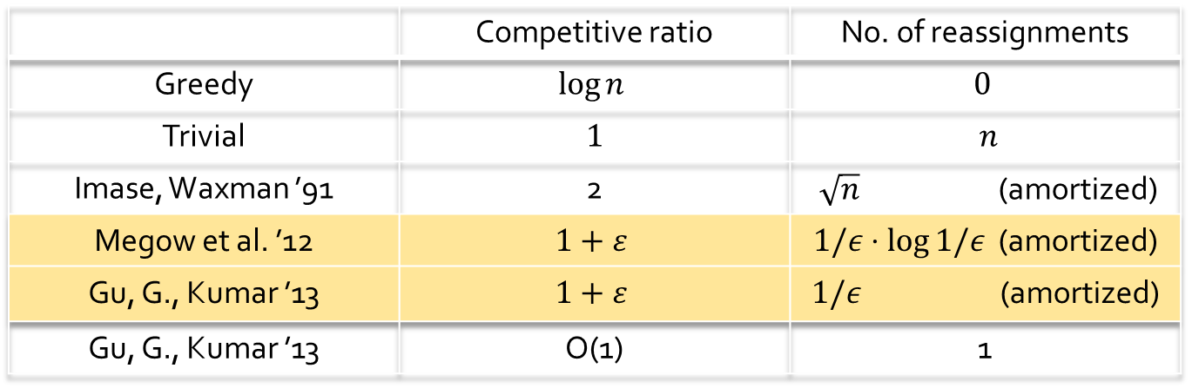
results
 | Competitive ratio | No. of reassignments
Greedy | $$log⁡n$$ | $$0$$
Trivial | $$1$$ | $$n$$
Imase, Waxman ’91 | 2 | $\sqrt{n}$ (amortized)
Megow et al. ’12 | $$1+ε$$ | $1/ε⋅\log{1/ε}$ (amortized)
Gu, G., Kumar ’13 | $$1+ε$$ | $1/ε$ (amortized)
Gu, G., Kumar ’13 | O(1) | 1

Slide 30

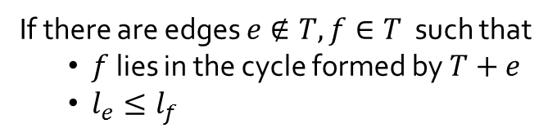
algorithm idea
(Greedy) When a new vertex arrives, it connects to the closest vertex in the tree.
If there are edges $e∉T, f∈T$ such that
$f$ lies in the cycle formed by $T+e$
$l_{e}≤l_{f}$
Repeat
Leads to MST, but may
incur too many swaps.
then swap $e,f$

Slide 31
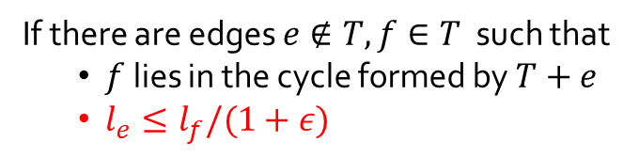
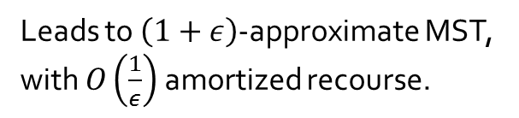
algorithm idea
(Greedy) When a new vertex arrives, it connects to the closest vertex in the tree.
If there are edges $e∉T, f∈T$ such that
$f$ lies in the cycle formed by $T+e$
$l_{e}≤l_{f}/(1+ε)$
Repeat
Leads to $\left(1+ε\right)$-approximate MST, with $O\left(\frac{1}{ε}\right)$ amortized recourse.
then swap $e,f$

Slide 32


analysis
Greedy Algorithm
(without swaps)
Optimal (MST)
Theorem 1: The ε-greedy algorithm maintains a (1+ε)-approximate MST, makes at most 2n/ε swaps during n arrivals.
Proof: uses a non-trivial potential function.
Lemma: $\frac{\text{Product} \text{of} \text{edges} \text{in} \text{the} \text{greedy} \text{tree}}{\text{Product} \text{of} \text{edges} \text{in} \text{MST}}$ is at most $4^{n}$
Each swap decreases the product of edge lengths by at least $\left(1+ε\right)$
Number of swaps is $≤\log_{1+ε}{4^{n}}\sim n/ε$

Slide 33
analysis
MST

Slide 34
analysis
1
2
MST
8
4
7
5
6
3
Greedy
0

Slide 35
analysis
1
2
MST
8
4
7
5
6
3
Greedy
0
Product of lengths of red greedy edges
Goal:
≤ 4^{n}
Product of lengths of blue edges
(no matter what order the vertices arrive)
Each swap some edge length decreases by (1+ε)
⇒ number of swaps is log_{1 + ε} 4^{n} = O(n/ε)
[Gu, also Abraham Bartal Neiman Schulman]

Slide 36

analysis
1
2
MST
8
4
7
5
6
e
3
Greedy
0
Product of lengths of red greedy edges
$$\frac{C^{n−1}}{n^{2}}$$
≤ 4^{n}
Goal:
≤
Product of lengths of blue edges
Exists e on this path P such that len(P)/ len(e) ≤ “small”
≤
len(first greedy edge)/ len(e)

Slide 37



analysis
1
MST
$L_{e}$ nodes
e
$R_{e}$ nodes
0
Greedy
Product of lengths of red greedy edges
$$\frac{C^{n−1}}{n^{2}}$$
Goal:
≤
Product of lengths of blue edges
$$\frac{C⋅L_{e}^{2}⋅R_{e}^{2}}{n^{2}}$$
Exists e on this path P such that len(P)/ len(e) ≤ “small”
≤
len(first greedy edge)/ len(e)

Slide 38
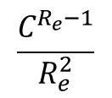
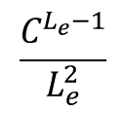
analysis
1
MST
$L_{e}$ nodes
e
$R_{e}$ nodes
0
Greedy
✓
Product of lengths of red greedy edges
$$\frac{C^{n−1}}{n^{2}}$$
Goal:
≤
Product of lengths of blue edges
len(first greedy edge)/ len(e)
$$\frac{C⋅L_{e}^{2}⋅R_{e}^{2}}{n^{2}}$$
≤
Induction on the two subtrees:
×
$$\frac{C^{L_{e}−1}}{L_{e}^{2}}$$
×
$$\frac{C^{R_{e}−1}}{R_{e}^{2}}$$
Product(greedy)/product(blue)
≤

Slide 39

analysis
1
MST
$L_{e}$ nodes
e
$R_{e}$ nodes
0
Greedy
$$\frac{C⋅L_{e}^{2}⋅R_{e}^{2}}{n^{2}}$$
New Goal:
Exists e on this path P such that len(P)/ len(e) ≤

Slide 40
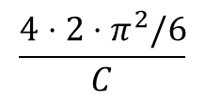
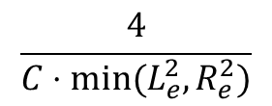
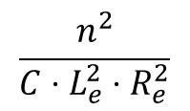
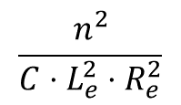
analysis
1
MST
e
0
Greedy
$$\frac{n^{2}}{C⋅L_{e}^{2}⋅R_{e}^{2}}$$
New Goal:
Exists e on this path P such that len(e)/ len(P) ≥
Suppose not:
1 =
≤
∑_{e in P}
$$\frac{n^{2}}{C⋅L_{e}^{2}⋅R_{e}^{2}}$$
≤
∑_{e in P}
$$\frac{4}{C⋅{min⁡(L}_{e}^{2},R_{e}^{2})}$$
$$\frac{4⋅2⋅π^{2}/6}{C}$$
∑_{e in P} len(e)/len(P)
≤
< 1
contradiction for C large!

Slide 41
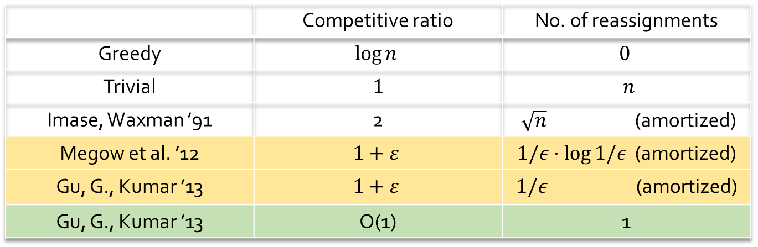
results
 | Competitive ratio | No. of reassignments
Greedy | $$log⁡n$$ | $$0$$
Trivial | $$1$$ | $$n$$
Imase, Waxman ’91 | 2 | $\sqrt{n}$ (amortized)
Megow et al. ’12 | $$1+ε$$ | $1/ε⋅\log{1/ε}$ (amortized)
Gu, G., Kumar ’13 | $$1+ε$$ | $1/ε$ (amortized)
Gu, G., Kumar ’13 | O(1) | 1

Slide 42
extensions
Allow vertex deletions too (fully-dynamic model). [G., Kumar ‘14]
Theorem: O(1)-competitive algorithm with O(1)-amortized swaps.
Theorem: non-amortized O(1)-swaps if we allow deletions only.
Theorem: $O(\sqrt{n})$-update time dynamic graph algorithms. [Łacki Pilipczuk Sankowski Zych ‘15]

Slide 43
extensions and open questions
Allow vertex deletions too (fully-dynamic model). [G., Kumar ‘14]
Theorem: O(1)-competitive algorithm with O(1)-amortized swaps.
Theorem: non-amortized O(1)-swaps if we allow deletions only.
Theorem: $O(\sqrt{n})$-update time dynamic graph algorithms. [Łacki Pilipczuk Sankowski Zych ‘15]
Q: Get fully-dynamic with single-swap per step?
Q: Extension to Steiner forest? Other network design problems?
Q: Simpler algorithms for the single-swap case?

Slide 44
road-map
v₁
v₀
v₄
v₃
$$e_{5}$$
$$e_{4}$$
$$e_{3}$$
$$e_{2}$$
$e_{1}$
v₂
In-degree $O(log⁡n)$
Cost $O(log⁡n)$
Cost $O(\log{m}log⁡n)$
In-degree $O(1)$
Recourse $O(1)$ (amortized)
Cost $O(1)$
Recourse $O\left(1\right)$
(worst-case)
Cost $O\left(\log{n}\right)$
Recourse O(1)
(amortized)
extend to load-balancing
and single-sink flows
extend to fully-dynamic
O(1) amortized
extend to fully-dynamic
O(1) amortized

Slide 45

online set cover
Given a collection of m sets
Elements arrive online. Element $e_{t}$ announces which sets it belongs to.
Pick some set to cover element if yet uncovered.
Minimize cost of sets picked.
Today: Allow recourse. Assume unit costs. Get O(log n) competitive with O(log n) recourse.
$$e_{5}$$
$$e_{4}$$
$$e_{3}$$
$$e_{2}$$
$e_{1}$

Slide 46
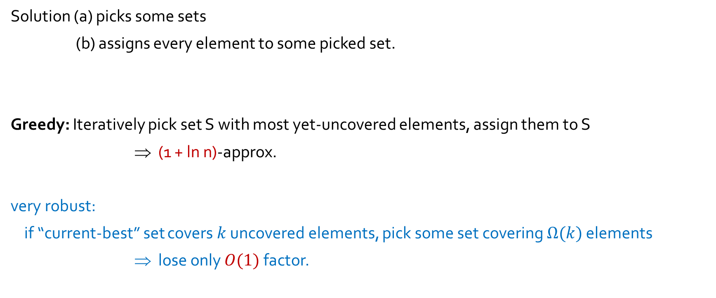
offline: the greedy algorithm
Solution (a) picks some sets
(b) assigns every element to some picked set.
Greedy: Iteratively pick set S with most yet-uncovered elements, assign them to S
⇒ (1 + ln n)-approx.
very robust:
if “current-best” set covers $k$ uncovered elements, pick some set covering $Ω(k)$ elements
⇒ lose only $O(1)$ factor.

Slide 47
online: the “greedy” algorithm
density = 3
density = 2
density = 2
density = 1
Universe of current points

Slide 48








online: the “greedy” algorithm
density = 3
density = 2
density = 2
density = 1
$$e_{1}$$
$$e_{2}$$
$$e_{5}$$
$$e_{3}$$
$$e_{8}$$
$$e_{4}$$
$$e_{7}$$
$$e_{6}$$

Slide 49








online: the “greedy” algorithm
$$e_{6}$$
density = 1
$$e_{3}$$
$$e_{8}$$
$$e_{4}$$
$$e_{7}$$
density = 2
$$e_{1}$$
$$e_{2}$$
$$e_{5}$$
density [3,4]
density [5,8]

Slide 50
online: the “greedy” algorithm
$$e_{6}$$
density = 1
$$e_{3}$$
$$e_{8}$$
$$e_{4}$$
$$e_{7}$$
density = 2
$$e_{1}$$
$$e_{2}$$
$$e_{5}$$
density [3,4]
density [5,8]
Unstable set S: set that contains ${∈(2^{i−1},2}^{i}]$ elements, all currently being covered at densities $≤2^{i−1}$.
E.g., suppose some set contains $e_{3}, e_{4}$ and $e_{6}$. Then it is unstable.
Lemma: no unstable sets ⇒ solution is O(log n)-approximate.

Slide 51





online: the “greedy” algorithm
$$e_{3}$$
$$e_{6}$$
$$e_{9}$$
$$e_{9}$$
$$e_{6}$$
density = 1
$$e_{3}$$
$$e_{8}$$
$$e_{4}$$
$$e_{7}$$
density = 2
$$e_{1}$$
$$e_{2}$$
$$e_{5}$$
density [3,4]
density [5,8]
Suppose $e_{9}$ arrives. Cover it with any set containing it.
Now green set is unstable.
So add it in, and assign $e_{3},e_{6},e_{9}$ to it.
Clean up, resettle sets at the right level.

Slide 52

overview of the analysis
Invariant: element at level $≈2^{i}$ has $2(log⁡n – i)$ tokens
When a new element arrives and not covered by current sets,
pick any set that covers it, add it with density 1
If some unstable set exists, add it to the correct level, assign those elements to it.
May cause other sets to lose elements, become lighter.
They “float up” to the correct level.
Cause other sets to become unstable, etc.
Claim: system stabilizes. Also, O(log n) changes per arrival, amortized.
Start each element with $2\log{n}$ tokens
Elements moving down lose 2 tokens use 1 to pay for new set
Sets moving up lose ½ of their elements use their other token to pay for rising up*
*minor cheating here.

Slide 53
road-map
v₁
v₀
v₄
v₃
$$e_{5}$$
$$e_{4}$$
$$e_{3}$$
$$e_{2}$$
$e_{1}$
v₂
In-degree $O(log⁡n)$
Cost $O(log⁡n)$
Cost $O(\log{m}log⁡n)$
In-degree $O(1)$
Recourse $O(1)$ (amortized)
Cost $O(1)$
Recourse $O\left(1\right)$
(worst-case)
Cost $O\left(\log{n}\right)$
Recourse O(1)
(amortized)
extend to load-balancing
and single-sink flows
extend to fully-dynamic
O(1) amortized
extend to fully-dynamic
O(1) amortized
get fully-dynamic polylog(n) update times too

Slide 54
other problems considered in this model
Online Bin-packing, Bin-covering [Jansen et al. ’14]
[G. Guruganesh Kumar Wajc ’17]
Makespan Minimization on parallel/related machines [Andrews Goemans Zhang ’01]
on unrelated machines [G. Kumar Stein ’13]
Traveling Salesman Problem (TSP) [Megow Skutella Verschae Wiese ’12]
Facility Location Problem [Fotakis ’06, ’07]
Tree Coloring [Das Choudhury Kumar ’16]
…

Slide 55
so in summary…
For combinatorial optimization problems online,
allowing bounded recourse can improve the competitive ratio qualitatively.
Many open problems:
specific problems like Steiner forest, or fully-dynamic matchings
understanding lower bounds
connections to dynamic algorithms (and lower bounds)
other models for ensuring solutions are Lipschitz?

Slide 56
thanks!!

