Slide 1

Online Algos for Robust Scheduling
(new algorithms for an ancient problem)
Anupam Gupta (NYU)

Slide 2
Online Response Time Scheduling
Jobs arrive over time, each with a required processing time.
Can work on one job at a time — but may pause and switch (preemption).
Flow time for a job: (finish time - arrive time).
Goal: minimize total flow time.
Also called “waiting time” or “response time”

Slide 3


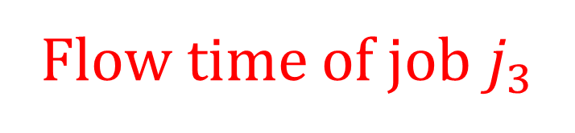



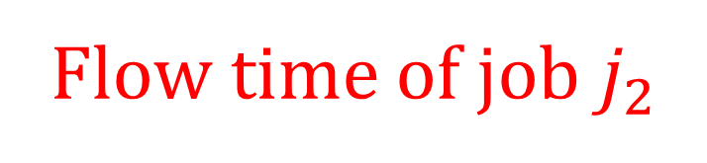



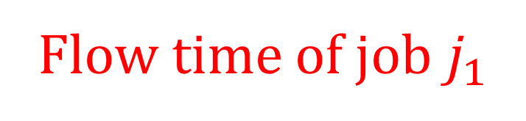







Online Flow Time Scheduling
$$j_{1}$$
$$j_{2}$$
$$j_{3}$$
$$j_{1}$$
$$j_{2}$$
$$j_{2}$$
$$j_{3}$$
$$j_{1}$$
$$timeline$$
$$A$$
$$B$$
$$C$$
$$D$$
$$E$$
$$F$$
Flow time of job $j_{2}$
Flow time of job $j_{3}$
Flow time of job $j_{1}$

Slide 4

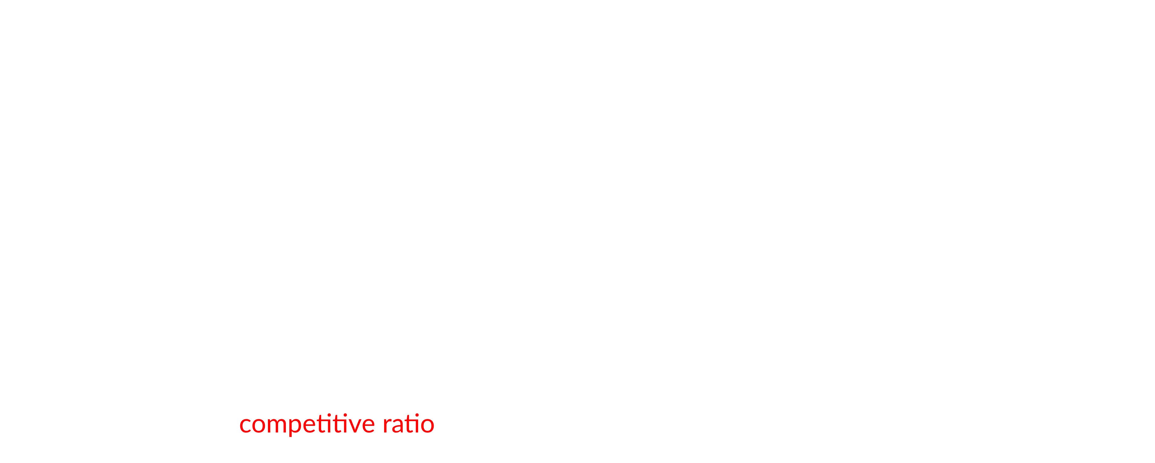

Formal Definition
Job $j$ processing time $p_{j}$ and revealed at time $r_{j}$.
Can process one job at a time — but may pause and switch (preemption).
$C_{j}$: completion time of job $j$.
$F_{j}$: Flow time of job $j$, equals $C_{j}−r_{j}$.
Want to minimize $\sum_{j}{F_{j}}$.
Goal: Minimize the competitive ratio!
Competitive ratio of algorithm $A$
$$\max_{instances I}{\frac{cost of algorithm A on instance I}{optimal cost to serve I}}.$$

Slide 5








Calculating Flow Time over time
Fact: $\text{Total} \text{Flow} \text{Time}=\sum_{t}{\left|number of alive jobs at time t\right|}.$
Total Flow Time? green + orange + blue
Or integrate over time….
$$timeline$$
$$r_{1}$$
$$r_{2}$$
$$r_{3}$$
$$C_{2}$$
$$C_{3}$$
$$C_{1}$$

Slide 6

SRPT: An optimal algorithm
$$\text{Total} \text{Flow} \text{Time}=\sum_{t}{\left|number of alive jobs at time t\right|}.$$
⇒ Want few jobs in system $⇒$ want to finish jobs as soon as possible!
SRPT (Shortest Remaining Processing Time first):
Always process the job with the least remaining processing time.
Classical theorem: SRPT is exact algorithm for Online Flow Time Scheduling.

Slide 7
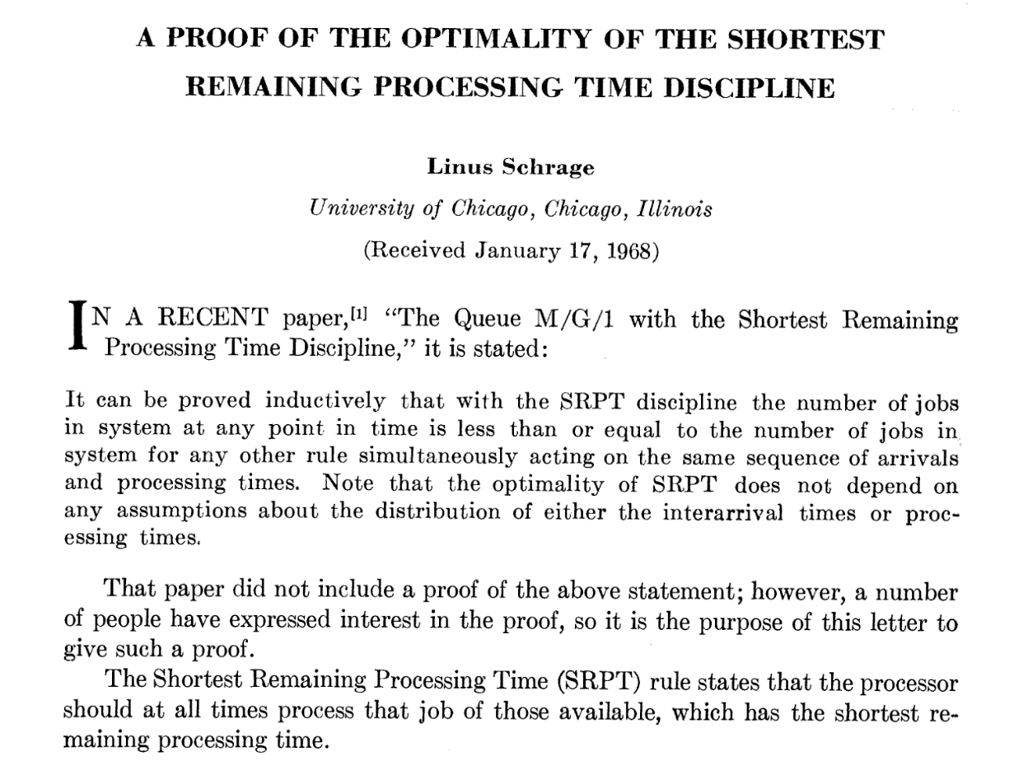
A Proof of the Optimality of the Shortest-Remaining-Processing Time Discipline, Operations Research, 1968
Proof of optimality based on exchange argument

Slide 8
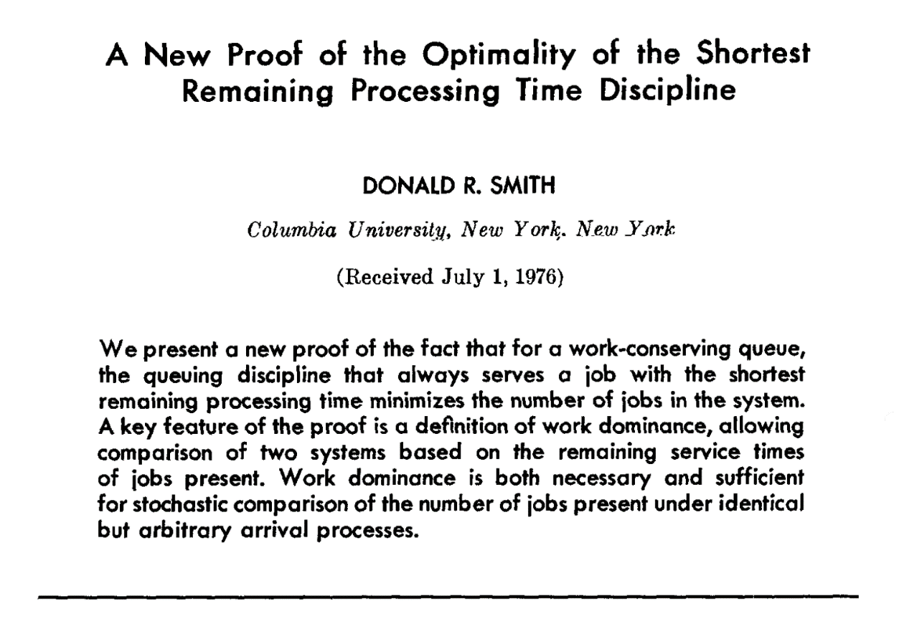
A New Proof of the Optimality of the Shortest Remaining Processing Time Discipline, Operations Research, 1978.
Proof of optimality based on elegant “work dominance” argument

Slide 9
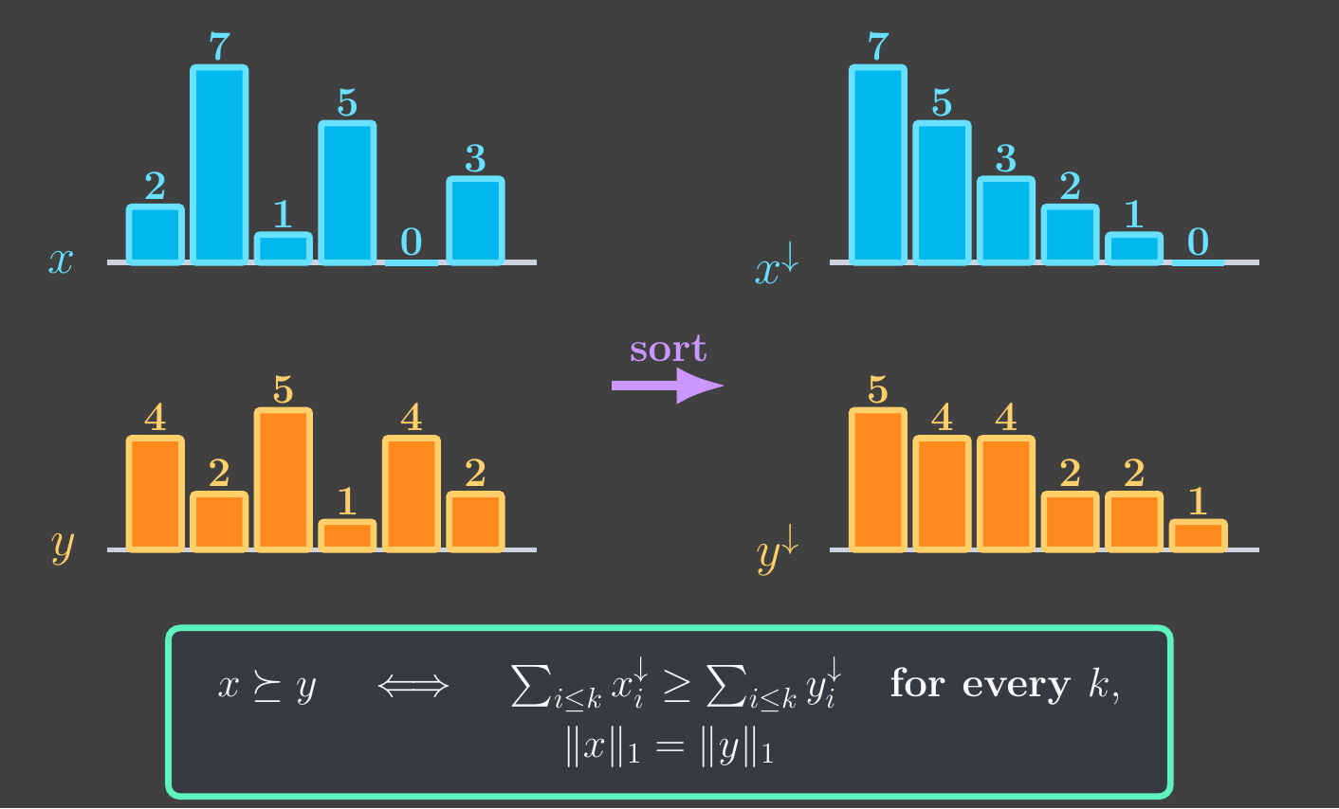
SRPT dominates everyone else
Theorem [Smith 76]: Remaining work in SRPT (@ time t) dominates that of any other algo @t.

Slide 10


but…
Classical theorem: SRPT is exact algorithm for Online Flow Time Scheduling.
But: needs “clairvoyance”.
We need exact job sizes to run SRPT.
Theorem: Any “non-clairvoyant” algorithm is $Ω\left(\log{n}\right)$-competitive.

Slide 11

htt`ps://kiriakakis.net/comics/mused/a-day-at-the-park

Slide 12


Guiding question for today
Can we do better if we “learn”?
Theorem 1:
Algo with $O\left(μ\right)$-comp’ness if given size estimate within $μ$ of true sizes.
“Suppose know job sizes to within O(1) factor $⇒$ O(1) competitive algo”

Slide 13
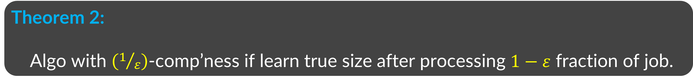

Guiding question for today
Can we do better if we “learn”?
Theorem 1:
Algo with $O\left(μ\right)$-comp’ness if given size estimate within $μ$ of true sizes.
Theorem 2:
Algo with $\left(1/ε\right)$-comp’ness if learn true size after processing $1−ε$ fraction of job.
“Suppose told true size when 50% of job done $⇒$ 2-competitive algo”

Slide 14
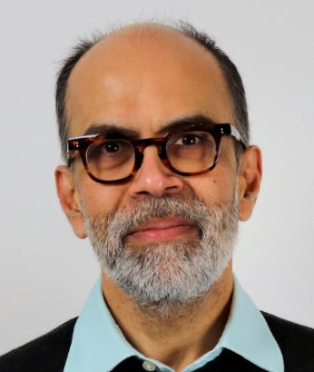
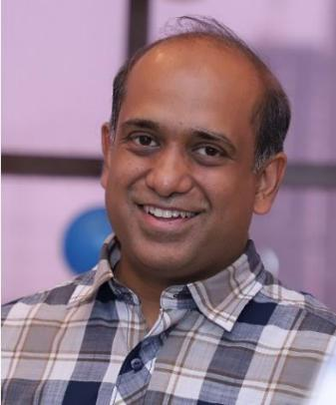
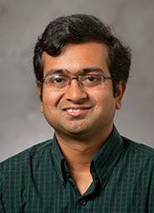

An Optimal Online Algorithm for
Robust Flow Time Scheduling
Anupam Gupta
Amit Kumar
Debmalya Panigrahi
Zhaozi Wang
NYU
IIT Delhi
Duke University
NYU

Slide 15
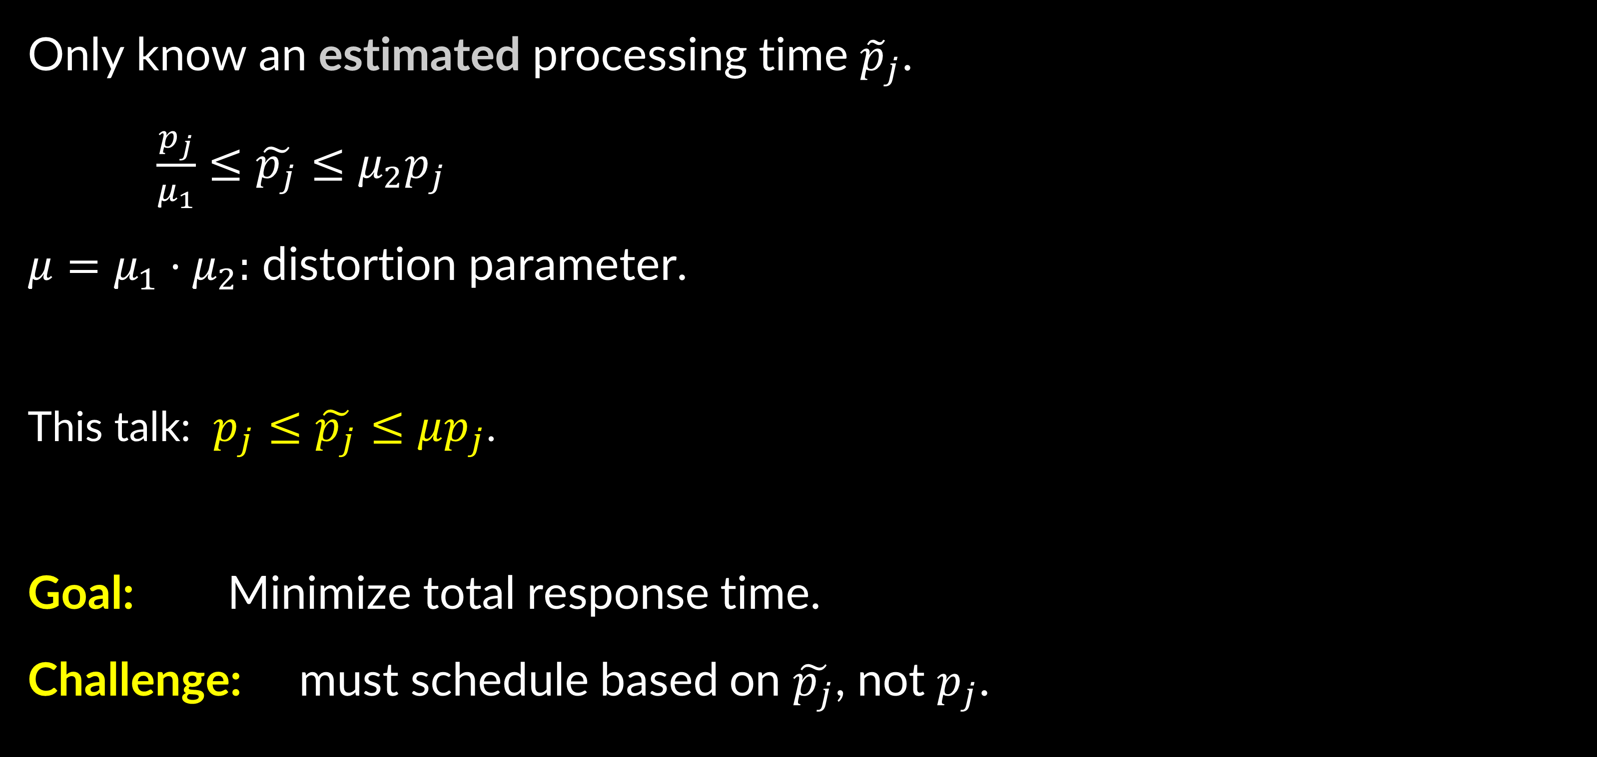
Online Robust Flow Time Scheduling
Only know an estimated processing time ${\tilde{p}}_{j}$.
$\frac{p_{j}}{μ_{1}}≤\tilde{p_{j}}≤μ_{2}p_{j}$
$μ=μ_{1}⋅μ_{2}:$ distortion parameter.
This talk: $p_{j}≤\tilde{p_{j}}≤μp_{j}$.
Goal: Minimize total response time.
Challenge: must schedule based on $\tilde{p_{j}}$, not $p_{j}$.
Notes:
Change to the actual version.

Slide 16
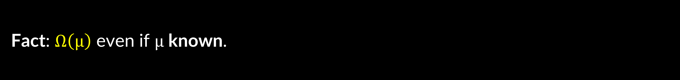


Results
Fact: $Ω\left(μ\right)$ even if $μ$ known.
Theorem: $O\left(μ log μ\right)$-comp algorithm, even if $μ$ unknown.
[Azar, Leonardi, Touitou STOC 21, SODA 22]
Our Main Theorem: An $O\left(μ\right)$ algorithm, even if $μ$ unknown.
New Simpler Algorithm BALANCE.
New Dual-Fitting Analysis technique.

Slide 17






Intuition (1)
SRPT on estimates is very bad even for distortion $μ$=2!
$$j_{1}$$
prediction correct
$$j_{2}$$
$$j_{3}$$
prediction = 2x true value
$$j_{4}$$
$$0$$
$$timeline$$

Slide 18






Intuition (2)
Is SJF (Shortest Job First: process job with minimum ${\tilde{p}}_{j}$) any good?
Bad News: bad even with exact estimates ($μ=1$)!
$$j_{1}$$
$$j_{2}$$
$$j_{3}$$
$$…$$
$$0$$
$$timeline$$

Slide 19
Strike right balance
  Prefer small estimated proc time. (To fix hard example for SRPT)
  Avoid creating too many partial jobs. (To fix hard instance for SJF)
Jobs that already processed for some time.
1

Slide 20












Our BALANCE algorithm
Def: job $j$ has class $k$, if ${\tilde{p}}_{j}∈[2^{k},2^{k+1})$.
There are “full” jobs and “partial” jobs.
Always process the job of the smallest class among partial jobs.
New released job is declared full.
If full job has smaller class than all partial jobs, and (#partial < 3 * #full) $⇒$make the job “partial”!
$$B_{1}$$
$$B_{2}$$
$$B_{3}$$
$$B_{4}$$
$$B_{5}$$
$$B_{6}$$
$$B_{7}$$
$$B_{8}$$
$B_{i}:$ jobs of class $i$.
$:$ “full” job.
$:$ “partial” job.

Slide 21

To give “dual fitting” proof, we need to…
Give an algorithm ⟹ BALANCE algorithm ✅
Write LP relaxation/Dual program for this problem.
Give an Dual Solution whose cost $≥\frac{1}{O\left(μ\right)}BALANCE\left(I\right).$
1

Slide 22


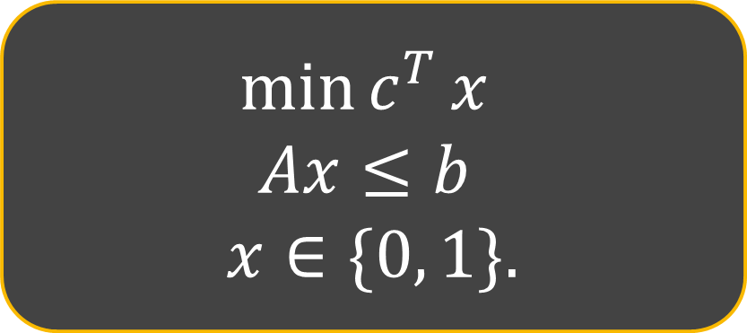






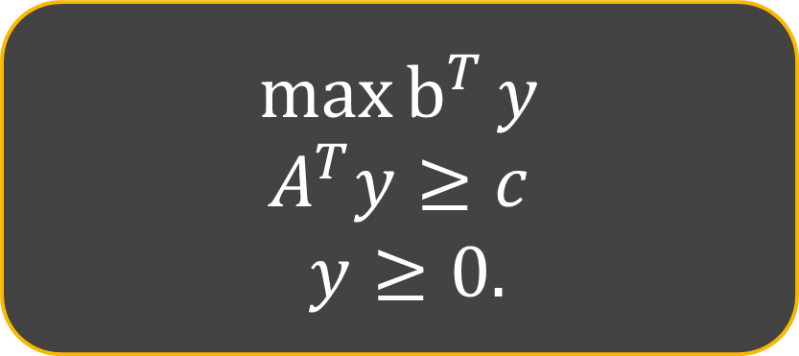


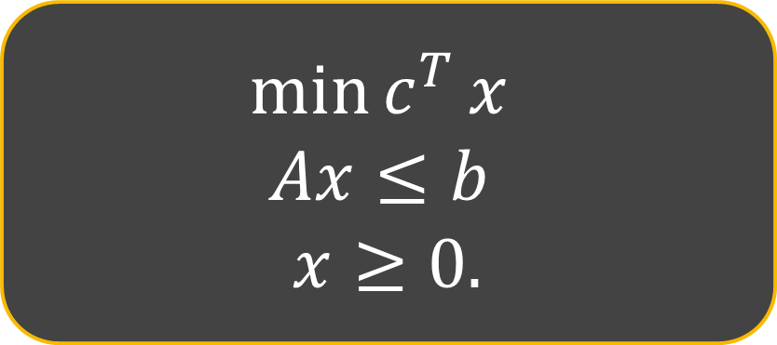


“Dual Fitting”
Analysis technique for approximation/online algorithms.
Say want to show: $\frac{1}{10}ALG(I)≤OPT(I),$ for all instances $I$.
Dual Program for the LP (DP)
Linear Program relaxation (LP)
Integer Program (IP)
$$\max{b^{T}}y$$
$$A^{T}y≥c$$
$y≥0.$
$$\min{c^{T}}x$$
$$Ax≤b$$
$$x≥0.$$
$$\min{c^{T}}x$$
$$Ax≤b$$
$$x∈\{0, 1\}.$$
s.t.
s.t.
s.t.
$DP^{∗}$: optimal solution for DP.
$LP^{∗}$: optimal solution for LP.
$IP^{∗}$: optimal solution for IP.
$$\frac{1}{10}ALG≤$$
some dual sol $≤$
opt $DP$ dual sol
=
opt $LP$ sol
$$≤$$
$$≤$$
opt $IP$ sol = $OPT$
$$ALG$$
Suffices to show
By Strong Duality!
LP is a relaxation!
By definition!

Slide 23









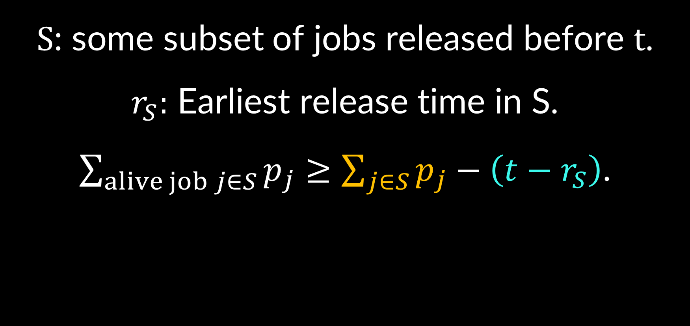


IP for our problem
Recall: want to min #alive jobs at time t.
⇒ Write IP w.r.t fixed time t to min #alive jobs at time t.
$$j_{1}$$
$S$: some subset of jobs released before $t$.
$r_{S}:$ Earliest release time in S.
$\sum_{alive job j∈S}{p_{j}}≥\sum_{j∈S}{p_{j}}−\left(t−r_{S}\right)$.
$$j_{2}$$
$$j_{3}$$
$$j_{4}$$
$$:=e(S, t)$$
$${:S=\{j}_{1},j_{2},j_{4}\}$$
$$r_{S}$$
$$t$$
$$timeline$$
$$e(S, t):$$
$$−$$

Slide 24
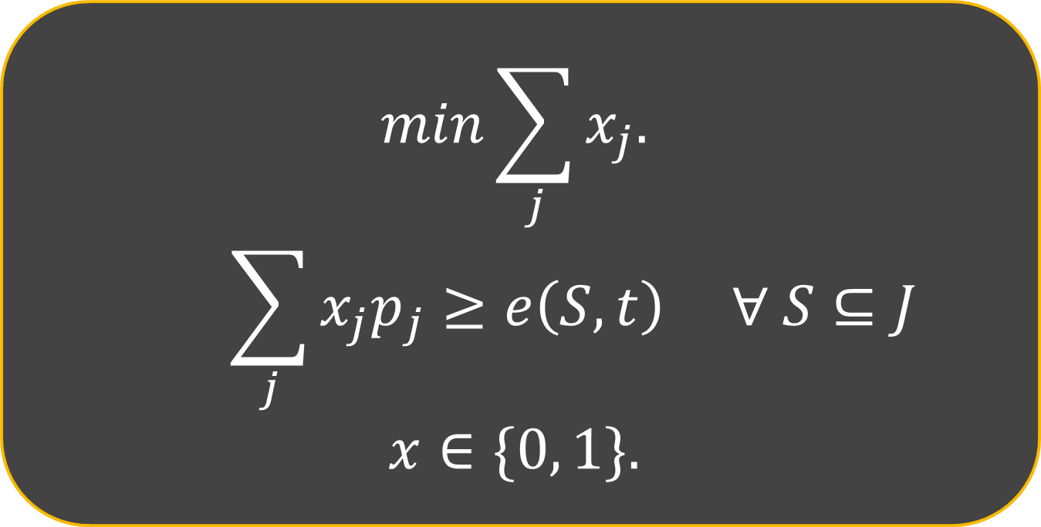

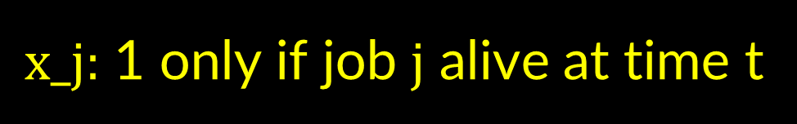
IP for our problem
Recall: want to min #alive jobs at time t.
⇒ Write IP w.r.t fixed time t to min #alive jobs at time t.
$x_j:$ 1 only if job $j$ alive at time t
$$min\sum_{j}{x_{j}.}$$
$$\sum_{j}{x_{j}p_{j}}≥e\left(S,t\right) ∀ S⊆J$$
$$x∈\{0, 1\}.$$
$$j_{1}$$
$$j_{2}$$
$$j_{3}$$
$$j_{4}$$
$$e\left(S, t\right)≔\sum_{j∈S}{p_{j}} −\left(t−r_{S}\right)$$
$$r_{S}$$
$$t$$
$$timeline$$

Slide 25
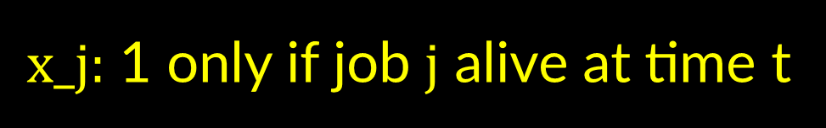
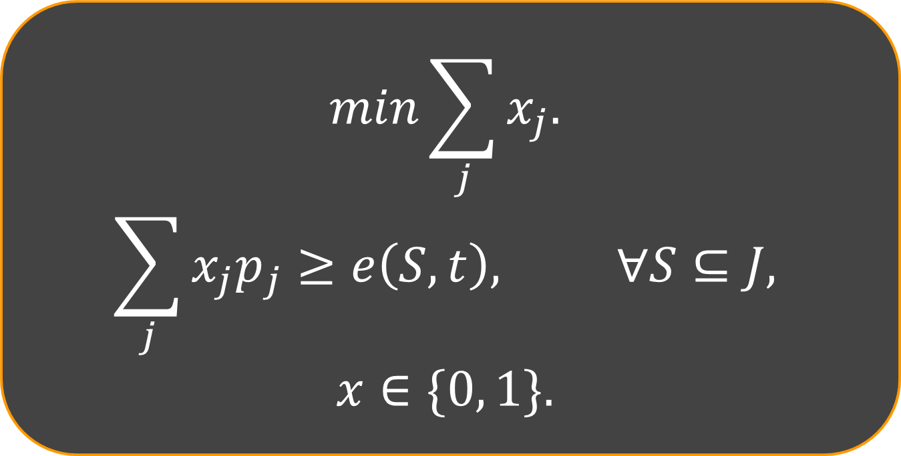
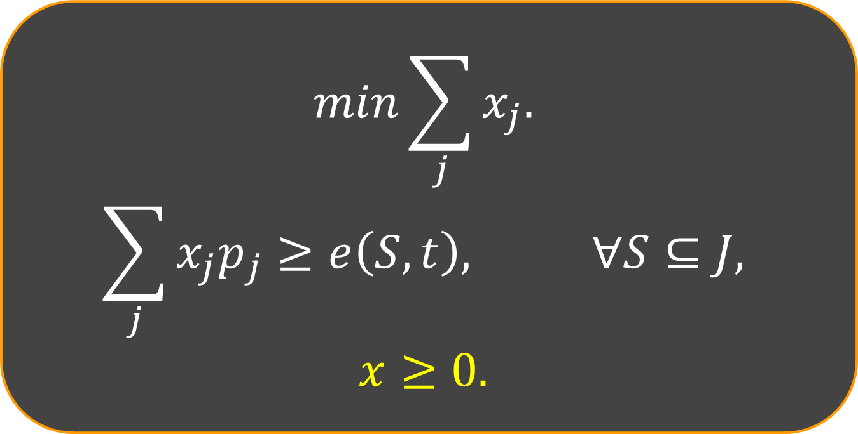
LP relaxation
$x_j:$ 1 only if job $j$ alive at time t
Linear Program
Integer Program
$$min\sum_{j}{x_{j}.}$$
$$\sum_{j}{x_{j}p_{j}}≥e\left(S,t\right), ∀S⊆J,$$
$$x≥0.$$
$$min\sum_{j}{x_{j}.}$$
$$\sum_{j}{x_{j}p_{j}}≥e\left(S,t\right), ∀S⊆J,$$
$$x∈\{0, 1\}.$$
Problem: Too large integrality gap!
Solution: Use Knapsack Cover Constraints!

Slide 26









Covering Knapsack
$\min{\sum_{i}{c_{i}{⋅y}_{i}}}$
$$B$$
$\sum_{i}{s_{i}{⋅y}_{i} ≥ B}$
$$y_{i}∈\{0,1\}$$
$$y_{i}∈[0,1]$$
$$c_{1}=2$$
$$c_{2}=1$$
$$c_{3}=7$$
Is the LP relaxation any good?
$$c_{4}=3$$

Slide 27







Covering Knapsack
$\min{\sum_{i}{c_{i}{⋅y}_{i}}}$
$$B$$
$\sum_{i}{s_{i}{⋅y}_{i} ≥ B}$
$$y_{i}∈\{0,1\}$$
$$y_{i}∈[0,1]$$
$$c_{1}=M$$
$$B⋅M$$
setting $y_{1}=1/M$ gives $LP=1$
Fix: set $s_{i}←min(s_{i}, B)$
but $OPT=M$

Slide 28


Covering Knapsack
$\min{\sum_{i}{c_{i}{⋅y}_{i}}}$
$$B$$
$\sum_{i}{s_{i}{⋅y}_{i} ≥ B}$
$$y_{i}∈[0,1]$$
$$c_{1}=0$$
$$c_{1}=M$$
Same problem at different scale!!

Slide 29






Fix: Knapsack Cover Ineqs
Fix any set $A$ of jobs
$\min{\sum_{i}{c_{i}{⋅y}_{i}}}$
sps these are all “assigned”
$\sum_{i}{s_{i}{⋅y}_{i} ≥ B}$
residual problem:
$$y_{i}∈[0,1]$$
remaining coverage needed: $B −s(A)$
so must truncate remaining item sizes: $s_{i}←min⁡(s_{i}, B −s\left(A\right))$
$$s_{i}^{A}$$
$\min{\sum_{i}{c_{i}{⋅y}_{i}}}$
$\sum_{i∉A}{s_{i}^{A}{⋅y}_{i} ≥ B}−s(A)$ for every $A⊆Items$
Thm: $\frac{OPT}{2}≤LP_{KC}≤OPT$
$$y_{i}∈[0,1]$$
[Carr Leung Fleischer Phillips SODA 2000]

Slide 30
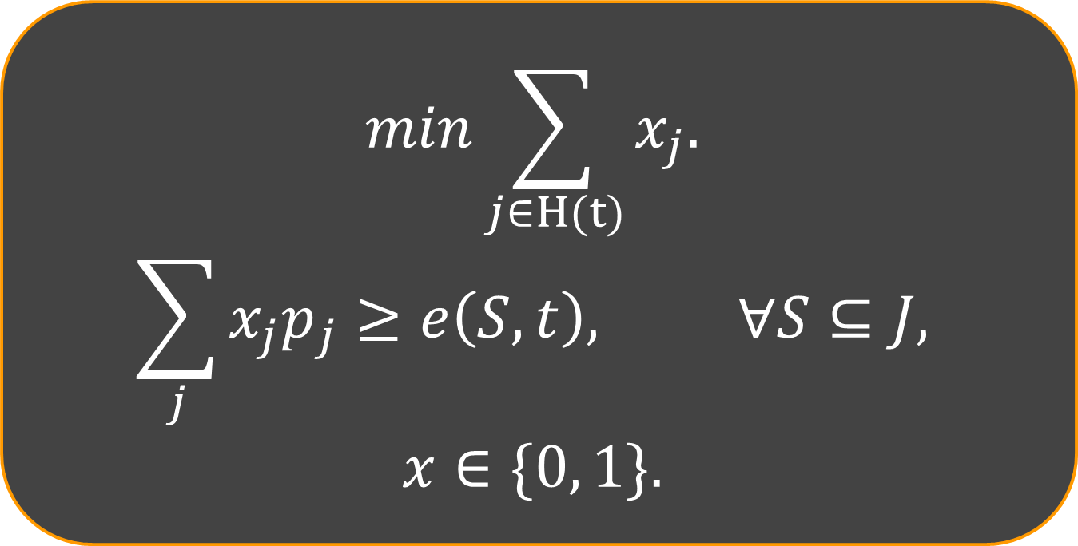
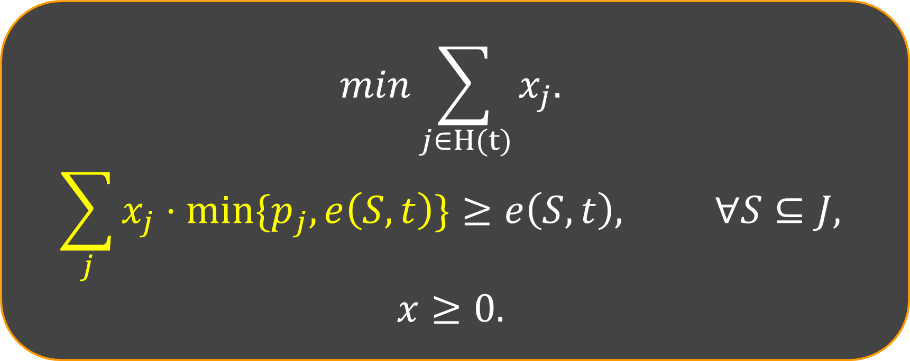
Same idea for Scheduling LP
$x_j:$ 1 only if job $j$ alive at time t
KC Linear Program
Integer Program
$$min\sum_{j∈H(t)}{x_{j}.}$$
$$\sum_{j}{x_{j}{⋅min\{p}_{j},e\left(S,t\right)\}}≥e\left(S,t\right), ∀S⊆J,$$
$$x≥0.$$
$$min\sum_{j∈H(t)}{x_{j}.}$$
$$\sum_{j}{x_{j}p_{j}}≥e\left(S,t\right), ∀S⊆J,$$
$$x∈\{0, 1\}.$$
Thm: integrality gap for scheduling case also at most 2!

Slide 31
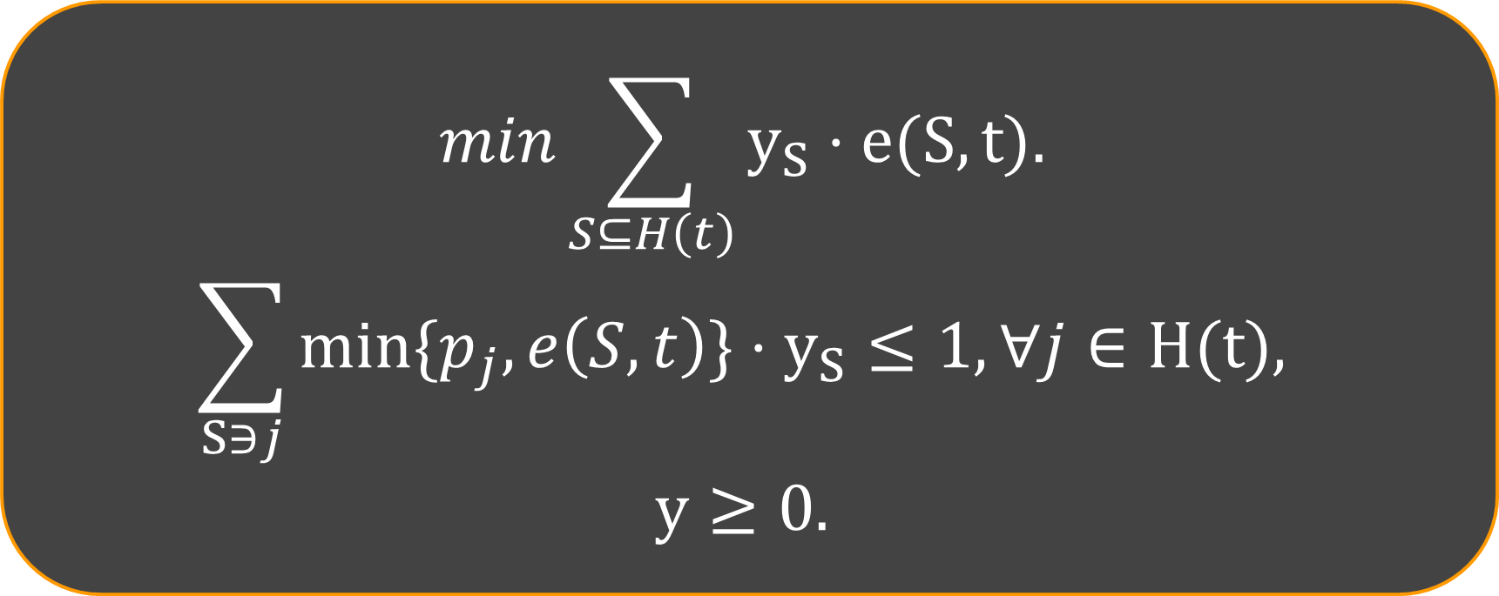
Dual LP
KC Linear Program
Dual Program
$$min\sum_{j∈H(t)}{x_{j}.}$$
$$\sum_{j}{x_{j}{⋅min\{p}_{j},e\left(S,t\right)\}}≥e\left(S,t\right), ∀S⊆J,$$
$$x≥0.$$
$$min\sum_{S⊆H\left(t\right)}{y_{S}⋅e(S, t).}$$
$$\sum_{S∋j}{{min\{p}_{j},e\left(S,t\right)\}⋅y_{S}}≤1,∀j∈H(t),$$
$$y≥0.$$

Slide 32

To give “dual fitting” proof, we need to…
Give an algorithm ⟹ BALANCE algorithm ✅
Write LP relaxation/Dual program for this problem. ✅
Give an Dual Solution whose cost $≥\frac{1}{O\left(μ\right)}BALANCE\left(I\right).$
See paper for this part…
1

Slide 33
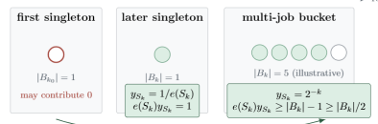

Slide 34
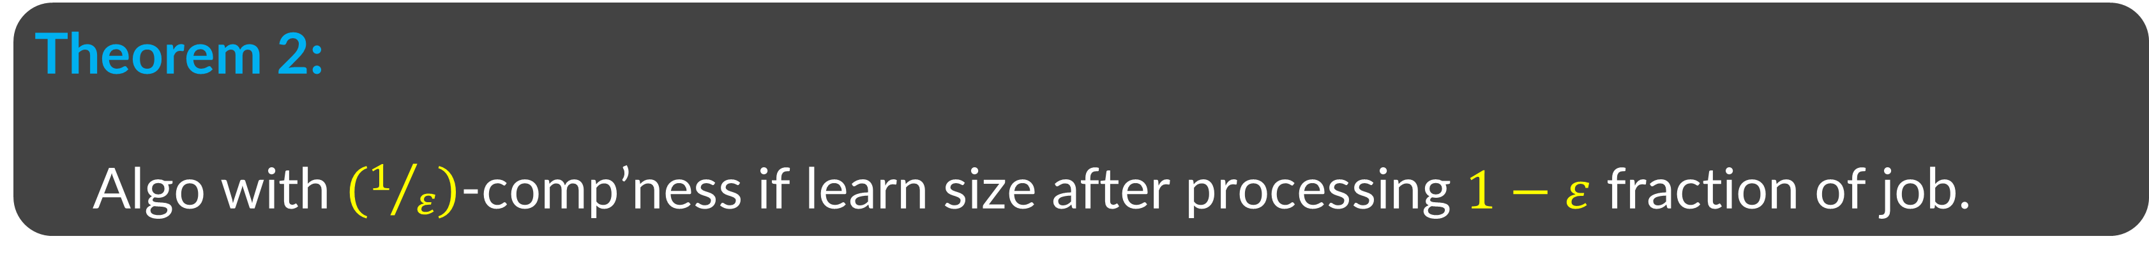
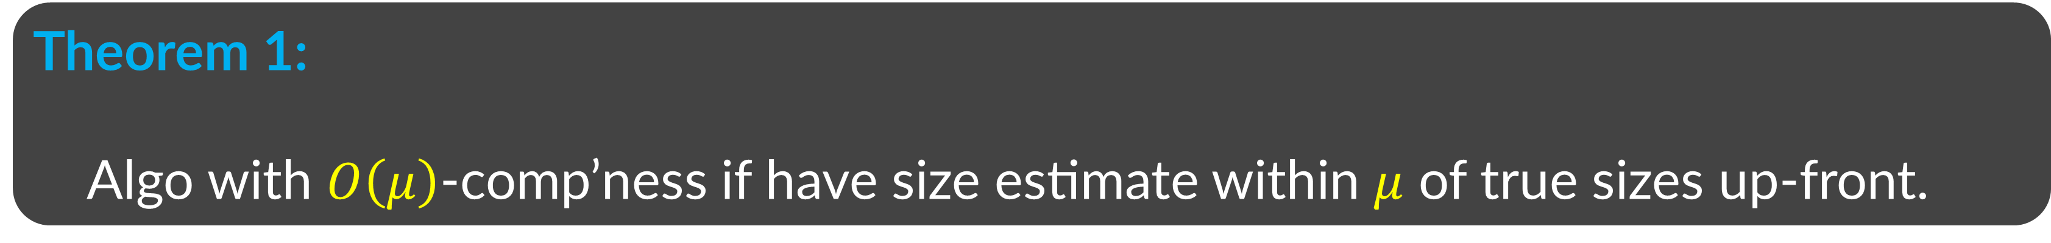
Back to guiding question
Can we do better if we “learn”?
Theorem 1:
Algo with $O\left(μ\right)$-comp’ness if have size estimate within $μ$ of true sizes up-front.
Theorem 2:
Algo with $\left(1/ε\right)$-comp’ness if learn size after processing $1−ε$ fraction of job.

Slide 35

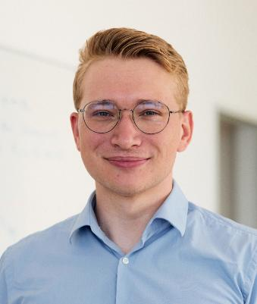

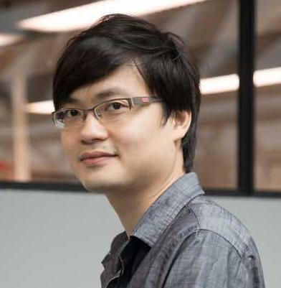



A Little Learning Goes a Long Way*
Anupam Gupta
(NYU)
Haim Kaplan (Tel Aviv U)
Alex Lindermayr
(U Bremen
$→$ TU Berlin)
Jens Schlöter (CWI Amsterdam
$→$ SDU Vejle)
Sorrachai
Yingchareonthawornchai
(ETH Zürich
$→$ Imperial College)
with apologies to Alexander Pope

Slide 36

$1/2$-clairvoyant scheduling:
For every job j
  $p_{j}$ is revealed once its remaining time becomes ${p_{j}}/2$
Example: Research projects = jobs
Hard to estimate
Eas(ier) to estimate once the project is about to finish
  [Yingchareonthawornchai Torng, 2017]

Slide 37
$1/2$-clairvoyant scheduling:
For every job j
  $p_{j}$ is revealed once its remaining time becomes ${p_{j}}/2$
A job arrives
Unknown
Example: Research projects = jobs
Hard to estimate
Eas(ier) to estimate once the project is about to finish
  [Yingchareonthawornchai Torng, 2017]

Slide 38
$1/2$-clairvoyant scheduling:
For every job j
  $p_{j}$ is revealed once its remaining time becomes ${p_{j}}/2$
Unknown
Example: Research projects = jobs
Hard to estimate
Eas(ier) to estimate once the project is about to finish
  [Yingchareonthawornchai Torng, 2017]

Slide 39
$1/2$-clairvoyant scheduling:
For every job j
  $p_{j}$ is revealed once its remaining time becomes ${p_{j}}/2$
Unknown
Elapsed time
Example: Research projects = jobs
Hard to estimate
Eas(ier) to estimate once the project is about to finish
  [Yingchareonthawornchai Torng, 2017]

Slide 40
$1/2$-clairvoyant scheduling:
For every job j
  $p_{j}$ is revealed once its remaining time becomes ${p_{j}}/2$
Unknown
Elapsed time
Example: Research projects = jobs
Hard to estimate
Eas(ier) to estimate once the project is about to finish
  [Yingchareonthawornchai Torng, 2017]

Slide 41

$1/2$-clairvoyant scheduling:
For every job j
  $p_{j}$ is revealed once its remaining time becomes ${p_{j}}/2$
See remaining time (job is now known)
Unknown $→$Known
Elapsed time
Example: Research projects = jobs
Hard to estimate
Eas(ier) to estimate once the project is about to finish
  [Yingchareonthawornchai Torng, 2017]

Slide 42
$1/2$-clairvoyant scheduling:
For every job j
  $p_{j}$ is revealed once its remaining time becomes ${p_{j}}/2$
See remaining time (job is now known)
Known
Elapsed time
Example: Research projects = jobs
Hard to estimate
Eas(ier) to estimate once the project is about to finish
  [Yingchareonthawornchai Torng, 2017]

Slide 43
$1/2$-clairvoyant scheduling:
For every job j
  $p_{j}$ is revealed once its remaining time becomes ${p_{j}}/2$
See remaining time (job is now known)
completed
Elapsed time
Example: Research projects = jobs
Hard to estimate
Eas(ier) to estimate once the project is about to finish
  [Yingchareonthawornchai Torng, 2017]

Slide 44


Main Theorem
Theorem 2:
Algo with $2$-comp’ness if learn size after processing half of job.
“Suppose know true size when 1-eps of job done $⇒$ (1/eps)-competitive algo”
Theorem 2b:
This is best possible (for both det. and rand. algos)

Slide 45

Algorithm SLF (Shortest Lower Bound First)
Q: What is smallest possible size of this job?
A: 2x
$⇒$ remaining time is at least x
Unknown
Elapsed time = x
When unknown: more time spent $⇒$larger estimate $⇒$lower priority

Slide 46
Algorithm SLF (Shortest Lower Bound First)
At any time, run job with smallest optimistic estimate
“optimism in face of uncertainty”

Slide 47
An example
Elapsed Time
Estimate
Unknown remaining time
At any time, run job with smallest optimistic estimate

Slide 48
An example
Elapsed Time
Estimate
Unknown remaining time
At any time, run job with smallest optimistic estimate

Slide 49
An example
Elapsed Time
Estimate
Unknown remaining time
At any time, run job with smallest optimistic estimate

Slide 50
An example
Elapsed Time
Estimate
Unknown remaining time
At any time, run job with smallest optimistic estimate

Slide 51
An example
Elapsed Time
Estimate
Known remaining time
Unknown remaining time
At any time, run job with smallest optimistic estimate

Slide 52
An example
Elapsed Time
Estimate
Known remaining time
Unknown remaining time
Obs: Working on any known job j => j is SRPT
At any time, run job with smallest optimistic estimate

Slide 53
An example
Elapsed Time
Estimate
Known remaining time
Unknown remaining time
A new job arrives
At any time, run job with smallest optimistic estimate

Slide 54
An example
Elapsed Time
Estimate
Known remaining time
Unknown remaining time
At any time, run job with smallest optimistic estimate

Slide 55
An example
Elapsed Time
Estimate
Known remaining time
Unknown remaining time
Estimate of this job = known remaining time
Switch to known job
At any time, run job with smallest optimistic estimate

Slide 56
An example
Elapsed Time
Estimate
Known remaining time
Unknown remaining time
At any time, run job with smallest optimistic estimate

Slide 57
An example
Elapsed Time
Estimate
Known remaining time
Unknown remaining time
At any time, run job with smallest optimistic estimate

Slide 58
An example
Elapsed Time
Estimate
Known remaining time
Unknown remaining time
Obs: SETF (shortest elapsed time first) on the unknown jobs
At any time, run job with smallest optimistic estimate

Slide 59
An example
Elapsed Time
Estimate
Known remaining time
Unknown remaining time
Obs: SETF on the unknown jobs
At any time, run job with smallest optimistic estimate

Slide 60
An example
Elapsed Time
Estimate
Known remaining time
Unknown remaining time
At any time, run job with smallest optimistic estimate

Slide 61
An example
Elapsed Time
Estimate
Known remaining time
Unknown remaining time
At any time, run job with smallest optimistic estimate

Slide 62
An example
Elapsed Time
Estimate
Known remaining time
Unknown remaining time
At any time, run job with smallest optimistic estimate

Slide 63
An example
Elapsed Time
Estimate
Known remaining time
Unknown remaining time
At any time, run job with smallest optimistic estimate

Slide 64
An example
Elapsed Time
Estimate
Known remaining time
Unknown remaining time
At any time, run job with smallest optimistic estimate

Slide 65
An example
Elapsed Time
Estimate
Known remaining time
Unknown remaining time
Obs: Always alternate between SRPT on known jobs and SETF on the unknown jobs
At any time, run job with smallest optimistic estimate

Slide 66
Analysis for Algos

Slide 67


“Work Dominance”
Maintain 1-to-2 map between active jobs in optimum and algo
$$OPT(t)$$
$$A(t)$$
Alternate proof: use dual-fitting but lose extra constants!

Slide 68
Back to guiding question
Can we do better if we “learn”?
Theorem 1:
Algo with $O\left(μ\right)$-comp’ness if have size estimate within $μ$ of true sizes up-front.
Theorem 2:
Algo with $\left(1/ε\right)$-comp’ness if learn size after processing $1−ε$ fraction of job.

Slide 69

old problem, new results & ideas
Two new models, two new algorithms
Thm 1: Algo with $O\left(μ\right)$-comp’ness if given size estimate within $μ$ of true sizes.
Thm 2: Algo with $\left(1/ε\right)$-comp’ness if learn true size after processing $1−ε$ fraction of job.
Forthcoming work (SODA) combines two:
If get good approx size estimate before finish $1−ε$ of job, then “optimistic balance” works well.
Many questions
New models for robust scheduling that learn to interpolate between “clairvoyance” and “non-clairvoyance”
Algos for them? For other robust opt. problems?
Thanks!!

Slide 70

htt`ps://kiriakakis.net/comics/mused/a-day-at-the-park

