Slide 1

Solving Problems with Our Eyes Closed
(with Stefano)
Anupam Gupta (NYU)

Slide 2
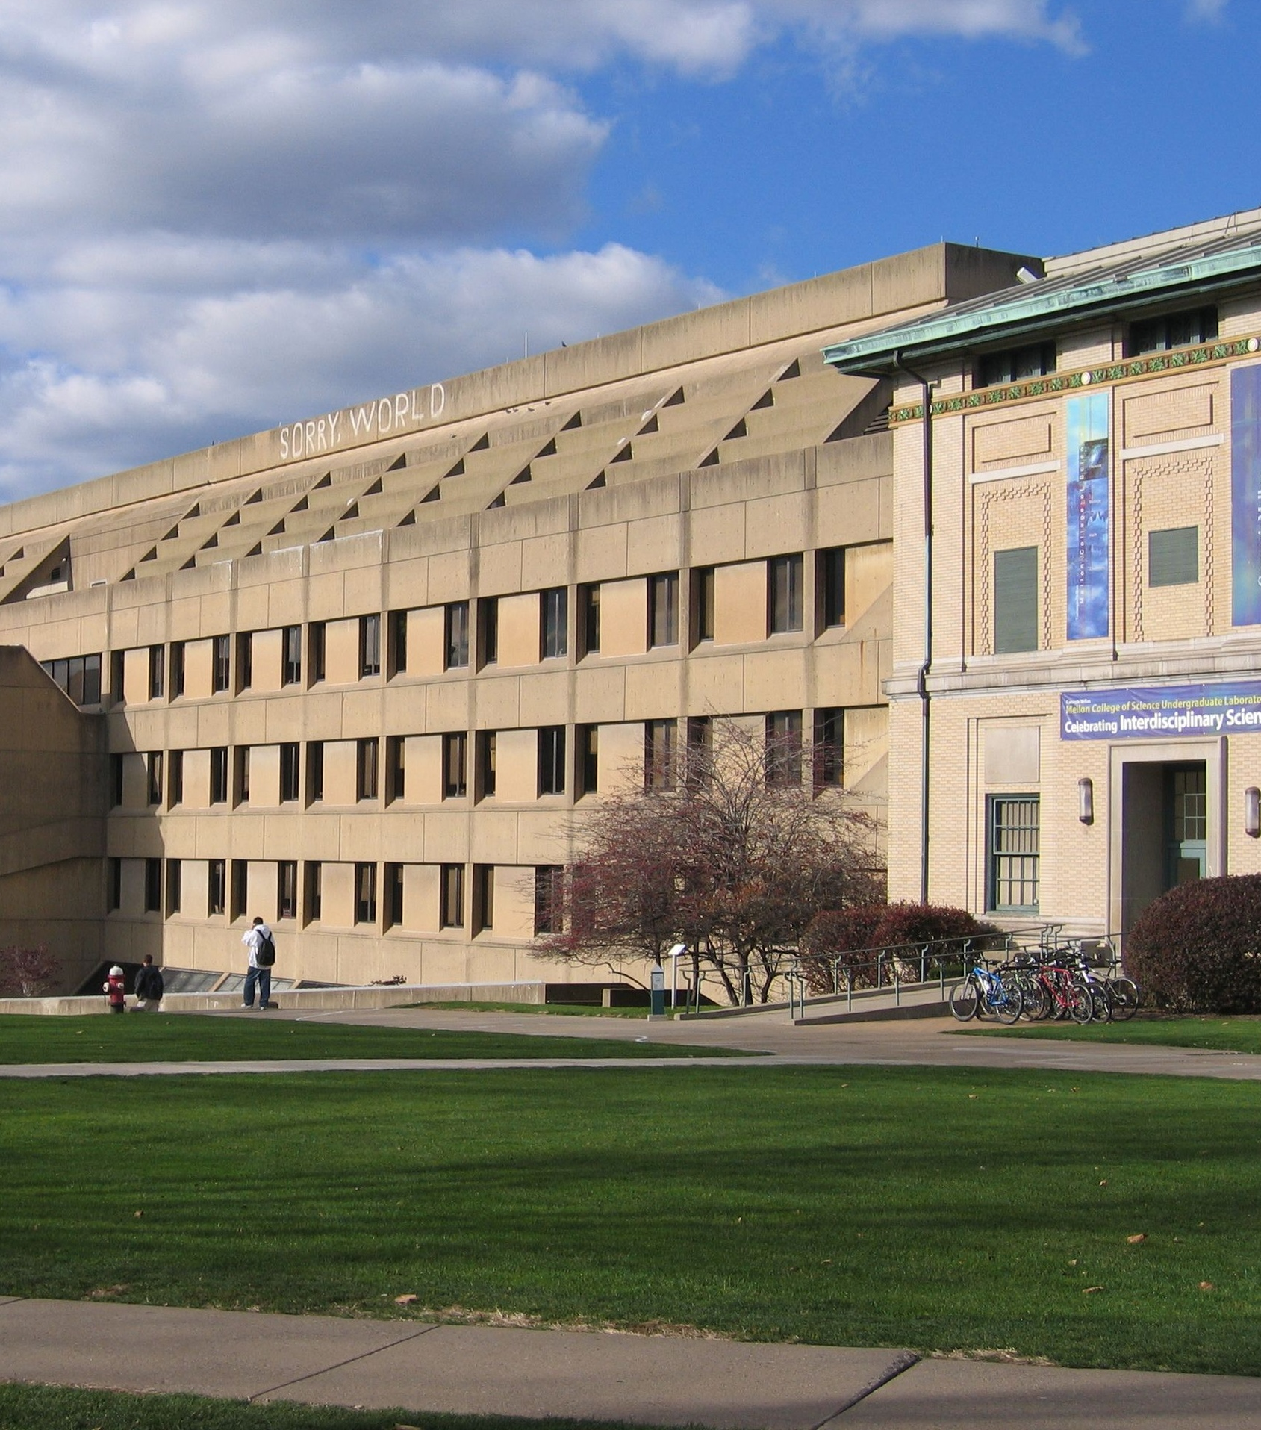
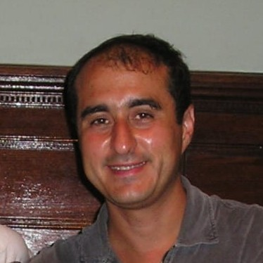
Stefano and Marilena
visited CMU for Fall 2005
we started working on
cost-sharing for approximations
stochastic approx. algos
beyond-worst case algos
continued collaborations
during workshops and visits…

Slide 3
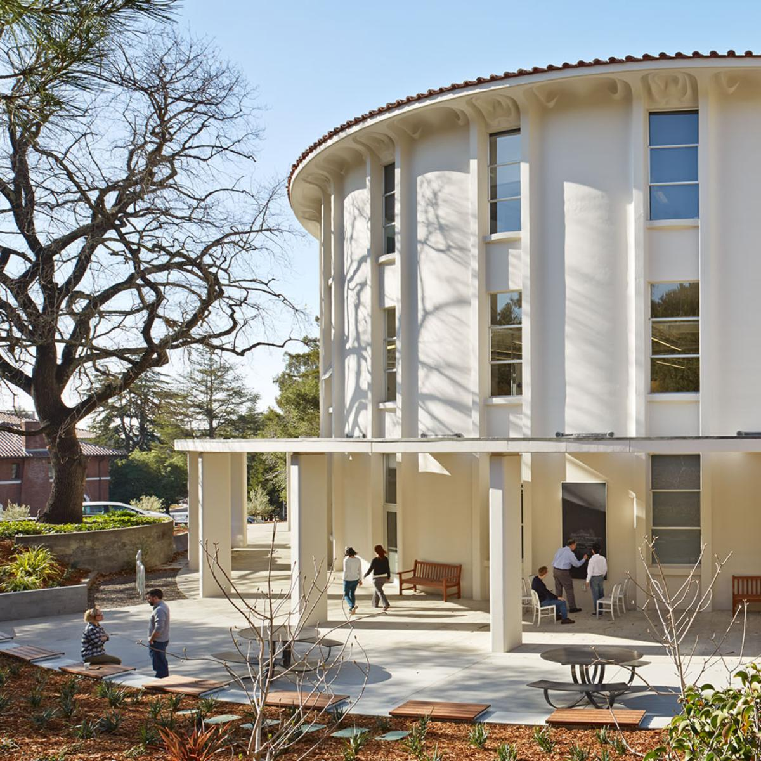

2016: we co-organized
semester program at
Simons Institute

Slide 4
back in 2005,
we both had been thinking about
Beyond Worst Case Analysis
Our discussions (then and later) were crucial to shaping my thinking
about these questions…
Question: what about online settings?
Talk today:
two results from 2008…

Slide 5
analyzing algorithms…
Ideally: want to get algorithms that are good for
worst-case and best-case and …. all cases.
Worst-case: robustness when data is unpredictable
Best-case: efficiency when data follows anticipated patterns
How to model these?
let’s see some ideas/techniques in context of online algos

Slide 6




price of uncertainty
Offline
Online
Steiner tree
$$\sim 1.3$$
$$Θ(\log{n})$$
Set Cover
$$O(\log{n)}$$
$$O(\log{m}\log{n})$$
can we do better in non-worst-case settings?

Slide 7
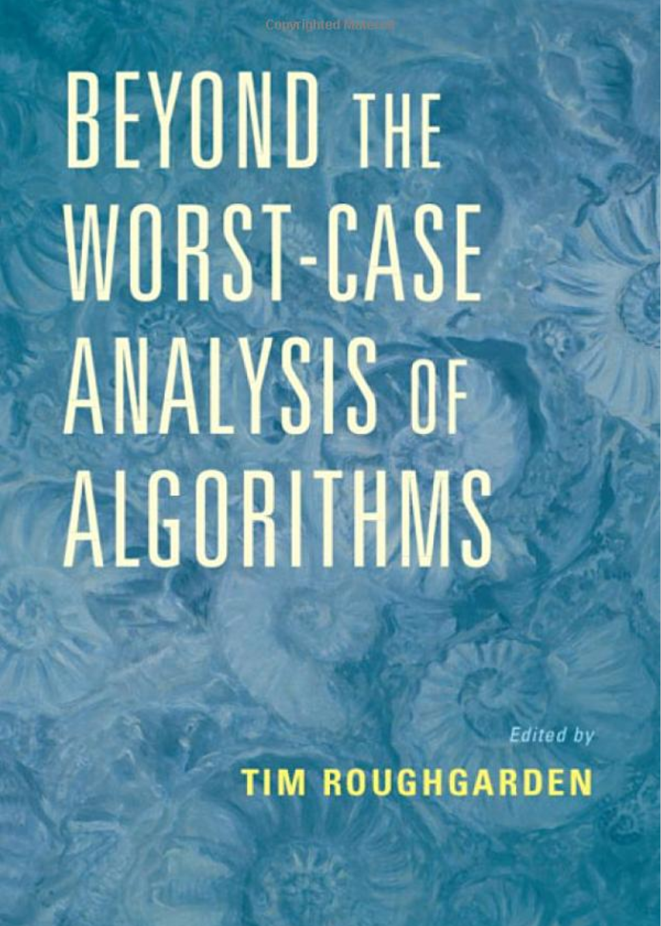
going beyond the worst case
Many ways to model non-worst-case instances
special structure to the instances
requests are “predictable”
arrival order is not worst-case?
semi-random models
train NN to find patterns, give predictions
…

Slide 8






“predictability” helps
Offline
Online
“stochastic”
Steiner tree
$$\sim 1.3$$
$$Ω(\log{n})$$
$$O(1)$$
Set Cover
$$O(\log{n)}$$
$$O(\log{m}\log{n})$$
$$O(\log{m}+ log{n})$$

Slide 9
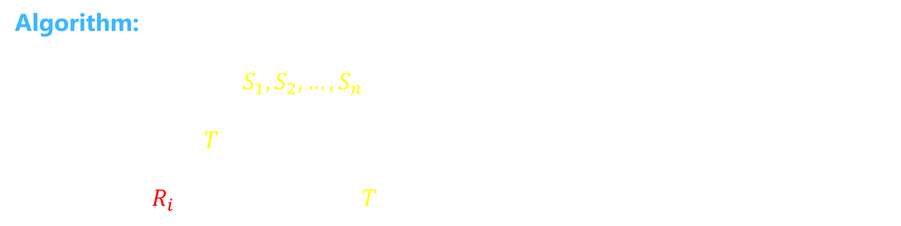

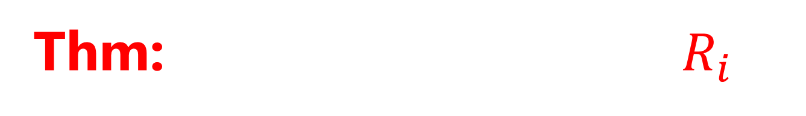
prophet model
[Krengel and Sucheston 78]
[Kesselhiem 17]
[Rubinstein Wang Weinberg 20]
$n$ items arrive online, have value $R_{i}∼𝒟_{i}$ (indep.) Distributions $𝒟_{i}$ known.
Pick one item. Maximize (expected) value.
Algorithm:
Take one sample $S_{1},S_{2},…, S_{n}$ from each distribution.
Set threshold $T←$ their maximum
Pick first $R_{i}$ above threshold $T$
Thm: $𝔼\left[Alg\right]≥1/4 𝔼[\max_{i}{R_{i}}]$

Slide 10





prophet model
[Krengel and Sucheston 78]
[Kesselhiem 17]
[Rubinstein Wang Weinberg 20]
Can get $1/2$ using
more careful anaylsis!!
Thm: $𝔼\left[Alg\right]≥1/4 𝔼[\max_{i}{R_{i}}]$
Samples $S_{1},…, S_{n}$ Real values $R_{1},…, R_{n}$
  sort
  $$W_{1}>W_{2}>…>W_{2n}$$
$Pr⁡[ W_{1} is real ]$ = ½
$⇒\operatorname{Pr}\left[ W_{1}=R_{max} chosen\right]≥$ ¼
$\operatorname{Pr}\left[ W_{2} is sample \right|W_{1} real ]≥$ ½

Slide 11
Steiner Tree

Slide 12
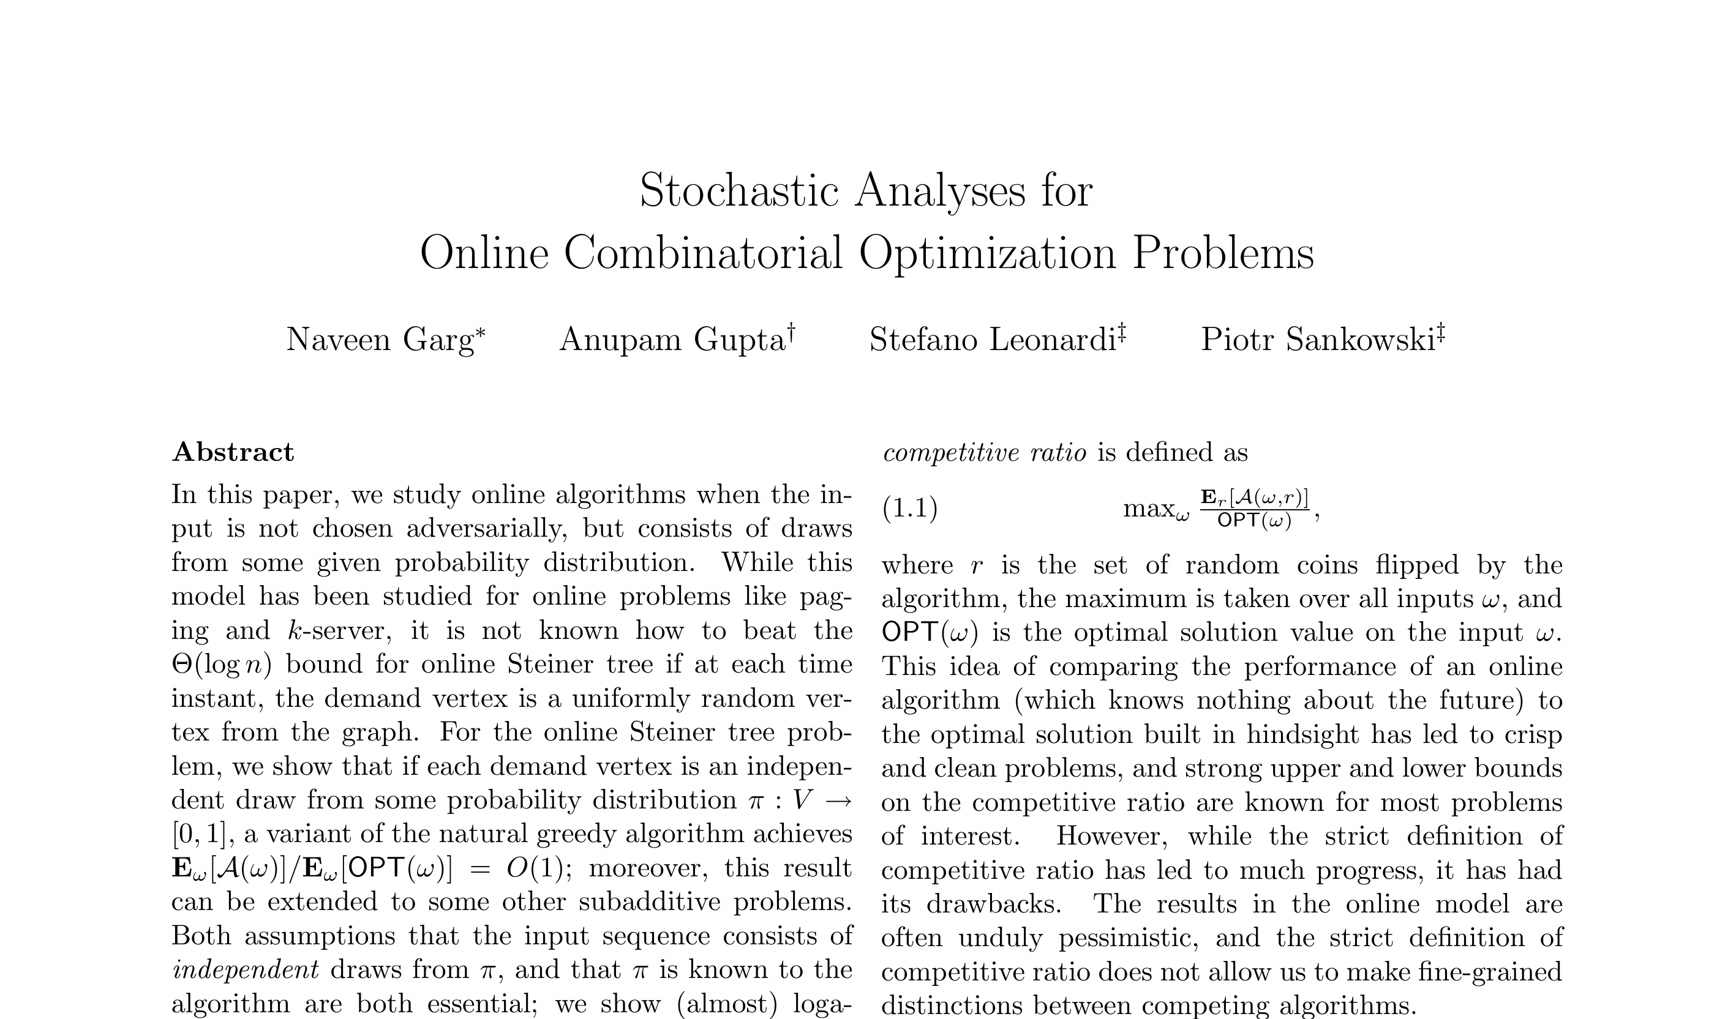

Slide 13







Online (Steiner) Tree
Metric space. n points arrive over time, maintain a connected tree.
Goal: minimize cost of tree
Competitive ratio of algorithm $A$:
$\max_{ instances I}{ \frac{cost of algorithm A on instance I}{optimal cost to serve I}}$
Want to minimize the competitive ratio.
$$v_{4}$$
$$v_{3}$$
$$v_{1}$$
$$v_{5}$$
$$v_{6}$$
$$v_{2}$$
[Imase Waxman 91]

Slide 14






online (steiner) tree
$$G_{0}$$
$$G_{1}$$
Suppose root vertex, n requests online
$$G_{2}$$
Connect each request on arrival
Goal: minimize total cost of edges
$$G_{3}$$
Thm 1: greedy is $O(\log{T})$ competitive
Thm 2: no online algorithm can do better
in the worst-case…
$G_{k}$: “diamond graph” or fractal of $K_{2,2}$
[Imase Waxman 91]

Slide 15
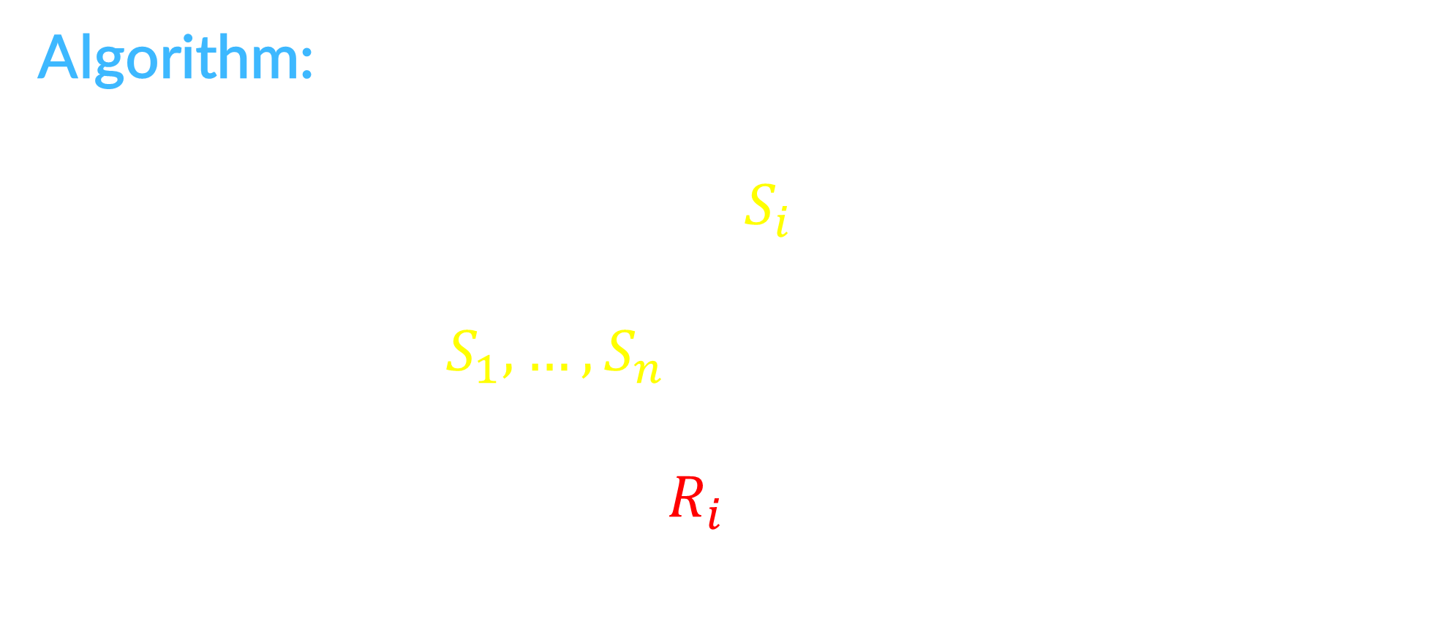
stochastic (steiner) tree
Suppose n requests: vertex $R_{i } \sim 𝒟_{i}$
Connect each request on arrival
Algorithm:
For all i, take one sample $S_{i} \sim 𝒟_{i}$ each
Build MST on $S_{1},…, S_{n}$
When actual requests $R_{i} \sim 𝒟_{i}$ arrive:
connect to closest previous point
Goal: minimize expected cost of edges
[Garg G. Leonardi Sankowski 08]

Slide 16

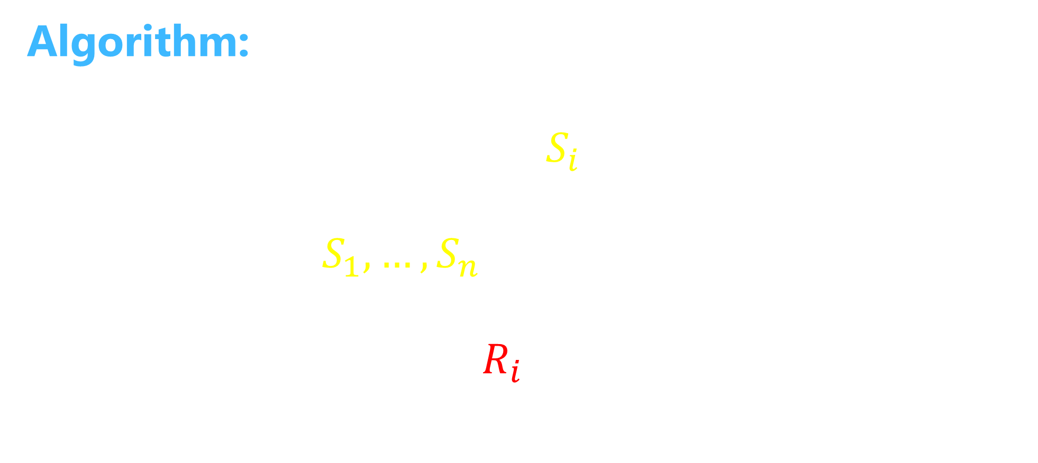


stochastic (steiner) tree
[Garg G. Leonardi Sankowski 08]
Suppose n requests: vertex $R_{i } \sim 𝒟_{i}$
Theorem: $𝔼\left[Algo\right]≤2 𝔼[MST\left(R_{1},…, R_{n}\right)]$
Connect each request on arrival
Algorithm:
For all i, take one sample $S_{i} \sim 𝒟_{i}$ each
Build MST on $S_{1},…, S_{n}$
When actual requests $R_{i} \sim 𝒟_{i}$ arrive:
connect to closest previous point
$$𝔼\left[MST\left(S_{1},…, S_{n}\right)\right]=𝔼\left[MST\left(R_{1},…, R_{n}\right)\right]$$
Proof:
$$𝔼\left[cost\left(R_{i}\right)\right]≤𝔼[dist\left(R_{i}, S\right)]$$
$$≤𝔼[dist\left(R_{i}, S_{−i}\right)]$$
$$=𝔼[dist\left(S_{i}, S_{−i}\right)]$$
$$⇒ Σ_{i} 𝔼\left[cost\left(R_{i}\right)\right]≤Σ_{i} 𝔼\left[dist\left(S_{i}, S_{−i}\right)\right]≤𝔼\left[ MST\left(S\right) \right]$$

Slide 17
Set Cover

Slide 18
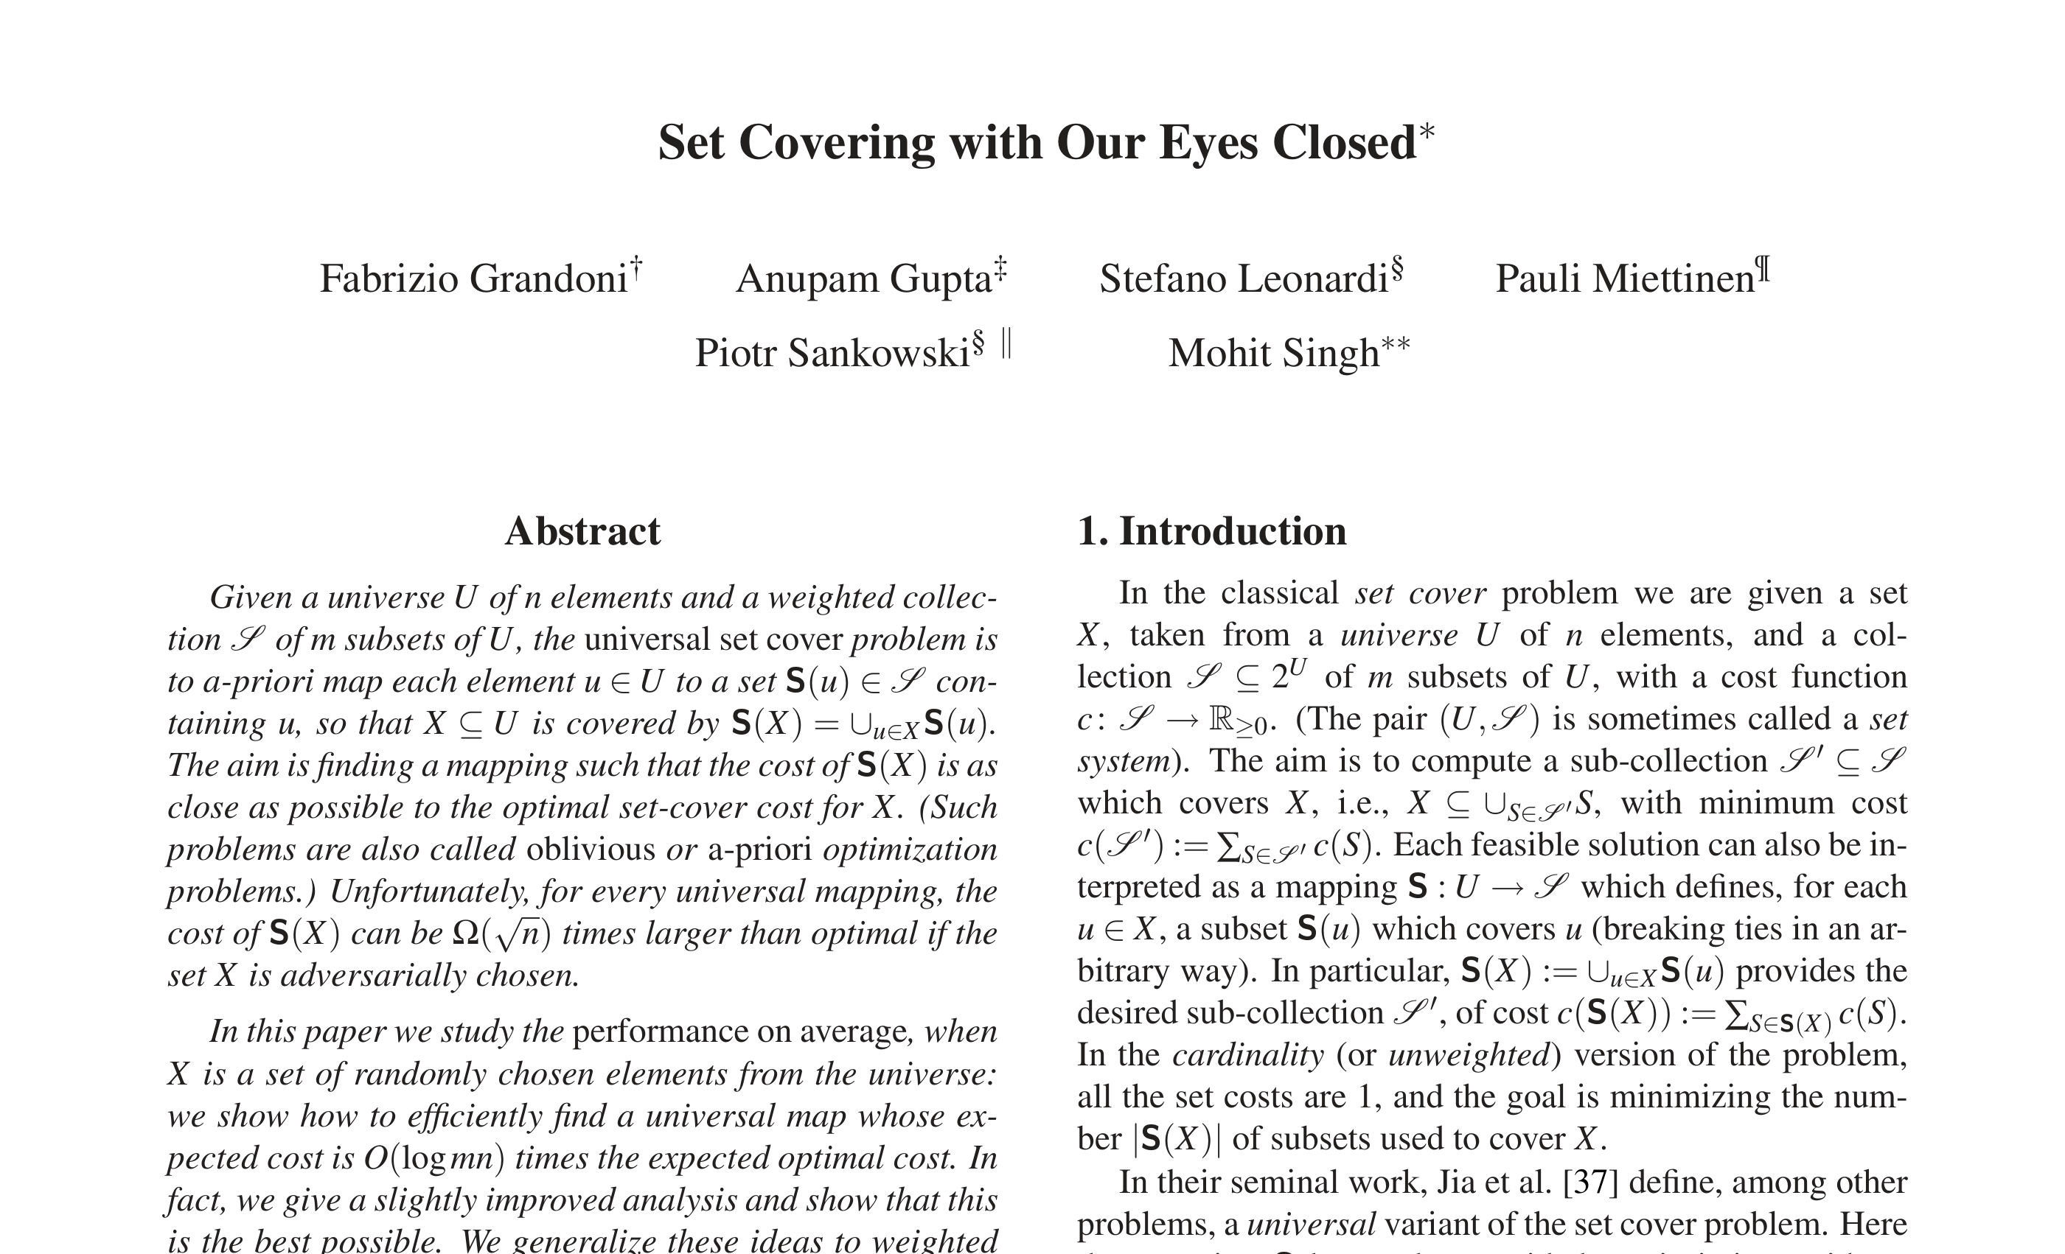

Slide 19

set cover
$|𝒰|=n=$# elements
$|ℱ|=m=$# sets
$$v_{4}$$
$$v_{4}$$
$$v_{5}$$
$$v_{2}$$
$$v_{5}$$
$$v_{2}$$
$$v_{3}$$
$$v_{3}$$
$$v_{1}$$
$$v_{1}$$
$$v_{6}$$
$$v_{6}$$
Goal: pick smallest # sets to cover all elements.
“weighted” problem: sets have costs, minimize cost of cover

Slide 20


Stochastic Model
Given: set system (U, $ℱ$), possibly with set cost c(S).
Request sequence $σ$ = {x₁, x₂, …, x_{k}} arrives online.
Each x_{t} is drawn uniformly at random from U.
On seeing request x_{t} that is yet uncovered, output some set S_{t} covering it.
Want to minimize the E[ cost of sets output on $σ$ ]
again, compared to E[ cost of optimal solution for $σ$ ]
In general, element $e∈U$ drawn w.p. $p_{e}$
[Grandoni G. Leonardi Miettinen Sankowski Singh 08]

Slide 21

Special solutions: Universal Maps
Given: set system (U, $ℱ$), possibly with set cost c(S).
Request sequence $σ$ = {x₁, x₂, …, x_{k}} arrives online.
Each x_{t} is drawn uniformly at random from U.
Up-front, give a “universal mapping”
associate set S(e) in $ℱ$ with each element e in U.
Want to minimize the E[ cost of sets output on $σ$ ]
again, compared to E[ cost of optimal solution for $σ$ ]

Slide 22
Universal Solutions
A potential solution:

Slide 23
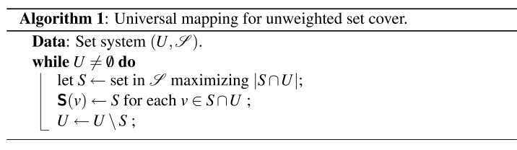
Universal Solutions
Theorem: Map given by greedy algorithm is O(log m + log n) competitive.
Each element maps to the first set in greedy which covers it.

Slide 24
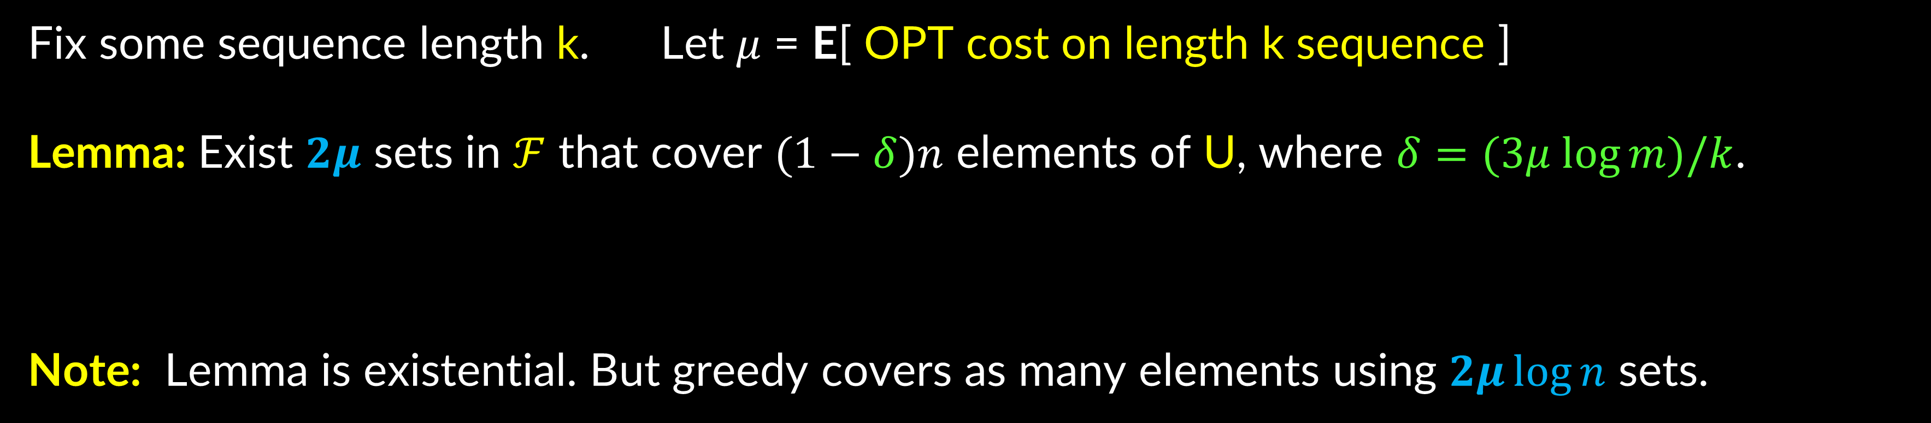
Exists Good Universal Map
Fix some sequence length k. Let $μ$ = E[ OPT cost on length k sequence ]
Lemma: Exist $2μ$ sets in $ℱ$ that cover $(1−δ)n$ elements of U, where $δ=(3μ log⁡m)/k$.
Note: Lemma is existential. But greedy covers as many elements using $2μ\log{n}$ sets.
call these “happy”
Proof: next slide
Happy elements in our sequence covered by $2μ\log{n}$sets
E[sad elements in our sequence] = $δk=O(μ\log{m)}$, use at most one set for each

Slide 25

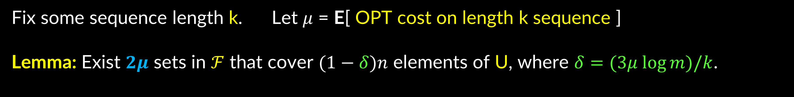

Exists Good Universal Map
Fix some sequence length k. Let $μ$ = E[ OPT cost on length k sequence ]
Lemma: Exist $2μ$ sets in $ℱ$ that cover $(1−δ)n$ elements of U, where $δ=(3μ log⁡m)/k$.
Proof: Consider all the $n^{k}$ sequences
Expected number of sets in OPT is $μ$
$⇒$ at least $½n^{k}$ sequences can be covered by $2μ$ sets (call them “good”)
Consider “bags” of elements $C_{1}, C_{2}, …, C_{L}$ got by taking unions of $2μ$ sets.
For contradiction, suppose each bag has $≤\left(1−δ\right)n$ elements.
$$L=m^{2μ}$$
Another way to generate good sequences: pick $C_{i}$ and pick $k$ elements
So: $L×{\left[\left(1−δ\right)n\right]}^{k}≥$ $½n^{k}$ $⇒m^{2μ} e^{−δk}≥1/2.$

Slide 26
“predictability” helps
Offline
Online
Prophet
Steiner tree
$$\sim 1.3$$
$$Ω(\log{n})$$
$$O(1)$$
Set Cover
$$O(\log{n)}$$
$$O(\log{m}\log{n})$$
$$O(\log{m}+ log{n})$$
for Set Cover:
can also handle (known) different distributions at each time
with one sample per distribution [G. Kehne Levin 24]

Slide 27


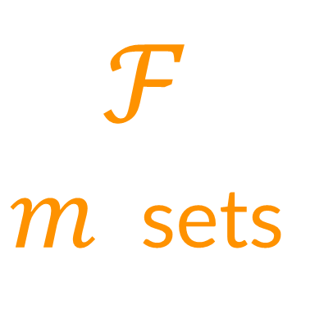








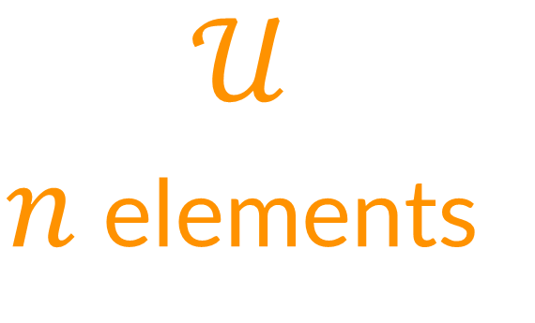


Random Order (RO)
[G. Kehne Levin 21]
$$s_{1}$$
$$v_{1}$$
$$v_{1}$$
$$s_{2}$$
$$v_{2}$$
$$v_{2}$$
$$ℱ$$
$m$ sets
$$𝒰$$
$n$ elements
$$s_{3}$$
$$v_{3}$$
$$v_{3}$$
$$s_{4}$$
$$v_{4}$$
$$v_{4}$$
$$s_{5}$$
$$v_{5}$$
$$v_{5}$$
$$s_{6}$$
$$v_{6}$$
$$v_{6}$$
$O\left(log mn\right)⋅OPT$ in random order online model

Slide 28
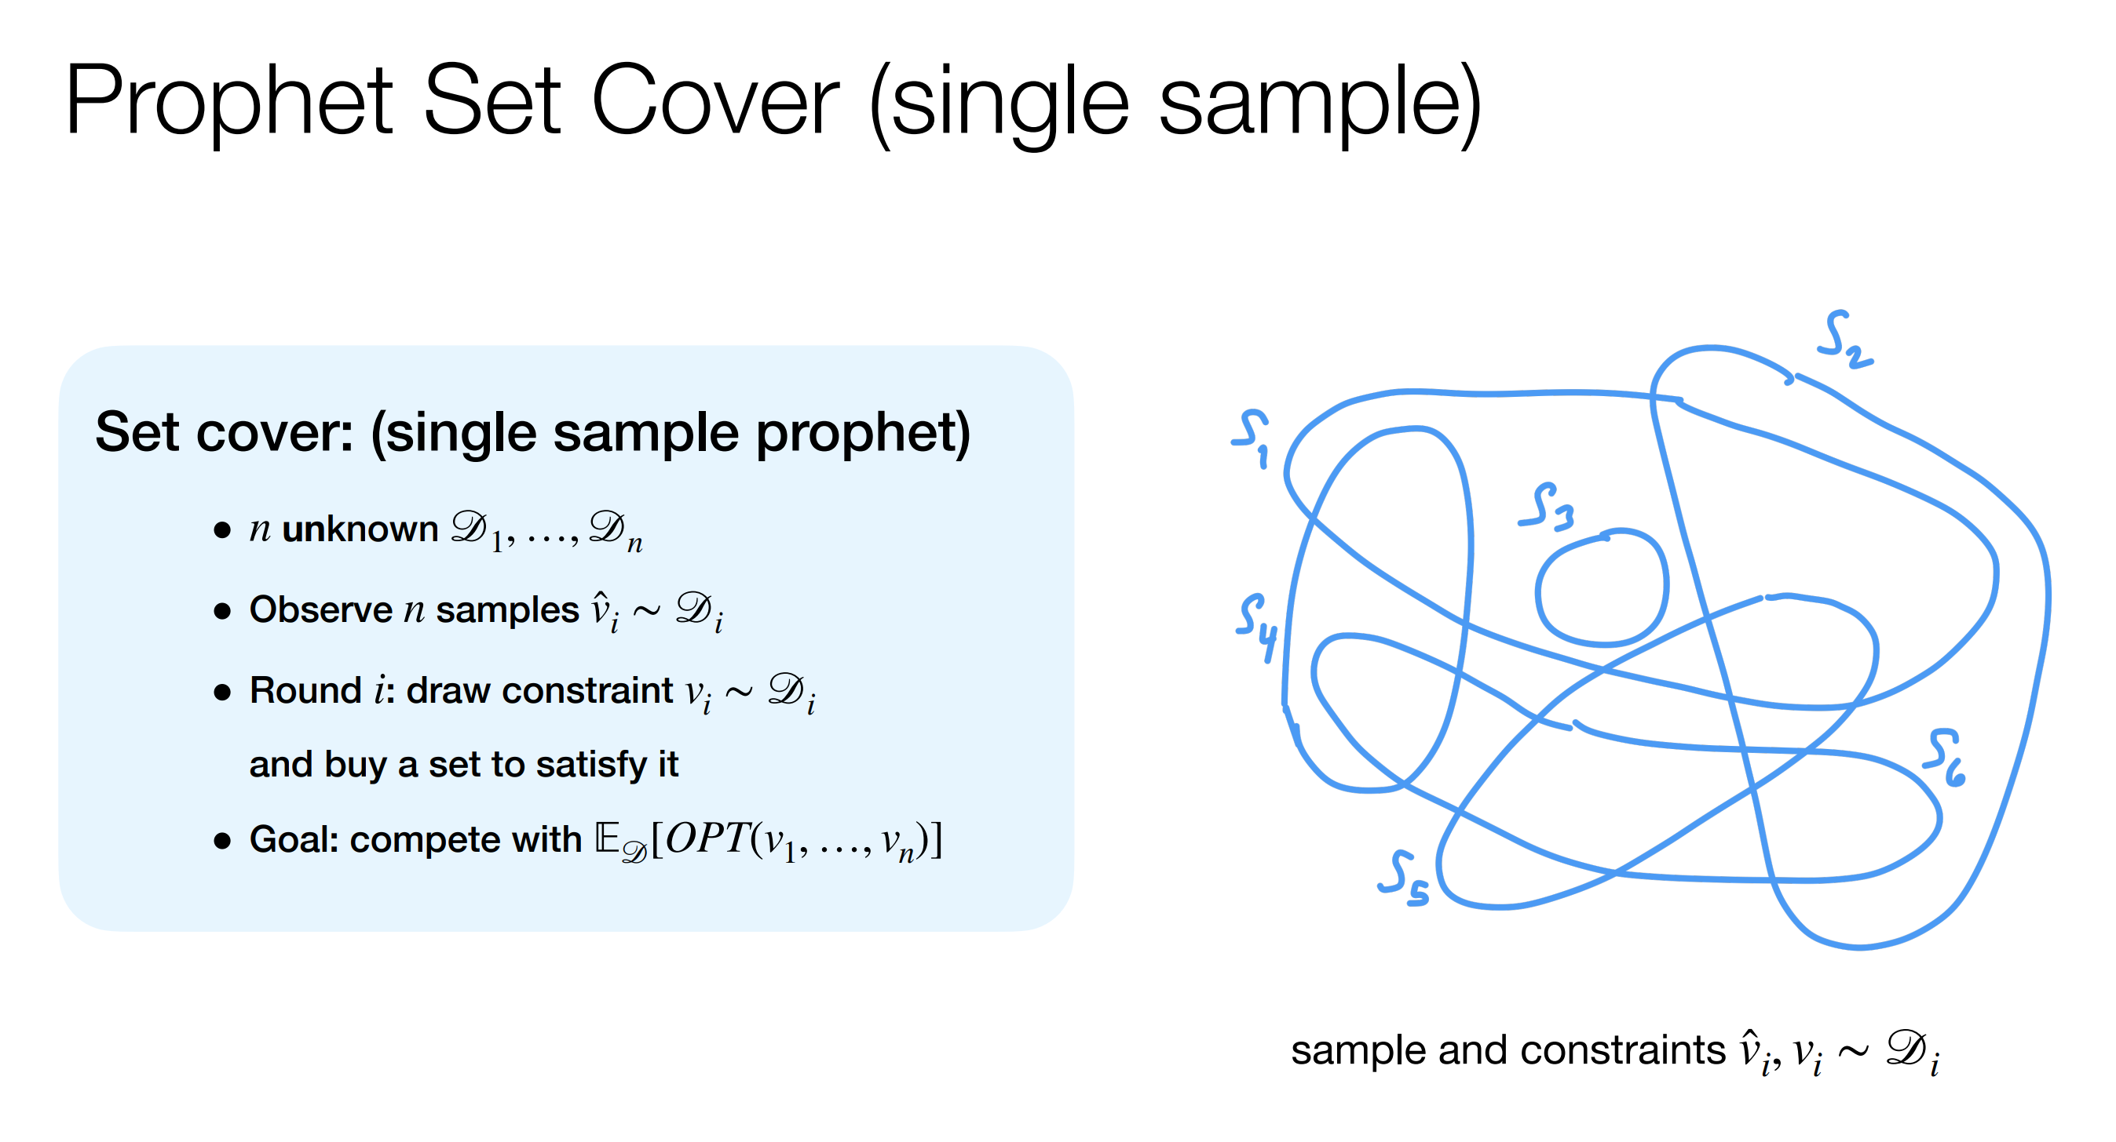
[G. Kehne Levin 24]

Slide 29
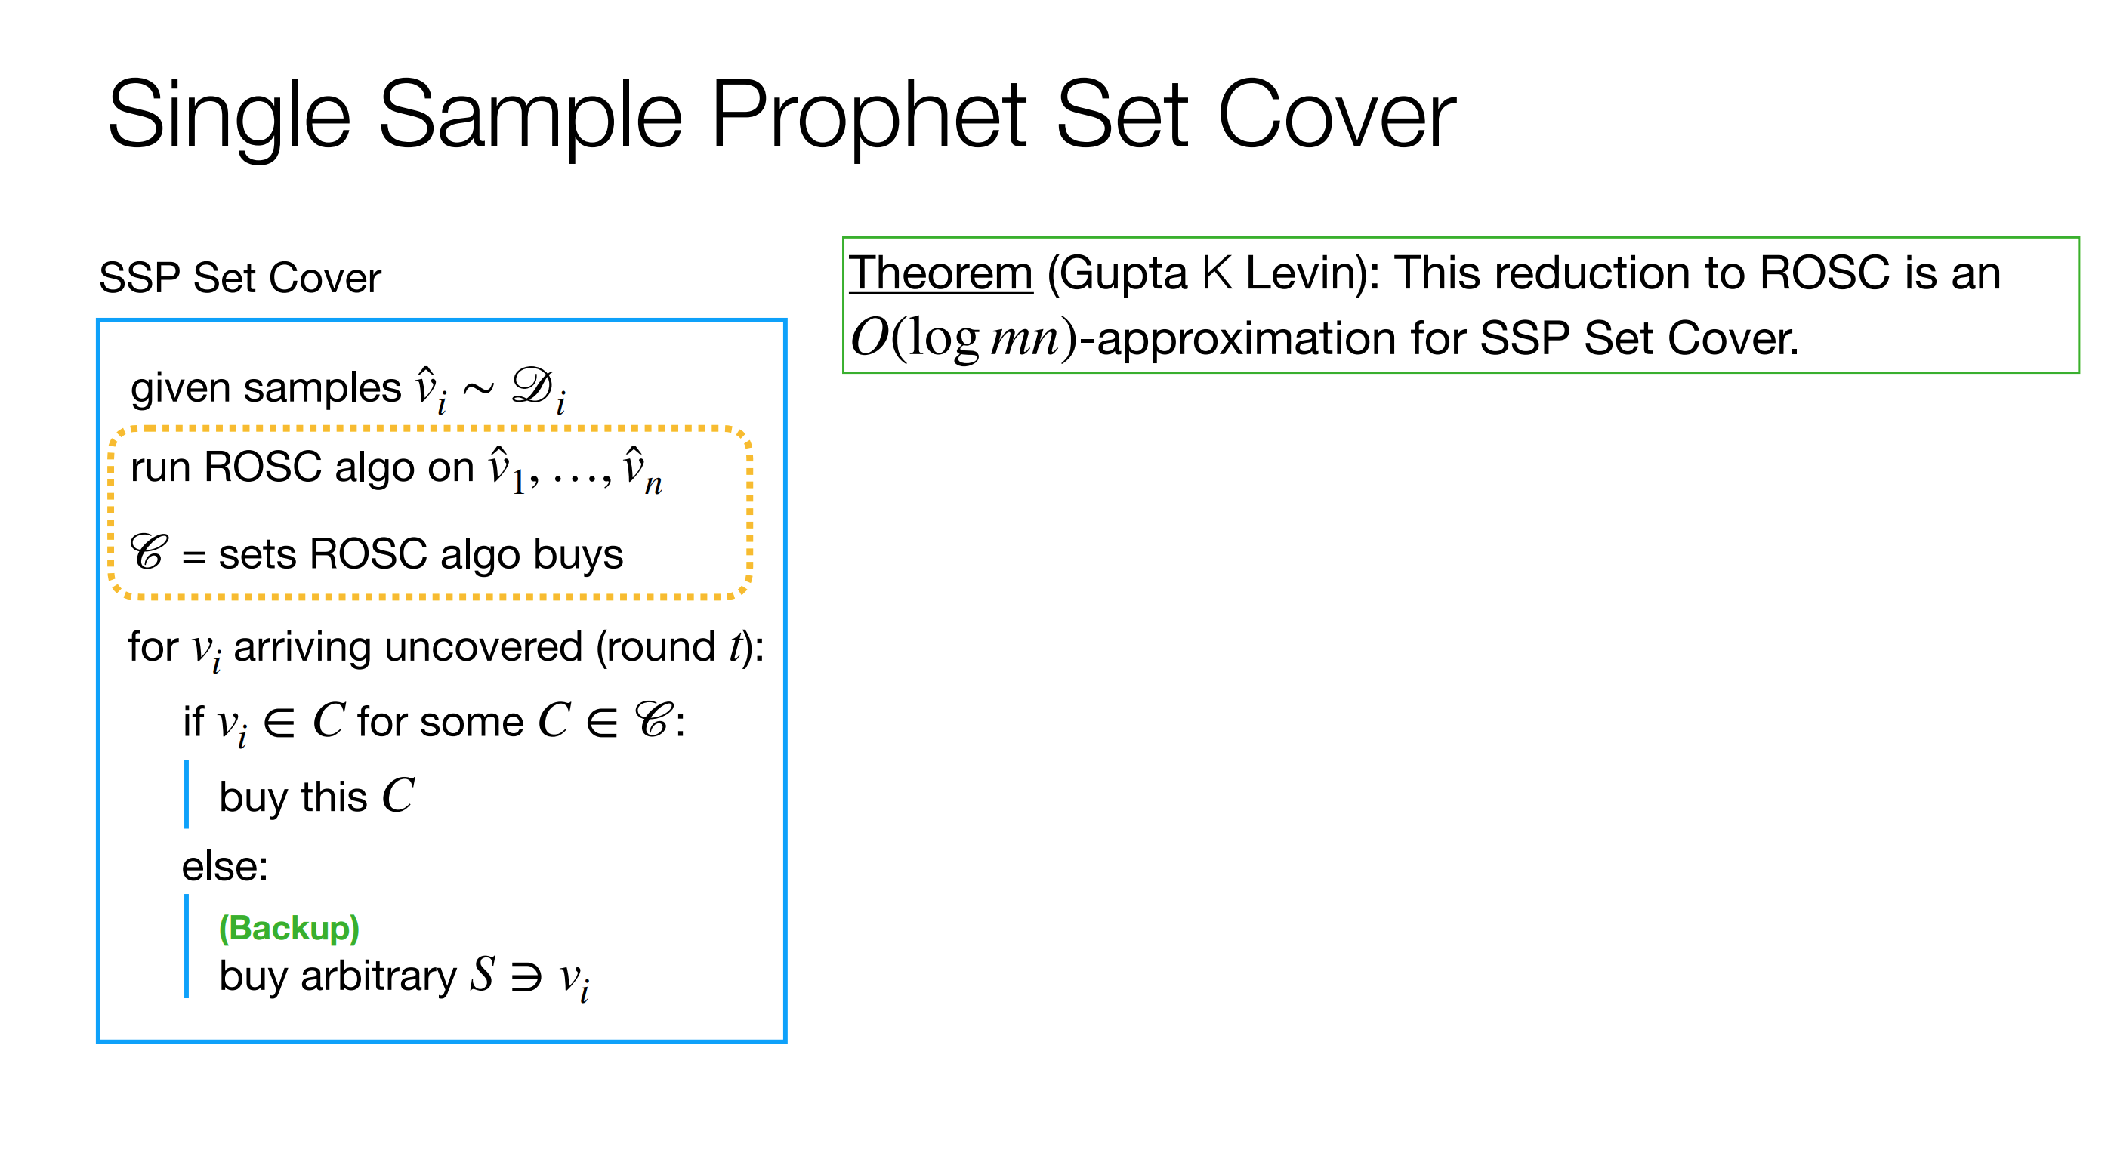
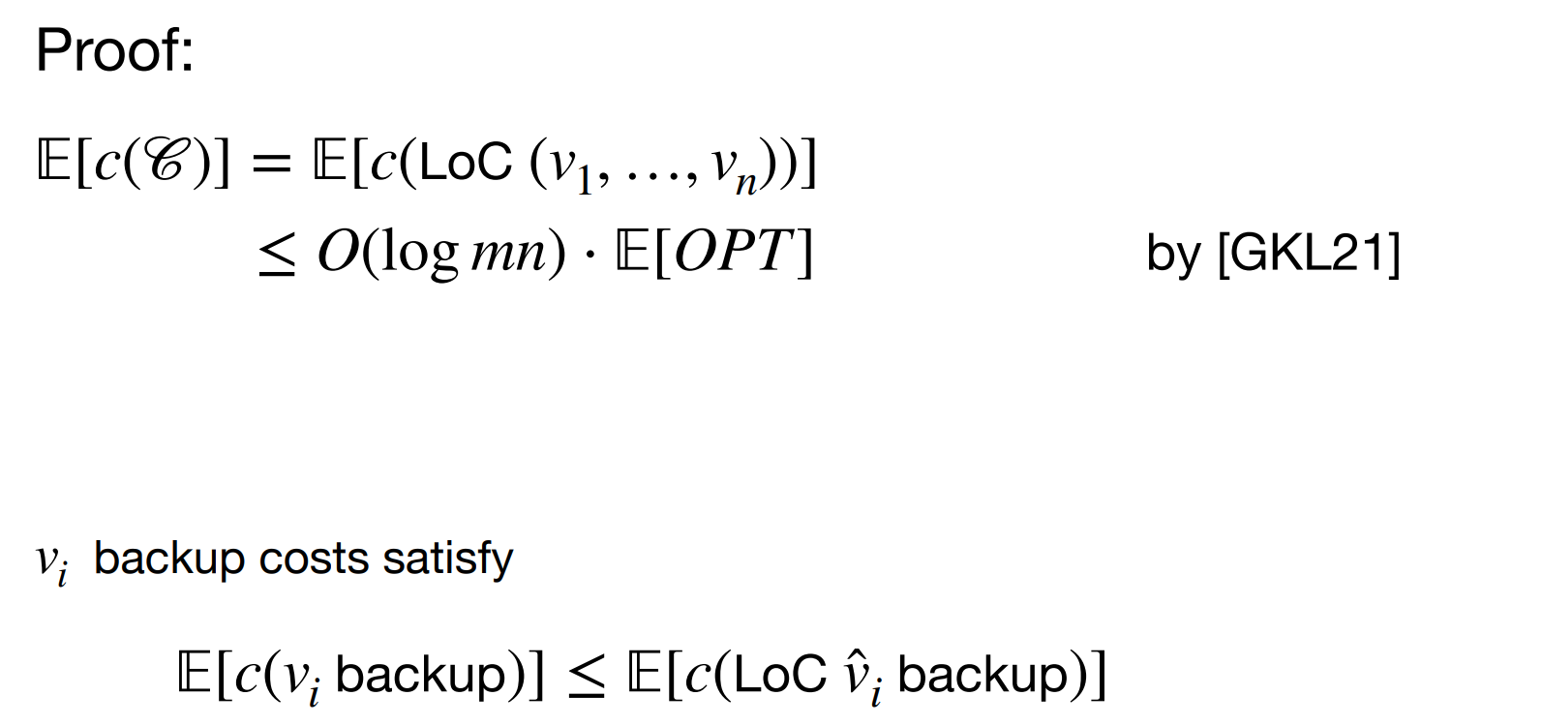
[G. Kehne Levin 24]
ROSC

Slide 30
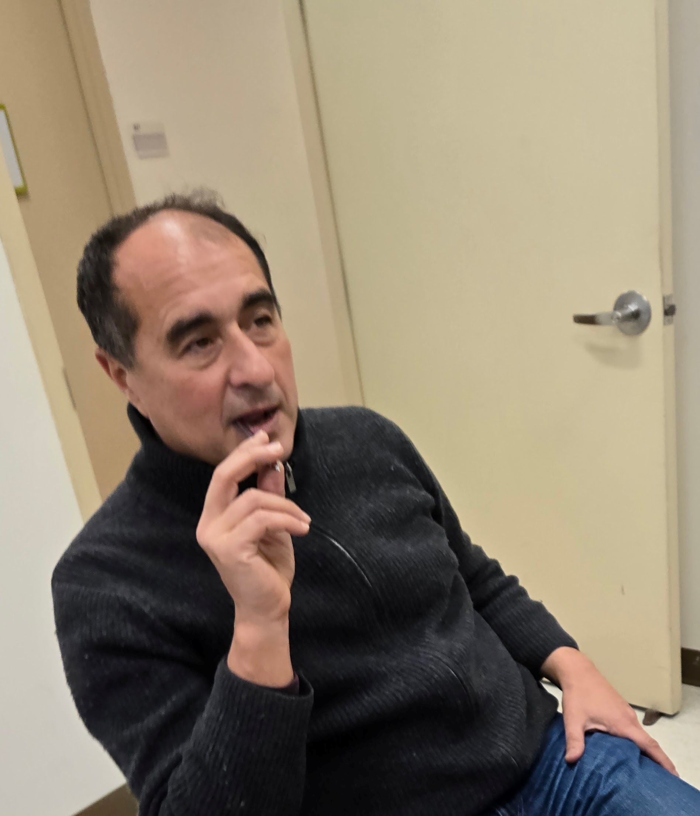
next steps
more sophisticated stochastic models:
random order, Markov chains,
shifting distributions?
best of both worlds:
algo for worst case + stochastic?
other discrete optimization problems?
lower bounds?
Looking forward to collaborating
for next 20 years!
Thanks Stefano!!

