Slide 1

Online Algos: Old and New
Lecture 4: Search Problems
Anupam Gupta (NYU)

Slide 2


lecture plan
Lecture #1: Set Cover (worst case)
Lecture #2: Set Cover (beyond worst case), Network design (both)
Lecture #3: Resource Allocation (aka packing)
Lecture #4: Search Problems (aka chasing)

Slide 3
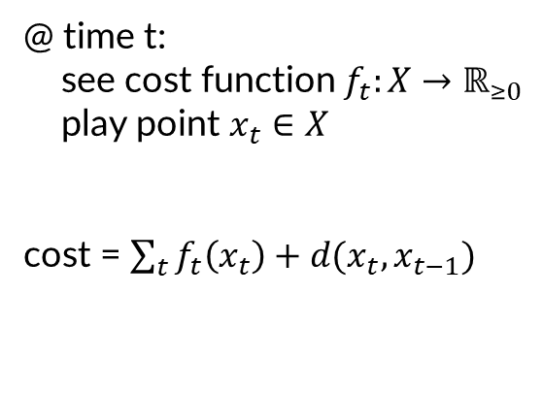

Metrical Task System = Function Chasing
Metric space $\left(X,d\right)$, $x_{0}∈X$
@ time t:
see cost function $f_{t}:X→ℝ_{≥0}$
play point $x_{t}∈X$
cost = $\sum_{t}{f_{t}\left(x_{t}\right)+d(x_{t},x_{t−1})}$
[Borodin Linial Saks 92]

Slide 4
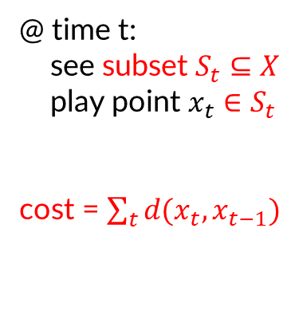
Metrical Service System = Set Chasing
Metric space $\left(X,d\right)$, $x_{0}∈X$
@ time t:
see subset $S_{t}⊆X$
play point $x_{t}∈S_{t}$
cost = $\sum_{t}{d(x_{t},x_{t−1})}$
[Borodin Linial Saks 92]

Slide 5
Set Chasing
Uniform Metric

Slide 6





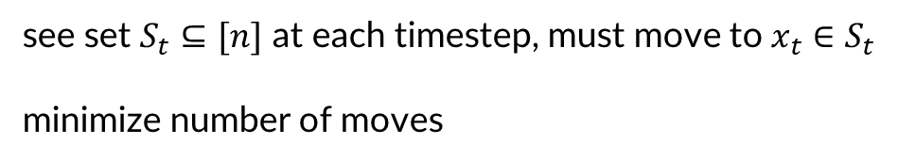






Uniform Metric Set Chasing
$$x_{0}=1$$
n points, unit distance from each other
$$S_{1}=\{2,3,4,5…n\}$$
$$x_{1}=2$$
see set $S_{t}⊆[n]$ at each timestep, must move to $x_{t}∈S_{t}$
minimize number of moves
$$S_{2}=\{1,3,4,5,…n\}$$
$$x_{2}=1$$
$$S_{3}=\{2,3,4,5…n\}$$
$$x_{3}=2$$
Algo 0: Move to arbitrary point in $S_{t}$
$$S_{4}=\{1,3,4,5,…n\}$$
$$x_{4}=1$$
…
OPT = 1
E[ALG] = $Θ(n)$

Slide 7

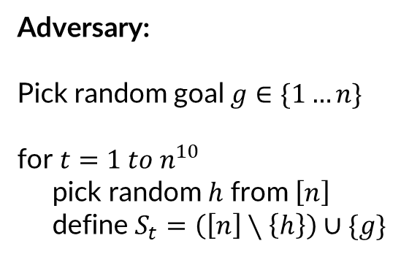

Uniform Metric Set Chasing
n points, unit distance from each other
Adversary:
Pick random goal $g∈\{1…n\}$
for $t=1 to n^{10}$
pick random $h$ from $\left[n\right]$
define $S_{t}=\left(\left[n\right]∖\left\{h\right\}\right)∪\{g\}$
see set $S_{t}⊆[n]$ at each timestep, must move to $x_{t}∈S_{t}$
minimize number of moves
Algo 0: Move to arbitrary point in $S_{t}$
Algo 1: Move to random point in $S_{t}$
OPT = 1
E[ALG] = $Θ(n)$

Slide 8
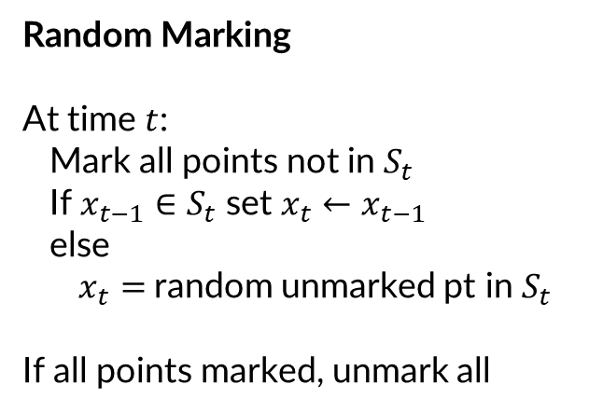


Uniform Metric Set Chasing
n points, unit distance from each other
Random Marking
At time $t$:
Mark all points not in $S_{t}$
If $x_{t−1}∈S_{t}$ set $x_{t}←x_{t−1}$
else
$x_{t}=$random unmarked pt in $S_{t}$
If all points marked, unmark all
see set $S_{t}⊆[n]$ at each timestep, must move to $x_{t}∈S_{t}$
minimize number of moves
Algo 2: Random marking
Thm 1: Random marking is $O(\log{n)}$ competitive
Last marked node in epoch
Epoch: times between two unmarks
OPT $≥1$ in an epoch
Epoch
ALG $≤O(\log{n)}$

Slide 9




Uniform Metric Set Chasing
n points, unit distance from each other
“antiset”
Yao’s lemma
see set $S_{t}⊆[n]$ at each timestep, must move to $x_{t}∈S_{t}$
minimize number of moves
$$S_{t}=\left[n\right]∖uniformly random node$$
Epoch ends when all pages have been
antiset in this epoch
Thm 1: Random marking is $O(\log{n)}$ competitive
Thm 2: Every (rand) algorithm is $Ω(\log{n)}$ competitive
Epoch length = $nH_{n}$
OPT $≅1$ per epoch (move to last antiset)
E[ALG] pays $1/n$ per step

Slide 10
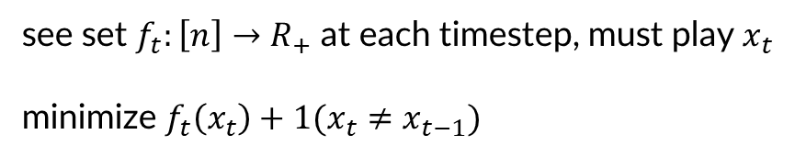
Uniform Metric Function Chasing
n points, unit distance from each other
see set $f_{t}:\left[n\right]→R_{+}$ at each timestep, must play $x_{t}$
minimize $f_{t}\left(x_{t}\right)+1(x_{t}≠x_{t−1})$
Thm 1: variant of Random marking is $O(\log{n)}$ competitive
Thm 2: Every (rand) algorithm is $Ω(\log{n)}$ competitive (follows from previous lower bound)

Slide 11



General Metric Function Chasing
General metric space $\left(V,d\right)$ on $n$ points
Each time function $f_{t}:V→ℝ_{+}$
must play $x_{t}$, pay $f_{t}\left(x_{t}\right)+d(x_{t}, x_{t−1})$
Thm 3: $O(\log^{2}{n)}$ competitive algo [Bubeck Cohen Lee Lee 17, Coester Lee 19]
Thm 4: Every (rand) algorithm is $Ω(\log^{2}{n)}$ competitive [Bubeck Coester Rabani 22]

Slide 12
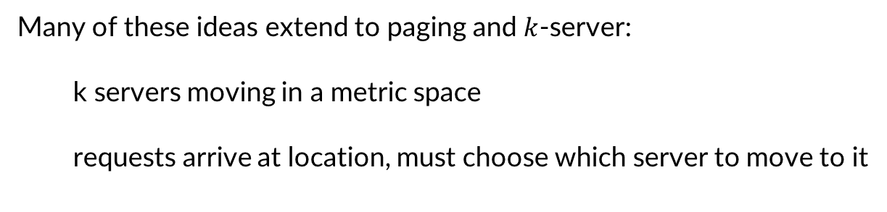
Further directions
Many of these ideas extend to paging and $k$-server:
k servers moving in a metric space
requests arrive at location, must choose which server to move to it

Slide 13
Convex Function Chasing

Slide 14

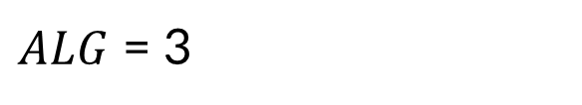



Convex Body Chasing: definition
algorithm controls point in $ℝ^{d}$
at time t:
convex body $K_{t}$ arrives
algorithm moves to $x_{t}$
3
pays $||{ x}_{t}−x_{t−1} ||$
$ALG$ = 3
[Friedman Linial 94]

Slide 15
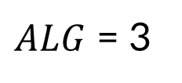
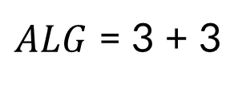
Convex Body Chasing: definition
algorithm controls point in $ℝ^{d}$
at time t:
convex body $K_{t}$ arrives
algorithm moves to $x_{t}$
3
pays $||{ x}_{t}−x_{t−1} ||$
3
$ALG$ = 3 + 3
$ALG$ = 3
[Friedman Linial 94]

Slide 16
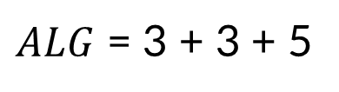
Convex Body Chasing: definition
algorithm controls point in $ℝ^{d}$
at time t:
convex body $K_{t}$ arrives
algorithm moves to $x_{t}$
5
3
pays $||{ x}_{t}−x_{t−1} ||$
3
$ALG$ = 3 + 3 + 5
$ALG$ = 3 + 3
[Friedman Linial 94]

Slide 17
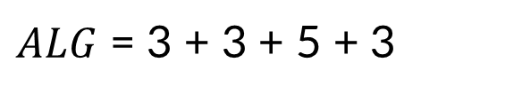
Convex Body Chasing: definition
algorithm controls point in $ℝ^{d}$
3
at time t:
convex body $K_{t}$ arrives
algorithm moves to $x_{t}$
5
3
pays $||{ x}_{t}−x_{t−1} ||$
3
$ALG$ = 3 + 3 + 5 + 3
$ALG$ = 3 + 3 + 5
[Friedman Linial 94]

Slide 18

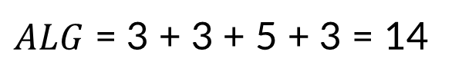

Convex Body Chasing: definition
algorithm controls point in $ℝ^{d}$
5
3
at time t:
convex body $K_{t}$ arrives
4
2
algorithm moves to $x_{t}$
5
3
pays $||{ x}_{t}−x_{t−1} ||$
3
$ALG$ = 3 + 3 + 5 + 3 = 14
$$cr(ALG)≔\max_{σ}{ \frac{ALG\left(σ\right)}{OPT\left(σ\right)}}$$
$OPT$ = 2 + 4 + 5 = 11
[Friedman Linial 94]

Slide 19

Nested Version
algorithm controls point in $ℝ^{d}$
at time t:
convex body $K_{t}$ arrives
algorithm moves to $x_{t}$
pays $||{ x}_{t}−x_{t−1} ||$
nested: $K_{t}⊆K_{t−1}$
[Bansal Bohm Elias Koumoutsos Umboh SODA 2018]

Slide 20
Nested Version
algorithm controls point in $ℝ^{d}$
at time t:
convex body $K_{t}$ arrives
algorithm moves to $x_{t}$
pays $||{ x}_{t}−x_{t−1} ||$
nested: $K_{t}⊆K_{t−1}$
[Bansal Bohm Elias Koumoutsos Umboh SODA 2018]

Slide 21
Nested Version
algorithm controls point in $ℝ^{d}$
at time t:
convex body $K_{t}$ arrives
algorithm moves to $x_{t}$
pays $||{ x}_{t}−x_{t−1} ||$
nested: $K_{t}⊆K_{t−1}$
[Bansal Bohm Elias Koumoutsos Umboh SODA 2018]

Slide 22
Nested Version
algorithm controls point in $ℝ^{d}$
at time t:
convex body $K_{t}$ arrives
algorithm moves to $x_{t}$
pays $||{ x}_{t}−x_{t−1} ||$
nested: $K_{t}⊆K_{t−1}$
[Bansal Bohm Elias Koumoutsos Umboh SODA 2018]

Slide 23
Nested Version
algorithm controls point in $ℝ^{d}$
at time t:
convex body $K_{t}$ arrives
algorithm moves to $x_{t}$
pays $||{ x}_{t}−x_{t−1} ||$
nested: $K_{t}⊆K_{t−1}$
[Bansal Bohm Elias Koumoutsos Umboh SODA 2018]

Slide 24


Nested Version
$$ALG$$
algorithm controls point in $ℝ^{d}$
at time t:
$$OPT$$
convex body $K_{t}$ arrives
algorithm moves to $x_{t}$
pays $||{ x}_{t}−x_{t−1} ||$
nested: $K_{t}⊆K_{t−1}$
[Bansal Bohm Elias Koumoutsos Umboh SODA 2018]

Slide 25


a closely related problem: convex function chasing
algorithm controls point in $ℝ^{d}$
at time t:
convex function $f_{t}$ arrives
algorithm moves to $x_{t}$
pays $||{ x}_{t}−x_{t−1} ||$
+ ${f(x}_{t})$
[Friedman Linial 94]

Slide 26



Reductions: $\text{CB}{\text{C}}_{d}≤\text{CF}{\text{C}}_{d}≤\text{CB}{\text{C}}_{d+1}$
algorithm controls point in $ℝ^{d}$
at time t:
convex function $f_{t}$ arrives
algorithm moves to $x_{t}$
pays $||{ x}_{t}−x_{t−1} ||$
+ ${f(x}_{t})$
within $O(1)$ of CBC in $d+1$ dim
[Bubeck, Lee, Li, Sellke STOC 2019]

Slide 27
why do we care about convex body chasing?
Generalization of (fractional version) of many online problems
  paging and k-server
  set cover and other packing/covering problems
get generic online convex program solvers?
get a unified algorithm for these problems?

Slide 28
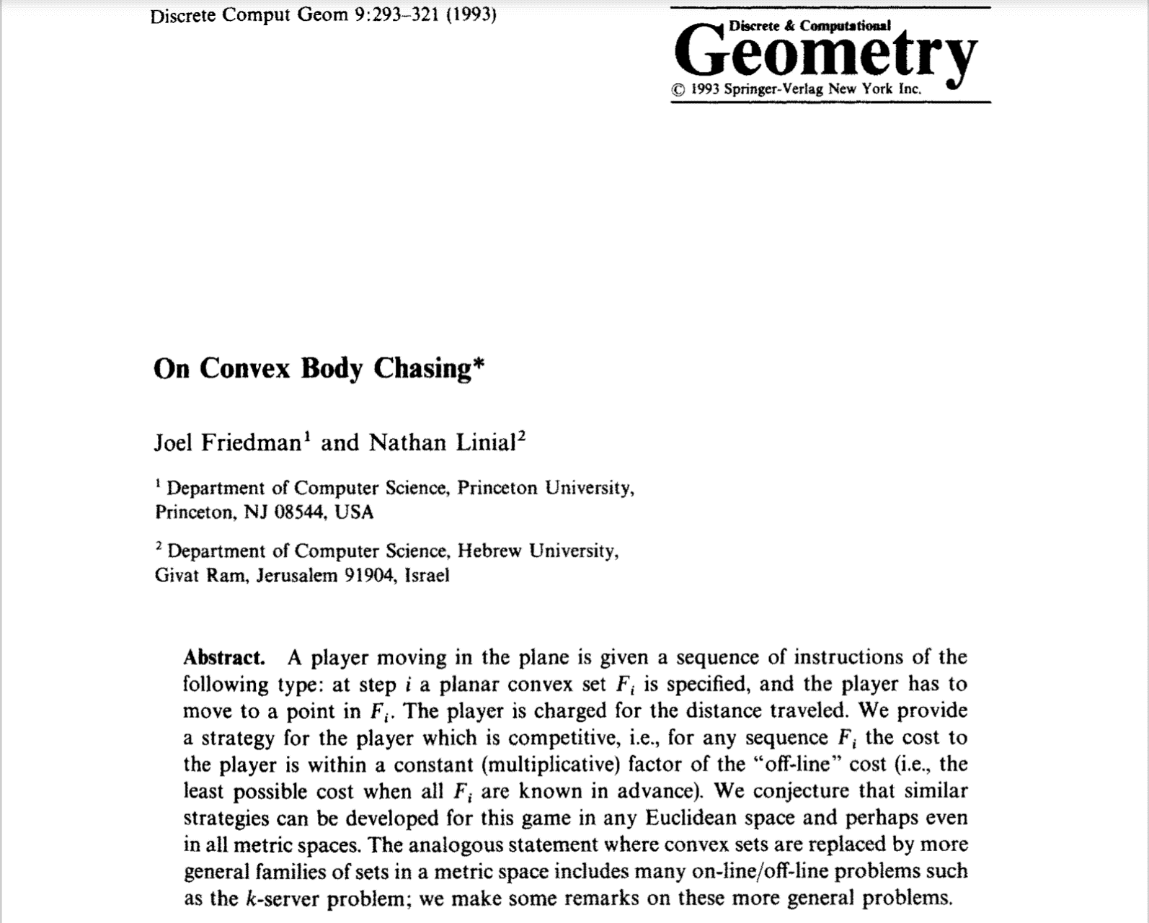
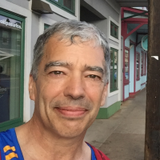
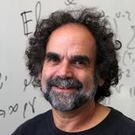
a brief history

Slide 29
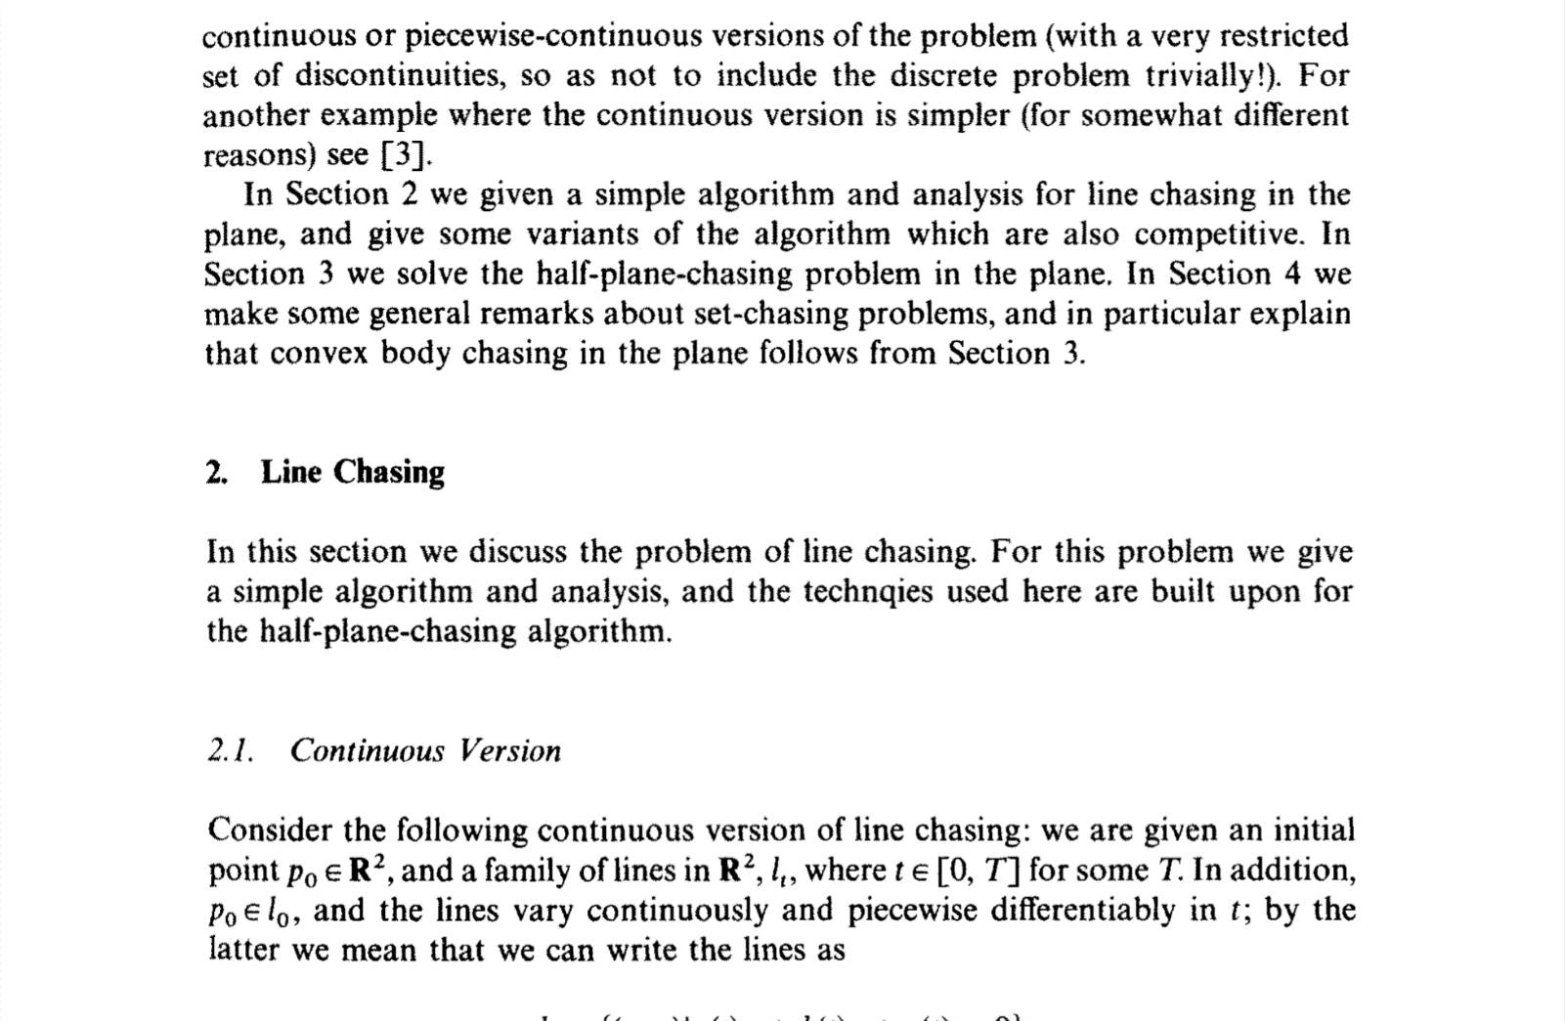
contains, among many things: two algorithms

Slide 30
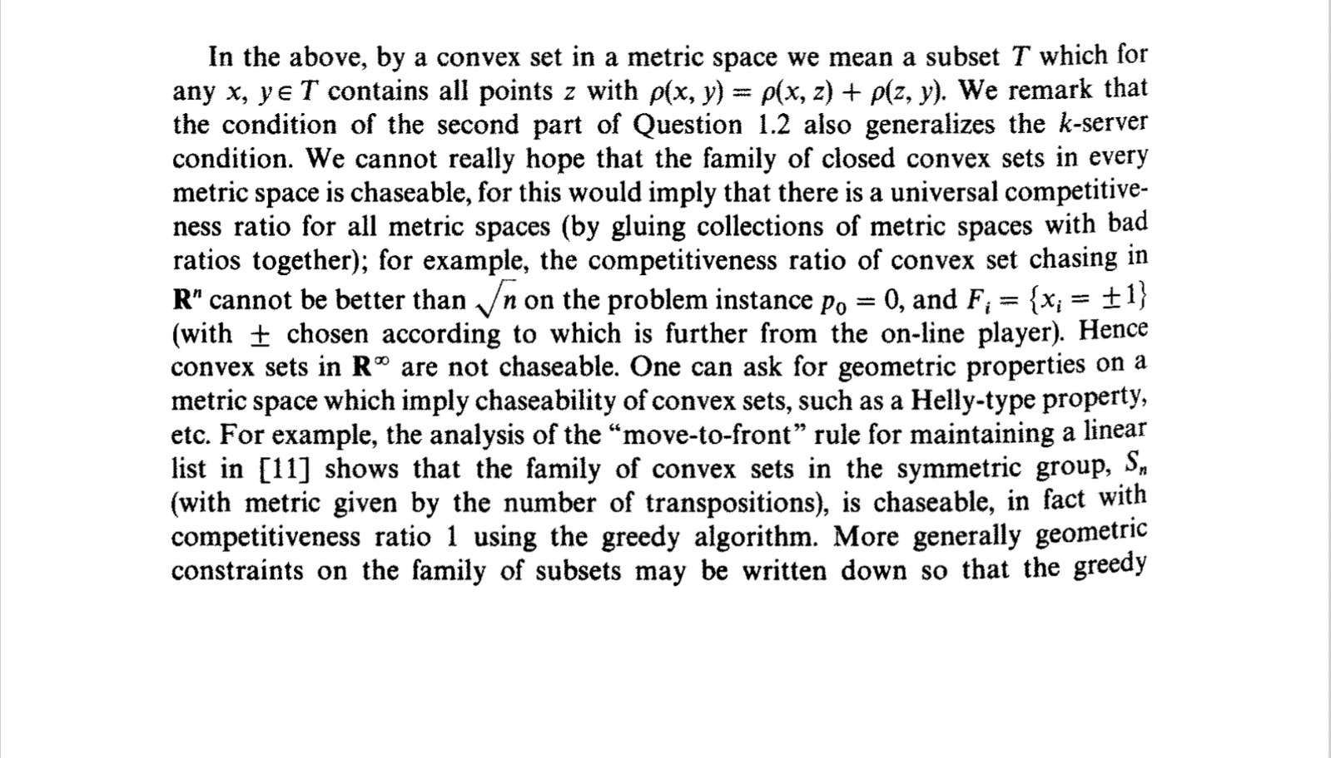
a lower bound

Slide 31
a lower bound

Slide 32
a lower bound

Slide 33




a lower bound
$$OPT$$
$$ALG$$
$$ALG≥\sqrt{2}⋅OPT$$
$$ALG≥\sqrt{d}⋅OPT$$

Slide 34
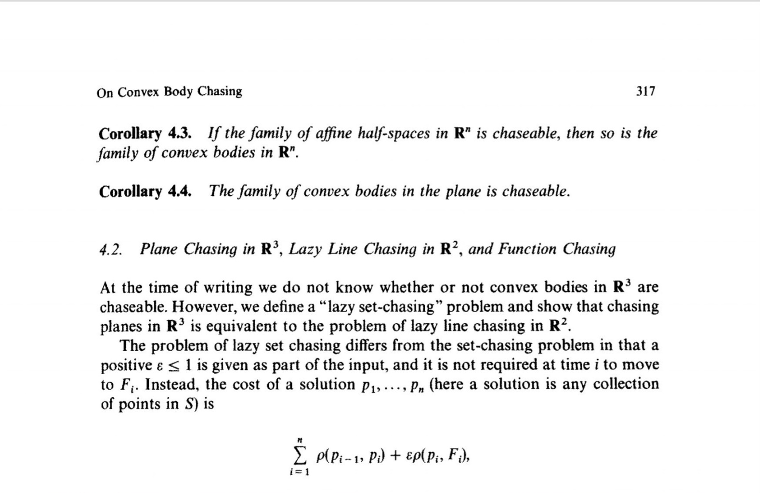
a reduction to half-spaces

Slide 35
a reduction to half-spaces

Slide 36
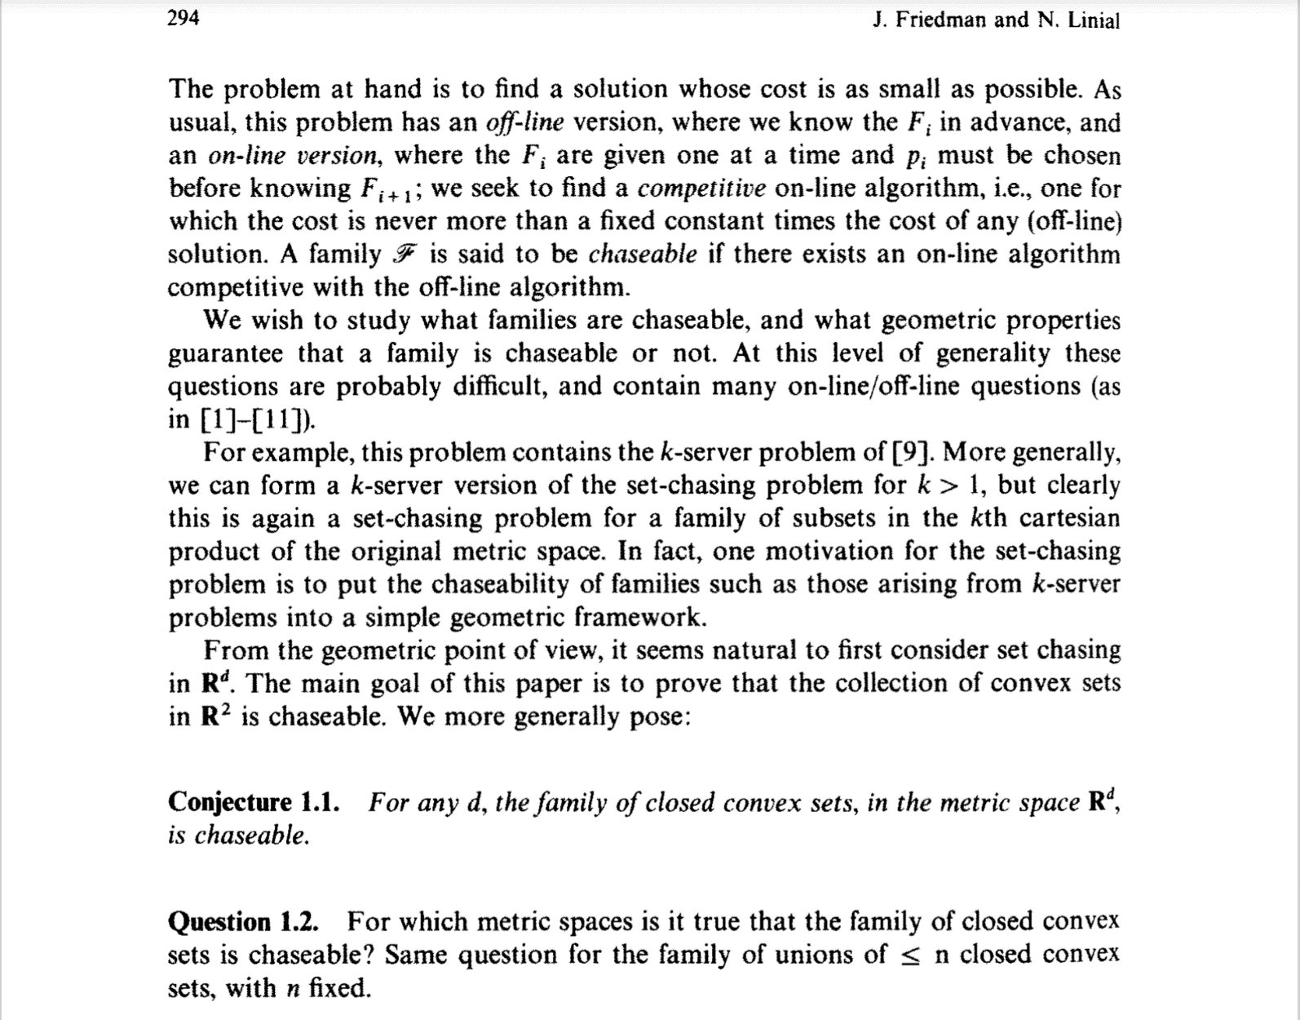
and a conjecture

Slide 37

recent developments
general, clean algos
achieving $poly(d)$ competitive bounds
nice connections to convex geometry
’17-’18
Nested body chasing
f(d)-comp. [Bansal+]
~O(d)-comp. [ABCGL]
’93 [Friedman Linial]
‘10-’17
Restricted cases
’19-’20
General body chasing
f(d)-comp. [BLLS]
O(d)-comp. [AGGT, S]

Slide 38

rest of the talk
Nested Convex Set Chasing (part I)
  - Some failed algos
  - $O(d\log{d)}$ algo via recursive centroid
Nested Convex Set Chasing (part II)
  - Steiner point
  - move to Steiner point
General Convex Set Chasing
  - reduction to nested Steiner point algo

Slide 39


simpler “bounded” version
Convex sets $B\left(0,r\right)=K_{0}$, followed by $K_{1}, K_{2}…$ all subsets of $B(0,r)$
Promise: $OPT≈r$
Want: $ALG≤ f\left(d\right)⋅r$
Fact: implies $O\left(f\left(d\right)\right)$-competitive for CBC.
Proof: guess-and-double.
$$r$$

Slide 40


simpler “bounded” version
Convex sets $B\left(0,r\right)=K_{0}$, followed by $K_{1}, K_{2}…$ all subsets of $B(0,1)$
Promise: $OPT≈1$
Want: $ALG≤ f\left(d\right)⋅1$
Fact: implies $O\left(f\left(d\right)\right)$-competitive for CBC.
Proof: guess-and-double.
$$1$$

Slide 41

strawman #1: greedy
move to the closest point in $K_{t}$

Slide 42
strawman #1: greedy
move to the closest point in $K_{t}$

Slide 43
strawman #1: greedy
move to the closest point in $K_{t}$

Slide 44


strawman #1: greedy
$$ALG$$
move to the closest point in $K_{t}$
unbounded competitive ratio!
$$OPT$$

Slide 45
Nested Case

Slide 46
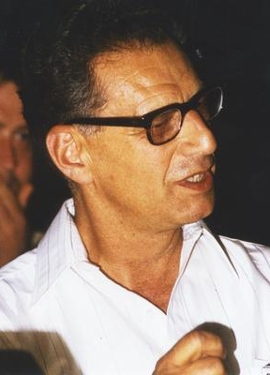
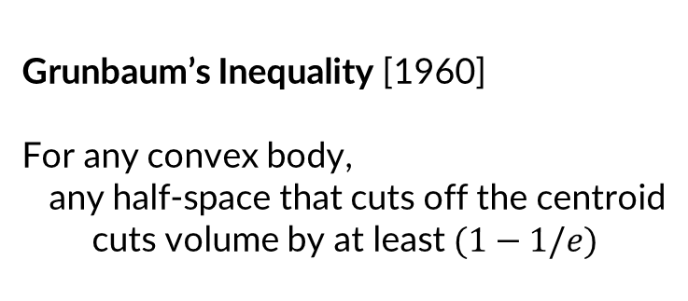

Grunbaum’s Inequality [1960]
For any convex body,
any half-space that cuts off the centroid
  cuts volume by at least $(1−1/e)$
%volume $={\left(1−\frac{1}{n}\right)}^{n}$
Branko Grunbaum, https://opc.mfo.de/detail?photo_id=7667

Slide 47
Algo for Nested Case:
Move to centroid of current body
Hope: each time volume decreases a lot
Maybe don’t need to move very often

Slide 48
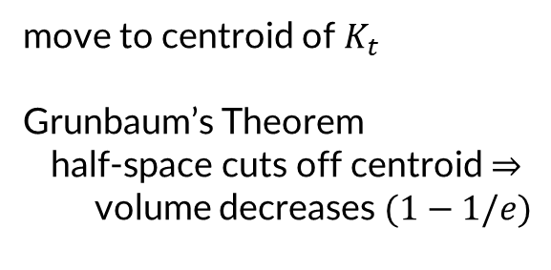
strawman #2 (for nested case): centroid
move to centroid of $K_{t}$
Grunbaum’s Theorem
half-space cuts off centroid $⇒$
  volume decreases $(1−1/e)$
[Argue Bubeck Cohen Gupta Lee 19]

Slide 49
strawman #2 (for nested case): centroid
move to centroid of $K_{t}$
Grunbaum’s Theorem
half-space cuts off centroid $⇒$
  volume decreases $(1−1/e)$
[Argue Bubeck Cohen Gupta Lee 19]

Slide 50
strawman #2 (for nested case): centroid
move to centroid of $K_{t}$
Grunbaum’s Theorem
half-space cuts off centroid $⇒$
  volume decreases $(1−1/e)$
[Argue Bubeck Cohen Gupta Lee 19]

Slide 51
strawman #2 (for nested case): centroid
move to centroid of $K_{t}$
Grunbaum’s Theorem
half-space cuts off centroid $⇒$
  volume decreases $(1−1/e)$
[Argue Bubeck Cohen Gupta Lee 19]

Slide 52
strawman #2 (for nested case): centroid
move to centroid of $K_{t}$
Grunbaum’s Theorem
half-space cuts off centroid $⇒$
  volume decreases $(1−1/e)$
[Argue Bubeck Cohen Gupta Lee 19]

Slide 53
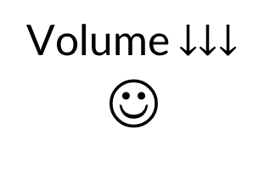
strawman #2 (for nested case): centroid
move to centroid of $K_{t}$
Grunbaum’s Theorem
half-space cuts off centroid $⇒$
  volume decreases $(1−1/e)$
Volume $↓↓↓$
☺
[Argue Bubeck Cohen Gupta Lee 19]

Slide 54
but alas…
move to centroid of $K_{t}$
Grunbaum’s Theorem
half-space cuts off centroid $⇒$
  volume decreases $(1−1/e)$
[Argue Bubeck Cohen Gupta Lee 19]

Slide 55
but alas…
move to centroid of $K_{t}$
Grunbaum’s Theorem
half-space cuts off centroid $⇒$
  volume decreases $(1−1/e)$
[Argue Bubeck Cohen Gupta Lee 19]

Slide 56
but alas…
move to centroid of $K_{t}$
Grunbaum’s Theorem
half-space cuts off centroid $⇒$
  volume decreases $(1−1/e)$
[Argue Bubeck Cohen Gupta Lee 19]

Slide 57

but alas…
$ALG$ unbounded
$OPT = O(1)$
Not competitive
move to centroid of $K_{t}$
Grunbaum’s Theorem
half-space cuts off centroid $⇒$
  volume decreases $(1−1/e)$
[Argue Bubeck Cohen Gupta Lee 19]

Slide 58
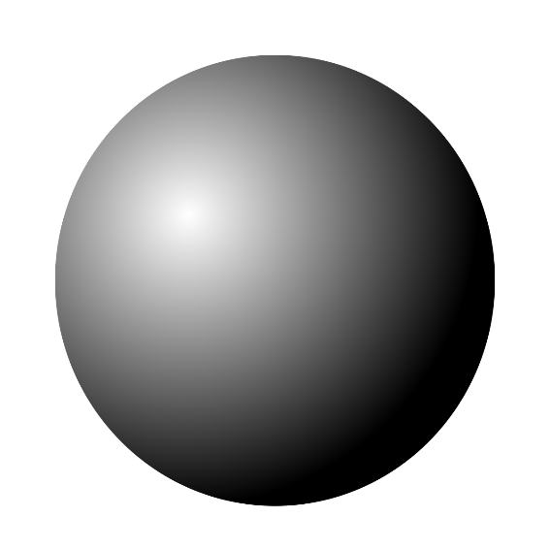
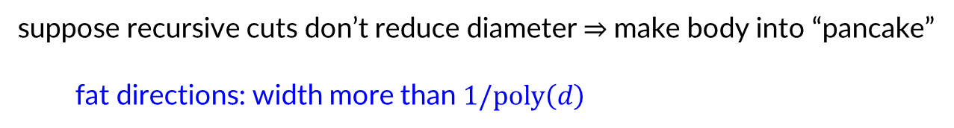


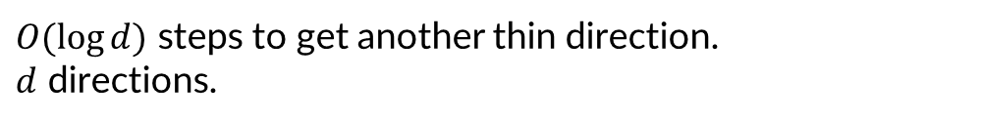
fix using recursive centroid: a sketch
suppose recursive cuts don’t reduce diameter $⇒$make body into “pancake”
fat directions: width more than $1/\text{poly}\left(d\right)$
project out thin directions, run centroid algo on fat directions
thin directions are “thin enough” $⇒$“movement in them controlled”
$$\}$$
$O(\log{d)}$ steps to get another thin direction.
$d$ directions.
$$⇒ O(d\log{d)}$$
[Argue Bubeck Cohen Gupta Lee 19]

Slide 59
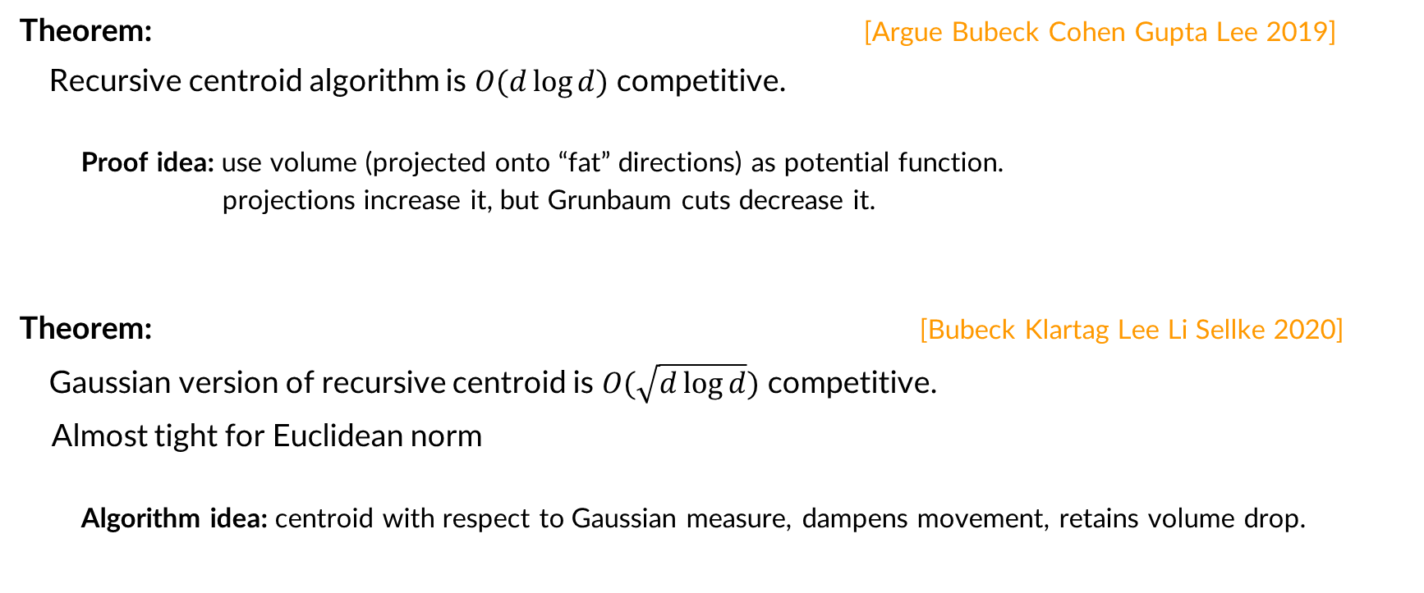
results for nested case
Theorem: [Argue Bubeck Cohen Gupta Lee 2019]
Recursive centroid algorithm is $O(d\log{d)}$ competitive.
  Proof idea: use volume (projected onto “fat” directions) as potential function.
  projections increase it, but Grunbaum cuts decrease it.
Theorem: [Bubeck Klartag Lee Li Sellke 2020]
Gaussian version of recursive centroid is $O(\sqrt{d\log{d}})$ competitive.
Almost tight for Euclidean norm
  Algorithm idea: centroid with respect to Gaussian measure, dampens movement, retains volume drop.
how to generalize to the non-nested case?

Slide 60
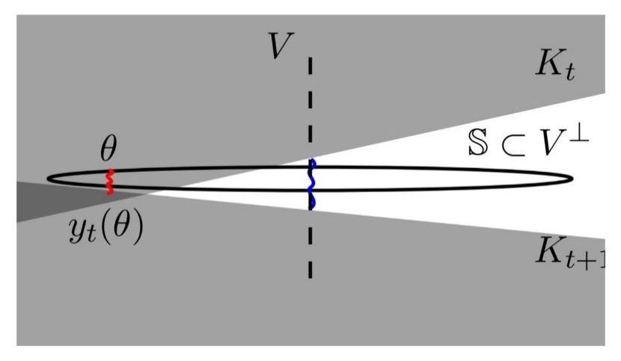

a breakthrough for the general case…
Theorem: [Bubeck Lee Li Sellke 2020]
(substantial extension of) recursive centroid algorithm is $2^{O\left(d\right)}$ competitive.
Proof:
It’s complicated.
Contains several clever ideas, we’ll discuss another day.
instead let’s approach the problem via a different angle…

Slide 61

rest of the talk: a simpler, better result
Theorem: [Argue Gupta Guruganesh Tang 2020] [Sellke 2020]
the work function Steiner point algorithm is $O\left(d\right)$-competitive.

Slide 62
Towards the General Case
Another Algo for Nested Case

Slide 63

another algo for nested case
support function of convex body
Steiner point of convex body
$⇒$ new O(d)-competitive algo for nested convex bodies

Slide 64



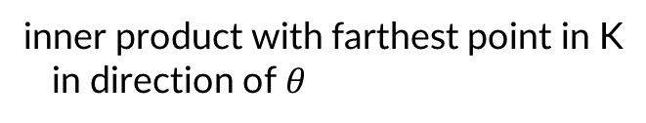



support function $h_{K}\left(θ\right)$ of convex body
$$h_{K}\left(θ\right)≔\max_{x∈K}⟨θ, x⟩$$
inner product with farthest point in K
in direction of $θ$
$${∇h}_{K}\left(θ\right)≔\underset{x∈K}{arg max}⟨θ, x⟩$$
$$θ$$
farthest point in K in direction of $θ$

Slide 65

support function $h_{K}\left(θ\right)$ of convex body
$$h_{K}\left(θ\right)≔\max_{x∈K}⟨θ, x⟩$$
inner product with farthest point in K
in direction of $θ$
$${∇h}_{K}\left(θ\right)≔\underset{x∈K}{arg max}⟨θ, x⟩$$
farthest point in K in direction of $θ$
$$θ$$

Slide 66

support function $h_{K}\left(θ\right)$ of convex body
$$h_{K}\left(θ\right)≔\max_{x∈K}⟨θ, x⟩$$
inner product with farthest point in K
in direction of $θ$
$${∇h}_{K}\left(θ\right)≔\underset{x∈K}{arg max}⟨θ, x⟩$$
farthest point in K in direction of $θ$
$$θ$$

Slide 67

support function $h_{K}\left(θ\right)$ of convex body
$$h_{K}\left(θ\right)≔\max_{x∈K}⟨θ, x⟩$$
inner product with farthest point in K
in direction of $θ$
$${∇h}_{K}\left(θ\right)≔\underset{x∈K}{arg max}⟨θ, x⟩$$
farthest point in K in direction of $θ$
$$θ$$

Slide 68


another algo for nested case
support function of convex body
Steiner point of convex body
$⇒$ new O(d)-competitive algo for nested convex bodies

Slide 69
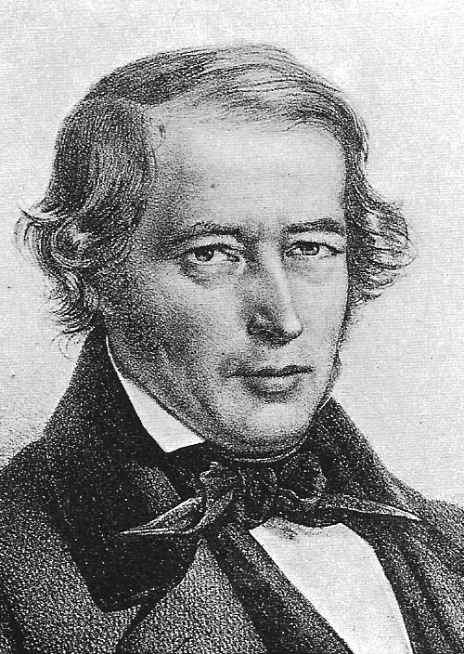

the Steiner point
Alternate “center” of convex body
Introduced by Jakob Steiner in 1840
$$st(K)$$

Slide 70



the Steiner point
Average of extreme points
in all directions
$⇒$Average of extreme points
weighted by size of normal cone
$$st(K)$$
$$st(K)$$

Slide 71
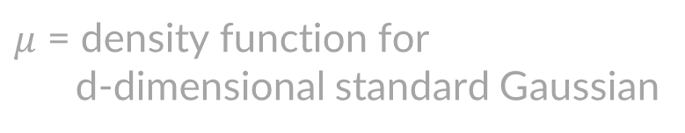

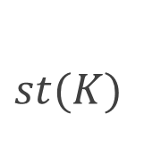


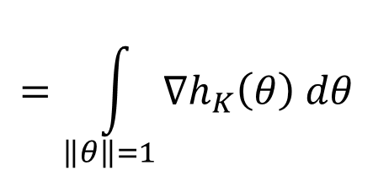
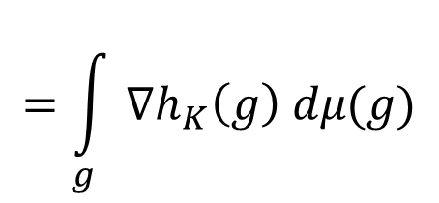
the Steiner point
    ${∇h}_{K}\left(θ\right)≔\underset{x∈K}{argmax}{ \left\langle θ,x\right\rangle }$
$$h_{K}\left(θ\right)≔\max_{x∈K}{ ⟨θ, x⟩}$$
$$st(K)$$
$$=\int_{\left\|θ\right\|=1}{∇h_{K}\left(θ\right) dθ}$$
$$=𝔼_{G \sim N{\left(0,1\right)}^{d}}[∇h_{K}\left(G\right)]$$
$$=\int_{g}{∇h_{K}\left(g\right) dμ(g)}$$
$$st(K)$$
$μ$ = density function for
d-dimensional standard Gaussian

Slide 72

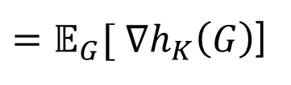
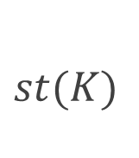
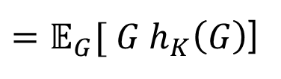
an equivalent definition
    ${∇h}_{K}\left(θ\right)≔\underset{x∈K}{argmax}{ \left\langle θ,x\right\rangle }$
$$h_{K}\left(θ\right)≔\max_{x∈K}{ ⟨θ, x⟩}$$
$$G \sim (N\left(0,1\right), N\left(0,1\right), …, N\left(0,1\right))$$
Visually intuitive
$$st(K)$$
$=𝔼_{G}[ ∇h_{K}\left(G\right)$]
$=𝔼_{G}[ G h_{K}\left(G\right)$]
$$st(K)$$
Algebraically useful

Slide 73
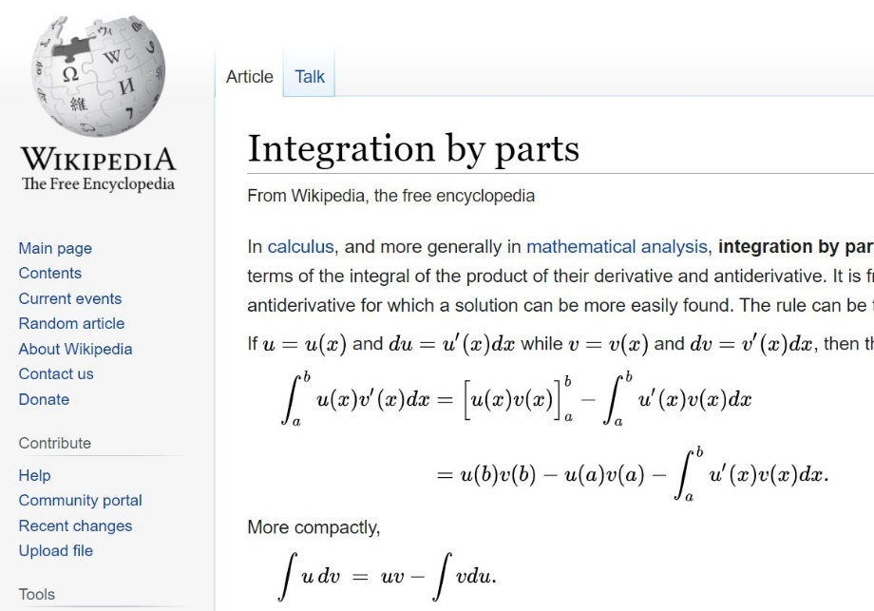
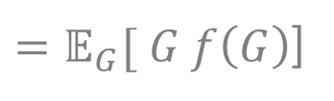
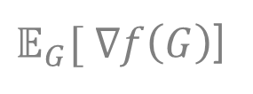


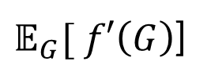
proving the equivalence
$𝔼_{G}[ ∇f\left(G\right)$]
$=𝔼_{G}[ G f\left(G\right)$]
In $1$-dimension:
$𝔼_{G}[ f′\left(G\right)$]
$$=∫f^{′}\left(x\right) μ\left(x\right) dx$$

Slide 74




proving the equivalence
$𝔼_{G}[ ∇f\left(G\right)$]
$=𝔼_{G}[ G f\left(G\right)$]
$μ\left(x\right)∝e^{−x^{2}/2}$
$⇒ μ^{′}\left(x\right)∝ e^{−x^{2}/2}$ $⋅(−2x/2)$
In $1$-dimension:
$𝔼_{G}[ f′\left(G\right)$]
$$=∫f^{′}\left(x\right) μ\left(x\right) dx$$
$$=f\left(∞\right)μ\left(∞\right)− f\left(−∞\right)μ\left(−∞\right)− ∫f\left(x\right) μ^{′}\left(x\right) dx$$
$$=− ∫f\left(x\right) (−x μ\left(x\right)) dx$$
$$= ∫x f\left(x\right) μ\left(x\right) dx$$
$=𝔼_{G}[ G f\left(G\right)$]
simple case of
Gaussian integration-by-parts

Slide 75

Steiner point
$$h_{K}\left(θ\right)≔\max_{x∈K}{ ⟨θ, x⟩}$$
    ${∇h}_{K}\left(θ\right)≔\underset{x∈K}{argmax}{ \left\langle θ,x\right\rangle }$
Visually intuitive
$$st(K)$$
$=𝔼_{G}[ ∇h_{K}\left(G\right)$]
$=𝔼_{G}[ G h_{K}\left(G\right)$]
Algebraically useful

Slide 76



another algo for nested case
support function of convex body
Steiner point of convex body
$⇒$ new O(d)-competitive algo for nested convex bodies

Slide 77


remember: suffices to solve bounded case (nested)
Given: nested convex sets $B\left(0,r\right)=K_{0}⊃K_{1}⊃ …⊃K_{t}$
Want: $x_{t}∈K_{t}$ and $ALG≤ f\left(d\right)⋅ r$
$$r$$

Slide 78

algorithm for nested case
Move to the Steiner point of $K_{t}$
[Bubeck Klartag Lee Li Sellke 2020]

Slide 79

bad example (revisited)
$x_{t}=st\left(K_{t}\right)$

Slide 80
bad example (revisited)
$x_{t}=st\left(K_{t}\right)$

Slide 81
bad example (revisited)
$x_{t}=st\left(K_{t}\right)$

Slide 82

bad example (revisited)
$x_{t}=st\left(K_{t}\right)$
Steiner point algo: smoother version of recursive centroid
$O(d)$ competitive!
memoryless!

Slide 83












proof of d-competitiveness (nested)
$∑$ $\left|| x_{t−1}−x_{t} |\right| =$
$∑$ $\left|| 𝔼[G h_{t−1}(G)] −𝔼[G h_{t}(G)] |\right|$
$$h_{t}=h_{K_{t}}$$
$= ∑$ $\left|| 𝔼\left[ G {(h}_{t−1}\left(G\right)− h_{t}\left(G\right)) \right] |\right|$
linearity of exp.
$= ∑$ $⟨ v_{t}, 𝔼\left[ G {(h}_{t−1}\left(G\right)− h_{t}\left(G\right)) \right] ⟩$
$v_{t}$ is unit vector
$= 𝔼 [ ∑ \left\langle v_{t},G\right\rangle {(h}_{t−1}\left(G\right)− h_{t}\left(G\right))$ $]$
linearity of exp.
$≤ 𝔼 [ \left|\left|G\right|\right| ∑{ (h}_{t−1}\left(G\right)− h_{t}\left(G\right))$ $]$
$$≤ 𝔼 [ \left|\left|G\right|\right| h_{0}\left(G\right) ]$$
$$K_{t}⊆K_{t−1 }…⊆K_{0}=B(0,1)$$
$$= 𝔼 [ {\left|\left|G\right|\right|}^{2}]$$
$= d$.

Slide 84
d-competitive for nested case
Move to the Steiner point of $K_{t}$
[Bubeck Klartag Lee Li Sellke 2020]

Slide 85
Finally: General Case

Slide 86


suffices to solve bounded case (non-nested)
Given: convex sets $B\left(0,r\right)=K_{0}, {K_{1}, K}_{2},…, K_{t}$
Want: $x_{t}∈K_{t}$ and $ALG≤ f\left(d\right)⋅ r$
$$r$$

Slide 87






Define $Ω_{t}≔$ {where OPT might be at time $t$, having paid $≤r$}
$$0$$
$$a$$
$$r−a$$
$$Ω_{1}$$
$$K_{1}$$
Notes:
Color the title

Slide 88













$Ω_{t}$ form convex, nested sets
$$x$$
$$r$$
$$x_{1}$$
$$B(0,r)$$
$$0$$
$$(x+y)/2$$
$$(x_{1}+y_{1})/2$$
$$Ω_{1}$$
$$y_{1}$$
$$y$$
$$K_{1}$$
$$K_{1}$$
$⇒f(d)$-competitive algo for nested case on $Ω_{1},…, Ω_{T}$ pays $f\left(d\right)⋅r$

Slide 89




Black-box algorithm to chase $Ω_{t}$ may be infeasible
$$Ω_{1}$$
$x_{t}∈Ω_{t}$ but is $x_{t}∈K_{t}?$
$$K_{1}$$
Notes:
Redo title

Slide 90




Key lemma: $st\left(Ω_{t}\right)∈K_{t}$
$$K_{t}$$
$$Ω_{t}$$

Slide 91





proof of feasibility lemma
$$K_{t}$$
Feasibility Lemma: $st\left(Ω_{t}\right)∈K_{t}$
$K_{t}=\left\{x ∣ \left\langle a,x\right\rangle ≥b\right\}$ (w.l.o.g.)
Define
$\begin{aligned}\hat{y}=\left\{\begin{aligned}&reflect\left(y\right) y∉K_{t} \\ &y y∈K_{t}\end{aligned}\right. \\ \end{aligned}$
$$\hat{y}$$
$$y$$

Slide 92













proof of feasibility lemma
$$K_{t}$$
Feasibility Lemma: $st\left(Ω_{t}\right)∈K_{t}$
$Ω_{t}=\{x∣w_{t}\left(x\right)≤r\}$
$$Ω_{t}$$
Fact: If$y∈Ω_{t}$ then $\hat{y}∈Ω_{t}$
$$\hat{y}$$
$$y=\hat{y}$$
$⇒$ the reflection of $Ω_{t}\backslash K_{t}$ is contained in $Ω_{t}$
$$y$$
$$z$$
Sps origin on separating hyperplane in $Ω_{t}$
$θ_{r}$
$θ_{ℓ}$
$⇒$ for any $θ_{r}$ to the right, and its reflection $θ_{ℓ}$ to the left,
$$h_{Ω_{t}}\left(θ_{r}\right)≥h_{Ω_{t}}\left(θ_{ℓ}\right)$$
$⇒st(Ω_{t})=𝔼_{θ}[ θ h_{Ω_{t}}\left(θ\right)]$ is on the right, in $K_{t}$

Slide 93

that proves
Theorem: [Argue Gupta Guruganesh Tang 2020] [Sellke 2020]
the work function Steiner point algorithm is $O(d)$ competitive.

Slide 94

functional Steiner point
Given a convex function $f$
$$st\left(f\right)≔ \int_{θ∈B^{∗}}{∇f^{∗}\left(θ\right)dθ}$$
where $f^{∗}\left(θ\right)=$Fenchel dual, and $B^{∗}≔$ dual space unit ball
Can define work function for function chasing
Algo: move to functional Steiner point of work function
doesn’t need guess-and-double
works for all norms
gives general unified view, potentially useful in other contexts
[Sellke SODA 20]

Slide 95

other directions
Chasing lines and subspaces
can reduce chasing k-dim affine subspaces in $ℝ^{d}$ to O(k)-dim chasing. [Argue Guruganesh Gupta]
see also [Antoniadis Barcelo Nugent Pruhs Schewior Scquizzato] [Bienkowski Byrka Coester Jez Koutsoupias]
Multi-server chasing
2-servers 2-d not chaseable, but special cases (k-median/means) doable [Bubeck Rabani Sellke]
Chasing well-conditioned functions
can chase fns having condition number $κ$ with comp.ratio $O\left(\sqrt{κ}\right)$
lower bd of $κ^{1/3}$. Close gap? [Argue Guruganesh Gupta]
can chase locally-polyhedral fns, other classes [Chen Goel Wierman, Goel Lin Sun Wierman]

Slide 96

wrap-up, and open questions
$O(d)$competitive algo for general convex body chasing algorithm
$O(\sqrt{d\log{d}}$) competitive algo for nested bodies
$Ω(d^{1/2}$) lower bound
better algorithms for special classes of convex body chasing?
  e.g., faces of a given polytope (arises in k-server, paging)?
broader classes of multiserver chasing?
tight bounds for well-conditioned function-chasing?
deeper understanding of connections to online learning?

Slide 97
lecture plan
Lecture #1: Set Cover (worst case)
Lecture #2: Set Cover (beyond worst case), Network design (both)
Lecture #3: Resource Allocation (aka packing)
Lecture #4: Search Problems (aka chasing)

