Slide 1

Online Algos: Old and New
Lecture #3: Online Resource Allocation
Anupam Gupta (NYU)

Slide 2



lecture plan
Lecture #1: Set Cover (worst case)
Lecture #2: Set Cover (beyond worst case), Network design (both)
Lecture #3: Resource Allocation (aka packing)
Lecture #4: Search Problems (aka chasing)

Slide 3
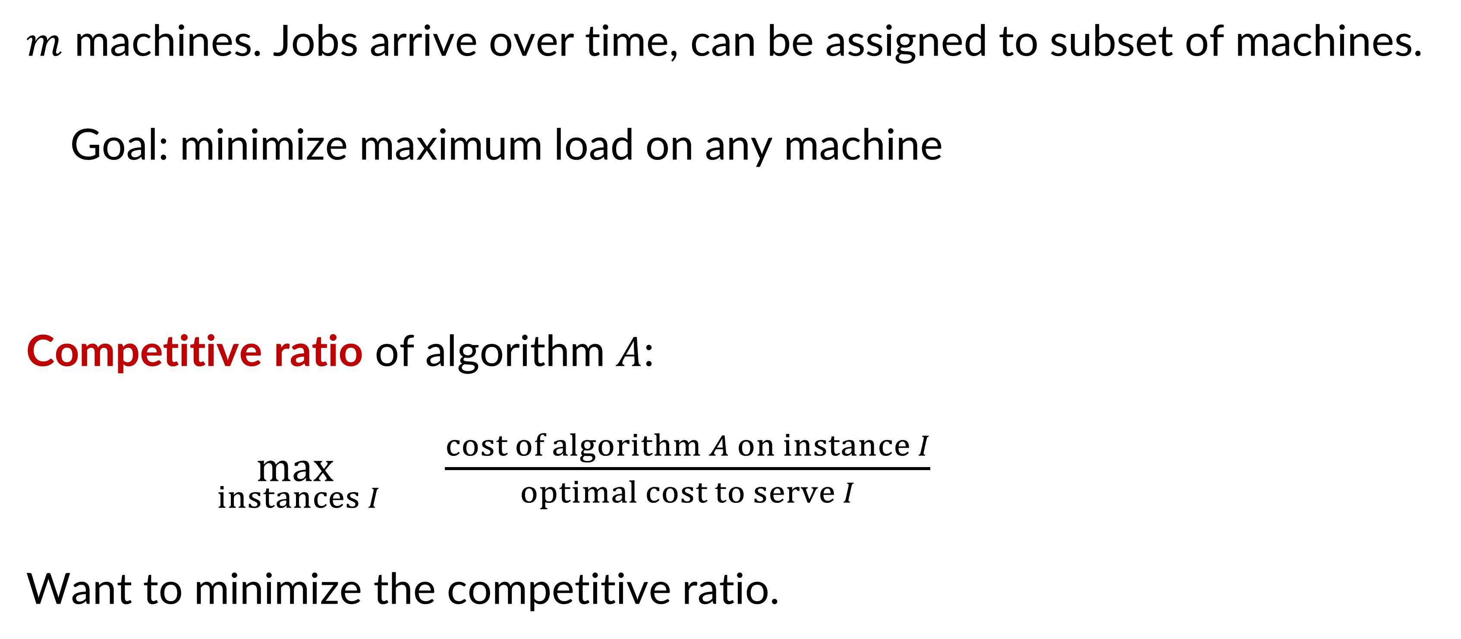
Online Load Balancing
$m$ machines. Jobs arrive over time, can be assigned to subset of machines.
Goal: minimize maximum load on any machine
Competitive ratio of algorithm $A$:
$\max_{ instances I}{ \frac{cost of algorithm A on instance I}{optimal cost to serve I}}$
Want to minimize the competitive ratio.
[Azar Naor Rom 92]

Slide 4
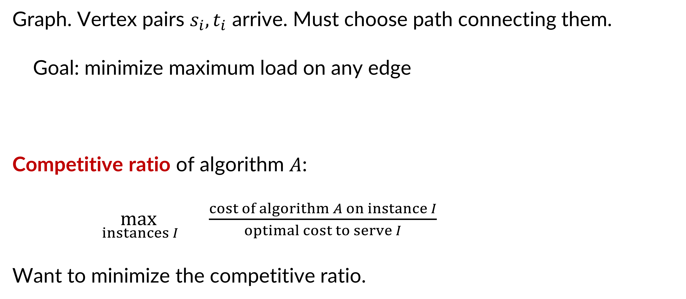
Online Low-Congestion Routing
Graph. Vertex pairs $s_{i}, t_{i}$ arrive. Must choose path connecting them.
Goal: minimize maximum load on any edge
Competitive ratio of algorithm $A$:
$\max_{ instances I}{ \frac{cost of algorithm A on instance I}{optimal cost to serve I}}$
Want to minimize the competitive ratio.
[Aspnes Awerbuch Azar Fiat Plotkin Waarts 97]

Slide 5


max-K finding
Competitive ratio of algorithm $A$:
$\max_{ instances I}{ \frac{cost of algorithm A on instance I}{optimal cost to serve I}}$
Want to minimize the competitive ratio.
$n$ people arrive over time, each has value $v_{i}$ -- can pick at most $K$
Goal: (say) maximize sum of values of picked people
Competitive ratio of algorithm $A$:
$\min_{ instances I}{ \frac{value of algorithm A on instance I}{optimal value on instance I}}$
Want to maximize the competitive ratio.

Slide 6

roadmap for today
Load Balancing problems
Parallel machines
Low-congestion routing
Online with a Sample
Packing Integer Programs and Random Order models
k-item secretary
robust packing LPs using experts

Slide 7
Load Balancing

Slide 8
online load balancing: model choices
Adversary fixes order of jobs, and allowed machines for each job
Each machine gets 1 unit of load per job assigned to it (“parallel machines”)
Algo sees jobs one by one
When job seen, must send to an allowed machine
Want to minimize maximum load

Slide 9
greed is good
Load of machine $i$ = number of jobs assigned to it
Goal: minimize maximum load over all machines
Theorem: Greedy is $O\left(\log{m}\right)$ competitive algorithm.
Let’s sketch a proof for case of OPT = 1
[Azar Naor Rom 92]

Slide 10
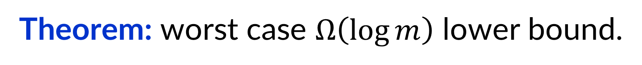
greed is good (up to a point)
Theorem: Greedy is $O\left(\log{m}\right)$ competitive algorithm.
Theorem: worst case $Ω\left(\log{m}\right)$ lower bound.

Slide 11
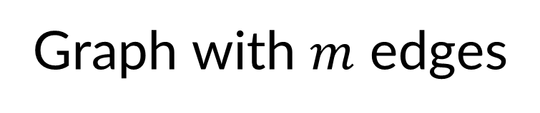

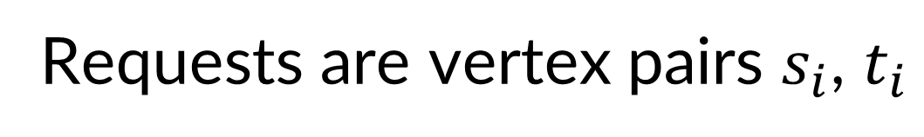

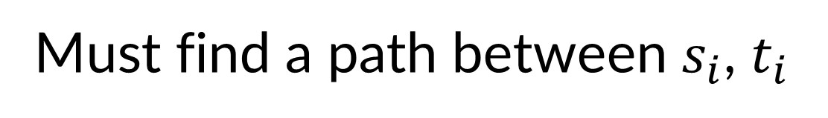
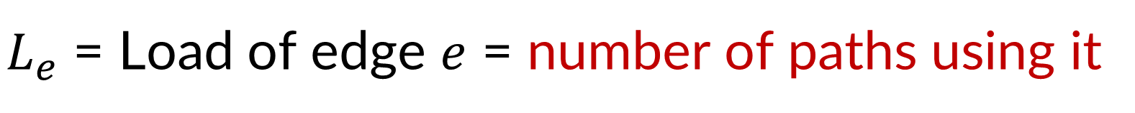
more general: low-congestion routing
Graph with $m$ edges
Requests are vertex pairs $s_{i}$, $t_{i}$
$$s_{i}$$
Must find a path between $s_{i}$, $t_{i}$
$L_{e}$ = Load of edge $e$ = number of paths using it
Goal: minimize maximum load over all edges
Theorem: worst case $Ω\left(\log{m}\right)$ lower bound for any algo.
Proof: load balancing is special case of routing
$$t_{i}$$
[Aspnes Awerbuch Azar Fiat Plotkin Waarts 97]

Slide 12



more general: low-congestion routing
Graph with $m$ edges
$$s_{i+1}$$
Requests are vertex pairs $s_{i}$, $t_{i}$
$$s_{i}$$
$$t_{i+1}$$
$$t_{i}$$
Must find a path between $s_{i}$, $t_{i}$
$L_{e}$ = Load of edge $e$ = number of paths using it
Goal: minimize maximum load over all edges
Theorem: worst case $Ω\left(\log{m}\right)$ lower bound for any algo.
Proof: load balancing is special case of routing
Fact: Greedy algorithm is arbitrarily bad in general
Theorem: “Softmax” greedy is $O\left(\log{m}\right)$ competitive

Slide 13
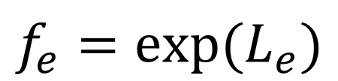
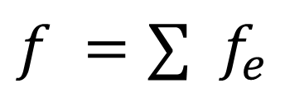
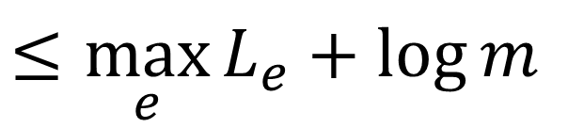
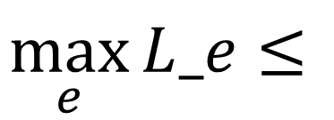
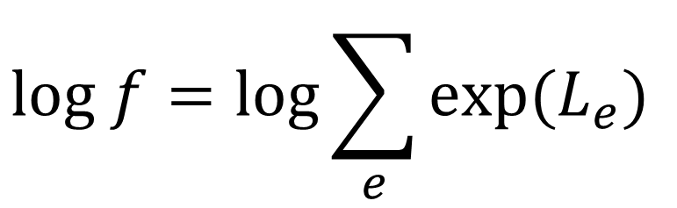
softmax
$$f_{e}=exp⁡(L_{e})$$
$$f =∑{ f}_{e}$$
$$log f=\log{\sum_{e}{exp⁡(L_{e})}}$$
$$\max_{e}{L_e}≤$$
$$≤\max_{e}{L_{e}}+\log{m}$$

Slide 14
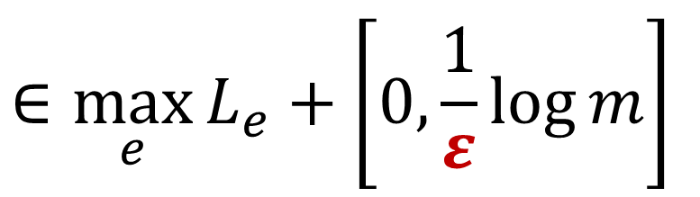
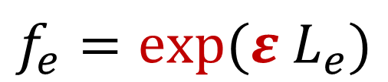
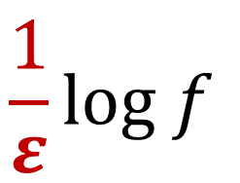
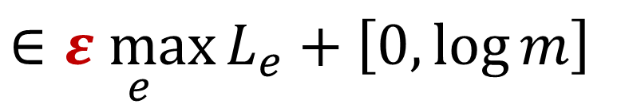
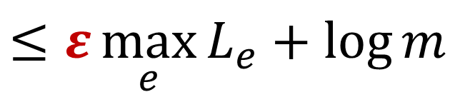
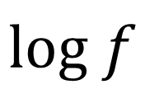
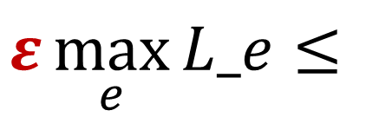
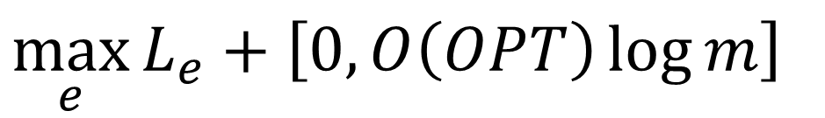
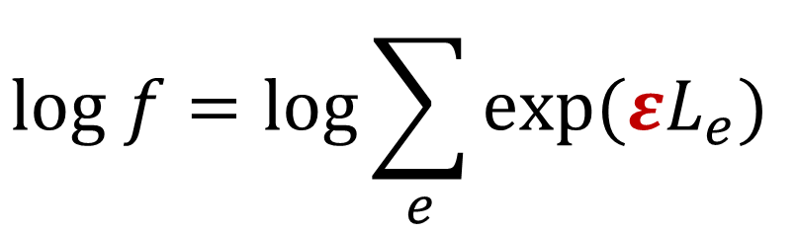
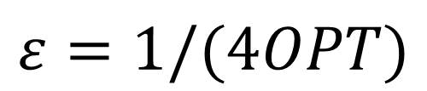
softmax
$$f_{e}=exp⁡(ε L_{e})$$
$$ε=1/(4OPT)$$
$$f =∑{ f}_{e}$$
$$log f=\log{\sum_{e}{exp⁡(εL_{e})}}$$
$$ε\max_{e}{L_e}≤$$
$$≤ε\max_{e}{L_{e}}+\log{m}$$
$$log f$$
$$∈\underset{e}{ε max}{L_{e}}+\left[0, \log{m}\right]$$
$$\frac{1}{ε}log f$$
$$∈\max_{e}{L_{e}}+\left[0, \frac{1}{ε}\log{m}\right]$$
$$\max_{e}{L_{e}}+\left[0, O\left(OPT\right)\log{m}\right]$$

Slide 15
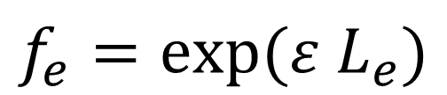
softmax greedy
$$f_{e}=exp⁡(ε L_{e})$$
$$ε=1/(4OPT)$$
$$f =∑{ f}_{e}$$
Route request $t$ on path that minimizes increase in $f$

Slide 16
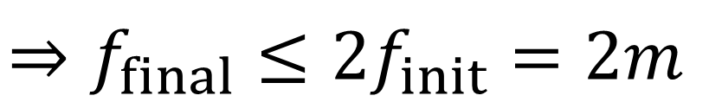
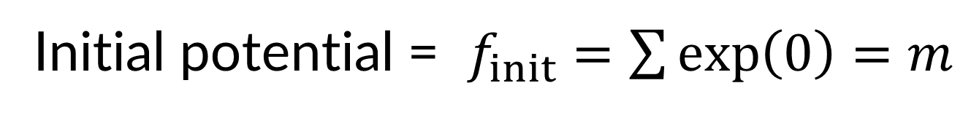

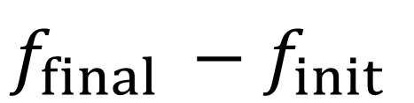
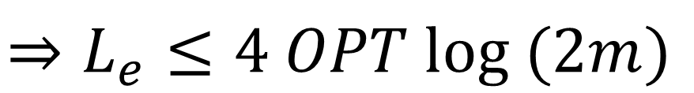
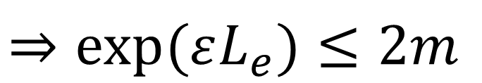
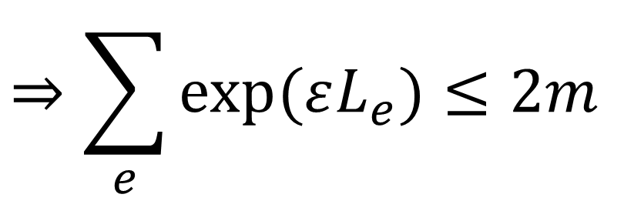
softmax greedy
$$f_{e}=exp⁡(ε L_{e})$$
$$ε=1/(4OPT)$$
$$f =∑{ f}_{e}$$
Route request $t$ on path that minimizes increase in $f$
Initial potential = $f_{init}=\sum{\exp\left(0\right)}=m$
$$≤ \frac{1}{2}f_{final}$$
$$f_{final} −f_{init}$$
$$⇒f_{final}≤2f_{init}=2m$$
$$⇒\sum_{e}{exp⁡(εL_{e})}≤2m$$
$$⇒exp⁡(εL_{e})≤2m$$
$$⇒L_{e}≤4 OPT log (2m)$$
Theorem: “Softmax” greedy is $O\left(\log{m}\right)$ competitive

Slide 17
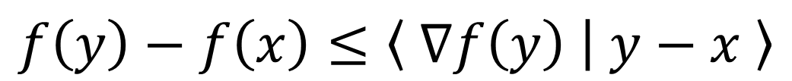
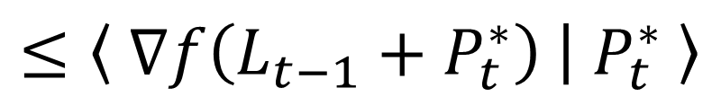
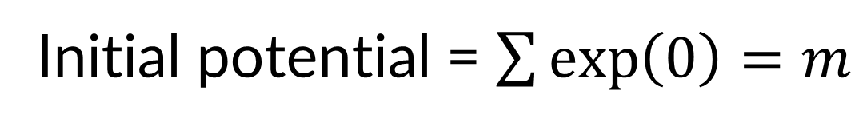
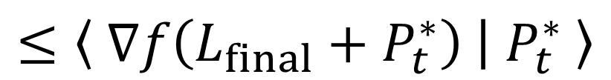
softmax greedy
$$f_{e}=exp⁡(ε L_{e})$$
$$ε=1/(4OPT)$$
$$f =∑{ f}_{e}$$
$$f\left(y\right)−f\left(x\right)≤\left\langle ∇f\left(y\right) | y−x \right\rangle$$
Route request $t$ on path that minimizes potential increase
Initial potential = $\sum{\exp\left(0\right)}=m$
$$f\left(L_{t−1}+P_{t}\right)−f\left(L_{t−1}\right)≤f\left(L_{t−1}+P_{t}^{∗}\right)−f\left(L_{t−1}\right)$$
$$≤\left\langle ∇f\left(L_{t−1}+P_{t}^{∗}\right) | P_{t}^{∗} \right\rangle$$
$$≤\left\langle ∇f\left(L_{final}+P_{t}^{∗}\right) | P_{t}^{∗} \right\rangle$$
$$f\left(L_{final}\right)−f\left(L_{init}\right)≤f\left(L_{t−1}+P_{t}^{∗}\right)−f\left(L_{t−1}\right)$$

Slide 18
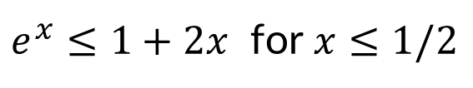
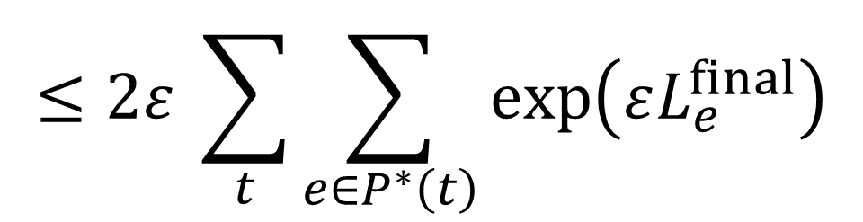
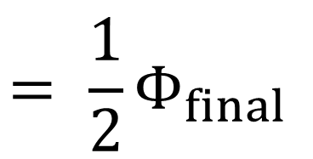
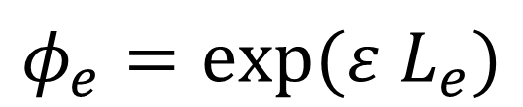
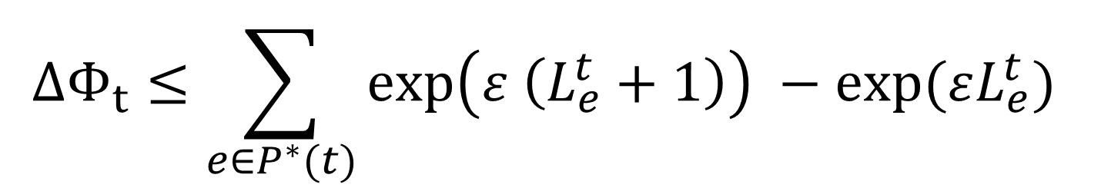
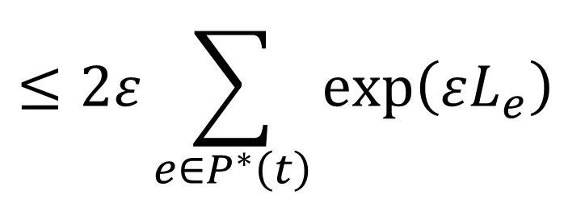
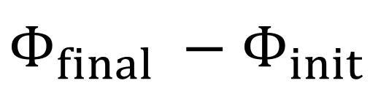
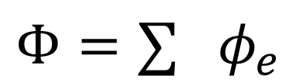
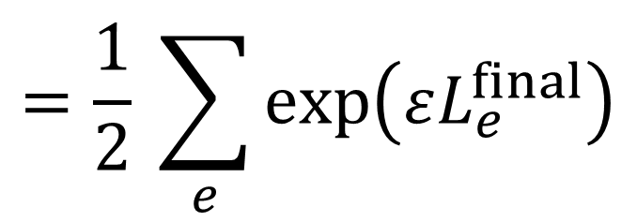
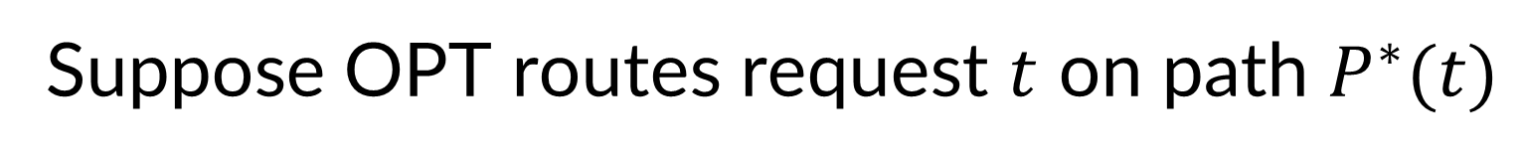
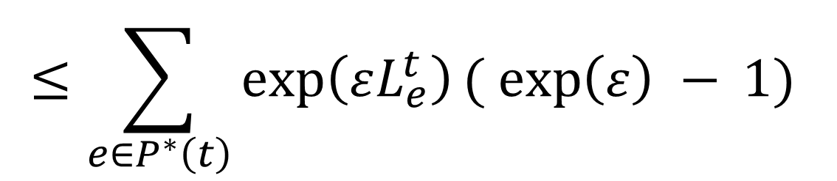
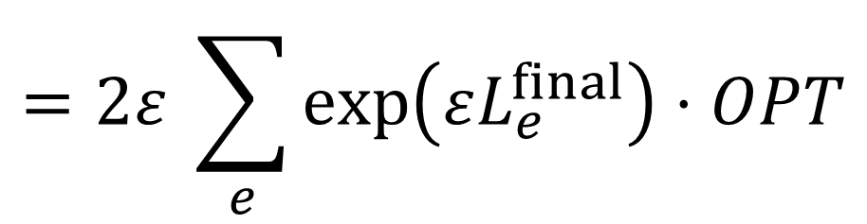
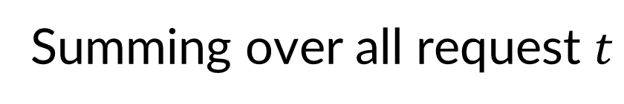
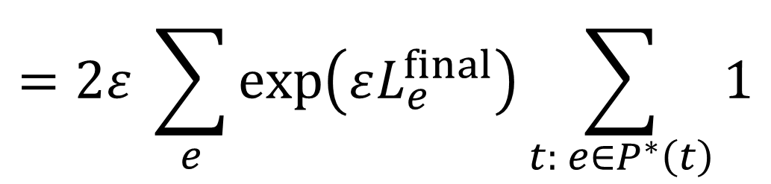
softmax greedy
$$φ_{e}=exp⁡(ε L_{e})$$
$$ε=1/(4OPT)$$
$$Φ=∑{ φ}_{e}$$
Summing over all request $t$
Route request $t$ on path that minimizes potential increase
$$Φ_{final} −Φ_{init}$$
Initial potential = $\sum{\exp\left(0\right)}=m$
$$≤2ε \sum_{t}{\sum_{e∈P^{∗}\left(t\right)}{\exp\left(εL_{e}^{final}\right)}}$$
Suppose OPT routes request $t$ on path $P^{∗}(t)$
$$=2ε \sum_{e}{\exp\left(εL_{e}^{final}\right)\sum_{t: e∈P^{∗}\left(t\right)}{1}}$$
$$ΔΦ_{t}≤\sum_{e∈P^{∗}(t)}{\exp\left(ε \left(L_{e}^{t}+1\right)\right) −exp⁡(εL_{e}^{t}) }$$
$$=2ε \sum_{e}{\exp\left(εL_{e}^{final}\right)}⋅OPT$$
$$≤\sum_{e∈P^{∗}\left(t\right)}{\exp\left(εL_{e}^{t}\right)( \exp\left(ε\right) −} 1)$$
$$≤2ε\sum_{e∈P^{∗}\left(t\right)}{\exp\left(εL_{e}\right)}$$
$$=\frac{1}{2} \sum_{e}{\exp\left(εL_{e}^{final}\right)}$$
$$= \frac{1}{2}Φ_{final}$$
$e^{x}≤1+2x$ for $x≤1/2$

Slide 19



even more general load balancing
$m$ resources
Request $t$ is collection of positive vectors $S_{t}=\{a_{t1}, …, a_{tN}\}$, each $a_{ti}∈ℝ^{m}$
Must choose one vector from $S_{t}$
Load vector = sum of chosen vectors
Goal: minimize ${\left|load vector\right|}_{∞}$
Theorem: “Softmax” greedy is $O\left(\log{m}\right)$ competitive

Slide 20


roadmap for today
Load Balancing problems
Parallel machines
Low-congestion routing
Online with a Sample
Packing Integer Programs and Random Order models
k-item secretary
robust packing LPs using experts

Slide 21
Samples

Slide 22

using predictions?
recent interest in using (machine learned) predictions
Question: where do predictions come from?
Answer #1: instances i.i.d. from some distribution $𝒟$
then use PAC learning to obtain predictions
Answer #2: online with a sample
Tomorrow: instance $I$ will arrive.
Today: given $p$-sample from $I$.
no distributional assumptions
[Kaplan Naori Raz 2019]

Slide 23


load balancing with sample
Answer #2: online with a sample
Tomorrow: instance $I$ will arrive. Today: given $p$-sample from $I$.
no distributional assumptions
Theorem: Can get load $\left(1+ε\right) OPT+poly\left(\frac{\log{m}}{εp}\right)$
$≈\left(1+ε\right) OPT$ if $OPT$ is large
explicitly learn a good strategy from samples!
Not possible in worst-case
[Argue Frieze G. Seiler]

Slide 24



three algorithmic ideas
Chernoff bound
Fact 1: if OPT large, then integer assignment $≈$ fractional assignment
$$1/7$$
1
2
$$2/7$$
3
Theorem 2: Exist machine “weights” so that proportional assignment is $\left(1+ε\right) OPT$
2
$$4/7$$
1
Theorem 3: Exists algorithm to find machine weights using small sample
4
1
5
[Argue Frieze G. Seiler]

Slide 25







idea #2: convex opt
Theorem 2: Exist machine weights $\left(θ_{1},…, θ_{m}\right)$ so that proportional assignment is $\left(1+ε\right) OPT$
$$\min{\sum_{ij}{x_{ij}}\log{x_{ij}}}$$
at optimality,
$x_{ij}=\frac{e^{μ_{i}}}{\sum_{k\sim j}{e^{μ_{k}}}}$ if $i\sim j$
$$\sum_{i\sim j}{x_{ij}}=1$$
$$=\frac{θ_{i}}{\sum_{k\sim j}{θ_{k}}}$$
$$\sum_{j}{x_{ij}}≤OPT$$
$$\sum_{j}{x_{ij}}≤\left(1+ε\right)OPT$$
$$x_{ij}≥0$$
Lagrangian $ℒ=\sum_{ij}{x_{ij}}\log{x_{ij}}+\sum_{j}{λ_{j}} \left( \sum_{i}{x_{ij}} −1\right)+\sum_{i}{μ_{i}} \left(\sum_{j}{x_{ij}}−OPT\right)−\sum_{i,j}{ν_{ij}{ x}_{ij}}$
[Agrawal Mirrokni Zadimoghaddam ICML 18]

Slide 26



naïve idea
Observe $p$-sample
Compute weights $\hat{θ}$ using convex program and sample
Use $\hat{θ}$ to allocate actual instance
“generalization”
Need proof that $\hat{θ}$ on actual instance gives low weight
Standard approaches require that max load $≫poly(m/ε)$
diff. approach to give $poly(\log{m}/ε)$!!

Slide 27



idea #3: compute weights explicitly
Theorem 3: Algorithm to find machine weights $\left(θ_{1},…, θ_{m}\right)$ using small sample
Suppose we had entire instance!
1
1$−ε$
1
Algorithm: start with all weights 1
1
1
1
Compute machine loads on instance, w.r.t current weights
1
1
if exist machines with load $≫OPT$, reduce their weights by $\left(1−ε\right)$
1
1$−ε$
1
1
Does this terminate?
Yes, cute MW analysis!
1
1
$O\left(\frac{\log^{2}{m}}{ε^{3}}\right)$ rounds!
1
How many rounds do we need?
1
But don’t we need entire instance?!
Use samples to estimate loads!
[Argue Frieze G. Seiler]

Slide 28


proof of termination
Lemma: algorithm terminates.
For simplicity: reduce if load > 2$OPT$, reduce weights by ½
Let optimal weights $θ^{∗}$ be powers of 2
Algo is invariant to scaling, so imagine start with weights = $θ_{\max{}}^{∗}$
Claim: $θ_{j}$ never dips below $θ_{j}^{∗}$
Proof: Suppose some $θ_{j}=θ_{j}^{∗}$, every other $θ_{k}≥θ_{k}^{∗}$.
By algo, $j$ receives less load than in OPT. So will never reduce $θ_{j}$. ☺
So finitely many iterations.
[Lattanzi Lavastida Moseley Vassilvitskii]

Slide 29


compute weights?
Theorem 3: Algorithm to find machine weights $\left(θ_{1},…, θ_{m}\right)$ using small sample
Suppose we had entire instance!
1$−ε$
Algorithm: start with all weights 1
1
1
Compute machine loads on instance, w.r.t current weights
1
if exist machines with load $≫OPT$, reduce their weights by $\left(1−ε\right)$
1$−ε$
1
Does this terminate?
Yes, cute MW analysis!
1
How many rounds do we need?
$O\left(\frac{\log^{2}{m}}{ε^{3}}\right)$ rounds!
(omitted: check slides/paper)
1
But don’t we need entire instance?!
Use samples to estimate loads!

Slide 30



idea #3b: parallel algo
How many rounds?
Expansion Lemma: Suppose $A(t)$ = #machines whose weights lowered at least $t$ times
Then $A\left(t+O(\log{m})\right)≤ 1/2 A(t)$
proof of Exp.Lemma omitted: catch me later
$$⇒ A\left(O(\log^{2}{m})\right)≤ 1/{2m} A(0)$$
$$≤ 1/{2m}⋅m<1$$

Slide 31



idea #3b: how many parallel rounds?
Expansion Lemma: Suppose $A(t)$ = #machines whose weights lowered at least $t$ times in $T$ rounds
Then $A\left(t+\log{m}\right)≤(1−ε) A(t)$
$$⇒ A\left(\log^{2}{m}\right)≤ 1/{2m} A(0)$$
$$≤ 1/{2m}⋅m<1$$
why is this good?

Slide 32
idea #3b: how many parallel rounds?
Expansion Lemma: Suppose $A(t)$ = #machines whose weights lowered at least $t$ times in $T$ rounds
Then $A\left(t+\log{m}\right)≤(1−ε) A(t)$
Monotonicity Fact:
(i) if machine weight not reduced at least once, load $≤$ $\left(1+2ε\right) OPT$ at all times after
(ii) if machine weight reduced at least once, load $≥$ $\left(1+ε\right) OPT$ at all times after
$⇒$ after $O\left(\log^{2}{m}\right)+1$ rounds, each weight not reduced at least once. So load is good.

Slide 33




proof of expansion lemma
Expansion Lemma: Suppose $A(t)$ = #machines whose weights lowered at least $t$ times in $T$ rounds
Then $A\left(t+\log{m}\right)≤(1−ε) A(t)$
weight $≤2^{−t−O(\log{m)}}=2^{−t}/poly(m)$
weight $≥2^{−t+1}$
B
weight $≤2^{−t}$
A

Slide 34



proof of expansion lemma
Expansion Lemma: Suppose $A(t)$ = #machines whose weights lowered at least $t$ times in $T$ rounds
Then $A\left(t+\log{m}\right)≤(1−ε) A(t)$
weights reduced at least once $⇒$ ALG load $≥\left(1+ε\right) OPT$
$⇒$ $≥\left(1+ε\right) OPT |B|$ jobs
all jobs loading machines in $B$
only see machines in $A∪B=A$
$⇒ ≤$ $|A| OPT$jobs
B
OPT load $≤$ OPT
A

Slide 35
compute weights?
Theorem 3: Algorithm to find machine weights $\left(θ_{1},…, θ_{m}\right)$ using small sample
Suppose we had entire instance!
1$−ε$
Algorithm: start with all weights 1
1
1
Compute machine loads on instance, w.r.t current weights
1
if exist machines with load $≫OPT$, reduce their weights by $\left(1−ε\right)$
1$−ε$
1
Does this terminate?
Yes, cute MW analysis!
1
How many rounds do we need?
$O\left(\frac{\log^{2}{m}}{ε^{3}}\right)$ rounds!
1
But don’t we need entire instance?!
Use samples to estimate loads!

Slide 36

idea #3: using parallel algo
Theorem 3: Algorithm to find machine weights $\left(θ_{1},…, θ_{m}\right)$ using small sample
Start with all weights 1
Break sample into $O\left(\frac{\log^{2}{m}}{ε^{3}}\right)$ chunks
Estimate machine loads w.r.t. current weights, using next chunk
calculate machine loads w.r.t. current weights
if exist machines with load $≫OPT$, reduce their weights by $\left(1+ε\right)$
Use these weights on actual instance

Slide 37

…which completes the proof
Fact 1: if OPT large, then integer $≈$ fractional assignment
Theorem 2: Exist machine weights so that proportional assignment is $\left(1+ε\right) OPT$
Theorem 3: Algorithm to find machine weights using small sample
Theorem: load $\left(1+ε\right) OPT+poly\left(\frac{\log{m}}{ε}\right)$
[Argue Frieze G. Seiler]

Slide 38
online with a sample
Given a sample of the instance, explicitly learn good strategy
Model makes less stochastic assumptions than random order, or IID
Open Questions: Can we use samples to get better algos for other problems?
other scheduling problems
network design: e.g., Steiner forest, 2-connectivity
better results for set cover

Slide 39

roadmap for today
Load Balancing problems
Parallel machines
Low-congestion routing
Online with a Sample
Packing Integer Programs and Random Order models
k-item secretary
robust packing LPs using experts

Slide 40
Online Packing

Slide 41



packing problem with hard constraints
$m$ resources. $n$ requests arrive
Request $t$ is positive vector $A_{t}∈ℝ_{+}^{m}$ with value $v_{t}≥0$
Can either choose $A_{t}$ and get value $v_{t}$
or not, get zero value
Budget vector $b∈ℝ^{m}$
Goal: maximize $\sum_{t}{v_{t}x_{t}}$ subject to $\sum_{t}{A_{t}x_{t}≤b}$ and $x_{t}∈\{0,1\}$
Let’s consider the simplest case, many of these ideas generalize

Slide 42
packing problem with hard constraints
$m$ resources. $n$ requests arrive
Request $t$ is positive vector $A_{t}∈ℝ_{+}^{m}$ with value $v_{t}≥0$
Can either choose $A_{t}$ and get value $v_{t}$
or not, get zero value
Budget vector $b∈ℝ^{m}$
Goal: maximize $\sum_{t}{v_{t}x_{t}}$ subject to $\sum_{t}{A_{t}x_{t}≤b}$ and $x_{t}∈\{0,1\}$
Let’s consider the simplest case, many of these ideas generalize
Sequence of $n$ agents/secretaries arrive. Want to pick at most $b$ item to maximize the value.

Slide 43









max finding and its variants
n unknown adversarial values $v_{1}>v_{2}>…>v_{n}$
arrive in some order
pick items immediately, irrevocably
max’ize Pr[select $v_{1}$]
or, max E[ value of $k$ item(s) picked ]
or, max E[$\left\langle v,x\right\rangle$] s.t. $Ax≤k1$
where $A∈{\left[0,1\right]}^{d×n}, x∈{\left\{0,1\right\}}^{n}$
$$v_{1}$$
$$v_{2}$$
$$v_{3}$$
$$v_{4}$$
$$v_{6}$$
$$v_{5}$$
$$t=0$$
$$t=1$$

Slide 44



adversarial setting…
select at random $⟹$ $1/n$ success probability
assume: random order
mathematically necessary, reasonable(?)
weaker assumption than unknown iid draws
$$t=0$$
$$t=1$$

Slide 45









…and stochastic setting
iid arrival times $t_{i} \sim unif[0,1]$
$$v_{1}$$
$$v_{2}$$
Dynkin’s Algorithm for single item
Ignore items until time $1/e$
Set threshold = largest item in first “half”
Pick any item in second “half” greater than threshold
k-item case: expected value $\left(1 −ε\right) OPT$ if $k=Ω(1/{ε^{2}})$ [R. Kleinberg 05]
LP case: expected value $\left(1 −ε\right) OPT$ if $k=Ω({\log{d}}/{ε^{2}})$ [Kesselhiem+ 13, G. Molinaro 14,
Agrawal Devanur 15, …]
$$v_{3}$$
$$v_{4}$$
$$v_{5}$$
$$t=0$$
$$t=1/e$$
$$t=1$$

Slide 46



picking top-K items
good items
Suppose $v_{1}≥v_{2}≥ …≥v_{k}≥ …≥v_{n}$
learn
exploit
$$n$$
$$δn$$

Slide 47






picking top-K items
learn
exploit
$$δn$$
$$n$$
good items
Suppose $v_{1}≥v_{2}≥ …≥v_{k}≥ …≥v_{n}$
learning the “right threshold”
$S=$ first $δn$ items in random order
Expect to see $δk$ good items in S
$τ$ = $δk^{th}$ largest item in S
Algorithm: Choose all items of value more than $τ$
Chernoff: rank of $τ$ in entire set = $\left(1±ε\right)k$ w.p. $1 −e^{−ε^{2}δk}$
Set $ε=δ={\left((log{k)/}k\right)}^{1/3}$ so that $e^{−ε^{2}δk}=1/poly(k)$
Will pick $\left(1±ε\right)k$ items whp and get value $\left(1−δ\right)OPT$
Picking the first $k$ items gives value $\left(1−δ\right)\left(1−ε\right)OPT$
Loosely $\left(1−k^{−1/3}\right) OPT$

Slide 48

picking top-K items
good items
Suppose $v_{1}≥v_{2}≥ …≥v_{k}≥ …≥v_{n}$
learn
exploit
$$n$$
$$n k^{−1/3}$$
Loosely $\left(1−k^{−1/3}\right) OPT$

Slide 49





picking top-K items
[R. Kleinberg 05]
good items
Suppose $v_{1}≥v_{2}≥ …≥v_{k}≥ …≥v_{n}$
$$n$$
$$\frac{n}{\sqrt{k}}$$
$$\frac{2n}{\sqrt{k}}$$
$$\frac{4n}{\sqrt{k}}$$
$$…$$
Loosely $(1−k^{−1/2}) OPT$

Slide 50

roadmap for today
Load Balancing problems
Parallel machines
Low-congestion routing
Online with a Sample
Packing Integer Programs and Random Order models
k-item secretary
robust packing LPs using experts

Slide 51
Robust?

Slide 52
robustness vs efficiency
carefully chosen
data model
worst-case
very robust
often can get strong results
pessimistic?
too stylized/optimistic?
define data model, give algorithms for data from that model
danger: may overfit to the model
Q: get best of both worlds?

Slide 53

semi-random models
Input drawn from some (stochastic) data model
adversary adds corrupts in some (bounded) way
E.g., max-finding (secretary setting)
$G$ “green” items appear according to the model
but adversary can inject $R$red items in worst-case ways
get (at least) pre-corruption value?
[Molinaro Kesselhiem 19]
[Bradac G. Singla Zuzic 19]
[Garg Kale Rohwedder Svensson 19]

Slide 54



byzantine K-item sec’y
Adversary chooses values for $G$ green and $R$ red items
Chooses times in $[0,1]$ for each red item
green items appear at random times in $[0,1]$
we don’t see colors, want value $≈$ sum of top $K$ green items
$$t=0$$
$$t=1$$

Slide 55

byzantine K-item sec’y
Adversary chooses values for $G$ green and $R$ red items
Chooses times in $[0,1]$ for each red item
green items appear at random times in $[0,1]$
we don’t see colors, want value $≈$ sum of top $K$ green items
recall algorithm
without corruptions?
$$t=0$$
$$t=1$$

Slide 56

byzantine K-item sec’y
Adversary chooses values for $G$ green and $R$ red items
Chooses times in $[0,1]$ for each red item
green items appear at random times in $[0,1]$
we don’t see colors, want value $≈$ sum of top $K$ green items
recall algorithm
without corruptions?
fails with
corruptions!!
$$t=0$$
$$t=1$$

Slide 57

Theorem 1
Informal Theorem:
If $K≥O(\log{n}\log{\log{n)}}$
then we can achieve value $Ω\left(OPT\right)$ even with corruptions
even for higher-dimensional allocation problems
[Argue G. Molinaro Singla 22]

Slide 58

robust algorithmic thinking
1. Show “robust” single-parameter algorithm
right value of parameter $⇒$ get good value even after corruption
2. Learn this parameter setting “robustly” in online setting
which
single-parameter
algorithm?
$$t=0$$
$$t=1$$
[Argue G. Molinaro Singla 22]

Slide 59


what threshold? idea #1
Suppose green values are $g_{1}>g_{2}> …>g_{n}$
Idea #1: pick items above threshold $T^{∗}=g_{k}$
is this robust to injecting
bad items??
Imagine
$$g_{1}= …=g_{k−1}=M$$
$$g_{k}=1$$
inject reds of value 1
$$t=0$$
$$t=1$$

Slide 60





idea #2: a robust threshold
Suppose green values are $g_{1}>g_{2}> …>g_{n}$
Idea #2: pick items above threshold $T^{∗}=$
Adding red items does not hurt…
$∃$ good solution:
OPT “loses” at most
$$\frac{OPT}{2k}⋅ k≤\frac{OPT}{2}$$
$$OPT/2k$$
each picked red item also gives $OPT/2k$…
$$OPT/2k$$
$$t=0$$
$$t=1$$

Slide 61

robust algorithmic thinking
1. Show robust “single-parameter” algorithm:
right threshold $⇒$ get good value even after corruption
2. Learn this parameter robustly
$$t=0$$
$$t=1$$

Slide 62
step 2: learn threshold robustly
a. Estimate of OPT to within $poly(n)$
$⇒$ $O(\log{n})$ different guesses for OPT, need to choose right guess
b. Use online learning (“experts” algorithm) to do almost as well as best one
Break time [0,1] into $L$ intervals
Use feedback from each interval to choose guess for next interval
Payoff $≥Ω(OPT) −$ regret
how much regret?

Slide 63







regret vs multilevel regret
$K$ = # experts
$$\max_{i} R_{i}−\sum_{t}{\left\langle r^{t} | p^{t}\right\rangle }≤ε \max_{i} R_{i}+M⋅\frac{\log{K}}{ε}$$
standard:
OPT = reward of
best expert
$ε$ OPT
$M=\max{reward}$
of any expert
in one step
ALG = our reward
$$R_{i}−\sum_{t}{\left\langle r^{t} | p^{t}\right\rangle }≤ε R_{i}+M_{i}⋅\frac{\log{K}}{ε}$$
multiscale:
reward of
expert i
max reward of
expert I
in one step
$$R_{i^{∗}}=Ω(OPT)$$
ALG
$$M_{i^{∗}} ≅ OPT/L$$
[Bubeck Devanur Huang Niazadeh]

Slide 64
step 2: learn threshold robustly
a. Estimate of OPT to within $poly(n)$
$⇒$ $O(\log{n})$ different guesses for OPT, need to choose right guess
b. Use online learning (“experts” algorithm) to do almost as well as best one
Break time [0,1] into $L$ intervals
Use feedback from each interval to choose guess for next interval
Payoff $≥Ω(OPT) −2\sqrt{L×log{\#experts}}×\left(\frac{OPT}{L}\right)$
small if $L$ is large. But want measure concentration per-interval, so $L$ not too large!

Slide 65

Theorem 1
Informal Theorem:
If $K≥O(\log{n}\log{\log{n)}}$
then we can achieve value $Ω\left(OPT\right)$ even with corruptions
and we have estimate of $OPT$ to within poly($n$)
even for higher-dimensional allocation problems
[Argue G. Molinaro Singla 22]

Slide 66


lecture plan
Lecture #1: Set Cover (worst case)
Lecture #2: Set Cover (beyond worst case), Network design (both)
Lecture #3: Resource Allocation (aka packing)
Lecture #4: Search Problems (aka chasing)

Slide 67
Trash Can

Slide 68


results for Byz secy problems
max E[$\left\langle v,x\right\rangle$] s.t. $Ax≤k1$
where $A∈{\left[0,1\right]}^{d×n}, x∈{\left\{0,1\right\}}^{n}$
Theorem: $O\left(1\right)$-approx to packing LPs where RHS $k=\tilde{Ω}(\log{(n,d)})$
Extensions to prophets, $\left(1−ε\right)$ under further restrictions
[Argue G. Molinaro Singla SODA 22]

Slide 69


what do we compare to?
can we hope to get max good item whp?
can’t distinguish the good item (green)
from increasing sequence of bad items
$$t=0$$
$$t=1$$

Slide 70

so, in conclusion…
Saw Byzantine secretary model, and two algorithms to handle such adversarial corruption
Our results:
$Ω(1/\log{n)}$ for single-item probability maximization
$Ω(1/\log^{∗}{n}$) for single-item value maximization
$Ω\left(1\right)$ for byzantine LPs when the budgets are large compared to item sizes
Q. better/tight results? lower bounds?
Q. other problems/models that interpolate between stochastic and adversarial settings?

