Slide 1

Online Algos: Old and New
Lecture 2b: Network Design, Worst-case and Beyond
Anupam Gupta (NYU)

Slide 2

Online Network Design
Metric space. n points arrive over time, maintain a connected graph.
Goal: minimize cost of tree
Competitive ratio of algorithm $A$:
$\max_{ instances I}{ \frac{cost of algorithm A on instance I}{optimal cost to serve I}}$
Want to minimize the competitive ratio.
$$v_{4}$$
$$v_{3}$$
$$v_{1}$$
$$v_{5}$$
$$v_{6}$$
$$v_{2}$$
[Imase Waxman 91]

Slide 3
Steiner Tree

Slide 4



(steiner) tree offline
Underlying metric space $ℳ$, root vertex $v_{0}$
Given $T$ terminals
$$v_{0}$$
find shortest tree connecting $T∪\{v_{0}\}$ in $ℳ$
Thm 1: $MST(T∪\left\{v_{0}\right\})$ is a 2-approximation
Proof:

Slide 5
(steiner) tree offline
Underlying metric space $ℳ$, root vertex $v_{0}$
Given $T$ terminals
find shortest tree connecting $T∪\{v_{0}\}$ in $ℳ$
Thm 1: $MST(T∪\left\{v_{0}\right\})$ is a 2-approximation
Proof:
suppose this is OPT

Slide 6


(steiner) tree offline
Underlying metric space $ℳ$, root vertex $v_{0}$
Given $T$ terminals
find shortest tree connecting $T∪\{v_{0}\}$ in $ℳ$
Thm 1: $MST(T∪\left\{v_{0}\right\})$ is a 2-approximation
cost $≤2$OPT
Thm 2: Exist $ln⁡(4)$-approx. (~1.386)
[Byrka Grandoni Rothvoss Sanita, Traub and Zenklusen]

Slide 7







online Steiner tree: model choices
Known Metric
Unknown Metric
Metric $ℳ$and root $v_{0}$ is fixed and public
root $v_{0}$ is fixed and public
Adversary chooses $T$ requests
Adversary chooses metric $ℳ$ and $T$ requests
Algo sees requests $v_{1}, v_{2}, …, v_{T}$ one-by-one
Algo sees requests $v_{1}, v_{2}, …, v_{T}$ one-by-one
When $v_{t}$ seen, we learn $d\left(v_{t}, v_{s}\right) ∀s<t$
$∀t$, when request $v_{t}$ seen, must connect it to root component

Slide 8


online (steiner) tree
connect $v_{t}$ to $\arg{\min_{s<t}{d(v_{s}, v_{t})}}$
Thm 1: greedy is $O(\log{T})$ competitive
number of requests
works in unknown metric
[Imase Waxman 91]

Slide 9
online (steiner) tree
connect $v_{t}$ to $\arg{\min_{s<t}{d(v_{s}, v_{t})}}$
Thm 1: greedy is $O(\log{T})$ competitive
number of requests
suppose this is OPT
works in unknown metric
[Imase Waxman 91]

Slide 10

online (steiner) tree
Thm 1: greedy is $O(\log{T})$ competitive
number of requests
cost $≤2$OPT
[Imase Waxman 91]

Slide 11













online (steiner) tree
Thm 1: greedy is $O(\log{T})$ competitive
number of requests
cost $≤2$OPT
say, green cost $≤$OPT
[Imase Waxman 91]

Slide 12



online (steiner) tree
$$v$$
Thm 1: greedy is $O(\log{T})$ competitive
$$u$$
number of requests
crucial observation:
total cost of these later requests $≤OPT$
[Imase Waxman 91]

Slide 13

online (steiner) tree
Thm 1: greedy is $O(\log{T})$ competitive
number of requests
Now recurse on other $T/2$ requests
[Imase Waxman 91]

Slide 14





online (steiner) tree
$$G_{0}$$
$$G_{1}$$
$$G_{2}$$
Thm 1: greedy is $O(\log{T})$ competitive
$$G_{3}$$
Thm 2: no online algorithm can do better
$G_{k}$: “diamond graph” or fractal of $K_{2,2}$
[Imase Waxman 91]

Slide 15

roadmap for today
Steiner tree
Online algo (using greedy algo)
Theorem: $O(\log{T})$-competitive using greedy algo
Some matching hardness results
Theorem: $Ω(\log{T})$ bound on diamond graphs
How to go beyond worst-case?
When requests from known distribution

Slide 16
Btw, approach #2

Slide 17
“Theorem”: Every n point metric space is “almost” a tree
in two senses:
approximation and randomization

Slide 18

Theorem:
Exists algo that takes any n point metric space $M = (V,d)$ and
outputs a random tree $T = (V, d)$ such that for all $x,y∈V$
$d_{T}\left(x,y\right)≥d_{M}\left(x,y\right)$
$𝔼\left[ d_{T}\left(x,y\right) \right]≤α d_{M}\left(x,y\right)$
where $α=O(\log{n})$
distances change
by only logarithmic factor
in expectation.
[Alon Karp Peleg West 94, Bartal 96, … , Fakcharoenphol Rao Talwar 04]

Slide 19

Evocative example:
$$C_{n}$$
[Alon Karp Peleg West 94, Bartal 96, … , Fakcharoenphol Rao Talwar 04]

Slide 20
Theorem:
Exists algo that takes any n point metric space $M = (V,d)$ and
outputs a random tree $T = (V, d)$ such that for all $x,y∈V$
$d_{T}\left(x,y\right)≥d_{M}\left(x,y\right)$
$𝔼\left[ d_{T}\left(x,y\right) \right]≤α d_{M}\left(x,y\right)$
where $α=O(\log{n})$
distances change
by only logarithmic factor
in expectation.
[Alon Karp Peleg West 94, Bartal 96, … , Fakcharoenphol Rao Talwar 04]

Slide 21

Algorithm #2
Underlying metric space, root vertex $r$
Sample a random tree $T$ from the theorem
When request $v_{t}$ comes, use unique path to $r$ in $T$
Thm 1: algo is $α$-competitive (randomized)
Recall that $α=O(\log{n})$
only works in known metric!!
[Awerbuch Azar 96]

Slide 22
Algorithm #2
Underlying metric space, root vertex $r$
Sample a random tree $T$ from the theorem
When request $v_{t}$ comes, use unique path to $r$ in $T$
Fact #1: ${ALG}_{T}=OPT_{T}$
Thm 1: algo is $α$-competitive (randomized)
Fact #2: $𝔼\left[cost\left(OPT_{T}\right)\right]≤α OPT_{M}$
Recall that $α=O(\log{n})$
Fact #3: $cost(ALG_{M})≤ALG_{T}$
$$=OPT_{T}$$
$$𝔼 ≤α OPT_{M}$$
$$cost(ALG_{M})≤ALG_{T}$$
[Awerbuch Azar 96]

Slide 23

Algorithm #2
Underlying metric space, root vertex $r$
Sample a random tree $T$ from the theorem
When request $v_{t}$ comes, use unique path to $r$ in $T$
Thm 1: algo is $α$-competitive (randomized)
Recall that $α=O(\log{n})$
Btw, lower bound shows $Ω(\log{T)}$-competitive
On this example: $log T=Θ\left(log n\right)$
$⇒$embedding diamond graphs into random trees requires $α=Ω(\log{n)}$.

Slide 24

Theorem:
Exists algo that takes any n point metric space $M = (V,d)$ and
outputs a random tree $T = (V, d)$ such that for all $x,y∈V$
$d_{T}\left(x,y\right)≥d_{M}\left(x,y\right)$
$𝔼\left[ d_{T}\left(x,y\right) \right]≤α d_{M}\left(x,y\right)$
where $α=O(\log{n})$
$⇒$ gives matching lower bound
of $Ω(\log{n)}$ for $α$
Can we get a similar technique to work
for unknown metric model?
“Online metric embeddings” (e.g., work by [Bartal Fandina Umboh 20])
[Alon Karp Peleg West 94, Bartal 96, … , Fakcharoenphol Rao Talwar 04]

Slide 25
“Theorem”: Every n point metric space is “almost” a tree
Gives randomized $O\left(\log{n}\right)$ competitive algo for Steiner tree
Approach useful for many network design problems as well!!

Slide 26
roadmap for today
Steiner tree
Online algo (using greedy algo)
Theorem: $O(\log{T})$-competitive using greedy algo
Some matching hardness results
Theorem: $Ω(\log{T})$ bound on diamond graphs
Second Algorithm via tree embeddings
How to go beyond worst-case?
When requests from known distribution
Two-connected Network Design

Slide 27
Steiner Tree:
Requests from Known Distributions

Slide 28
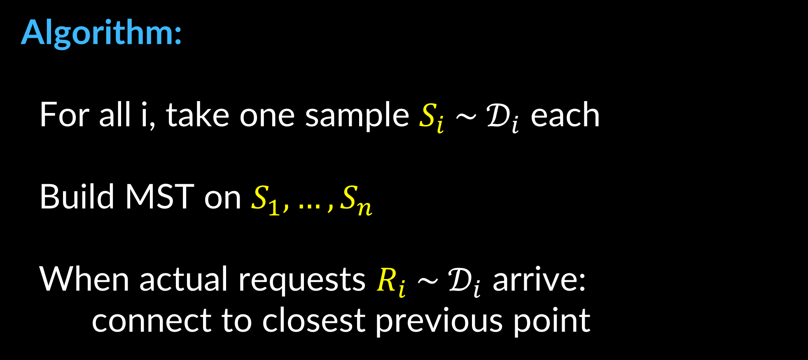
stochastic (steiner) tree
Suppose n requests: vertex $R_{i } \sim 𝒟_{i}$
Connect each request on arrival
Algorithm:
For all i, take one sample $S_{i} \sim 𝒟_{i}$ each
Build MST on $S_{1},…, S_{n}$
When actual requests $R_{i} \sim 𝒟_{i}$ arrive:
connect to closest previous point
Goal: minimize total cost of edges
[Garg Gupta Leonardi Sankowski 08]

Slide 29



stochastic (steiner) tree
Suppose n requests: vertex $R_{i } \sim 𝒟_{i}$
Theorem: $𝔼\left[Algo\right]≤2 𝔼[MST\left(R_{1},…, R_{n}\right)]$
Connect each request on arrival
Algorithm:
For all i, take one sample $S_{i} \sim 𝒟_{i}$ each
Build MST on $S_{1},…, S_{n}$
When actual requests $R_{i} \sim 𝒟_{i}$ arrive:
connect to closest previous point
$$𝔼\left[MST\left(S_{1},…, S_{n}\right)\right]=𝔼\left[MST\left(R_{1},…, R_{n}\right)\right]$$
Proof:
$$𝔼\left[cost\left(R_{i}\right)\right]≤𝔼[dist\left(R_{i}, S\right)]$$
$$≤𝔼[dist\left(R_{i}, S_{−i}\right)]$$
$$=𝔼[dist\left(S_{i}, S_{−i}\right)]$$
$$⇒ Σ_{i} 𝔼\left[cost\left(R_{i}\right)\right]≤Σ_{i} 𝔼\left[dist\left(S_{i}, S_{−i}\right)\right]≤𝔼\left[ MST\left(S\right) \right]$$

Slide 30

roadmap for today
Steiner tree
Online algo (using greedy algo)
Theorem: $O(\log{T})$-competitive using greedy algo
Some matching hardness results
Theorem: $Ω(\log{T})$ bound on diamond graphs
How to go beyond worst-case?
When requests from known distribution
Theorem: $O(1)$ bound for Stochastic inputs

Slide 31


lecture plan
Lecture #1: Set Cover (worst case)
Lecture #2: Set Cover (beyond worst case), Network design (both)
Lecture #3: Resource Allocation (aka packing)
Lecture #4: Search Problems (aka chasing)

