Slide 1

Graph Searching with Predictions
Anupam Gupta
(Courant @ NYU / Google)

Slide 2



with Siddhartha Banerjee (Cornell), Vincent Cohen-Addad (Google), and Zhouzi Li (CMU)
partly based on work at ITCS 2023

Slide 3


algos with predictions
Remarkable interest in algorithms with (unreliable) predictions
Central theme:
use predictions to get improved results (beyond worst-case)
careful of bad predictions (robustness vs consistency)
ideal: smoothly interpolate between worst-case and best-case
Today’s talk:
“old” application of predictions to exploring unknown terrains

Slide 4


Problem Definition: Graph Searching
r
photo credit: Gemini

Slide 5
Problem Definition: Graph Searching
r
photo credit: Gemini

Slide 6
Problem Definition: Graph Searching
r
photo credit: Gemini

Slide 7
Problem Definition: Graph Searching
r
photo credit: Gemini

Slide 8
Problem Definition: Graph Searching
r
photo credit: Gemini

Slide 9
Problem Definition: Graph Searching
r
Visited
photo credit: Gemini

Slide 10
Problem Definition: Graph Searching
r
Observed
Visited
photo credit: Gemini

Slide 11
Problem Definition: Graph Searching
r
photo credit: Gemini

Slide 12
Problem Definition: Graph Searching
r
g
photo credit: Gemini

Slide 13
Problem Definition: Graph Searching
r
g
photo credit: Gemini

Slide 14
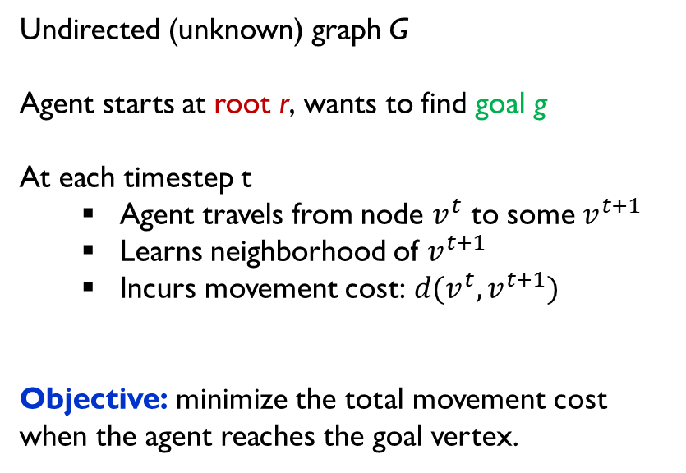
Problem Definition: Graph Searching
Undirected (unknown) graph G
Agent starts at root r, wants to find goal g
At each timestep t
Agent travels from node $v^{t}$ to some $v^{t+1}$
Learns neighborhood of $v^{t+1}$
Incurs movement cost: $d(v^{t},v^{t+1})$
Objective: minimize the total movement cost when the agent reaches the goal vertex.
Competitive analysis: Compare with $D := d(r, g)$, the optimal cost incurred in hindsight.
photo credit: Gemini

Slide 15
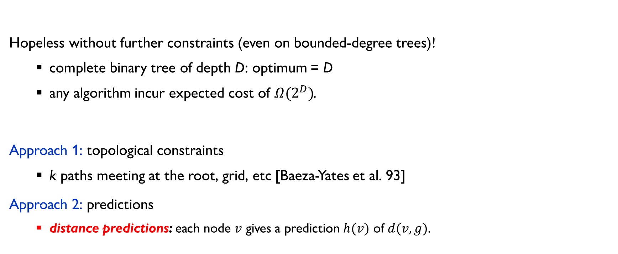
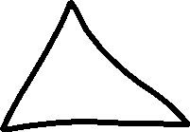
barriers and hopes…
Hopeless without further constraints (even on bounded-degree trees)!
complete binary tree of depth D: optimum = D
any algorithm incur expected cost of $Ω(2^{D})$.
Approach 1: topological constraints
k paths meeting at the root, grid, etc [Baeza-Yates et al. 93]
Approach 2: predictions
distance predictions: each node $v$ gives a prediction $h(v)$ of $d(v,g)$.

Slide 16

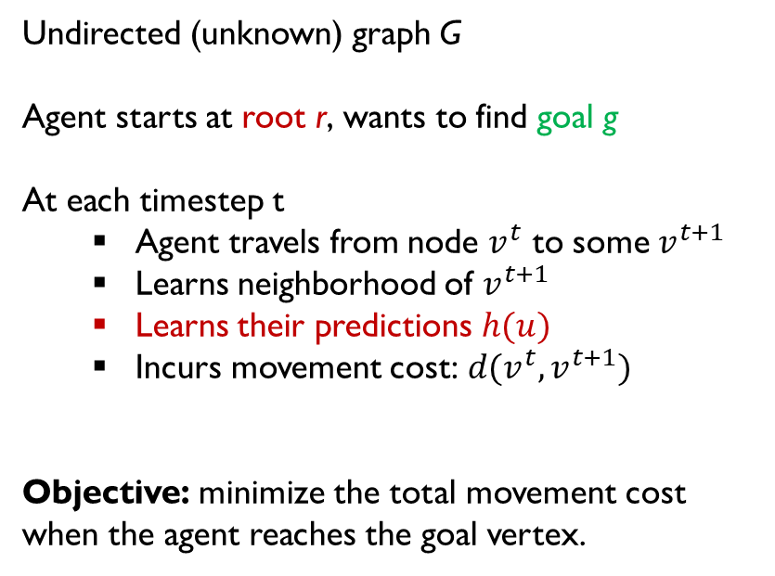
Graph Searching with Predictions
Undirected (unknown) graph G
Agent starts at root r, wants to find goal g
At each timestep t
Agent travels from node $v^{t}$ to some $v^{t+1}$
Learns neighborhood of $v^{t+1}$
Learns their predictions $h(u)$
Incurs movement cost: $d(v^{t},v^{t+1})$
Objective: minimize the total movement cost when the agent reaches the goal vertex.
photo credit: Gemini

Slide 17
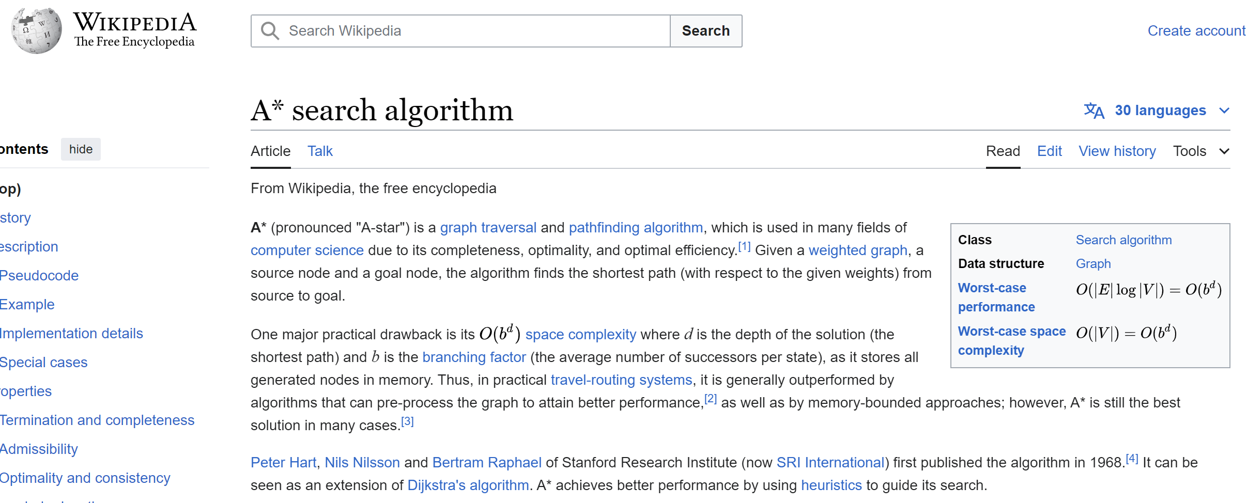
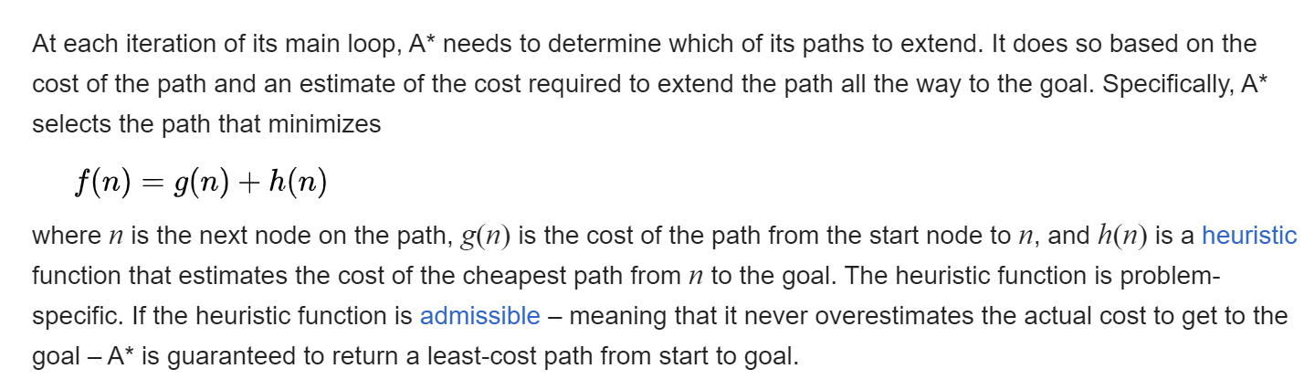
the setting is not new…

Slide 18


the setting is not new…

Slide 19




the setting is not new…

Slide 20
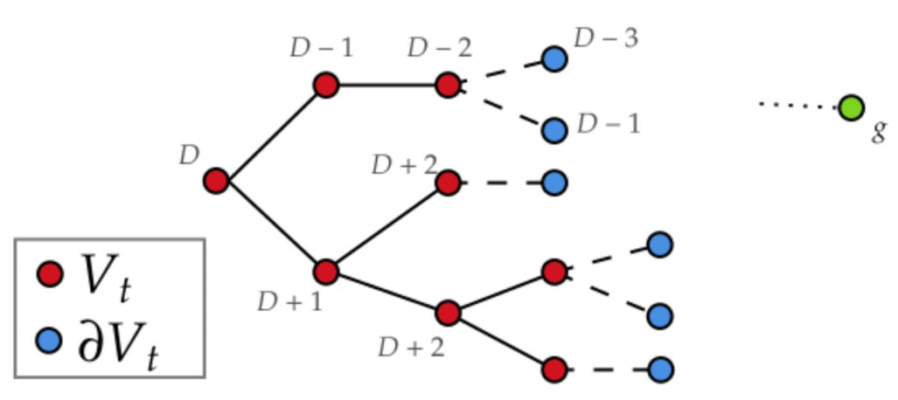

perfect predictions
If predictions all correct: just “walk downhill”
each timestep t, move to neighbor $v^{t}$ of $v^{t−1}$ with $h(v^{t})=h(v^{t−1})−ℓ(v^{t−1},v^{t})$.
What if the predictions are not all correct?

Slide 21
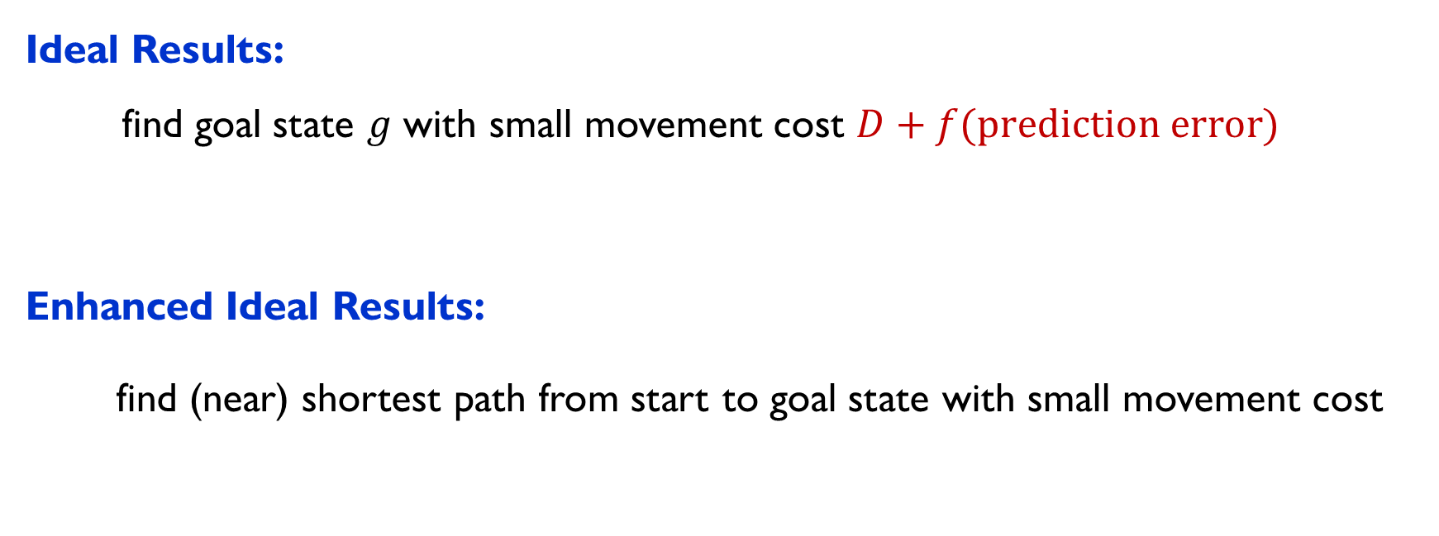
what do we want?
Ideal Results: find goal state $g$ with small movement cost $D+f(prediction error)$
Enhanced Ideal Results:
find (near) shortest path from start to goal state with small movement cost

Slide 22
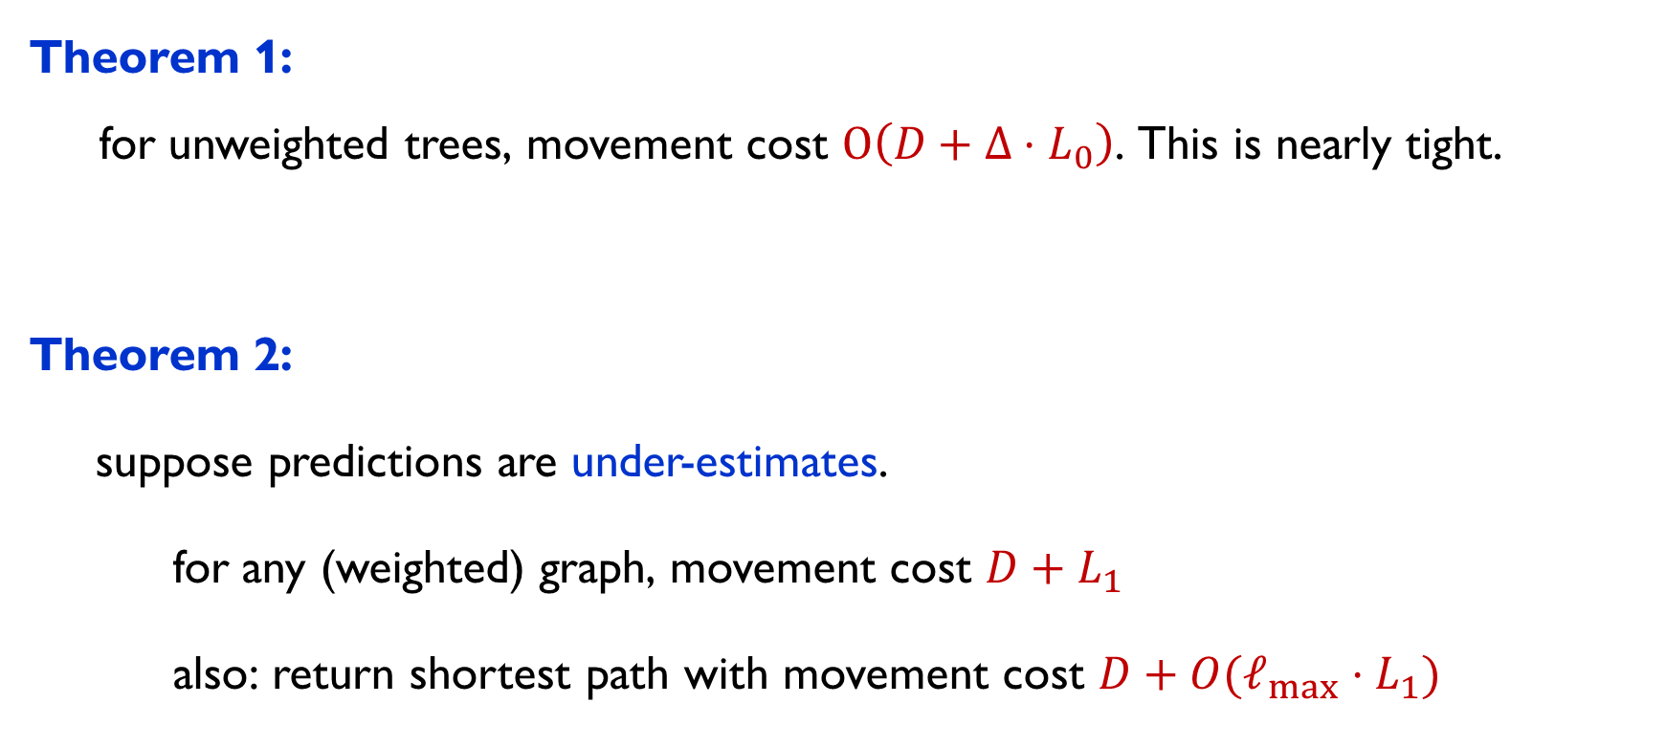

what do we have?
Theorem 1: for unweighted trees, movement cost $O\left(D+Δ⋅L_{0}\right)$. This is nearly tight.
Theorem 2:
suppose predictions are under-estimates.
for any (weighted) graph, movement cost $D+L_{1}$
also: return shortest path with movement cost $D+{O(ℓ}_{max}⋅L_{1})$
maximum degree
Erasmo’s talk gave an extension:
$D+ L_{1}^{−}+{nL}_{∞}^{+}$
maximum edge-length
$L_{0}$ is number of erroneous nodes. $L_{1}$ is sum of absolute errors.

Slide 23
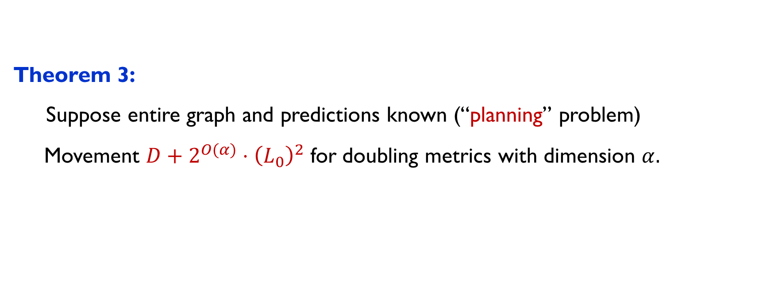
what do we have? (part two)
Theorem 3: Suppose entire graph and predictions known (“planning” problem) Movement $D+2^{O(α)}⋅{\left(L_{0}\right)}^{2}$ for doubling metrics with dimension $α.$
$L_{0}$ is number of erroneous nodes. $L_{1}$ is sum of absolute errors.

Slide 24
let’s focus on this today…
Theorem 1: for unweighted trees, movement cost $O\left(D+Δ⋅L_{0}\right)$. This is nearly tight.
Theorem 2:
suppose predictions are under-estimates.
for any (weighted) graph, movement cost $D+L_{1}$
also: return shortest path with movement cost $D+{O(ℓ}_{max}⋅L_{1})$
maximum degree
maximum edge-length
$L_{0}$ is number of erroneous nodes. $L_{1}$ is sum of absolute errors.

Slide 25



Lower Bound Example

Slide 26






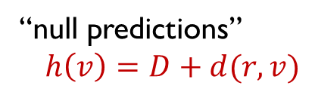


Lower Bound Example
“null predictions”
$h\left(v\right)=D+d(r,v)$
OPT = $D$, but ALG = $Ω\left(Δ⋅D\right)=Ω(Δ⋅L_{0})$

Slide 27

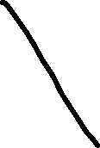
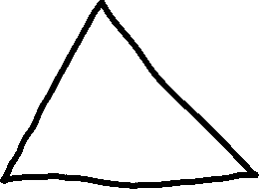
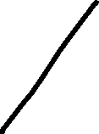





Another Example

Slide 28

Another Example

Slide 29


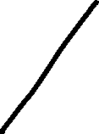



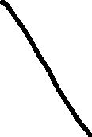




Another Example
Lots of errors here, so can afford to explore the entire tree!

Slide 30





Yet Another Example

Slide 31



Yet Another Example
Again, only $D$ mistakes and constant degree, so want to explore only $O(D)$
How should we do it?

Slide 32

recall: theorem
Theorem 1: for unweighted trees, movement cost $O\left(D+Δ⋅L_{0}\right)$. This is nearly tight.
Case 1: Null Predictions
Case 2: Known target distance D
Case 3: Unknown D

Slide 33






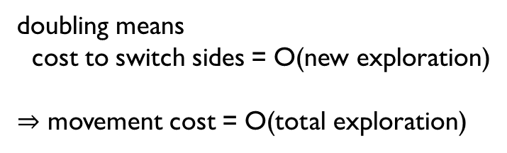







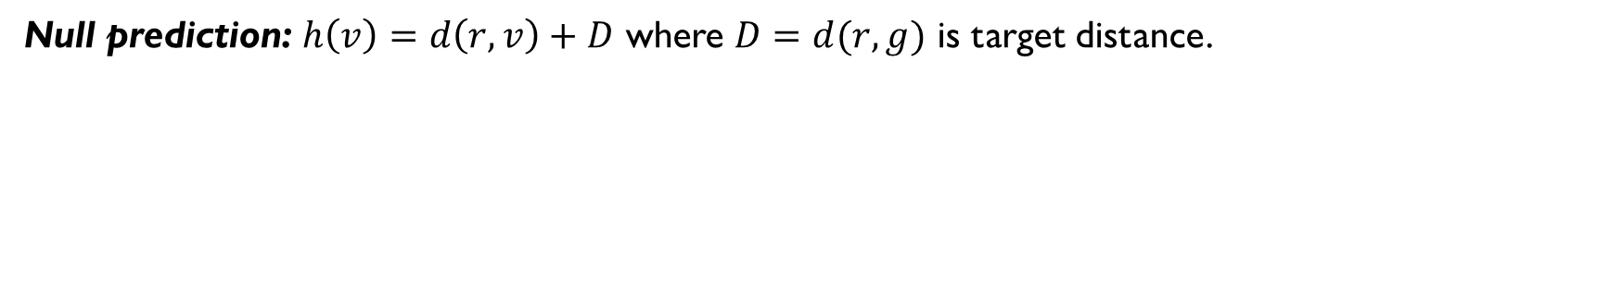







null predictions
Null prediction: $h\left(v\right)=d\left(r,v\right)+D$ where $D=d(r,g)$ is target distance.
#explored nodes
= green nodes (correct predictions) + yellow nodes (mistakes)
$≤ O(Δ⋅mistakes)$ = $O(Δ⋅L_{0})$
Truncate tree to have depth $D$
movement cost:
Use “guess and double”: run DFS for doubling lengths in each subtree of root.
doubling means
cost to switch sides = O(new exploration)
$⇒$ movement cost = O(total exploration)

Slide 34
recall: theorem
Theorem 1: for unweighted trees, movement cost $O\left(D+Δ⋅L_{0}\right)$. This is nearly tight.
Case 1: Null Predictions
Case 2: Known target distance D
Case 3: Unknown D

Slide 35




roadmap for known $D$
Recall: $D=d(root,goal)$
Intuition:
balance the (node-specific) “load” on each side of each node.
define “loads” soon
for each node one of “loads” is erroneous
$⇒$ exploration = $Δ⋅$ error
finally, movement = O(exploration) by doubling ideas.

Slide 36





















def: anchors
$τ\left(u\right)$ $=$ anchor of node $u$
$:=$ $u$’s ancestor at depth $\frac{D+d\left(r,u\right)−h\left(u\right)}{2}$
Fact: If $h\left(u\right)$ correct
$⇒$ anchor $τ(u)$ is LCA($u,g$)
If $h(u)$ incorrect, anchor is meaningless, but error gives budget to explore more.
$$τ(u)$$
$$d(r,u)$$
$$D$$
$h(u)$ is prediction
of this distance

Slide 37




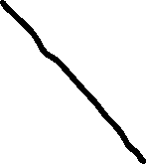


















def: anchors
$τ\left(u\right)$ $=$ anchor of node $u$
$:=$ $u$’s ancestor at depth $\frac{D+d\left(r,u\right)−h\left(u\right)}{2}$
Fact: If $h\left(u\right)$ correct
$⇒$ anchor $τ(u)$ is LCA($u,g$)
If $h(u)$ incorrect, anchor is meaningless, but error gives budget to explore more.
with perfect predictions….

Slide 38








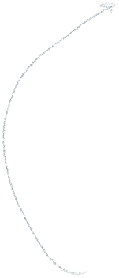


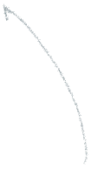

ex: anchors for null preds
$τ\left(u\right)$ $=$ anchor of node $u$
$:=$ $u$’s ancestor at depth $\frac{D+d\left(r,u\right)−h\left(u\right)}{2}$
If null predictions:
$h\left(u\right)=D+d(r,u)$
and hence anchor = root for everyone
with null predictions….

Slide 39

ex: anchors for perfect preds
$τ\left(u\right)$ $=$ anchor of node $u$
$:=$ $u$’s ancestor at depth $\frac{D+d\left(r,u\right)−h\left(u\right)}{2}$
Fact: If $h\left(u\right)$ correct
$⇒$ anchor $τ(u)$ is LCA($u,g$)
with perfect predictions….

Slide 40
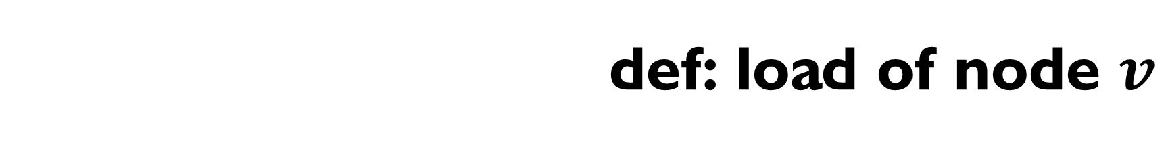



def: load of node $v$
$τ\left(u\right)$ $=$ anchor of node $u$
$:=$ $u$’s ancestor at depth $\frac{D+d\left(r,u\right)−h\left(u\right)}{2}$
Def:
$v$’s load = explored nodes that have $v$ as anchor
goal must be here
with perfect predictions….

Slide 41



def: load of node $v$
$τ\left(u\right)$ $=$ anchor of node $u$
$:=$ $u$’s ancestor at depth $\frac{D+d\left(r,u\right)−h\left(u\right)}{2}$
Def:
$v$’s load = explored nodes that have $v$ as anchor
should explore subtrees
with load << size
with imperfect predictions….

Slide 42

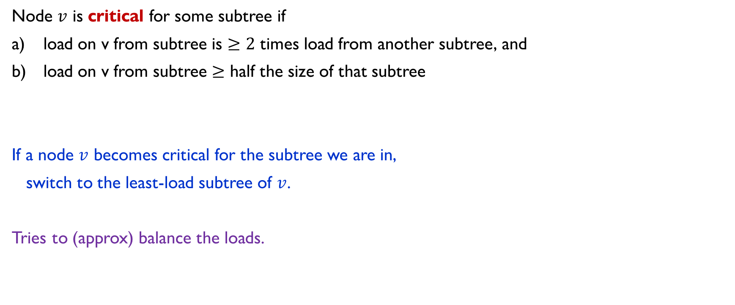

when to stop exploring?
Node $v$ is critical for some subtree if
load on v from subtree is $≥2$ times load from another subtree, and
load on v from subtree $≥$ half the size of that subtree
If a node $v$ becomes critical for the subtree we are in,
switch to the least-load subtree of $v$.
Tries to (approx) balance the loads.
with imperfect predictions….

Slide 43







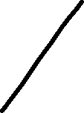


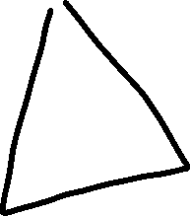










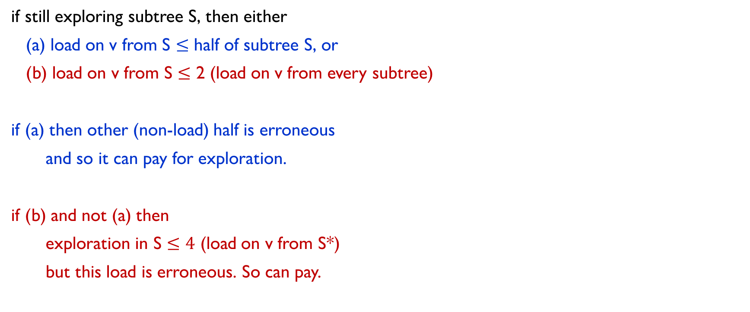




analysis: extra exploration
if still exploring subtree S, then either
(a) load on v from S $≤$ half of subtree S, or
(b) load on v from S $≤$ 2 (load on v from every subtree)
if (a) then other (non-load) half is erroneous
and so it can pay for exploration.
if (b) and not (a) then
exploration in S $≤4$ (load on v from S*)
but this load is erroneous. So can pay.
how much exploration done here?
Subtree S
Need doubling ideas to bound movement cost, skip for today…
main subtree S*

Slide 44
recall: theorem
Theorem 1: for unweighted trees, movement cost $O\left(D+Δ⋅L_{0}\right)$. This is nearly tight.
Case 1: Null Predictions
Case 2: Known target distance D
Case 3: Unknown D

Slide 45
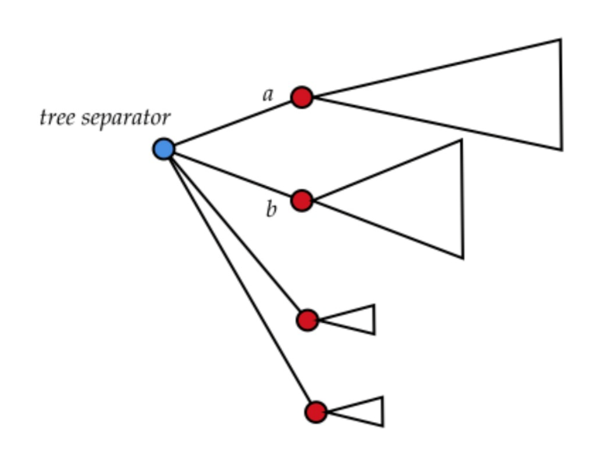
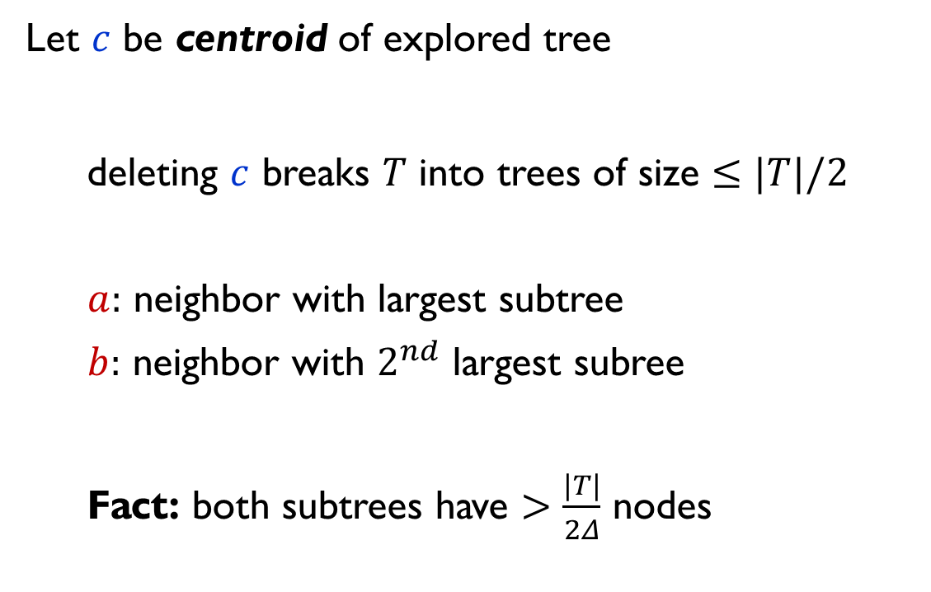

tree separators
Let $c$ be centroid of explored tree
deleting $c$ breaks $T$ into trees of size $≤|T|/2$
$a:$ neighbor with largest subtree
$b:$ neighbor with $2^{nd}$ largest subree
Fact: both subtrees have $>\frac{|T|}{2Δ}$ nodes

Slide 46
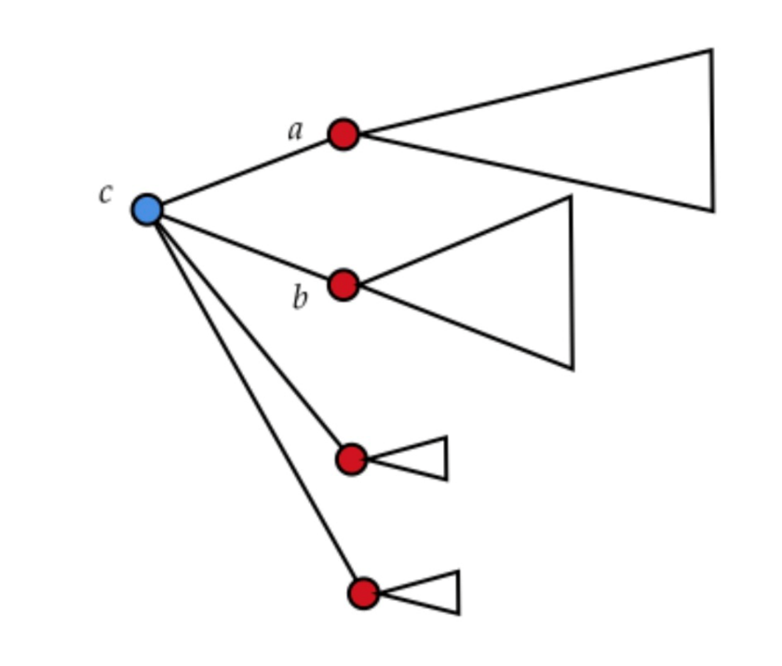

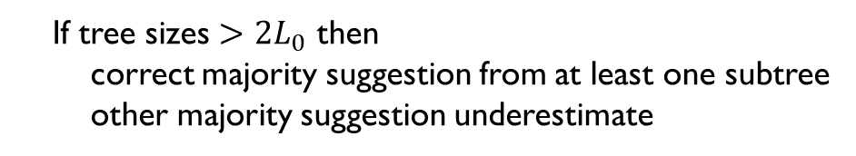



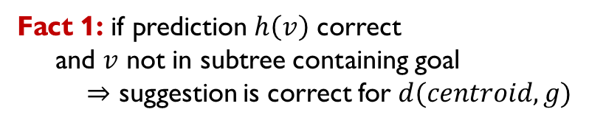

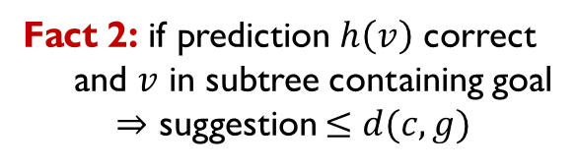
voting for $D$
each node $v$ “suggests” value $h\left(v\right)−d\left(v,c\right)$
$$v$$
Fact 1: if prediction $h\left(v\right)$ correct
and $v$ not in subtree containing goal
$⇒$ suggestion is correct for $d(centroid,g)$
centroid
$$v$$
Fact 2: if prediction $h\left(v\right)$ correct
and $v$ in subtree containing goal
$⇒$ suggestion $≤d(c,g)$
$$g$$
Take two largest subtrees, look at majority suggestions
If tree sizes $>2L_{0}$ then
correct majority suggestion from at least one subtree
other majority suggestion underestimate
$\hat{D}$ for “root” $c$ = max of these majority suggestions

Slide 47
that concludes…
Theorem 1: for unweighted trees, movement cost $O\left(D+Δ⋅L_{0}\right)$. This is nearly tight.
Case 1: Null Predictions
Case 2: Known target distance D
Case 3: Unknown D

Slide 48
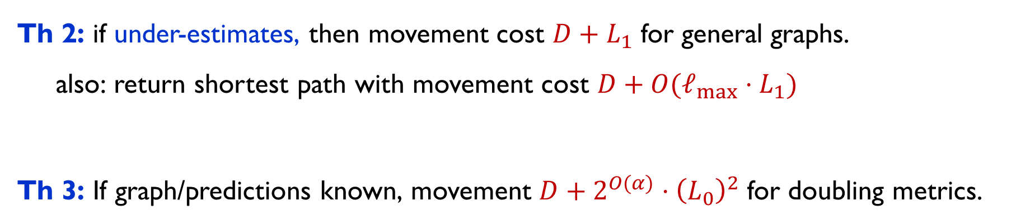
summary of results
Theorem 1: for unweighted trees, movement cost $O\left(D+Δ⋅L_{0}\right)$. This is nearly tight.
Th 2: if under-estimates, then movement cost $D+L_{1}$ for general graphs. also: return shortest path with movement cost $D+{O(ℓ}_{max}⋅L_{1})$
Th 3: If graph/predictions known, movement $D+2^{O(α)}⋅{\left(L_{0}\right)}^{2}$ for doubling metrics.

Slide 49
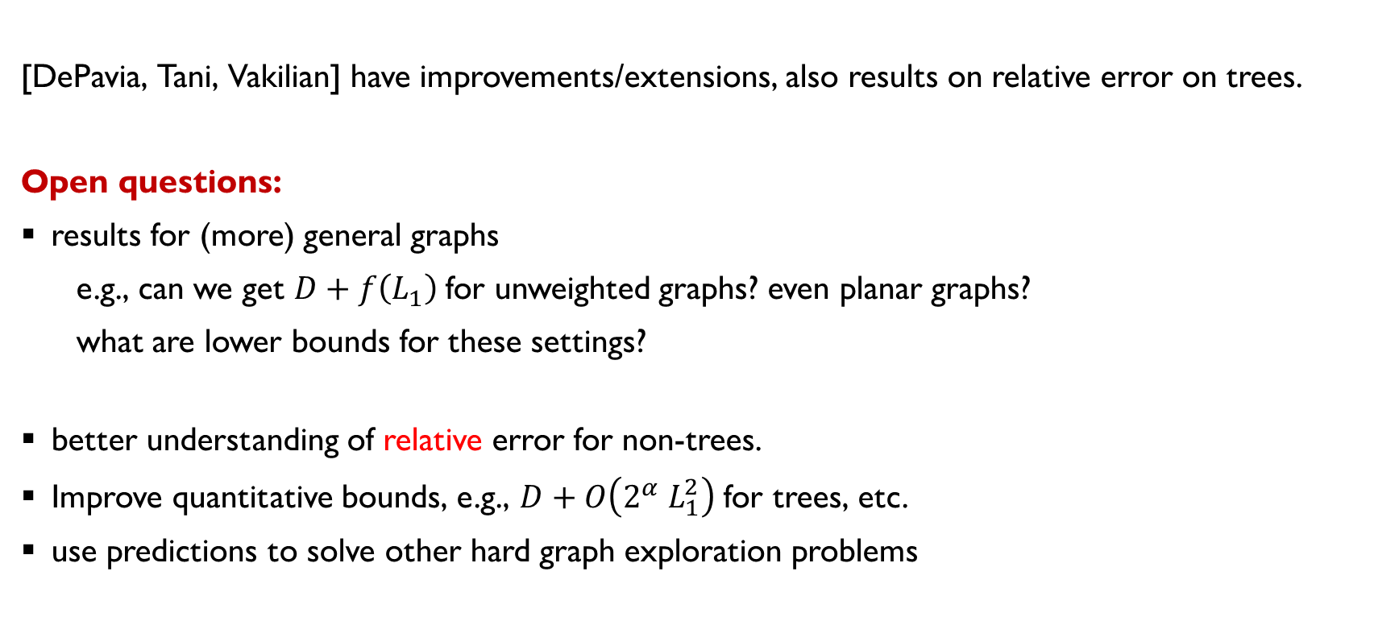
further results and open problems
[DePavia, Tani, Vakilian] have improvements/extensions, also results on relative error on trees.
Open questions:
results for (more) general graphs
e.g., can we get $D+f\left(L_{1}\right)$ for unweighted graphs? even planar graphs?
what are lower bounds for these settings?
better understanding of relative error for non-trees.
Improve quantitative bounds, e.g., $D+O\left(2^{α} L_{1}^{2}\right)$ for trees, etc.
use predictions to solve other hard graph exploration problems
Thanks!

