Slide 1
The Price of Explainability for Clustering
Anupam Gupta (NYU)
Work with Ola Svensson (EPFL), Madhusudhan R. Pittu (CMU) and Rachel Yuan (CMU)
(slides credit: Ola, mostly)
Rutgers, April 2, 2024

Slide 2
k-Median
Given a set of n points $X$ and a distance metric $d(., .)$
Find a set of k centers $C⊆X$
So that the distance of each point to its nearest center is minimized:
closest center to x

Slide 3
k-Means
Given a set of n points $X$ and a distance metric $d(.,.)$
Find a set of k centers $C⊆X$
So that the squared distance of each point to its nearest center is minimized:
2
closest center to x

Slide 4
Approximation algorithms
Problem | Lower bound | Upper bound
k-median | 1.74.. [Guha, Kuller’99] | 2.613 [Gowda et al’23] 2.612 +[Cohen Addad et al’23]
k-means | 3.94.. [Guha, Kuller’99] 1.37 [Cohen Addad, Karthik, Lee’21] | 9 [Ahmadian et al’17] 5.9 [Cohen Addad et al’17]
Beautiful (hard) open questions

Slide 5
Explainable clustering

Slide 6
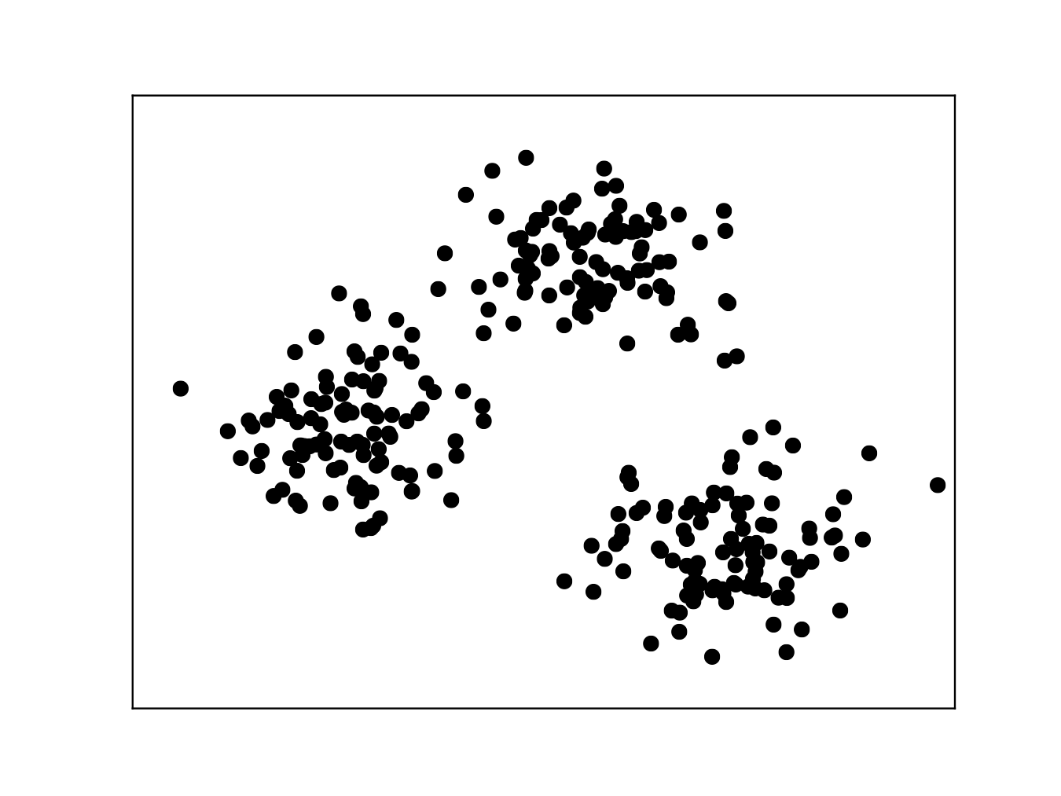
Optimal clustering sometimes hard to explain
points in $ℝ^{d}$

Slide 7
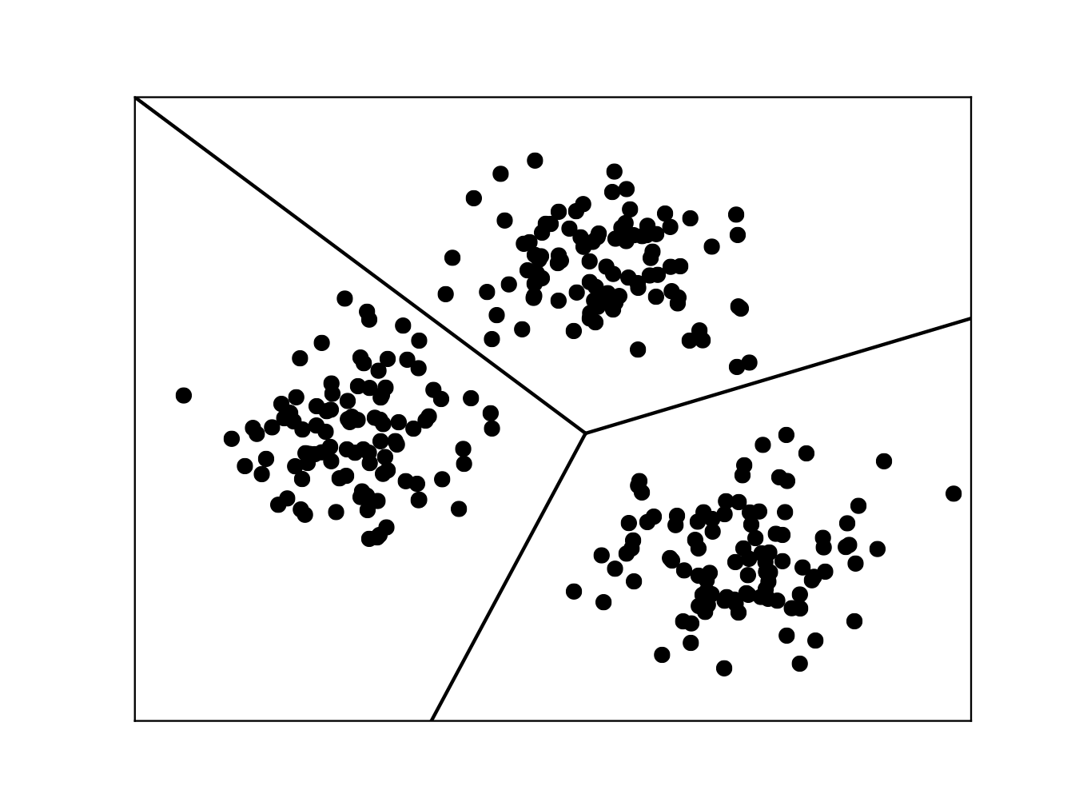
Optimal clustering sometimes hard to explain
points in $ℝ^{d}$

Slide 8
Optimal clustering sometimes hard to explain
points in $ℝ^{d}$

Slide 9
Optimal clustering sometimes hard to explain
points in $ℝ^{d}$
More explainable “threshold tree”

Slide 10
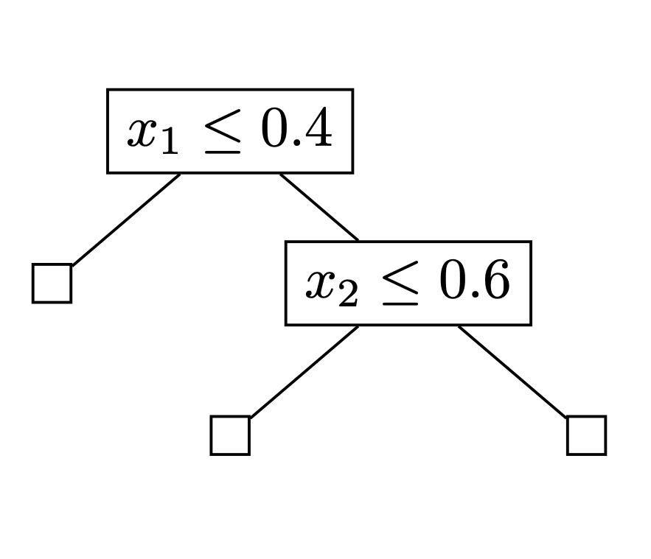
Optimal clustering sometimes hard to explain
points in $ℝ^{d}$
More explainable “threshold tree”

Slide 11
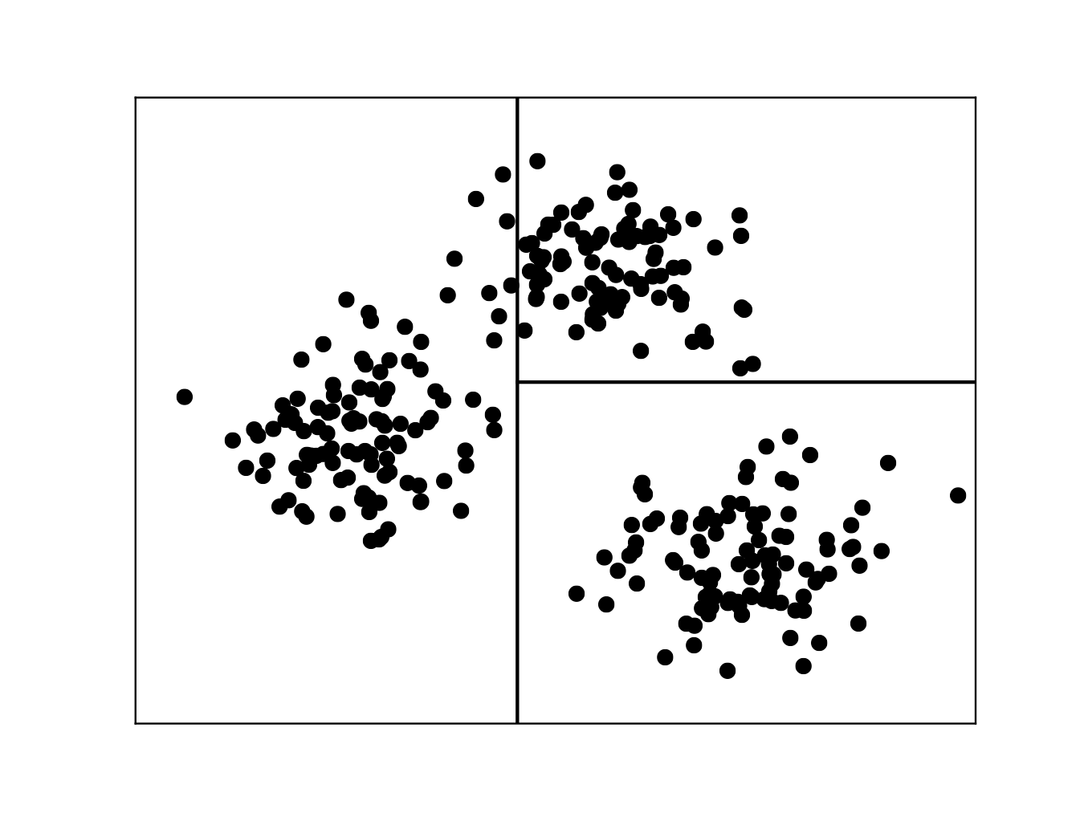
Optimal clustering sometimes hard to explain
points in $ℝ^{d}$
More explainable “threshold tree”

Slide 12
Optimal clustering sometimes hard to explain
points in $ℝ^{d}$
$$0.6⋅\text{techniques}+0.7⋅\text{novelty}+2⋅\text{conceptual}≤1.5$$
and
$$0.9⋅\text{techniques}+1.4⋅\text{novelty}+0.7⋅\text{conceptual}≥2.5$$
More explainable “threshold tree”
$$\text{techniques}≤−1$$
$$\text{novelty}≤−2$$
$$\text{conceptual}≤0$$

Slide 13
Explainable clustering
A threshold tree is a binary tree where each non-leaf node is an axis-aligned threshold cut
An explainable k-clustering is one formed by a threshold tree with k leaves

Slide 14
Price of explainability
How much more expensive is an optimal explainable clustering?
Can we find a good explainable clustering efficiently?
Can we (approximately) find the best possible explainable clustering?
First introduced and studied theoretically by Moshkovitz, Dasgupta, Rashtchian, and Frost (ICML’20)

Slide 15
Explaining explainable clustering in four steps
General Approach of Moshkovitz, Dasgupta, Rashtchian, and Frost
Random Thresholds Algorithm
Analyses in prior work
Newer results/analysis ideas

Slide 16
Focus on k-median in $ℓ_{1}$
c
f
Points $X$ in $ℝ^{d}$
Distance $ℓ_{1}$-norm. That is
e
d
a
$$dist(x,y)=\overset{d}{\underset{i=1}{∑}}|x_{i}−y_{i}|$$
b
Cost of optimal unconstrained clustering equals sum of dotted edges
$$OPT=a+b+c+d+e+f$$

Slide 17
General approach
Transform given reference clustering of cost $OPT$ to an explainable clustering with not much higher cost (one leaf per center)

Slide 18
General approach
Transform given reference clustering of cost $OPT$ to an explainable clustering with not much higher cost (one leaf per center)

Slide 19
General approach
Transform given reference clustering of cost $OPT$ to an explainable clustering with not much higher cost (one leaf per center)

Slide 20
The algorithm of MDRF
While there is a leaf with more than one center, select a min-cut

Slide 21
The algorithm of MDRF
While there is a leaf with more than one center, select a min-cut
cut that separates fewest number of points from their closest center

Slide 22
The algorithm of MDRF
While there is a leaf with more than one center, select a min-cut
cut that separates fewest number of points from their closest center

Slide 23
The algorithm of MDRF
While there is a leaf with more than one center, select a min-cut
cut that separates fewest number of points from their closest center

Slide 24
Idea behind Analysis
c
Look at bounding box containing current centers.
Say sum of box widths = $L$
Pick a random threshold cut in this box.
$Pr⁡$[point $x$ separated from closest center $c$]
$≤d(x,c)/L$
$⇒𝔼\left[\# separated pts\right]≤OPT/L$
$⇒𝔼\left[\# separated pts\right]⋅L≤OPT$
f
x
e
d
a
b
$⇒$ exists a cut such that (#separated points) $×L≤OPT$

Slide 25
#{points separated by min-cut} * {distance to farthest away centre} $≤$ OPT
OPT(Left) + OPT(Right) $≤$ OPT
$≤$ OPT
Cost increase at each level is at most OPT
Price of explainability is at most the height of tree and hence at most $O(k)$
MDRF’20
Price of explainability of k-means is $O(k^{2})$
There are instances where the price of explainability is $Ω(log k)$
MDRF’20

Slide 26
Three independent works in 2021
Makarychev and Shan:
$O(logk loglogk)$
Gamlath, Jia, Polak, Svensson:
$O(\log^{2}k)$
Esfandiari, Mirrokni, Narayanan:
$O(min(logk loglogk,d\log^{2}d))$
Other works by:
Laber and Mourtinho
Charikar and Hu

Slide 27
Random Thresholds Algorithm
While there is a leaf with more than one center, select a min-cut
select a uniformly at random cut

Slide 28
Random Thresholds Algorithm
While there is a leaf with more than one center, select a min-cut
select a uniformly at random cut

Slide 29
Random Thresholds Algorithm
While there is a leaf with more than one center, select a min-cut
select a uniformly at random cut
$$L_{2}$$
$$L_{1}$$

Slide 30
Random Thresholds Algorithm
While there is a leaf with more than one center, select a min-cut
select a uniformly at random cut
$$L_{2}$$
$$L_{1}$$

Slide 31
Random Thresholds Algorithm
While there is a leaf with more than one center, select a min-cut
select a uniformly at random cut
$$L_{2}$$
$$L_{1}$$

Slide 32
Random Thresholds Algorithm
While there is a leaf with more than one center, select a min-cut
select a uniformly at random cut
$$L_{2}$$
$$L_{1}$$

Slide 33
Ideas of their analysis
Enough to analyze the cost increase of a single point (by linearity of expectation)
By translation, we may assume the point is located at the origin

Slide 34
A Poly-log Bound
Makarychev and Shan
Esfanidiari, Mirrokni and Narayanan
Gamlath, Jia, Polak, and Svensson
Suppose max distance between current set of centers $≈D≤L.$
1. $Pr⁡$[ two centers $x, y$ separated by random cut ] $= d(x,y)/L$
2. Take $T$ random cuts $⇒ \operatorname{Pr}\left[ two centers at distance≥D/2 not sep \right]≤{\left(1−\frac{D/2}{L}\right)}^{T}≤\exp\left(−\frac{DT}{2L}\right)$
Set $T≈L/D\ln{k} ⇒ Pr\left[…\right]≤ 1/poly(k)$, so all “far” centers separated whp.
3. $Pr⁡[$ point $p$ separated from its closest center ] $≤\frac{d\left(p,c\right)}{L}$
4. $𝔼[$ cost point $p$ pays in $T$ cuts ] $≤ D⋅T⋅d(p,c)/L$ $≈d\left(p,c\right)⋅\ln{k}$
So expected cost in all $T$ cuts is $OPT\ln{k}$. There are $\log{ \left(\frac{d_{max }}{d_{min}}\right)}$ distance scales $⇒O(\log{k}\log{aspect ratio).}$

Slide 35
So…
Upper bound $O\left(\log{k}\log{aspect ratio}\right)$
improve to $O(\log^{2}{k})$
improve to $O(\log{k\log{\log{k})}}$
Lower bound $Ω(\log{k)}$

Slide 36
So how good is the Algo?
Special case: A single point at origin
Centers at distances $d_{1}≤d_{2}≤…≤d_{k}$ each along unique dimension
Cost of unconstrained clustering thus equals $d_{1}$
Expected cost of explainable clustering determined by following process
While there are more than one center
Remove a center $i$ with probability proportional to its distance $d_{i}$
What is the expected distance to the last remaining center?
$$d_{2}$$
$$d_{3}$$
$$d_{1}$$

Slide 37
Balls-and-bin perspective
Equivalent to special case
k bins of different width $1=d_{1}≤d_{2}≤…≤d_{k}$
For k-1 steps, random ball hits one of the remaining bins with probability promotional to $d_{i}$
$$d_{1}=1$$
$$d_{2}$$
$$d_{3}$$

Slide 38
Balls-and-bin perspective
Equivalent to special case
k bins of different width $1=d_{1}≤d_{2}≤…≤d_{k}$
For k-1 steps, random ball hits one of the remaining bins with probability promotional to $d_{i}$
w.p. $\frac{d_{1}}{d_{1}+d_{2}+d_{3}}$
$$d_{1}=1$$
$$d_{2}$$
$$d_{3}$$

Slide 39
Balls-and-bin perspective
Equivalent to special case
k bins of different width $1=d_{1}≤d_{2}≤…≤d_{k}$
For k-1 steps, random ball hits one of the remaining bins with probability promotional to $d_{i}$
w.p. $\frac{d_{1}}{d_{1}+d_{2}+d_{3}}$
w.p. $\frac{d_{3}}{d_{2}+d_{3}}$
$$d_{1}=1$$
$$d_{2}$$
$$d_{3}$$

Slide 40
Balls-and-bin perspective
Equivalent to special case
k bins of different width $1=d_{1}≤d_{2}≤…≤d_{k}$
For k-1 steps, random ball hits one of the remaining bins with probability promotional to $d_{i}$
The expected width of remaining bin = price of explainability in special case
w.p. $\frac{d_{1}}{d_{1}+d_{2}+d_{3}}$
w.p. $\frac{d_{3}}{d_{2}+d_{3}}$
$$d_{1}=1$$
$$d_{2}$$
$$d_{3}$$

Slide 41
One bin
$$d_{1}=1$$
Remaining bin is of width 1
Price of explainability with one center is 1…

Slide 42
Two bins
$$d_{1}=1$$
$$d_{2}$$
$$Pr[d_{1}\text{remains}]⋅d_{1}+Pr[d_{2}\text{remains}]⋅d_{2}$$
$$=\frac{d_{2}}{d_{1}+d_{2}}⋅d_{1}+\frac{d_{1}}{d_{1}+d_{2}}⋅d_{2}$$
$$≤2d_{1}=2$$
Price of explainability in special case with two centers is 2…

Slide 43
Three bins
$$d_{1}=1$$
$$d_{2}$$
$$d_{3}$$
$$Pr[d_{1}\text{remains}]⋅d_{1}+Pr[d_{2}\text{remains}]⋅d_{2}+Pr[d_{3}\text{remains}]⋅d_{3}$$
$$=…$$
$$≤(1+1/1+1/2)d_{1}$$
Price of explainability in special case with three centers is 1+1/1+1/2…

Slide 44
k Bins
$1=d_{1}≤d_{2}≤…≤d_{k}$
The expected width of remaining bin is $1+H_{k−1}$
In special case, price of explainability is $1+H_{k−1}$
Here, $H_{k−1}=1/1+1/2+…+1/(k−1)≈lnk$

Slide 45
Proof by induction on k
We already verified base cases and here is the inductive step
Let $D=d_{1}+d_{2}+…+d_{k}$
Expected width of remaining bin is
$$Pr[\text{1}\text{st} \text{ball} \text{lands} \text{in}{ d}_{1}]⋅𝔼[\text{width} \text{of} \text{remaining} \text{bin} \text{in} \text{instance} (d_{2},…d_{k})]$$
$$≤\frac{d_{1}}{D}⋅\frac{(d_{2}+…+d_{k})}{k−1}≤\frac{d_{1}}{k−1}$$
$$+$$
$$\overset{k}{\underset{i=2}{∑}}Pr[\text{1}\text{st} \text{ball} \text{lands} \text{in} d_{i}]⋅𝔼[\text{width} \text{of} \text{remaining} \text{bin} \text{in} \text{instance} \text{without} d_{i}]$$
$$≤\left(1+H_{k−2}\right) d_{1}$$
$$≤(1+H_{k−1})d_{1}=1+H_{k−1}$$

Slide 46
Conjecture: The expected cost of Random Thresholds Algorithm is at most $(1+H_{k−1})$ times the original clustering cost
$1+H_{k−1}$ is tight even in the axis aligned case
Cuts eliminate sets of points
$$d_{2}$$
$$≠$$
$$d_{1}=1$$

Slide 48
[Gupta, Pittu, Svensson, Yuan ’23]
Even Better Bounds
Theorem: The price of explainability of RandThresholds algo is $1+H_{k−1}$
$2lnk+2$ around same time by Makarychev/Shan
Theorem: The price of explainability least $\left(1−ε\right) ln(k)$ for any $ε>0$
Also, NP-hard to approximate better than $(1−ε)ln(k)/2$

Slide 49
RandThreshold via Exponential Clocks

Slide 50
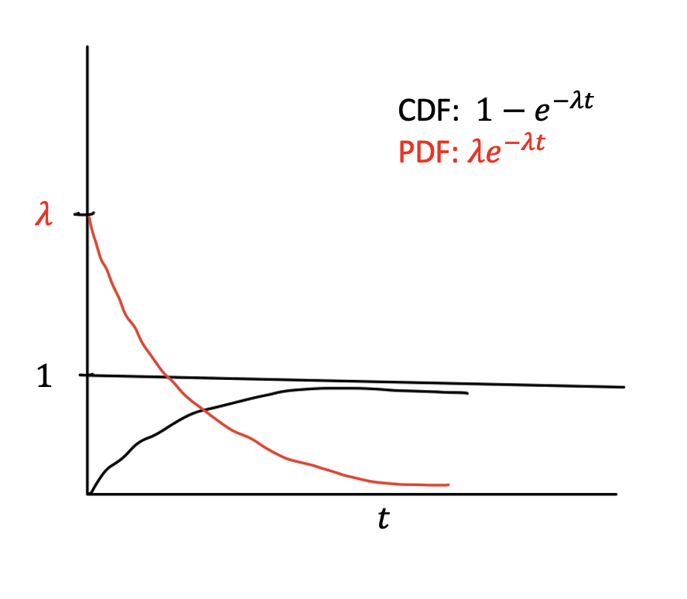
Direct proof with exponential clocks
(for the simple “orthogonal” case)
Exponential Distribution $X∼exp(λ)$
$$Pr[X≥t]=e^{−λt}$$
Memoryless: $Pr[X≥s+t∣X≥t]=Pr[X≥s]$
Proportionality: $Pr[X_{1}≤X_{2},X_{3},…X_{k}]=\frac{λ_{1}}{λ_{1}+λ_{2}+…+λ_{k}}$

Slide 51
k bins of different width $1=d_{1}≤d_{2}≤…≤d_{k}$
For k-1 steps, random ball hits one of the remaining bins with probability promotional to $d_{i}$
$$d_{1}=1$$
$$d_{2}$$
$$d_{3}$$

Slide 52
k bins of different width $1=d_{1}≤d_{2}≤…≤d_{k}$
For k-1 steps, random ball hits one of the remaining bins with probability promotional to $d_{i}$
$$d_{1}=1$$
$$d_{2}$$
$$d_{3}$$
Sample $Z_{1}∼exp(d_{1}),Z_{2}∼exp(d_{2}),…,Z_{k}∼exp(d_{k})$

Slide 53
k bins of different width $1=d_{1}≤d_{2}≤…≤d_{k}$
For k-1 steps, random ball hits one of the remaining bins with probability promotional to $d_{i}$
w.p. $\frac{d_{1}}{d_{1}+d_{2}+d_{3}}$
$$d_{1}=1$$
$$d_{2}$$
$$d_{3}$$
Sample $Z_{1}∼exp(d_{1}),Z_{2}∼exp(d_{2}),…,Z_{k}∼exp(d_{k})$
$$Z_{1}$$

Slide 54
k bins of different width $1=d_{1}≤d_{2}≤…≤d_{k}$
For k-1 steps, random ball hits one of the remaining bins with probability promotional to $d_{i}$
w.p. $\frac{d_{1}}{d_{1}+d_{2}+d_{3}}$
w.p. $\frac{d_{3}}{d_{2}+d_{3}}$
$$d_{1}=1$$
$$d_{2}$$
$$d_{3}$$
Sample $Z_{1}∼exp(d_{1}),Z_{2}∼exp(d_{2}),…,Z_{k}∼exp(d_{k})$
$$Z_{1}$$
$Z_{3}$

Slide 55
k bins of different width $1=d_{1}≤d_{2}≤…≤d_{k}$
For k-1 steps, random ball hits one of the remaining bins with probability promotional to $d_{i}$
w.p. $\frac{d_{1}}{d_{1}+d_{2}+d_{3}}$
w.p. $\frac{d_{3}}{d_{2}+d_{3}}$
$$d_{1}=1$$
$$d_{2}$$
$$d_{3}$$
Sample $Z_{1}∼exp(d_{1}),Z_{2}∼exp(d_{2}),…,Z_{k}∼exp(d_{k})$
The value of process equals $∑{ d}_{i} Pr[ Z_{i} \text{is} \text{last} ]$
$$Z_{1}$$
$Z_{3}$
$Z_{2}$

Slide 56
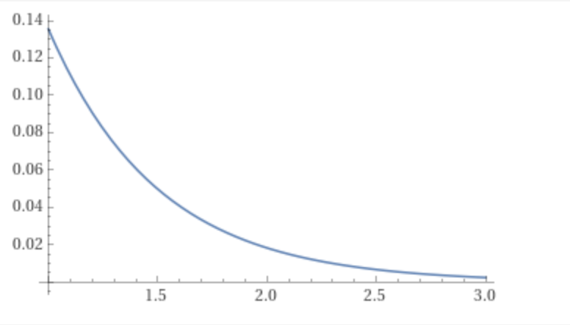
Event $E_{i}$= {$i$is last among “far away” centers}, and say $p_{i} :=Pr⁡[E_{i}]$
Then payment of bin $i$ is $≤d_{i}×\operatorname{Pr}\left[X_{1}≤X_{i}∧E_{i}\right]$
Some measure $g(t)$
$$∫_{0}^{∞}Pr[X_{1}≤t∧E_{i}∣X_{i}=t]{ f}_{X_{i}}(t)$$
$$=∫_{0}^{∞}Pr[X_{1}≤t]⋅Pr[E_{i}∣X_{i}=t]{ f}_{X_{i}}(t)$$
$$=∫_{0}^{∞}Pr[X_{1}≤t]⋅g(t)$$
To maximize this, move $g\left(.\right)$ to larger values
But have $p_{i}= Pr\left[E_{i}\right]=∫g\left(t\right)$
area = $p_{i}$
And $g\left(t\right)≤f_{X_{i}}\left(t\right)=d_{i} e^{−d_{i}t}$ for all $t$
$$a_{i}$$

Slide 57
Event $E_{i}$= {$i$is last among “far away” centers}, and say $p_{i} :=Pr⁡[E_{i}]$
Then payment of bin $i$ is $≤d_{i}×\operatorname{Pr}\left[X_{1}≤X_{i}∧E_{i}\right]$
Some measure $g(t)$
$$∫_{0}^{∞}Pr[X_{1}≤t∧E_{i}∣X_{i}=t]{ f}_{X_{i}}(t)$$
$$=∫_{0}^{∞}Pr[X_{1}≤t]⋅Pr[E_{i}∣X_{i}=t]{ f}_{X_{i}}(t)$$
$$=∫_{0}^{∞}Pr[X_{1}≤t]⋅g(t)$$
$$≤∫_{a_{i}}^{∞}Pr\left[X_{1}≤t\right]⋅f_{X_{i}}(t)$$
Using value of $a_{i}$ and doing algebra gives payment of bin $i$ to be ${≤p}_{i}+ p_{i}\ln{1/p_{i}}$
area = $p_{i}$
Now sum over bins to get $1+ H\left(p\right)≤1+\ln{k}.$
$$a_{i}$$

Slide 58
going beyond the special case
With bit more work, this gives $ln⁡k (1+o\left(1\right))$ for general point sets.
For the tight bound of $1+H_{k−1}$ we use an inductive argument.

Slide 59
Lower bounds via Hitting Set Problem

Slide 60
Simple Gap Example
Hypercube in d-dims.
Two centers: at origin and at all-ones.
Infinitely many data points at each of these centers.
Plus d green data points, one at each $e_{i}$
Original cost = d.
Any “interesting” cut separates one green data point, making new cost 2(d-1).

Slide 61
s-uniform Hitting set problem
Input: Set system $([d],T=\{S_{1},S_{2},…,S_{k}\})$ where $|S_{i}|=s$
Output: Subset $H⊆[d]$ of min size so that$S_{i}∩H≠∅$ for all $i$
Fractional solution: pick $1/s$ of each element, so cost $d/s$.
Integrality gap: Exist instances so that any hitting set has size $\frac{d}{s}ln k$
Hardness: (more or less) hard to distinguish between size $\frac{d}{s}$ and $\frac{d}{s}ln k$

Slide 62
Reduction from HS to ExpCluster
Starting clustering $𝒰=\{μ_{0},μ_{1},…,μ_{k}\}$ in $ℝ^{d}$ where
$μ_{0}$ is origin and $μ_{i}$ is characteristic vector of set $S_{i}$
Infinitely many data points at each center in $𝒰$ $⇒$Any reasonable clustering must contain one leaf per center $⇒$ must separate each $μ_{k}$ from $μ_{0}$

Slide 63
Reduction from HS to ExpCluster
Starting clustering $𝒰=\{μ_{0},μ_{1},…,μ_{k}\}$ in $ℝ^{d}$ where
$μ_{0}$ is origin and $μ_{i}$ is characteristic vector of set $S_{i}$
Infinitely many data points at each center in $𝒰$ $⇒$Any reasonable clustering must contain one leaf per center $⇒$ must separate each $μ_{k}$ from $μ_{0}$
Plus one “green” data point at location $e_{i}$ for each $i∈[d]$
Observation 1: reference clustering cost = d
Observation 2: explainable clustering separates each $μ_{i}$ from $μ_{0}$ $⇒$ hitting set (of size = # green pts sep)
Observation 3: increase in cost = $\left(s−2\right)⋅\#($green data points cut separated from origin)
$= \left(s−2\right)⋅$ hitting set size

Slide 64
…and now use known results
Integrality gap implies PoE:
Hitting set size $h≥\frac{d}{s}lnk$ means cost of explainable clustering ~= $d+s⋅h ≥d lnk$
Hardness:
Hard to distinguish between $≤d+s⋅d/s$ and $≥d+s⋅d/s ln k$
Same results hold for k-means. (Stronger PoE of $Ω(k)$ known, but approximability still open!)

Slide 65
[Gupta, Pittu, Svensson, Yuan ’23]
Let’s recap…
Theorem: The price of explainability of RandThresholds algo is $1+H_{k−1}$
(see Liren’s talk Wednesday for their proof, and for more details!)
Theorem: The price of explainability least $\left(1−ε\right) ln(k)$ for any $ε>0$
Also, NP-hard to approximate better than $(1−ε)ln(k)/2$

Slide 66
Finally, a bit about K-means

Slide 67
k-Means
Prior upper bound of O($k log k)$ [Esfandiari, Mirrokni, Narayanan’21], see also [Charikar and Hu’21]
Lower bound of $Ω(k)$
Conjecture: price of explainability for k-means is $Θ(k)$
We prove $O(k\log{\log{k)}}$ in the paper
Today let’s see a simple $O(k\log{k)}$
based on the $O(\log{k)}$ for k-medians

Slide 68
Embedding $ℓ_{2}^{2}$ into $ℓ_{1}$
$${{\left|p−q\right|}_{2}}^{2}=b_{3}^{2}+{\left(a_{2}+a_{3}\right)}^{2}$$
$${\left|\hat{p}−\hat{q}\right|}_{1}=b_{3}^{2}+a_{2}^{2}+a_{3}^{2}$$

Slide 69
Embedding $ℓ_{2}^{2}$ into $ℓ_{1}$
Embedding satisfies: ${\left|p−q\right|}_{2}^{2}≥{\left|\hat{p}−\hat{q}\right|}_{1}≥\left(1/k\right)⋅{\left|p−q\right|}_{2}^{2}$
Embedding satisfies: ${\left|p−q\right|}_{2}^{2}≥{\left|\hat{p}−\hat{q}\right|}_{1}≥\left(1/k\right)⋅{\left|p−q\right|}_{2}^{2}$
(by Cauchy-Schwarz)
Now lose another $O(\log{k)}$ to make it explainable
$${{\left|p−q\right|}_{2}}^{2}=b_{3}^{2}+{\left(a_{2}+a_{3}\right)}^{2}$$
$${\left|\hat{p}−\hat{q}\right|}_{1}=b_{3}^{2}+a_{2}^{2}+a_{3}^{2}$$

Slide 70
In summary
The price of explainability…
of k-medians is $\ln{k}±O(1)$
of k-means is between $Ω(k)$ and $O(k\log{\log{k)}}$
Approximating the best explainable solutions is $Ω(\log{k)}$ hard for both…
Q. Get better algorithms or hardness for k-means?
Q. Better understanding of non axis-aligned threshold cuts? Thresholds that are $c$-juntas?
Q. Other notions of explainability?

