Slide 1
Approximation Algorithms for Adaptive Stochastic Optimization {knapsack, matching, probing, MABs} {decision trees, LPs, rounding}
Anupam Gupta
Carnegie Mellon University
IPCO Summer School Lecture II

Slide 2
approximation algorithms
Development of approximation algorithms for NP-hard stochastic optimization problems is relatively recent.
Several different models, several different techniques.
Talk 1: multi-stage stochastic optimization with recourse
using LPs, scenario reduction, combinatorial algorithms
Talk 2: adaptive decision-making
using LPs to capture decision trees, stochastic knapsack, stochastic matchings
Talk 3: prophets and secretaries
two flavors of “online” decision-making, optimal algorithms (using LPs!)

Slide 3
Adaptive Stochastic Optimization
The model:
Known distribution D
Unknown realized input X ~ D
Solution (policy) is adaptive sequence of actions
Each action reveals extra information about X
Goal: policy having best expected objective
This lecture: maximization objective
Stochastic knapsack
Stochastic matching

Slide 4
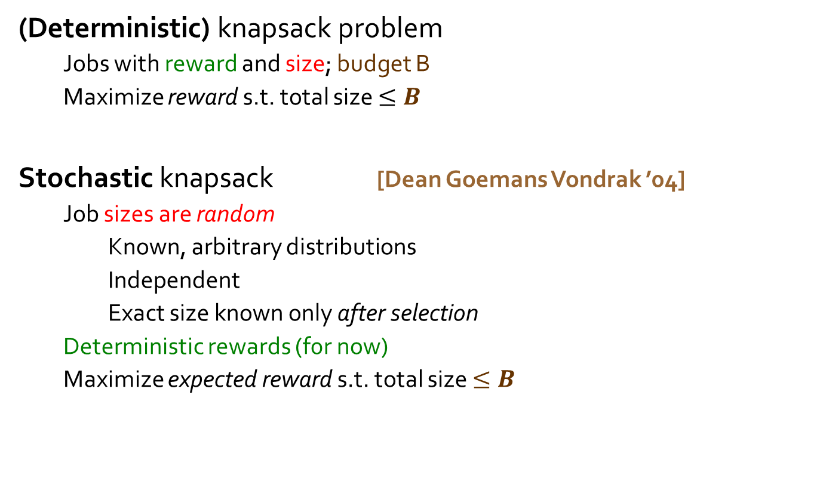
Stochastic Knapsack
OPT=6
7
(Deterministic) knapsack problem
Jobs with reward and size; budget B
Maximize reward s.t. total size $≤B$
Stochastic knapsack [Dean Goemans Vondrak ’04]
Job sizes are random
Known, arbitrary distributions
Independent
Exact size known only after selection
Deterministic rewards (f0r now)
Maximize expected reward s.t. total size $≤B$
5
3
B = 9
r₁=2
r₂=4
r₃=5
S=5
Pr=1/2
S=0
Pr=1/2
r = 1

Slide 5
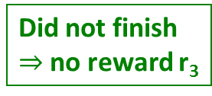
Example: Stochastic Knapsack
Feasible solution: select jobs sequentially
S₃=6
Pr=0.9
S₁=5
Pr=1/2
S₂=5
Pr=1
S₃=0
12
2
S₂=5
3
0.1
S₁=0
Pr=1/2
S₃=0
Pr=0.1
S₁=0
0.9
0.5
2
S₃=6
1
r₁ = 1
r₂ = 1
r₃ = 10
0.5
S₃=0
11
S₁=5
3
0.1
0.9
Did not finish
$⇒$no reward r₃
Budget B = 5
1
S₃=6
E [ Reward ] = ½ * [0.1*12 + 0.9*2] + ½ * [0.1*11 + 0.9*1] = 2.5

Slide 6
Representing Solutions
Decision tree or dynamic program
nodes represent residual budget and jobs already chosen
branches represent random size outcomes
a.k.a. adaptive policy
Markov Decision Process, we can solve by dynamic program.
Describing policy may take exponential space
Eg. policy dynamic program
Eg. policy tree
. . . .
. . . .

Slide 7
Simpler Class of Policies
Non adaptive policy
Add jobs in a priori fixed order, until budget exhausted
Polynomial space to represent policy: just a permutation
Adaptivity gap captures loss in objective
1
3
2
. . .
OPT(AD(I))
max _{instance I}
OPT(NA(I))

Slide 8
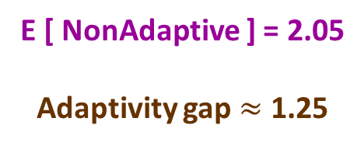
Adaptivity Gap Example
S₃=0
12
S₃=6
Pr=0.9
2
S₂=5
3
S₁=5
Pr=1/2
S₂=5
Pr=1
S₁=0
S₃=6
2
S₁=0
Pr=1/2
S₃=0
Pr=0.1
1
S₃=0
11
E[Adaptive] = 2.5
S₁=5
3
r₁ = 1
r₂ = 1
r₃ = 10
1
S₃=6
E [ NonAdaptive ] = 2.05
Adaptivity gap $≈$ 1.25
Budget B = 5
2
5
12
1
3
2
0
0
3
6
2
1
1
5
11
5
3
0
2
6
2
1

Slide 9
Why non-adaptive?
Problem consists of “offline” and “online” phases
Offline = before any job is run
Online = when jobs are running
Non-adaptive:
All the work in offline phase
Online phase easy/fast to implement
online
offline
. . .
NA
algo
. . .
. . .
AD algo

Slide 10

Approximation Ratio
Given stochastic knapsack instance I
OPT(I) = max E [objective under $π$] : $π$ is a policy
Ideal result:
give a poly-time non-adaptive policy that compares well to best adaptive policy.
(proves both approximation ratio, and adaptivity gap).
Approximation ratio = max _{instance I}
OPT(I)
ALG(I)

Slide 11
the menu for today
Adaptive stochastic problems
Stochastic knapsack (SK) basics, adaptivity gap
Non-adaptive algorithm for stochastic knapsack
A simple LP relaxation to capture optimal policies
Best box problem, and stochastic matchings
Another simple LP, versatile rounding
Correlated stochastic knapsack (CSK)
A richer LP, smarter rounding

Slide 12
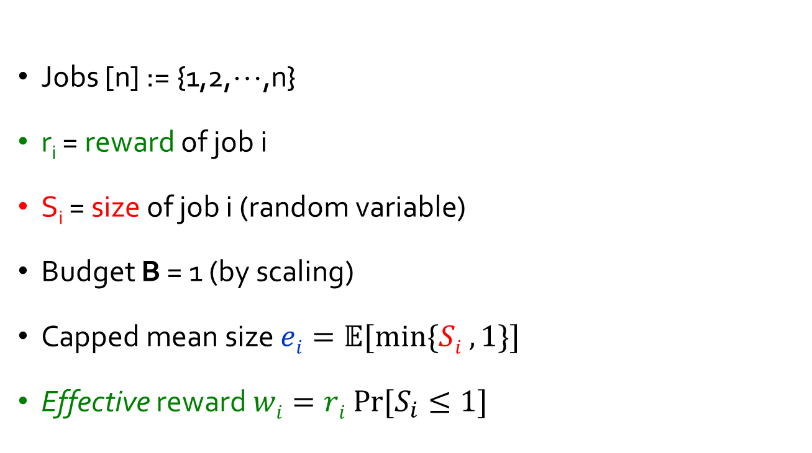
stochastic knapsack: definitions
Jobs [n] := {1,2,☹,n}
r_{i} = reward of job i
S_{i} = size of job i (random variable)
Budget B = 1 (by scaling)
Capped mean size $ei=𝔼[min⁡\{Si , 1\}]$
Effective reward $wi=ri Pr⁡[S_{i}≤1]$

Slide 13

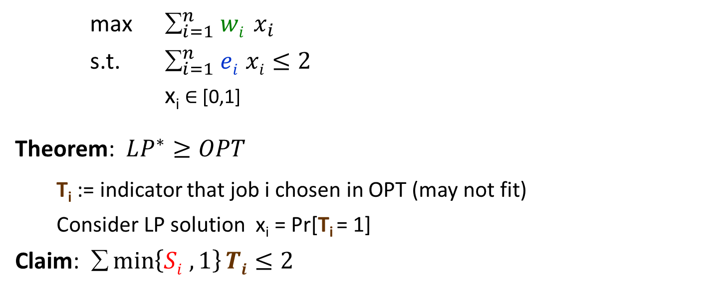


LP Relaxation
max $_{i=1}^{n} wi x_{i}$
s.t. $_{i=1}^{n} ei xi≤2$
x_{i} $∈$ [0,1]
Theorem: $LP^{∗}≥OPT$
T_{i} := indicator that job i chosen in OPT (may not fit)
Consider LP solution x_{i} = Pr[T_{i} = 1]
Claim: $\min\left\{Si , 1\right\}Ti≤2$
$$wi=ri Pr⁡[S_{i}≤1]$$
$$ei=𝔼[min⁡\{Si , 1\}]$$
$⇒x∈LP$(S_{i} & T_{i} independent)
In each decision path,
at most one overflows
ends
. . . .
1
1

Slide 14

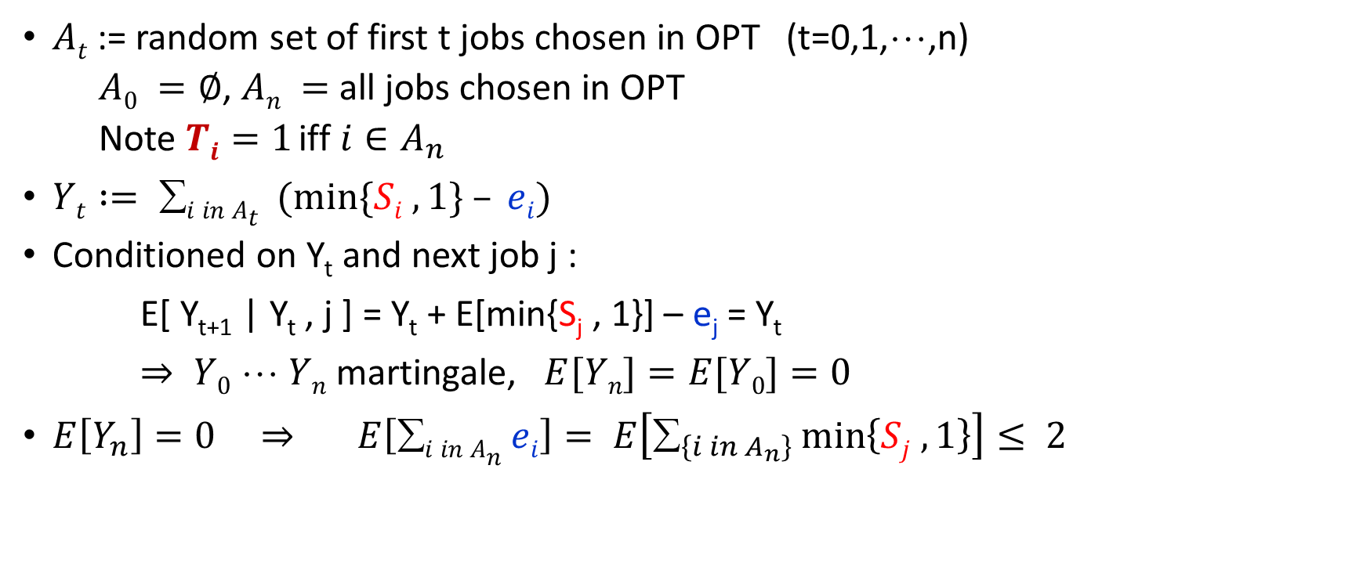
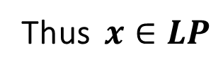
LP relaxation: formal proof
$At$:= random set of first t jobs chosen in OPT (t=0,1,☹,n)
$A0 =∅$, $An =$all jobs chosen in OPT
Note $Ti=1$ iff $i∈A_{n}$
$Yt := i in At (min⁡\{Si , 1\} – ei)$
Conditioned on Y_{t} and next job j :
E[ Y_{t+1} | Y_{t} , j ] = Y_{t} + E[min{S_{j} , 1}] – e_{j} = Y_{t}
$⇒ Y0 ☹ Yn$martingale, $E[Yn]=E[Y0]=0$
$E\left[Y_{n}\right]=0 ⇒ E\left[∑i in An ei\right]= E\left[∑_{\left\{i in A_{n}\right\}}\min\left\{Sj , 1\right\}\right]≤ 2$
Thus $x∈LP$
$$i ei Pr⁡[Ti=1]$$
By Claim

Slide 15

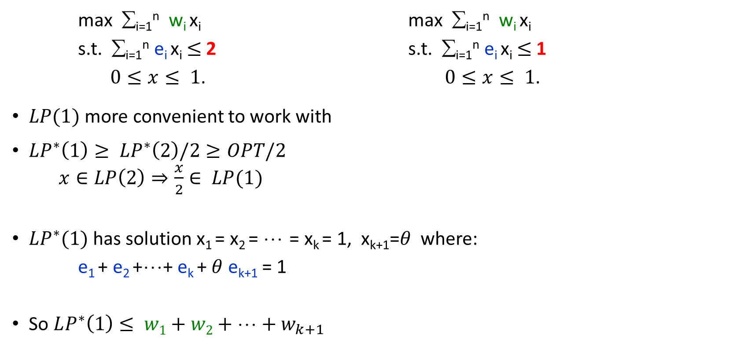
Scaled LP
max ∑_{i=1}^{n} w_{i} x_{i} max ∑_{i=1}^{n} w_{i} x_{i}
s.t. ∑_{i=1}^{n} e_{i} x_{i} $≤$ 2 s.t. ∑_{i=1}^{n} e_{i} x_{i} $≤$ 1
$0≤x≤ 1$. $0≤x≤ 1$.
$LP(1)$ more convenient to work with
$LP^{∗}\left(1\right)≥ LP^{∗}\left(2\right)/2≥OPT/2$
$x∈LP\left(2\right)⇒\frac{x}{2}∈ LP(1)$
$LP^{∗}(1)$has solution x₁ = x₂ = ☹ = x_{k} = 1, x_{k+1}=$θ$ where:
e₁ + e₂ +☹+ e_{k} + $θ$ e_{k+1} = 1
So $LP^{∗}\left(1\right)≤ w1+w2+Λ+w_{k+1}$
w₁/e₁ $≥$w₂/e₂ ☹ $≥$ w_{k}/e_{k} $≥\text{Λ}$
e₁
e₂
☹
e_{k}
e_{k+1}
1

Slide 16
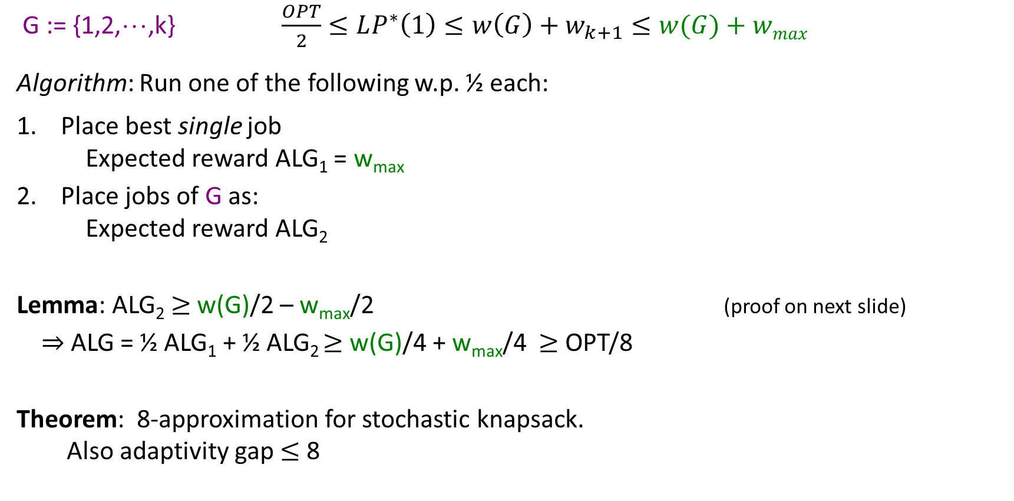
Algorithm
G := {1,2,☹,k} $\frac{OPT}{2}≤LP^{∗}\left(1\right)≤w\left(G\right)+w_{k+1}≤w(G)+wmax$
Algorithm: Run one of the following w.p. ½ each:
Place best single job
Expected reward ALG₁ = w_{max}
Place jobs of G as:
Expected reward ALG₂
Lemma: ALG₂ $≥$ w(G)/2 – w_{max}/2 (proof on next slide)
$⇒$ALG = ½ ALG₁ + ½ ALG₂ $≥$w(G)/4 + w_{max}/4 $≥$OPT/8
Theorem: 8-approximation for stochastic knapsack.
Also adaptivity gap $≤$8
1
2
☹
k
or
k
k-1
☹
1

Slide 17

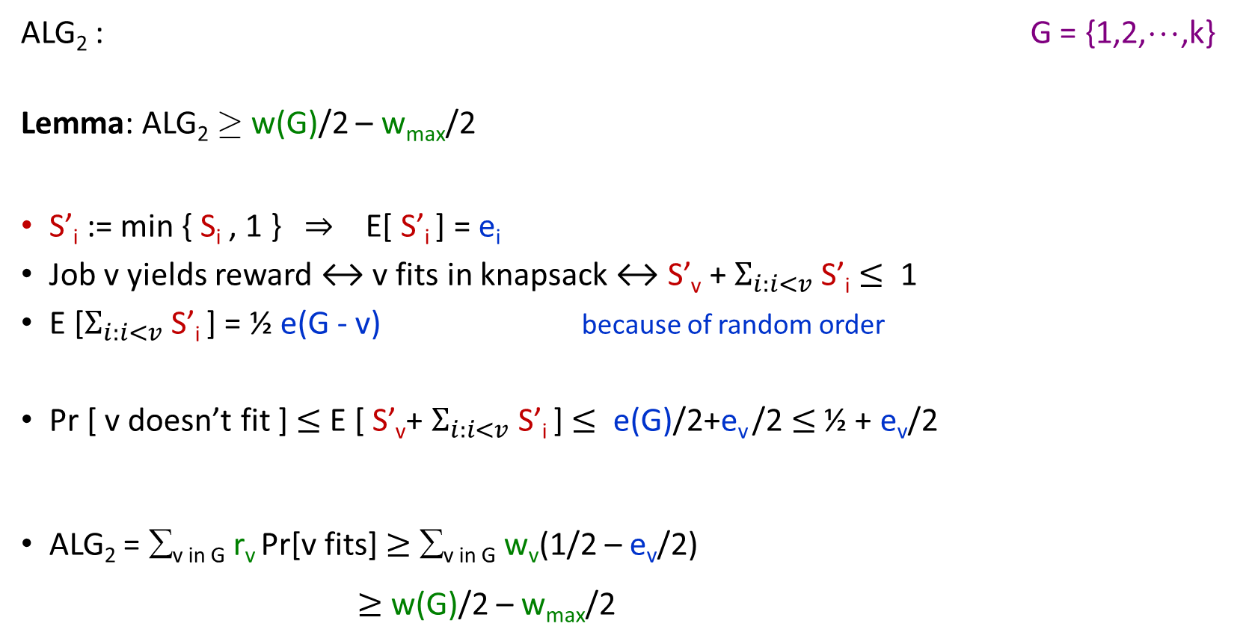
Analysis of ALG₂
1
2
☹
k
or
k
k-1
☹
1
ALG₂ : G = {1,2,☹,k}
Lemma: ALG₂ ¸ w(G)/2 – w_{max}/2
S’_{i} := min { S_{i} , 1 } $⇒$ E[ S’_{i} ] = e_{i}
Job v yields reward ↔ v fits in knapsack ↔ S’_{v} + $Σ_{i:i<v}$ S’_{i} $≤$ 1
E [$Σ_{i:i<v}$ S’_{i} ] = ½ e(G - v) because of random order
Pr [ v doesn’t fit ] $≤$ E [ S’_{v}+ $Σ_{i:i<v}$ S’_{i} ] $≤$ e(G)/2+e_{v} /2 $≤$ ½ + e_{v}/2
ALG₂ = ∑_{v in G} r_{v} Pr[v fits] $≥$ ∑_{v in G} w_{v} (1/2 – e_{v}/2)
$≥$w(G)/2 – w_{max}/2
Markov’s ineq.
e(G) = ∑_{v} _{in G} e_{v} $≤$1

Slide 18
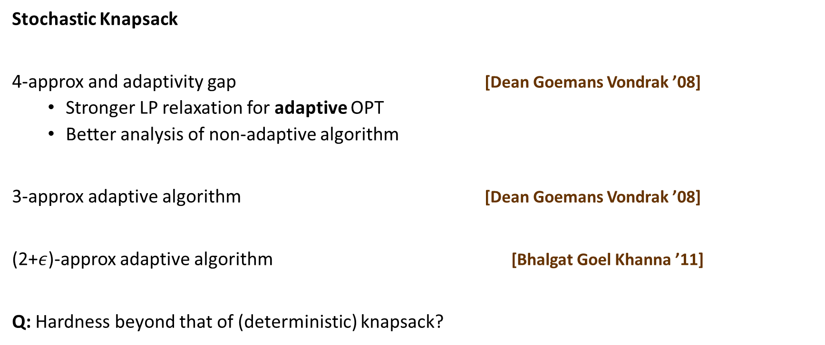
Better Bounds
Stochastic Knapsack
4-approx and adaptivity gap [Dean Goemans Vondrak ’08]
Stronger LP relaxation for adaptive OPT
Better analysis of non-adaptive algorithm
3-approx adaptive algorithm [Dean Goemans Vondrak ’08]
(2+$ε$)-approx adaptive algorithm [Bhalgat Goel Khanna ’11]
Q: Hardness beyond that of (deterministic) knapsack?

Slide 19
the menu for today
Adaptive stochastic problems
Stochastic knapsack (SK) basics, adaptivity gap
Non-adaptive algorithm for stochastic knapsack
A simple LP relaxation to capture optimal policies
Best box problem, and stochastic matchings
Another simple LP, versatile rounding
Correlated stochastic knapsack (CSK)
A richer LP, smarter rounding

Slide 20
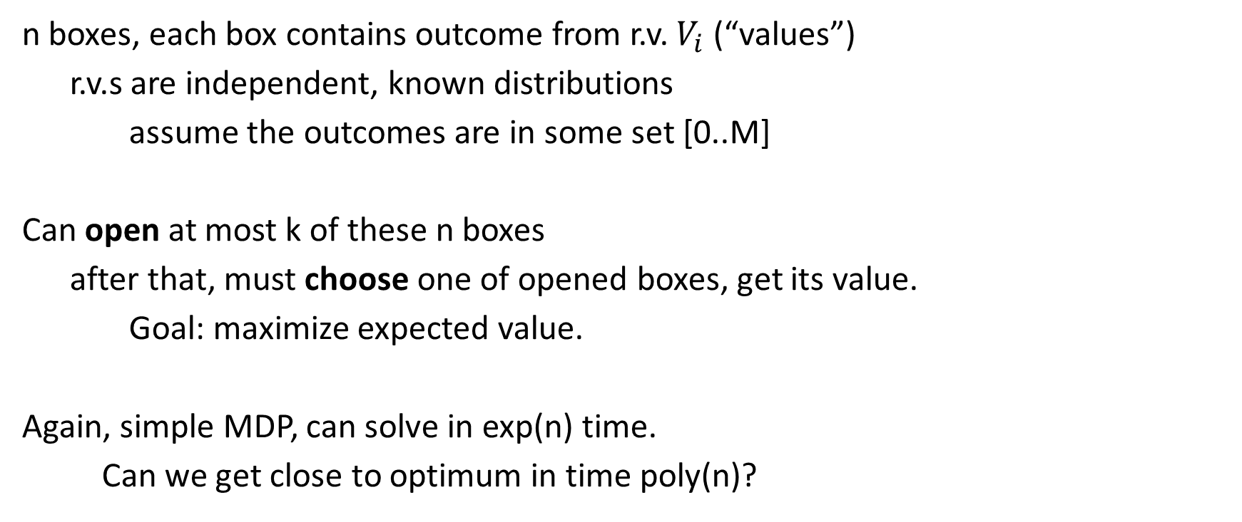
best box problem
n boxes, each box contains outcome from r.v. $V_{i}$(“values”)
r.v.s are independent, known distributions
assume the outcomes are in some set [0..M]
Can open at most k of these n boxes
after that, must choose one of opened boxes, get its value.
Goal: maximize expected value.
Again, simple MDP, can solve in exp(n) time.
Can we get close to optimum in time poly(n)?

Slide 21

best box problem: LP relaxation
$x_{i}$: probability that strategy opens box i
$y_{iv}$: probability that box i value is v, and strategy chooses box i
$\max{\sum_{i,v}{v}⋅y_{iv}}$
$s.t.$ $y_{iv}≤x_{i}⋅p_{i}\left(v\right)$
$\sum_{i,v}{y_{iv}}≤1$
$\sum_{i}{x_{i}}≤k$
$x, y≥0$
Claim: $LP≥OPT$

Slide 22
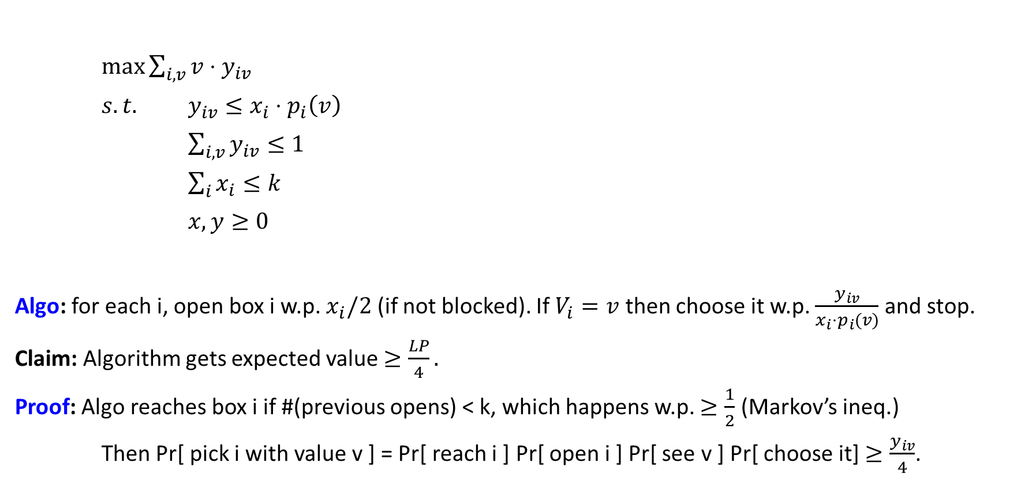
best box problem: algorithm
$\max{\sum_{i,v}{v}⋅y_{iv}}$
$s.t.$ $y_{iv}≤x_{i}⋅p_{i}\left(v\right)$
$\sum_{i,v}{y_{iv}}≤1$
$\sum_{i}{x_{i}}≤k$
$x, y≥0$
Algo: for each i, open box i w.p. $x_{i}/2$ (if not blocked). If $V_{i}=v$ then choose it w.p. $\frac{y_{iv}}{x_{i}⋅p_{i}(v)}$ and stop.
Claim: Algorithm gets expected value $≥\frac{LP}{4}.$
Proof: Algo reaches box i if #(previous opens) < k, which happens w.p. $≥\frac{1}{2}$ (Markov’s ineq.)
Then Pr[ pick i with value v ] = Pr[ reach i ] Pr[ open i ] Pr[ see v ] Pr[ choose it] $≥\frac{y_{iv}}{4}$.

Slide 23
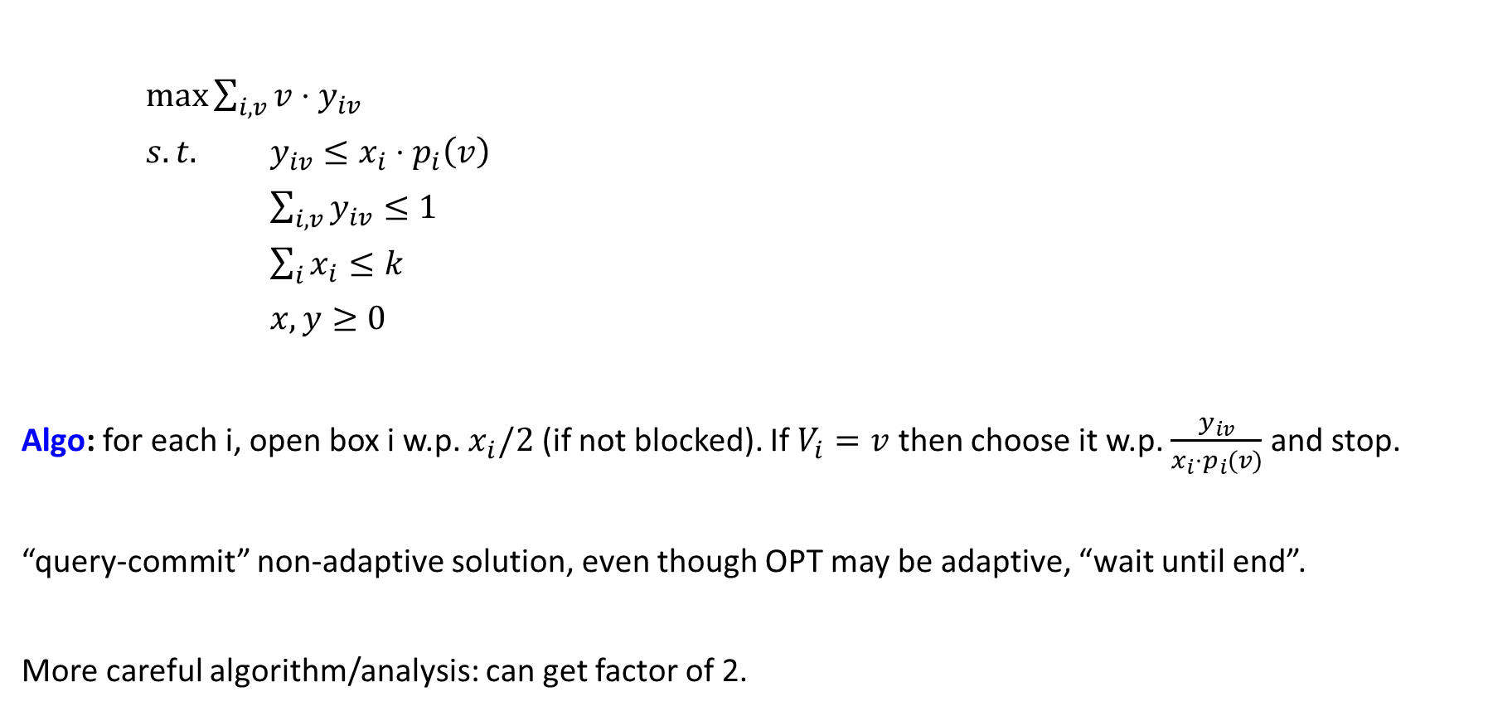
best box problem: algorithm
$\max{\sum_{i,v}{v}⋅y_{iv}}$
$s.t.$ $y_{iv}≤x_{i}⋅p_{i}\left(v\right)$
$\sum_{i,v}{y_{iv}}≤1$
$\sum_{i}{x_{i}}≤k$
$x, y≥0$
Algo: for each i, open box i w.p. $x_{i}/2$ (if not blocked). If $V_{i}=v$ then choose it w.p. $\frac{y_{iv}}{x_{i}⋅p_{i}(v)}$ and stop.
“query-commit” non-adaptive solution, even though OPT may be adaptive, “wait until end”.
More careful algorithm/analysis: can get factor of 2.

Slide 24
extension: online dating
Men M and Women W
p_{uv} = probability that u and v compatible
t_{s} = patience level of s
If (u,v) date and are compatible, they get matched
Similar “query and commit” in kidney exchange
t_{s}
s
Maximize expected number of matches
Stochastic matching
M
W
u
p_{uv}
v

Slide 25
example of stochastic matching
2
a
x
2
(a,x)
1
b
y
2
(b,z)
(b,y)
3
c
z
2
(c,y)
(b,y)
(a,z)
(b,z)
Matching size = 2
. . .
Adaptive solution
(a,x)
(b,y)
(b,z)
(c,x)
. . .
Non-Adaptive solution
How good are such solutions?
Again: adaptivity gap

Slide 26
stochastic matching
Graph G = (V, E)
Random edges e=(u,v)
probability p_{e} of being active
weight w_{e}
query-commit
Patience threshold t_{v}
t_{s}
s
w_{uv}
u
p_{uv}
v
Maximize expected weight matching
[Chen Karlin Immorlica Mahdian Rudra, Bansal G. Li Mestre Nagarajan Rudra ‘10]

Slide 27
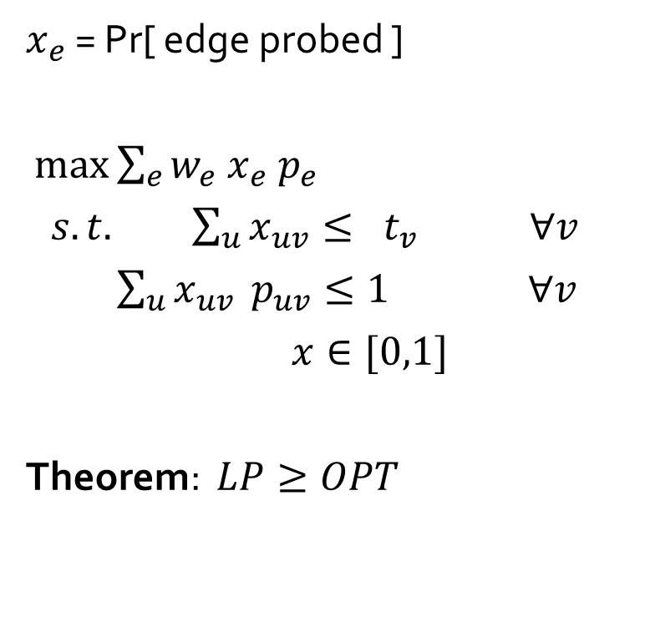
LP Relaxation
$x_{e}$ = Pr[ edge probed ]
$\max{\sum_{e}{w_{e} x_{e}{ p}_{e}}}$
$s.t. \sum_{u}{x_{uv}}≤ t_{v} ∀v$
$\sum_{u}{x_{uv}} p_{uv}≤1 ∀v$
$x∈[0,1]$
Theorem: $LP≥OPT$
At most t_{v} edges probed
in each decision path
At most 1 edge matched
in each decision path.
Pr[e], Pr[e probed] indep.

Slide 28
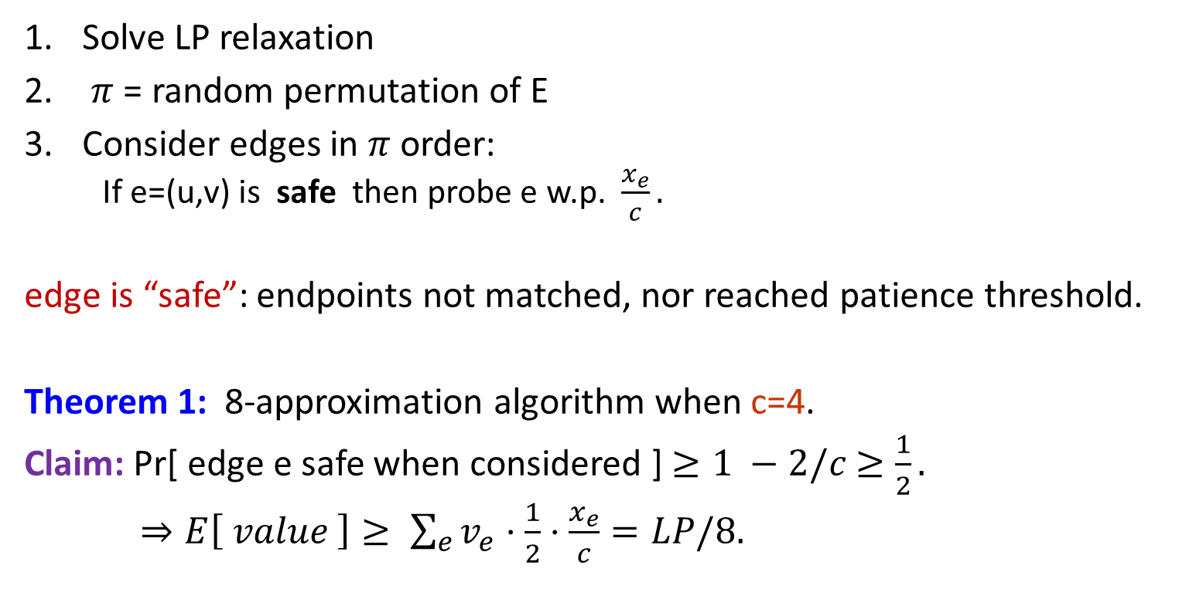
Non-Adaptive Algorithm
Solve LP relaxation
$π$ = random permutation of E
Consider edges in $π$ order:
If e=(u,v) is safe then probe e w.p. $\frac{x_{e}}{c}.$
edge is “safe”: endpoints not matched, nor reached patience threshold.
Theorem 1: 8-approximation algorithm when c=4.
Claim: Pr[ edge e safe when considered ] $≥1 −2/c$ $≥\frac{1}{2}.$
$⇒E\left[ value \right]≥ \sum_{e}{v_{e}⋅\frac{1}{2}⋅\frac{x_{e}}{c}}=LP/8.$
< t_{u}
< t_{v}
u
v
unmatched
unmatched

Slide 29
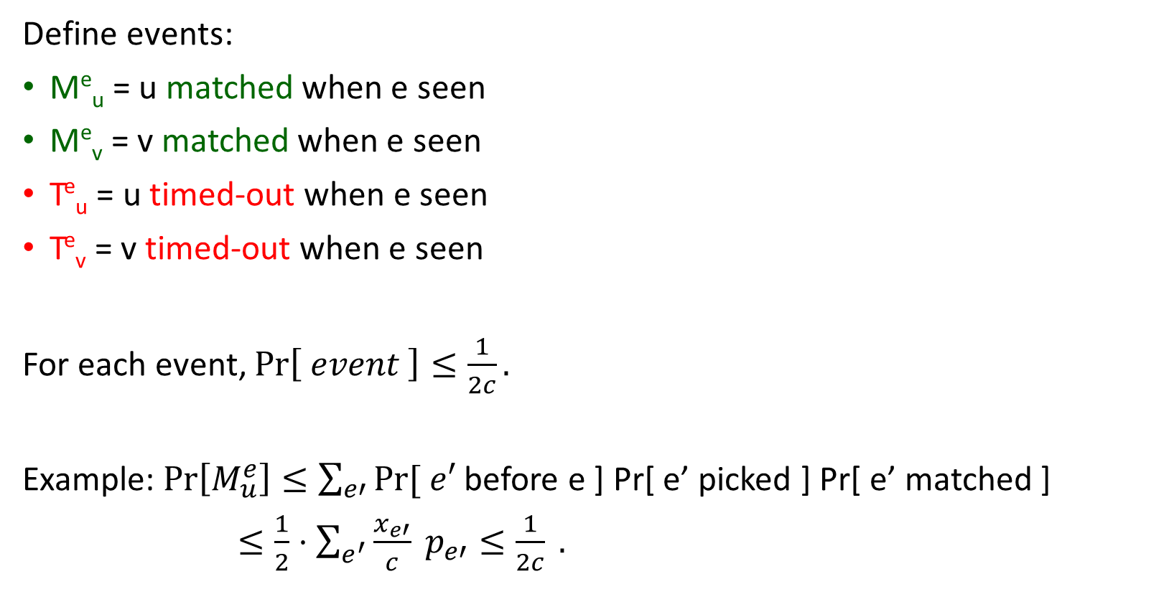
Simple Analysis₍₁₎
Define events:
Me_{u} = u matched when e seen
Me_{v} = v matched when e seen
T^{e}_{u} = u timed-out when e seen
T^{e}_{v} = v timed-out when e seen
For each event, $\operatorname{Pr}\left[ event \right]≤\frac{1}{2c}.$
Example: $\operatorname{Pr}\left[M_{u}^{e}\right]≤\sum_{e′}{Pr⁡[ e′}$ before e ] Pr[ e’ picked ] Pr[ e’ matched ]
$≤\frac{1}{2}⋅\sum_{e^{′}}{\frac{x_{e′}}{c}} p_{e′}≤\frac{1}{2c} .$
u
v
Implies the claim above
Me_{v}
remaining three event analyses identical

Slide 30
better results
5-approximation when c = 1
use positive correlation and the FKG inequality.
4-approximation for stochastic matching
3-approx on bipartite graphs [Bansal G. Li Mestre Nagarajan Rudra ‘10]
2-approximation for unweighted stochastic matching [Adamczyk ’11]
Generalizes to other problems
Pick a spanning tree instead of matching, same patience constraints?
More generally, pick a common independent set from intersection of k matroids
(but the elements we can probe must also belong to intersection of k’ matroids.
[G. Nagarajan ’13, Adamczyk Sviridenko Ward ‘14]
E.g., captures Bayesian Mechanism design problems.
Extends to submodular functions, arbitrary downward-closed constraints [G. Nagarajan Singla ’16,’17]
Notes:
4-approx, 3-approx bipartite, unweighted 2-approx

Slide 31
the menu for today
Adaptive stochastic problems
Stochastic knapsack (SK) basics, adaptivity gap
Non-adaptive algorithm for stochastic knapsack
A simple LP relaxation to capture optimal policies
Best box problem, and stochastic matchings
Another simple LP, versatile rounding
Correlated stochastic knapsack (CSK)
A richer LP, smarter rounding

Slide 32
Correlated Stochastic Knapsack
Job rewards R_{i} also random, correlated to size S_{i}
Joint distribution Pr [R_{i}=a , S_{i}=b]
Different jobs independent
Max expected reward s.t. budget B
Assume S_{i} integers in {1, ☹ B} = [B]
Wlog. by zeroing reward for larger sizes
Distribution for item i explicitly given: {(p_{it} , r_{it})} for t in [B]
p_{it} = Pr[ S_{i}=t ] , r_{it} = E[ R_{i} | S_{i}=t ]
S=5
R = 3
Pr=1/2
S=1
R = 1
Pr=1/2
[Gupta Krishnaswamy Molinaro Ravi ’11]

Slide 33


Distribution Information Used
In uncorrelated case, we only used
capped mean size e_{i} = $E\left[\min\left(Si , B\right)\right]$, and effective reward w_{i} = $E[R_{i}⋅1_{S_{i}≤B}]$
SOL₁ = $i, i,☹$has reward 1
SOL₂ = $j, j,…$ has reward B/2
Need to use more info from the distribution in CorrSK
S=B
R=B
Pr=1/B
S=2
R=1
Pr=1
e_{i} = e_{j} = 2
w_{i} = w_{j} = 1
S=B/(B-1)
R=0
Pr=1-1/B
job j
job i
$⇒$Previous LP/algorithm insufficient

Slide 34
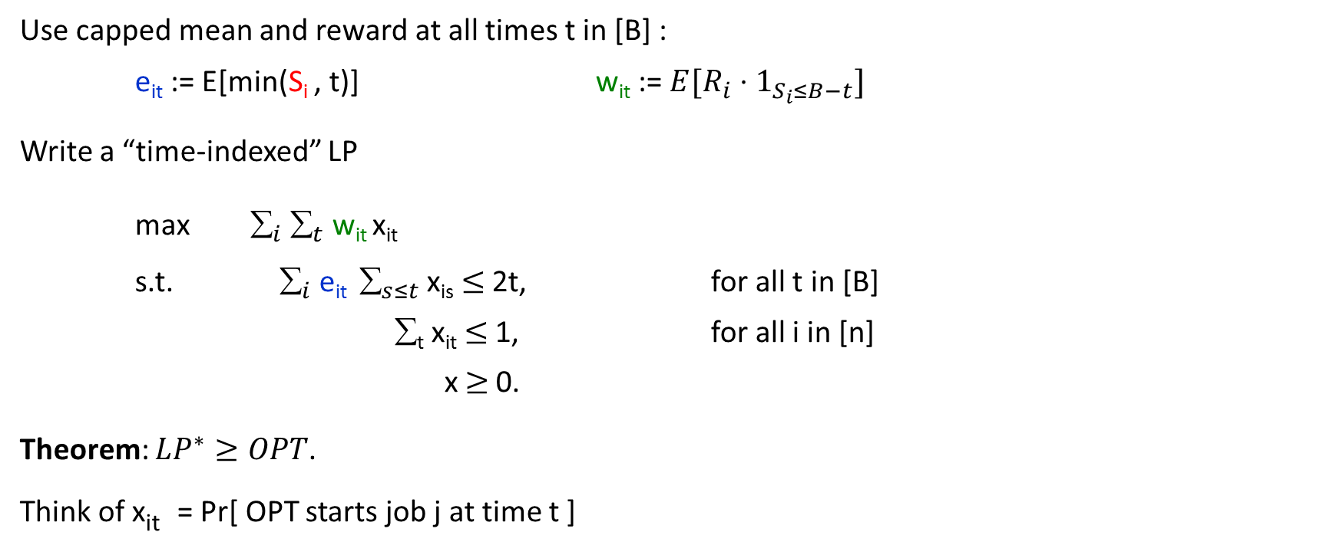
LP Relaxation for CorrSK₍₁₎
Use capped mean and reward at all times t in [B] :
e_{it} := E[min(S_{i} , t)] w_{it} := $E[R_{i}⋅1_{S_{i}≤B−t}]$
Write a “time-indexed” LP
max $_{i} _{t}$ w_{it} x_{it}
s.t. $_{i}$e_{it} ${ }_{s≤t}$x_{is} $≤$2t, for all t in [B]
∑_{t} x_{it} $≤$1, for all i in [n]
x $≥$0.
Theorem: $LP^{∗}≥OPT$.
Think of x_{it} = Pr[ OPT starts job j at time t ]
Notes:
= ∑_{s=0}^{t} p_{is}¢s + ∑_{s=t+1}^{B} p_{is}¢t = ∑_{s=0}^{B-t} p_{is}¢ r_{is}

Slide 35
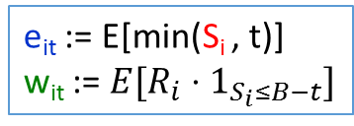
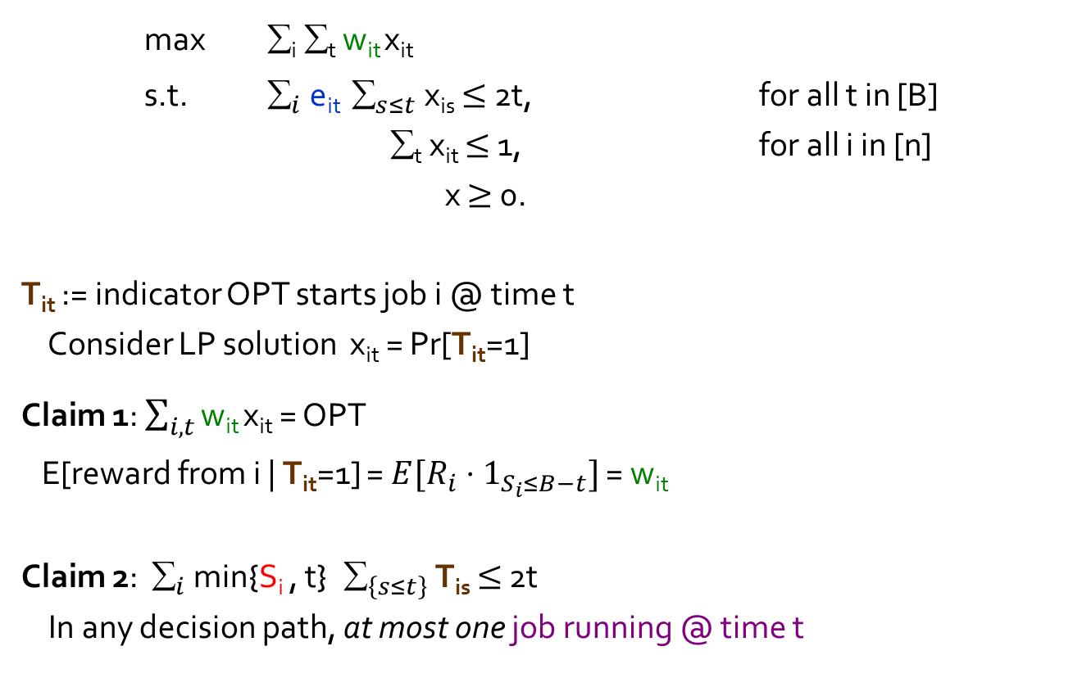
LP Relaxation for CorrSK₍₂₎
max ∑_{i} ∑_{t} w_{it} x_{it}
s.t. $_{i}$e_{it} ${ }_{s≤t}$x_{is} $≤$2t, for all t in [B]
∑_{t} x_{it} $≤$1, for all i in [n]
x $≥$0.
T_{it} := indicator OPT starts job i @ time t
Consider LP solution x_{it} = Pr[T_{it}=1]
Claim 1: $\sum_{i,t}{\text{w}\text{it} \text{x}\text{it}}$= OPT
E[reward from i | T_{it}=1] = $E[R_{i}⋅1_{S_{i}≤B−t}]$ = w_{it}
Claim 2: $_{i}$ min{S_{i} , t} $_{\left\{s≤t\right\}}$ T_{is} $≤$ 2t
In any decision path, at most one job running @ time t
e_{it} := E[min(S_{i} , t)]
w_{it} := $E[R_{i}⋅1_{S_{i}≤B−t}]$
0
t
job i
B
0
t
2t

Slide 36
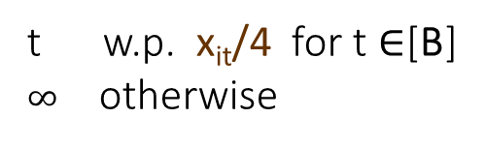
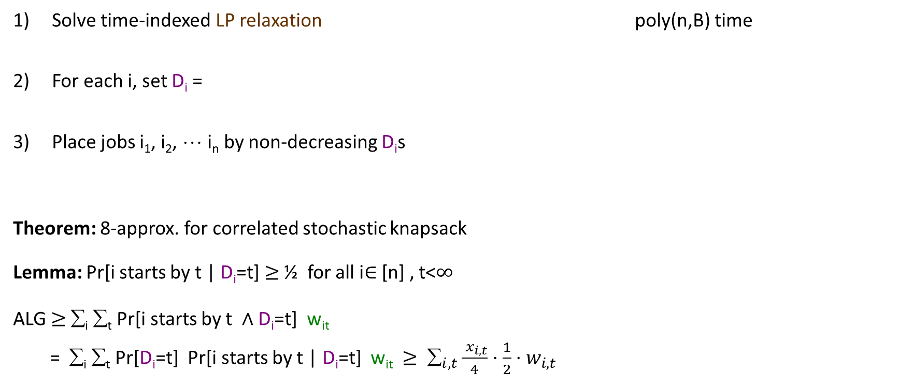

Non-Adaptive Algorithm
Solve time-indexed LP relaxation poly(n,B) time
For each i, set D_{i} =
Place jobs i₁, i₂, ☹ i_{n} by non-decreasing D_{i}s
Theorem: 8-approx. for correlated stochastic knapsack
Lemma: Pr[i starts by t | D_{i}=t] $≥$ ½ for all i $∈$[n] , t<$∞$
ALG $≥$ ∑_{i} ∑_{t} Pr[i starts by t $∧$ D_{i}=t] w_{it}
= ∑_{i} ∑_{t} Pr[D_{i}=t] Pr[i starts by t | D_{i}=t] w_{it} $≥$ $_{i,t}\frac{ x_{i,t}}{4}⋅\frac{1}{2}⋅w_{i,t}$
t w.p. x_{it}/4 for t $∈$[B]
$∞$ otherwise
(valid since ∑_{t} x_{it} $≤$1)
0
t
B

Slide 37

Analysis
Lemma: Pr[i doesn’t start by t | D_{i}=t] $≤\frac{1}{2}$ for all $i∈\left[n\right], t<∞$
Fix job i, time $t<∞$
Z_{j} := $1_{D_{j}≤t}⋅$min(S_{j} , t)
E[Z_{j}] = $_{s≤t}$Pr[D_{j}=s] E[min(S_{j} , t) | D_{j}=s] = $_{s≤t}$ x_{js}/4 $⋅$e_{jt}
“i doesn’t start by t | D_{i}=t” $⇒$ ∑_{j before i} S_{j} > t $⇒$ ∑_{j≠i} Z_{j} $≥$ t
So Pr[ ] $≤$ E[∑_{j≠i} Z_{j} ] / t = $_{j≠ i}_{s≤t}$e_{jt} x_{js} /(4t) $≤\frac{1}{2}.$
t
indep.
t
Markov’s ineq.

Slide 38
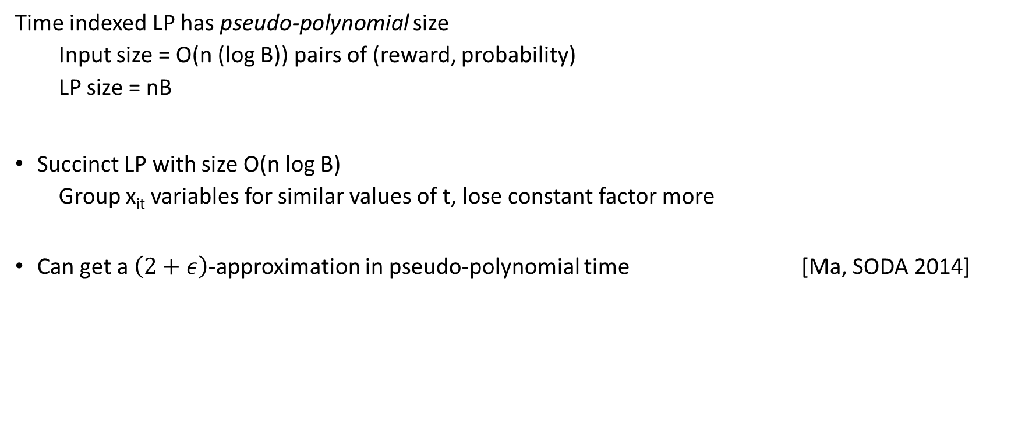
Polynomial Time Algorithm for CSK
Time indexed LP has pseudo-polynomial size
Input size = O(n (log B)) pairs of (reward, probability)
LP size = nB
Succinct LP with size O(n log B)
Group x_{it} variables for similar values of t, lose constant factor more
Can get a $\left(2+ε\right)$-approximation in pseudo-polynomial time [Ma, SODA 2014]

Slide 39
Budgeted Multi-Armed Bandits
Collection of Markov chains
Each play yields reward
Limited number of plays (cardinality/cost constraint)
2-approx “non-adaptive” algorithm for Martingale rewards
O(1)-approx “adaptive” algorithm in general
☹
MC₁
MC_{n}
MC₁
MC₁
MC₂
☹
MC₃
[Guha Munagala ’07]
[G. Krishnaswamy Molinaro Ravi ’12]

Slide 40

Stochastic Orienteering
Jobs at vertices of metric
random size S_{i}
deterministic distances
Bound B on total allowed time
travel-time plus size
Find policy for visiting and running jobs
maximize expected reward
starts at root r, non-preemptive
$O(log log B)$-approximation
$(\sqrt{log log B})$adaptivity gap
S=5
Pr=0.7
S=1
Pr=0.3
r
r = 1
r
j2
j4
. . .
[G. Krishnaswamy Nagarajan Ravi ’12]
[Bansal Nagarajan ’14]
j7
j1
time

Slide 41
the menu for today
Adaptive stochastic problems
Stochastic knapsack (SK) basics, adaptivity gap
Non-adaptive algorithm for stochastic knapsack
A simple LP relaxation to capture optimal policies
Best box problem, and stochastic matchings
Another simple LP, versatile rounding
Correlated stochastic knapsack (CSK)
A richer LP, smarter rounding

Slide 42
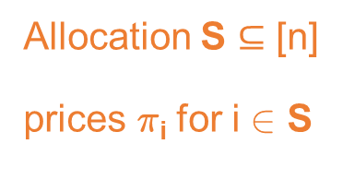
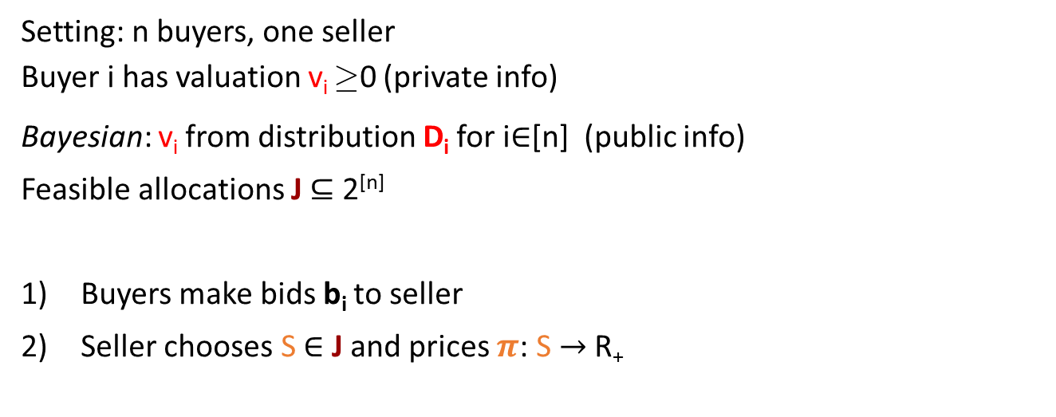
application: Bayesian auctions
Setting: n buyers, one seller
Buyer i has valuation v_{i} ¸ 0 (private info)
Bayesian: v_{i} from distribution D_{i} for i$∈$[n] (public info)
Feasible allocations J $⊆$ 2^{[n]}
Buyers make bids b_{i} to seller
Seller chooses S $∈$ J and prices $π$: S $→$R₊
b₁
¼₂
…
Allocation S $⊆$ [n]
prices ¼_{i} for i 2 S
Seller’s
Mechanism
¼₅
Buyers’
bids
b_{i}
…
¼_{i}
b_{n}

Slide 43
auction design criteria
Maximize expected revenue of auction
Truthfulness: buyers bid true values
Profit of buyer i is v_{i} - ¼_{i} (if served)
Expected profit_{i} maximized when b_{i} = v_{i}
[Myerson ’81] designed optimal auctions
Computational efficiency depends on J
Auctions can take complicated forms
Sequential Posted-price Mechanism: Ignore bids, offer `take it or leave it’ prices sequentially
offer ¾₃
to buyer 3
offer ¾₅
to buyer 5
offer ¾₂
to buyer 2
. . .
How good are such auctions?

Slide 44
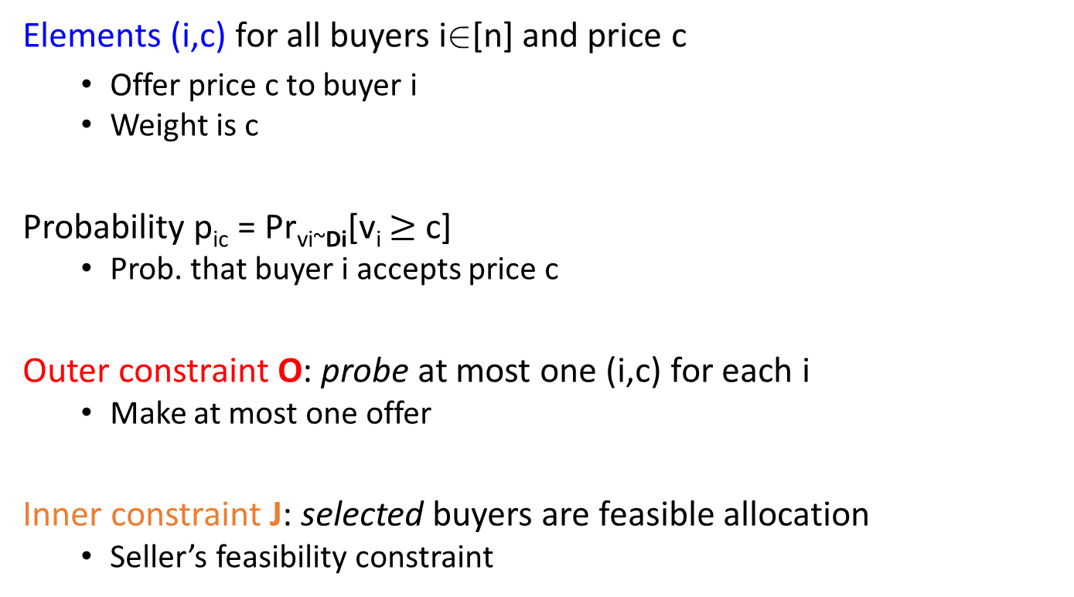

Bayesian Auction
Model SPMs
Elements (i,c) for all buyers i2[n] and price c
Offer price c to buyer i
Weight is c
Probability p_{ic} = Pr_{vi~Di}[v_{i} $≥$ c]
Prob. that buyer i accepts price c
Outer constraint O: probe at most one (i,c) for each i
Make at most one offer
Inner constraint J: selected buyers are feasible allocation
Seller’s feasibility constraint
$≤$1
price
buyers
feas. J
Notes:
No correlations between (i,c) and (i,c’)

Slide 45
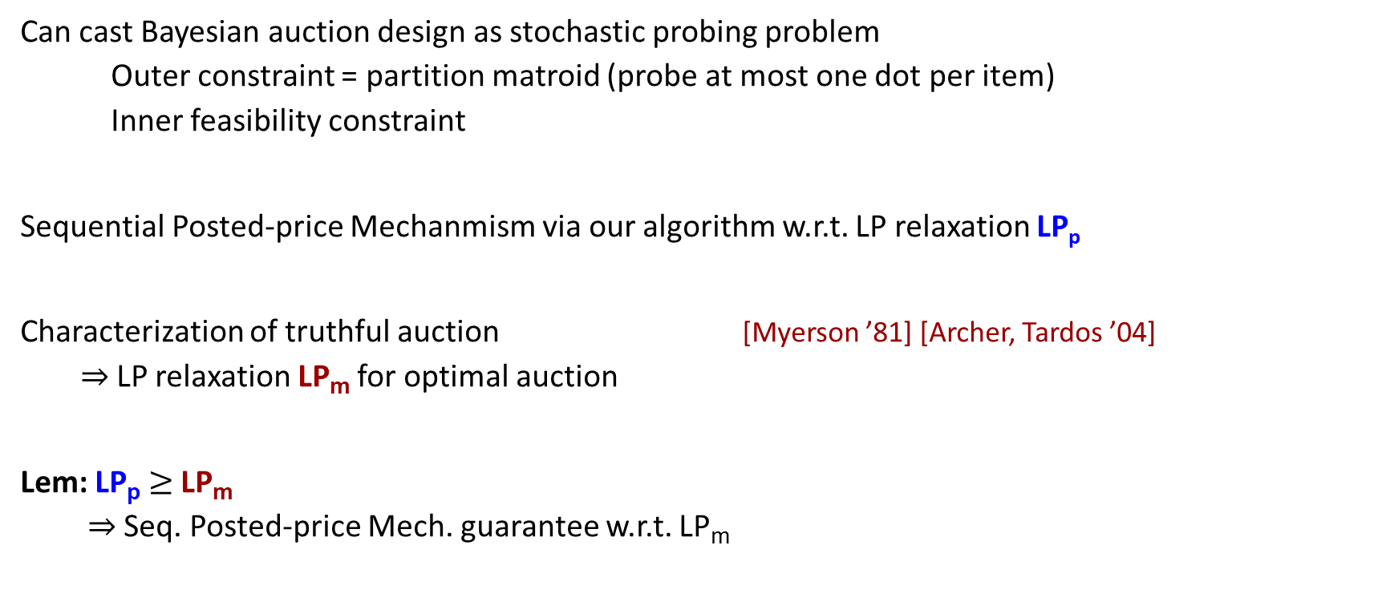
application to Bayesian auctions
Can cast Bayesian auction design as stochastic probing problem
Outer constraint = partition matroid (probe at most one dot per item)
Inner feasibility constraint
Sequential Posted-price Mechanmism via our algorithm w.r.t. LP relaxation LP_{p}
Characterization of truthful auction [Myerson ’81] [Archer, Tardos ’04]
$⇒$LP relaxation LP_{m} for optimal auction
Lem: LP_{p} $≥$ LP_{m}
$⇒$Seq. Posted-price Mech. guarantee w.r.t. LP_{m}

Slide 46
References: stochastic knapsack
B. Dean, M. Goemans, J. Vondrak, Approximating the stochastic knapsack problem: the benefit of adaptivity, Math. of OR 2008.
S. Guha, K. Munagala, Approximation algorithms for budgeted learning, STOC 2007
A. Gupta, R. Krishnaswamy, M. Molinaro, R. Ravi, Approximation algorithms for correlated knapsacks and non-martingale bandits, FOCS, 2011.
S. Guha and K. Munagala. Multi-armed bandits with metric switching costs. ICALP 2009.
A. Bhalgat, A. Goel, S. Khanna, Improved approximation results for stochastic knapsack problems, SODA 2011.
A. Gupta, R. Krishnaswamy, V. Nagarajan, R. Ravi, Approx. algorithms for stochastic orienteering, SODA 2012.
N. Bansal, V. Nagarajan, On the adaptivity gap of stochastic orienteering, IPCO 2014.
J. Li, W. Yuan, Stochastic combinatorial optimization via Poisson approximation, STOC 2013.
W. Ma, Improvements and generalizations of stochastic knapsack and multi-armed bandit approximation algorithms, SODA, 2014.

Slide 47
References: best box and stochastic matchings
S. Guha, K. Munagala, Approximation algorithms for budgeted learning, STOC 2007
N. Bansal, A. Gupta, J. Li, J. Mestre, V. Nagarajan, A. Rudra. When LP is the Cure for Your Matching Woes: Improved Bounds for Stochastic Matchings, ESA 2011.
N. Chen, N. Immorlica, A. R. Karlin, M. Mahdian, and A. Rudra. Approximating matches made in heaven. ICALP 2009
A. Gupta and V. Nagarajan. A stochastic probing problem with applications. IPCO 2013.
A. Gupta, V. Nagarajan, S. Singla. Algorithms and adaptivity gaps for stochastic probing. SODA 2016.
M. Adamczyk, M. Sviridenko, J. Ward. Submodular stochastic probing on matroids. STACS 2014.
M. Adamczyk. Improved analysis of the greedy algorithm for stochastic matching. IPL 2011.

