Slide 1
Beyond the Worst-Case in Online Algorithms
Anupam Gupta (NYU)

Slide 2
analysis of algorithms
Ideally: want to get algorithms that are good for
worst-case and best-case and …. all cases.
Worst-case: robustness when data is unpredictable
Best-case: efficiency when data follows anticipated patterns
How to model these?
let’s see glimpse of ideas/techniques in context of online algos

Slide 3
Online Algorithms
[Graham 66, Sleator Tarjan 85]
Requests arrive over time, must be served immediately/irrevocably
Goal: (say) minimize cost of the decisions taken
Competitive ratio of algorithm $A$:
$\max_{ instances I}{ \frac{cost of algorithm A on instance I}{optimal cost to serve I}}$
Want to minimize the competitive ratio.
worst case!

Slide 4
Online Set Cover
[Alon Awerbuch Azar Buchbinder Naor 03]
Set system. n elements arrive over time, want to maintain a cover.
Goal: minimize cost of sets picked
Competitive ratio of algorithm $A$:
$\max_{ instances I}{ \frac{cost of algorithm A on instance I}{optimal cost to serve I}}$
Want to minimize the competitive ratio.
$$S_{1}$$
$$v_{1}$$
$$v_{3}$$
$$v_{2}$$
$$S_{3}$$
$$S_{2}$$

Slide 5
Online Load Balancing
[Azar Naor Rom 03]
$m$ machines. Jobs arrive over time, can be assigned to subset of machines.
Goal: minimize maximum load of machines
Competitive ratio of algorithm $A$:
$\max_{ instances I}{ \frac{cost of algorithm A on instance I}{optimal cost to serve I}}$
Want to minimize the competitive ratio.

Slide 6
price of uncertainty
Offline
Online
Set Cover
$$O(\log{n})$$
$$Ω(\log^{2}{n})$$
Load Balancing
$$1$$
$$Θ(\log{m})$$
can we do better in non-worst-case settings?

Slide 7
price of uncertainty
Offline
Online
Beyond…
Set Cover
$$O(\log{n})$$
$$Ω(\log^{2}{n})$$
$$?$$
Load Balancing
$$1$$
$$Θ(\log{m})$$
$$?$$
can we do better in non-worst-case settings?

Slide 8
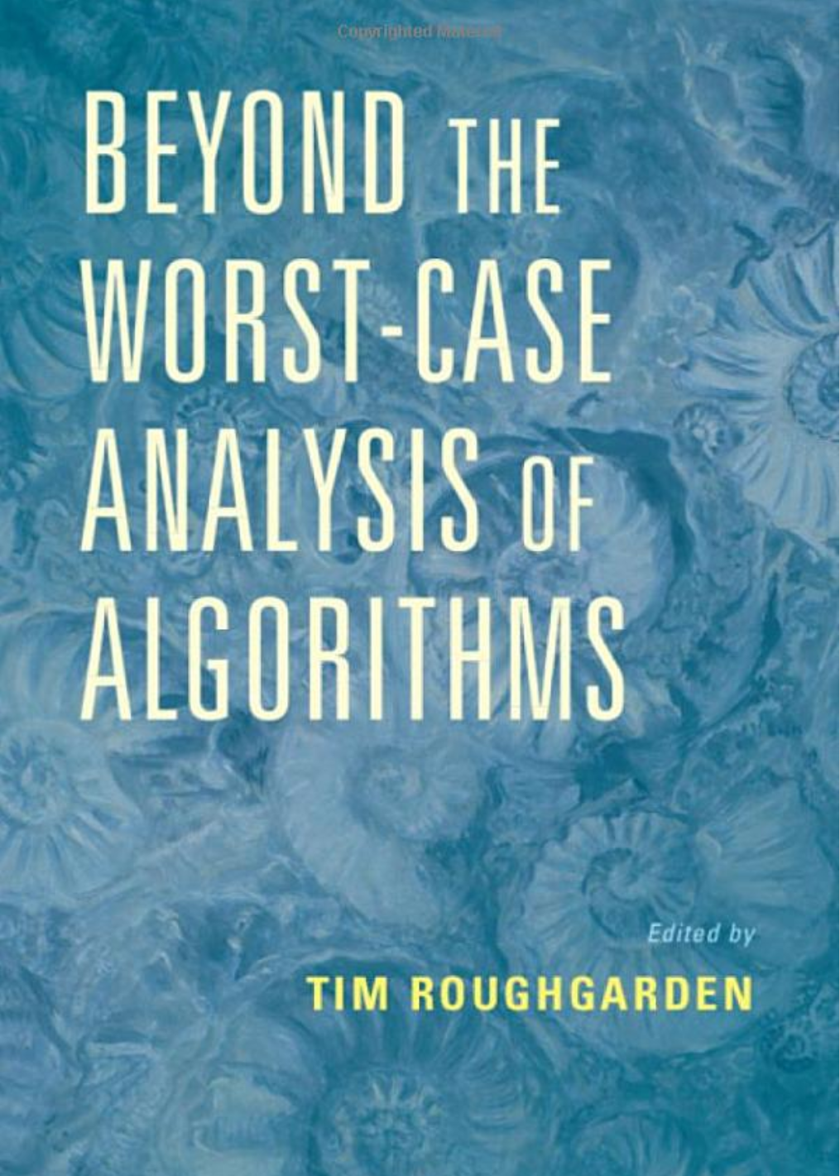
going beyond the worst case
Ways to model non-worst-case instances
special structure to the instances
requests are “predictable”
arrival order is not worst-case?
train NN to find patterns, give predictions
…

Slide 9
price of uncertainty
Offline
Online
Beyond…
Set Cover
$$O(\log{n})$$
$$Ω(\log^{2}{n})$$
$$?$$
Load Balancing
$$1$$
$$Θ(\log{m})$$
$$?$$
can we do better in non-worst-case settings?

Slide 10
Online Set Cover
[Alon Awerbuch Azar Buchbinder Naor 03]
$|𝒰|=n=$# elements
$|𝒮|=m=$# sets
$$v_{4}$$
$$v_{4}$$
$$v_{5}$$
$$v_{2}$$
$$v_{5}$$
$$v_{2}$$
$$v_{3}$$
$$v_{3}$$
$$v_{1}$$
$$v_{1}$$
$$v_{6}$$
$$v_{6}$$
Goal: pick smallest # sets to cover all elements.

Slide 11
Online Set Cover
$$s_{1}$$
$$v_{1}$$
$$s_{2}$$
$$v_{2}$$
$$ℱ$$ $m$ sets
$$𝒰$$
$n$ elements
$$s_{3}$$
$$v_{3}$$
$$s_{4}$$
$$v_{4}$$
$$s_{5}$$
$$v_{5}$$
$$s_{6}$$
$$v_{6}$$

Slide 12
Online Set Cover
[Alon Awerbuch Azar Buchbinder Naor 03, Feige Korman 05]
Algorithm: $O(log n log m)$ competitive
CR: $Ω(log n log m)$
for deterministic algos
and for poly-time algos
Q: What happens beyond the worst case?

Slide 13
Random Order (RO) model
$$s_{1}$$
$$v_{1}$$
$$v_{1}$$
$$s_{2}$$
$$v_{2}$$
$$v_{2}$$
$$ℱ$$ $m$ sets
$$𝒰$$
$n$ elements
$$s_{3}$$
$$v_{3}$$
$$v_{3}$$
$$s_{4}$$
$$v_{4}$$
$$v_{4}$$
$$s_{5}$$
$$v_{5}$$
$$v_{5}$$
$$s_{6}$$
$$v_{6}$$
$$v_{6}$$

Slide 14
LearnOrCover
[G. Kehne Levin FOCS 21]
“hands” of possible solutions
(Unit cost, exp time)
$$𝒫$$
when random element $v$ arrives
if $v$ not already covered, in parallel:
$\left(\begin{matrix}m \\ k\end{matrix}\right)$
$1$. select random remaining hand
pick random set from it
2. remove sols that don’t cover $v$
pick any set covering $v$
$$𝒰$$
Main Q: how many elements uncovered on arrival?
$$Sol R:$$

Slide 15
LearnOrCover
[G. Kehne Levin FOCS 21]
“hands” of possible solutions
(Unit cost, exp time)
$$𝒫$$
when random element $v$ arrives
if $v$ not already covered, in parallel:
$1$. select random remaining hand
pick random set from it
2. remove sols that don’t cover $v$
pick any set covering $v$
$$𝒰$$
Q: do ½ of remaining hands cover ½ of uncovered elements?
Yes: random set covers many uncovered elements!
$$Sol R:$$
No: random element removes many hands!!

Slide 16
Case 1: $≥1/2$ of $P∈𝒫$ cover $≥1/2$ of $𝒰$.
$R$ covers $\frac{|𝒰|}{4k}$ in expectation.
$𝒰$ shrinks by $\left(1−\frac{1}{4k}\right)$ in expectation.
|$𝒰$| initially $n$
$⇒$ $O(k logn)$ COVER steps suffice.
Case 2: $>1/2$ of $P∈𝒫$ cover $<1/2$ of $𝒰$.
|$𝒫$| initially $\left({m \atop k}\right)≈m^{k}$
$⇒$ $O(k logm)$ LEARN steps suffice.
$≥1/2$ of $P∈𝒫$ pruned w.p. $1/2$.
$𝒫$ shrinks by $3/4$ in expectation.
$⇒$ $O(k log mn)$ steps suffice.

Slide 17
LearnOrCover
(Unit cost, exp time)
Case 1: (COVER)
Case 2: (LEARN)
$𝒰$ shrinks by $\left(1−\frac{1}{4k}\right)$ in expectation.
$𝒫$ shrinks by $3/4$ in expectation.
Φ=1𝑘log|𝒫|+
$$\frac{1}{k}log|𝒫|$$
$$log|𝒰|$$
How to make polytime?
Can we reuse LEARN/COVER intuition?
Claim 1: $Φ(0)=O(log mn)$ and $Φ(t)≥0$.
Claim 2: If $v$ uncovered, then $E[ΔΦ]≤−Ω\left(\frac{1}{k}\right).$

Slide 18
LearnOrCover
$$\underset{S}{∑}x_{S}^{∗}log\frac{x_{S}^{∗}}{x_{S}^{t}}$$
(Unit cost)
Idea: Measure convergence with potential function
Init. $x←1/m$.
$Φ(t)=c_{1}$ $\text{KL}(x^{∗}||x^{t})$ $+c_{2}$ $log|𝒰^{t}|$
@ time $t$, element $v$ arrives:
If $v$ covered, do nothing.
$𝒰^{t}$ := uncovered elements @ time $t$
Else:
(I) Buy random $R∼x$.
(II) $∀S∋v$, set $x_{S}←e⋅x_{S}$.
Renormalize $x←x/∥x∥_{1}$.
$x^{∗}$ := uniform distribution on OPT
Claim 1: $Φ(0)=O(log mn)$, and $Φ(t)≥0$.
Buy arbitrary set to cover $v$.
Claim 2: If $v$ uncovered, then $E[ΔΦ]≤−\frac{1}{k}$.
If $𝔼_{v}\left[ x_{v} \right]>\frac{1}{4}$ $⇒ 𝔼_{R}[k Δlog|𝒰^{t}|]$ drops by $Ω\left(1\right)$. Else $𝔼_{v}[k ΔKL]$ drops by $Ω\left(1\right)$.
(Recall $k=|OPT|$)

Slide 19
extensions
similar ideas work for:
“prophet” model where requests drawn from known distributions
covering LPs in random order
non-metric facility location
Q1: Harder covering problems? Covering IPs w/ box constraints?
Q2: Unified theory? Reinterpret old RO results as LearnOrCover?

Slide 20
price of uncertainty
Offline
Online
Beyond…
Set Cover
$$O(\log{n})$$
$$Ω(\log^{2}{n})$$
$$O(\log{n})$$
RO
Load Balancing
$$1$$
$$Θ(\log{m})$$
$$?$$

Slide 21
load balancing
$m$ (identical) machines
job $j$arrives online
must assign job $j$ to some “valid” machine
Load of machine $i$ = number of jobs assigned to it
Goal: minimize maximum load over all machines
Theorem: Greedy is $O\left(\log{n}\right)$ competitive algorithm.

Slide 22
load balancing
$m$ (identical) machines
job $j$arrives online
must assign job $j$ to some “valid” machine
Load of machine $i$ = number of jobs assigned to it
Goal: minimize maximum load over all machines
Theorem: Greedy is $O\left(\log{n}\right)$ competitive algorithm.
Theorem: worst case $Ω\left(\log{n}\right)$ lower bound.
What can we do beyond worst case?

Slide 23
using predictions?
recent interest in using (machine learned) predictions
Question: where do predictions come from?
Answer #1: instances i.i.d. from some distribution $𝒟$
then use PAC learning to obtain predictions
Answer #2: online with a sample
Tomorrow: instance $I$ will arrive.
Today: given epsilon (i.i.d.) sample from $I$.
no distributional assumptions
[Kaplan Naori Raz 2019]

Slide 24
load balancing with sample
Answer #2: online with a sample
Tomorrow: instance $I$ will arrive. Today: given epsilon (i.i.d.) sample from $I$.
no distributional assumptions
Theorem: Can get load $\left(1+ε\right) OPT+poly\left(\frac{\log{m}}{ε}\right)$
$≈\left(1+ε\right) OPT$ if $OPT$ is large
explicitly learn a good strategy from samples!
Not possible in worst-case
[Argue Frieze G. Seiler Neurips 2022]

Slide 25
three algorithmic ideas
Chernoff bound
Fact 1: if OPT large, then integer assignment $≈$ fractional assignment
$$1/7$$
1
2
$$2/7$$
3
Theorem 2: Exist machine “weights” so that proportional assignment is $\left(1+ε\right) OPT$
2
$$4/7$$
1
Theorem 3: Exists algorithm to find machine weights using small sample
4
1
5
[Argue Frieze G. Seiler Neurips 2022]

Slide 26
idea #2: convex opt
Theorem 2: Exist machine weights $\left(θ_{1},…, θ_{m}\right)$ so that proportional assignment is $\left(1+ε\right) OPT$
$$\min{\sum_{ij}{x_{ij}}\log{x_{ij}}}$$
at optimality,
$x_{ij}=\frac{e^{μ_{i}}}{\sum_{k\sim j}{e^{μ_{k}}}}$ if $i\sim j$
$$\sum_{i\sim j}{x_{ij}}=1$$
$$=\frac{θ_{i}}{\sum_{k\sim j}{θ_{k}}}$$
$$\sum_{j}{x_{ij}}≤OPT$$
$$\sum_{j}{x_{ij}}≤\left(1+ε\right)OPT$$
$$x_{ij}≥0$$
Lagrangian $ℒ=\sum_{ij}{x_{ij}}\log{x_{ij}}+\sum_{j}{λ_{j}} \left( \sum_{i}{x_{ij}} −1\right)+\sum_{i}{μ_{i}} \left(\sum_{j}{x_{ij}}−OPT\right)−\sum_{i,j}{ν_{ij}{ x}_{ij}}$
[Agrawal Mirrokni Zadimoghaddam ICML 18]

Slide 27
compute weights?
Theorem 3: Algorithm to find machine weights $\left(θ_{1},…, θ_{m}\right)$ using small sample
Suppose we had entire instance!
1
1$−ε$
1
Algorithm: start with all weights 1
1
1
1
Compute machine loads on instance, w.r.t current weights
1
1
if exist machines with load $≫OPT$, reduce their weights by $\left(1−ε\right)$
1
1$−ε$
1
1
Does this terminate?
Yes, cute MW analysis!
1
1
$O\left(\frac{\log^{2}{m}}{ε^{3}}\right)$ rounds!
1
How many rounds do we need?
1
But don’t we need entire instance?!
Use samples to estimate loads!
[Argue Frieze G. Seiler Neurips 2022]

Slide 28
proof of termination
Lemma: algorithm terminates.
For simplicity: reduce if load > 2$OPT$, reduce weights by ½
Let optimal weights $θ^{∗}$ be powers of 2
Algo is invariant to scaling, so imagine start with weights = $θ_{\max{}}^{∗}$
Claim: $θ_{j}$ never dips below $θ_{j}^{∗}$
Proof: Suppose some $θ_{j}=θ_{j}^{∗}$, every other $θ_{j}≥θ_{j}^{∗}$.
By algo, $j$ receives less load than in OPT. So will never reduce $θ_{j}$. ☺
So finitely many iterations.
[Lattanzi Lavastida Moseley Vassilvitskii]

Slide 29
compute weights?
Theorem 3: Algorithm to find machine weights $\left(θ_{1},…, θ_{m}\right)$ using small sample
Suppose we had entire instance!
1$−ε$
Algorithm: start with all weights 1
1
1
Compute machine loads on instance, w.r.t current weights
1
if exist machines with load $≫OPT$, reduce their weights by $\left(1−ε\right)$
1$−ε$
1
Does this terminate?
Yes, cute MW analysis!
1
How many rounds do we need?
$O\left(\frac{\log^{2}{m}}{ε^{3}}\right)$ rounds!
1
But don’t we need entire instance?!
Use samples to estimate loads!

Slide 30
idea #2: parallel algo
How many rounds?
Expansion Lemma: Suppose $A(t)$ = #machines whose weights lowered at least $t$ times
Then $A\left(t+O(\log{m})\right)≤ 1/2 A(t)$
proof of Exp.Lemma omitted: catch me later
$$⇒ A\left(O(\log^{2}{m})\right)≤ 1/{2m} A(0)$$
$$≤ 1/{2m}⋅m<1$$

Slide 31
compute weights?
Theorem 3: Algorithm to find machine weights $\left(θ_{1},…, θ_{m}\right)$ using small sample
Suppose we had entire instance!
1$−ε$
Algorithm: start with all weights 1
1
1
Compute machine loads on instance, w.r.t current weights
1
if exist machines with load $≫OPT$, reduce their weights by $\left(1−ε\right)$
1$−ε$
1
Does this terminate?
Yes, cute MW analysis!
1
How many rounds do we need?
$O\left(\frac{\log^{2}{m}}{ε^{3}}\right)$ rounds!
1
But don’t we need entire instance?!
Use samples to estimate loads!

Slide 32
idea #3: using parallel algo
Theorem 3: Algorithm to find machine weights $\left(θ_{1},…, θ_{m}\right)$ using small sample
Summary sketch of algo:
Start with all weights 1
calculate machine loads w.r.t. current weights
if exist machines with load $≫OPT$, reduce their weights by $\left(1+ε\right)$

Slide 33
idea #3: using parallel algo
Theorem 3: Algorithm to find machine weights $\left(θ_{1},…, θ_{m}\right)$ using small sample
Start with all weights 1
Break sample into $O\left(\frac{\log^{2}{m}}{ε^{3}}\right)$ chunks
Estimate machine loads w.r.t. current weights, using next chunk
calculate machine loads w.r.t. current weights
if exist machines with load $≫OPT$, reduce their weights by $\left(1+ε\right)$
Use these weights on actual instance

Slide 34
…which completes the proof
Fact 1: if OPT large, then integer $≈$ fractional assignment
Theorem 2: Exist machine weights so that proportional assignment is $\left(1+ε\right) OPT$
Theorem 3: Algorithm to find machine weights using small sample
Theorem: load $\left(1+ε\right) OPT+poly\left(\frac{\log{m}}{ε}\right)$
[Argue Frieze G. Seiler Neurips 2022]

Slide 35
online with a sample
Given a sample of the instance, explicitly learn good strategy
Model makes less stochastic assumptions than random order, or IID
Open Questions: Can we use samples to get better algos for other problems?
other scheduling problems
network design: e.g., Steiner forest, 2-connectivity
better results for set cover

Slide 36
price of uncertainty
Offline
Online
Beyond…
Set Cover
$$O(\log{n})$$
$$Ω(\log^{2}{n})$$
$$O(\log{n})$$
RO
Load Balancing
$$1$$
$$Ω(\log{m})$$
$$O(1+ε)$$
OwaS

Slide 37
to summarize
the worst-case analysis of algorithms has served us well
but we should also prove things beyond robust/pessimistic guarantees
+ when do our algorithms outperform these worst-case bounds?
+ what if the input is stochastic?
+ are we over-fitting to the stochastic model?
+ can we learn some not-easy-to-describe ML model to give predictions?
+ …
Thanks!

