Slide 1
Computational Bio Research
Rich Bonneau, Bud Mishra, Dennis Shasha

Slide 2
What is Computational Biology
Analysis of biological data to discover facts about nature, e.g. which genes or combinations of genes cause a disease.
Engineer changes that will “improve” species, e.g. plants that use less nitrogen.
Synthetic biology, e.g. create a DNA detector and neutralizer of toxic chemicals.

Slide 3
How Much Biology Do You Need to Know?
Not much: biological entities (genes, RNA, proteins) either induce or repress one another. Our job is to figure out how and to suggest the next most useful experiment.
A lot like debugging a circuit in electrical engineering.
Computational tools: machine learning, statistics, visualization.

Slide 4
Why Is It Cool?
Impact can be enormous.
Lots of new very real problems, e.g. can you design a protein to bind copper? Computational geometry, physics, algorithms to take advantage of special structure of problem.

Slide 5
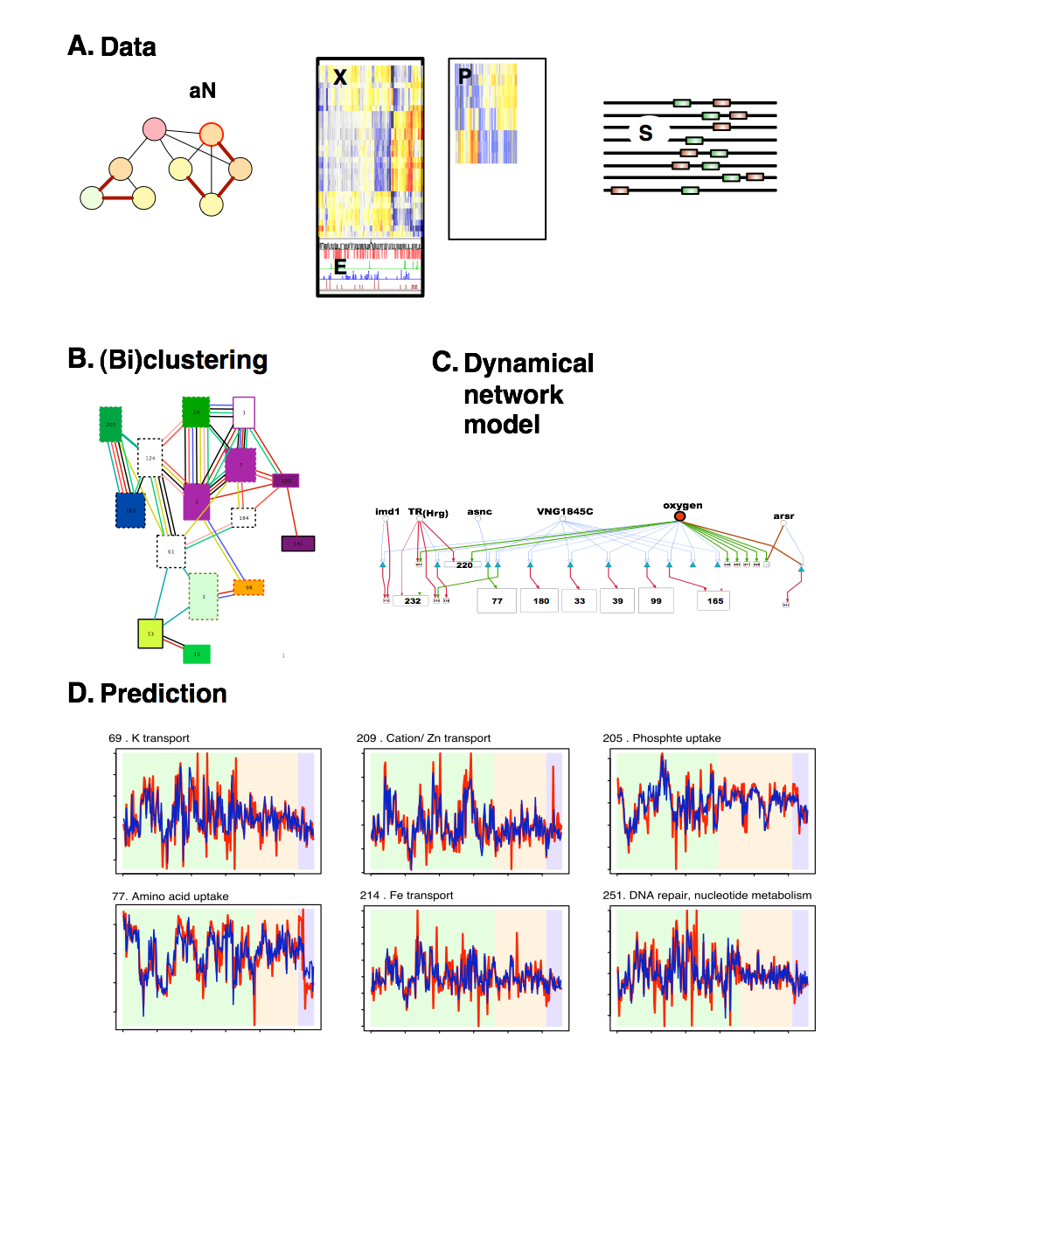
Overview
Integrating data to detect biologically relevant modules:
cMonkey and multi-species
Methods 1 - multiple species biclustering
Methods 2 - network inference dynamics, intervention, chromatin, and constraints
Th17 network example
Bonneau, Richard. Learning biological networks: from modules to dynamics. Nature Chemical Biology 4, 658 - 664 (2008)

Slide 6
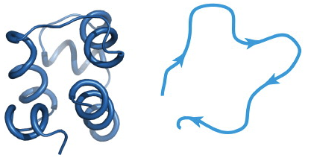
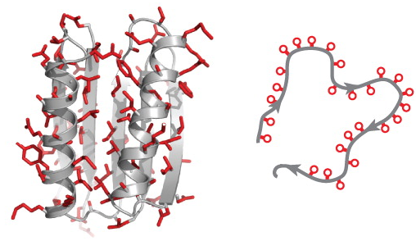
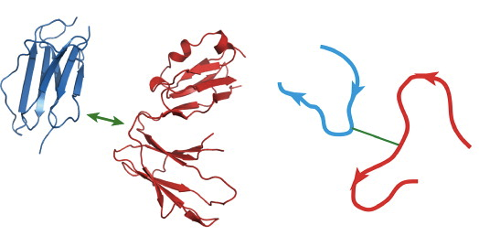
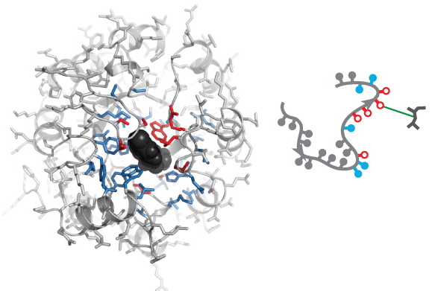
What can Rosetta do?
De novo Prediction
Novel Fold Design
Bradley P, Misura KM, Baker D. 2005. Science
Kuhlman, B et al. 2003. Science
Protein Docking
Novel Enzyme Design
Gray, J.J. et al. 2003 J. Mol. Biol.
Jiang L, et al. 2008. Science
Images: Rhiju Das and David Baker 2008

Slide 7
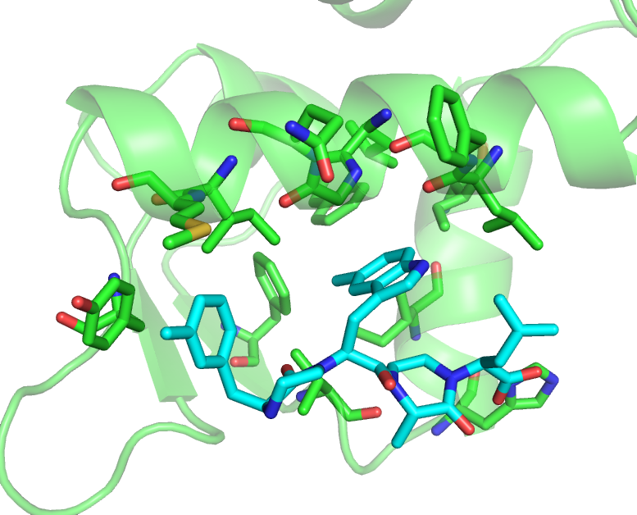
Design Movie
P53 - MDM2 interface inhibitor

Slide 8
Bud Mishra
Developing for more than a decade algorithmic and statistical techniques to solve critical problems in biology, biotechnology and biomedicine.
Funding received from Air Force, Army, CCPR, DARPA, NIH, NIST, NSF, NYSTAR, etc. and various other governmental and commercial entities.
Part of a prestigious NSF funded “Expedition in Computing” project (CMACS: Center for Modeling and Analysis of Complex Systems at CMU).
The group is highly multi-disciplinary: mathematics, statistics, computer science, and biology.

Slide 9
Projects
Many active projects focussig on computational biology and systems biology:
Analysis of Single-Molecule/Single-Cell Data
SPM-based Transcriptomic Profiling
Whole-Genome Haplotype Sequencing using SMASH
SUTTA assembly algorithm, TRC Base-Caller
Model Checking and Model Building for Systems Biology
Analysis of EHR (Electronic Health Record Data) and Disease Models (e.g., Chronic Fatigue Syndrome, Deep Vein Thrombosis, etc.),
Models of Cancer, Applications to Pancreatic Cancer,
Genome Wide Association Studies (GWAS).

Slide 10
Ex: Finding Causal Networks
Goal is to find a circuit diagram among genes, short RNAs, and proteins to enable statements like: if you want to increase the production of protein p, then over-express g1 and under express- g2 Find parsimonious causality
Way under-determined – hundreds of thousands of edges vs. hundreds of experiments.
Fortunately, biology is redundant and robust.
Notes:
The main goal is to figure out causal links between genes.
How does one gene influence another and under what conditions?
It is also important to obtain a parsimonious answer: weak edges may just be statistical flukes so we want to ignore them.
Typically there is too little data to infer the whole network, so we focus on only the strongest edges

Slide 11
Approach : combine experiments.
Time-series – closely spaced experiments over time (how close? Initial shock/not steady state)
Knockout/Knock-down – diminish expression of a gene
Over-expression – enhance expression of a gene
Steady state experiments (least informative): change condition and wait.
Notes:
Each data type contains different information about the network and has different pros and cons
For example, time-series data contains the dynamics of how the expression levels move between steady-state points, but can be expensive and difficult to collect
Taking readings at only steady-state points is cheaper and easier, but gives no information about the dynamics of the system
How can we construct an algorithm that takes information about each one?

Slide 12
Overexpression data
GENIE3
Output
Network
DFG
DEX/CHX
DEX/CHX give information about overexpression of specific genes
Preliminary results add DEX/CHX data for only 2 genes
Work is ongoing, but combining results helps.
Notes:
- Next, DEX/CHX data was used to augment the prior. DEX over-expresses a gene and then CHX cuts off its expression, the idea being that this can illuminate the targets of a specific gene in a network.
- 78% correct, plan to add more DEX data

Slide 13
Complementary Data and Methods
Different types of data give complementary information.
Different methods for same data type combine to give better results.
Crowdsourcing works.
Notes:
- The basic take away idea is that different experiments and different data types can illuminate different features of a network, and different algorithms excel at extracting some features but not others.
- What we’ve tried to do is to put it all together to extract as much of the network as we can, rather than relying on any one dataset or algorithm to recover the whole thing.

