Slide 1
Towards Robotic Identification of Base Station Strength
Students: Cole Smith and Eric Lin,
Prof Dennis Shasha

Slide 2
Use Case
Millimeter waves are very sensitive to obstacles.
Helpful to understand whether a certain set of base stations would cover some area.
Sending around people to accomplish this is too expensive and time-consuming.
Robots might do better.
In our use case, millimeter waves were simulated by light sources of different colors.

Slide 3
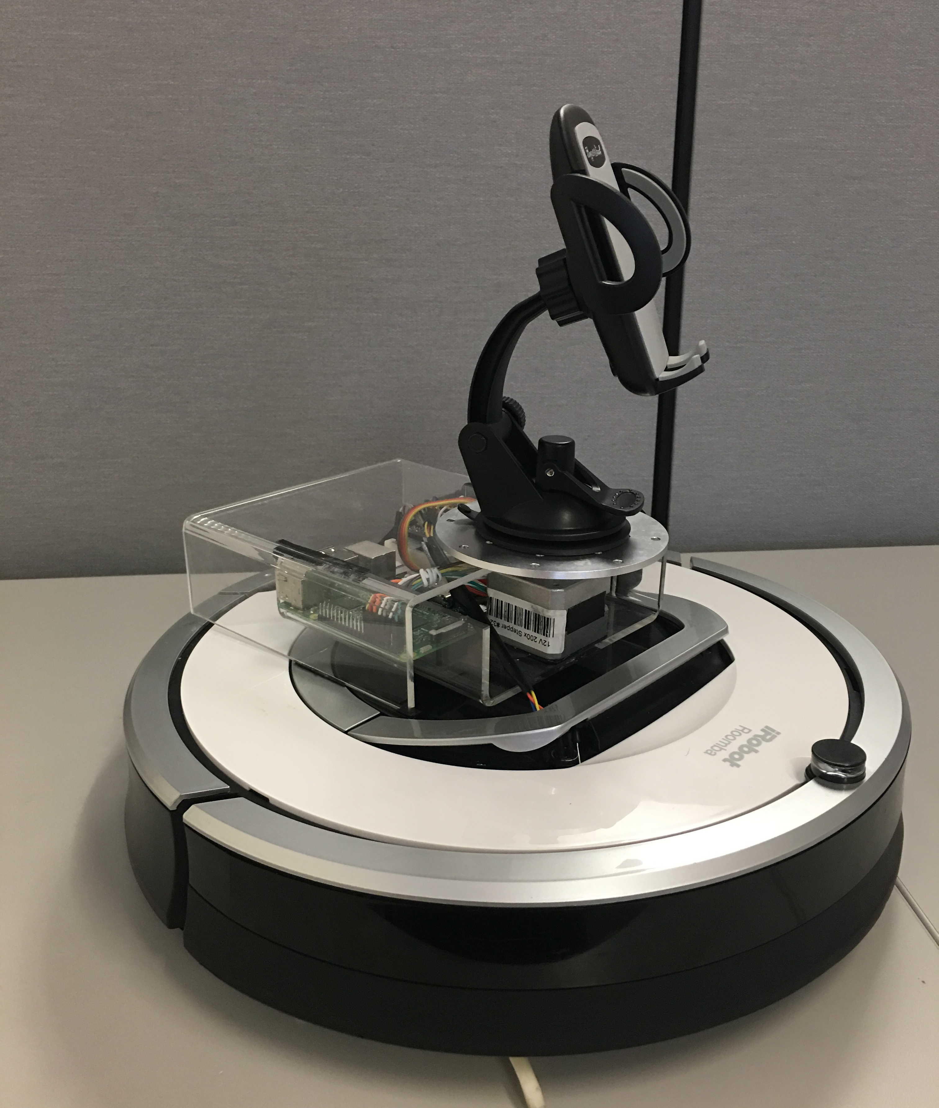
Roomba Platform Room Traversal
An iPhone’s camera buffer is streamed to a Raspberry Pi over TCP
The iphone detects light of various colors (like millimeter waves from different base stations).
A room profile indicates over-coverage and dead zones.

Slide 4
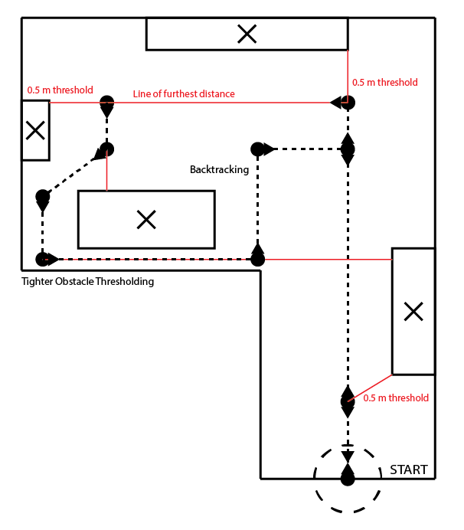
Room Coverage
Ranges to obstacles can be used to choose a path
Thresholds can adjust dynamically for tighter spaces
Channel strength can be measured independently and continuously
    Can be compared with timestamps and the recorded position

