Slide 1
Confronting Concept Drift by Refusing to Guess
Mustafa A. Kocak¹, Jing Leng, Elza Erkip¹ Dennis Shasha^{2,3}
¹NYU Tandon SoE, ²Courant Institute ³ 7Chord

Slide 2
Motivation
Making a bad decision can be costly
an unnecessary medical operation, a bad trade in finance.
Most of medicine is i.i.d. (independent identically distributed). One patient has same causal factors as other.
Finance is not, causal factors can change: concept drift.

Slide 3
Concept Drift in Several Domains
Recommender systems must change over time, e.g. if I go to a movie recommendation system, it should not recommend Casablanca if I’m looking for a recent release.
Epidemic spreads can change as the epidemic evolves.
Financial decisions can be independent of politics often, but what about around election time?

Slide 4
Tools at Our Disposal
(i) Machine learning methods that adapt over time.
(ii) Multi-armed bandit style algorithms that can weight different algorithms.
(iii) SafePredict to refuse to predict sometimes.
(iv) Experiments

Slide 5
Neural Nets – adaptive by design
Neural nets use an updating algorithm called gradient descent: each prediction is compared with the correct answer and weights are adjusted if there are errors.
Thus feedback is continuous.
So, neural nets are adaptive to concept drift by design.
However…. Not always the most accurate choice.

Slide 6
Random Forests – can be made adaptive
A random forest is a collection of decision trees (or if we want a continuous outcome, classification and regression trees), each on randomly chosen subset of data features.
Normally (for i.i.d. data), train once and use forever.
Adaptation strategy idea: If a tree is often wrong, rebuild it based on recent data.

Slide 7
Tools at Our Disposal
(i) Machine learning methods that adapt over time.
(ii) Multi-armed bandit style algorithms that can weight different algorithms.
(iii) SafePredict to refuse to predict sometimes.
(iv) Experiments

Slide 8
Adjusting Weights Among Machine Learning Algorithms
Suppose you have several machine learning algorithms, e.g. different neural nets, several random forests, others.
Evaluate predictions of each machine learning method.
Adaptation strategy (bandit idea): If one method does better than others, then give it more weight.
Similar to adaptive random forests except that one adjusts weights given to algorithms rather than changing the algorithms themselves.

Slide 9
Tools at Our Disposal
(i) Machine learning methods that adapt over time.
(ii) Multi-armed bandit style algorithms that can weight different algorithms.
(iii) SafePredict to refuse to predict sometimes.
(iv) Experiments

Slide 10
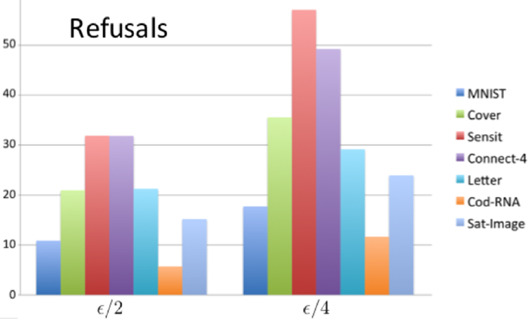
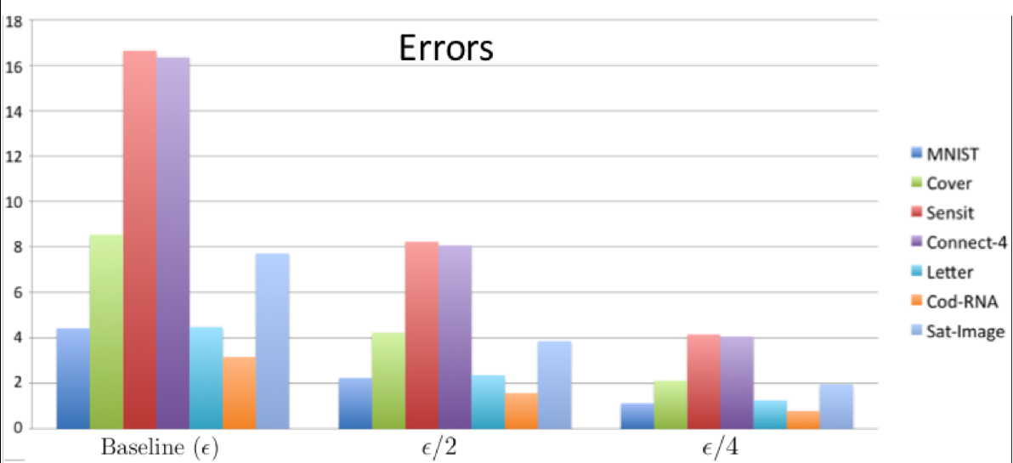
Accuracy refusal tradeoff
Can cut the error rate for iid
in half by refusing 6 -32% of the time.
to a quarter by refusing 12-57% of the time.

Slide 11
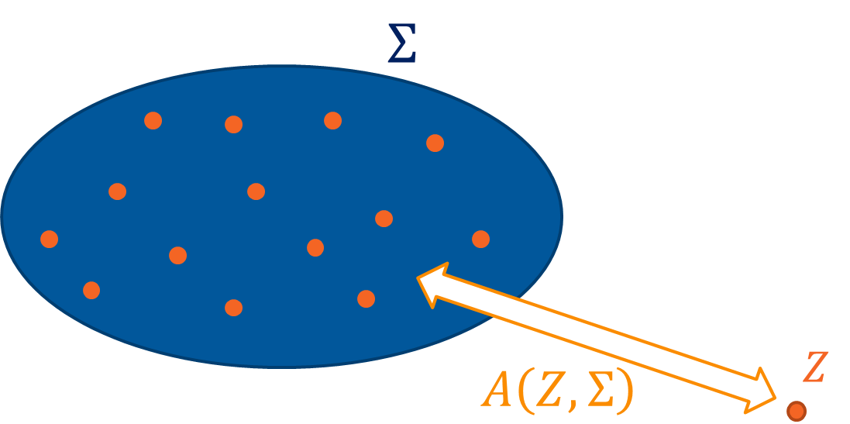
Non-conformity Score of Data Point to a Set
Distance between a data point ($Z$) and a data set ($Σ$).
Denote with $A\left(Z,Σ\right)$.
The farther Z is from $Σ$, the larger the score. Intuitively, if $Σ$ doesn’t provide a good prediction model for Z, then non-conformal.

Slide 12
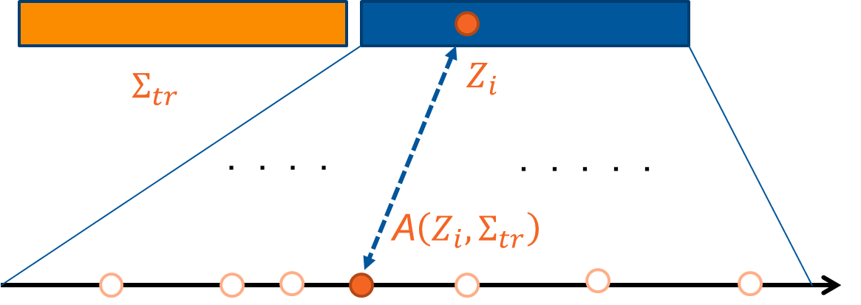
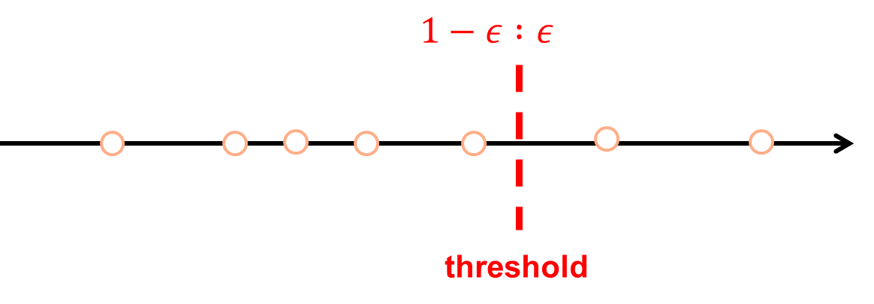
Conformal Prediction – Train & Calibration
Split training set into core and calibration sets.
In calibration set, find fraction of trees that must agree to make prediction that exceeds correctness target (e.g. 90%).
If a given data point gets insufficient votes, refuse.
Conforming Non-conforming

Slide 13
What if not Independent Identically Distributed (iid)?
Idea is to look at the non-refused output of conformal prediction.
If that has high error rate, then refuse even more.
Issue: get into a regime in which you are always refusing.
Resolution: (i) “weight-shifting” make guesses on occasion even if things are looking bleak. (ii) Re-calibrate conformal prediction.

Slide 14
Algorithm
At time $t=1,…, T$:
Environment reveals $x_{t}$
Adaptive predictor P makes prediction: ${\hat{y}}_{t}$, computes reliability score: $r_{t}$
Confidence Based Rejection (CBR) rejects based on $r_{t}$
Combine based on bandits.
If any accept, SafePredict (SP) decide on whether to accept.
Ground truth $y_{t}$ is revealed, CBR and SP updates their inner states.
Parameters: target error rate $ε$, CBR window size: w
Notes:
Problems:
Font in model graph is too small.
Bar graph too small font. Lacking x-axis name.
Bar graph no explanation: error rate and efficiency? Explain model names (arf, hat). Change sp to sf.
Include only one dataset (wireless): include plot of error rate.
Stashed text: dataset 2: Input variables are prices and demands in New South Whales and Victoria, and the amount of power transferred between the states.
The class label identifies the change of the transfer price relative to a moving average of the last 24 hours (increase or decrease).

Slide 15
Tools at Our Disposal
(i) Machine learning methods that adapt over time.
(ii) Multi-armed bandit style algorithms that can weight different algorithms.
(iii) SafePredict to refuse to predict sometimes.
(iv) Experiments

Slide 16
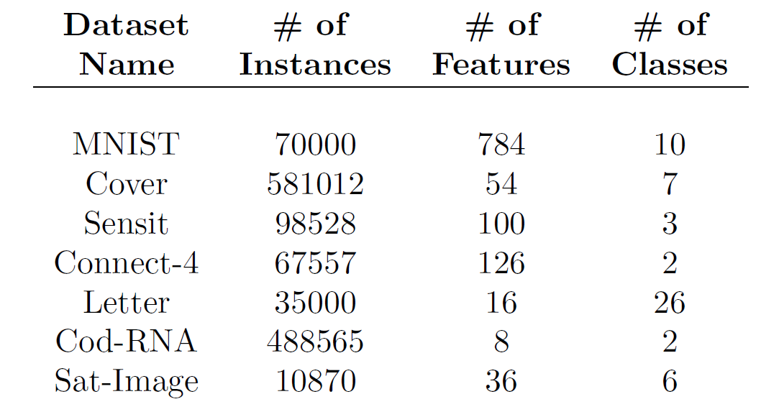
Datasets(independent identically distributed)
Public datasets from Machine Learning Data Set Repository (mldata.org)
MNIST (scanned handwritten digits),
Cover (dominant forest type based on images),
Sensit (vehicle types from WSN),
Connect-4 (outcome of a multiplayer game),
Letter (letter recognition from pixel displays),
Cod-RNA (coding/non-coding parts of RNA),
Sat-Image (soil type based on satellite images)

Slide 17
Experimental Setup
Base classifier : Random Forest ( n_trees = 100, min_leaf = 10 )
Score: 1 $−$model.predict_proba(X)[Y]
Compute the baseline test error rate:
Train a random forest over 75% of the data and test on remaining 25%
Our meta-algorithm with target rates baseline/2 and baseline/4
core/calibrate/test : 50/25/25

Slide 18
i.i.d. Results
Refusal rate increases as the target error rate decreases
baseline/2: 6-32%,
baseline/4: 12-58%

Slide 19
SafeForecast: Better Forecasting using Machine Learning and Rejection
Concept Drift Experiment
Tested on three base algorithms: adaptive random forest (ARF), Hoeffding adaptive tree (HAT) and neural network.
Evaluation: 1. Effective error rate: $\frac{{∑l}_{t}×a_{t}}{∑a_{t}}$
2. Efficiency: $\frac{∑a_{t}}{T}$
Description: a binary classification task to predict electricity price change (UP or DOWN) from the demand and supply of the market.
Fig 2. evaluation
Notes:
Problems:
Font in model graph is too small.
Bar graph too small font. Lacking x-axis name.
Bar graph no explanation: error rate and efficiency? Explain model names (arf, hat). Change sp to sf.
Include only one dataset (wireless): include plot of error rate.
Stashed text: dataset 2: Input variables are prices and demands in New South Whales and Victoria, and the amount of power transferred between the states.
The class label identifies the change of the transfer price relative to a moving average of the last 24 hours (increase or decrease).

Slide 20
Models
Moving Average – A technique using a look-back strategy to find the mean of the prices leading up to a certain day and smooth out price histories
Random Forest – A meta estimator that fits multiple decision tree classifiers on sub-samples of data and uses averaging to improve the predictive accuracy
Linear Regression – Ordinary least-squares linear model that minimizes the residual sum of squares between the observed targets and the predictions
K-Nearest Neighbors (K-NN) – A classifier using a form of majority vote where a predefined number (k) of training samples closest in some measured distance to the input are used to predict the label of the input
Support Vector Regression (SVR) – A model based on the SVM technique of finding an optimal hyperplane which helps classify or predict on new data points
Theta Method – Model for forecasting equivalent to exponential smoothing (SES) with drift
Multi Layer Perceptron – A model otherwise known as a fully connected neural network to learn a representation mapping

Slide 21
Base Performance (Predicting Amazon’s next day’s closing price)
cl
Ratios of predictions made that were correct (simply up/down)
Moving Average – 62.73%
Random Forest – 80.98%
Linear Regression – 52.79%
K-Nearest Neighbors (K-NN) – 47.2%
Support Vector Regression (SVR) – 47.83%
Theta Method – 52.79%
Multi Layer Perceptron – 47.82%

Slide 22
Performance With Threshold
Ratios of predictions made that were correct with a threshold of 1% change or above
Moving Average – 83.33%
Random Forest – 85.98%
Linear Regression – 52.89%
K-Nearest Neighbors (K-NN) – 48.59%
Support Vector Regression (SVR) – 51.77%
Theta Method – 65.5%
Multi Layer Perceptron – 55.34%

Slide 23
Lessons from Mini-Experiment
Base predictors can vary in performance.
Refusing to act unless base predictor predicts a big move can help.
Weighting can help this further.

Slide 24
Talk Summary
Concept Drift is an issue in finance (causal factors can change)
Machine learning algorithms can be made adaptive.
Multi-armed bandit to weight among them.
ConformalPrediction and SafePredict to refuse to predict judiciously.
A lot of work to do…

