Slide 1


Slide 2
EpiPolicy: A Tool for Epidemic Policy
Define compartmental models of arbitrary simplicity/complexity
e.g. COVID-19
Define populations
e.g. young, adults, seniors, male, female, etc.
Define locales
e.g. a country, state, city, or town
Define facilities
e.g. home, school, workplace

Slide 3
EpiPolicy: A Tool for Epidemic Policy
Define interventions and their effects
e.g. school closure, border restrictions, etc.
Define interventions (e.g. school closure)
Define schedules of interventions
  across locales and population groups
Optionally optimize using Monte Carlo Simulation

Slide 4
EpiPolicy Depends on Expert Epidemiologists and Data
EpiPolicy is not a particular model of any pandemic
The model we present to you today is based on:
  A rough approximation of data we have gathered
  Our conception of a compartment/locale/facility model
Our operational goal is to interest experts like you in using the tool
Our societal goal is to minimize social, economic and health costs when combatting an epidemic like Covid-19.

Slide 5
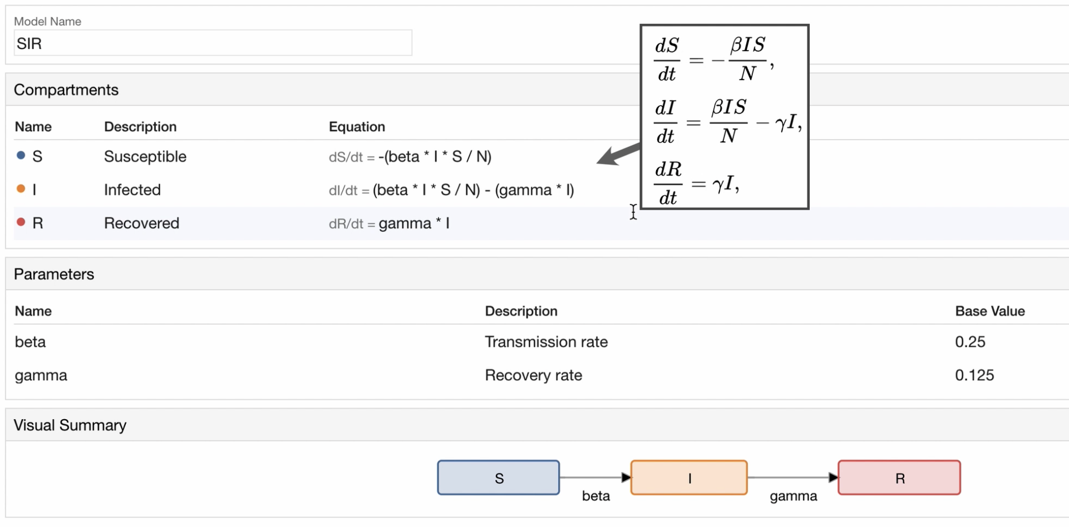
Model Definition Example: SIR
Compartment
  Name
  Description
  Differential Equations
Parameters

Slide 6
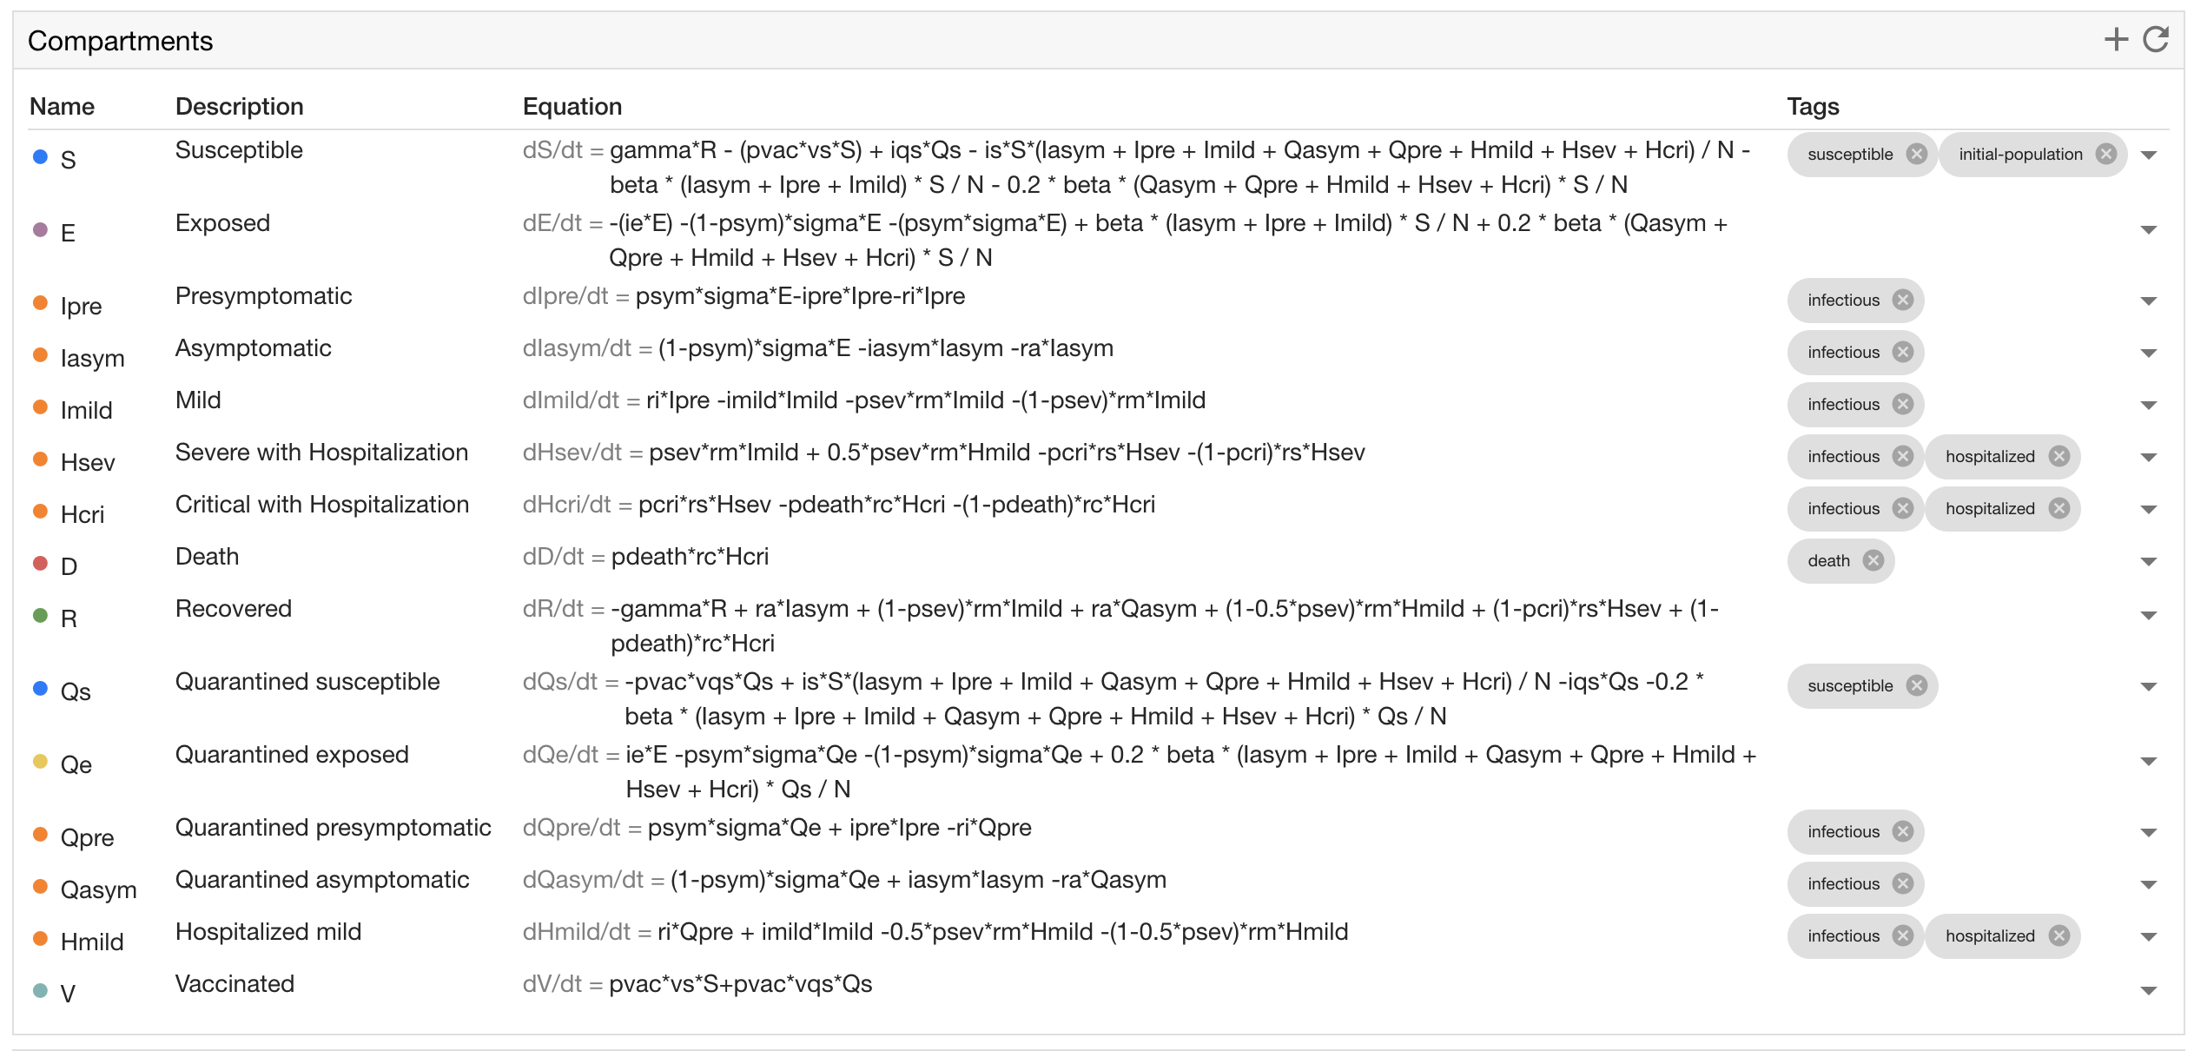
Covid-19 Compartments

Slide 7
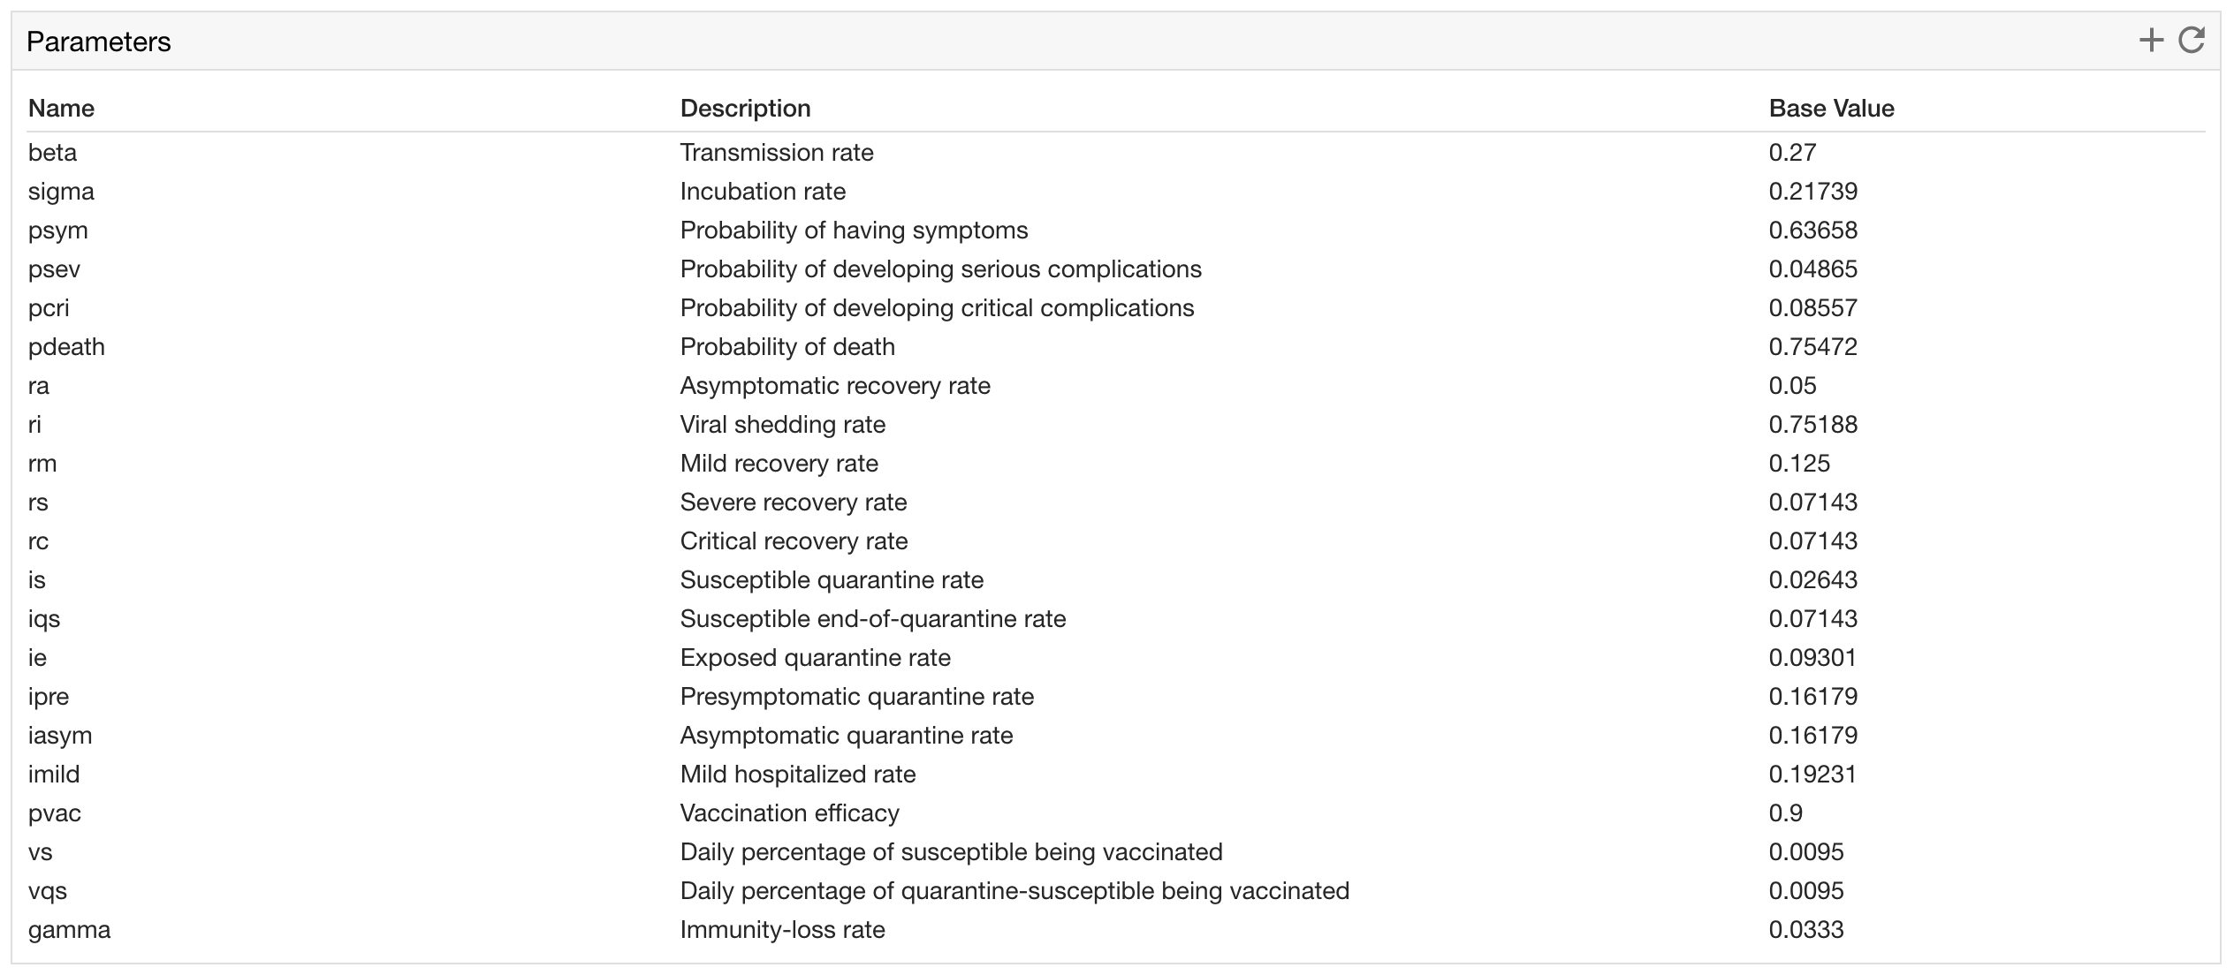
Covid-19 Parameters

Slide 8
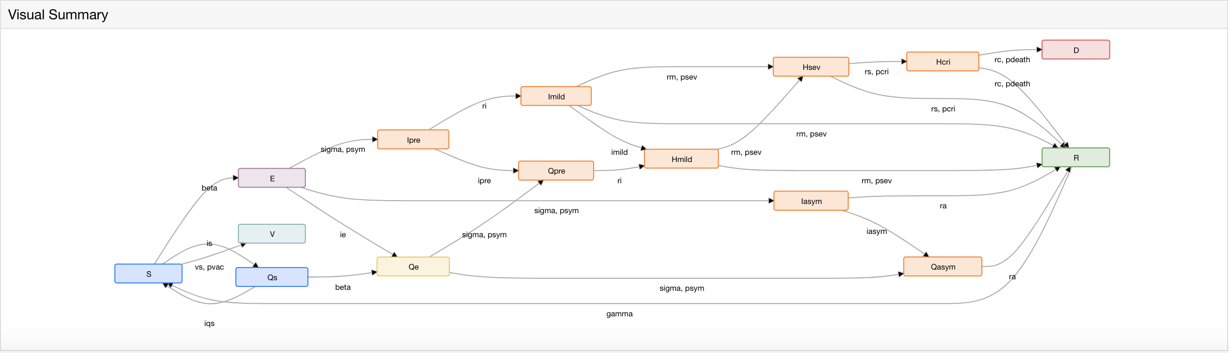
EpiPolicy Covid-19 Summary
EpiPolicy automatically generates a visual graph summary of the model
    Nodes represent compartments
    Edge-labels represent parameters that affect the transition rate from one compartment to the other

Slide 9
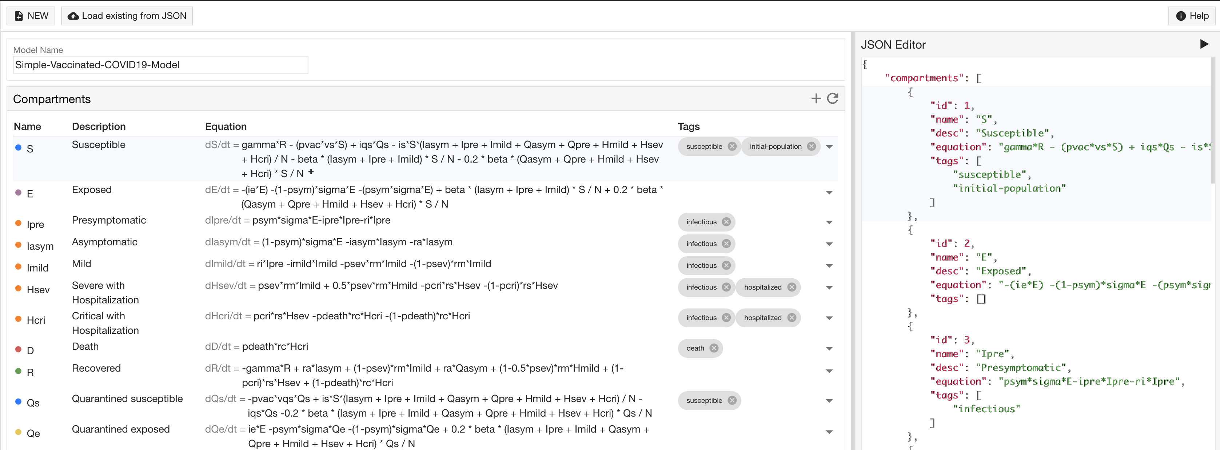
EpiPolicy JSON Specifications
EpiPolicy is backed by a simple text-based JSON specification language.

Slide 10
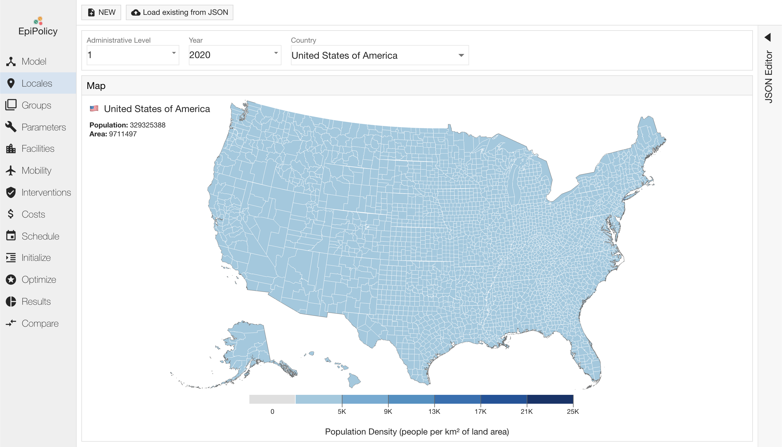
Locale Definition
Policy makers can specify the geographic and population properties.

Slide 11
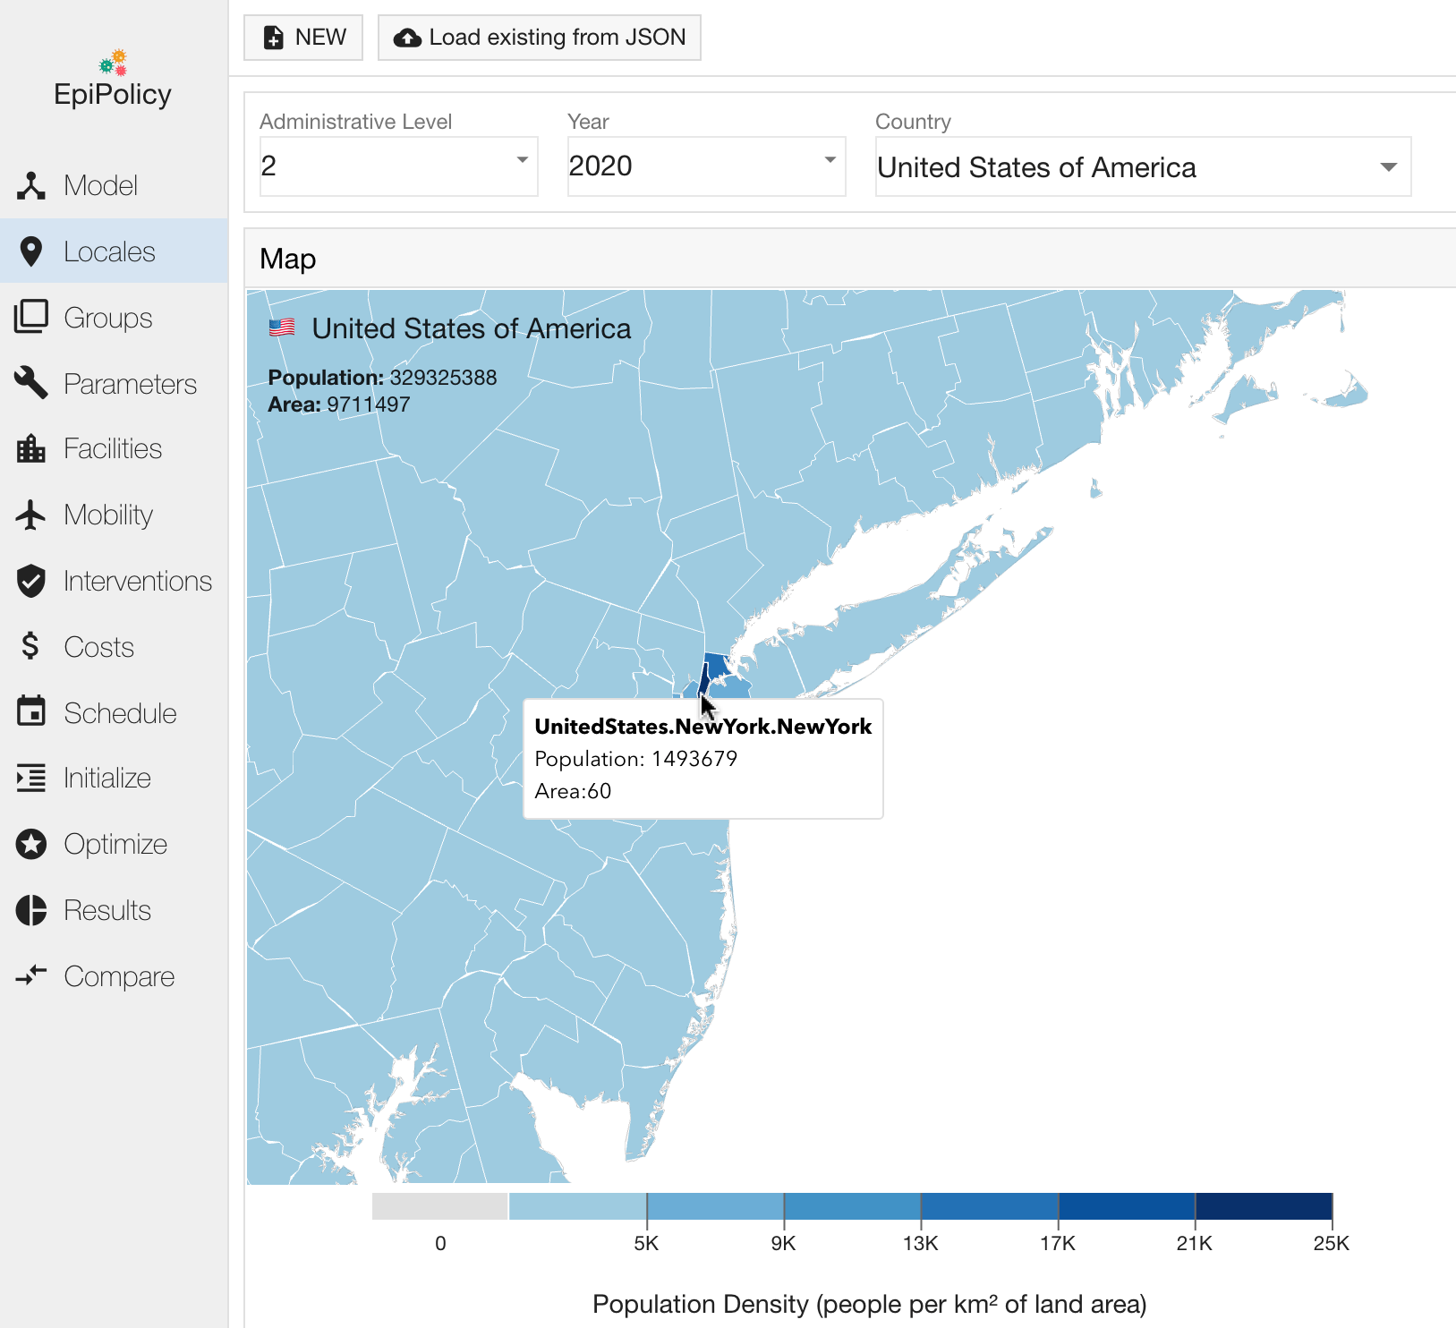
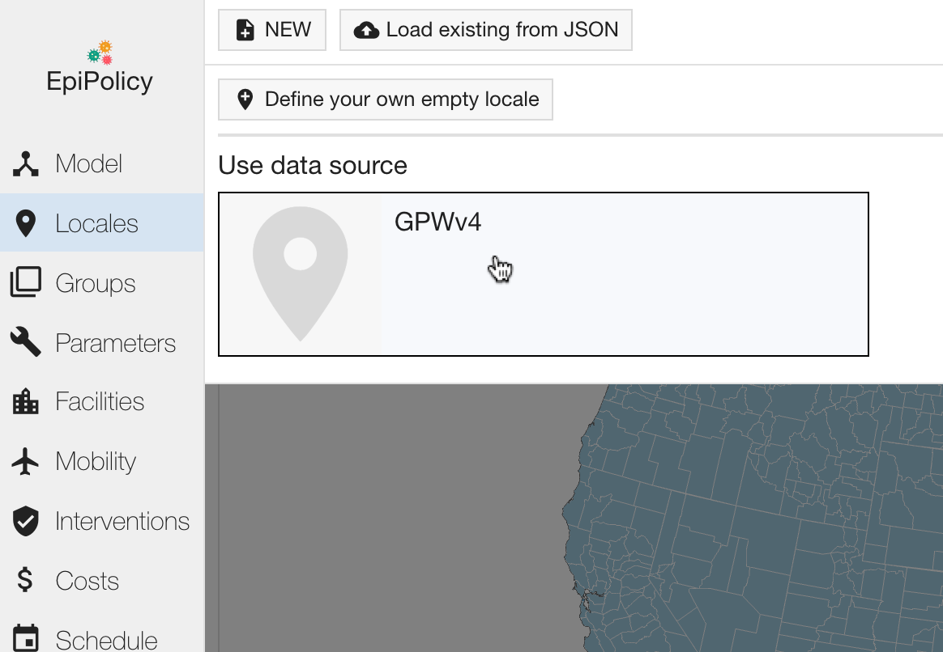
Locale Definition – GPWv4 plugin
EpiPolicy provides a plugin to automatically load this information from NASA’s Gridded Population of the World collection.

Slide 12
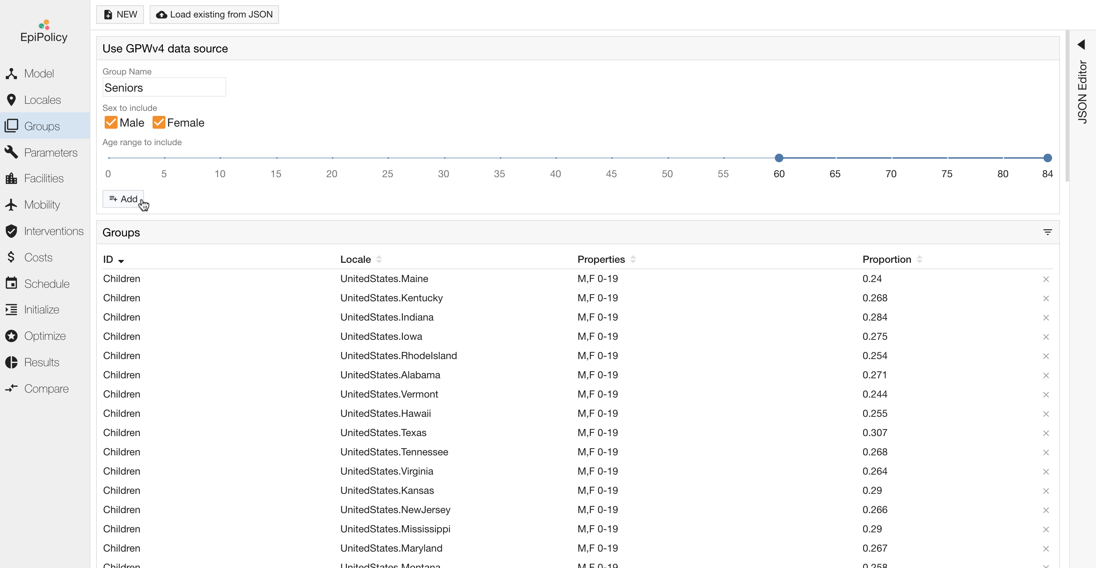
Groups Definition
One can define groups for which the disease behaves differently or that require unique interventions.

Slide 13
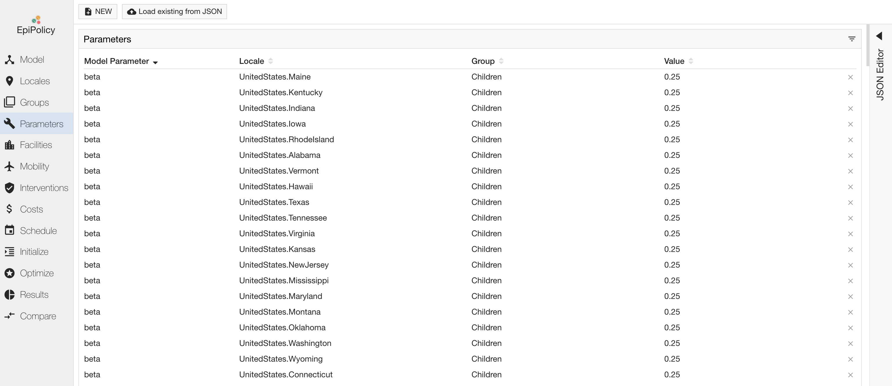
Parameters Definition
One can specify this difference by customizing the relevant parameters in the disease model for each population group.

Slide 14
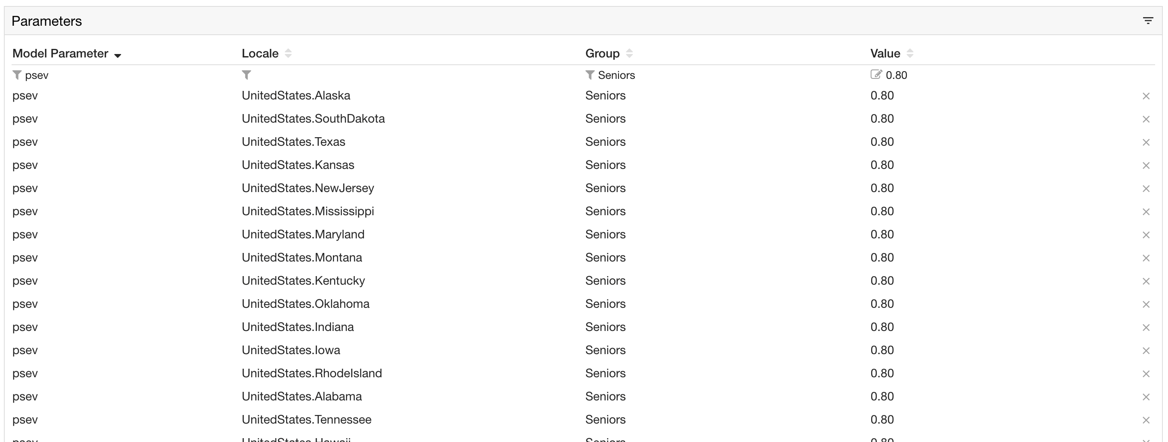
Parameters Definition – Senior Example
For example, you can set a higher probability of getting severe or critical complications
for seniors across the US.

Slide 15
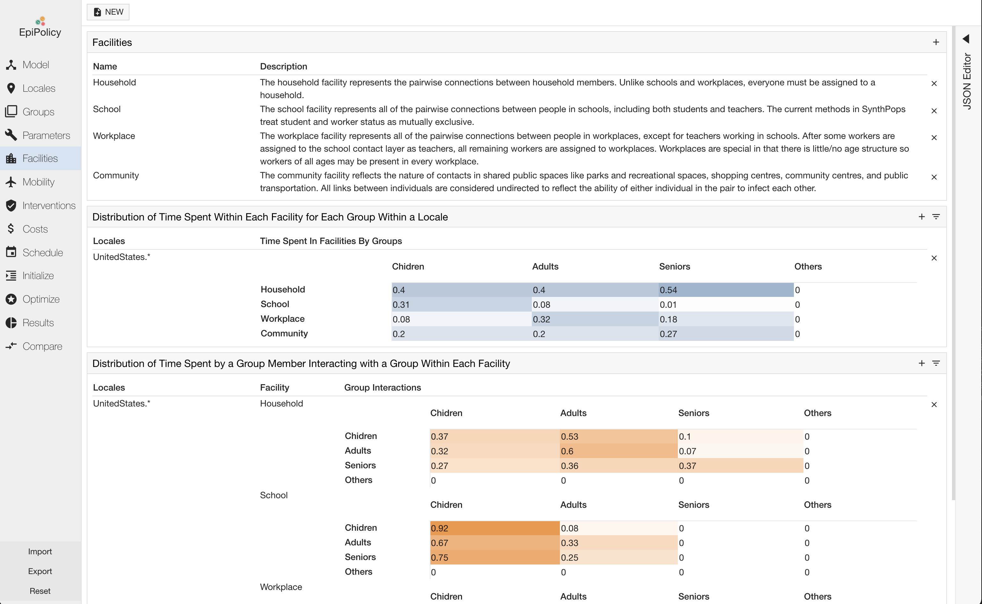
Facilities Definition
Within each locale, children, adults, and seniors will travel to different facilities for their daily activities.
You can provide the name and description of each facility.

Slide 16
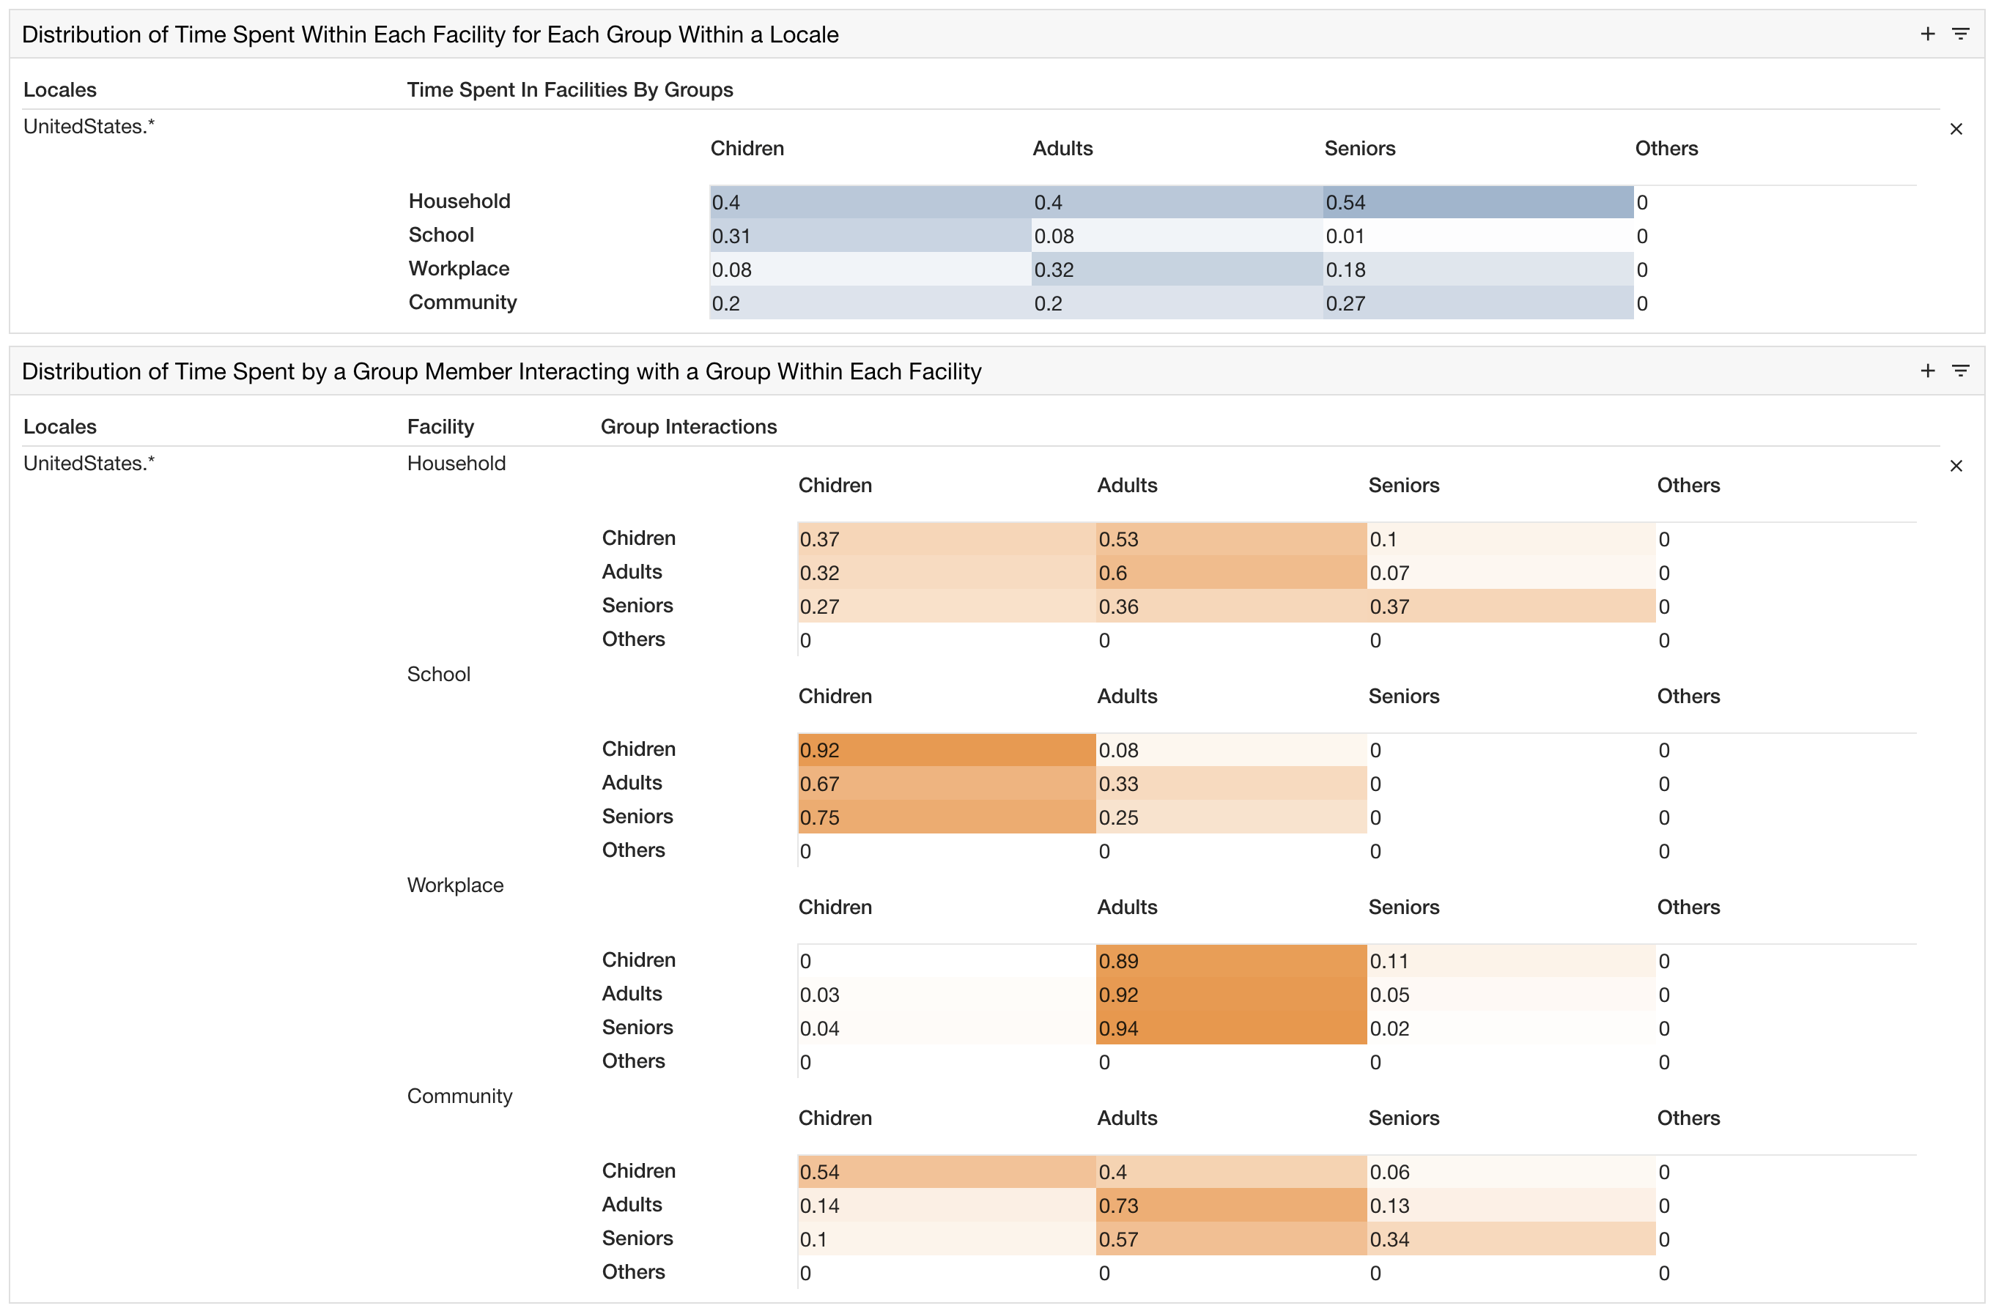
Facilities Definition - SynthPop
For convenience, EpiPolicy can automatically define the properties for four facilities:
Households, Schools, Workplace, and Community.

Slide 17
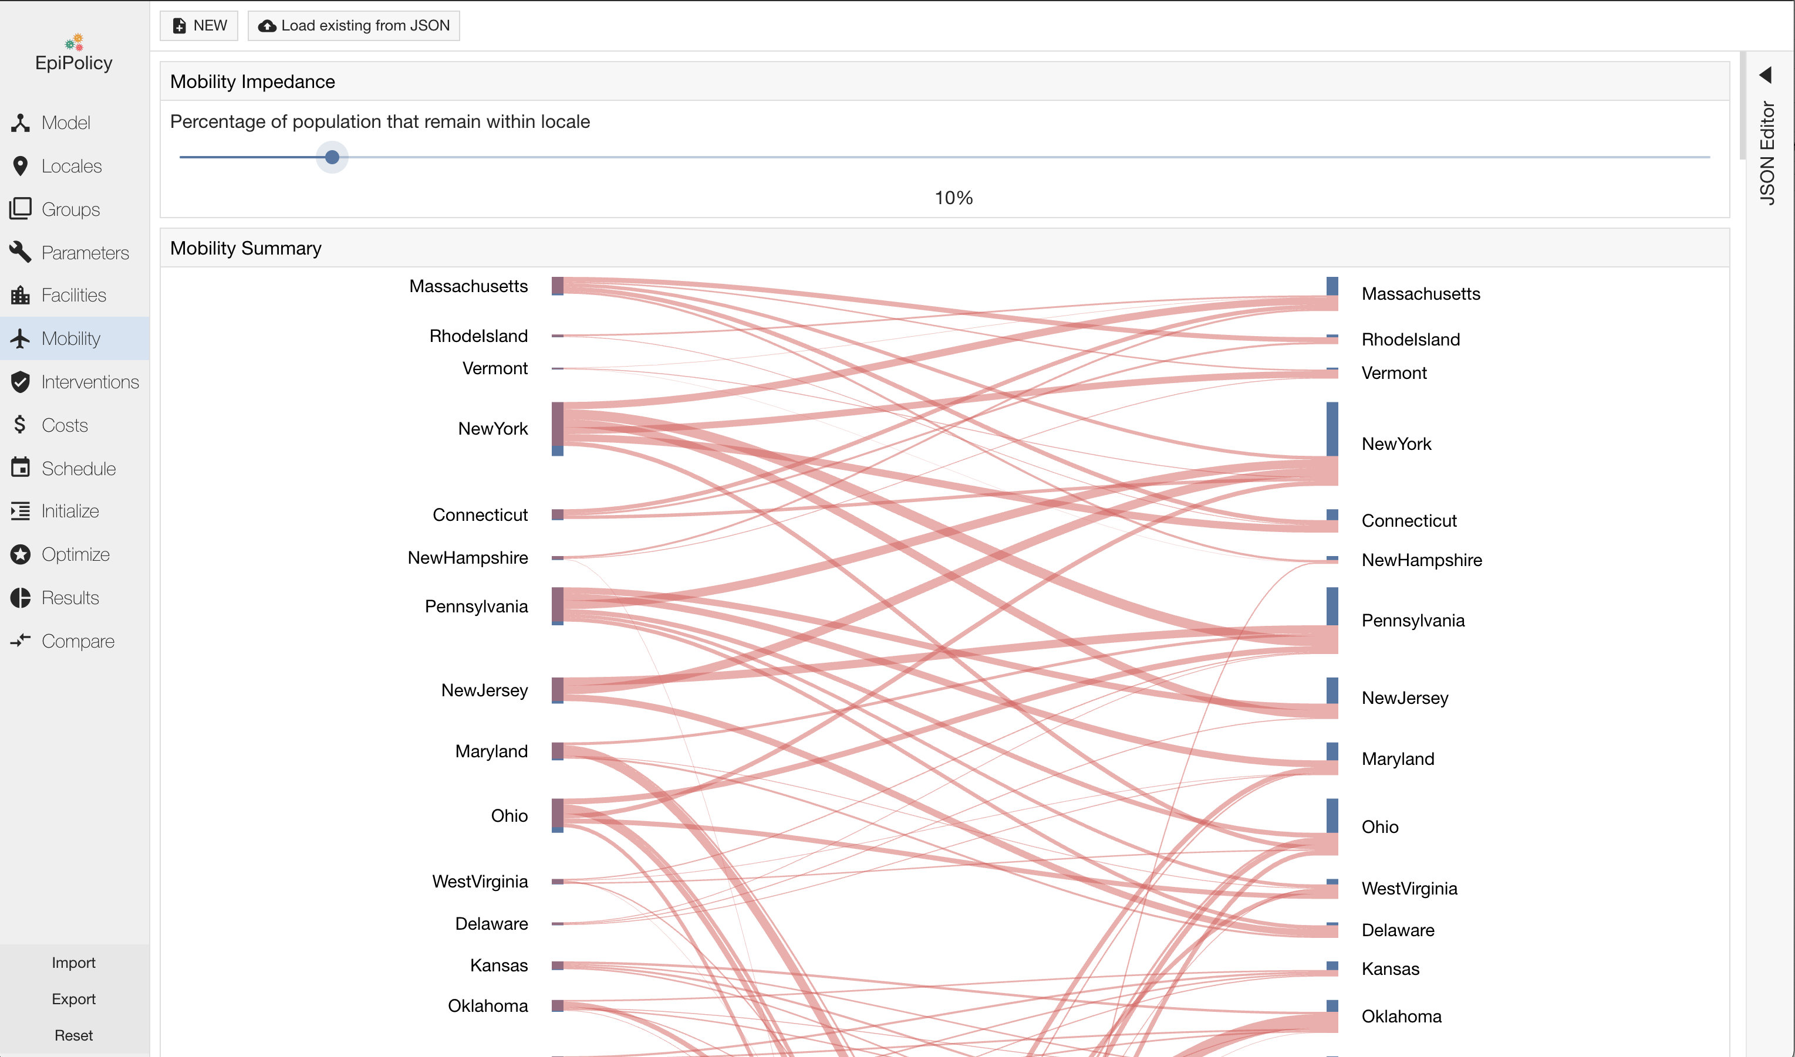
Mobility Definition
Using standard algorithms such as impedance or radiation, you can describe the movement of individuals across borders between neighboring locales.

Slide 18
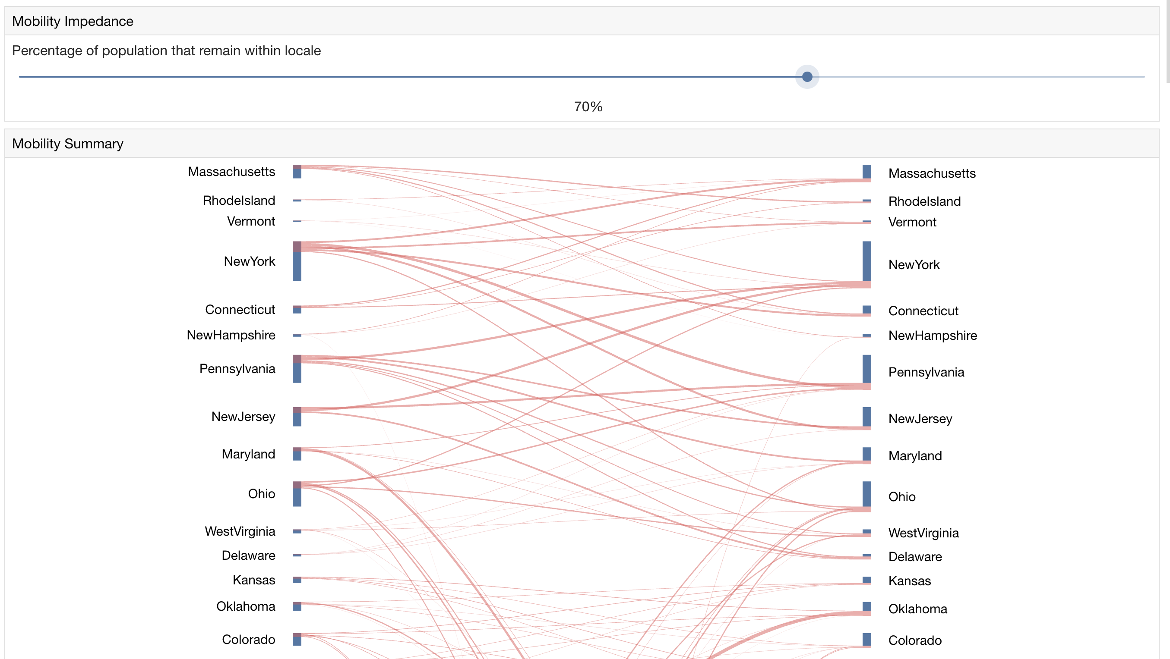
Mobility Definition – travelers proportion
You can globally modify the proportion of your population that are travelers.
For example, here 70% of the population does not travel across borders.

Slide 19
EpiPolicy Interventions
Schedule and simulate the effect of different plans
Find an optimal plan of interventions
Specify different interventions
Examples
Social distancing
School and workplace closures
Border mobility restrictions
We will show how a policy maker can specify the US’s 2020-2021 Intervention plan
Monte Carlo Tree Search
Generate millions of possible intervention plans
Find one that minimizes overall disease burden
Exploring the effects of
Reducing mask wearing compliance
Vaccine (Pfizer, Moderna, J&J)

Slide 20
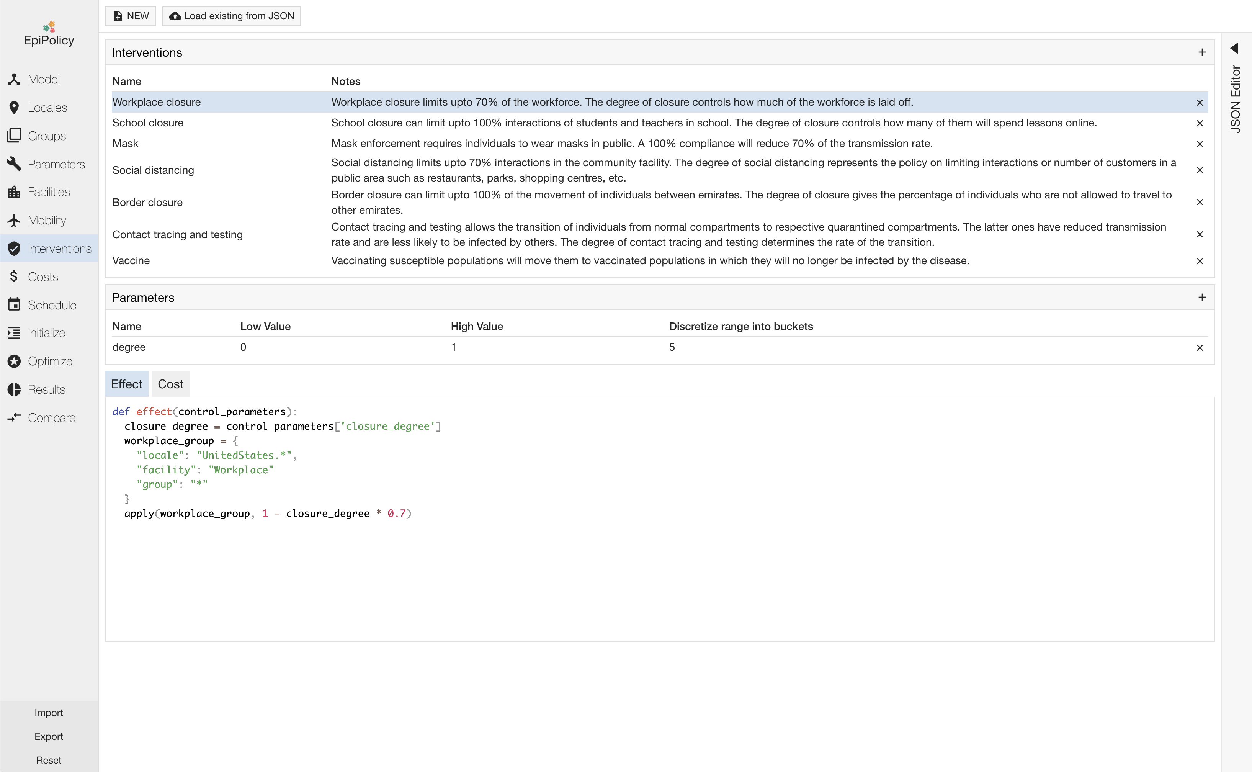
Interventions
In EpiPolicy, interventions are specified as python functions: effect and cost.

Slide 21
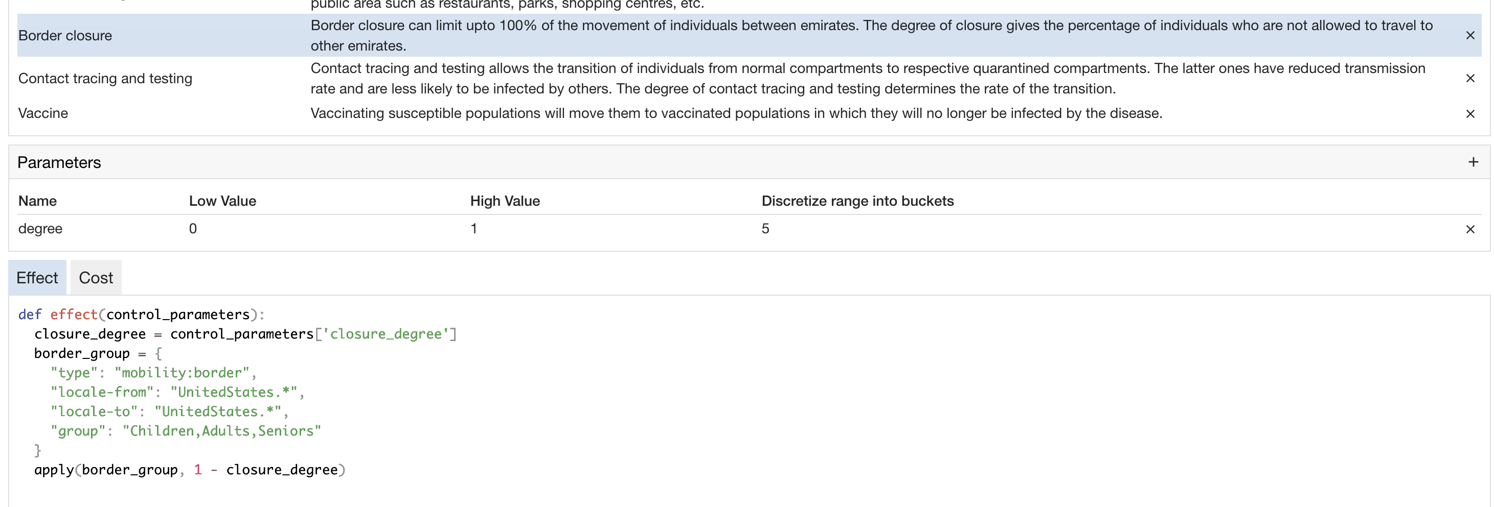
Interventions - effect
The effect method is called at every time step of the simulation. In this method, users specify how the intervention will modify parameters that control disease spread or population dynamics such as the degree of interaction between individuals.

Slide 22
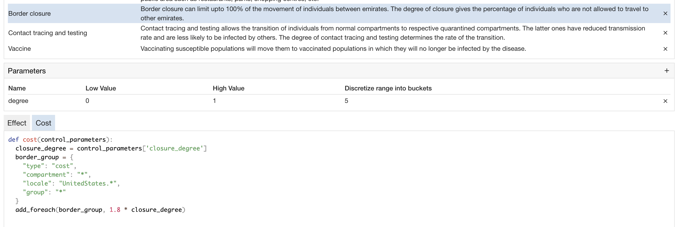
Interventions - cost
The cost method that is also called at every time step. In this method, users specify how much applying the intervention costs at each time step.

Slide 23
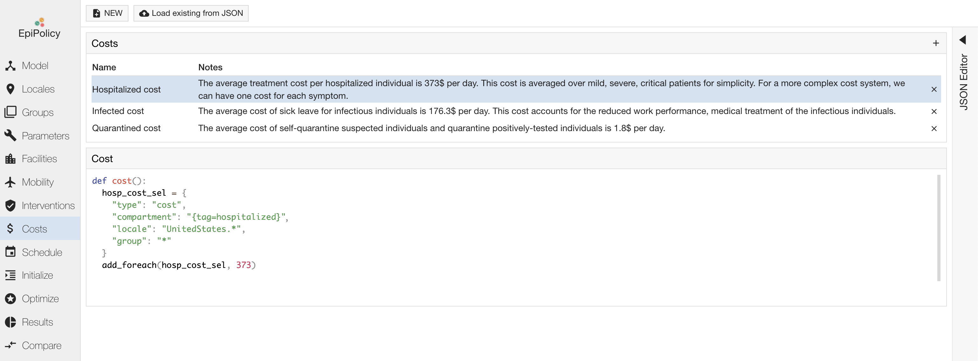
Costs
In EpiPolicy, you can specify running costs independently of any intervention with the help of the costs class.
You define them as a simple method cost() which is applied at every time step of a simulation.

Slide 24
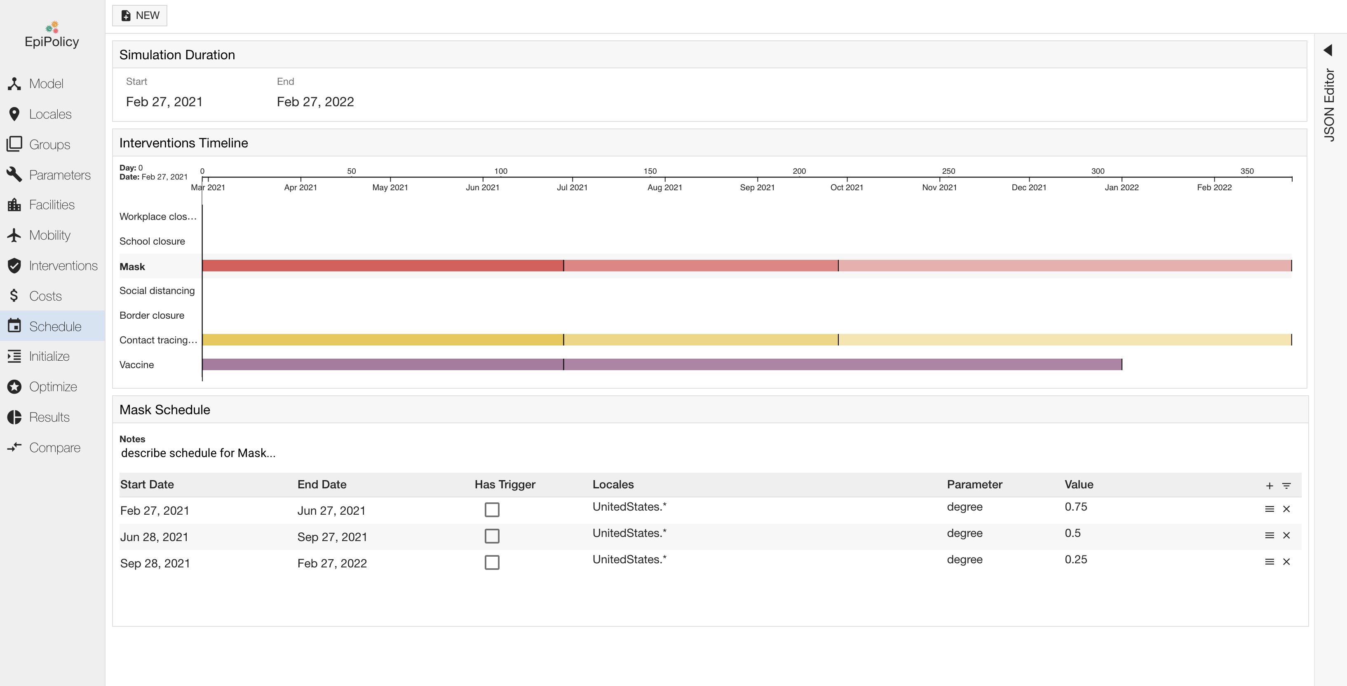
Schedule
In EpiPolicy, you can schedule a intervention plan. In this case are considered workplace, school and border closure, with also social distancing, vaccines and mask.

Slide 25
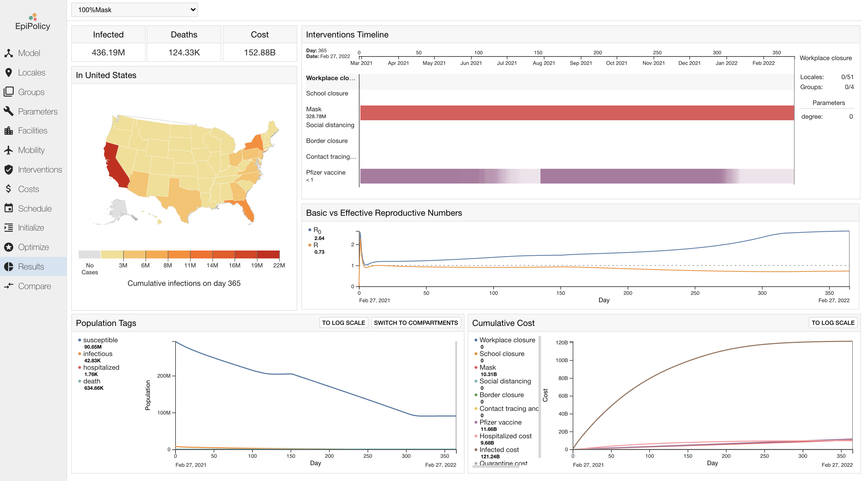
Results
You can see the overall effect of a plan in the results page, which provides an overview of the number of deaths and infections, the economic costs, and other metrics such as the effective viral reproduction number.

Slide 26
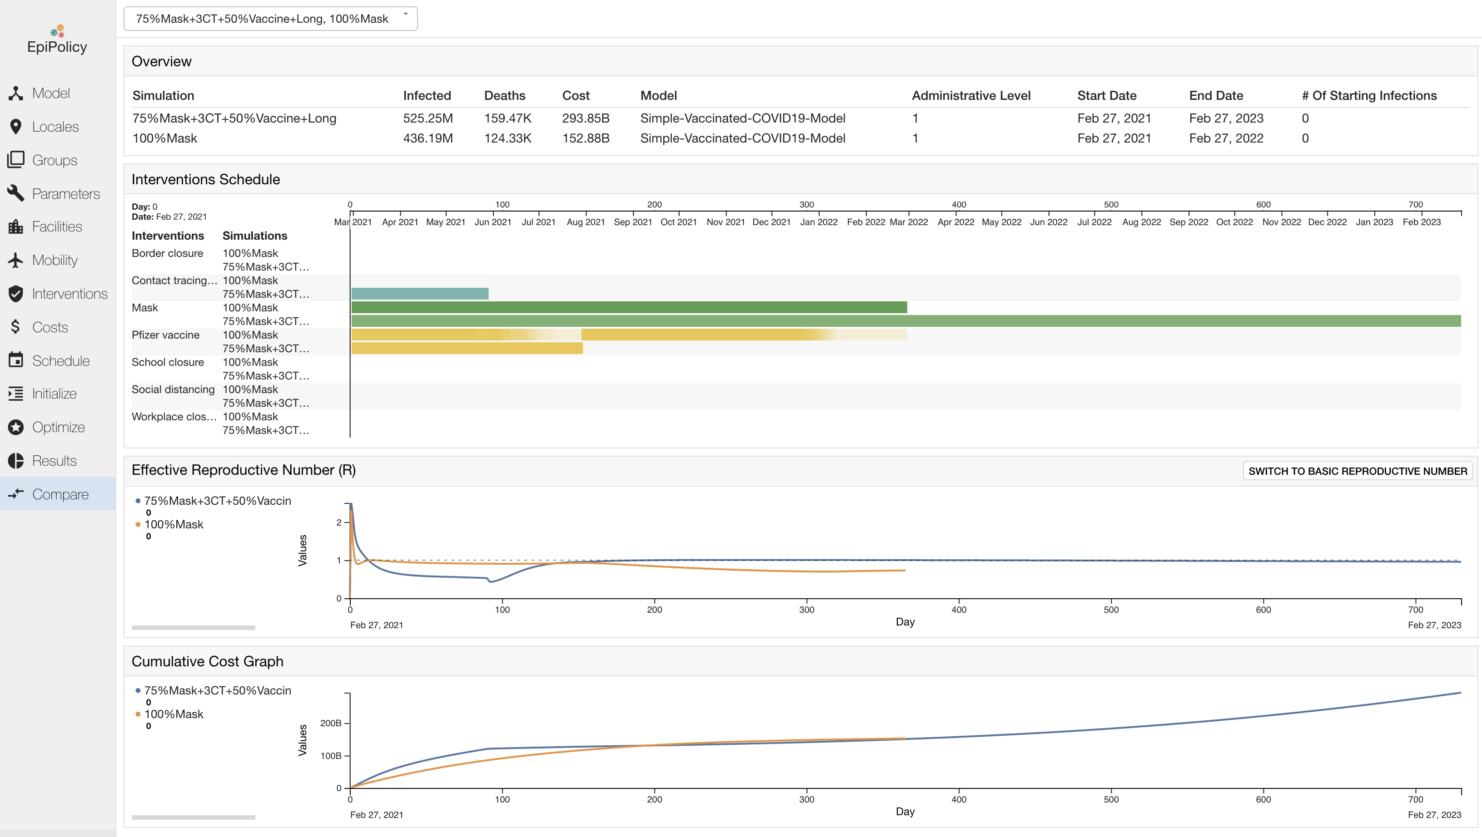
Policy optimization
With EpiPolicy it is easy to determine the best intervention plan.

Slide 27
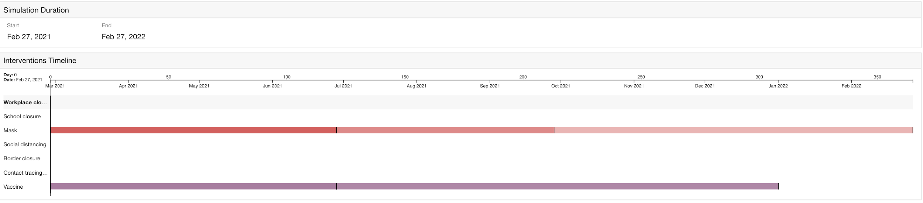
Exploring possible future US scenarios
We consider the WHAT-IF scenarios in the US in conjunction with 3 important interventions:
Mask
Contact tracing and testing
Vaccination
Our base scenario:

Slide 28
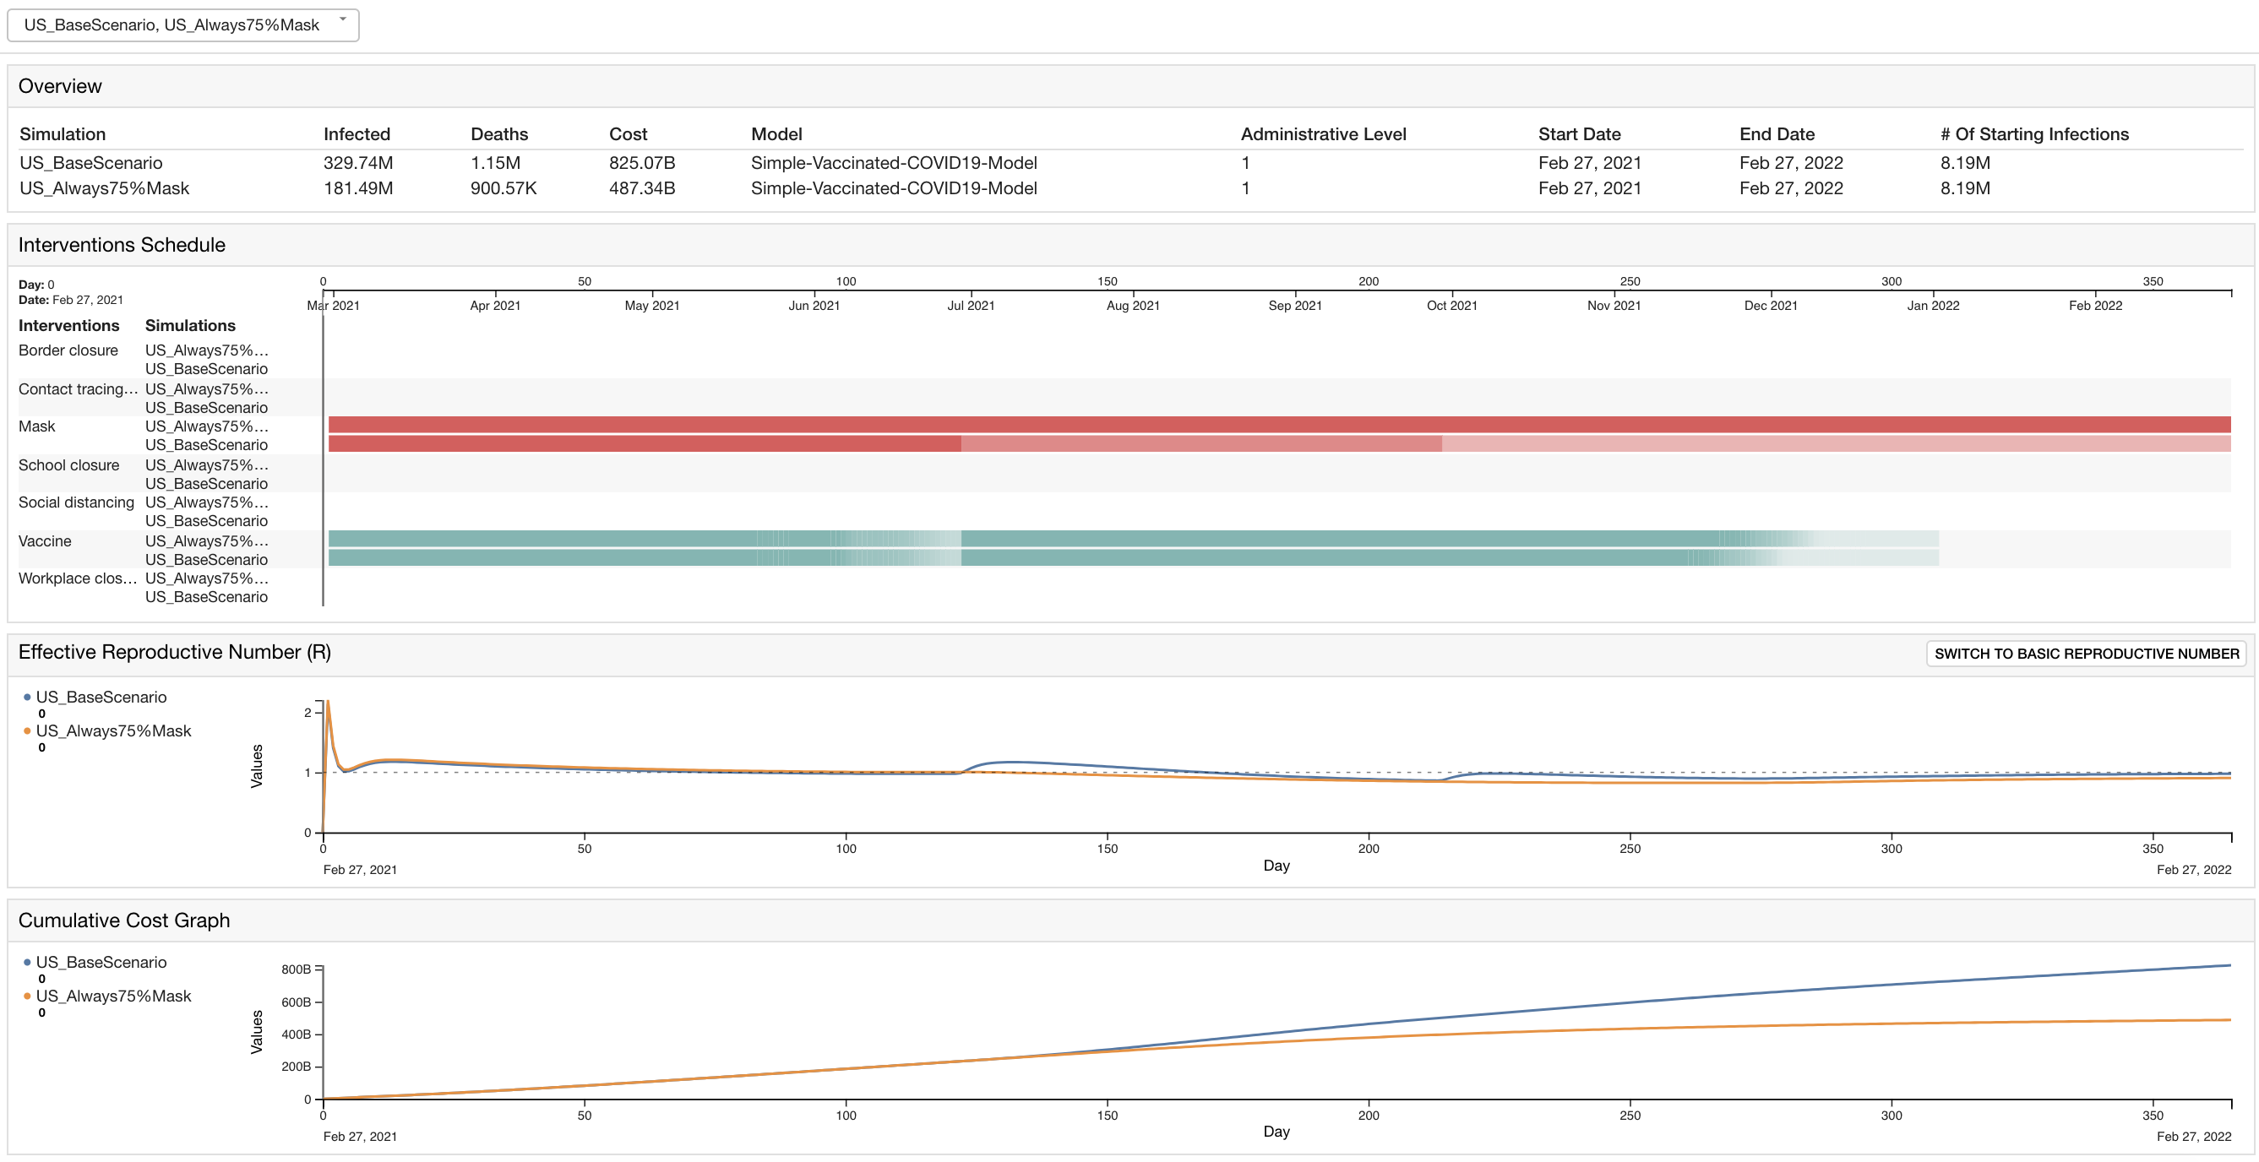
Importance of mask
What if people still maintain 75% mask compliance even after the vaccination program?

Slide 29
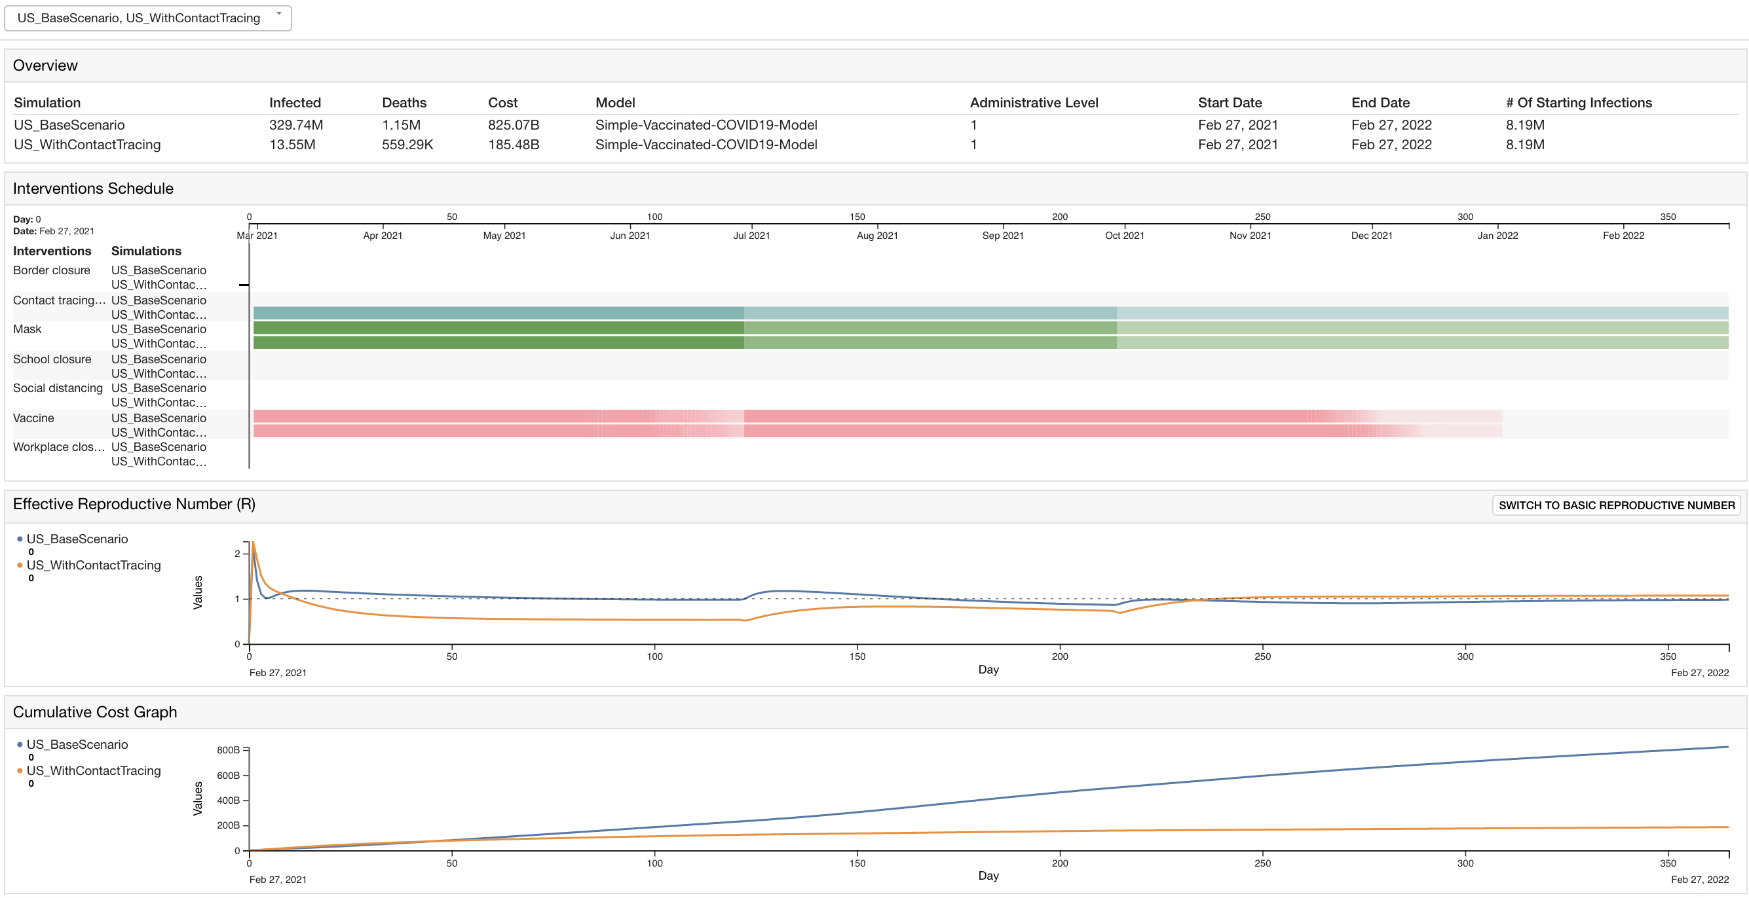
Importance of contact tracing and testing
What if we have a contact tracing and testing regime that is relaxed after each reduction in mask compliance?

Slide 30
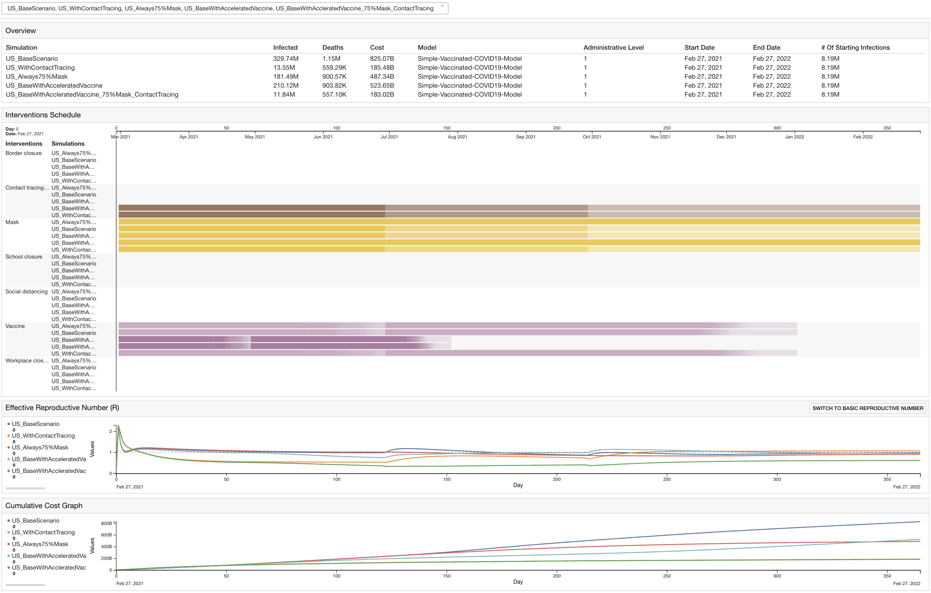
Five plausible scenarios

Slide 31
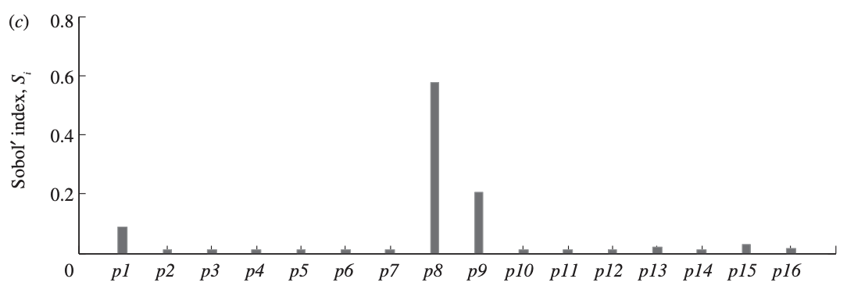
Future features
Automatic sensitivity analysis:
  Given: Parameter values and ranges, outputs of interest for the sensitivity analyses
  Results: Sensitivity of the outputs of interest to changes in parameters (measured by Morris index, PRCC index, Sobol index)

Slide 32


Slide 33
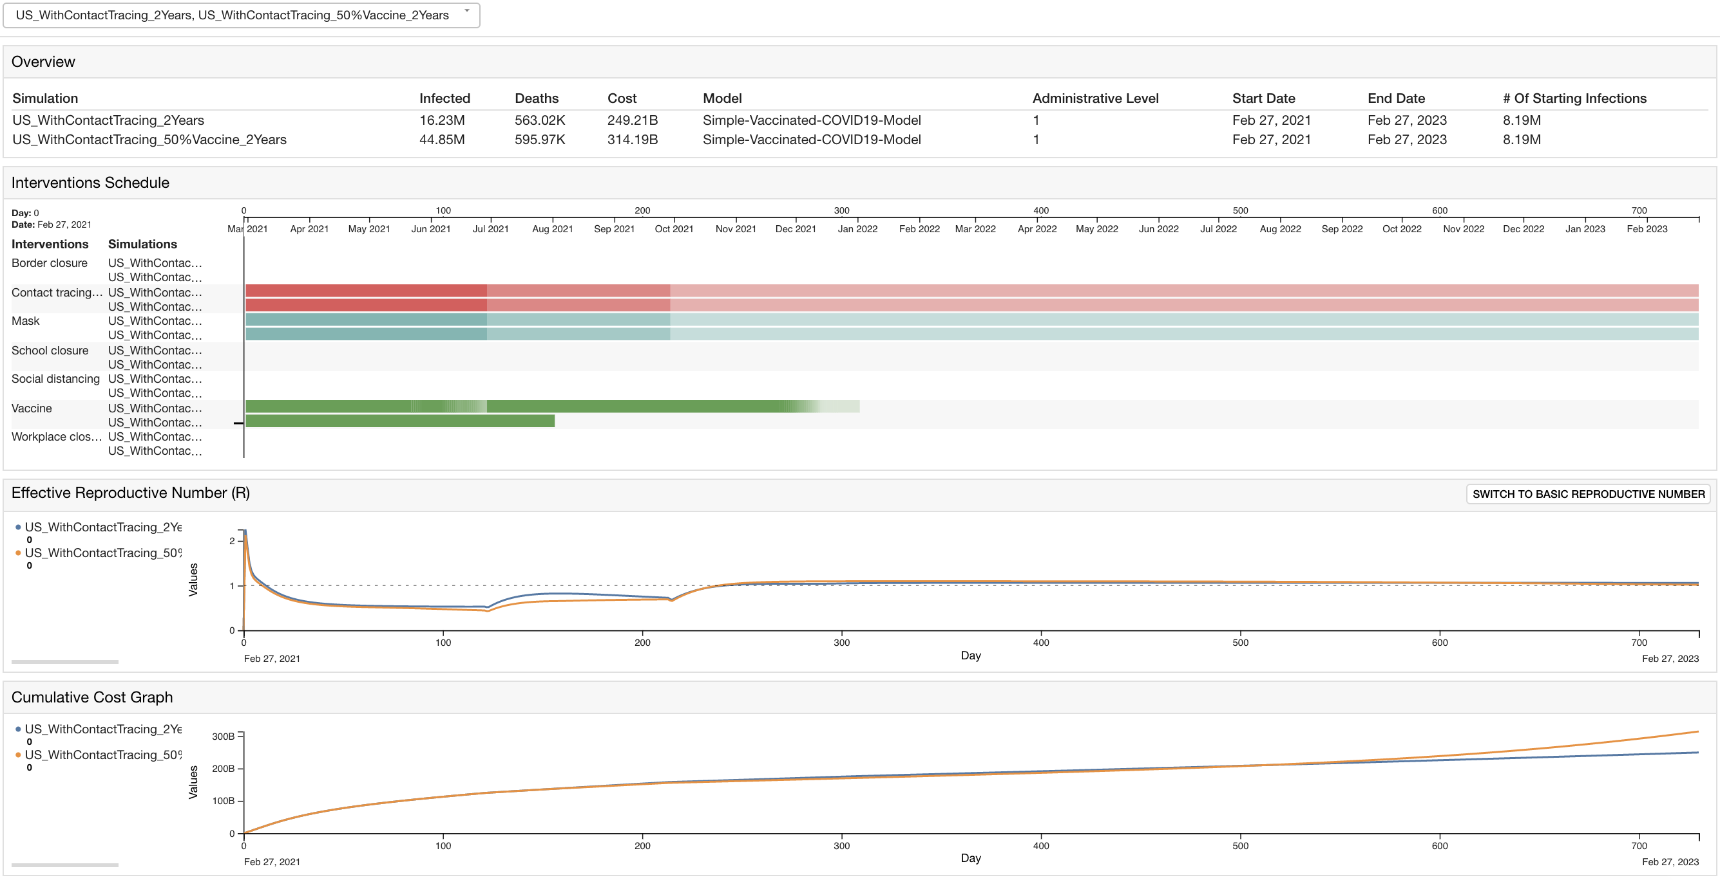
Importance of vaccination
What if there are only 50% of the eligible population want to get vaccinated?

Slide 34
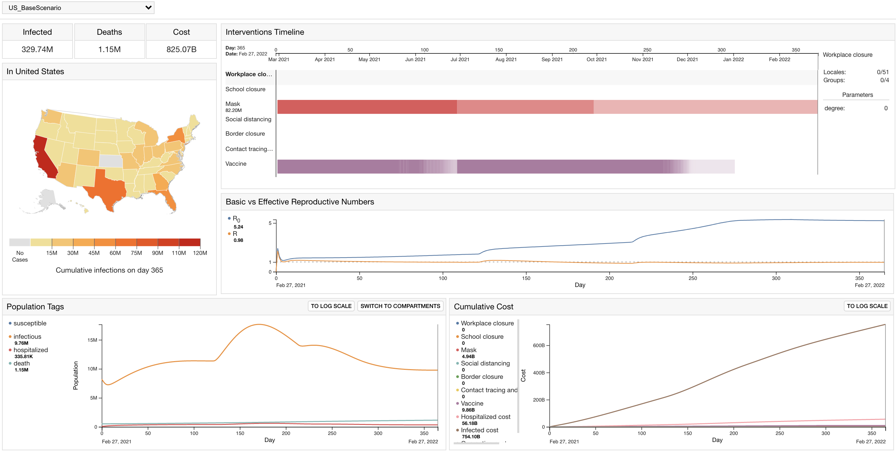
Appendix: US Base Scenario

Slide 35
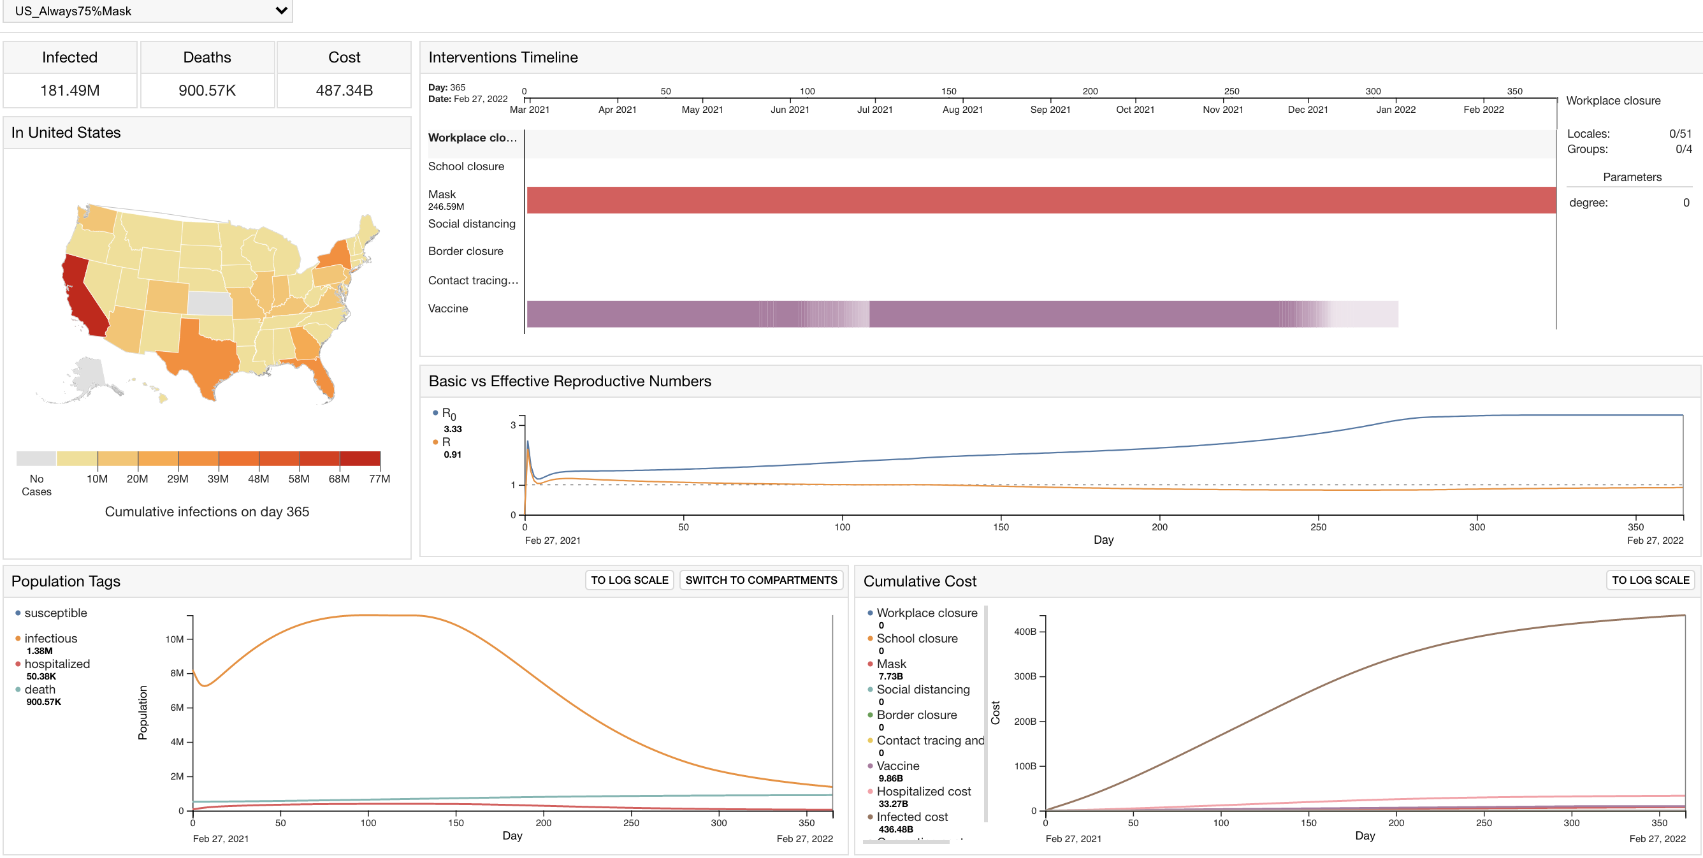
Appendix: US – Always 75% Mask

Slide 36
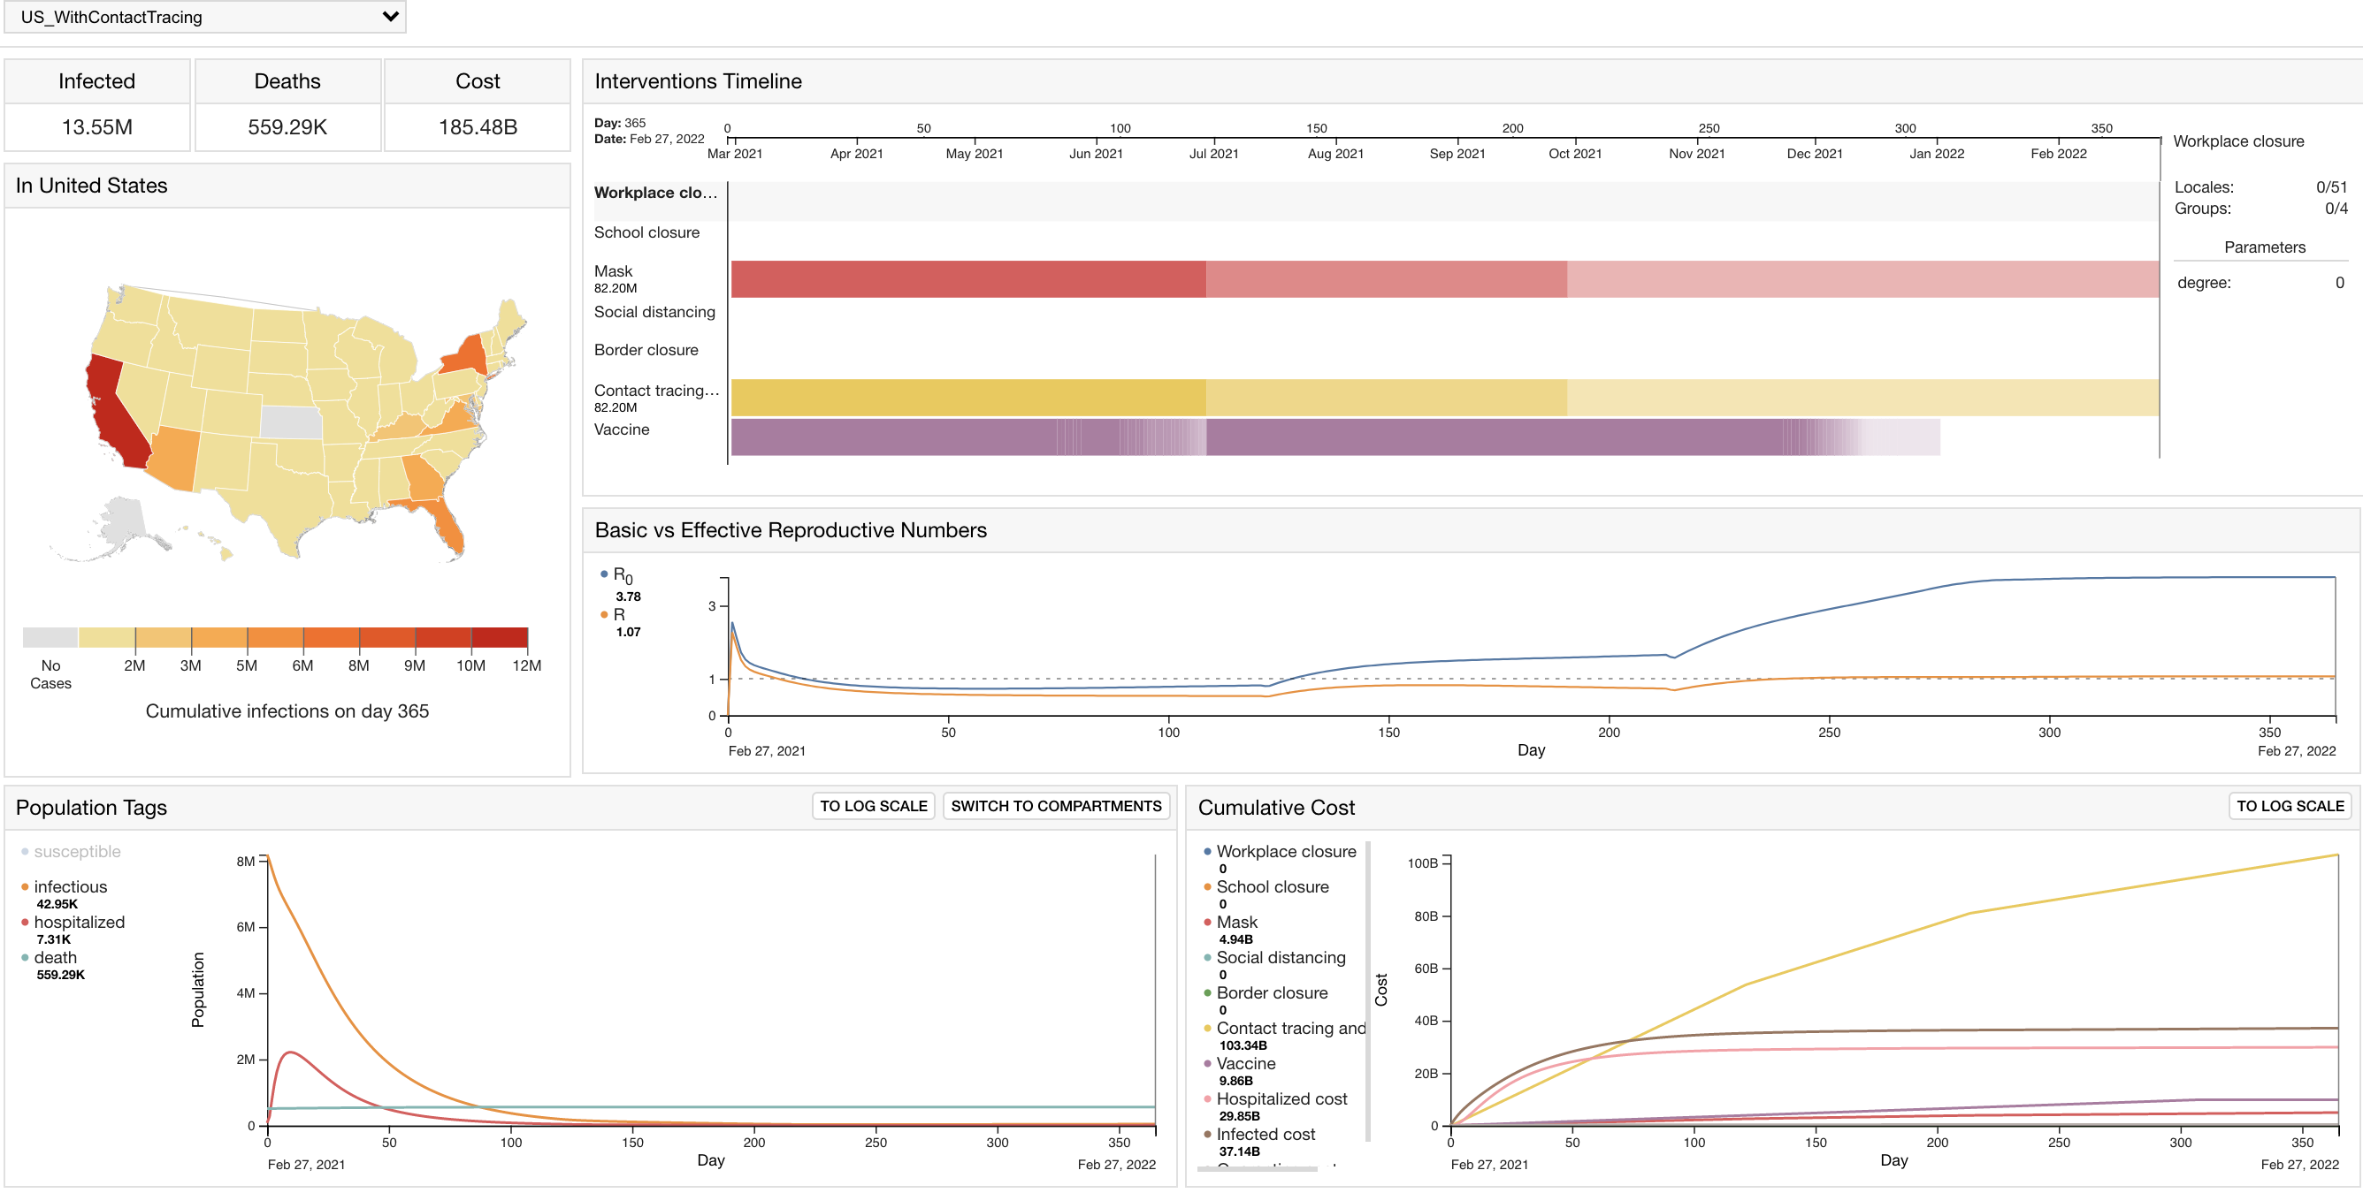
Appendix: US – With contact tracing and testing

Slide 37
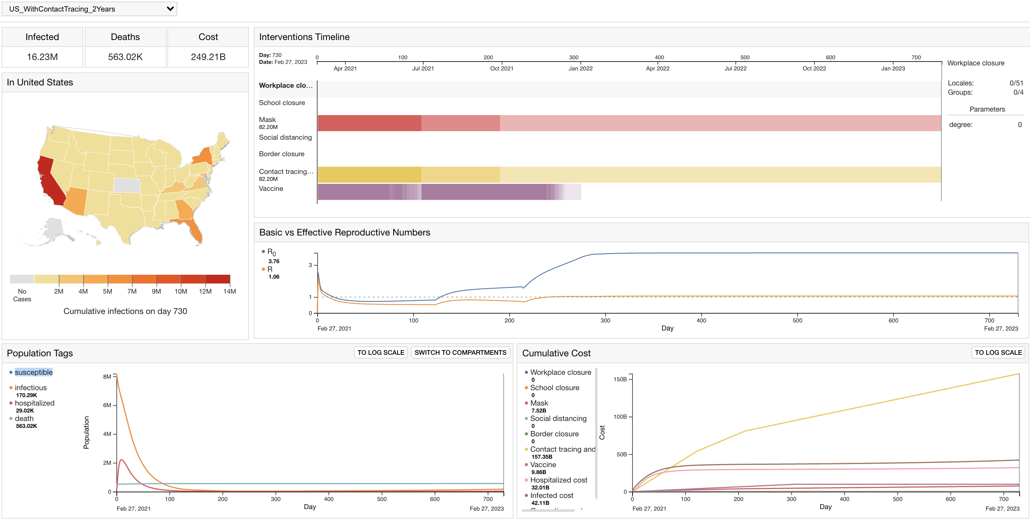
Appendix: US – 100% Vaccination for 2 years

Slide 38
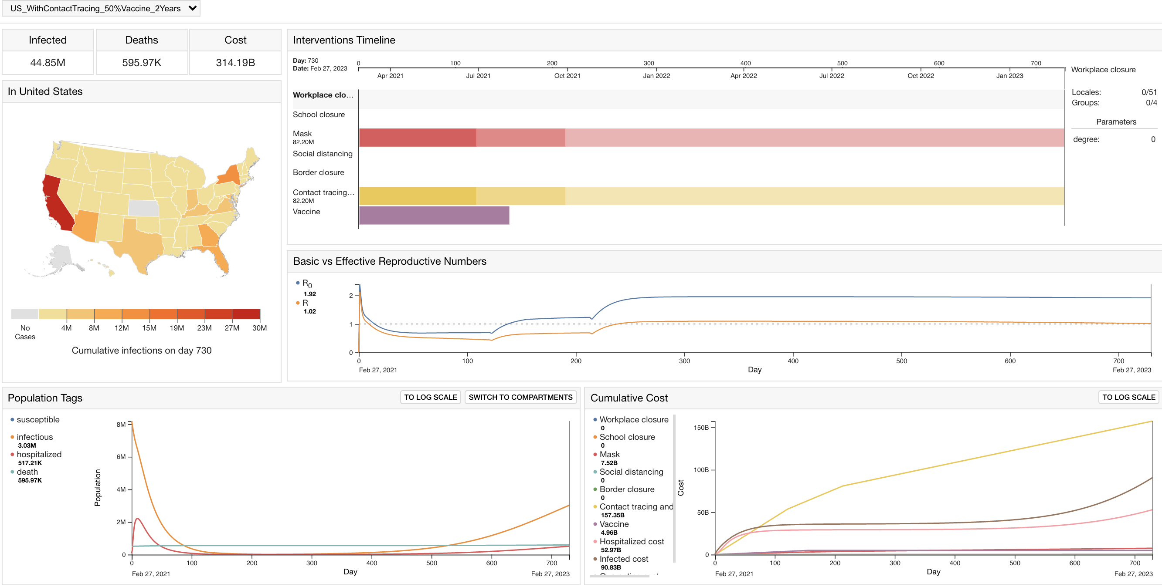
Appendix: US – 50% Vaccination for 2 years

Slide 39
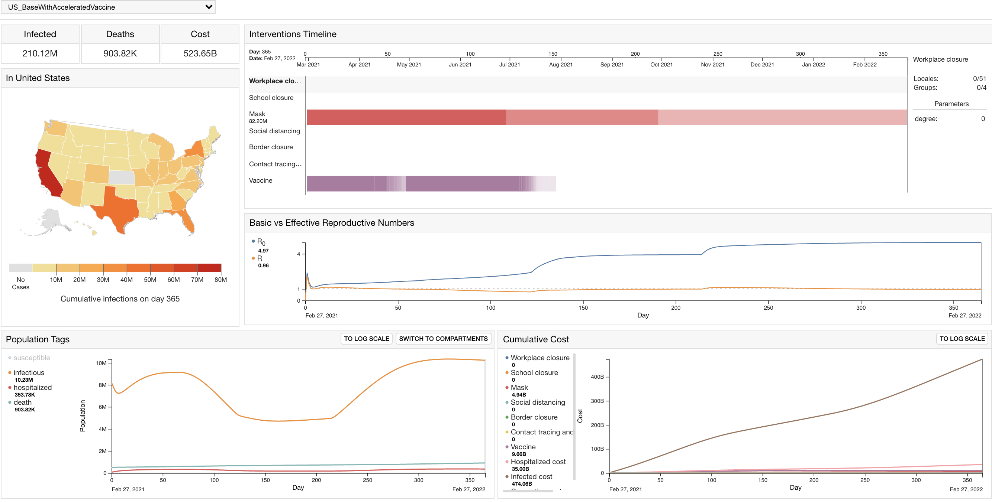
Appendix: US – With accelerated vaccination

Slide 40
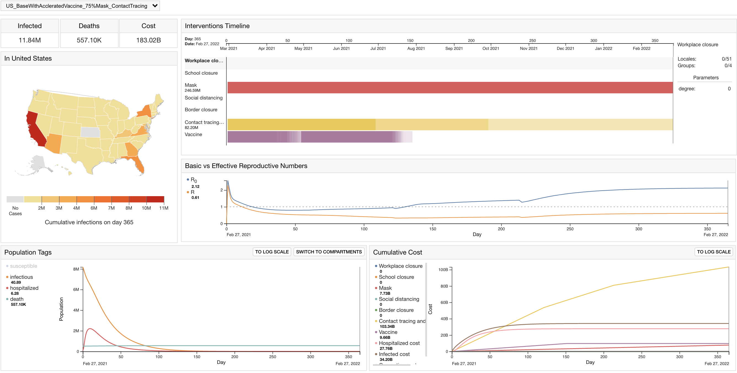
Appendix: US – With accelerated vaccination, 75% Mask and Contact tracing

