Slide 1

Where We are
Statistics is Easy discusses non-parametric statistical methods on many different statistical metrics (means, correlations, etc.)
For example:
Shuffling labels for hypothesis testing
Bootstrapping for confidence intervals

Slide 2

The Case Studies book
Workflow of most dataset analyses.
Chicken Weight (straight statistics to determine best weights)
Breast cancer (use cell shape to diagnose normal vs. cancerous cells)
Cystic Fibrosis RNA-seq (find genetic markers for disease)
Neural Network approaches (interpret radiological images for diagnosis)

Slide 3
Workflow
Data preparation (format the data, normalize if necessary, and handle missing data)
Analysis (could be simple measurement or machine learning)
Statistical evaluation:
  Figure of merit (e.g. accuracy, f1-score, root mean squared error)
  Paired vs. unpaired test
  Correction for multiple testing.
Find important features

Slide 4
Data Preparation: normalization
Normalizing the data is most useful when different features give vastly different values, e.g. weights, ages, salaries. Typical normalization is z-score: (value – mean of values)/(standard deviation).
Normalization is not usually necessary for tree based machine learning methods or neural nets, but turns out to be useful for Support Vector Machines.

Slide 5
Data Preparation: missing values
Throw away records having any missing values (e.g. if a single value in a sequence is missing, throw away the sequence).
Interpolate missing values based on sequence for an individual (e.g. my weight yesterday is probably between my weight two days ago and my weight today). Use with time sequence of values.
Choose the median of all non-missing values (e.g. if I don’t know Bob’s age but he’s a university student, guess his age as median of students’)

Slide 6
Classification Figures of Merit
Often the problem is to classify results into two classes A and B.
Confusion matrix:
True A | True B Accuracy: (AA + BB)/(AA+AB+BA+BB)
Predict A AA | AB Precision for A: AA/(AA+AB)
--------------------------------- Recall for A: AA/(AA + BA)
Predict B BA | BB F1-score: 2*(prec*recall)/(prec+recall)

Slide 7
Which Classification Figure of Merit to Use
If one of these classes (say A) is the primary one of interest, then precision for A says what fraction of the predictions of A are correct.
Recall for A says what fraction of the As are predicted.
F1-score balances the two.
If the two classes are equally interesting, then use accuracy.

Slide 8
Numerical Figures of Merit
If one is predicting a continuous value or set of values, then there are two principal figures of merit:
Absolute error: sum (| predicted – actual|)
Root mean square error: sqrt( sum (predicted – actual)² )

Slide 9
Unpaired vs. Paired Experimental Design
Suppose one is testing diet A on one population and diet B on another population. There is no association between an individual of the first population and an individual of the second one. The weights are unpaired.
By contrast, suppose one is comparing the weights of individuals before a diet and after a diet. Then one can compare the weights per individual. That is, the weights are said to be paired.

Slide 10
Unpaired Test
We have seen these already.
Shuffle the labels for significance.
Bootstrap values for confidence interval.

Slide 11
Paired Test
Individual, beforeweight, afterweight
Bob, 70, 60
Alice, 50, 45
Suppose mean(beforeweight – afterweight) = diff. diff > 0.

Slide 12
Paired Test significance
Count= 0
Do 10,000 times:
With probability 0.5 swap beforeweight and afterweight values of each row.
e.g.
Bob, 70, 60
Alice, 50, 45
If mean(beforeweight – afterweight) >= diff then count+=1
P-val = count/10000

Slide 13
Paired Test confidence
Differencearray = []
Do 10,000 times:
choose random rows with replacement
e.g.
Alice, 50, 45
Alice, 50, 45
differencearray.append(mean( beforeweight-afterweight))
Sort difference array and pick the 500th and 9500th for 90% conf interval.

Slide 14
Application to Biological dataset: Chicken Weight
Chicken Weight - At least 10 different chickens raised with each of four different diets. Weight was measured every other day for up to 21 days.
Which diet was the best? (paired or unpaired?)
Is the difference significant?
What is the confidence interval of the difference?
Is quadratic regression significantly better than linear regression in characterizing weight gain?

Slide 15
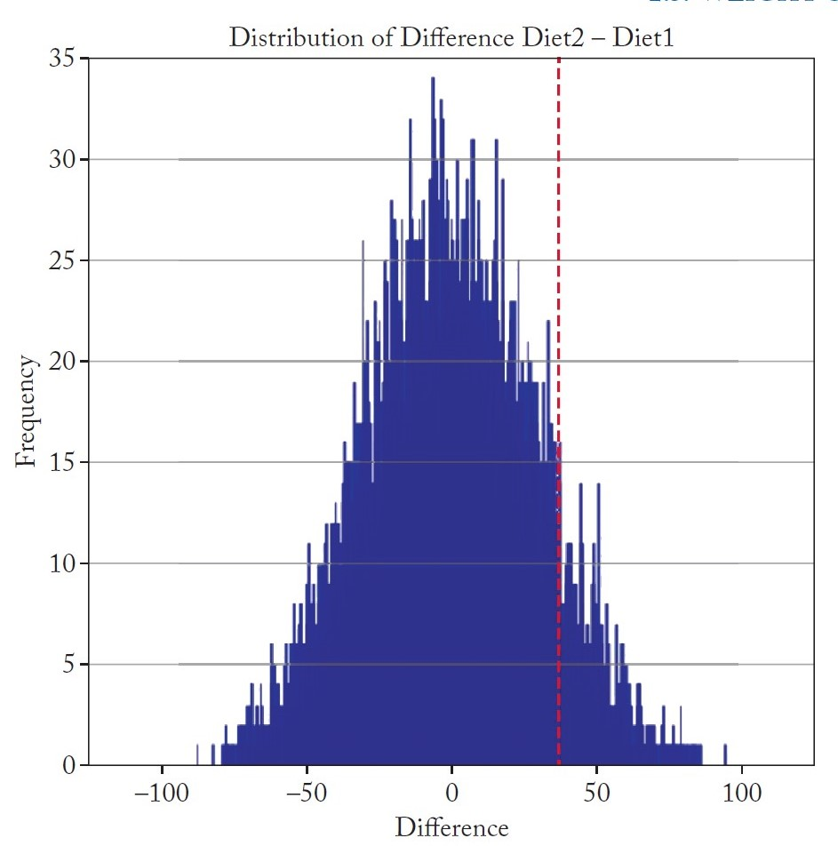
Pairwise Shuffle test
10,000 times, shuffle the labels of the two diets being compared, effectively disassociating the weight from diet.
Calculate their difference
Count the number of times the difference was greater than the one observed with unshuffled diet (red)
P-value is the number divided by 10,000

Slide 16
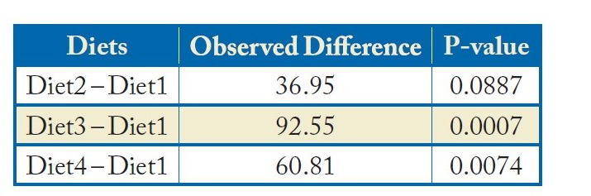
Pairwise Shuffle test p-value
10,000 times, shuffle the labels of two diets being compared.
Calculate their difference
Count the number of times the difference was greater than the one observed
P-value is the number divided by 10,000
P-value high (not significant) for diet2 vs. diet 1, but significant for diet3 and diet4 vs. diet 1.

Slide 17
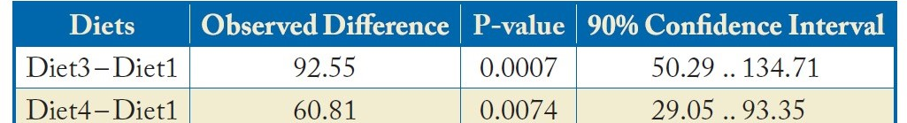
Confidence interval
Repeat 10,000 times:
W1 are the weight measurements of chick on Diet 1 and W3 is of chick on Diet 3.
Select the same number of data points as are present in W1, from W1, randomly and with replacement. Do the same for W3.
Calculate the difference between the means of W1 and W3.
The value in the 500th and 9500th position mark the 90% confidence interval of the difference.

Slide 18
Comparing regression lines
A higher order polynomial regression line will always have a smaller error than a lower order regression line. However, to avoid over-fitting, one should use a higher order regression only IF it is significantly better than the simpler one..
Instead of measuring the difference of the means, we calculate difference of the error, We look for a statistically significant reduction in error. The approach to calculating the confidence interval is to use bootstrapping with error instead of weight.

Slide 19
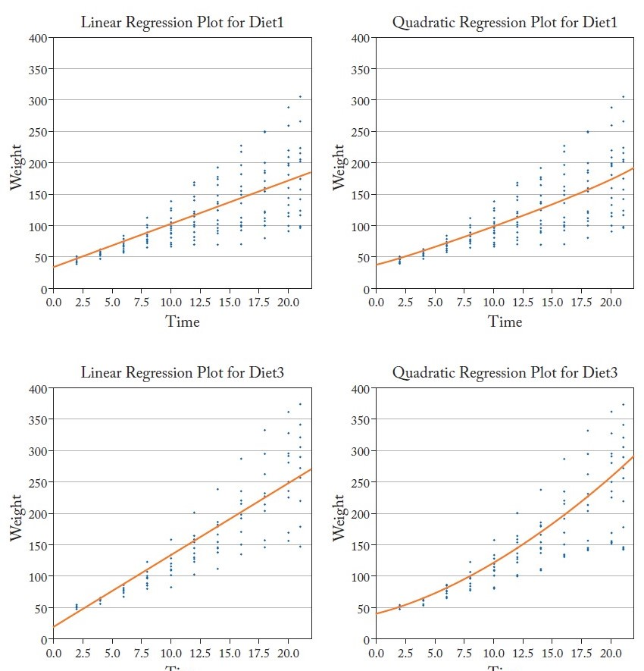
Comparing
regression lines

Slide 20
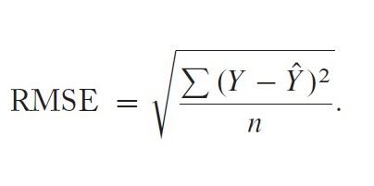
Root Mean Square Error
Y is the actual value
Y hat is the predicted value
n is the number of points

Slide 21
Pseudo code for determining paired significant difference
For a given diet, create a table with 4 columns:
Chick id, time, linear regression error, quadratic regression error
Calculate the difference between RMSE of linear regression and quadratic regression.
10,000 times do the following:
  For every row, with 50% probability, swap the values.
  Recalculate the difference between RMSEs
  If >= observed difference add one to a counter
  Pval = counter/10000

Slide 22
Pseudo code for determining paired confidence interval
For a given diet, create a table with 4 columns:
Chick id, time, linear regression error, quadratic regression error
To calculate the difference between RMSE of linear regression and quadratic regression.
10,000 times do the following:
  Bootstrap ( randomly select with replacement the rows) and recalculate the difference in RMSE

Slide 23
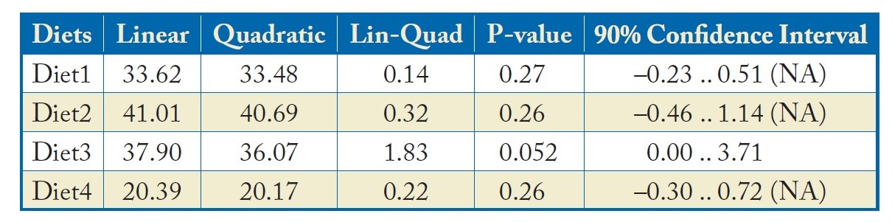
Comparing regression lines: only diet 3 has a low enough p-value for confidence interval to be meaningful

Slide 24
Application to Biological dataset: Breast Cancer
Breast cancer - Features of 3D images of biopsy samples.
Predict whether a sample is Benign or Malignant
Dealing with missing data
Feature selection
Important features

Slide 25
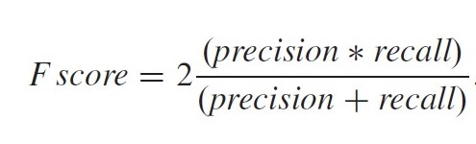
The F1-score (or simply F-score): based on precision for Malignancy and Recall for Malignancy

Slide 26
The Data
Features are cell characteristics of ten cells taken from each patient:
(ten values of) radius, texture, smoothness, fractal dimension, ….
Inputs to machine learning model are:
Mean values of radius, texture, …
Standard deviation of radius, texture, …
Target: benign or malignant

Slide 27
Reminder: Ideal Machine Learning workflow
Sequester a random percentage of your data for testing before you do ANYTHING.
This includes any normalization or imputing missing values.
Don’t worry about class imbalance. Your test set should represent scenarios you will naturally observe.
2) Use cross validation on the training data (the nonsequestered part) to fine tune your hyper-parameters.
3) Publish your model’s performance on the sequestered test data.

Slide 28
What not to do: Pollute the Test Set During Hyperparameter Tuning
A common mistake is to tune hyperparameters (e.g. the machine learning method and fitting parameters of those methods) on the entire dataset, but create the model on the training set.
The results that researchers report is the summary of the optimized model.
But this is deceptive. The hyperparameters are trained on the test data, so overstate the predictive power. “Polluting the test set”

Slide 29
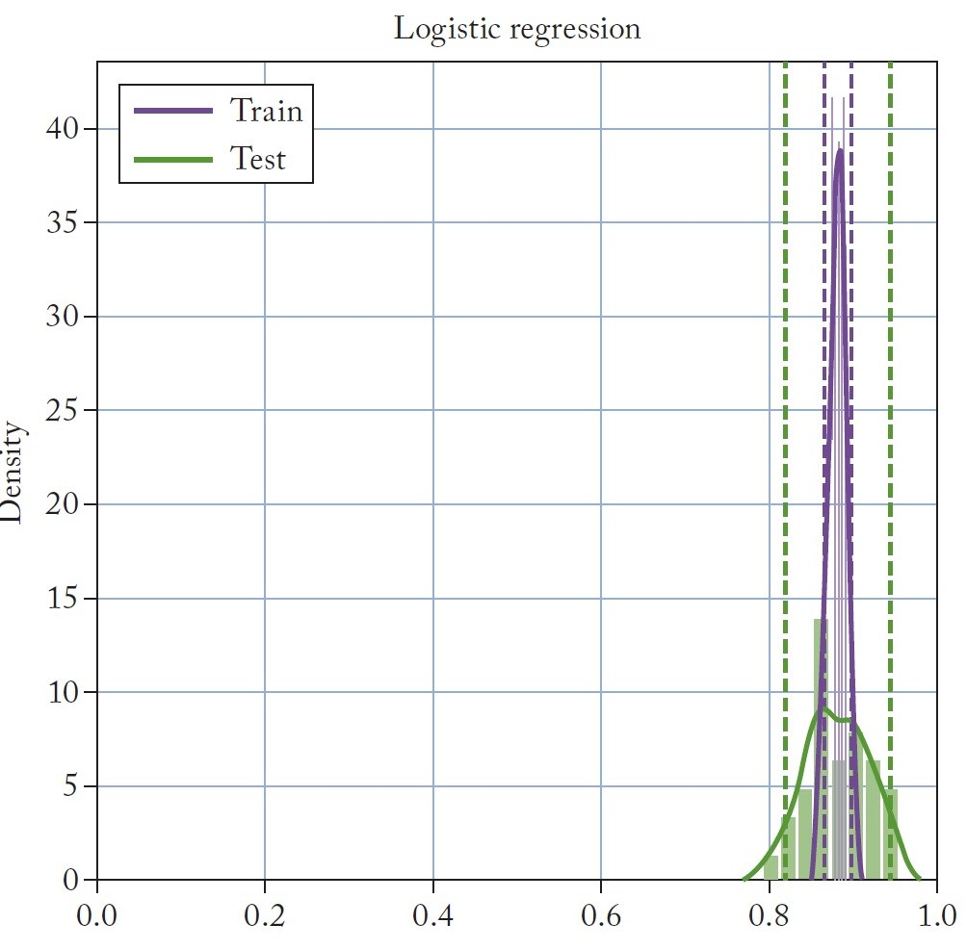
Alternative: cross-validation approach without hyperparameter tuning
Instead of splitting the data into specific portions, randomly select perform 80/20 split 100 times. You will cover all points and get a distribution of metrics (here, f-scores).

Slide 30
Show figures from book for each method p. 26ff or..
Logistic regression
(https://en.wikipedia.org/wiki/Logistic_regression)
Decision tree (https://www.geeksforgeeks.org/decision-tree-introduction-example/ dynamic decision trees:
https://ethan-delgado.github.io/DynamicDecisionTree.github.io/templates/index.html)
Random forest
Support Vector Machines (https://en.wikipedia.org/wiki/Support_vector_machine)

Slide 31
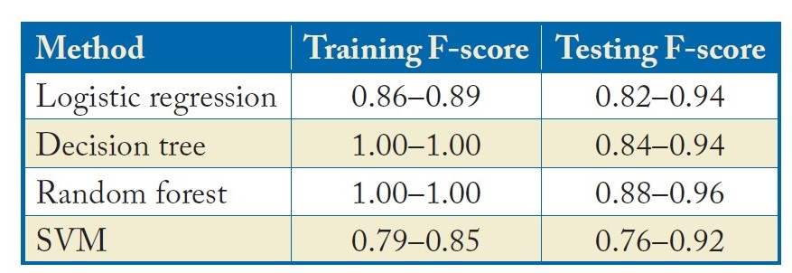
Difference between Training and Testing F-score
Training score and Testing score should be very close. If your training score is significantly higher than testing score, than you most likely are overfitting.

Slide 32
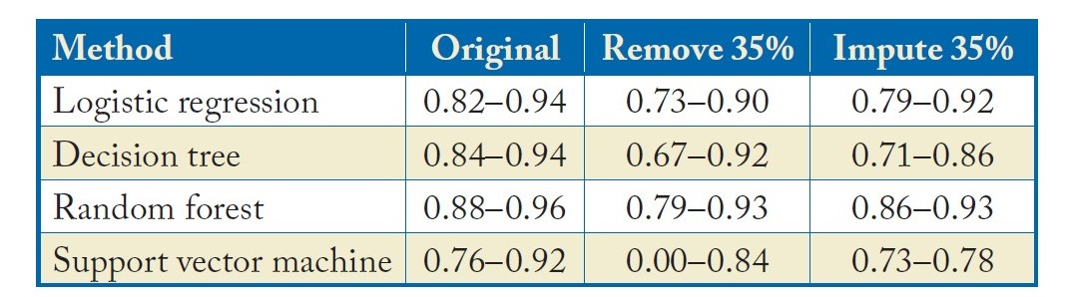
Dealing with missing data
Remove any rows that have missing data
Impute by replacing nulls by the median value for the feature.

Slide 33
What to Notice About Previous Table
Random forests give the best results and are most robust to missing data.
All methods do better when imputing missing data than when removing cells that contain missing data.

Slide 34
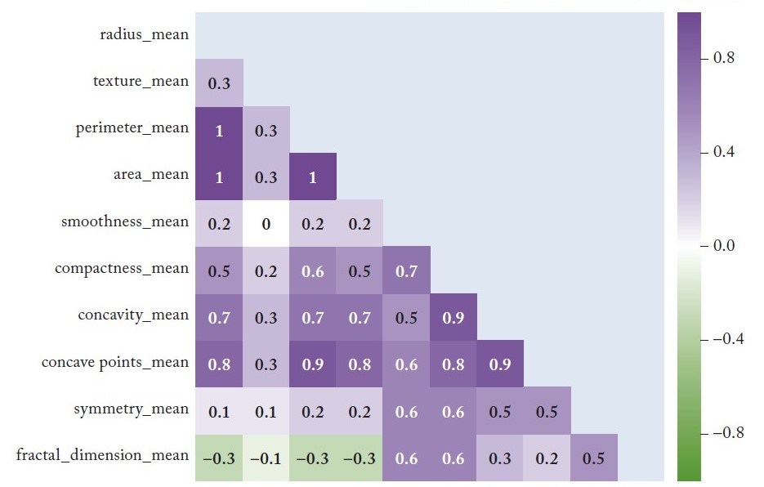
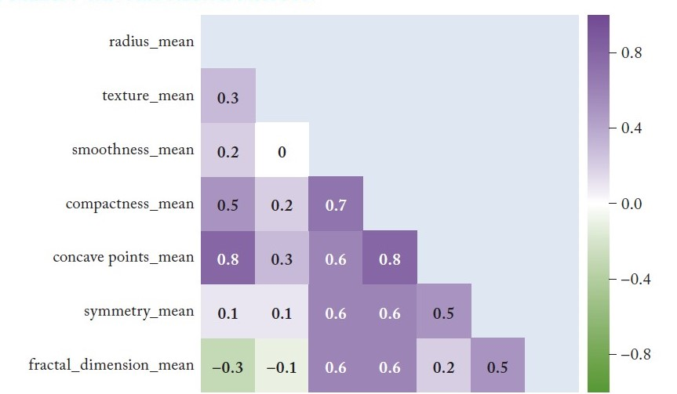
Feature Selection
How important is it to remove redundant features? (correlation heatmap)

Slide 35
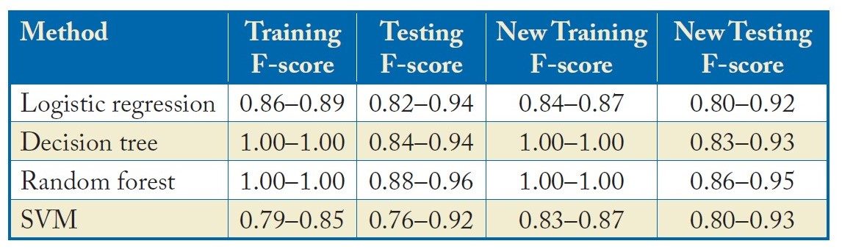
SVM (support vector machine) benefits from feature reduction

Slide 36
RNA-seq example: Cystic Fibrosis
20 healthy control
20 with cystic fibrosis
20 with cystic fibrosis after medication
Workflow
Normalize using cpm (count per million) giving relative proportions of genes
Remove genes having low normalized counts (low expression)
Use shuffle for all genes to determine differentially expressed genes and bootstrap for confidence intervals.
Multiple hypothesis testing
Predictive modeling using top 10 genes

Slide 37
Correcting for Multiple Testing: Bonferroni correction
Basic problem: If you test enough genes, some will have a low p-value even if disease status doesn’t matter.
Don’t want to think those genes are significantly changed. So we have to “correct” for multiple testing of say N genes.
Bonferroni correction: instead of asking for a given gene’s expression to have p-value < 0.05, ask for “significant” genes to have p-value < 0.05/N.

Slide 38
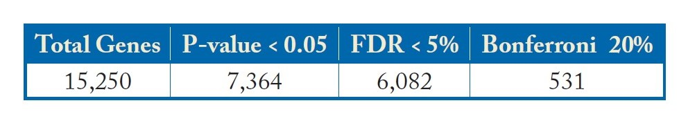
Unpaired test comparing healthy and cf patients
To obtain p-values that are low enough to be adjusted for multiple hypotheses testing, we had to perform 100,000 shuffle tests for each gene. 531 genes had 0 or 1 instance of difference in mean being greater than the observed value. FDR = false discovery rate; fraction of genes that may not be actually influenced by disease status among the 6,082.

Slide 39
False Discovery Rate (FDR): Benjamani Hochberg
List the individual gene p-values in ascending order, from smallest to largest.
The smallest p-value has a rank i = 1, the next smallest has i = 2, etc.
Compare each individual p-value to its Benjamini-Hochberg critical value, (i/m)Q, where i is the rank, m is the total number of tests (15,250, as above), and Q is the false discovery rate the user can tolerate, say 5%.
The gene associated with the largest p-value P that has P < (i/m)Q should be included as should all of the genes associated with p-values less than P.
Rewriting: Q > (m/i)P, so FDR is always at least as large as greatest p-value being considered.

Slide 40
Intuition underlying Benjamani Hochberg, part I
Suppose there are 1000 genes altogether and all expression differences had a p-value of 7% after some treatment.
That would mean that approximately 7% of the genes had an expression difference just by chance.
7% would be the false discovery rate. FDR = (1000/1000)*0.07

Slide 41
Intuition underlying Benjamani Hochberg, part II
Now suppose there are 1000 genes altogether and 200 have a p-value of 1% and the remaining 800 have a p-value of 7% after some other treatment.
Because 1000 genes were tested we’d expect that at the very minimum 10 genes (1% of 1000) would have different expression just by chance.
If we take 10 out of the first 200, we get a false discovery rate of 5%.
That is 1% = (200/1000)*5%. Or FDR = 5% = (1000/200)*0.01.

Slide 42
Intuition underlying Benjamani Hochberg, part III
Notice how conservative this method is.
It assigns all the false positives to the selected elements (the 200 in the example above)
It also considers only the last p-value of the selected elements.
So, we’d get an FDR of 5% even if 199 elements had p-values of 0.001% and the 200th one had a p-value of 1%.

Slide 43
Benjamani Hochberg vs. Bonferroni by Numbers
Compare each individual p-value to its Benjamini-Hochberg critical value, (i/m)Q, where i is the rank, m is the total number of tests (15,250, as above), and Q is the false discovery rate the user can tolerate, say 5%.
For Bonferroni, critical p-value is Q/m. Much stricter.

Slide 44
Benjamani Hochberg vs. Bonferroni by Concept
False discovery rate of 5% says that approximately 5% of genes thought to be significantly different are false positives.
For Bonferroni, 5% means that of all the genes passing the threshold, there is a 5% chance that at least one is a false positive.

Slide 45
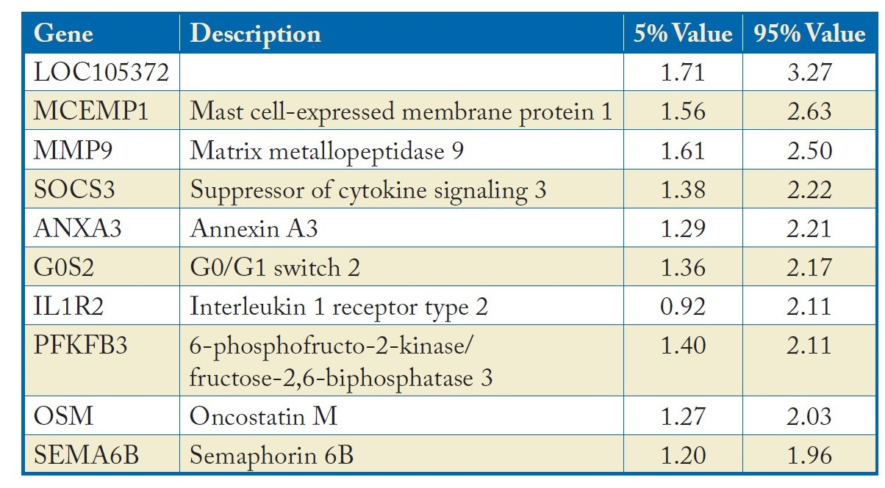
Top 10 genes based on log₂ ratio change of expression (of Bonferroni genes) – confidence interval
Part of top 20 discussed in paper

Slide 46
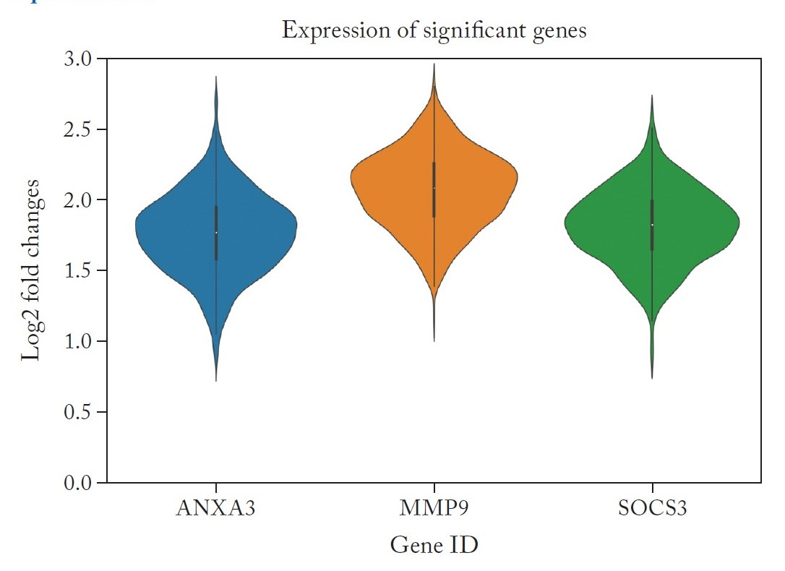
Three genes discussed in detail in paper from which we take data.
They were experimentally validated

Slide 47
Just for fun: Can Gene Expression be Used to Infer Cystic Fibrosis
So far, we have asked which genes were affected by disease/no disease.
Now we ask whether we could infer disease/no disease from gene expression.
Random Forest approach gives roughly 90% precision, recall and F-score.
Caveat: all on the same dataset. Would have liked separate one.

Slide 48
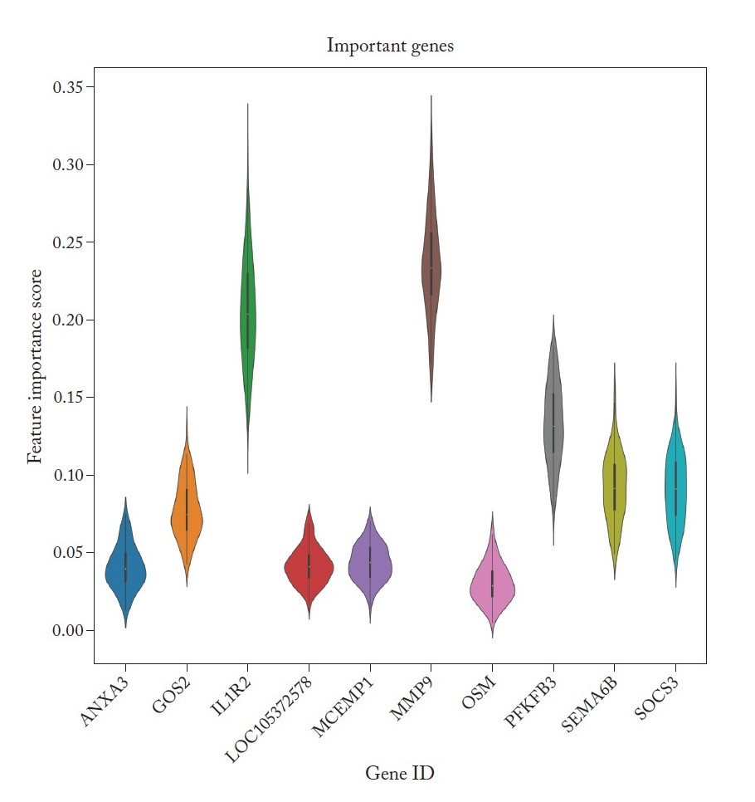
Important markers
Based on the importance ranking in Random Forest classifier, MMP9 is the most useful in identifying CF.
Needs reconfirmation on new data (exercise).

Slide 49
Application to Biological dataset: Chest X Ray
(Nicola Zucchia)
Pneumonia- X Ray images
Predict whether somone has pneumonia or not
Uses a variety of neural net methods
Compare the methods using paired tests (because applied to the same images)
https://www.kaggle.com/code/mohitbaliyan/chest-x-ray-pneumoniadiagnosis-with-cnn/data.

Slide 50
Application to Biological dataset: Chest X Ray
Pneumonia- X Ray images
Predict whether somone has pneumonia or not
Uses a variety of neural net methods
Compare the methods using paired tests (because applied to the same images)
https://www.kaggle.com/code/mohitbaliyan/chest-x-ray-pneumoniadiagnosis-with-cnn/data.
Implementation by Nicola Zucchia

Slide 51
Pneumonia Dataset
Training set consisting of 5200 images.
Validation dataset (for threshold cutoff) has 200 images
Test set 420 images

Slide 52
Convolutional Neural Network Approaches
Sequential is a stack of layers, where each layer has exactly one input tensor and one output tensor.
DenseNet is a convolutional networkwhere all layers are directly connected to every other one, rather than just to the next one in series.
Vgg16 processes images through a stack of smaller and smaller layers.
ResNet consists of several layers but allows some connections to skip subsequent layers.
InceptionNet version 3 like other versions of InceptionNet, incorporate several filters (or levels of resolution).

Slide 53
Tuning Approach on Validation Set
For each method, we tuned the cutoff value that determines whether to predict PNEUMONIA or HEALTHY.
The tuning process consisted of trying all cutoff values between 0 and 1 in a step size of 0.01 and then measured accuracy on the validation set.
Accuracy is measured against human diagnoses.

Slide 54
Tuning Approach on Validation Set
For each method, we tuned the cutoff value that determines whether to predict PNEUMONIA or HEALTHY.
The tuning process consisted of trying all cutoff values between 0 and 1 in a step size of 0.01 and then measured accuracy on the validation set.
Accuracy is measured against human diagnoses.

Slide 55
Testing Approach
For each method, evaluate on test set
Use both the default cutoff of 0.5 and the tuned one.
Accuracy is measured against human diagnoses.

Slide 56
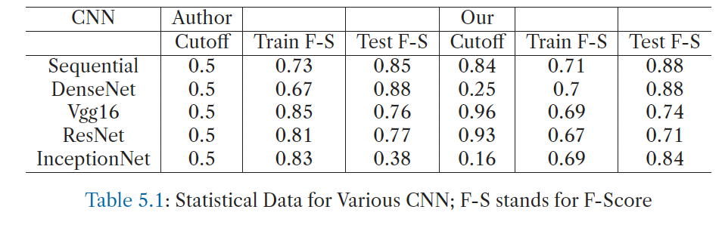
Testing Results (our cutoff didn’t work out so well)

Slide 57
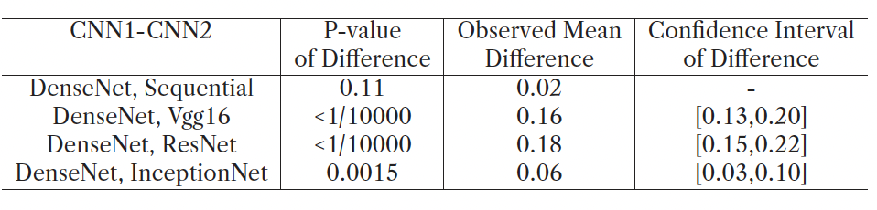
Testing Results Paired Test (DenseNet is promising)

Slide 58
Never Forget the Hyperparameters
So far, we have used the same number of epochs, the same steps per epoch as in the Kaggle study.
Increasing these can make a difference:
Number of epochs = 20; Steps per epoch = 200; Validation steps = 100
F-score goes from 0.88 to 0.93.

Slide 59
Conclusions : Widely Applicable Conclusions
If you have enough data points, you can use non-parametric methods effectively to identify significance/confidence intervals using shuffling methods. This entails fewer assumptions
When creating predictive models, be sure to sequester a test set that you will have no influence on your training and tuning of hyperparameters (including inference methods)
Imputing values is better than throwing out data.
Robust signals will not be sensitive to the normalization methods.

Slide 60
Acknowledgements
Manpreet: For the bulk of the coding.
Sudo: Helped start the coding portion of the book
Gloria Coruzzi: Motivation for all this work.
https://github.com/StatisticsIsEasy/CaseStudies
https://www.morganclaypool.com/doi/abs/10.2200/S01078ED1V01Y202102MAS039

