Slide 1
Bounce Blockchain
Dennis Shasha
shasha@courant.nyu.edu
October, 2019

Slide 2
Blockchain Semantics: Goals
Transactions (with whatever semantics) are in a pure sequence ordered at least approximately in time.
Anyone can walk the sequence through a chain of hashes.
Cannot be forked: always just one sequence, so cannot hide a transaction.

Slide 3
Blockchain In Practice
Proof-of-Work blockchains like BitCoin. i) Enormous electricity consumption (> 20 terawatt-hours per year). $6-$10 per transaction ii) Oligopoly of mining sites who could fork the blockchain, so not really secure.
Proof-of-stake: cheaper but vulnerable to collusion. Could be forked with enough resources.

Slide 4
Permissioned Blockchain
A host organization, e.g. IBM, collects transactions from participants and uses a set of trusted nodes to determine which transactions go to which blocks and the order of blocks.
Inexpensive and fast.
Very dependent on the security at the host organization.
Permissioned: only known users can enter transactions.

Slide 5
Bounce Blockchain: strawman (idealized) implementation
Single completely reliable/ownerless satellite receives/orders transactions and sends them back to earth.
Satellite is the arbiter of the blockchain and maintains the sequence.
No forking by construction.
Minimal electricity use (no proof of work/satellite runs on solar).

Slide 6
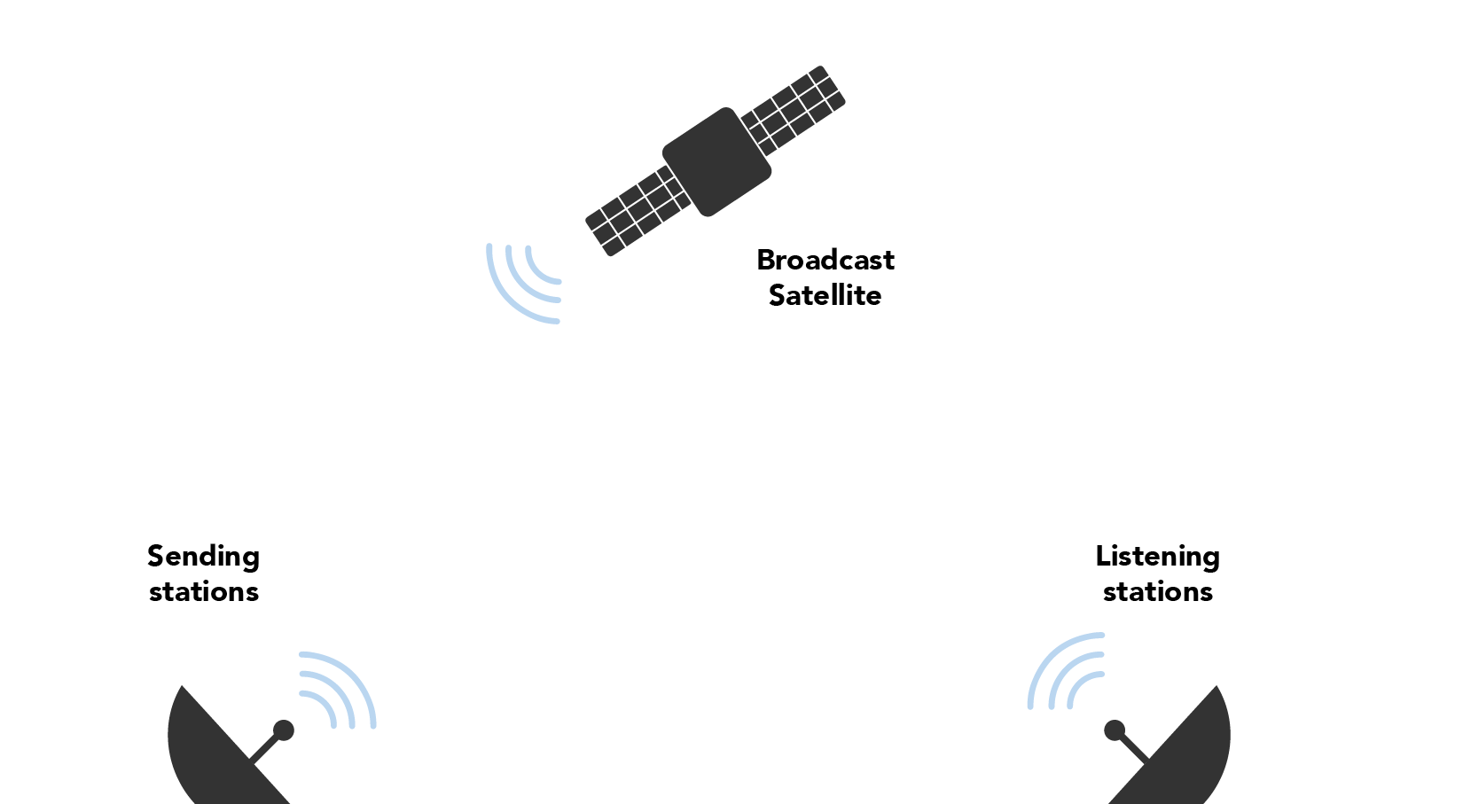
Strawman

Slide 7
Bounce Blockchain Strawman Issues
Satellite could be destroyed.
Single satellite does not scale.
Communications satellites cost > $100 million.

Slide 8
Bounce Blockchain Architecture
Cubesats (10 cm on a side) each embedded with a hardware security module.
Scalable, cheap (less than $100,000 per configured cubesat)
Socio-technically safe (embedded hardware security modules).
Multiple sending stations, so no practical censorship.

Slide 9
Hardware Security Modules Primer
Each Hardware Security Module (HSM) generates a private key through a physical process and which it keeps secret from all outside entities.
HSM then generates a corresponding public key which is publishes.
Used ubiquitously in ecommerce.
Here are some vendors: Gemalto NV, IBM Corporation, Ultra Electronics Group, Utimaco GmbH, Futurex, Thales e-Security, Inc., Hewlett Packard Enterprise Development L.P., SWIFT, and Yubico

Slide 10
More Reliable, Faster, Cheaper
Multiple Cubesats (10 centimeter cubes) for redundancy to fail-stop failures and to achieve scalability.
Sending stations to deliver information to the Cubesats and Listening Stations to collect and re-distribute.

Slide 11
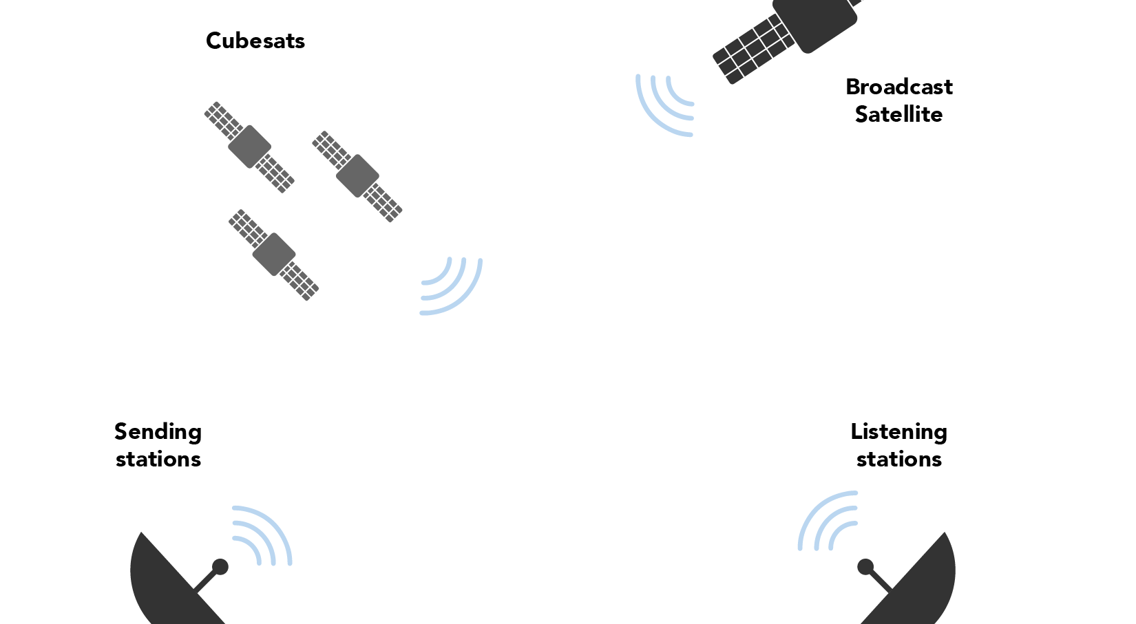
Cubesat/Sending/Listening

Slide 12
Lift-off Protocol (time point of max vulnerability)
Cubesats with embedded Hardware Security Modules (HSMs) deployed en masse under supervision of security validation experts and broadcast on television (like a SpaceX liftoff).
HSMs generate private/public key pairs through physical process and are validated by sending stations and become common knowledge.
Socio-technical strategies to guarantee integrity of HSMs: NIST level 4 requires tamper resistance.

Slide 13
Cubesats Organized in Sequence each has a time slice
Launch sequences the cubesats in some order, giving each one a time slice
If a cubesat misses its time slice it is spliced out.

Slide 14
Basic Cubesat Protocol
User send to some Sending Stations with payment. Sending Station sends block of transactions (Merkle root) to one Cubesat.
At its time slice, Cubesat c assembles its transactions into a block, signs, and sends sgn_c(block) to Listening Stations.
Each Listening Station signs and sends sgn_c(block) to every other Listening Station.

Slide 15
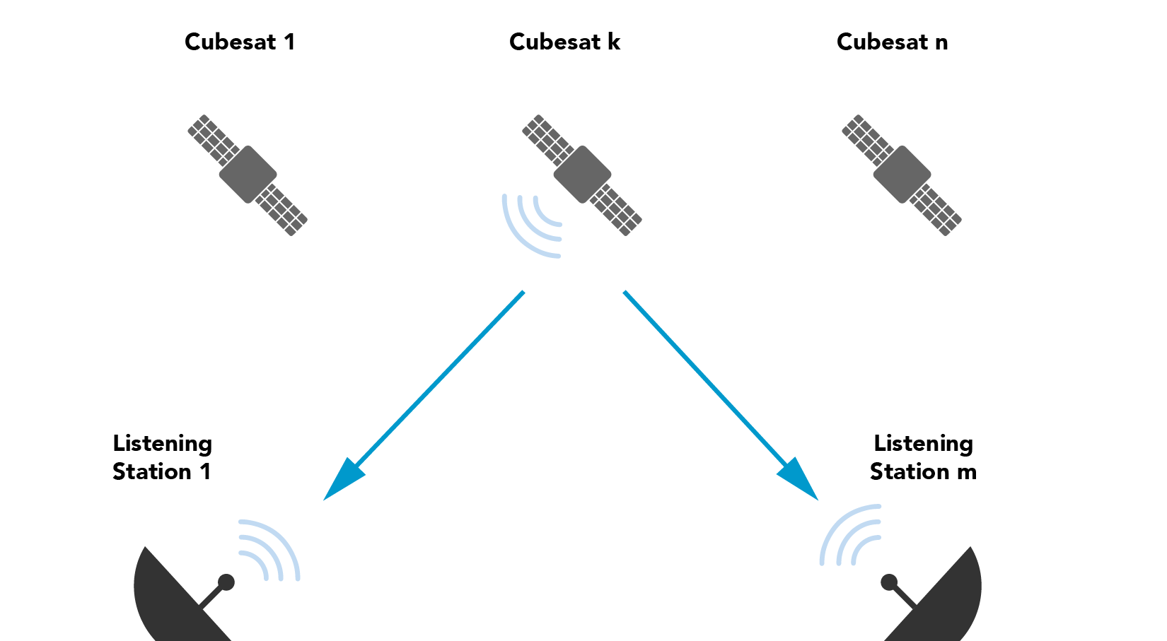
Basic Cubesat Protocol: cubesat sends

Slide 16
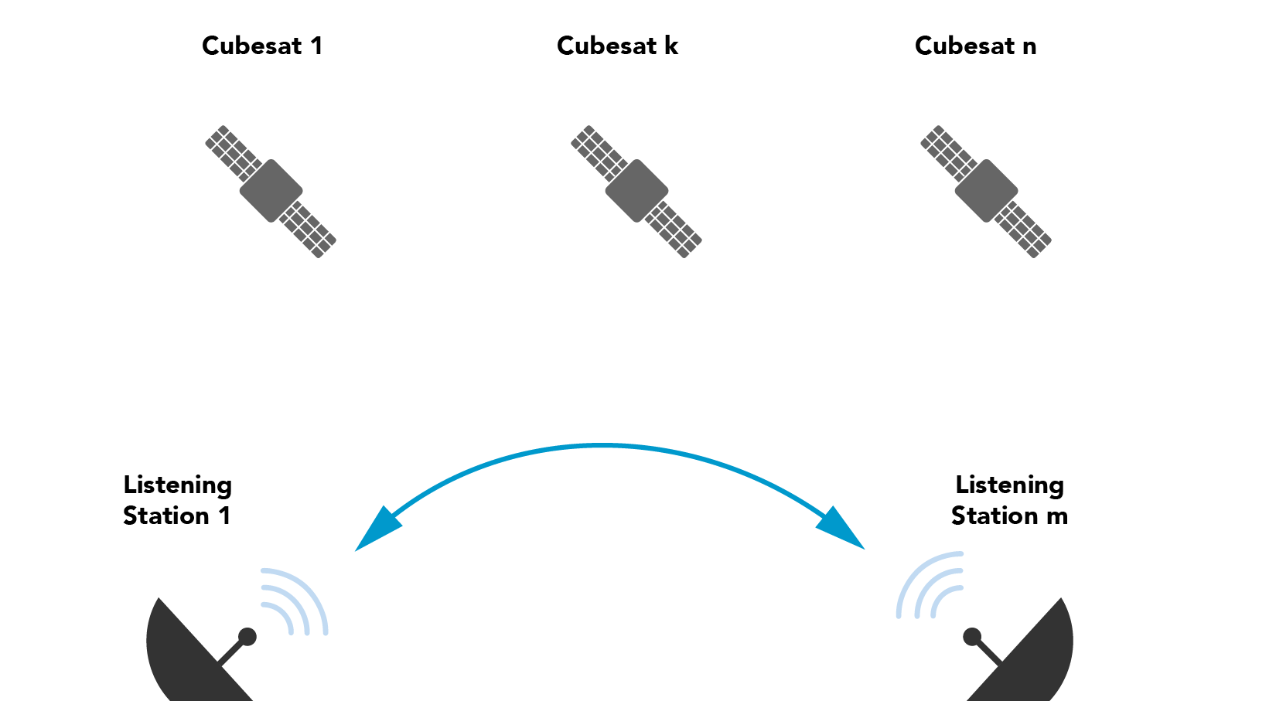
Basic Continued: Listening Stations gossip

Slide 17
What Have the Cubesats Given Us
Safety almost always because the cubesats can’t in practice be spoofed or hacked.
Further: If cubesat c is hacked and sends different signed blocks to different well-functioning Listening Stations, the inconsistency will be discovered and c will be exposed.

Slide 18
Exposure Aversion Implies More Safety
If bad cubesats are exposure-averse, then forking the blockchain will require collusion between (a) a traitorous or spoofed cubesat; and (b) a traitorous group consisting of more than 2/3 of the Listening Stations.
Reason: For two blocks sgn_c(b) sgn_c(b’) to be added to two forks, more than 2/3 of the Listening Stations must agree without exposing the inconsistencies. Only traitors will do that.

Slide 19
Exposure Aversion Level 2
If traitorous Listening Stations are exposure averse, then they will not fork, because if any recipient sees both sgn_c(b) and sgn_c(b’) as signed by Listening Station L, then that recipient can prove that L is a traitor.
So the traitorous Listening Stations would have to maintain « fork consistency »

Slide 20
Comparison with State of the Art
Current distributed Bitcoin protocol: A few data centers control more than half the hashing power, so could fork it if they wish.
Algorand: Modified proof of stake where stake is proportional to investment. Malevolent actor could buy up 1/3 of a coin to control the other 2/3.
By contrast, bounce blockchain has punctuated trust (lift-off).

Slide 21
State of the Art II
Use Intel trusted computing kernel SGX and run a random process to trip an alarm when done. Earliest machine to trip determines the next block.
There have already been attacks on SGX and, with so much at stake, some hacker will figure out a way to hack the chip sitting in front of them.

Slide 22
Other Alternatives
Guarded places on earth that organize the blocks.
Guards or owner can be bribed or overcome making likelihood of traitorous failure more likely.
Communication is not naturally broadcast.
Cubesats hard to destroy, much less capture, and even if captured tamper-proof.

Slide 23
Economics
For 20 cubesats at 1 cent per transaction (vs. $6.00 for Bitcoin now), could handle 2000 transactions per second (vs. 20 per second for each of Bitcoin/Ethereum), yielding as much as $600 million per year.
Fully loaded cubesat including launch costs $100,000, so $2 million for 20 cubesats with lifetime of 20 years.
Engineering and communications cost say another $2 million per year (estimate).

Slide 24
Upshots
Cost of blockchain vastly reduced, with new applications possible.
Practically speaking more secure
Positive impact both economically and ecologically.

