Slide 1
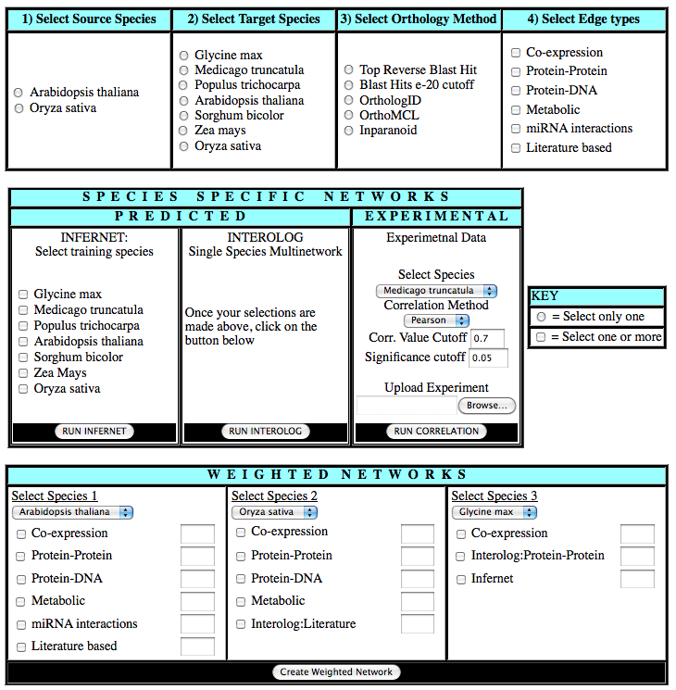
Notes:
Figure 6 shows a prototype interface for X-net. The first row shows some of the options available to the researcherwho wants to generate a predicted network. These options include selecting a source species, a target species, an orthology method, and a type of edge.. For Orthology method, we have listed some of the more commonly used methods, but this can be expanded as more methods and databases become available. Similarly some of the common edge types are shown in the figure and this option will change based on the source species selected and the edge types available for that species. The second row shows the different types of networks that can be created. A researcher who wishes to use Infernet must select at least one species for training, whereas this is not necessary for interolog. Researchers can also upload their own experiments from which a correlation network will be created using the different options the researcher provides. The third row shows how a researcher can create a weighted network by combining different networks from different species. The text field near the different edge types allows the user to provide their own weight to the edges. The output here again is merged network which the user can visualize using Cytoscape (Shannon et al)

