Slide 1
Causality in Jane Eyre

Slide 2
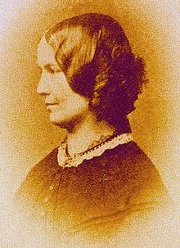

Charlotte Brontë
Born: 21 April 1816
Died: 31 March 1855
English novelist and poet
Eldest of the Bronte sisters
She wrote Jane Eyre under the pen name Currer Bell.
Her experiences echo those of Jane Eyre, it’s been often put forward that her experiences as a pupil at Clergy Daughter’s School inspired Jane’s trials.

Slide 3

Jane Eyre

Slide 4
About Jane Eyre...
  A type of coming of age story, centred around the journey of the titular character Jane Eyre , including her childhood, her coming of age as an adult, and her relationship with Mr. Rochester of Thornfield Hall.
  The novel has been described to “internalize the action , in that the focus is on the gradual unfolding of Jane's moral and spiritual sensibility and all the events are colored by a heightened intensity that was previously the domain of poetry .
  In this respect, the novel was said to revolutionize the art of fiction.
  “Charlotte Brontë has been called the 'first historian of the private consciousness' and the literary ancestor of writers like Joyce and Proust.”

Slide 5
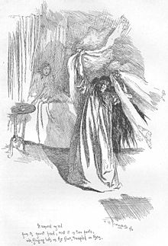
BERTHA
ANTOINETTA
MASON
“The violently insane first wife of Edward Rochester; moved to Thornfield and locked in the attic and eventually commits suicide by burning down Thornfield Hall.”

Slide 6
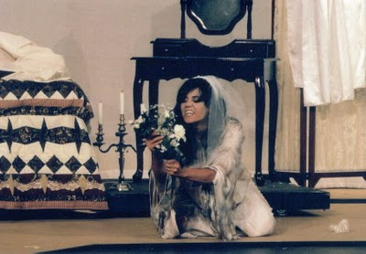
Bertha Mason
Inherited insanity...
Violent insanity ran in the Mason family, for three subsequent generations
Bertha’s mother in asylum.
Younger brother “mentally retarded”
Bertha’s condition deteriorates to the point that she exhibits “bestial” behavior

