Slide 1
Proof Verification Technology and Physics
Ernest Davis
Google Research NYC
December 20, 2017

Slide 2
Formal Mathematical Proof
Rigorous mathematical proofs can be expressed as deductions in extensional logic (FOL or HOL).
Deduction in formal logic can be characterized in terms of rules for symbol manipulation.
No human understanding; no intuition.
[Set theory suffices as foundation.]
(Frege, Peano, Whitehead & Russell, Tarski, etc.)

Slide 3
Proof Verification Software
has been successfully used to verify very complex and difficult mathematical proofs:
The prime number theorem
The Kepler conjecture
Feit-Thompson theorem (All groups of odd order are solvable.)
Most theorems in undergraduate math.
More or less, any rigorously proven theorem presumably can be verified if one wants to put in the work.

Slide 4
Can something similar be done for physics?
Outline:
Discussion of math as point of comparison
Doing this for physics
Straw man: Tee-shirt model of physics
Knocking down the straw man
  Representation
  Reasoning
What can be done: Textbook word problems
My own work [anti-climax]
Earlier similar proposals and related work
Looking forward and summary

Slide 5
Disclaimers
It would be better if I knew more AI and logic.
I don’t know nearly enough philosophy of science.
My knowledge of physics is altogether inadequate.
However,
At 61, you do research with the knowledge and skills that you have, not with those that you wish you had (Rumsfeld).

Slide 6
Value of the logical analysis for math
A formal standard for rigorous proof.
    Separate questions:
      Is this all of what one means by “math” or by “proof”.
      Historical: Is this what Euclid/Euler meant by “number” or “proof”?
      Cognitive: Is this how mathematicians/lay people/rats think about mathematical concepts.?
Metatheorems (Gödel , Turing, etc.)

Slide 7
Value of the proof verification technology for math and CS
Increase confidence in difficult theorems
Formal verification of mathematically-oriented software (e.g. floating point).
Step toward automatically proving theorems
Technology for other applications e.g. program verification, other kinds of reasoning, tutoring.

Slide 8
What hasn’t been done for math
An AI that reads a journal article and translates it into a formal proof.
A user interface that is inviting enough to tempt the “mathematician on the street” to use verification technology.

Slide 9
“Real world” word problems
Leaving aside the NLP problems, what math word problems do we know how to represent?
For high school and college freshman math (algebra, geometry, calculus, combinatorics, discrete math)
Perhaps for probability.
Statistics is doubtful. [Statistics is non-monotonic: If you add more information, then conclusions become invalid.]

Slide 10
Word problem
“If a baseball and a bat cost $1.10 together, and bats cost $1.00 more than balls, how much does each cost?”
∀_{s:Set} Cost(s) = ∑_{x ∊ s} Cost(x)
Ball(X). Bat(Y).
∀_{x,y} Ball(x) ⋀ Bat(y) ⟹ Cost(y) = Cost(x)+1.00
∀_{x,y} Ball(x) ⋀ Bat(y) ⟹ x ≠ y
Cost({X,Y}) = 1.10.
Axioms of real addition and naïve set theory.

Slide 11
Word problem
Two trains 100 miles apart are flying toward each other. One is going 75 mph, the other is going 25 mph. A bird flies back and forth between them at 150 mph. How far does the bird travel before they collide?

Slide 12
y(0) − x(0) = 100
Until(0, y(t) = x(t), x’(t) = 25)
Until(0, y(t) = x(t), y’(t) = −75).
C = min(t | t > 0 ˄ y(t) = x(t))
z(0) = x(0)
∀_{t} 0 < t < C ˄ z(t) = x(t) ⇒
Until(t,z(s)=y(s),z’(s)=150 ∙ Sg(y(t) − x(t))
∀_{t} 0 < t < C ˄ z(t) = y(t) ⇒
Until(t,z(s)=x(s),z’(s)=150 ∙ Sg(x(t) − y(t))
Evaluate: arclength(z,0,C)

Slide 13
Physics
Can we
Represent physics ― principles, measurements, observations, experiments ―in a formal language?
Characterize [some] physical argumentation, from principles to observables, in some formal theory of reasoning?
Implement verification technology?

Slide 14
Potential value
Philosophical understanding of the nature of physics. We’ll come back to this.
More powerful reasoning about physical systems: Beyond simulation
Verification of software controlling physical systems (airplanes, robots, nuclear reactors)
Step toward the super-AI-scientist, who will understand all of science.

Slide 15
Bayesian/MDL formulation
(as framework and foil)
Space of scientific theories Φ.
Experiments/observations E.
Outcomes D_{E}
argmax_{H∈Φ} P(H|D _{E} ) ₌
argmax_{H∈Φ} P(D _{E} |H) ∙ P(H)
P(H) ∝ 2^{−|H|} (say).
In what language can one express all possible theories in Φ, and all possible experiments E?
Is there a theory-neutral language of experiments?

Slide 16

Straw man: Tee-shirt model of physics
We encode the 100 top equations of physics into Coq/Isabelle. And then we’re pretty much done.

Slide 17
Tee shirt model
In math, all you need is ZFC + definitions.
Doesn’t work at all for the other sciences (Chemistry, Biology, Cognitive Science, Social Sciences)
Physics is a borderline case.

Slide 18
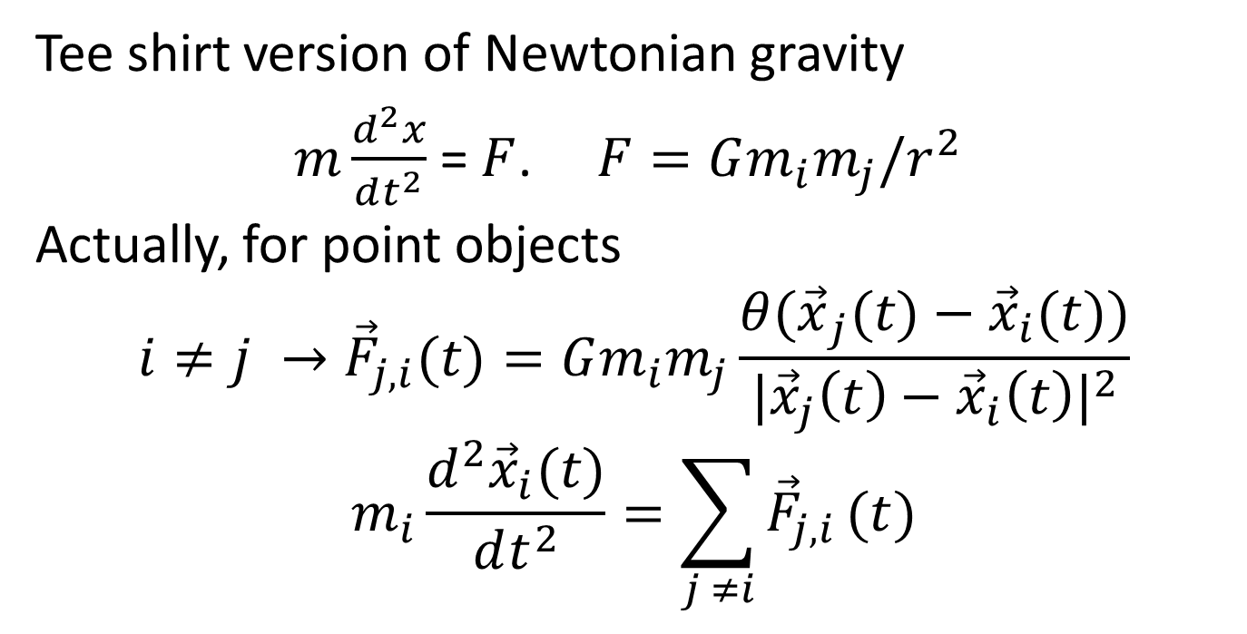
The equations themselves are more complicated than on the tee-shirt
Tee shirt version of Newtonian gravity
$m\frac{d^{2}x}{dt^{2}}$ = $F$. $F=Gm_{i}m_{j}/r^{2}$
Actually, for point objects
$${i≠j →\vec{F}}_{j,i}(t)=Gm_{i}m_{j}\frac{{θ(\vec{x}}_{j}(t)−{\vec{x}}_{i}(t))}{{|{\vec{x}}_{j}\left(t\right)−{\vec{x}}_{i}\left(t\right)|}^{2}}$$
$$m_{i}\frac{d^{2}{\vec{x}}_{i}(t)}{dt^{2}}=\sum_{j ≠i}{{\vec{F}}_{j,i}}(t)$$

Slide 19
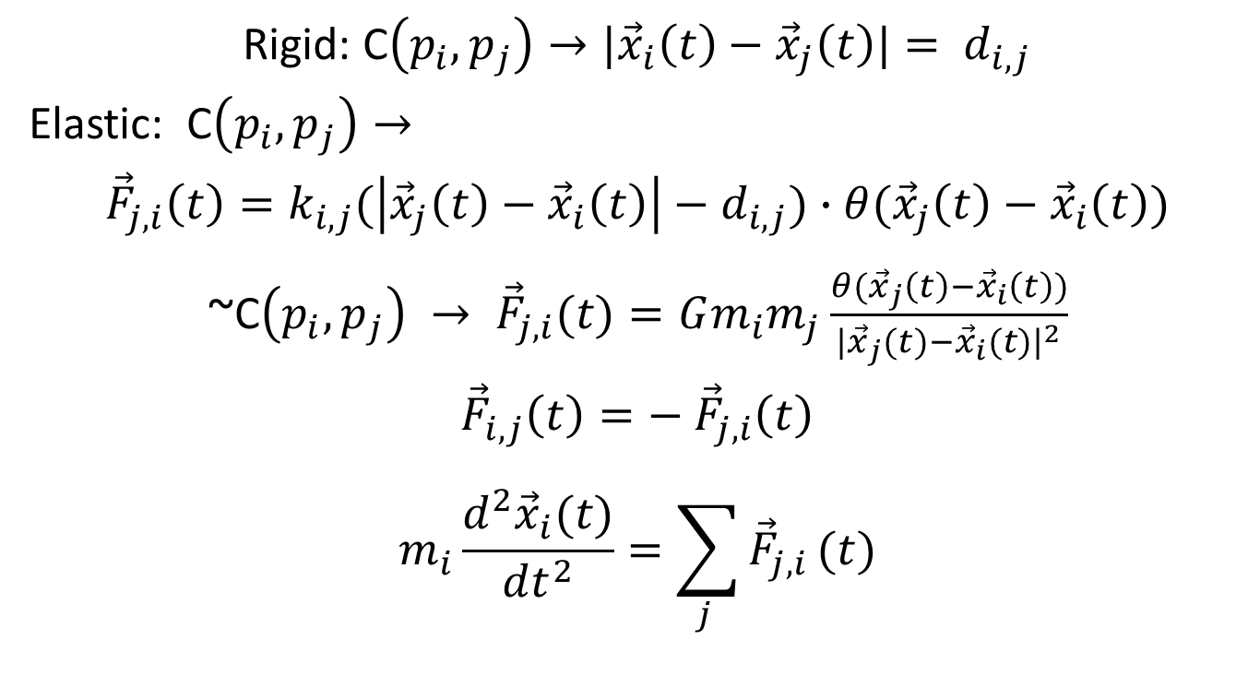
Extended Objects: Particle model
Rigid: C$\left(p_{i},p_{j}\right)→{|\vec{x}}_{i}\left(t\right)−{\vec{x}}_{j}\left(t\right)|= d_{i,j}$
Elastic: C$\left(p_{i},p_{j}\right)→$
$${\vec{F}}_{j,i}\left(t\right)=k_{i,j}(\left|{\vec{x}}_{j}\left(t\right)−{\vec{x}}_{i}\left(t\right)\right|−d_{i,j})∙θ({\vec{x}}_{j}\left(t\right)−{\vec{x}}_{i}\left(t\right))$$
~C$\left(p_{i},p_{j}\right) → {\vec{F}}_{j,i}(t)=Gm_{i}m_{j}\frac{θ({\vec{x}}_{j}\left(t\right)−{\vec{x}}_{i}\left(t\right))}{{|{\vec{x}}_{j}(t)−{\vec{x}}_{i}(t)|}^{2}}$
$${\vec{F}}_{i,j}\left(t\right)=− {\vec{F}}_{j,i}\left(t\right)$$
$$m_{i}\frac{d^{2}{\vec{x}}_{i}(t)}{dt^{2}}=\sum_{j }{{\vec{F}}_{j,i}}(t)$$

Slide 20
What the straw man is missing:
Grounding
You have to understand the manifestation of gravity in experiments and observations:
  Objects on spring scales and balance scales
  Falling objects
  Solar system
  Tides
  Stars

Slide 21
Really basic stuff is not on the tee-shirt
“What [scientific] statement … contain[s] the most information in the fewest words? … The atomic hypothesis … that all things are made of atoms.’’ Feynman Lectures on Physics chap. 1
But: Atoms and their interactions are not on the tee shirt. They are a class of solutions to Schrödinger’s equation given the characteristics of atomic nuclei, electrons, and the EM force, in a certain temperature range.

Slide 22
Boundary conditions
A lot of physics
— most of |H| —
is a characterization what the boundary conditions look like in various settings, across a range of scales.

Slide 23
Experimental equipment
Experimental and observational measurements are not direct perceptions; they rely on technology of ever-increasing complexity.
So the measurement technology itself has to be validated, theoretically and empirically (when possible — with gravitational lenses, there’s only so much you can do.)

Slide 24
Extreme example: BACON
“Discovered” Kepler’s third law T² ∝ R³.
(Langley and Simon, IJCAI-81)
Input to BACON: A table of T and R for planets
Input to Johannes Kepler: Positions of planets and stars in the sky over years. (Projection of their 3D position onto the dome of earth’s sky, which itself moves.)

Slide 25
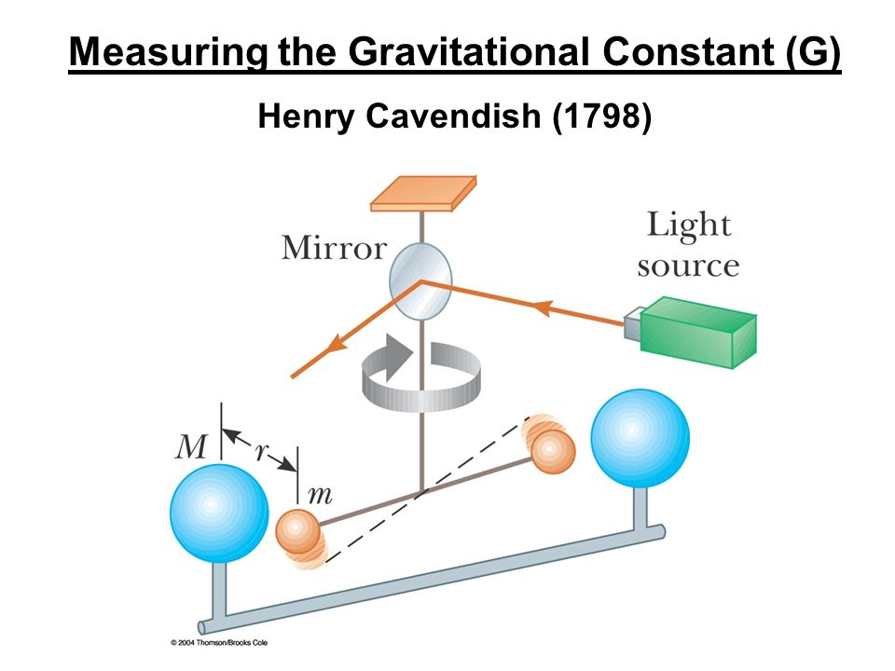
Measuring the gravitational constant

Slide 26
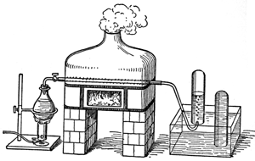
Chemical reaction
Passing steam over heated iron filings, the iron rusts, and you generate hydrogen.
2Fe + 3H₂O → Fe₂O₃ + 3H₂
Faraday, The Natural History of a Candle

Slide 27
Universality
Rubner’s demonstration of conservation of energy in a dog is an important experiment for physics; it shows that the constraints of physics apply to animals.
Claim (Laplace): Newton’s law can almost perfectly account for all planetary motions with very high accuracy.
Feynman: “All things are made of atoms.”
Claim: Almost all terrestrial phenomena (except a few nuclear reactions) are consequences of quantum mechanics, EM, and gravity, as applied to a configuration of atomic nuclei and electrons.

Slide 28
Hand-waving arguments
Eliminable in mathematics
Not eliminated in physics. In practice “arguments from first principles” include:
  Idealization. “Assume a spherical cow.”
  Abstraction. Circuit diagram.
  Approximate models: Continuum mechanics.
  Ignore irrelevant issues, negligible quantities.
  Argument by analogy
  “Physical intuition” (perhaps analogy)
But the physicists largely agree on how to hand wave, and apparently are doing it right.

Slide 29
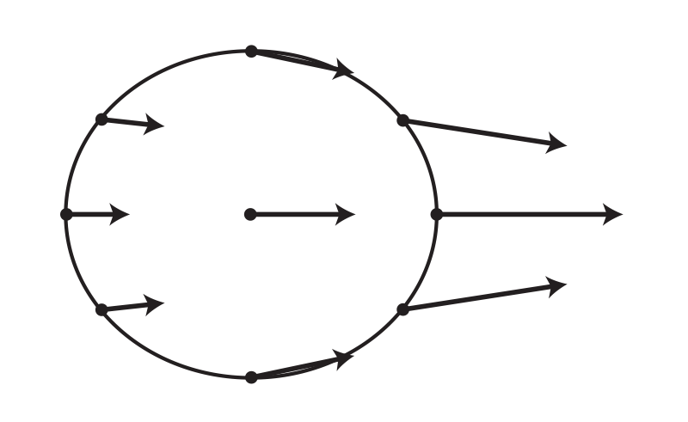
Explanation of the Tides
On the side of Earth that is directly facing the moon, the moon's gravitational pull is the strongest. The water on that side is pulled strongly in the direction of the moon.
On the side of Earth farthest from the moon, the moon's gravitational pull is at its weakest. At the center of Earth is approximately the average of the moon's gravitational pull on the whole planet. (NOAA, NASA, “SciJinks”)

Slide 30
Maxwell-Boltzmann distribution
Assume that the distribution of velocities of particles in a gas:
Is isotropic
The components of the velocity in two orthogonal directions are independent.
Then the distribution of velocities follows a Gaussian. (The only remaining degree of freedom is the variance, which is the temperature.) Michael Strevens, Tychomancy

Slide 31
Covalent bonding
The reason is simply that when you allow an electron to wander over a larger space, the kinetic energy always goes down. If you double the size of the space in one direction, the kinetic energy in that direction goes down by a factor of 4. If you consider the two H-atoms as two boxes, doubling the x-size of the box keeping the y and z sizes the same, reduces the kinetic energy from X+X+X to X/4 + X +X or by a factor of 3/4, so the binding energy of two boxes end to end with non-interacting electrons is 1/4 the kinetic energy.
The kinetic energy of an electron in an H-atom is equal to the binding energy (this is the Virial theorem--- the kinetic energy cancels half the potential energy in a 1/r potential to make a binding energy), so you get 1/4 of 12 eV or 3eV of binding energy from this. This is a terrible approximation, because the electrons repel each other, and the H-atom is not a box, but it shows you that allowing the electron volume to spread gains you a lot of energy on the atomic scale, and it is now plausible that even with repulsion, the electrons will bind, and they do.
― Ron Maimon, Physics Stack Exchange

Slide 32
Things that are partially understood
Historical example: the tides.
  Generally, the twice-daily tides were understood in terms of the moon’s gravity by the early –mid 18th century.
  Predicting the tides at a particular location from first principles could not be done until the late 19th century.

Slide 33
Things that are partially understood
In the first chapter we spoke of the great strides that have been made since the early Greek observations of the strange behavior of amber and of lodestone. Yet in all our long and involved discussion, we have never explained why it is that when we rub a piece of amber we get a charge on it nor have we explained why a lodestone is magnetized ... So you see this physics of ours is a lot of fakery --- we start out with the phenomena of lodestone and amber, and we end up not understanding either of them very well.
Feynman Lectures on Physics, vol. 2 chap. 37

Slide 34
Textbook word problems
Ignoring the NLP issues:
Choosing the idealization
Setting up the equations
Solving the equations

Slide 35
Textbook word problems
Ignoring the NLP issues:
Choosing the idealization
    Problem wording gives clues. E.g. if no geometric constraints on the shape of an object is not mentioned, then treat it as a point mass.
Setting up the equations
    Largely doable.
Solving the equations
    Piece of cake

Slide 36
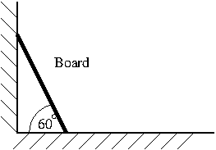
Word problem example
Assuming that the board slides without friction, when does it lose contact with the wall?

Slide 37
Word problem
Solid(Board). Solid(Wall). Solid(Ground).
Fixed(Wall). Fixed(Ground). Rigid(Board).
RightFace(Wall) = 0 × [0,1].
UpperFace(Ground) = (−∞,∞) × 0
Place(Board,0) = LineSeg(<0,sin(60⁰)><1/2,0>)
Isolated(Board,{Wall, Ground}).
NoInterpenetrate. NoFriction.
UniformGravity(<0, −g>).

Slide 38
Idealization
Pendulum: Galileo, Cavendish, Foucault, Yo-yo
Setting: 2D/3D. Attachment fixed/rotating with earth.
Bob: Point mass, extended.
String: Fixed distance from attachment. Inelastic. Elastic
Bends along its length. Twists along its axis.
Massless/massed.
Can interfere with itself or with bob.

Slide 39
My own research
Developing a formal language in which physical behavior can be described at the commonsense (mesoscopic) level.
Support for qualitative reasoning.
First-order language with naïve set theory, real arithmetic, real-valued time, Euclidean space
Solids, liquids, gasses.
Containers.
Towards representing experiments like Faraday, Cavendish

Slide 40
Some sample inferences
If a container remains closed, then matter cannot go from inside to outside.
Liquid can be carried carefully without spilling in an open container.
If you put rocks into a pail of water, the level of the water will rise.
The reaction 2H₂ + O₂ → 2H₂O consumes twice as many moles of H₂ as of O₂.

Slide 41
Similar proposals
Hilbert’s 6th problem: Mathematical Treatment of the Axioms of Physics.
The investigations on the foundations of geometry suggest the problem: To treat in the same manner, by means of axioms, those physical sciences in which already today mathematics plays an important part; in the first rank are the theory of probabilities and mechanics.

Slide 42
Similar proposal
Work on axiomatizing physics by:
Hilbert, Russell, Carnap, Montague, etc.
Clarifying the relation of thermodynamics to statistical mechanics.
Clarifying the relation of continuum mechanics to particle mechanics.
Quantum logic.

Slide 43
Similar thought
“The Master Algorithm is the germ of every theory: all we need to add to it to obtain theory X is the minimum data necessary to induce it. In the case of physics, this would be the results of perhaps a few hundred key experiments.”
Pedro Domingos, The Master Algorithm

Slide 44
The Vienna Circle and Logical Positivism
Am I reinventing, badly, an 80-year old project by much smarter people, that completely failed?
I hope not.
The refutations of logical positivism establish that it can’t be the whole story. But it still could be part of the story, or a useful approach.
We can somewhat punt on the question of the ultimate foundations

Slide 45
Hostile reactions
Refutations of logical positivism: Wittgenstein, Popper, Quine, Kuhn
General non-interest of physicists and mathematicians
Jack Schwartz, “The pernicious influence of mathematics on science”

Slide 46
Philosophical insights, revisited
Bayesian/MDL: argmax_{H∈Φ} P(H|D _{E} ) ₌
argmax_{H∈Φ} P(D _{E} |H) ∙ P(H)
Characterize physical theories (Φ).
Characterize physics arguments (P(D _{E} |H)).
Characterize inductive bias (P(H)): Symmetry? Locality? Mechanical theories? Simple foundational theories and complex boundary conditions?
Establish external validity?

Slide 47
Going forward
Develop representational languages, at many levels of scale and abstraction.
Push on deductive reasoning, from various starting points.
Work on characterizing the “hand-waving”. Incorporate work on analogy etc. (Forbus & Gentner)

Slide 48
Final comments
Carrying out this project for college physics would be orders of magnitude larger than formally verifying college math.
Justifying equipment may require more advanced physics.
We are far from the general AI scientist.
But even doing some of this might be very valuable.

