Slide 1
AI and
Elementary Science and Math Problems
Ernest Davis
IEEE 14th Annual Ubiquitous Computing, Electronics, &
Mobile Communication Conference (UEMCON)
Columbia University, October 12, 2023

Slide 2
Outline
Preliminary brief digressions:
AI in science and math research
Ancient history to bear in mind
Current AI’s capabilities in elementary (common sense, high school, undergrad) science and math
Large language model (LLM)-based approaches in general
AI, common sense, and basic arithmetic
AI and science word problems.
AI and math word problems.

Slide 3
AI is now a widely -used tool in scientific research
Applications: (thousands)
Marquee success:
AlphaFold (DeepMind, 2018, 2020). Protein folding.
Natural science: Physics, chemistry, biology …
Social sciences: Economics, sociology, political science …
Technology:
Deep learning
Reinforcement learning
Each research undertaking is carefully designed by experts.
Rarely large language models (LLMs)

Slide 4
AI has had a handful of successes in math research
1 original theorem proved (Robbins conjecture, 1996. 18 step equation munging.)
Deep learning assistance in formulating conjectures for representation theory, knot theory, graph theory (1 each).
1 incredibly complicated uncertain proof verified (Kepler conjecture, 2014. Proof verification technology.) (Many previously known theorems have been verified, but that’s not math research.)
A small number of theorems proved by reduction to huge satisfiability problems and running a SAT solver.
[Not AI: Many theorems e.g. 4-color thm assisted by conventional software.]
All but the first involve a lot of heavy lifting by human mathematicians.

Slide 5
Ancient history
The first AI program to successfully pass an exam from an MIT math course was written in [YEAR]?

Slide 6
Ancient history
The first AI program to successfully pass an exam from an MIT math course was written in 1961 (James Slagle’s SAINT program, did symbolic integration). Scored 96/100.
The first AI program to solve algebra word problems was Daniel Bobrow’s STUDENT program (1962).

Slide 7
Some techniques for adapting LLMs to word problems
GPT* out of the box doesn’t get to the top of the leaderboards.

Slide 8
Approaches with LLMs
Generate:
  The answer directly
  Code (Python, Mathematica) to compute the answer
  Proof verification specifications (Coq, Lean)
Prompt
  Zero-shot (just the question)
  Few-shot
  Many-shot (dozens of examples)
  Cheerleading (“Let’s think step by step”)
  Self-correction
Plug-ins
Fine turning
Integrate external resources
  Knowledge bases / knowledge graphs
  Wikipedia, WordNet …
Preprocess training/test data
Specialized tokenizer/ embeddings
Multimodal
User interaction (little studied)

Slide 9
AI, common sense,
and basic arithmetic

Slide 10
Commonsense Math Word Problems
Problems requiring no specialized knowledge, small integers, basic arithmetic. You can do these in your head.
GPT-4 can handle most of these.
Problems where GPT-4 fails are encountered sporadically.
It seems that OpenAI patches these quickly when they are found.
However, the patches are sometimes not very general.

Slide 11
Challenging elementary problems
These tend to be spotted non-systematically and patched rapidly.
Example: (Tweet by Vince Vatter, 9/11/23):
Prompt: Sally (a girl) has 3 brothers. Each brother has 2 sisters. How many sisters does Sally have?
Out of 60 LLMs he tested, 60 (including GPT-4) got a wrong answer, or no answer.
By Sept. 13 GPT-4 was getting that problem but other numerical variants wrong.
By Sept 18, GPT-4 got numerical variants right, but was still unreliable on abstract formulation.

Slide 12
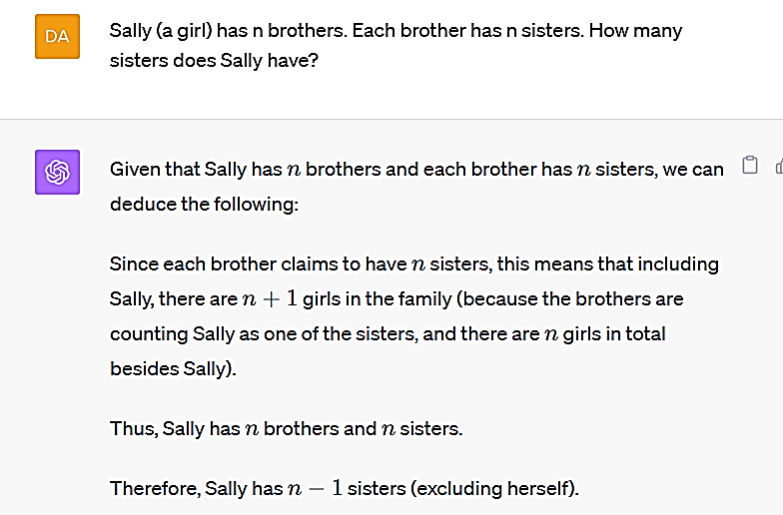
Experiment run on GPT-4 9/26/2023

Slide 13
Experiment on GPT-4 by Yejin Choi
4/18/23. Experiment 1.
Prompt: I left 5 cloths to dry out in the Sun. It took them 5 hours to dry completely. How long would it take to dry 30 clothes?
GPT-4: 30 hours.

Slide 14
Yejin Choi’s experiments cntd.
6/18/23. GPT-4 got the answer to Experiment 1 correct.
Experiment 2:
Prompt: If it takes 10 hours to dry 5 clothes, how long would it take 20 clothes to dry in the sun?
GPT-4: 40 hours

Slide 15
Yejin Choi’s experiment cntd.
8/13/23. GPT-4 got the answer to both Experiments 1 and 2 correct.
Experiment 3:
Prompt: Suppose it takes 3 hours to dry a shirt and 5 hours to dry a pair of pants in the sun. How long would it take to dry two shirts?
GPT-4: Six hours

Slide 16
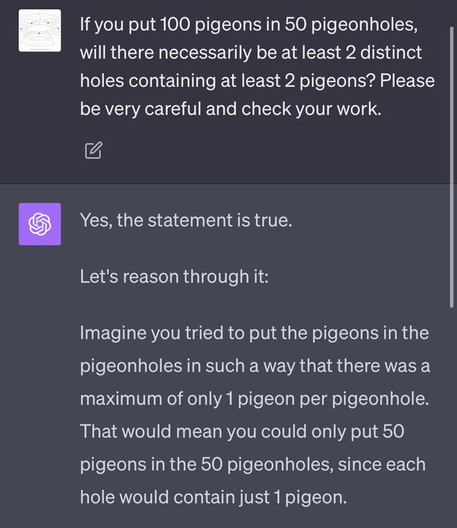
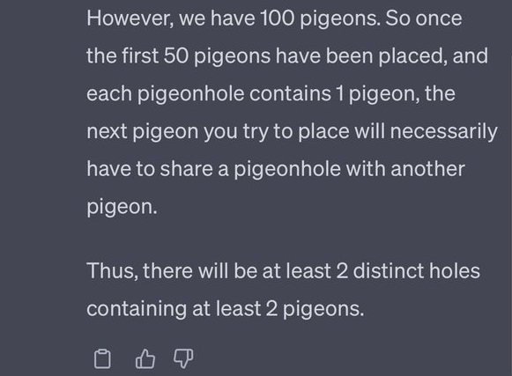
Tweet by Daniel Litt, 10/1/23

Slide 17
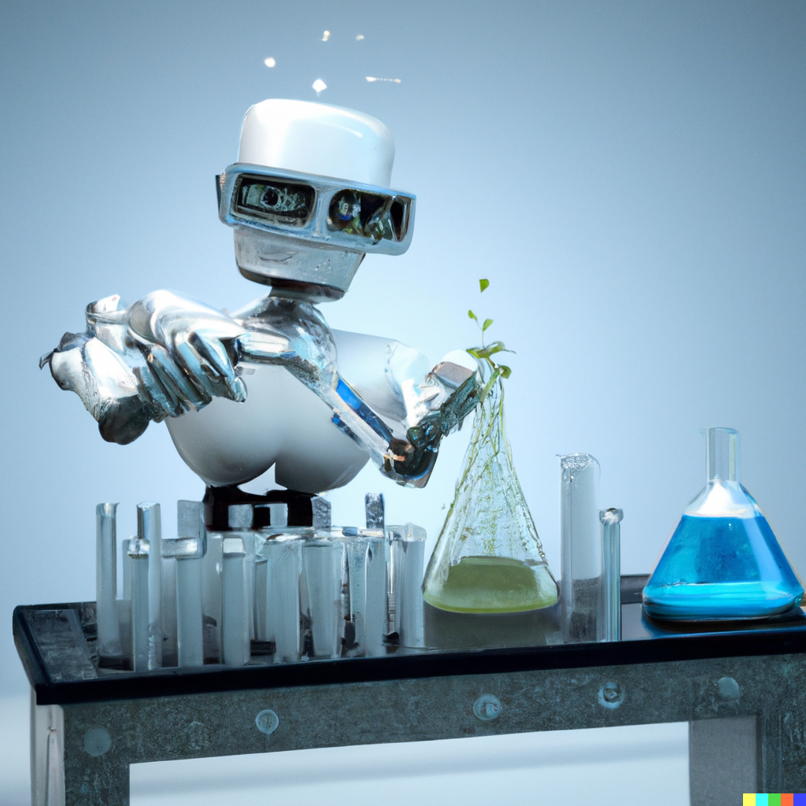
AI and Science
Word Problems
Image generated by DALL-E 2
Prompt: “Robot doing
chemistry experiment”
9/27/23.

Slide 18
GPT-4 results on standardized tests
AP Biology 4
AP Calculus BC 4
AP Chemistry 4
AP Environmental 5
AP Physics 2 4
AP Statistics 5
SAT Math 710/800
GRE Quant 163/170

Slide 19
Some science word problem datasets
OpenBookQA. Multiple-choice problems.
Examples:
The sun is responsible for
A. puppies learning new tricks
B. children growing up and getting old
C. flowers wilting in a vase
D. plants sprouting, blooming and wilting
When standing miles away from Mount Rushmore
A. the mountains seem very close
B. the mountains are boring
C. the mountains look the same as from up close
D. the mountains seem smaller than in photographs

Slide 20
Some science word problem datasets
OpenBookQA. Multiple-choice problems.
Examples:
The sun is responsible for
A. puppies learning new tricks
B. children growing up and getting old
C. flowers wilting in a vase
D. plants sprouting, blooming and wilting
When standing miles away from Mount Rushmore
A. the mountains seem very close
B. the mountains are boring
C. the mountains look the same as from up close
D. the mountains seem smaller than in photographs
Best AI result: 95.2%
MVP-Tuning
Hybrid system combining neural net with knowledge-graph retrieval.
GPT3.5 (davinci) 60%
(HELM test)

Slide 21
Flawed examples from OpenBookAI
The amount of friction and the speed of an object have what kind of relation:
A. inverse. B. reverse C. direct D. equal
Every evening a child can look into the night sky and see that the moon is A. gone B. breaking C. falling D. moving upwards
Over a period of time, the weather can change
A. the way I walk. B. the color of my hair. C. the size of a statue
D. the sound a computer makes.
Perhaps 15% of problems are problematic.
Hard to avoid in datasets created with crowd sourcing.
An AI or person who gets these right is using knowledge about tests, not scientific knowledge.

Slide 22
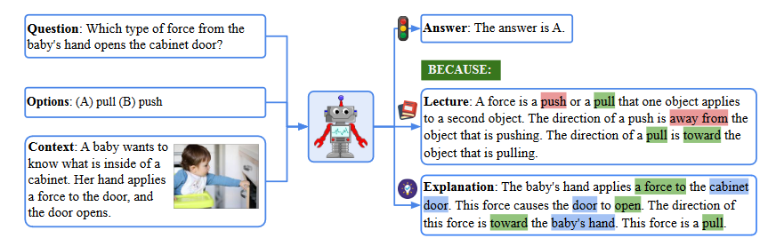
Some science word problem datasets
ScienceQA (Lu et al. 2022): 21,000 multimodal science questions:
SotA: 95.6%. GPT-4 72.4%

Slide 23
AI results on ScienceQA
GPT4 Chain of Thought (4/23): 72.4%
Llama-SciTune (7/23): 95.6%
Leaderboard

Slide 24

Experiments with GPT-4 and Code Interpreter / Wolfram Alpha plugins
Joint work with Scott Aaronson,
U. Texas at Austin/OpenAI
http://arxiv.org/abs/2308.05713

Slide 25
GPT-4+Code Interpreter/Wolfram Alpha plug-ins
User gives prompt to GPT-4.
GPT-4 decides whether to call plug-In to do some of the problem solving.
GPT-4 constructs Python/Mathematica code, calls plug-in.
Plugin executes code, returns result to GPT-4.
GPT-4 interprets result, gives answer plus discussion to user.
Multiple calls to plug-in may be required, either because the problem has multiple parts, or because the first attempt fails.
User can see a trace of the communications between GPT-4 and the plug-in, plus GPT-4’s “thought processes” along the way.

Slide 26
Experiments
Experiments by Scott Aaronson and me, June-August 2023
Three sets of original problems:
  “Motivated Numerical” (Scott, 20 problems)
  “Arbitrary Numerical” (Me, 32 problems)
  “Calculation-free” multiple-choice/True-False (Me, 53 problems).
No prompt engineering
Link to our paper.

Slide 27
Wide range of difficulty
Most in “Calculation-Free” can be answered by “the man on the street” with access to Wikipedia and maps without explicitly calculating.
Several numerical that high school student with access to Wikipedia and a calculator can answer.
All but a few can be solved with some thought by a strong college math/physics major.
A few are quite tough. A strong math/physics major may well not get 100%, if they haven’t taken the relevant courses (not all of which are required).

Slide 28
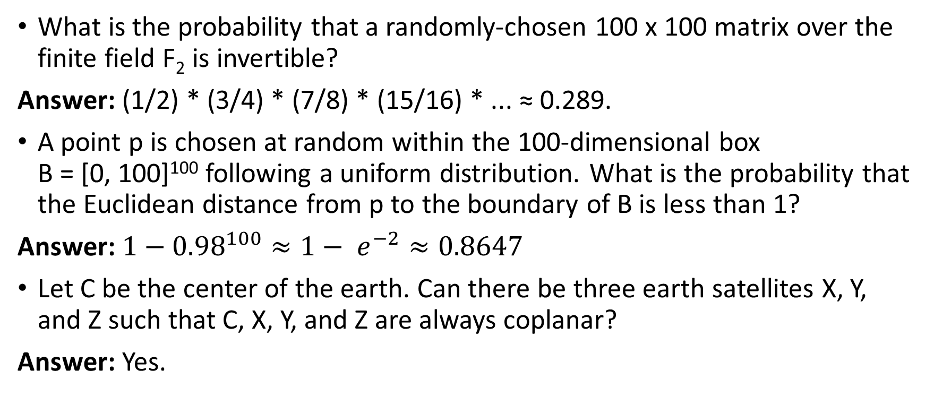
Impressive Successes
What is the probability that a randomly-chosen 100 x 100 matrix over the finite field F₂ is invertible?
Answer: (1/2) * (3/4) * (7/8) * (15/16) * ... ≈ 0.289.
A point p is chosen at random within the 100-dimensional box
B = [0, 100]¹⁰⁰ following a uniform distribution. What is the probability that the Euclidean distance from p to the boundary of B is less than 1?
Answer: $1−{0.98}^{100}≈1− e^{−2}≈0.8647$
Let C be the center of the earth. Can there be three earth satellites X, Y, and Z such that C, X, Y, and Z are always coplanar?
Answer: Yes.

Slide 29
Failures
What is the Shannon entropy of a positive integer n that’s chosen with probability Pr[n] = 6/(π² · n²)?
Answer: 2.362.
GPT4+WA: did not return an answer.
GPT4+CI: 0.9265 (wrote it as a sum and got the sign wrong on one part).

Slide 30
Failures
Prompt: Viewed from Vega, what is the angle between Sirius and the Sun?
GPT4+WA: Used an inappropriate formula from spherical geometry.
GPT4+CI: The angle between Sirius and the Sun as viewed from Vega depends on the time of year, as well as the specific time of day. This is because the Earth and Vega both orbit the Sun, but at different rates, and because the Earth also rotates on its axis. . . .

Slide 31
Failures
Problem: A pendulum is hanging on a 2 meter cord attached to the ceiling 3 meters above the floor. It is brought to a position 25 degrees from the vertical and released. It swings past the bottom and the cord is cut when it is 10 degrees from the vertical on the far side. Then the bob flies through the air and hits the ground. What is the distance from the point where the bob is released to the point where it hit the ground?

Slide 32
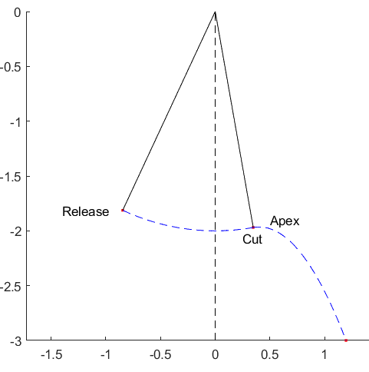
Failures
Find the cut point and release point.
Use energy to find the speed at cut.
Use energy to find the time to apex.
Calculate the position at landing.
Calculate distance
20 lines of simple Matlab
Answer: 2.3606 m
GPT-4+WA: 1.35 m
GPT-4+CI: 10.7 cm
GPT-4 did not set up the problem
close to correctly either time.

Slide 33
Failures
Joe says that he lives 10 miles from Lake Michigan, that Beth lives 10 miles from Lake Michigan, and that he and Beth live 100 miles apart. Is it possible that Joe is telling the truth?
Answer: Yes
Both plug-ins: No.

Slide 34
Sources of error
Misinterpreted the problem
Wrong physical theory (e.g. classical rather than relativistic).
Wrong mathematical formulation
Error in calling the plug-in , especially Wolfram Alpha.
Often multiple unsuccessful attempts; once, 40 unsuccessful attempts.
Error in interpreting or accepting the answer from the plug-in (rare)
Fail to detect an impossible or meaningless answer
Fail to call plug-in when it would have been useful. GPT sometimes, unwisely, decides to do its own calculations. E.g. sorting.
Called plug-in uselessly.

Slide 35
Weaknesses
Spatial reasoning and visualization
Multistep reasoning
Large and small numbers (unreliable)

Slide 36
Bottom line on GPT+WA/CI
Overall impressive. At the level of a middling math/physics major.
A lot of room for improvement.
Some low-hanging fruit, some challenges that seem very hard.
Might be more useful in interactive mode between user and GPT.

Slide 37
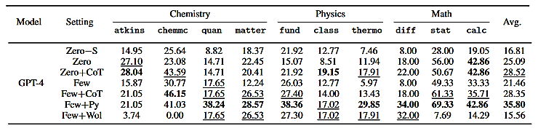
SciBench (Wang et al. 2023)
Benchmark collection: 695 problems from existing college-level online material.
Constructed their own interface to Python and Wolfram Alpha.

Slide 38
SciBench Problems
Problem: Two charged particles are fixed to an x axis. Particle 1 of charge q₁ = 2.1 x 10^{‒8} C is at position x=20 cm and particle 2 of charge q₂ = ‒4.00 q₁ is at position x = 70 cm. At what coordinate on the axis (other than at infinity) is the net electric field produced by the two particles equal to zero?
Answer: ‒30 cm
Problem: Halley's comet, which passed around the sun early in 1986, moves in a highly elliptical orbit with an eccentricity of 0.967 and a period of 76 years. Calculate its minimum distance from the Sun.
Answer: 8.8 x 10¹⁰ m

Slide 39
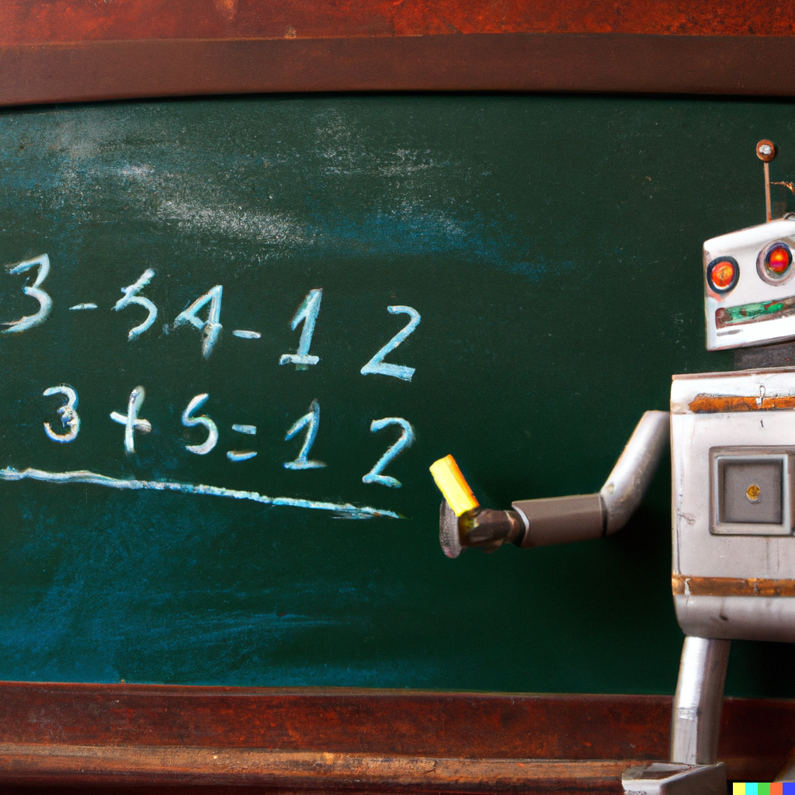
AI and Math
Word Problems
Image generated by DALL-E 2
Prompt: “Robot doing
math at a blackboard”
9/27/23.

Slide 40
Math Word Problem Benchmarks: Math23K
(Wang, Liu, and Shi, 2017)
23,000 problems, crawled from Chinese online education sites. Numerical answers.
Problem: Dan have 5 pens and 3 pencils. Jessica have 4 more pens and 2 less pencils than him. How many pens and pencils do Jessica have in total?
Equation: x = 5 + 4 +3 -2
Solution: 10
SotA: 87.1% by Multi-View (Zhang et al. 2022)

Slide 41
Math Benchmarks: MathQA
(Amini et al. 2017): 37,000 numerical answer problems. Extracted from AQuA dataset and annotated.
AQuA (Ling et al. 2017) has 100,000 multiple-choice problems: 34,000 drawn from GRE and GMAT and the rest generated by crowd-workers.
Problem: An artist wishes to paint a circular region on a square poster that is 3.4 feet on a side. If the area of the circular region is to be 1/2 the area of the poster, what must be the radius of the circular region in feet?
SotA: 80.6% (Multi-View)

Slide 42
Math Benchmarks
LILA. (Mishra et al. 2022) 134,000 problems. Created by combining 20 pre-existing collections and normalizing their form.
Categories
Addition/subtraction Statistics
Multiplication/division Calculus
Number theory Linear Algebra
Algebra Advanced Math
Geometry

Slide 43
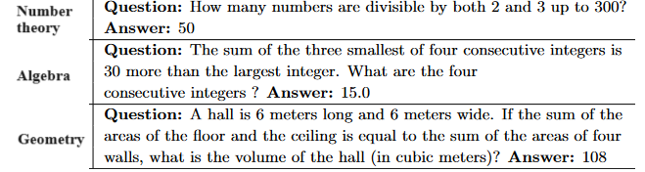
LILA Examples

Slide 44
Systems tested on LILA
GPT-3, few shot
Codex, few shot
NEO-A – GPT3-Neo, configured to output answers (always bad)
NEO-P – GPT3-Neo, configured to output Python
Bhaskara-A – GPT3-Neo, finetuned on LILA, configured to output answers
Bhaskara-P – GPT3-Neo, finetuned on LILA, configured to output Python

Slide 45
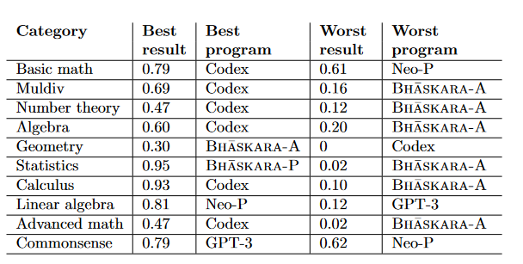
LILA Results
(Neo-A omitted)

Slide 46
Takeaways from LILA experiments
Outputting Python is generally better than outputting the answer, though not in all domains.
No system is uniformly the best, though Codex tends to be good.
Some categories (statistics) are much easier for the technology than others (geometry).

Slide 47
Defects in math word problem benchmarks
Artifacts: An AI trained on one dataset learned that if “every” appeared in a problem, you multiply, and if “each” appeared, you divide.
Flawed examples: Typos, grammatical errors, answer not of the form specified, unwarranted assumptions, wrong answers. Example from Lila: “There are 11 boys and 10 girls in a class. If three students are selected at random, in how many ways that 3 girl and 2 boys are selected?”
Data leakage: Obvious risk in datasets largely derived from online sources

Slide 48
Defects in math word problem benchmarks
Benchmark overlap. Many benchmarks are substantially copied from one another or a common source.
Possibly, near repetitions. Risk in examples produced by crowd workers working from examples or illicitly using bots.
Inadvertent Omissions.
  Counting. (GPT-3 was very bad at it.)
  Parallel execution (Yejin Choi’s example of drying clothes.)
  Extended spatial regions (Lake Michigan example.)
  Others (Pigeon hole example)
Problems with diagrams. Beginning to be studied.

Slide 49
Summary
State of the art: The current AI technology can solve:
  elementary problems -- usually
  high school/early college problems – often.
  more advanced problems -- sometimes
  Reliably? Only very limited classes of problems.
Best technology: A highly specialized system built on top of an LLM. Not GPT-4 out of the box.

Slide 50
Summary: Benchmarks
There are a lot of benchmarks for math, fewer for science.
There are issues with quality.
It is not clear what the benchmarks measure.
It is not clear what we want them to measure.
It is not clear how we could get them to better measure that.
Does it even matter? The technology is changing almost faster than we can measure it.

Slide 51
Challenges & Opportunities
Short term:
Improve plug-in interface
Explore user interaction
Longer term:
Integrate symbolic reasoning, knowledge bases.
Take advantage of multi-modality: generating and understanding diagrams and images.
Long reasoning chains
Abstraction and generalization

