Slide 1
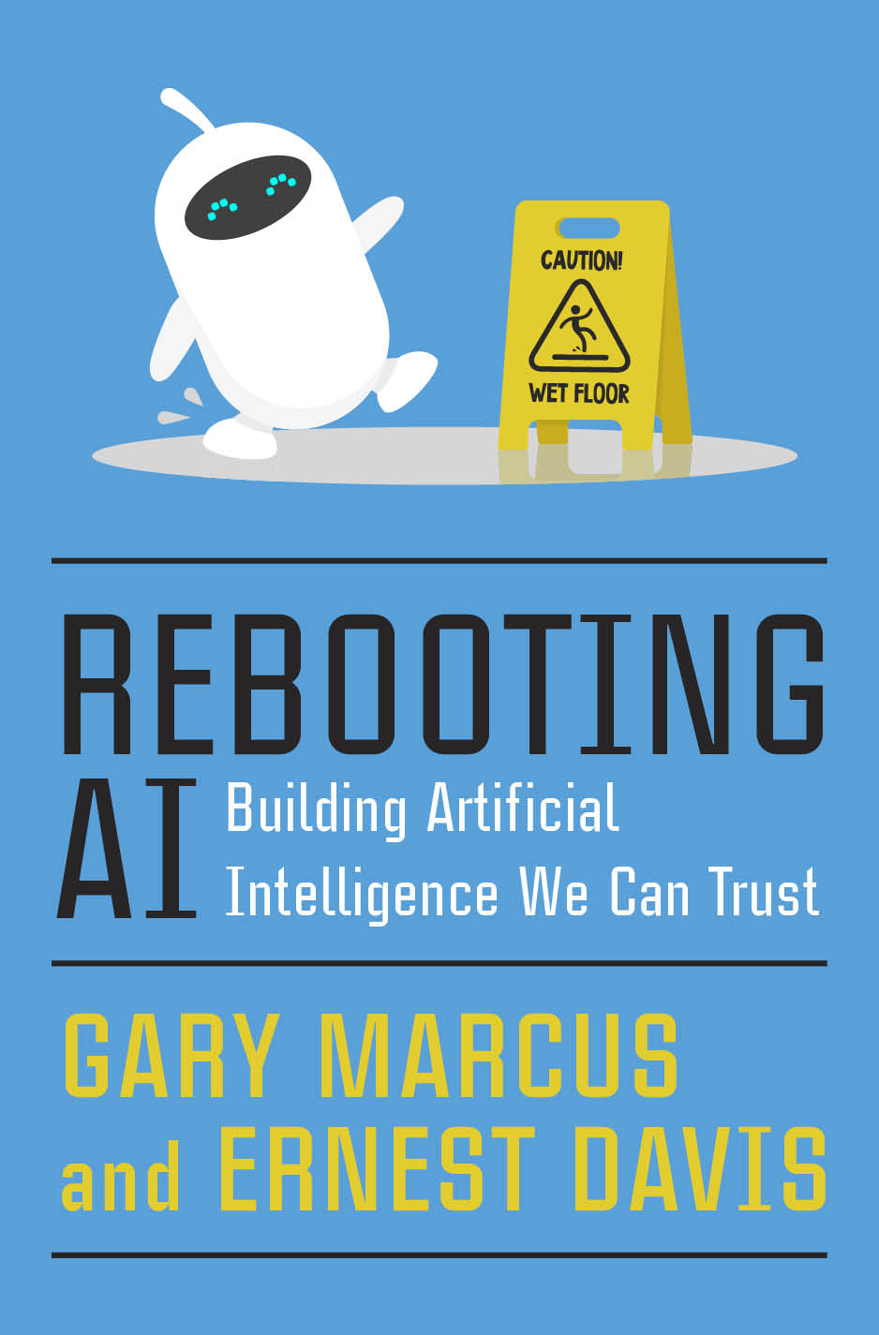
Building AI We Can Trust
  Ernest Davis
  Renaissance Numérique
  February 23, 2021

Slide 2
Artificial Intelligence So Far
Marquee successes: Backgammon, chess, Jeopardy, Go.
Important successes: Optical character recognition, hand-written digits, speech transcription, web search, machine translation, image tagging.
Disappointments (thus far): Self-driving cars. Useful chatbots. “Cognitive computing” (i.e. Watson for medical information).

Slide 3

Hype

Slide 4
Reality
Reads a text and a question whose answer is given in some phrase in the text and finds the phrase.
E.g.
  Chloe and Alexander went for a walk. They both saw a dog and a tree. Alexander also saw a cat and pointed it out to Chloe. She went to pet the cat.
  Q: Who went for a walk? A: Chloe and Alexander.
  But not
  Q: What did Alexander see. A: A dog, a tree, and a cat (Not consecutive).
  Q: Was Chloe frightened by the cat? A. No. (Inferred)

Slide 5
Dangers of trusting AI
Unwarranted confidence
“A lot can go wrong when we put blind trust in big data.”
--- Cathy O’Neil
Tesla crashes because drivers trusted Autopilot.
Police relied on Google Translate.
Trusting to AutoCorrect.
Trusting to iPhone app that reads email and makes appointments.

Slide 6
Systems do not generalize past training set
Print reading systems trained with black on white do not work with white on black.
Self-driving cars trained in one city can be unreliable when used in another.

Slide 7
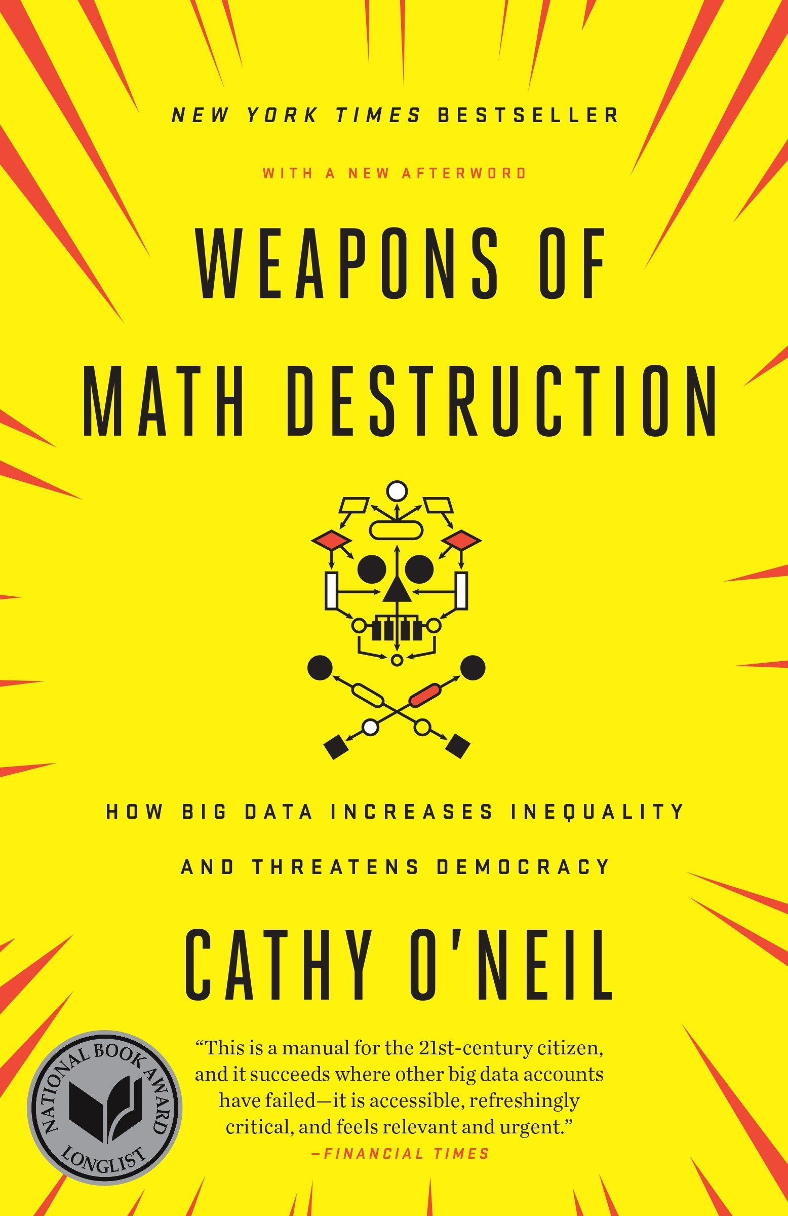
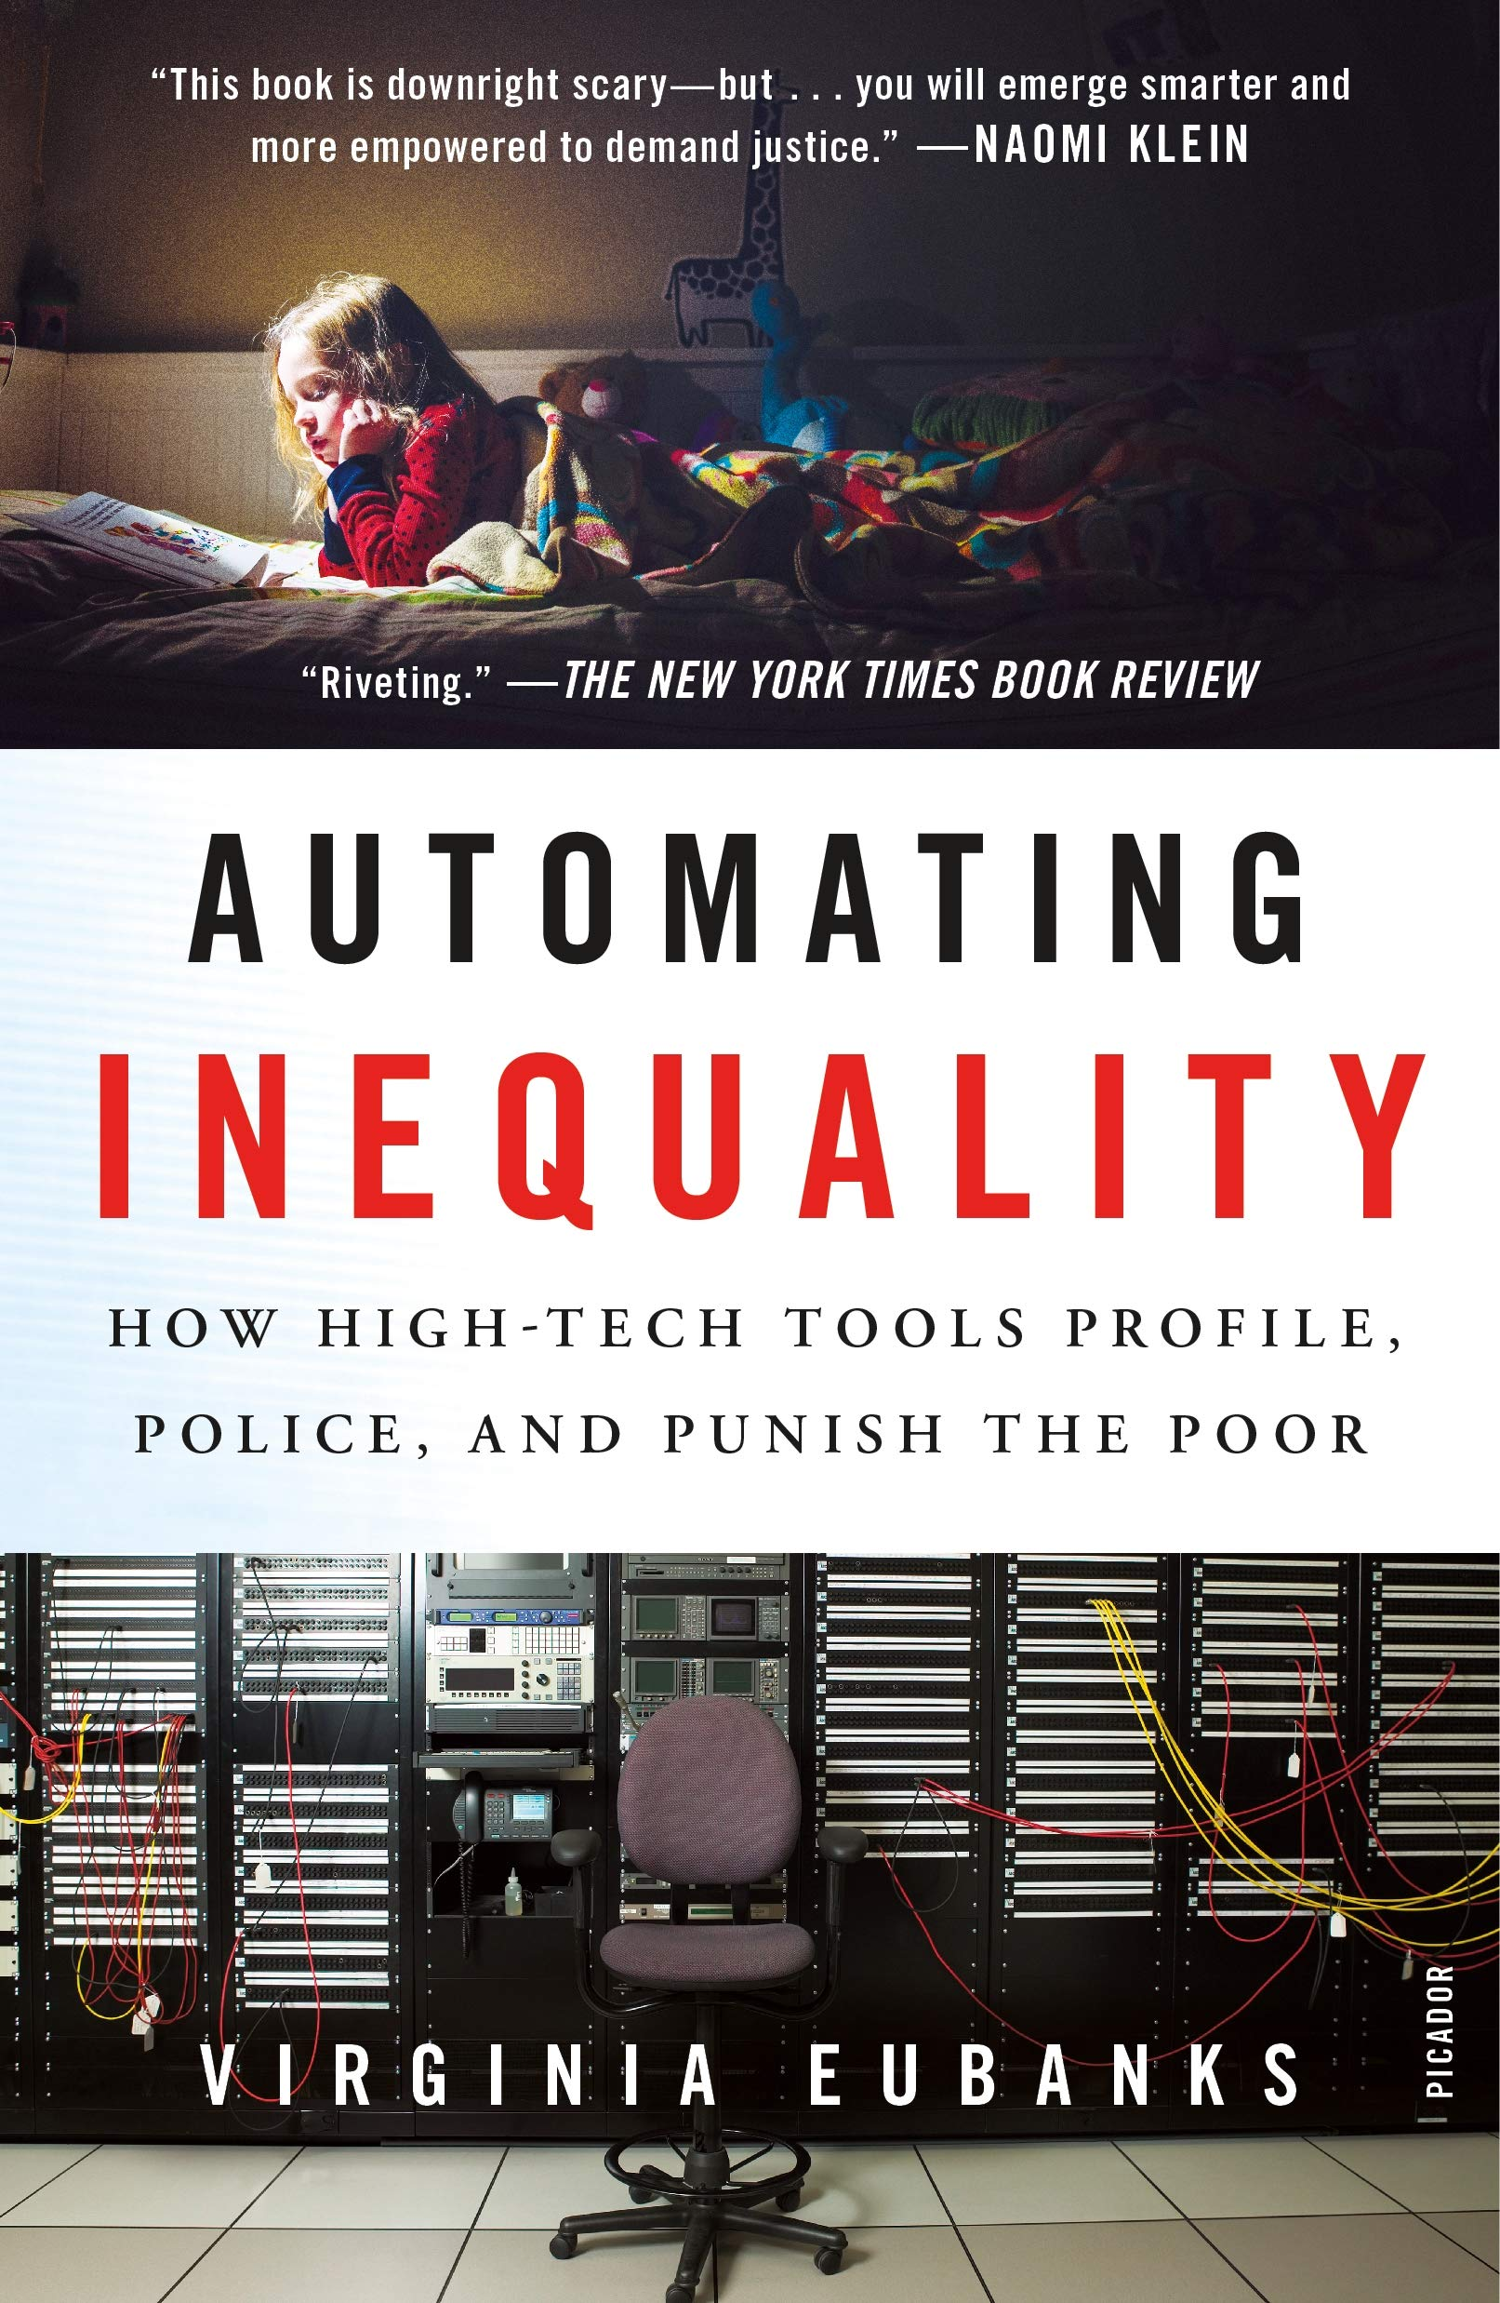
AI programs reinforce societal biases
A policing program sends police to neighborhoods where many arrests have been made in the past.
A child services program takes children away from poor parents.

Slide 8
More issues
AI systems feed on their own output, creating echo chambers.
AI systems can be gamed. E.g. automated essay grading that rewards long sentences and fancy words.
AI systems are given the wrong goals.

Slide 9
Bad Actors misuse AI
Criminals
Cybercrime
Cyberterrorism
Fake news, deep fakes
Governments
Surveillance
Smart weapons

Slide 10
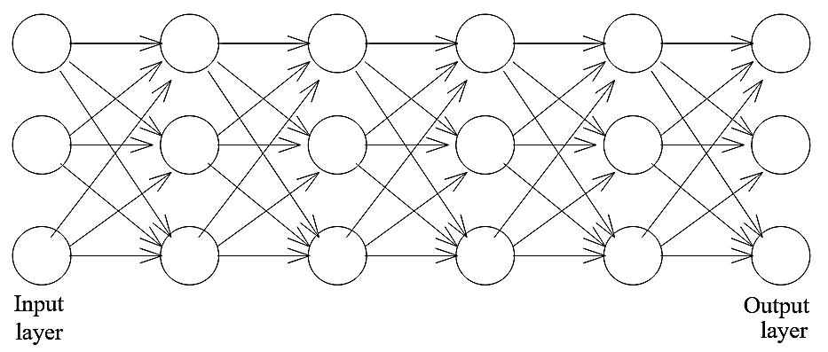
Deep learning: the dominant approach to AI:
One slide explanation
Two stage process.
Stage 2: Inference: The system does its job (translate text, label images). Input is fed on the right. Each “neuron” reads input, computes, and creates an output. The computation is controlled by “weights” on in-arrows. This is somewhat modeled on how the brain works.
Stage 1: Training: The system is trained from a corpus of examples (bitexts, hand-labelled images.) Training consists in setting the weights. Does not at all resemble how the brain learns.

Slide 11
Problems with Deep Learning
Data greedy
Opaque. If things go wrong, there is no way to know why.
Can’t be debugged. You can only change the training set or experiment with the architecture.
Brittle
No model of the situation
No knowledge of the world
Generalizes the wrong way.
In vision, it puts more emphasis on surface texture than on shape.

Slide 12
The road to AI we can trust
Common sense knowledge and reasoning
Lessons from the human mind
Good engineering principles:
AI programs are complicated tools, not peculiar people.

Slide 13
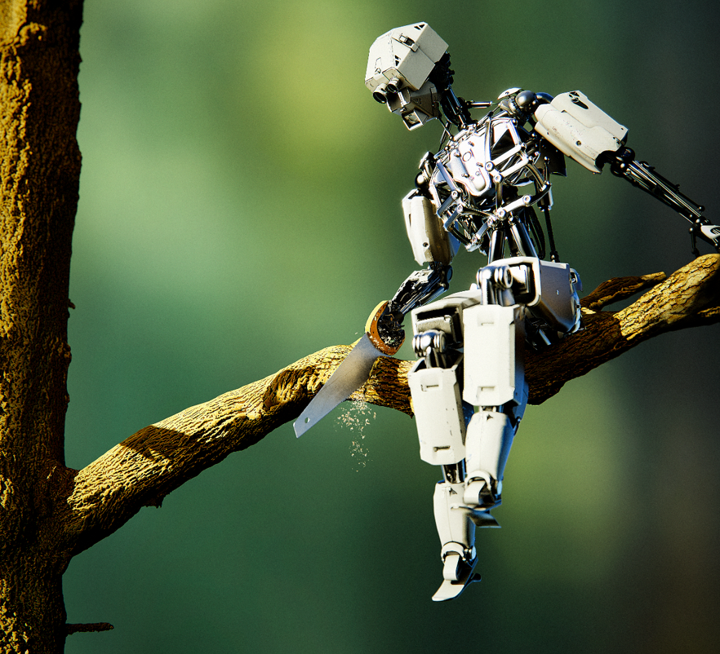
Common Sense
The great gap in current AI

Slide 14
What is common sense?
Basic knowledge about the world.
Children learn and master.
Too obvious to be worth writing down or teaching in school.
We take it for granted that other people know it.

Slide 15
Domains of common sense
Time
Space
Causality
Physical interaction
Theory of mind
Human interactions
etc.

Slide 16
Why is common sense important?
Vision
Language
Robotics
Science
Computer interface

Slide 17
Lessons from the human mind:
Cognitive psychology, linguistics, epistemology
No silver bullets
Symbolic, compositional representations
Abstraction
Innate knowledge
Understanding = building a cognitive model
Tracking individuals

Slide 18
Thank you!

